Slide 1

Board of Directors Meeting
January 20, 2023

Slide 2
Approval of Agenda

Slide 3
Approval of Minutes
December 16, 2023 – Regular Meeting

Slide 4

President’s Remarks
Rick Farr

Slide 5
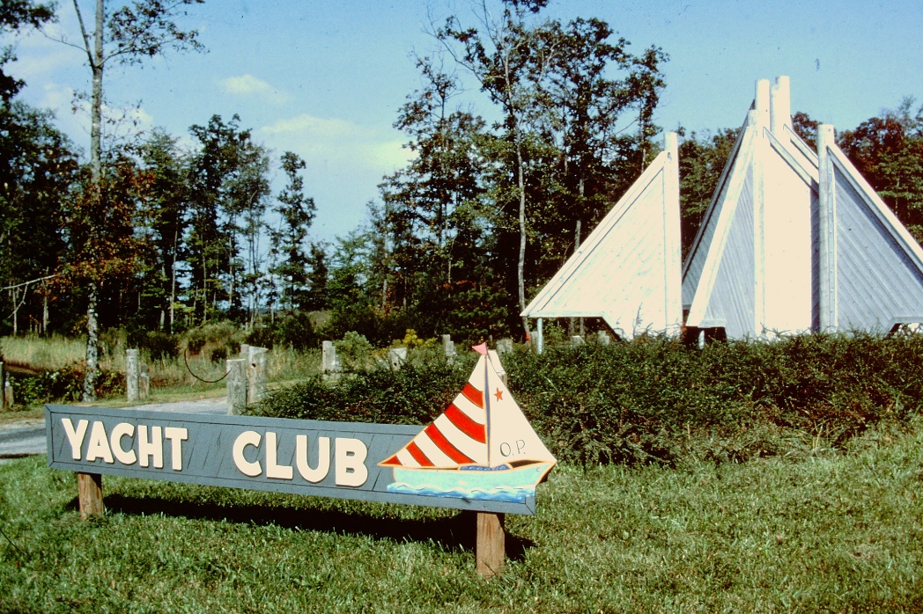
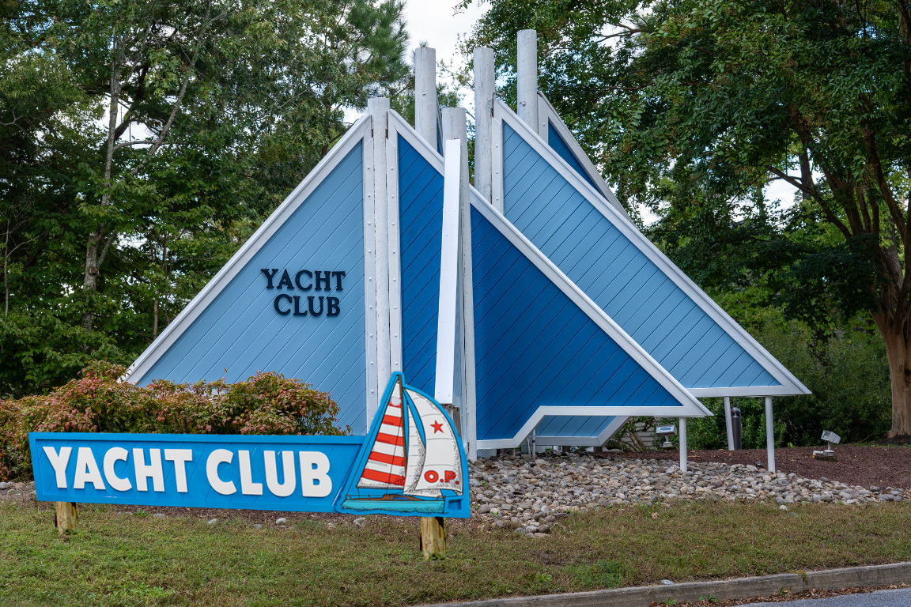
GM Leadership Report –
John Viola

Slide 6
Initiatives
  Tiki Bar
  Budget 2024/2025
  South Gate Pond
  Racquet Sports Building
  Seasonal Banner
  Reserve Study
  Dog Park
  Maintenance
  Signage
  Trash Contract
  Metrics

Slide 7
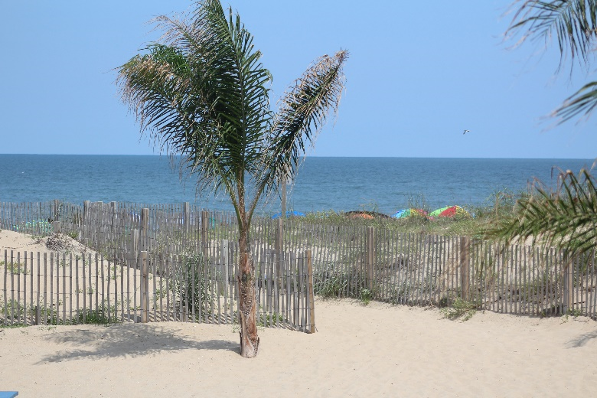
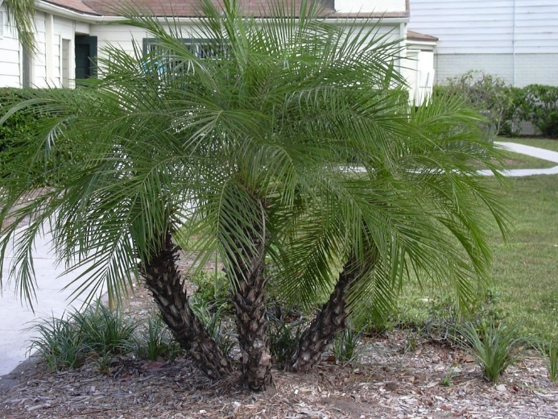
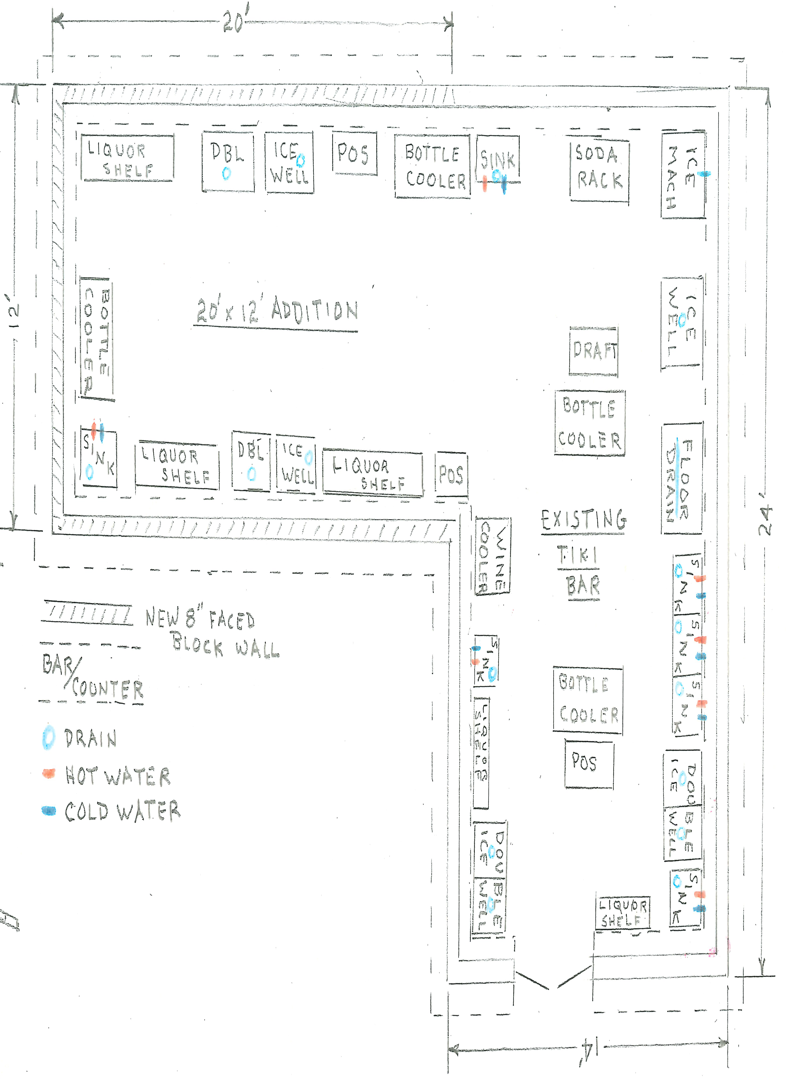
Tiki Bar
Tiki Bar
  Electrical, plumbing, and interior site plans done by Vista and will be sent to County next week along with to the construction company
  Updating County since beginning of project
  Matt Ortt Co. had opportunity to give us complete feedback on what they desired
  Project status: GREEN
Status of other approved initiatives:
  Racquet Sports Building Renovation
    Now that Vista has completed tiki bar drawings, will begin racquet center drawings
    Began dialogue with contractor
    Public Works already addressed other items
  Pavilion at Veterans Memorial
    Began dialogue with contractor on material and preliminary drawings

Slide 8
Budget 2024/2025
Board sent GM changes to the budget on January 18, 2024 which will be implemented into the recommended budget
Town Hall review and discussion will be held on Wednesday, February 7, 2024 at 11:00 a.m. at the Clubhouse Meeting Room

Slide 9
South Gate Pond
Soft shoreline project:
  Maryland Coastal Bay Program (MCBP) is committed
  Workplan submitted to EPA – anticipate approval
  Federal money – direct $150,000 reimbursable based upon presenting invoices
  Will be allocated to various components (review stage)
    Development of site plan and entire plan
    Environmentally techniques to stabilize shoreline to protect from erosion (plantings, etc.)
  RFP will be developed (MCBP will assist) – need 3 bids

Slide 10
Racquet Sports Building
Water damage to building due to heavy rain
Building reviewed by General Manager and Public Works (immediately)
Temporary fix made to downspout to divert water away from building
Permanent repairs to be addressed during approved building renovation

Slide 11
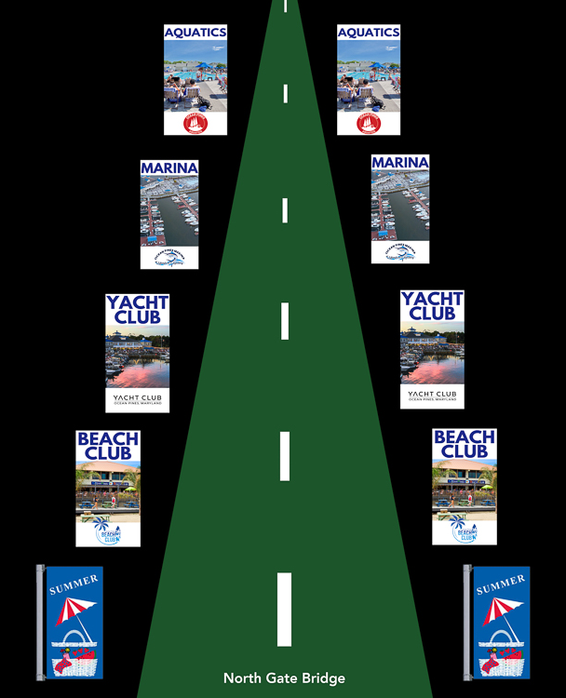
Seasonal Banners
The GM asked the PR staff to develop designs and a plan for year-round banners at the north and south gates
Marketing Coordinator Nancy MacCubbin led that effort
Plans are to rotate banners seasonally to promote OPA amenities
  Golf during Spring
  Summer amenities Memorial Day-Labor Day (Yacht Club, Beach Club, Marina, and Aquatics)
  Golf and Racquet Sports during the Fall
  Holiday and seasonal flags during the Christmas season and winter season
The team is working with the vendor to order the banners – implementation should take several weeks
Estimated cost: $5,000

Slide 12
Reserve Study
Phone conversation with Doug Green from DMA to discuss future reserve study
Study to be conducted by January 2025
Ocean Pines selected as beta tester for the DMA navigator portal for updates to study (available September 2024)
Reviewed with Doug that we were in compliance
  Original DMA Study Date: September 2018
  DMA “Lite” Date: November 2021

Slide 13
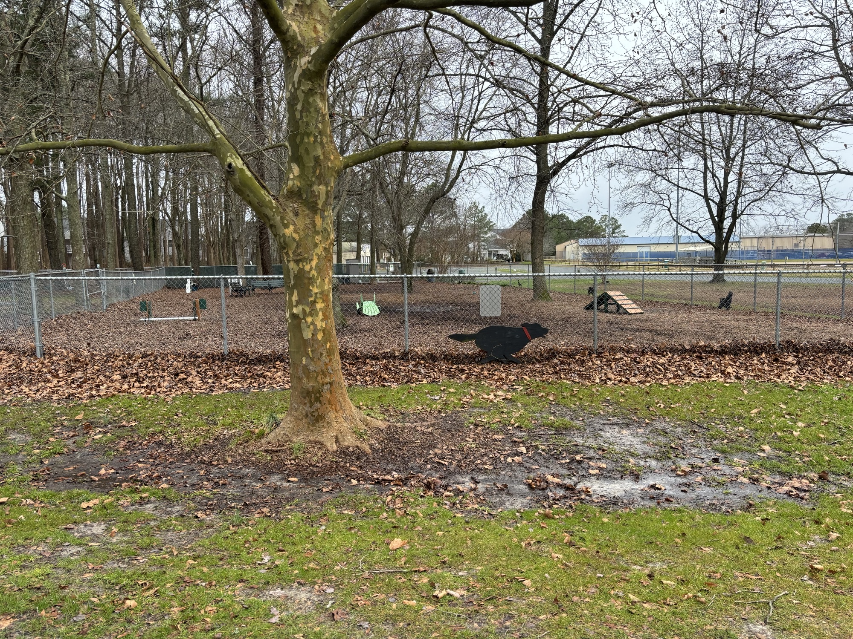
Dog Park
Two pieces of agility equipment ordered and placed in dog park by Public Works
Thanks to George Alston and Jack Levering for their input regarding the equipment and placement

Slide 14
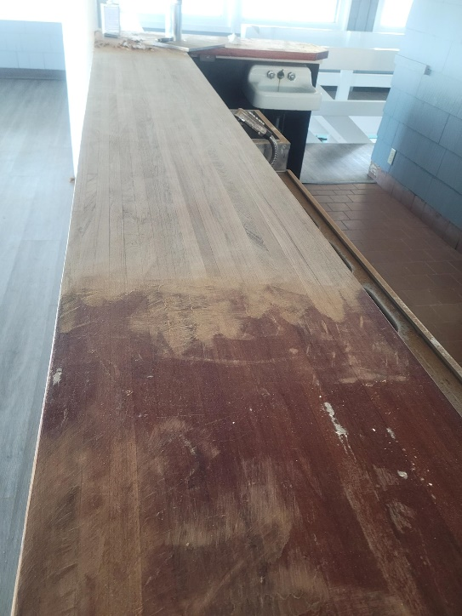
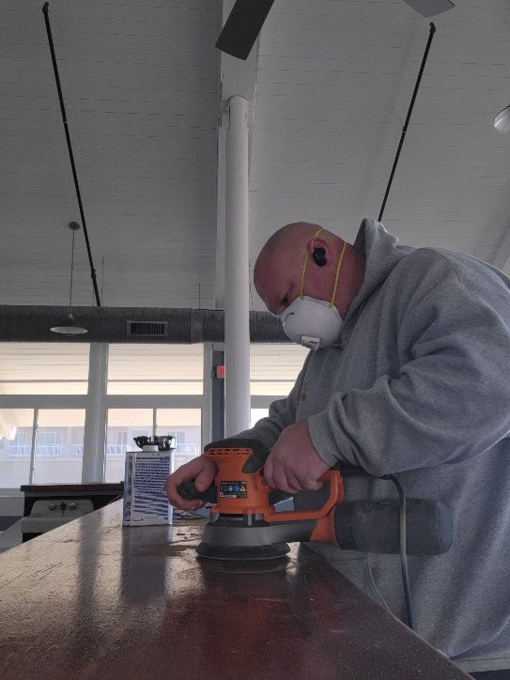
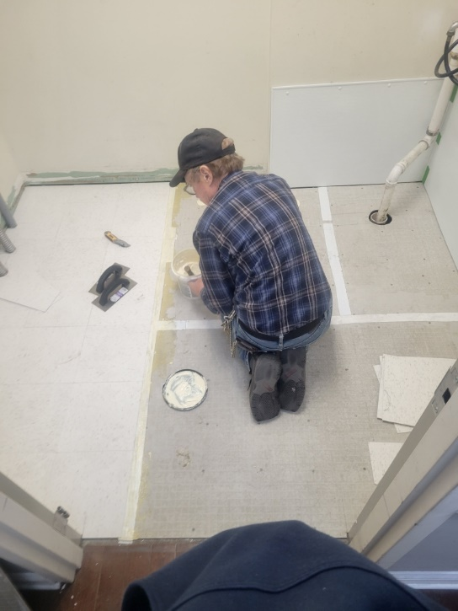
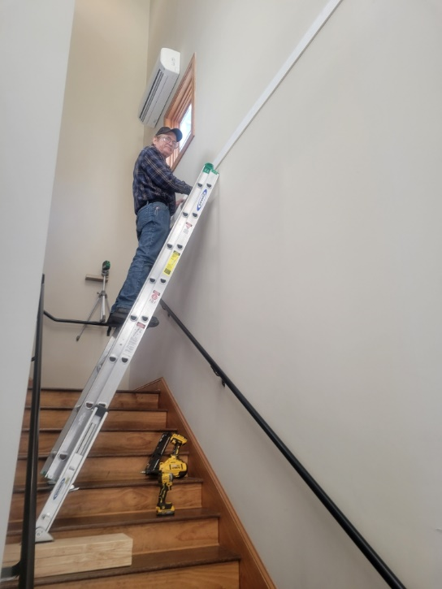
Maintenance
Public Works performing ongoing maintenance to buildings
Beach Club:
  Sanded down damaged counters and restained
Yacht Club:
  Floor repair throughout building and drywall repair

Slide 15
Signage
Per recommendation of Recreation & Parks Committee, signage ordered for all parks
  Directional signs, walking trail signs, adopt-a-park signs, curb your dog signs, playground rules
  Additional park signage to be added later this year
Signage designed and installed by Josh Vickers

Slide 16
Trash Contract
Republic contract renewed for another 3 years
New trash containers to be arriving in the next few months
Special event leaf collection
  Designated dates: November 9, November 16, November 23, December 7, December 14, & December 21
  To include leaves in paper bags only – no limit to the number of bags

Slide 17
CPI Violation Dashboard
December
Violations
As of 11/30/23 | New Violations | Closed Violations | As of 12/31/23
138 | 61 | 55 | 144
61 violations initiated in December: 5 maintenance/trash/debris; 25 leaf placement; 9 no permit; 22 miscellaneous
  Miscellaneous violations includes signs, stop work orders, trailers, unregistered/junk vehicles, and vehicle parking
55 violations complied out; 144 remain open
  34 maintenance/trash/debris; 25 leaf placement; 31 no permit; 54 miscellaneous

Slide 18
Work Orders
December
Open Work Orders as of 11/30/23 | New Work Orders | Closed Work Orders | Open Work Orders as of 12/31/23
111 | 74 | 60 | 125
74 work orders initiated in December: 1 bulkhead; 36 drainage; 7 grounds/landscaping; 4 roads; 6 signs; 20 general maintenance
Majority still open in drainage (57):
  5 – over 30 days; 20 – over 60 days
    Average 1-4 work orders a day to complete depending upon severity

Slide 19
Customer Service Dashboard
(from info@oceanpines.org)
December
Type | # Received – Dec.
Amenities | 7
CPI | 10
Drainage | 1
General | 30
Public Works | 13
TOTAL | 61

Slide 20
Financials

Slide 21
UNAUDITED FINANCIAL CHANGE
MONTH OF DECEMBER 2023
December (In 000’s)
 | Budget | Current Year | Favor/ (Unfavor) vs. Budget
Net Revenues | $239 | $278 | $39
Expenses | 1,242 | 1,160 | 82
Net Operating | ($1,003) | ($882) | $121

Slide 22
UNAUDITED MONTH OF DECEMBER
FAVOR/(UNFAVORABLE) VS. BUDGET (IN 000’s)
Department/Amenity | Favorable/(Unfavorable)
Golf Ops + Maintenance | 37
Public Works/Gen Maint/CPI | 24
Recreation & Parks | 19
Police | 14
Aquatics | 13
Yacht Club | 11
Other Net (GM Office, Beach Club, Marinas) | 3
TOTAL | $121

Slide 23
UNAUDITED FINANCIAL CHANGE
YTD DECEMBER 2023
December YTD (In 000’s)
 | Budget | Current Year | Favor/ (Unfavor) vs. Budget
Net Revenues | $13,330 | $14,062 | $732
Expenses | 10,284 | 10,183 | 101
Net Operating | $3,046 | $3,879 | $833

Slide 24
UNAUDITED YTD DECEMBER
FAVOR/(UNFAVORABLE) VS. BUDGET (IN 000’s)
Department/Amenity | Favorable/(Unfavorable)
Police | $201
Golf Ops + Maintenance | 171
Public Works/Gen Maint/CPI | 156
Admin/Finance/GM/Public Relations | 101
Beach Club | 59
Beach Parking | 51
Aquatics | 50
Recreation & Parks | 45
Clubhouse Grille | 39
Yacht Club | 28
Marinas | (38)
Racquet Sports | (30)
TOTAL | $833

Slide 25
UNAUDITED RESERVES DECEMBER 2023 ($ MILLIONS)
 | GeneralReplace | Bulkheads | Roads | Drainage | New Capital | Total
4/30/23 Balance | $5.1 | $0.5 | $0.7 | $0.2 | $0.1 | $6.6
Contributions/ Interest | 2.1 | 1.1 | - | 0.1 | 0.1 | 3.4
Casino Funds | - | - | 0.4 | 0.1 | - | 0.5
Transfer (Spend) | (1.0) | (0.7) | - | - | (0.1) | (1.8)
12/31/23 Balance | $6.2 | $0.9 | $1.1 | $0.4 | $0.1 | $8.7

Slide 26

Treasurer’s Report -
Monica Rakowski

Slide 27

Cash & Short-Term Investments
Month of December
As of December 31, 2023, the Association had Approximately (~) $15.7M in Cash
  Cash Increased ~ $0.6M from the Same Time Period Last Year
  Cash Decreased ~ ($1.1)M from November 2023
  $11.3M Invested in CDAR’s
  $53K in Interest Income Recognized for the Month
  Remaining $4.4M in Insured Cash Sweep, Treasury Bills, Money Market and Other Operating Accounts (Diversified Between 2 Local Banks)

Slide 28


Public Comments
Members wishing to make comments must state their name and address

Slide 29
CPI Violations
See list

Slide 30
New Business
Motion to approve the OPA Season Kick-Off Day 2024 event – Monica Rakowski
First Reading of revisions to the Architectural Review Committee Guidelines – Elaine Brady

Slide 31
Appointments
John Dilworth – Extension – Architectural Review
Donald McMullen – 3rd Term – Golf
Suzanne Russell – 1st Term – Racquet Sports
Leslie Shippee – 1st Term – Racquet Sports
Fred Stiehl – 1st Term – Strategic Planning

Slide 32
Adjournment

