Slide 1

Board of Directors Meeting
January 22, 2022

Slide 5
Approval of Agenda

Slide 6
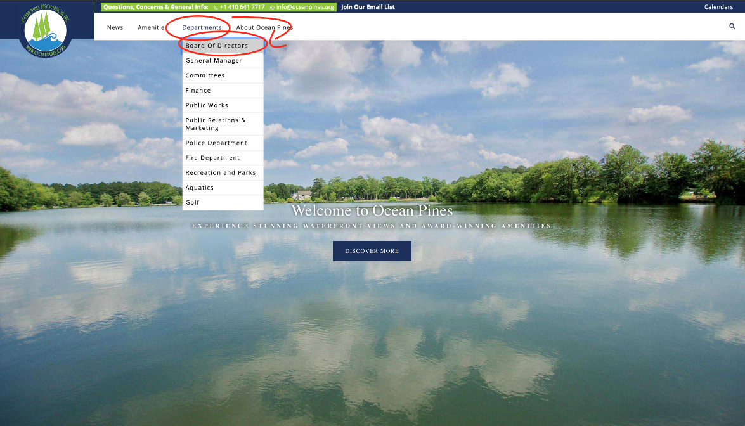
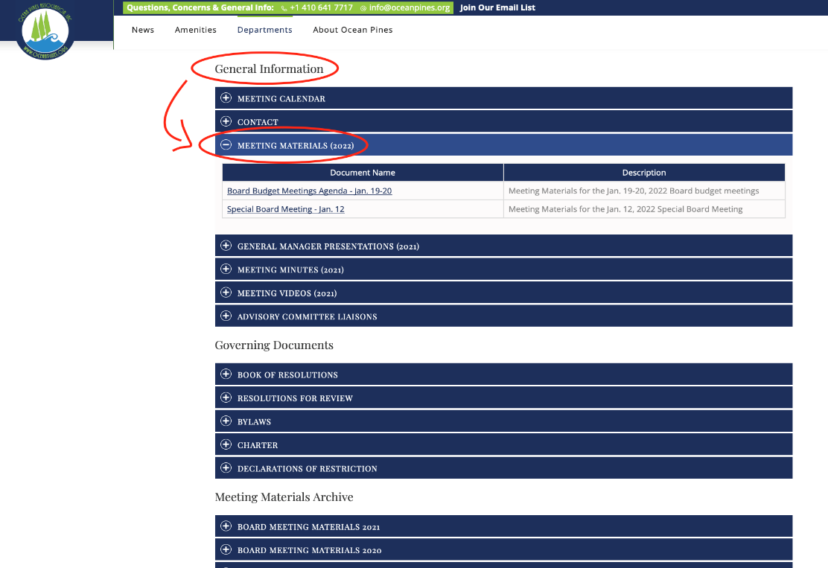
How to access board packets
The packets can be found on www.oceanpines.org under the Departments – Board page, then General Information:
  https://www.oceanpines.org/web/pages/board-of-directors.
Also posted on the News page of the website:
  https://www.oceanpines.org/web/pages/news_content?announcementId=1071&backURL=/web/pages/opa-news

Slide 7
Approval of Minutes
December 11, 2021 – Regular Meeting
January 12, 2o22 – Special Meeting

Slide 8

President’s Remarks colette horn

Slide 9
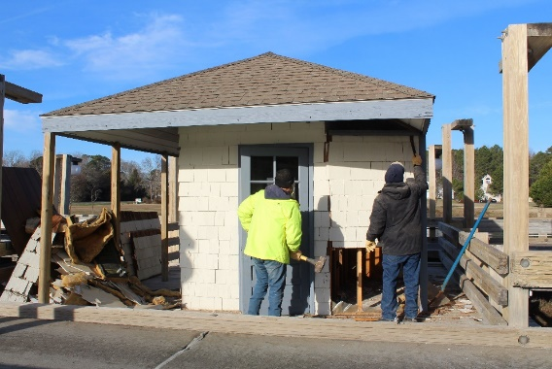
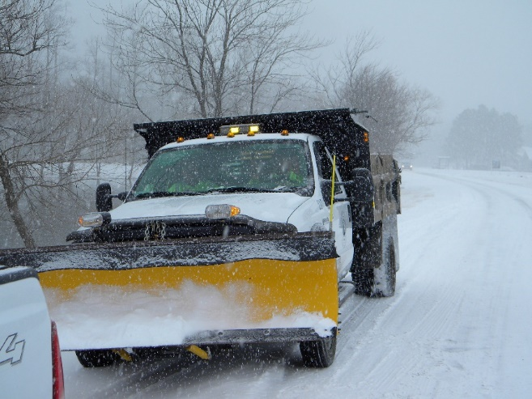
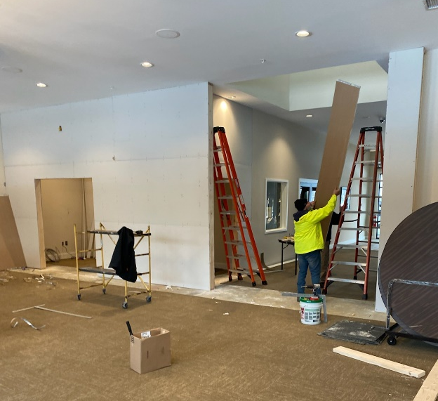
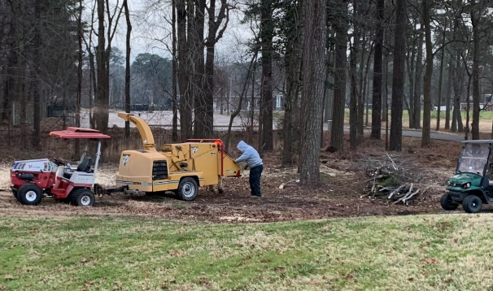
GM Leadership Report - John Viola

Slide 10
Initiatives
Pickleball Courts
Audio System
Clubhouse
Assateague Room
Clubhouse – Wall and Door
Drainage – Pinehurst, Sandyhook and Beaconhill
Mailboxes
Proposed – FY 2022/2023 Budget
North Gate Bridge
Guard Shack
Lights
Recreation Pier & Kayak Launch
Electronic Signs
Administration Building Renovations

Slide 11
Pickleball Courts
Approved by the Board on January 20, 2021
We received a budget number from a contractor back in July of $180,000.00
Status:
  Vista is preparing pickleball court plans to go out for bids
  Bid packet sent 1/21/22; bids due back 2/18/22
  Bids will be leveled within a week of receiving them, with bids being awarded right after that
Timeframe: Work will be scheduled, and the timing of the project, will be determined by contractor’s schedule and availability of material

Slide 12
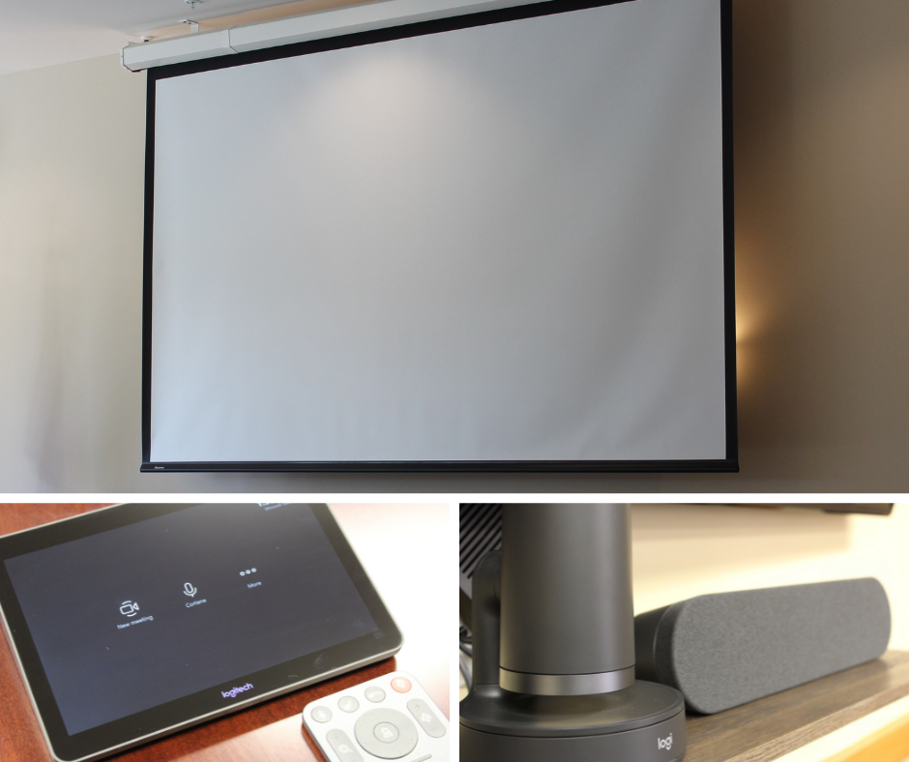
Audio System
Hybrid meeting functionality to be installed in the Clubhouse Meeting Room and the Assateague Room
Mid-South Audio to install the hybrid meeting system, to include a custom table with built-in microphones and cameras, which will be integrated into the existing audio system to work with Microsoft Teams
Estimated Cost:
  Clubhouse Meeting Room: $15,000
  Assateague Room: $23,000 ($15,000 + $8,000 for projector/screen)

Slide 13
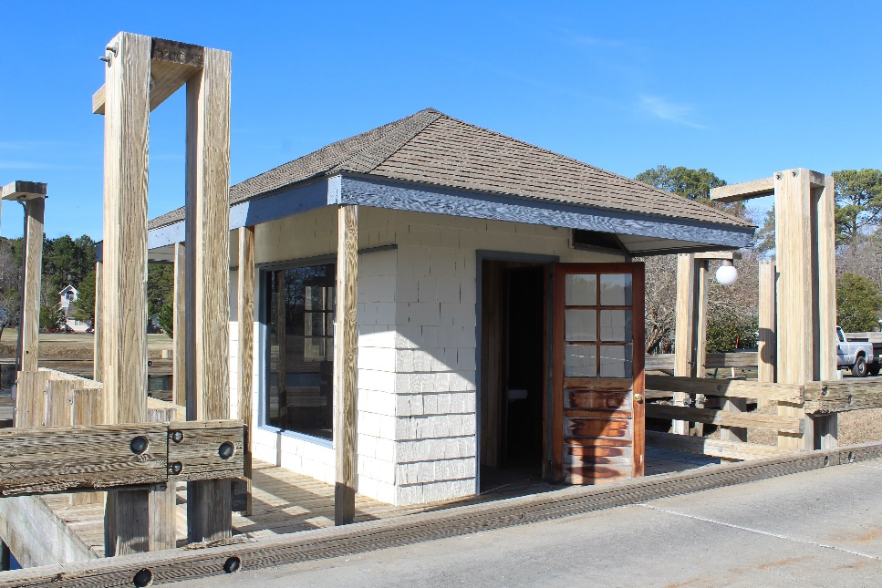
North Gate Bridge
Guard Shack:
  Decision made to remove guard shack at estimated cost of $2,500
  Work to be done in-house
  Timeframe:
    Shack and old decking being removed now – to be completed in 2-3 weeks
    Power that feeds the lights on the bridge, flagpole, and entrance signs will be relocated out of shack to new location
  Options discussed for area:
    Extend guard rail on both sides to cover openings
Lights:
  Cost and installation time frame depends on the type of light chosen and availability

Slide 14
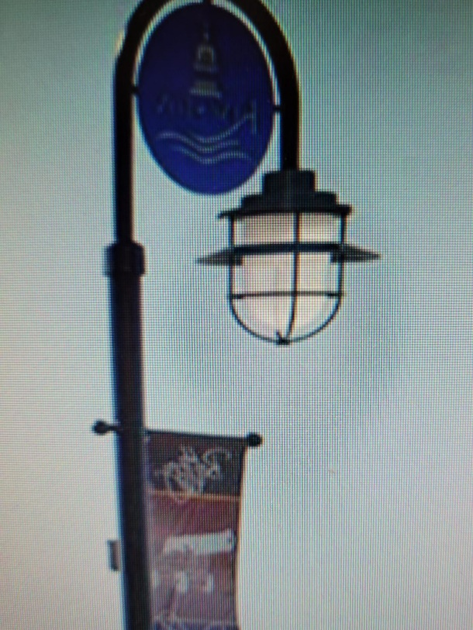

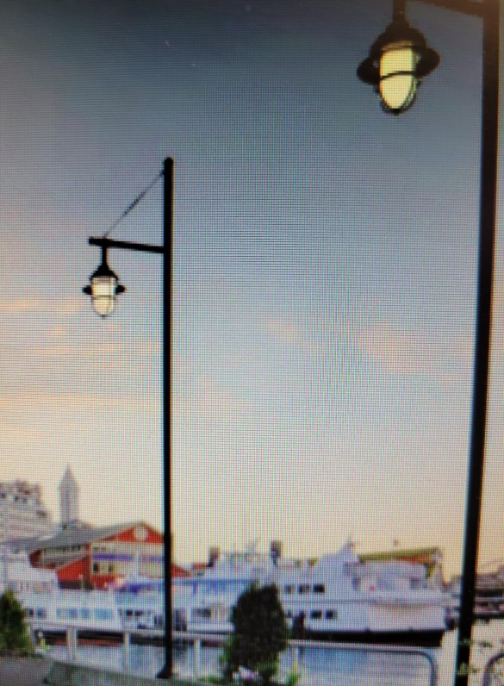
Entrance Bridge Lighting – Design Ideas
Lights to attach to bridge
Light poles on 4 corners
Lights to attach to Bridge

Slide 15
Recreation Pier & Kayak Launch
Team has reviewed 4 possible locations:
  Grand Canal
  Pintail Park
  Swim & Racquet Marina
  White Horse Park Boat Ramp
Recommendation made from Recreation Committee was Pintail Park due to parking, portable bathrooms, and handicap access:
  Bulkhead scheduled to be replaced in the area this Fall
    If Pintail Park is chosen as the site, pier and launch will not be installed until 2023
Estimated construction cost: $40,000-$50,000
Pier in Replacement Reserves, but not included in current or proposed budget

Slide 16
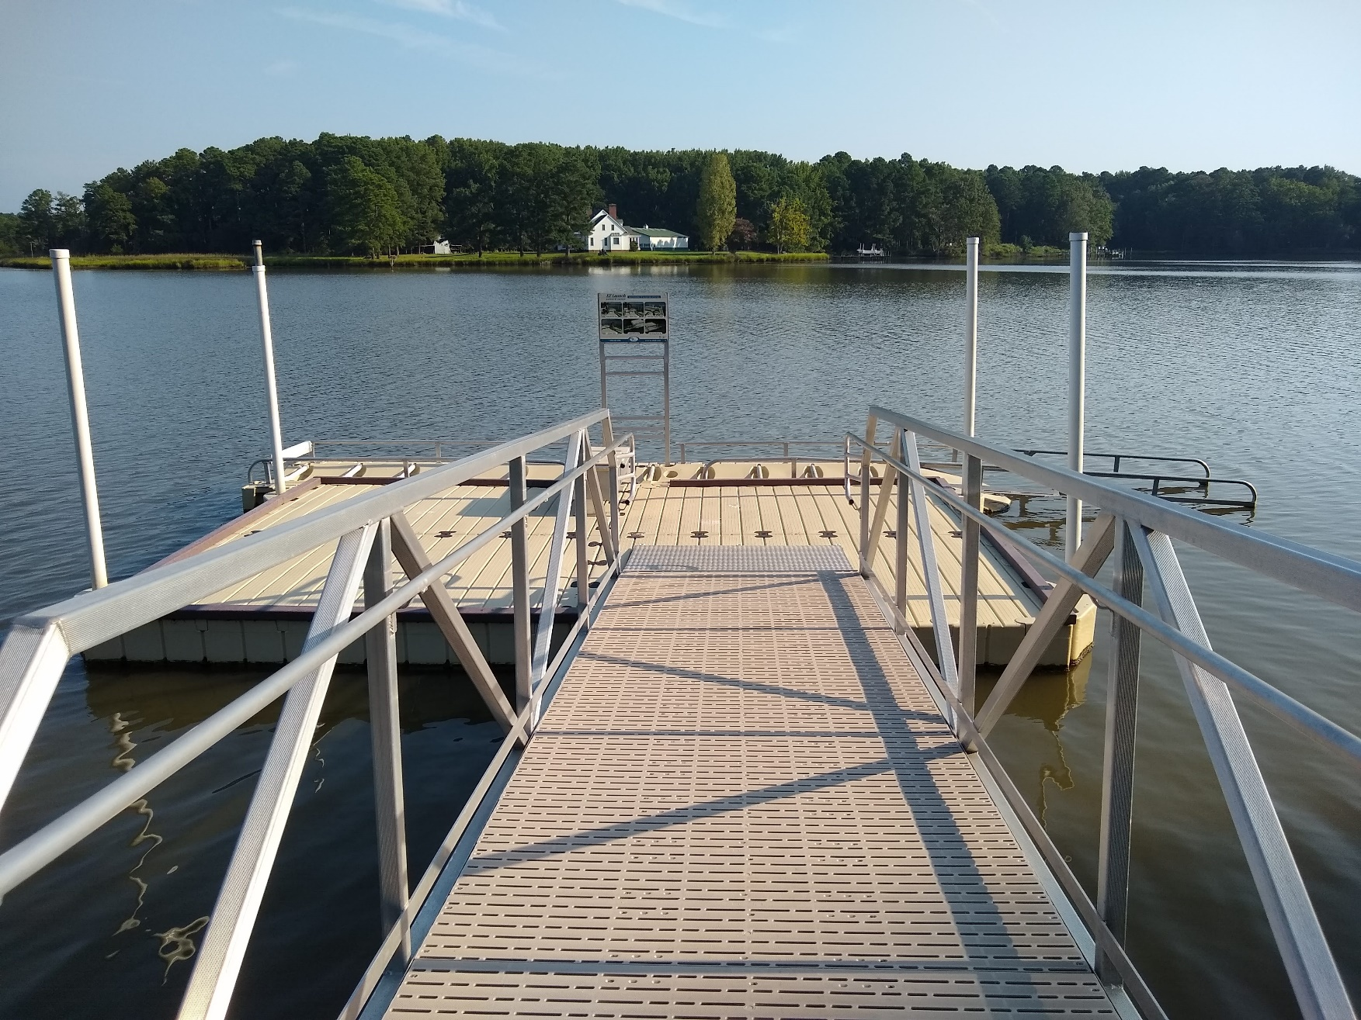

Slide 17
Clubhouse Wall and Door
Work started this week on the construction of new wall
Wall lights will be moved next week
Contractor to relocated HVAC units next week
Fire Protection Services has been contacted about moving the alarm items that have to be relocated
Wall should be completed within 3 weeks, pending if material is available
New doorway and glass panels have been ordered and are due in next week
Doors to the closet have been ordered and will take over 4 weeks to be delivered
Estimated cost for entire project is $15,000 (door: $8,000; relocation of HVAC units: $2,000; relocation of alarms: $1,000; material: $4,000)

Slide 18
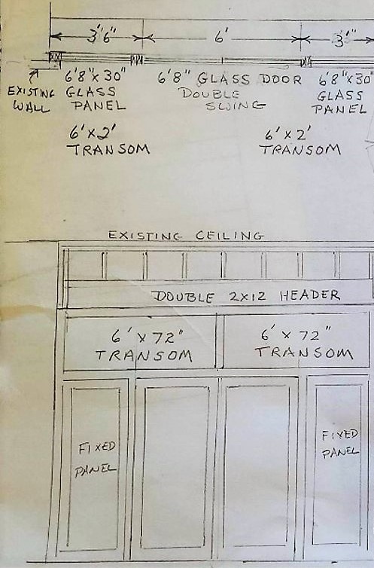
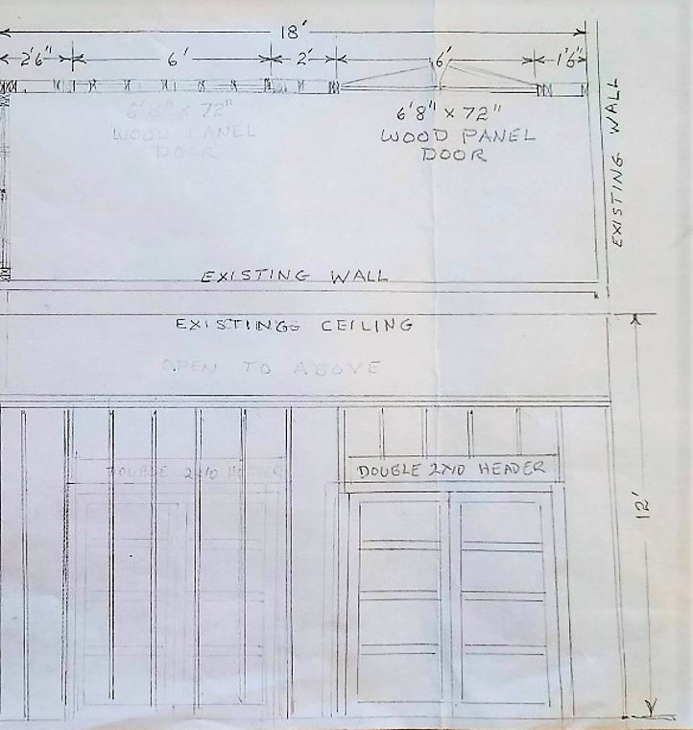
Wall/Solid Doors for New Storage Closet
Replaces the current partitions being used to conceal banquet tables and chairs
New Wall/Glass Doors for Interior Entrance to Clubhouse Meeting Room
Provides noise reduction by fully enclosing the meeting room

Slide 19
Drainage – Pinehurst, Sandyhook & Beaconhill
Received quote from Worcester County DPW for $76,230 to have the utility work completed
Total for this portion of the project: $297,000
  This includes the utility work, additional pipes, and the installation of the pipes
Met with Worcester County representatives on January 12, 2022
Project moving forward per Board approval at the December 11, 2021 Meeting
Timeframe: material for what Worcester County needs to move utilities will arrive in about 2 months, with work being completed in early Spring

Slide 20
Electronic Signs
Quotes received:
  Gable (Curtis Bay, MD): estimated $35,000-$45,000 per 4’ x 5’ sign (estimated $70,000-$90,000 total)
  Fast Signs (Annapolis, MD): estimated $34,399.50 per 4’8” x 6’3” sign (estimated $68,799 total)
  Phillips Signs (Seaford, DE): $38,446.76 per 4’5” x 8’3” sign ($76,893.52 total)
Phillips Signs recommended by Communications Committee
Additional estimate of $1,500 per sign for permitting ($3,000 total)
Additional estimate of $7,500 per sign for labor ($15,000 total)
Total estimated expense for 2 signs: $94,893.52
Quote received for 8, 4’5”x8’3” signs (to replace existing marquees) of $31,936.24 ($255,489.92 total)
If installed, per Worcester County, any existing signs would need to be removed

Slide 21
Administration Building Renovations
Office renovations, including moving employees and building new offices
Total project cost: $125,000
  New HVAC system: $45,000
  New flooring: $50,000
  New ceiling system: $10,000
  New lights: $5,000
  Painting: $15,000

Slide 22
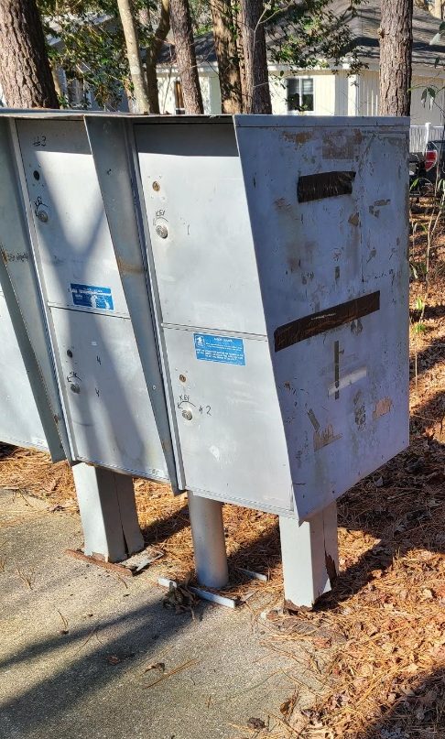
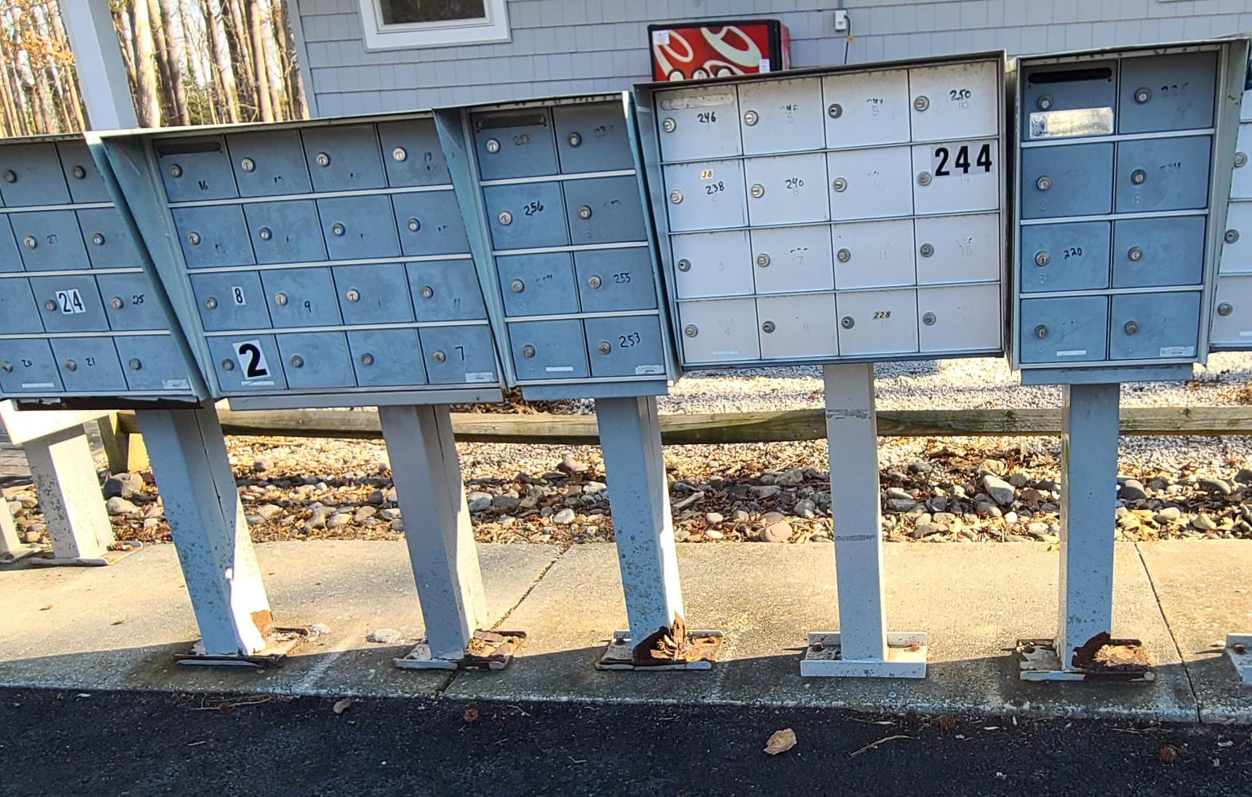
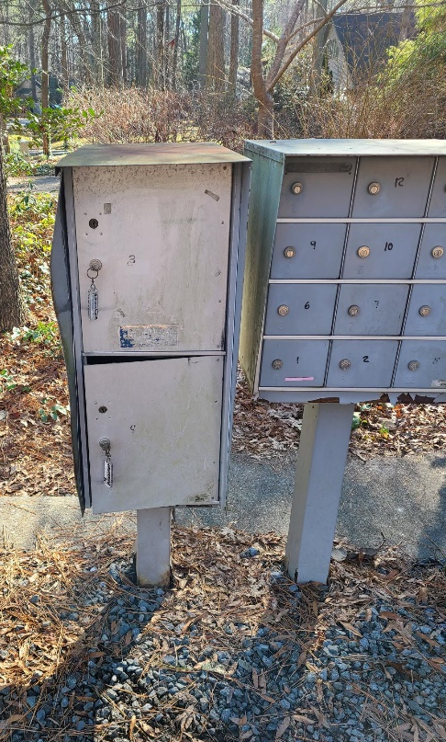
Mailboxes
Concrete pads will be reviewed to be determined which need to be replaced as priority (weather permitting)
  Will need to be replace prior to pedestal replacement
Will identify next week 10 locations as priority to begin work on
Approximately 100 pedestals in total that are priority to replace
  Reaching out to fabricator on time estimate for pedestals
  cost per pedestal is $500 each ($50,000 total estimated cost)
Will review mailboxes (clusters) and determine priority that are to be repaired/replaced
Obtaining bids for cleaning options of each mailbox cluster
  Cannot be power washed due to damaging mail inside boxes

Slide 23
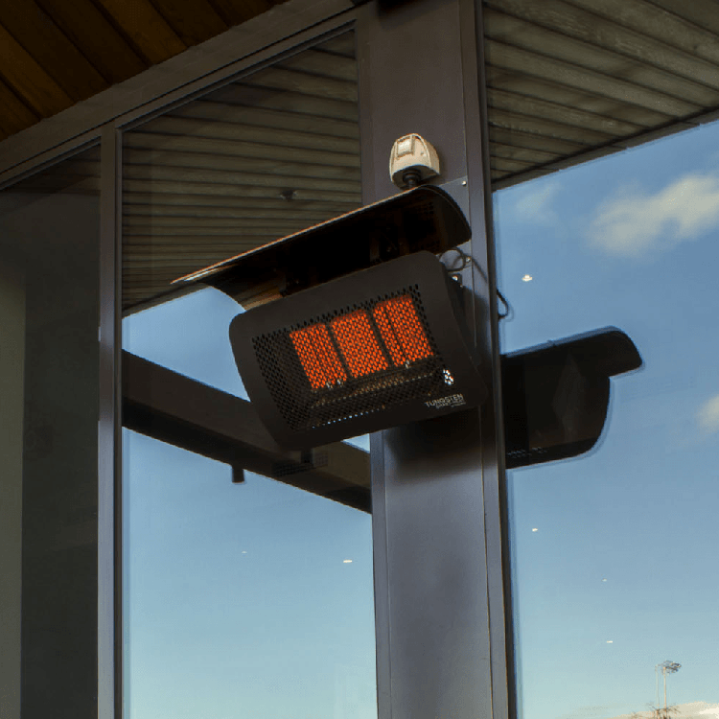
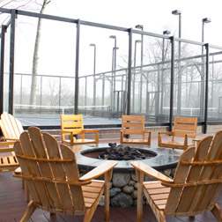
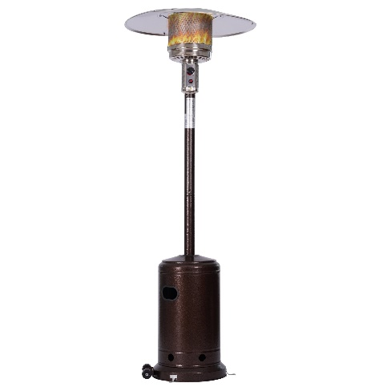
Racquet Center Upgrades/Warming Hut
Existing hut is the old south gate guard shack
Current size: 11x15 (165 sq. ft.)
  Hut has baseboard electric heat (no a/c), lights, and outlets
  Per DMA, not due for replacement:
    Roof installed in 2009; due to be replaced in 2029
    Siding & soffits installed 2009; due to be replaced in 2059
    Windows installed in 2009; due to be replaced in 2059
    Door installed in 2009; due to be replaced in 2059
Committee requesting a 14x20 hut (280 sq. ft.)
  Estimated cost: $25,000 ($16,783 for hut + estimated $8,500 for labor/permits/ material)
    Additional items needed: permits, demolition of existing building, site preparation, electric and fixtures, insulation, finish surface (drywall/paneling), & HVAC
Other options to consider:
  Outside heat source in existing hut (gas heaters in the eaves), fire pit, or outside heaters
    Estimated cost: $500-$800

Slide 24
Proposed FY 2022/2023 Budget
Prior Year 2021/2022 Assessment $996
Favorability from efficiencies and organic growth (94)
One-time assessment reduction from current realized surplus (to be reviewed every year) (53)
Offset by statutory and “mark to market” adjustments and inflation (also includes merit increases and Fire Dept. increase of $38) 76
Proposed FY 2022/2023 Budget Assessment $925
Waterfront Lots (Bulkhead) Differential
No increase from prior year $615

Slide 25
Proposed FY 2022/2023 Budget – Capital Summary
General Replacement $492,255
Roads (note: also contains increase to reserve) $350,000
Drainage $400,000
Note:
The Balance Sheet Reserves will be at approximately 25.1%+ within the Budget & Finance range

Slide 26
Financials

Slide 27
Financial Change month of NOVEMBER 2021
November (In 000’s)
 | Budget | Current Year | Favor/ (Unfavor) vs. Budget
Net Revenues | $261 | $319 | $58
Expenses + New Capital | 952 | 968 | (16)
Net Operating | ($691) | ($649) | $42

Slide 28
Financial Change
YEAR-TO-DATE November 2021
YTD November 2021 (In 000’s)
 | Budget | Current Year | Favor/ (Unfavor) vs. Budget
Net Revenues | $11,983 | $13,263 | $1,280
Expenses + New Capital | 8,318 | 8,185 | 133
Net Operating | $3,665 | $5,078 | $1,413

Slide 29
Detail for the Month of november
Favor/(Unfavorable) Vs. Budget (in 000’s)
Department/Amenity | Favorable/(Unfavorable)
Recreation & Parks | 34.8
General Admin | 31.7
Public Works/General Maint/CPI | 30.9
Golf Ops + Maintenance | 20.5
Yacht Club | (47.6)
Police | (10.0)
New Capital | (9.3)
Other Net (Racquet, Clubhouse Grille, Marketing, Finance, GM Office, Beach Parking, Aquatics, Beach Club) | (9.4)
TOTAL | $41.6

Slide 30
Detail for year-to-date november
Favor/(Unfavorable) Vs. Budget (in 000’s)
Department/Amenity | Favorable/(Unfavorable)
Public Works/General Maint/CPI | $297.7
Golf Ops + Maintenance | $292.3
Aquatics | 197.8
Admin, Finance, GM, PR/Mktng | 153.1
Yacht Club | 151.0
Police | 81.9
Beach Parking | 54.9
Recreation & Parks | 48.1
Beach Club | 45.3
Marinas | 42.6
Racquet Sports | 34.1
Clubhouse Grille | 33.5
New Capital | (19.6)
TOTAL | $1,412.7

Slide 31
“flash” for month of december 2021 (in 000’s)
Department/Amenity | Favorable/(Unfavorable)
General Admin | $29.6
Public Works/General Maint/CPI | 28.0
Police | 9.9
Aquatics | 9.8
Golf Ops + Maintenance | 8.3
Recreation & Parks | 7.7
Food & Beverage (Total) | (61.0)
Other Net (GM, Marketing, Finance, Tennis, Platform, Pickle, Beach Parking, Marinas) | 4.4
TOTAL | $36.7

Slide 32

Treasurer’s Report - larry Perrone

Slide 33

Cash & Short-Term Investments
Activity for Month of November
Overall Laddered Investment Rate of Return on CDAR’s for November Approx. 0.75%
As of November 30, 2021, the Association had approx. $14.8 million in cash
  Approx. $7.1 million invested in CDAR’s, fully FDIC insured
  Approx. $7.7 million in Money Market, and other operating accounts, fully insured

Slide 34
Unaudited Reserves November 2021 ($Millions)
 | GeneralReplace | Bulkheads | Roads | Drainage | New Capital | Total
4/30/21 Balance | $3.9 | $1.0 | $0.2 | $0.5 | $0.1 | $5.7
Contributions/ Interest | 1.6 | 1.1 | - | - | 0.2 | 2.9
Casino Funds + Grant Income | - | - | - | 0.7 | - | 0.7
Transfer (Spend) | (0.5) | (0.9) | (0.2) | (0.4) | - | (2.0)
11/30/21 Balance | $5.0 | $1.2 | $- | $0.8 | $0.3 | $7.3

Slide 35
Reserves year-end unaudited estimate
(in ooo’s)
 | Beginning Balance |  |  | Unaudited EST Balance
 | 4/30/21 | Additions | Expenditures | 4/30/2022
Major Maintenance & Replacement:
Public Works – Fleet Vehicles |  |  | (302)
Public Works Tractor in 21 Budget |  |  | (146)
Police Vehicles (x 3) |  |  | (133)
Aquatics (Furniture, Roof, Equip) |  |  | (75)
Golf Maintenance Tri-plex Mower |  |  | (49)
Public Works Boom Mower |  |  | (36)
Yacht Club Kitchen Equipment |  |  | (20)
Golf Ops (Ball Dispenser/Washer) |  |  | (14)
Racquet (Lighting,Fountains) |  |  | (10)
Other |  |  | (50)
Total | 3,853 | 1,685 | (835) | 4,703
Bulkheads & Waterways | 1,010 | 1,070 | (1,908) | 172
Roads | 216 | 3 | (209) | 10
Drainage | 469 | 835 | (800) | 504
New Capital | 102 | 183 | (190) | 95
TOTAL 4/30/22 ESTIMATE | 5,650 | 3,776 | (3,942) | 5,484

Slide 36

Public Comments

Slide 37
Public Comments
Members wishing to make comments must state their name and address. Time limit for comments is 5 minutes. Comments may be made on any topic of interest to the member that pertains to the mission of OPA. Order for comments for hybrid meetings: 1st – members in attendance in-person; 2nd – MS Teams Participants (use of “raise hand” function required to enter speaking queue); 3rd – members participating through the MS Teams call-in (audio only) function. To enter call-in queue, text Josh Davis at 443-377-1079. Chat function of MS Teams is for Public Comments only; all other comments in the chat function will be considered out of order, as will be speaking during the meeting without being given the floor by the Chair.

Slide 38
Capital Purchase requests
None

Slide 39
CPI VIOLATIONS
None

Slide 40
Unfinished Business
None

Slide 41
New Business
First Reading – Resolution M-09 –
Colette Horn
RACQUET CENTER UPGRADES/WARMING HUT – AMY PECK
ELECTRONIC SIGN INITIATIVE – COLETTE HORN
Motion to adjourn to closed session – Colette horn

Slide 42
appointments
Ellen hench – chair – aquatics committee
Sharon santacroce – chair – environmental & natural assets committee
Robert Windsor – 2nd term – elections committee

Slide 43
NEXT MEETING DATE
Wednesday, February 23rd at 11:00 a.m.
(HYBRID MEETING AT clubhouse meeting room)

Slide 44
Adjournment

