Slide 1

Board of Directors Meeting
October 15, 2022

Slide 2
Approval of Agenda

Slide 3
Approval of Minutes
September 24, 2022 – Regular Meeting

Slide 4


President’s Remarks
Doug Parks

Slide 5


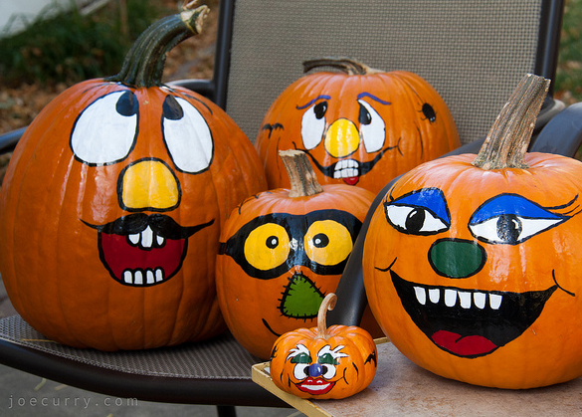

GM Leadership Report –
John Viola

Slide 6
Initiatives
Budget Process
North Gate Bridge
Golf
Drainage
Fire Department Work Group
Aquatics
Roads
Racquet Sports
Marina Gas Pump Line
Strategic Plan
Metrics
Short Term Rentals

Slide 7
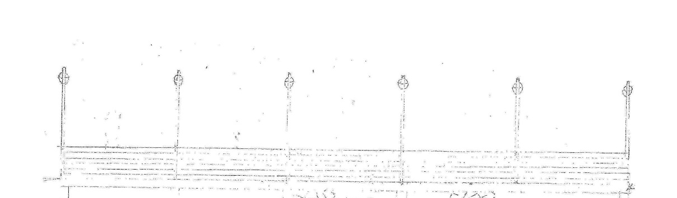
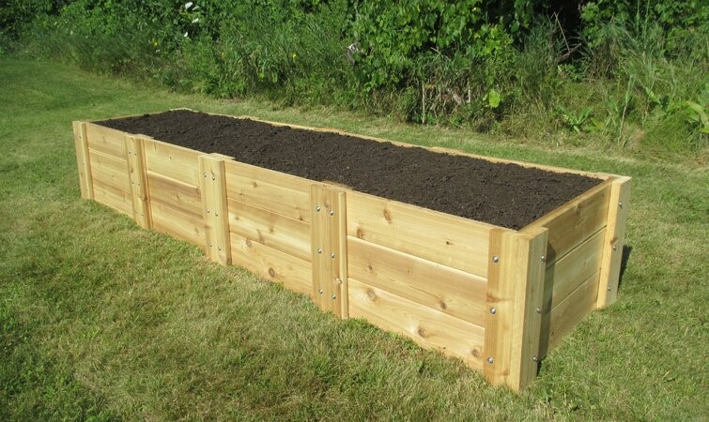
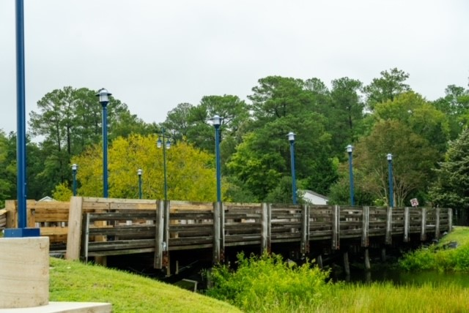
North Gate Bridge
North Gate Bridge:
  Lights completed
  Raised Flower Box
    Guidance from the Garden Club
  Outside Wall Trim Finish
    Guidance from Work Group

Slide 8
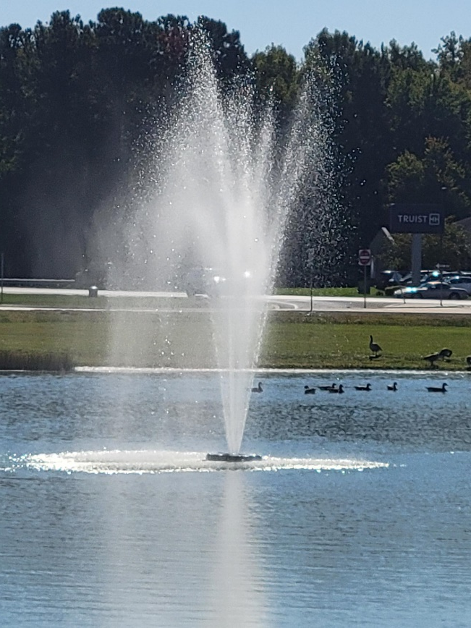
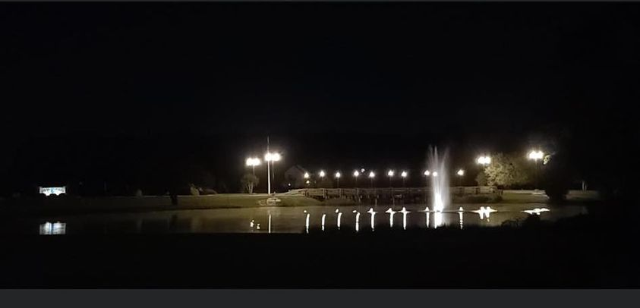
North Gate Bridge
  Potential fountain for the northside of the Bridge.

Slide 9
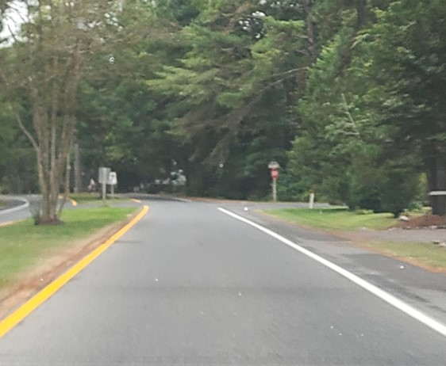
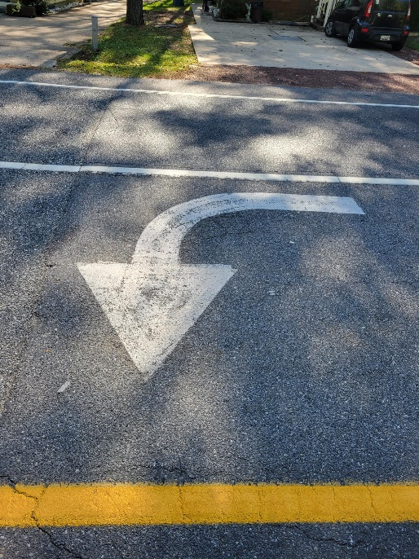
Roads
Paving
Approximately 3 miles of roads to be completed: Barnacle Court, Beach Court, Birdnest Drive, Fosse Grange, Garrett Drive, Ivanhoe Court, Liberty Bell Court, Little John Court, Moonshell Drive, Rabbit Run Lane, Surfers Way, Watergreen Lane, and Willow Way
Striping
Striping completed on Monday, September 26, 2022
Currently working on Crosswalks and Arrows (Ocean Parkway)

Slide 10
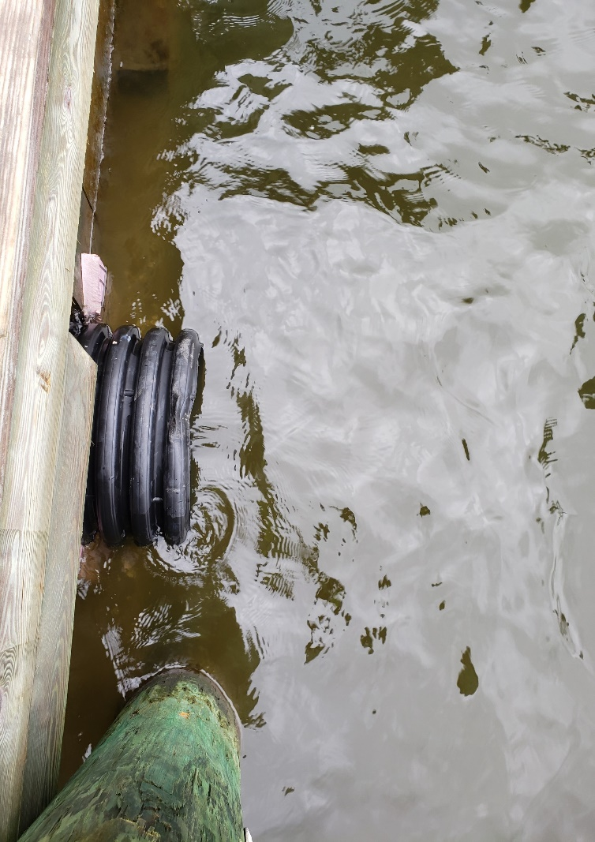
Drainage
  Water’s Edge Pipe
  Deppe Bros
  $8,850
  Completed September 30, 2022
  Clubhouse Drive Pipe
  Deppe Bros
  $8,850
  Will begin October 17, 2022
  Birdnest Drive Pipe
  Need to bid
  Late fall, early winter

Slide 11
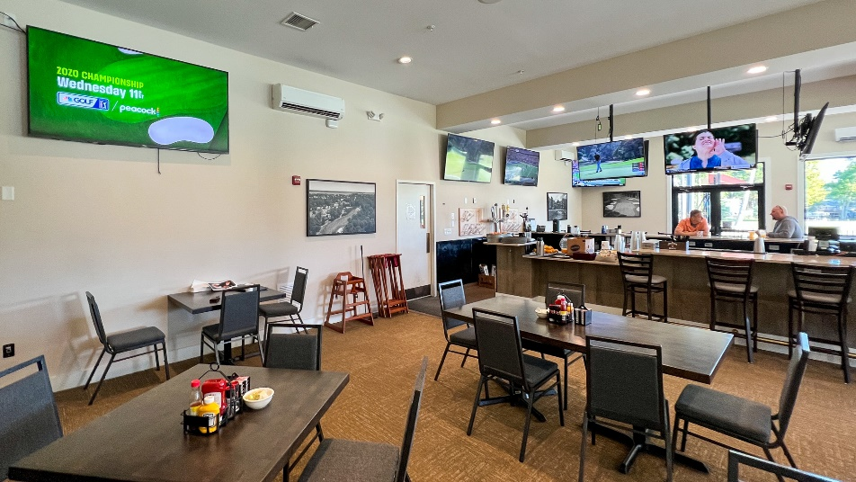
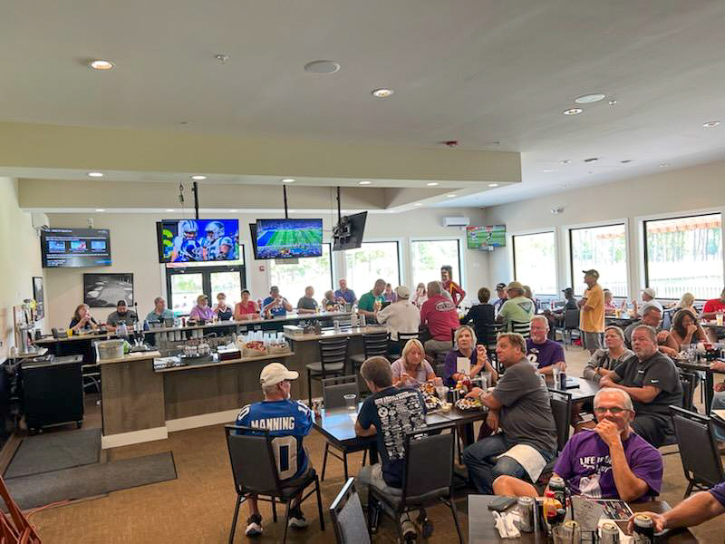
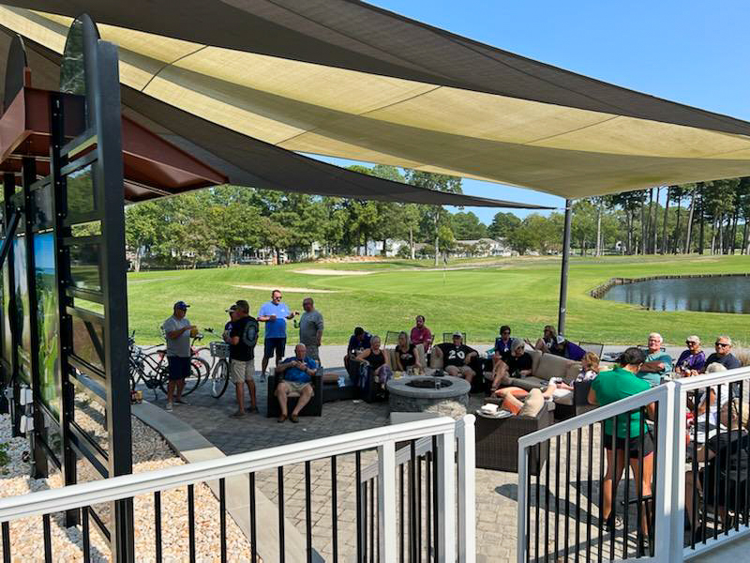
Clubhouse Grill
Football Sundays – Specials – Happy Hour Drinks
Additional TVs
Numbers show a positive trend
Every seat in the building was filled on October 2, 2022 during Hurricane Ian

Slide 12
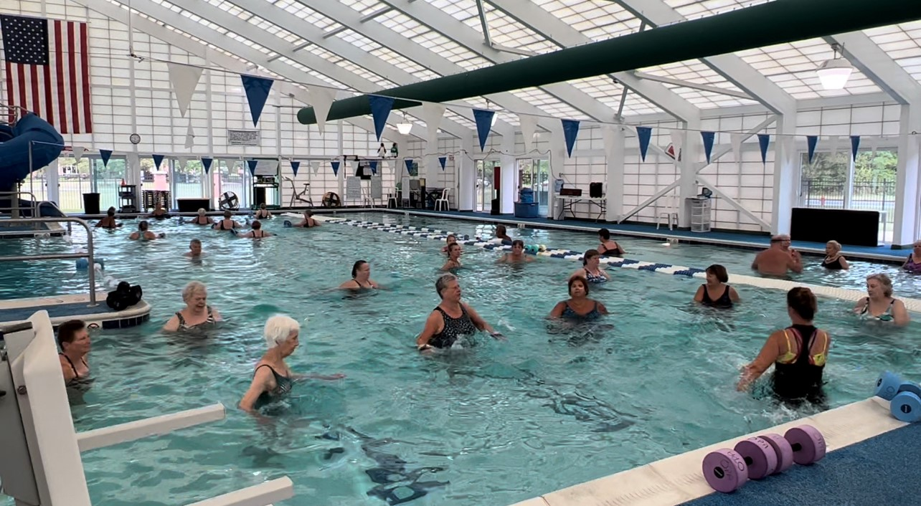
Aquatics
Currently looking at different options to fill open positions, such as
Paying for certification for lifeguards
Summer differential
Job Fairs
Working with Human Resources
Working to quantify positions

Slide 13
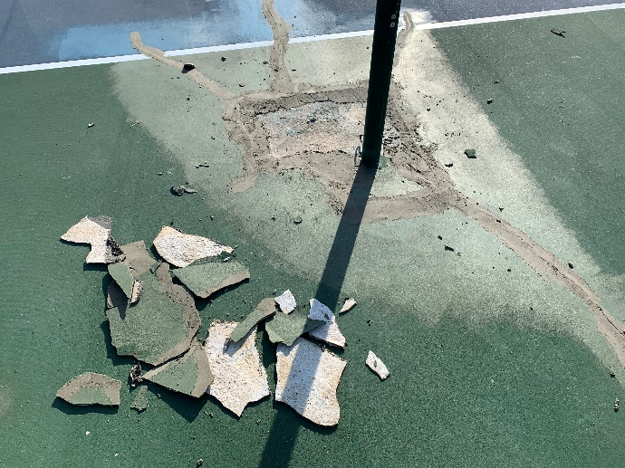
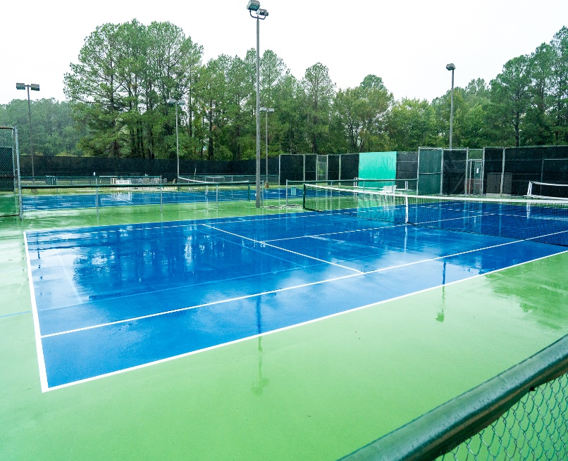
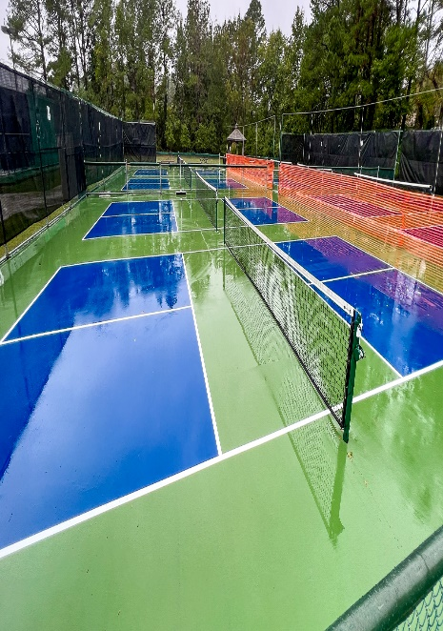
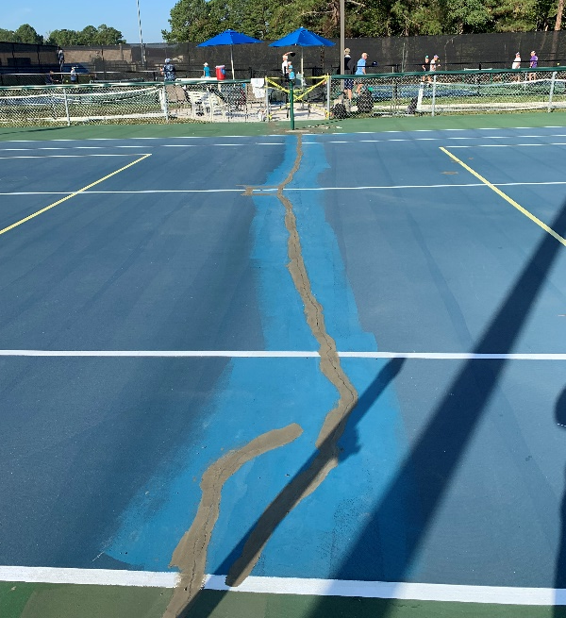
Racquet Sports
Renovation of Existing Courts
Renovation completed on September 28, 2022
Cost is approximately $75,000
Renovation completed on time for October 7th tournaments

Slide 14
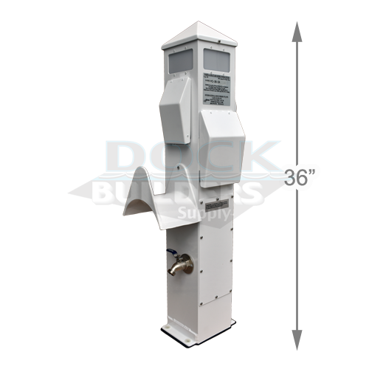
Marina
C Dock
  We worked with Vista on plans for C dock
  Bids were completed and reviewed with recommendation (see capital requests)
  Power Pedestal will have two hose connections, two hose holders and two electrical outlets.

Slide 15
Golf
Days continue to be busy with all types of bookings especially weekends with Package Play
We have several events going on from now through the end of the year
  Oct 12th – Ladies Pink Ribbon Tournament for Breast Cancer
  Oct 21st & 22nd – Men’s Golf Ryder Cup Tournament
  Nov 3rd – OOPMGA End of Year Fall Banquet and Dance
  Dec 10th – Santa’s Open Golf Tournament by Big Brothers and Sisters of the Eastern Shore
Golf Maintenance
  Verticutting greens, tees, and fairways
  Ninja tine aerification on greens
  Topdressing (applying light amounts of sand) greens and tees
  Addressing irrigation issues from summer. Especially current leaks on holes 1-4-7-12
  Storm cleanup following the recent hurricane
  Planning tree and drainage work for this fall/winter
  Planning next season chemical and fertilization plan to take advantage of early order discounts pricing
Days continue to be busy with all types of bookings esp. weekends with Package Play.
We have several events going on from now through the end of the year.
  Oct 12th – Ladies Pink Ribbon Tournament for Breast Cancer
  Oct 21st & 22nd – Men’s Golf Ryder Cup Tournament
  Nov 3rd – OOPMGA End of Year Fall Banquet and Dance
  Dec 10th – Santa’s Open Golf Tournament by Big Brothers and Sisters of the Eastern Shore

Slide 16
OPVFD Work Group
Issued RFP for consultant (feasibility study) on 9/26/22 to seven firms/individuals
Questions and responses accepted through 10/14/22
Proposals due 10/31/22
Update board with team recommendations on 11/19/22

Slide 17
Budget FY 2023/2024
Budget process has started!
All departments have received their respective budget sheets
Key items to be addressed:
  Pricing/income
  Open positions
  Salaries – $13.25 minimum wage as of 1/1/23 ($14.00 minimum wage as of 1/1/24) and market adjustments
  Efficiencies on expenditures
Timetables and assignments have been set
Budget binders to be delivered to the Board and Budget & Finance Committee by December 23, 2022
Budget & Finance Committee presentation tentatively scheduled for January 4th – 6th, 2023
Board work session to be determined (usually held the 3rd week of January), with public hearing by the first week of February

Slide 18
Strategic Plan
Recommended goals established by the Strategic Planning Committee:
  Achieve a strong and sustainable financial position
  Maintain and enhance infrastructure, community appearance, and current amenities
  Maintain a high level of safety
  Foster a sustainable and engaged community, driven by our core values (integrity, accountability, collaboration, respect, sustainability, and transparency)
  Goal added by OPA staff: Support leadership training and development
Team began developing the plans for their individual locations in July
Final draft sent to Strategic Planning Committee in August for review; meeting with Bernie McGorry on September 15, 2022 to go over recommendations from the committee
Changes incorporated in draft and reviewed with each department for approval
Final completed October 13, 2022
Next steps:
  Presentation/distribution of plan to advisory committees and Board

Slide 19
Short-Term Rentals
Done so far:
  John assigned implementation team
  Team has a plan on how to perform the referendum
  Met with attorney on referendum language
  Met with Board representative on July 18th with questions regarding the referendum
  Opening informational statement developed
Next steps:
  Team is ready to go!
Coming to the Board on next steps:
  Begin mailing process?
  How many time should the mailing be done?

Slide 20
CPI Violation Dashboard
September
Violations (includes legal)
As of 8/31/22 | New Violations | Closed Violations | As of 9/31/22
105 | 22 | 34 | 93
Legal Cases
As of 8/31/22 | New Violations to Legal | Closed Violations in Legal | As of 9/30/22
56 | 8 | 6 | 58

Slide 21
Work Orders
September
Open Work Orders as of 8/31/22 | New Work Orders | Closed Work Orders | Open Work Orders as of 9/30/22
178 | 88 | 83 | 183
88 work orders initiated in September: 5 bulkhead; 19 drainage; 20 grounds/landscaping; 11 roads; 9 signs; 24 general maintenance
Majority still open in drainage (62) and grounds/landscaping (50)
  Drainage (11 – over 30 days; 10 – over 60 days; 27 – over 90 days
    Average 1-4 work orders a day to complete depending upon severity

Slide 22
Customer Service Dashboard
(from info@oceanpines.org)
September
Type | # Received – Sept.
Amenities | 14
CPI | 7
Drainage | 0
General | 31
Public Works | 15
TOTAL | 67

Slide 23
Financials

Slide 24
PRELIMINARY month of SEPTEMBER
Favor/(Unfavorable) Vs. Budget (in 000’s)
Department/Amenity | Favorable/(Unfavorable)
Golf Ops + Maintenance | 25
Marinas | 18
General Maintenance | 16
Police | 15
Clubhouse Grille | 14
Beach Club | 11
Yacht Club | (13)
Other Net (Racquet Sports, Rec & Parks, CPI, Marketing, GM Office, Finance, Admin, Public Works, Beach Parking, Aquatics) | (4)
TOTAL | $82

Slide 25
PRELIMINARY Year-to-date SEPTEMBER
Favor/(Unfavorable) Vs. Budget (in 000’s)
Department/Amenity | Favorable/(Unfavorable)
Golf Ops & Maintenance | 185
Aquatics | 120
Yacht Club | 101
Public Works | 84
Beach Club | 84
General Maintenance | 46
Marinas | 35
Admin/GM Office/Finance/PR&Marketing | 32
Police | 30
Rec & Parks | 25
Racquet Sports | 24
Beach Parking | 18
CPI | (8)
TOTAL | $776

Slide 26
Treasurer’s Report
Monica Rakowski

Slide 27

Cash & Short-Term Investments
Activity for Month of September
Preliminary Cash Balance as of September 30, 2022, is Approximately (~) $17.4M
    Up ~ $1M from the Same Time Period in 2021
    Down ~ ($0.6)M from August 2022 (Significantly Driven by Cap Expenditures – Specifically for Drainage, a Vehicle, and Racquet Court Renovations)
In September 2022, OPA transferred $10M in Cash Reserves to CDAR’s from ICS Account
    Given Current Interest Rate Trends, this Transfer will Produce Significantly Larger Returns for OPA in the Coming Months

Slide 28

Public Comments
Members wishing to make comments must state their name and address. The order for comments will be members in attendance in-person, followed by members attending via MS Teams. Members attending via MS Teams can use the “raise hand” function to be recognized for making a public comment.

Slide 29
Capital Requests
Golf Maintenance – Surrounds Mower
Golf Maintenance – Utility Vehicle
Marina – Marina Fuel C Dock
Marina – Power Pedestals for C Dock
Public Works – Emergency Bulkhead Replacement

Slide 30
Capital Requests
Golf Maintenance –
Surrounds Mower
Requesting authorization to go forward with staff recommendation of $53,568.00 for Turf Equipment (Toro)

Slide 31
Capital Requests
Golf Maintenance -
Utility Vehicle
Requesting authorization to go forward with staff recommendation of $38,495.74 for Finch Turf (John Deere)

Slide 32
Capital Requests
Marina – Marina Fuel C Dock
Requesting authorization to go forward with staff recommendation of $350,720.38 for Gator Dock & Marine Inc.

Slide 33
Capital Requests
Marina – Power Pedestals for C Dock
Requesting authorization to go forward with staff recommendation of $16,581.93 for Dock Builders Supply

Slide 34
Capital Requests
Public Works – Emergency Bulkhead Replacement
Requesting authorization to go forward with staff recommendation of $75,075.00 for Fisher Marine Construction.

Slide 35
CPI Violations
None

Slide 36
Unfinished Business
None

Slide 37
New Business
Motion to confer on Jim Trummel honorary membership on the Bylaws and Resolutions Committee the remainder of 2022/2023 – Steve Jacobs
Discussion on returning to the practice of sending paper ballots for each property – Steve Jacobs
Discussion on conducting a meet and greet (town hall) to communicate/market all that Ocean Pines has to offer – Steve Jacobs
Motion to declare the existence of the open violations and thereby suspending the voting rights and use of Association amenities – Colette Horn

Slide 38
Appointments
George Alston – 1st Term – Elections Committee
Deborah Bloom – 1st Term – Elections Committee
Elaine Brady – 1st Term – Elections Committee
August Flentje – 1st Term – By-Laws & Resolutions Committee
Robert Hillegass – 1 Year Extension – By-Laws & Resolutions Committee
Nanci Osborne – 1st Term – Elections Committee
Timothy Peck – 1st Term – Environmental & Natural Assets Committee
Tom Piatti – 1st Term & Chair – Elections Committee
Steve Ransdell – 1st Term – Aquatics Committee
Thomas Schwartz – 1st Term – Elections Committee
Sherrie Clifford – 1st Term – Elections Committee
Ken Petrini – 1st Term – Elections Committee

Slide 39
Adjournment

