Slide 1
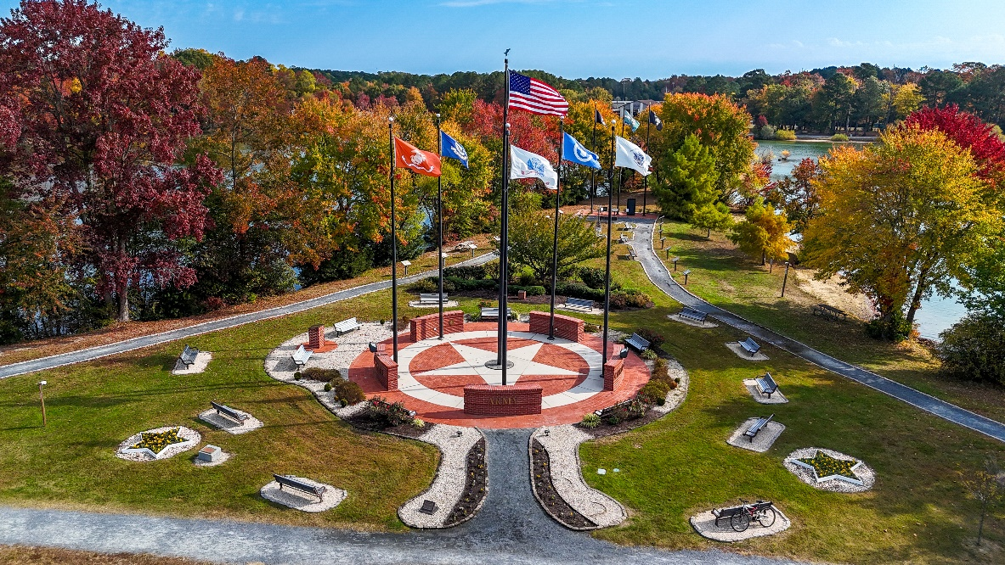
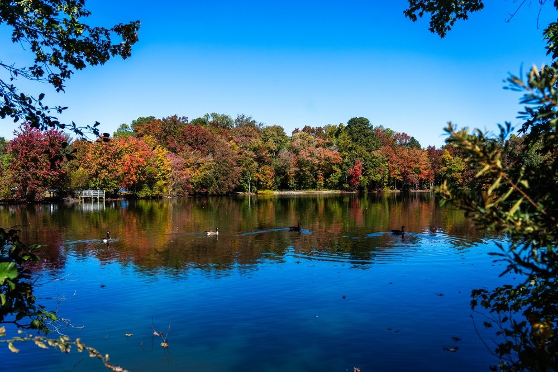
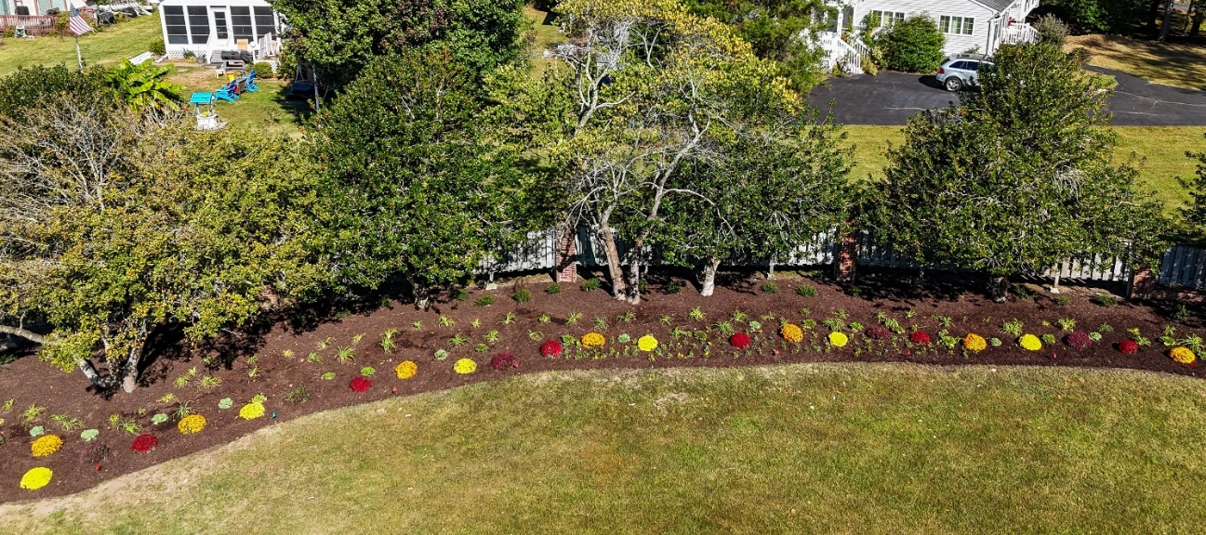
GM Leadership Report –
John Viola

Slide 2
Initiatives
  Veterans Memorial Pavilion
  Racquet Sports
  Maintenance
  RFP – Food & Beverage
  Recreation and Parks
  Marina
  Electronic Signs
  Trash Contract
  Metrics

Slide 3
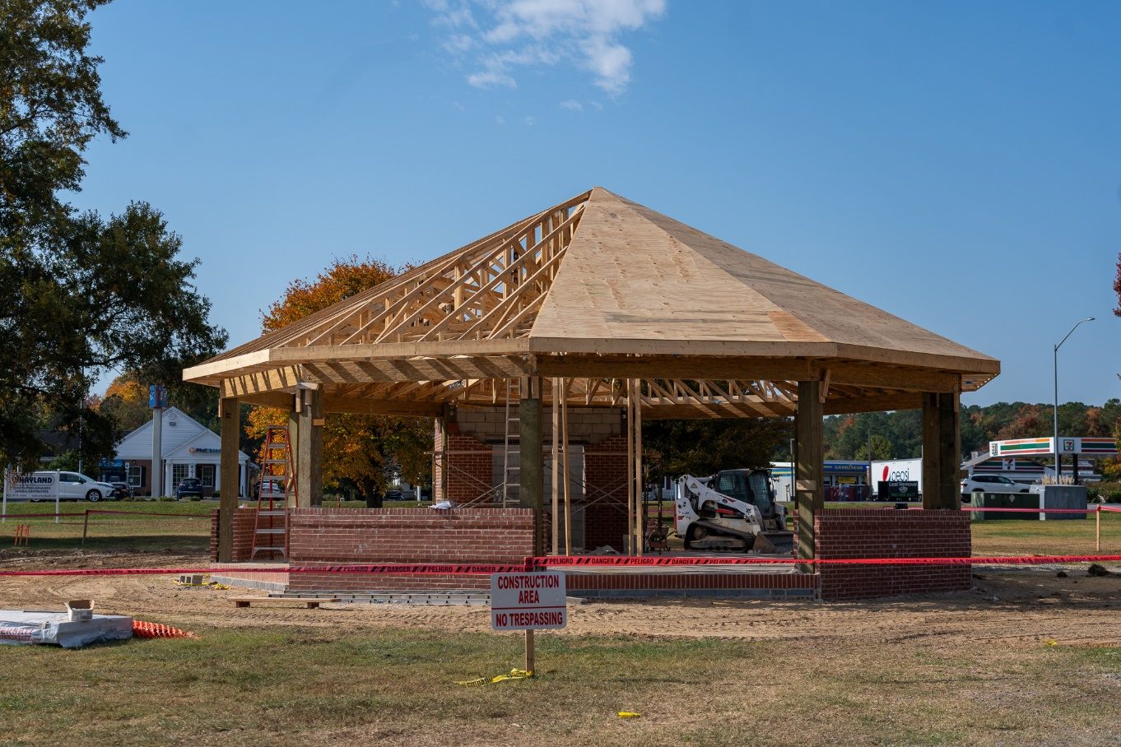
Veterans Memorial Pavilion
  This will be a legacy structure addition to an OPA iconic area
  Status: green – on track; goal is to open by Veterans Day

Slide 4
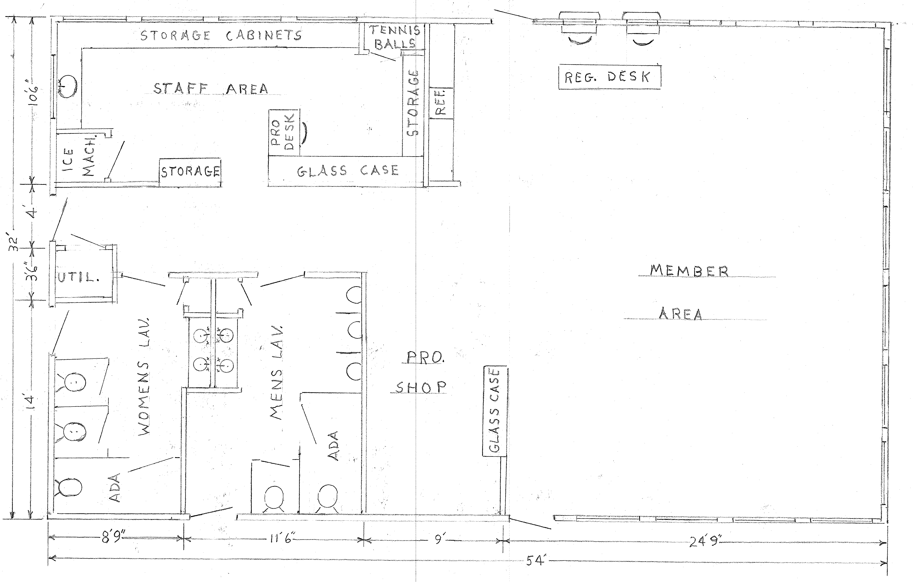
Racquet Sports –
New Building
  Status: green
    Plans were addressed and/or shown at January, February, May, June, and September Board meetings along with annual meeting
    Layout finalized and approved by Racquet Center Director in August
    Permits obtained
  Next steps:
    Project to begin in the winter

Slide 5

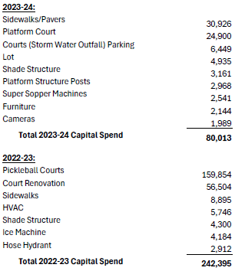
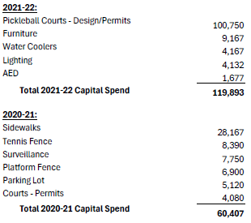

Racquet Sports –
Capital Spend Over 5 Years

Slide 6
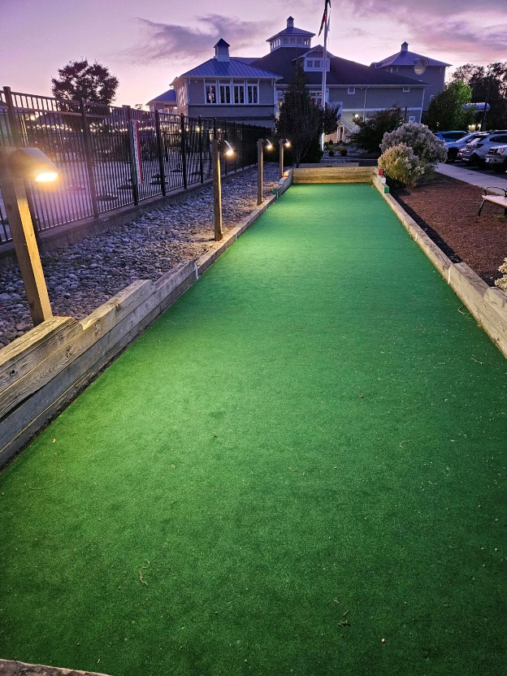
Maintenance
  Sports Core:
    Pool shut down from October 9-11 to address maintenance issue; reopened October 12
  Yacht Club:
    Per request, bocce ball court recarpeted and lights added
    Work done in-house
    Total cost: $5,140
  White Horse Park:
    Repairs made to bocci ball court (new border and additional stone dust added) and horseshoe pit (additional stone dust and wood power washed)
    Shuffleboard courts power washed and to be painted next week

Slide 7
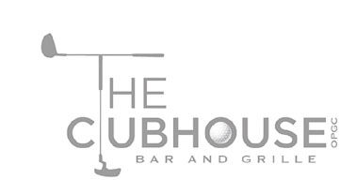
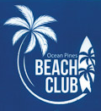
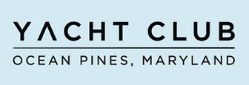
RFP – Food & Beverage
  Current contract for food and beverage services ends April 30, 2025
  RFP required per Section 9.05 of the Bylaws
  Board tasked GM to initiate and deliver proposals with analysis and recommendation(s)
  Multiple proposal(s) submitted by October 18, 2024 deadline
  Next steps:
    Team currently reviewing all proposals and will submit staff recommendation to Board

Slide 8


Director of Business Administration –
Linda Martin

Slide 9
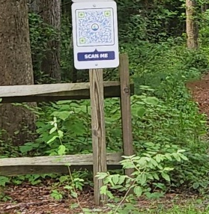
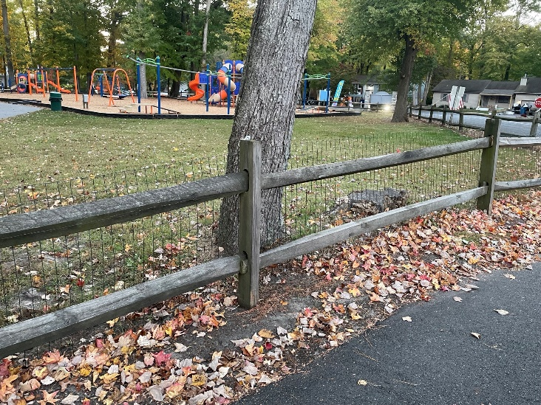
Recreation & Parks
  Received charging documents from the Recreation & Parks Committee:
    QR codes on signs: Committee wanted signs to be trail specific – currently signs takes you to the website that you can select information on each trail
      Staff is recommending to keep signs as current to eliminate extra expense of creating new signs ($70/each – 2 for each trail) along with developing specific pages on the website for each trail
    Playground fencing:
      Green PVC wired fencing already installed at White Horse Park and Manklin playgrounds for safety (total cost: $1,120); gate to be installed at Manklin playground in lieu of a perimeter fence ($20,000)
      Fencing at Bainbridge, Somerset or Huntington parks is not needed because they are away from traffic

Slide 10
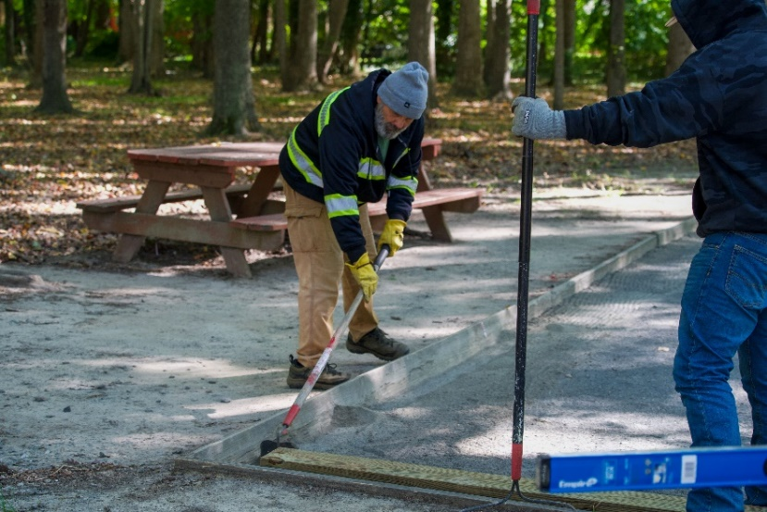
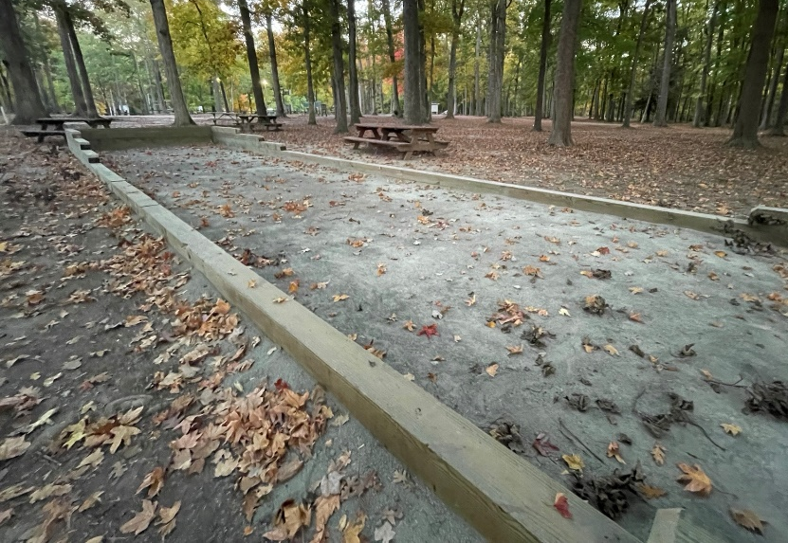
Recreation & Parks
(continued)
before
  Maintenance at White Horse Park:
    Horseshoe pit post replaced and area cleaned up
    Bocci court borders replaced and court leveled with additional stone dust (total cost: $3,630)
    Shuffleboard courts power washed and scheduled to be painted
    Signage will be installed to advertise these areas
  Crosswalks:
    Seabreeze Road/Ocean Parkway: will further review – staff believes there is not enough foot traffic that crosses this area
    Ocean Parkway/Route 90 Bridge: crosswalk requested for bicyclists but per MD law crosswalks are meant for foot traffic; also concerns about visibility of proposed crosswalk location – recommending signage instead of crosswalk
after

Slide 11
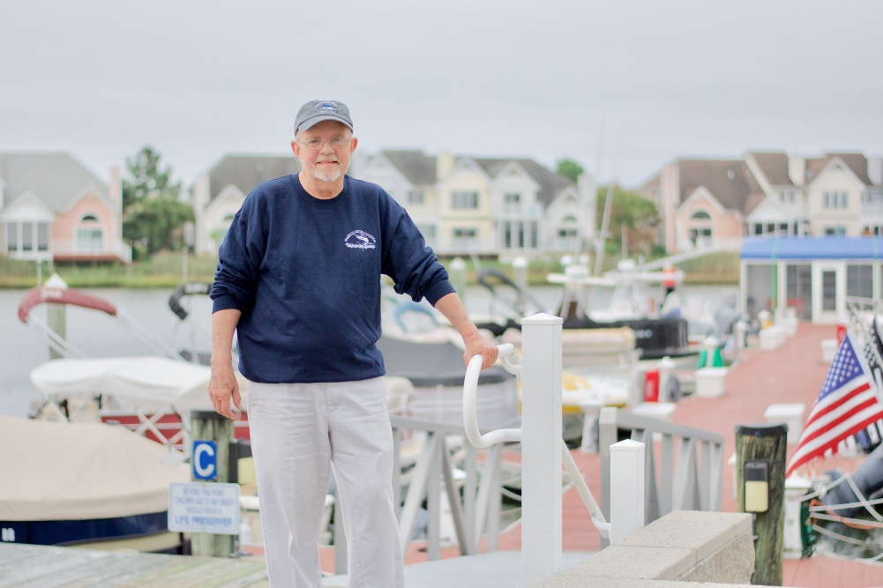
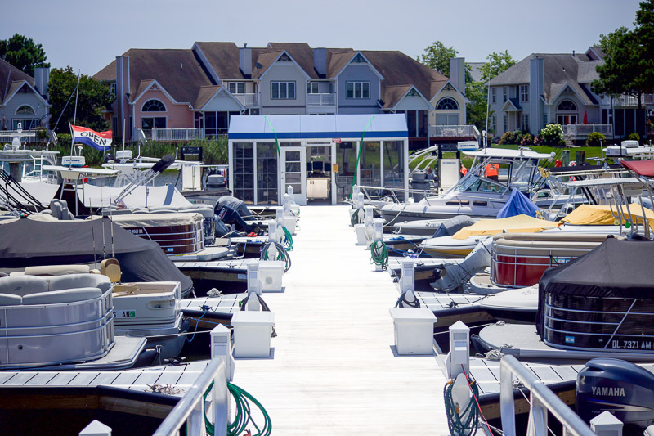
Marina
  To enhance customer service (and per Board request), hours of operation at the Marina extended past October 31st to accommodate boat owners
  Marina will be open on weekends in November until November 17th
  Hours of operation: 8:00 a.m. – 5:00 p.m.

Slide 12
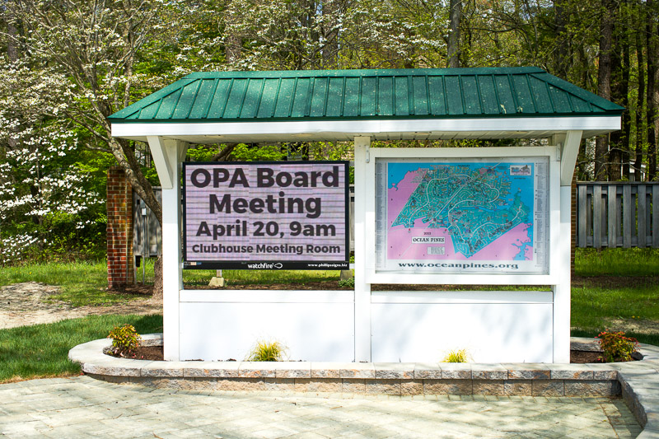
Electronic Signs
  4 additional signs ordered
  Total cost: $85,079
  To be placed at Ocean Parkway at Community Center, Yacht Club entrance, south gate (Sherwood Forest), and Cathell Road

Slide 13
Trash Contract
  Trash contract awarded to Republic and approved by Board at the December 2023 Board Meeting
  New contract addressed at the October, November, December and January Board Meetings along with the Winter 2024 newsletter
    Homes would receive new receptacles and would no longer pay a monthly rental fee
    New trucks with mechanical arms would be picking up the receptacles
  Town Hall held on October 18, 2024 with Republic representatives
    Smaller receptacle of 36 gallons presented
    Those that wish to exchange new receptacle to smaller receptacle requested to contact Republic directly at 443-210-3505
    Old receptacles will be picked up by Republic subcontractor in the next few weeks

Slide 14
CPI Violation Dashboard
September
Violations
As of 9/1/24 | New Violations | Closed Violations | As of 9/30/24
243 | 140 | 76 | 307
140 violations initiated in September: 44 maintenance/trash/debris; 14 no permit; 42 signs; 42 miscellaneous
  Miscellaneous violations includes stop work orders, trailers, unregistered/junk vehicles, and vehicle parking
76 violations complied out; 307 remain open
  108 maintenance/trash/debris; 69 no permit; 21 signs; 109 miscellaneous

Slide 15
Work Orders
September
Open Work Orders as of 9/1/24 | New Work Orders | Closed Work Orders | Open Work Orders as of 9/30/24
115 | 97 | 118 | 94
97 work orders initiated in September: 10 bulkhead; 19 drainage; 14 grounds/landscaping; 13 roads; 1 sign; 40 general maintenance
Majority still open in drainage (52):
  21 – over 30 days; 16 – over 60 days
    Average 1-4 work orders a day to complete depending upon severity

Slide 16
Customer Service Dashboard
(from info@oceanpines.org)
September
Type | # Received – Sept.
Amenities | 17
CPI | 10
Drainage | 0
General | 54
Public Works | 6
TOTAL | 87

Slide 17
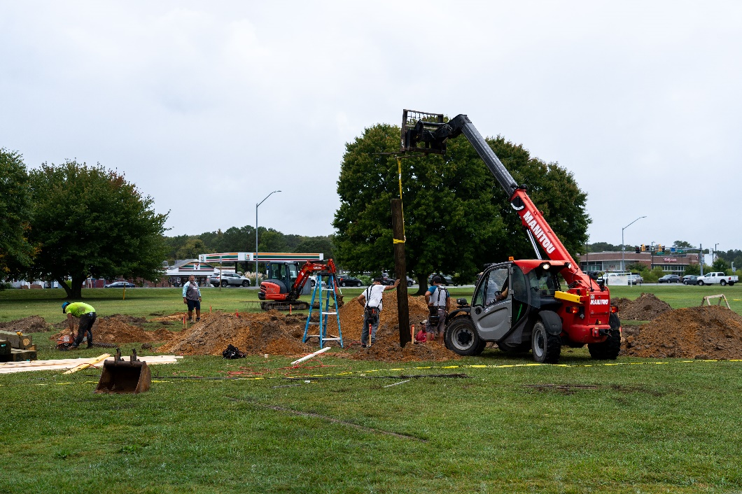
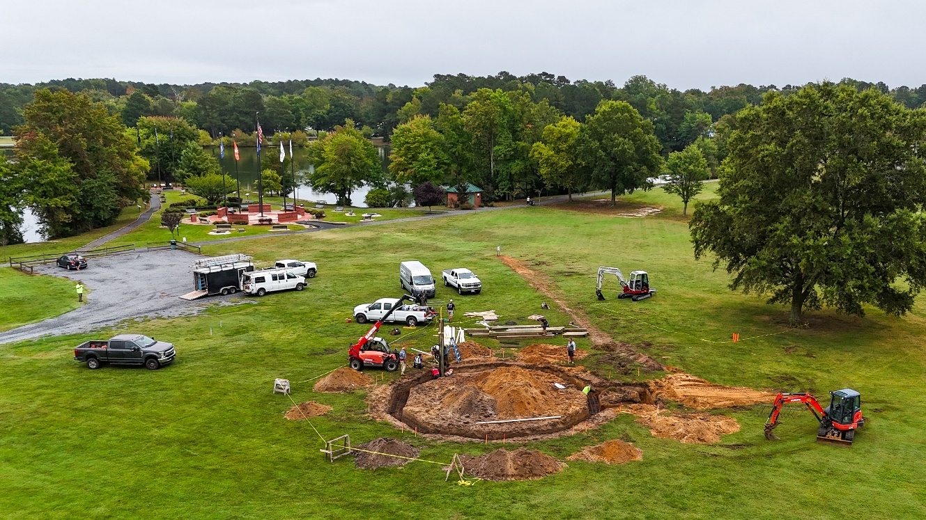
ADDENDUM
Veterans Memorial Pavilion
WEEK 1: 9/23 – 9/27

Slide 18
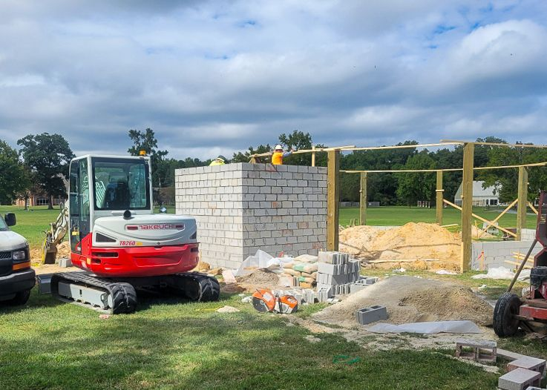
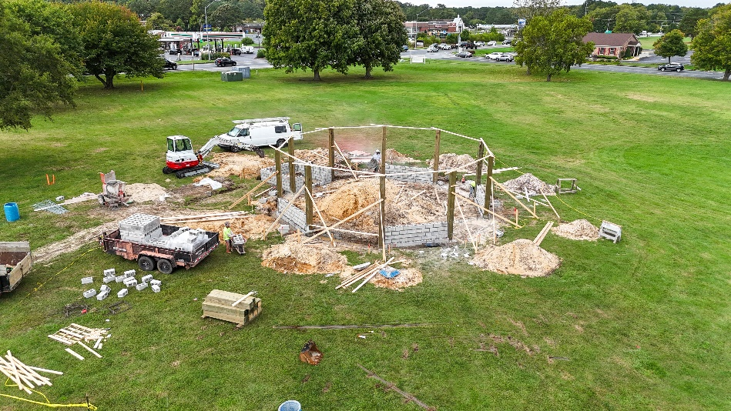
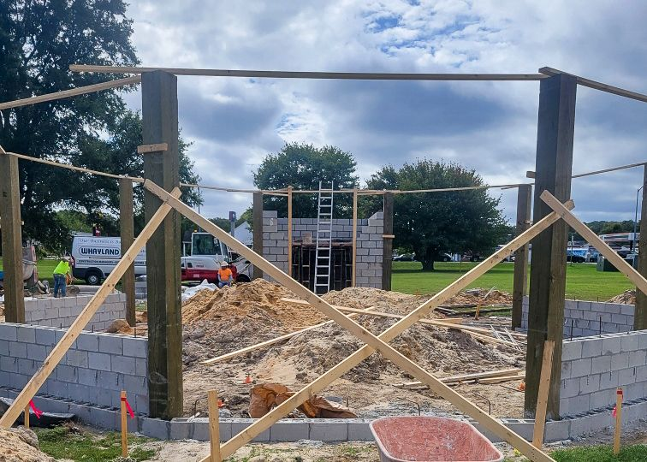
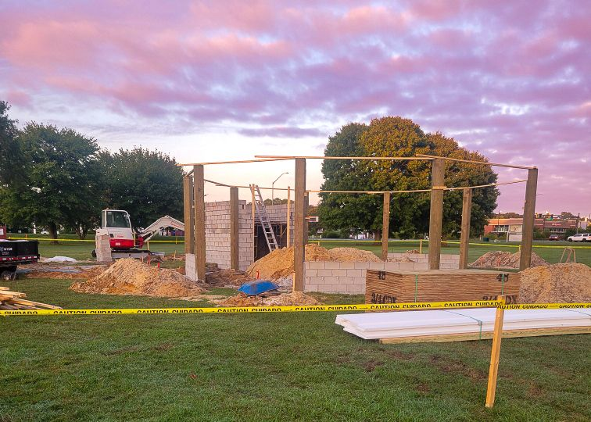
ADDENDUM
Veterans Memorial Pavilion
WEEK 2: 9/30 – 10/4

Slide 19
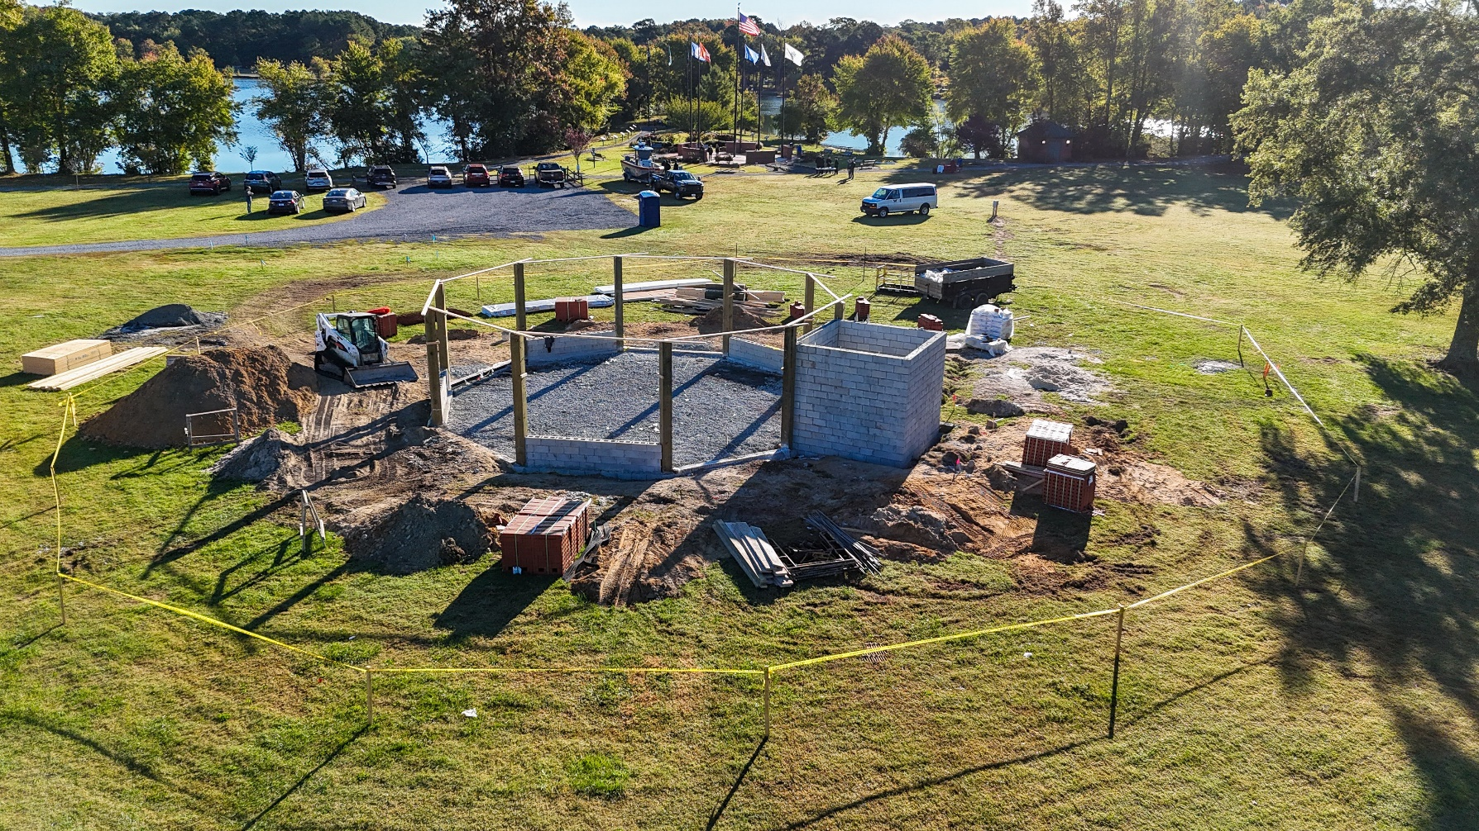
ADDENDUM
Veterans Memorial Pavilion
WEEK 3: 10/7 – 10/11

Slide 20
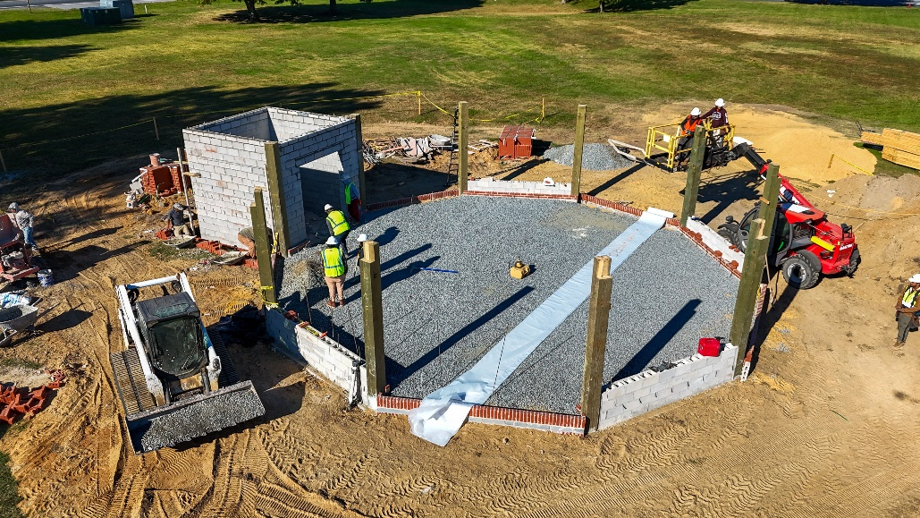
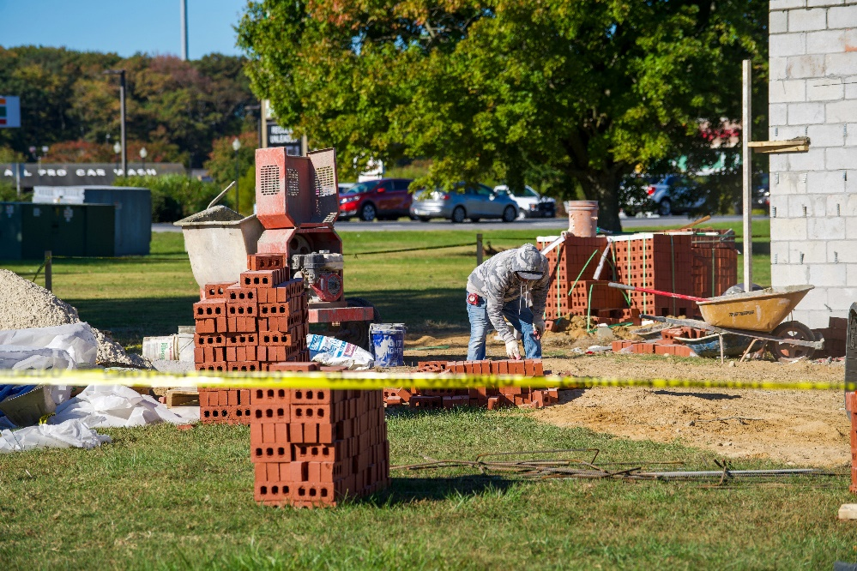
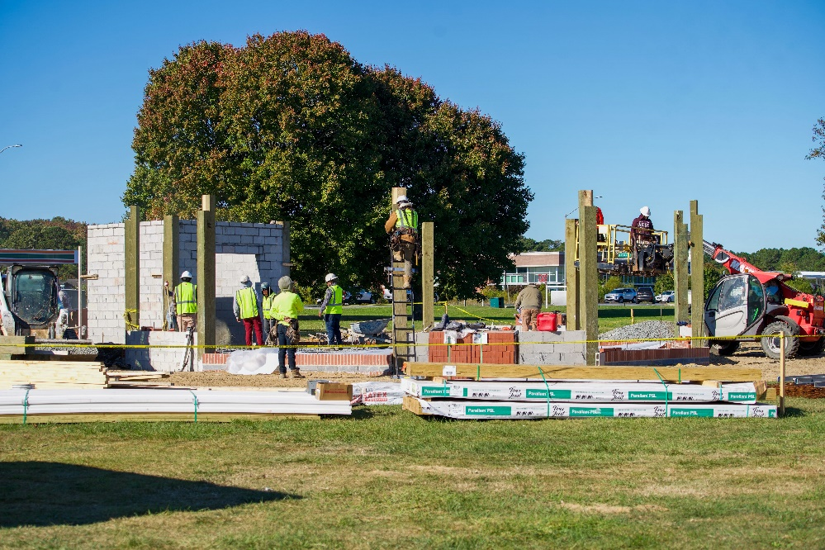
ADDENDUM
Veterans Memorial Pavilion
WEEK 4: 10/14 – 10/18

Slide 21
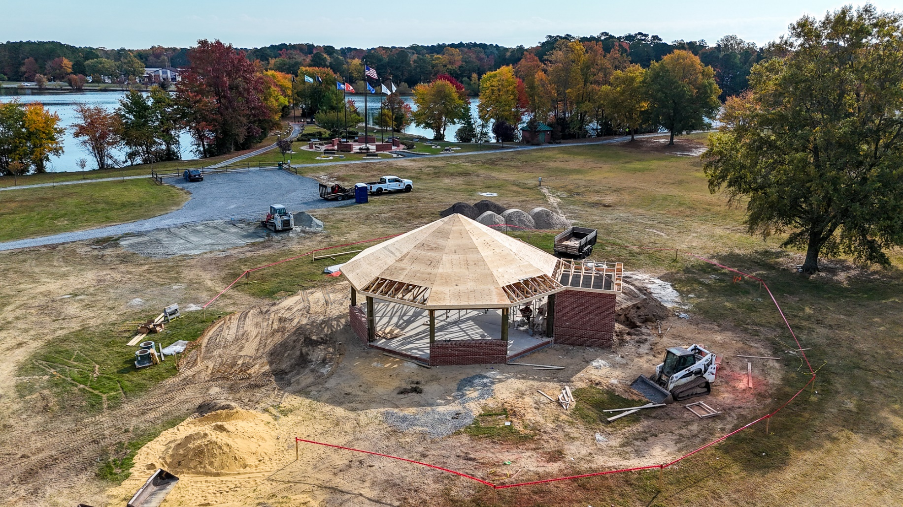
ADDENDUM
Veterans Memorial Pavilion
WEEK 5: 10/21 – 10/25

Slide 22
Financials

Slide 23
MONTH OF SEPTEMBER 2024
FINANCIAL RESULTS

Slide 24
SEPTEMBER 2024 YTD
FINANCIAL RESULTS

Slide 25
UNAUDITED RESERVE SUMMARY
SEPTEMBER 2024 ($ MILLIONS)
 | General Replace | Bulkheads | Roads | Drainage | New Capital | Total
4/30/24 Balance | $5.5 | $0.3 | $0.8 | $0.4 | $0.1 | $7.1
Contributions/ Interest | 1.8 | 1.1 | - | - | - | 2.9
Casino Funds | - | - | 0.3 | 0.1 | - | 0.4
Transfer (Spend) | (1.4) | (0.3) | - | (0.2) | - | (1.9)
9/30/24 Balance | $5.9 | $1.1 | $1.1 | $0.3 | $0.1 | $8.5
Est Remaining FY Spend | (1.0) | (0.8) | (0.3) | (0.2) | - | (2.3)
4/30/25 Estimate | $4.9 | $0.3 | $0.8 | $0.1 | $0.1 | $6.2

Slide 26
PUBLIC SAFETY PERCENTAGE OF ASSESSMENT

Slide 27
PUBLIC SAFETY INCREASES TO ASSESSMENT

Slide 28
Budget FY 2025/2026
  Budget process has started
  All departments have completed their respective budget sheets; we are now in the review process
  Key items to be addressed:
    Pricing
    Reserves
  Budget binders to be delivered to the Board and Budget & Finance Committee before the December holiday
  Schedule:
    Budget & Finance Committee presentation tentatively scheduled for January 2, 2025
    Board work session tentatively scheduled for January 16, 2025
    Public hearing tentatively scheduled for February 6, 2025

Slide 29
PRICING STUDY
  We compared CPI year over year % increases for the last 5 years to membership price % increases
  We also compared to outside comparables as identified by our department leads

Slide 30

Treasurer’s Report -
Monica Rakowski

Slide 31

Cash & Short-Term Investments
Month of September
As of September 30, 2024, the Association had Approximately (~) $17.9M in Cash
  Cash Decreased ~ ($0.1)M from the Same Time Period Last Year
  Cash Decreased ~ ($1.0M) from August 2024
  $11.7M Invested in CDAR’s
  $63K in Interest Income Recognized for the Month
  Remaining $6.2M in Insured Cash Sweep, Treasury Bills, Money Market and Other Operating Accounts (Diversified Between 2 Local Banks)

