Slide 1

Board of Directors Meeting
November 18, 2023

Slide 2
Approval of Agenda

Slide 3
Approval of Minutes
October 28, 2023 – Regular Meeting

Slide 4

President’s Remarks
Rick Farr

Slide 5
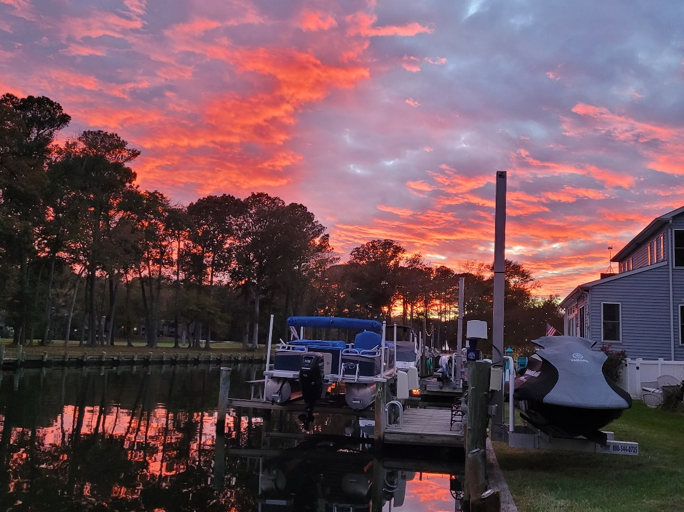
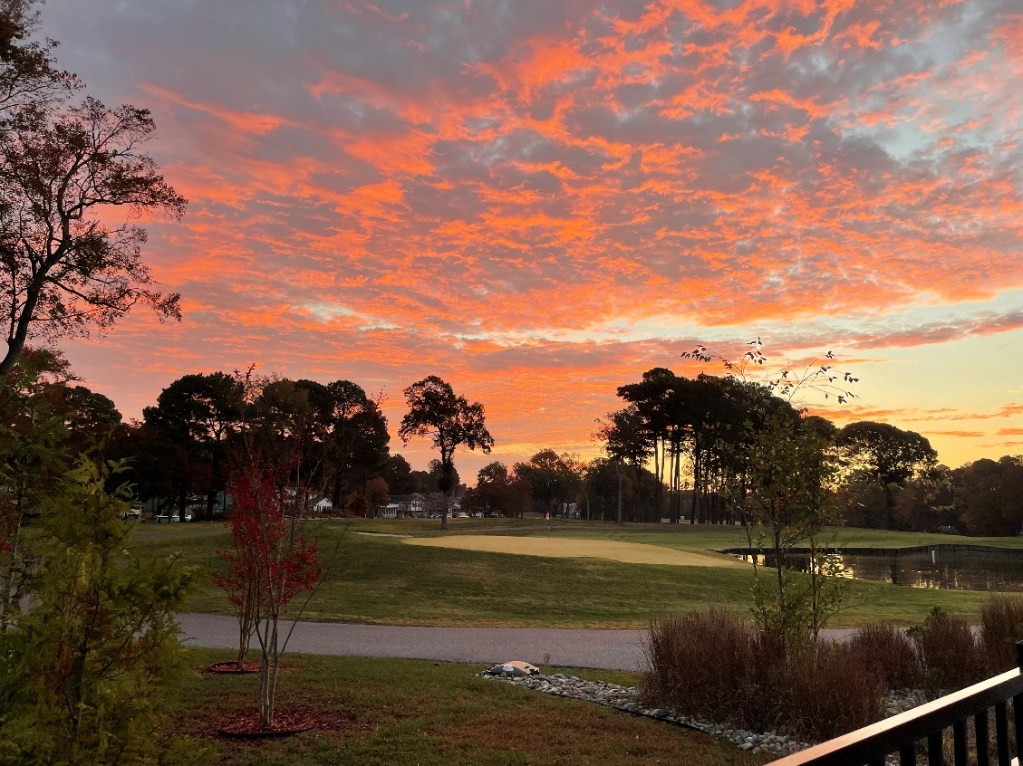
GM Leadership Report –
John Viola
photo by Patricia Curtin
photo by Faye Jeffries

Slide 6
Initiatives
  Racquet Center
  Leaf Collection
  Bulkheads
  Drainage
  Roads
  Firehouse
  Budget 2024/2025
  Holiday
  Holiday Giving & Events
  RFP Trash Service
  Metrics

Slide 7
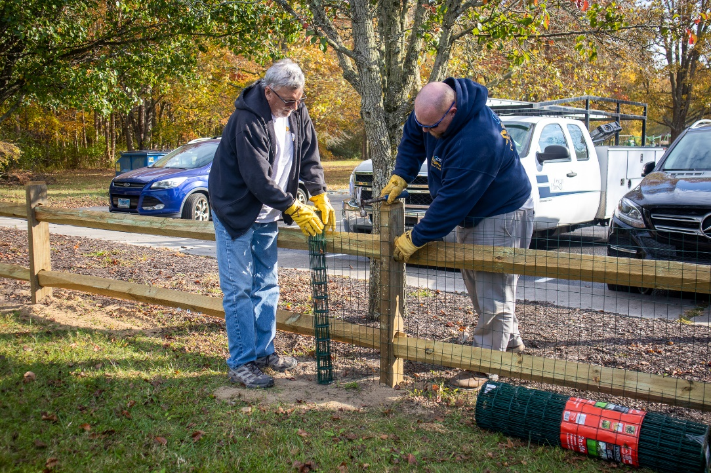
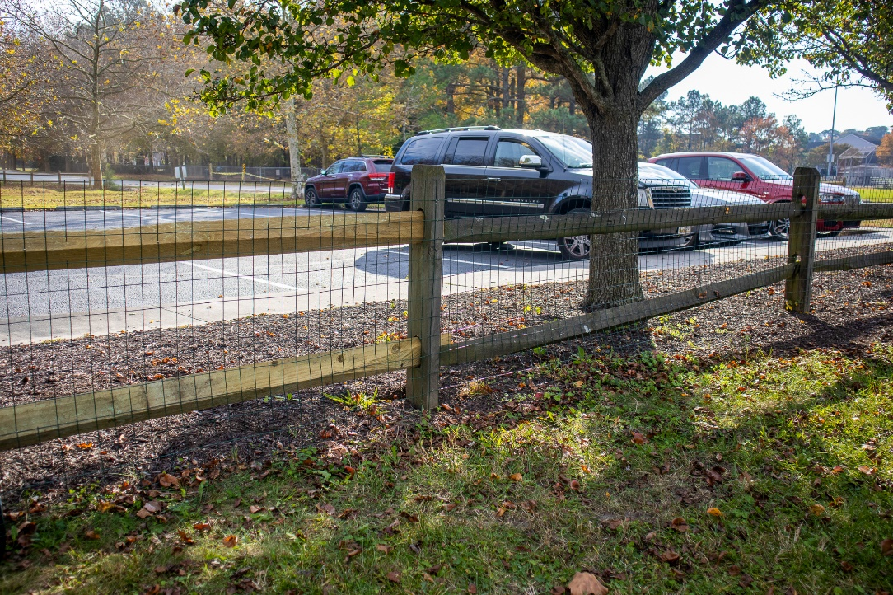
Racquet Center
Fence at Racquet Center
  Installed by Public Works
  Total cost: $2,200
Shed to be installed

Slide 8
Leaf Collection
Bagged leaves:
  Will be picked up by Republic during regularly scheduled trash collection days (4 bags)
  Public Works will pick up bagged leaves from November 27th-December 29th opposite Republic Services collection days
Yard waste can be dropped off to the Public Works yard:
  Open on Wednesday’s from 8:00 a.m.-3:00 p.m.
  Also open from November 27th-December 30th, 8:00 a.m.-3:00 p.m.
  Loose or in paper bags only
  Must have free sticker, which can be obtained at Public Works
Reminder: leaf vacuum program has ended – you will need to bag your leaves for pick up

Slide 9
Bulkheads
2023/2024 bulkhead replacement has begun this month (second week of October)
Estimated completion: April 2024
Approved by Board on 12/17/22
Total contract: $977,500
Areas to be replaced by Fisher Marine:
  Watergreen Lane: 2, 4, 6, 8, 10, 12, 14, 16, 18, & 20
  Goldeneye Court: 2, 4, 6, 8, 12, 14, 16, 18, 21, 22, 23, & 24
  Wood Duck Drive: 20, 22, 24, 26, 34, & 42

Slide 10
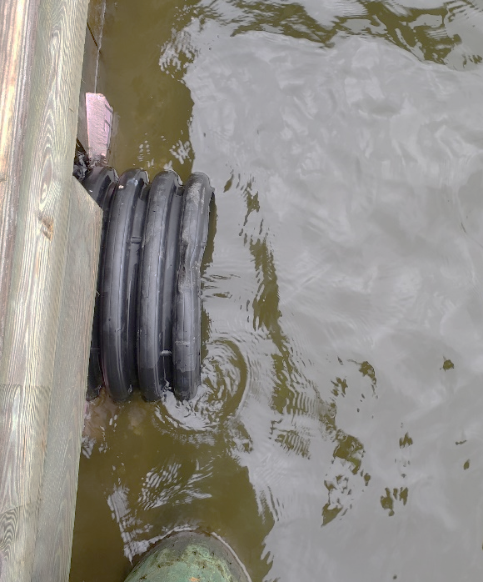
Drainage
  Secondary Pipes completed by Deppe Bros. in September and October:
  191 & 193 Teal Circle bulkhead stormwater pipe
    $12,640.00
  60-61 Moonshell Drive stormwater drainage pipe
    $12,964.71
  Pelican scheduled to be on-site in the winter to do pipe lining
  Total forecasted spend for the year:
  Per reserves: $250,000.00
  Drainage maintenance: $175,000.00

Slide 11
Roads
Approved by Board at the 10/28/23 Meeting
Total contract: $356,618.20
Roads to be completed by Asphalt Maintenance LLC starting next month:
  Battersea Road, Canal Road, Deerfield Court, Driftwood Lane, Moonraker Road, Waters Edge Court, Wharf Court, and overlay of St. Martins Lane

Slide 12
Firehouse
Work group formed for a new OPVFD firehouse in June 2022
Board received notice from OPVFD
Thanks to the work group for their support
  Ocean Pines representatives: Frank Brown, Josh Davis, Pete Gomsak, Linda Martin, Ted Moroney, Steve Phillips, Bill Stamp, Marvin Steen, Eddie Wells
  OPVFD representatives: Steve Grunewald, Dave Van Gasbeck

Slide 13
Budget 2024/2025
Worked with all department heads (bottom – up)
Packets being reviewed
All department heads have signed off on their budget
Agenda and dates prepared
  B & F Review - January 2-3, 2024
  Board Review – January 11-12, 2024 (tentatively)
  Town Hall – February 7, 2024 (tentatively)
Binders of the proposed budget to be sent to B & F Committee and Board before holidays

Slide 14
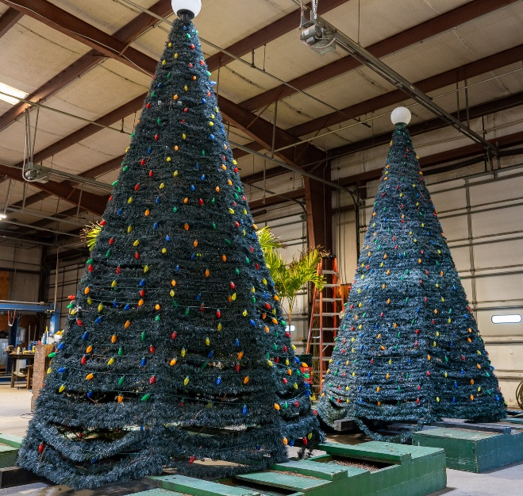
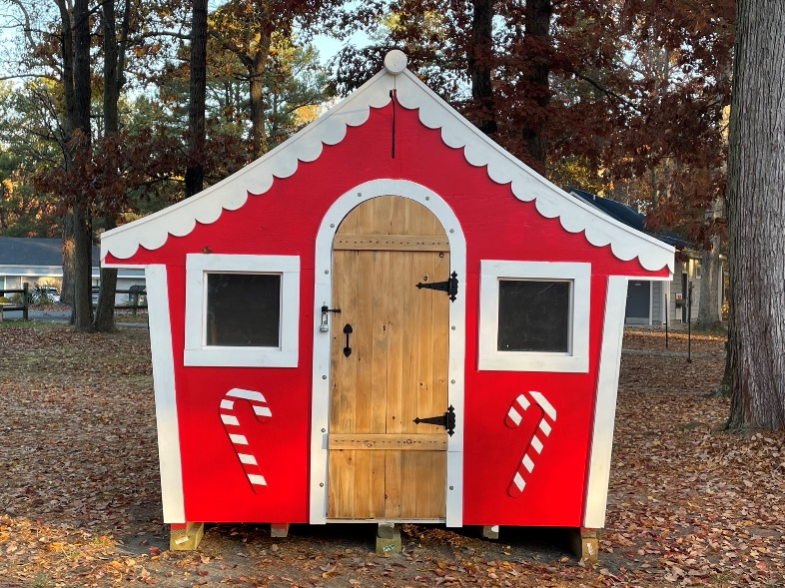
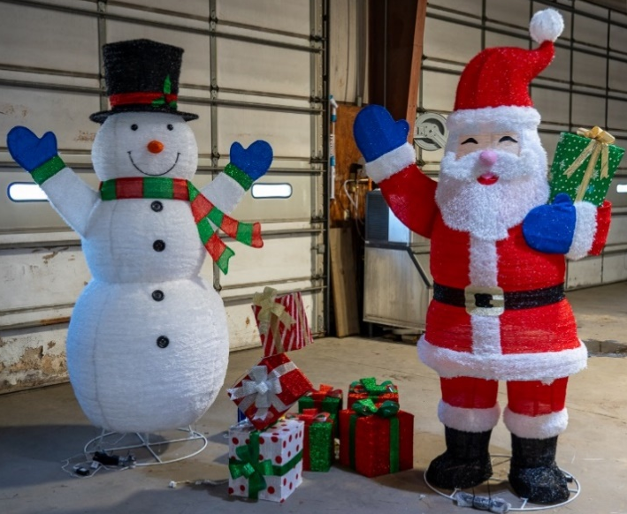
Holiday
Public Works began installing holiday lighting this week
Additional holiday decorations:
  7 trees total (5 artificial; 2 live)
  Additional lighting and garland to be added to north gate bridge
  Wreaths and street light poles with have flags
  Approximately 25,000 lights throughout the community
Working with the Recreation & Parks Department on installing the trees in White Horse Park on November 20th
Santa house redone ($2,000); done by Public Works (Ed Miller and Jon Brown)

Slide 15
Holiday Giving & Events
Recreation & Parks taking part in “Be a Santa to a Senior” with Home Instead
  Email crystal.heiser@homeinstead.com for more information
Aquatics has an “Angel Tree” to help support local children and families
  Call 410-641-5255 for more information
Administration will also set up an “Angel Tree” to support a local family
  More details to follow next week
Hometown Christmas tree lighting on November 25th at 6:30 p.m. at White Horse Park
Registration for “Light Up the Pines” is November 20-December 8
  Email info@oceanpines.org for more information
For more information on all the events and charitable giving through Ocean Pines this holiday season, visit www.oceanpines.org

Slide 16
RFP Trash Service
Current trash & recycling contract ends December 31st
Bids received on November 13th
  3 bidders, including current contractor
All bids being reviewed by staff now
All-inclusive contract to be approved by Board and awarded in December

Slide 17
CPI Violation Dashboard
October
Violations (includes legal)
As of 9/30/23 | New Violations | Closed Violations | As of 10/31/23
122 | 155 | 77 | 200
Legal Cases
As of 9/30/23 | New Violations to Legal | Closed Violations in Legal | As of 10/31/23
42 | 27 | 2 | 67
155 violations initiated in October: 85 maintenance/trash/grass; 20 no permit; 50 miscellaneous
  Miscellaneous violations includes signs, stop work orders, trailers, unregistered/junk vehicles, and vehicle parking
77 violations complied out; 200 remain open (includes the 67 violations in legal)
  90 maintenance/trash/grass; 40 no permit; 70 miscellaneous

Slide 18
Work Orders
October
Open Work Orders as of 9/30/23 | New Work Orders | Closed Work Orders | Open Work Orders as of 10/31/23
119 | 91 | 81 | 129
91 work orders initiated in October: 9 bulkhead; 14 drainage; 13 grounds/landscaping; 9 roads; 1 signs; 45 general maintenance
Majority still open in drainage (60):
  14 – over 30 days; 38 – over 60 days
    Average 1-4 work orders a day to complete depending upon severity

Slide 19
Customer Service Dashboard
(from info@oceanpines.org)
October
Type | # Received – Oct.
Amenities | 106
CPI | 16
Drainage | 0
General | 67
Public Works | 10
TOTAL | 199

Slide 20
Financials

Slide 21
UNAUDITED FINANCIAL CHANGE
MONTH OF OCTOBER 2023
October (In 000’s)
 | Budget | Current Year | Favor/(Unfavor) vs. Budget
Net Revenues | $529 | $578 | $49
Expenses | 1,117 | 1,073 | 44
Net Operating | ($588) | ($495) | $93

Slide 22
UNAUDITED MONTH OF OCTOBER
FAVOR/(UNFAVORABLE) VS. BUDGET (IN 000’s)
Department/Amenity | Favorable/(Unfavorable)
Police | 38
Admin/Finance/GM Office/Marketing | 31
Yacht Club | 19
Golf Ops + Maintenance | 13
Recreation & Parks | 11
Public Works/Gen Maint/CPI | 7
Racquet Sports | (11)
Aquatics | (10)
Clubhouse Grille | (9)
Other Net (GM Office, Beach Club, Marinas) | 4
TOTAL | $93

Slide 23
UNAUDITED FINANCIAL CHANGE
YTD OCTOBER 2023
October YTD (In 000’s)
 | Budget | Current Year | Favor/ (Unfavor) vs. Budget
Net Revenues | $12,801 | $13,427 | $626
Expenses | 7,979 | 8,027 | (48)
Net Operating | $4,822 | $5,400 | $578

Slide 24
UNAUDITED YTD OCTOBER
FAVOR/(UNFAVORABLE) VS. BUDGET (IN 000’s)
Department/Amenity | Favorable/(Unfavorable)
Police | $140
Golf Ops + Maintenance | 109
Admin/Finance/GM/Public Relations | 101
Public Works/Gen Maint/CPI | 95
Beach Club | 61
Beach Parking | 50
Clubhouse Grille | 29
Aquatics | 24
Recreation & Parks | 20
Yacht Club | 12
Marinas | (46)
Racquet Sports | (17)
TOTAL | $578

Slide 25
UNAUDITED RESERVES OCTOBER 2023
($ MILLIONS)
 | General Replace | Bulkheads | Roads | Drainage | New Capital | Total
4/30/23 Balance | $5.1 | $0.5 | $0.7 | $0.2 | $0.1 | $6.6
Contributions/ Interest | 2.0 | 1.1 | - | 0.1 | - | 3.2
Casino Funds | - | - | 0.4 | 0.1 | - | 0.5
Transfer (Spend) | (0.9) | (0.4) | - | - | - | (1.3)
10/31/23 Balance | $6.2 | $1.2 | $1.1 | $0.4 | $0.1 | $9.0

Slide 26
RESERVES YEAR-END UNAUDITED ESTIMATE (IN 000’S)
 | Begin Balance |  |  | Unaudited EST Balance
 | 4/30/23 | Additions | Expenditures | 4/30/2023
Major Maintenance & Replacement:
Golf Carts |  |  | (277)
C-Dock/Gas Pumps |  |  | (153)
Rough Mower |  |  | (83)
Racquet Sports Various |  |  | (73)
Aquatics |  |  | (70)
Public Works |  |  | (65)
Yacht Club/Beach Club/Clubhouse |  |  | (60)
Pintail Gangway & Floating Dock |  |  | (58)
Other Golf Maintenance |  |  | (45)
Pintail Recreation Pier |  |  | (25)
Other Replacement Emergencies |  |  | (150)
Total | 5,154 | 2,100 | (1,059) | 6,195
Bulkheads & Waterways | 523 | 1,125 | (1,151) | 497
Roads | 715 | 400 | (350) | 765
Drainage | 185 | 225 | (250) | 160
New Capital | 114 | 35 | (40) | 109
TOTAL 4/30/23 ESTIMATE | 6,691 | 3,885 | (2,850) | 7,726

Slide 27

Treasurer’s Report -
Monica Rakowski

Slide 28

Cash & Short-Term Investments
Month of October
As of October 31, 2023, the Association had Approximately (~) $17.4M in Cash
  Cash Increased ~ $0.7M from the Same Time Period Last Year
  Cash Decreased ~ ($600)K from September 2023
  $11.2M Invested in CDAR’s
  $54K in Interest Income Recognized for the Month
  Remaining $6.2M in Insured Cash Sweep, Treasury Bills, Money Market and Other Operating Accounts (Diversified Between 2 Local Banks)

Slide 29


Public Comments
Members wishing to make comments must state their name and address

Slide 30

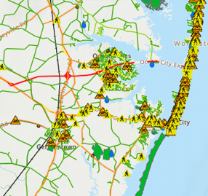
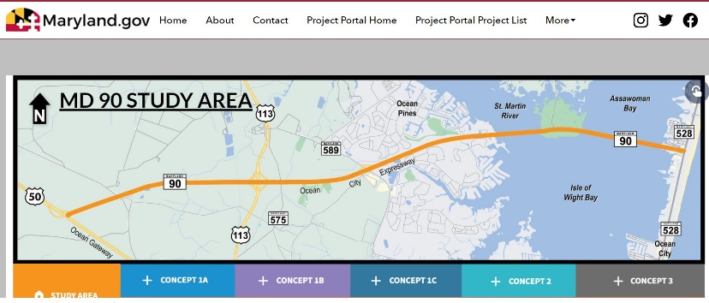
Ocean Pines Community Pedestrian & Bike Safety & Access Workgroup
Goal – Identify ways to improve safety and accessibility for people to walk, bike, and roll in and around Ocean Pines. MD VISION ZERO – CRASHES are NO ACCIDENT
Data and research show most crashes are caused by human error and road design flaws and can be prevented by the 3 Es - Education, Engineering, Enforcement
Communities around the state with bike and pedestrian plans have obtained state grants and technical assistance.
Worcester County Trails & Greenway Project is seeking input for trails and paths to connect communities.
Workgroup includes representatives of Ocean Pines Chamber of Commerce, residents, public safety and public works and will engage SHA District 1 & Worcester County.
Problem
Opportunity

Slide 31
New Business
Second reading of revisions to Resolution C-02 (Architectural Review Committee) – Elaine Brady
Second reading of revisions to Resolution M-01 (Policy and Compliance Procedures for Declaration of Restrictions and ARC Guidelines Violations) – Elaine Brady
First reading of revisions to Resolution M-04 (Maintenance of Lots) – Elaine Brady
Discussion on digital signage – Elaine Brady

Slide 32
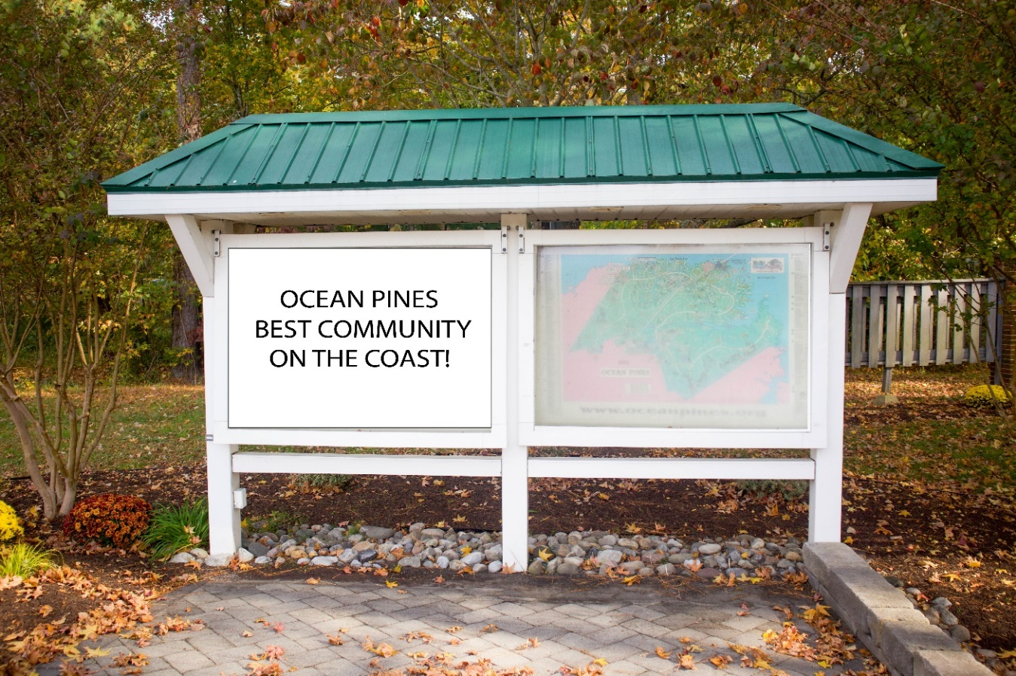
Proposed New Digital Sign

Slide 33
Appointments
Brian Burgess – 1st Term – Environmental & Natural Assets
Rob Keesling – 2nd Term – Strategic Planning
William (Fritz) Lahner – 2nd Term - Golf
Jerry Murphy – 1st Term – Strategic Planning
Donald Nederostek – 2nd Term – Budget & Finance
Anne O’Connell – 3rd Term – Environmental & Natural Assets
Ann Shockley – 2nd Term - Golf
Don Wolski – 1st Term – Environmental & Natural Assets

Slide 34
Adjournment

