Slide 1

Board of Directors Meeting
November 20, 2021

Slide 2
Approval of Agenda

Slide 3
Approval of Minutes
September 30, 2021 – Special Meeting
October 11, 2021 – Special Meeting
October 16, 2021 – Regular Meeting
N

Slide 4

President’s Remarks
Larry Perrone

Slide 5
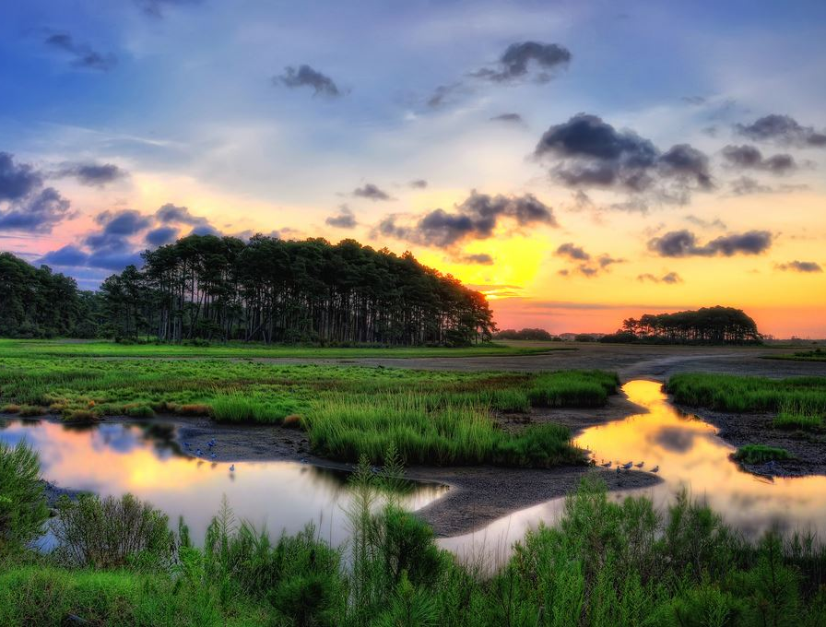
Jenkins Point Restoration for Resilience Project
Presentation To
Ocean Pines Association Board
November 20, 2021

Slide 6
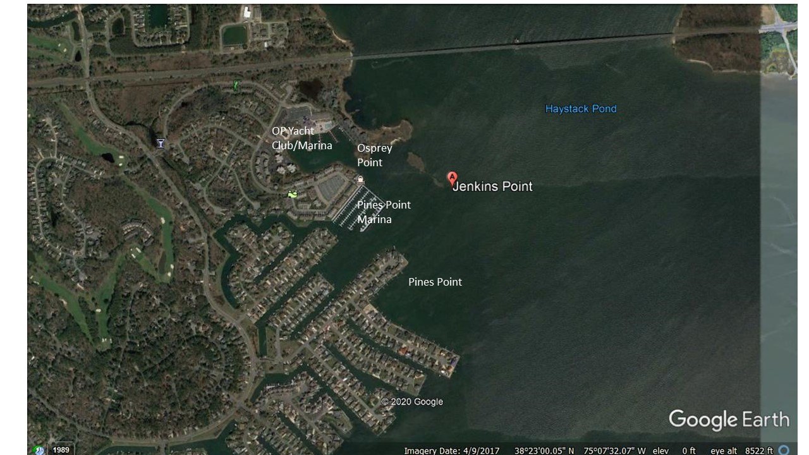
Jenkins Point Restoration for Resilience Project

Slide 7
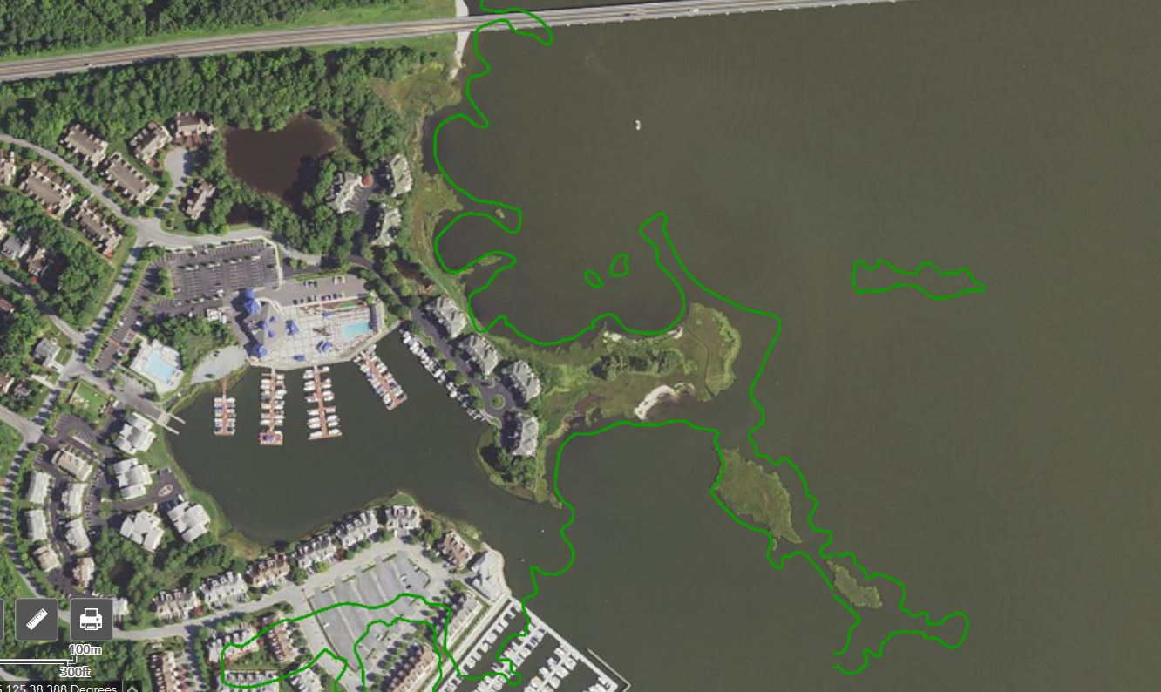
Route 90 Bridge
Isle Of Wight Bay
Green Line Represents Shoreline as it Existed in 1961
Jenkins Point
2018 Base Map

Slide 8
Jenkins Point Restoration for Resilience Project
Once an unbroken peninsula providing significant protective buffer to adjacent Ocean Pines and Osprey Point residential and community assets (OP Yacht Club and Marina, Pines Point and Marina)
Peninsula has eroded and fragmented over time to current shorter peninsula and two small islands
Absent restoration effort, erosion process will accelerate and peninsula (and its protection) will disappear
Maryland Department of Natural Resources (DNR) offers grants to enhance community resilience to effects of climate change

Slide 9
Jenkins Point Restoration for Resilience Project
In 2021 Maryland Coastal Bays Program (MCBP) approached OPA Board Member Doug Parks regarding DNR Community Resilience Grant opportunity
Reviewed several project opportunities and selected Jenkins Point as most compelling and competitive option
With OPA consent, submitted proposal for project Design and Permitting in late 2020 for FY22 grant cycle but denied funding
Feedback from DNR indicated project rated high with reviewers
Encouraged to re-submit for FY23 Cycle with minor modifications, including local (OPA) cost-share commitment
Letter of commitment for $10,000 cost-share received in July 2021
Submission deadline is December 15, 2021
Here today to confirm interest and satisfy HOA/public hearing requirement

Slide 10
Jenkins Point Restoration for Resilience Project
Proposed project limited to Design and Permitting phase
Project budget of ~$80,000 including $10,000 OPA cost-share
OPA financial commitment limited to this phase only
OPA can be as involved in monitoring and reviewing design process as desired
If accepted for grant, and design completed and permits approved, project may enter queue for construction funding from DNR
Decision to proceed to construction phase in hands of OPA

Slide 11
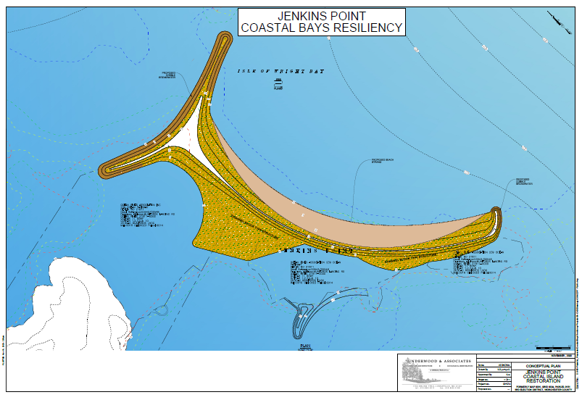
Jenkins Point Restoration Concept Plan

Slide 12
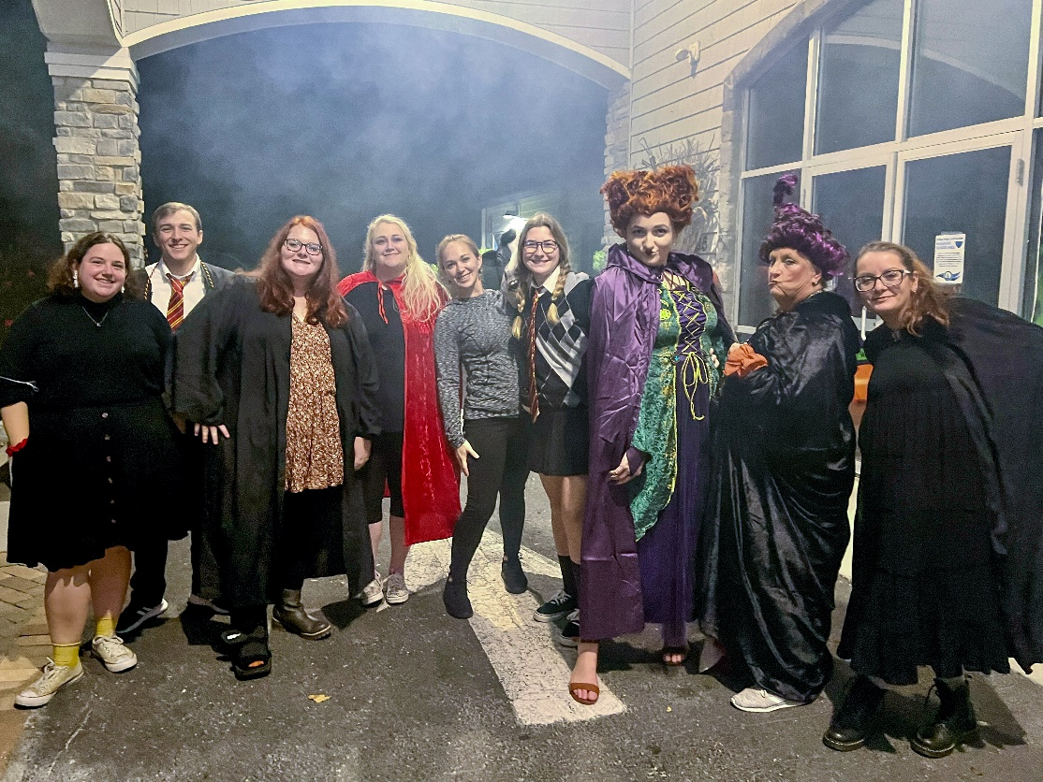
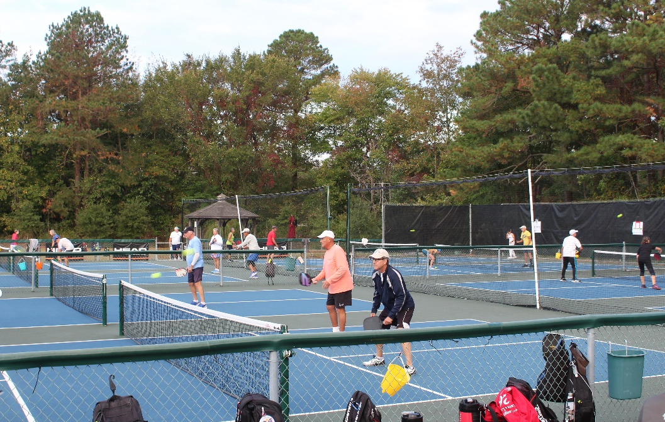
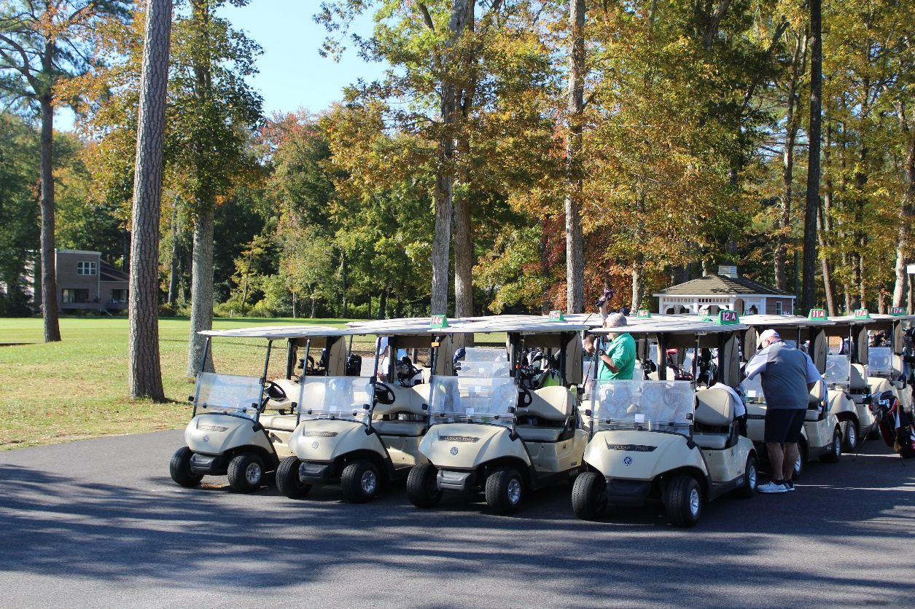
GM Leadership Report
John Viola

Slide 13
GM Report
Initiatives
North Gate Bridge
DMA “Lite” Study
2022-23 Proposed Budget
Defibrillators
Overview
Flight Turf Information

Slide 14
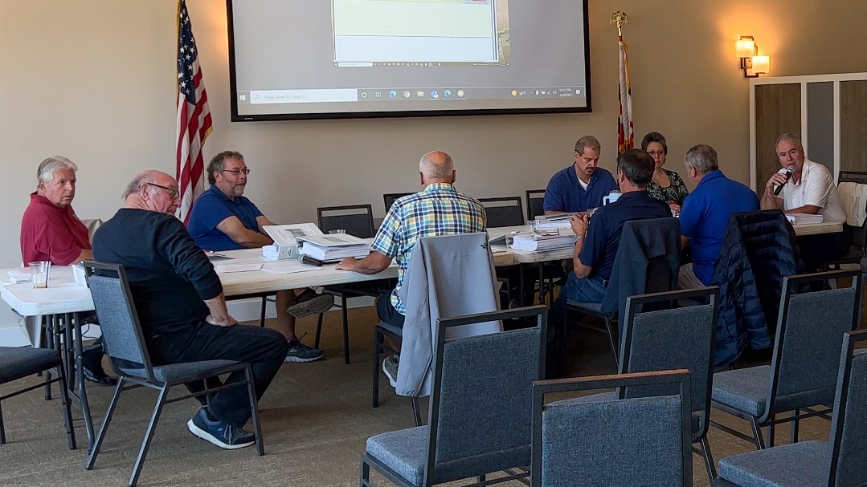
Overview - GM
Objective
Team Effort with Outside Consultant Input
Assigned Linda Martin as Lead
Received B&F sign-off on assumptions and detail
DMA “Lite” Study

Slide 15
Overview - GM
FY 2022/23 Budget
Meetings have been completed with-
  B&F
  All Department Heads
Timetable and assignments have been set
Addressed any assumptions, pricing, expense control, capital outlays (DMA Study) with the Team. I have also addressed the surplus
There are headwinds
  Minimum wage statutory increase
  Ability to hire and retain (market adjustment needed)
  Inflation
  Other “micro factors”

Slide 16
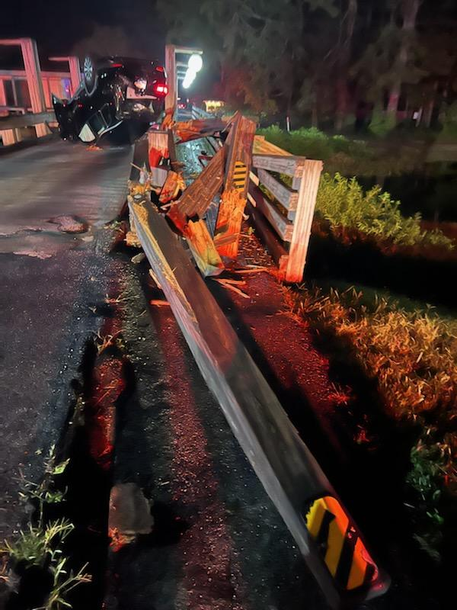
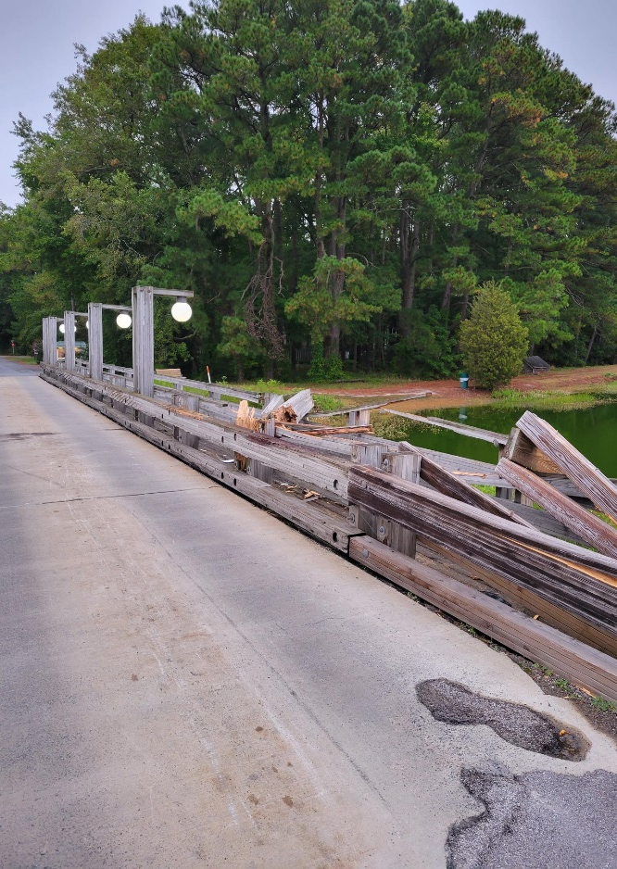
North Gate Bridge Accident 10/5/21

Slide 17
North Gate Bridge
Repairs /Maintenance
Maintenance:
Power washing
Approach to Bridge
Vista
MDOT and SHA Standards
Contractor Recommended by the County & State
Damage to bridge (10/5/21 Accident)
County sent Inspector
Temporary repairs (waiting for materials)
Material (timber) $7,800 ~ 16-20 weeks
Estimated Labor for Repairs ($7,500 in house)
Estimated total $15,500, Insurance Company

Slide 18
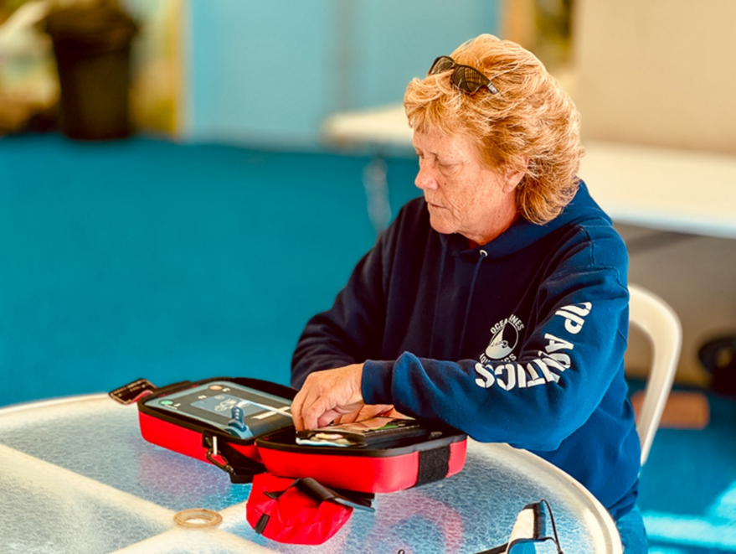
Defibrillators
AEDs currently located at -
Public Works
Racquet
Pools X 5
Yacht Club Restaurant - One portable
Administration
Marina
Community Center
All departments have had initial training
Aquatics, Marina and Recreation & Parks employees have been certified.
Ordered 1 AED, cabinets and pediatric keys for Golf
Ordered replacement pads for all
Ordered two spare replacement batteries
AED is on back order
Golf has AED from Swim & Racquet, on loan, until theirs comes in.
We have reached out to 3 instructors to get training dates.

Slide 19
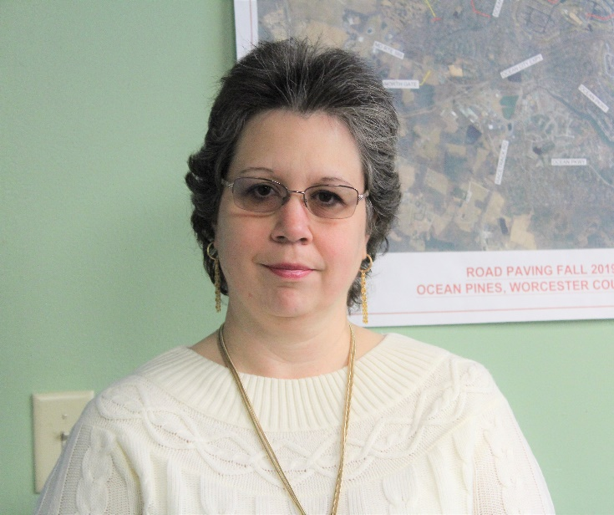
Linda Martin
Returned to Ocean Pines in October 2020 as Office Manager, Previously with Ocean Pines from 2006-2017 as the CPI/Public Works Office Coordinator
Has held financial-related and customer service positions in retail, medical and community-based organizations
Majored in Accounting
Has been leading an effort to update a study of Ocean Pines’ replacement reserves
Handles customer service inquiries to info@oceanpines.org.

Slide 20
Customer Service
Since it’s inception in March, over 1,000 emails/phone calls have been addressed
While in the summer the majority of the question were in regards to amenities (especially pools and activities), overall the most questions received are general questions about the Association
The Ocean Pines Facebook page, the Ocean Pines News and Info Facebook page, and the Ocean Pines Forum are also monitored daily
  Although monitored, we still encourage everyone to use the info@oceanpines or call 410-641-7717 (410-641-7747 after business hours and on weekends)

Slide 21
DMA Lite
Sign-offs made by the Budget & Finance Committee at the November 10, 2021 Working Session:
  Expenditures for all departments for the next five years reviewed and approved by the Budget & Finance Committee
  Inflation rate factor used by DMA of 3.08% approved
  Transfer rate used by DMA of 3.80% approved
  Accepted fully funded average percentage of 20% (fell between 18.8%-21.3%)
  DMA recommended an increase of contribution to General Reserves
  DMA recommended considering a funding source for Road Reserves

Slide 22
Budget Update FY 2022-2023
Overview:
  Budget worksheets and capital worksheets sent out to all Department Heads first week of November
Where Are We Now?:
  GM met with each Department Head to review preliminary budget numbers
  Reviewing Capital
  Reviewing pricing
  Headwinds: inflation and minimum wage
  Tailwinds: operating on all cylinders
Budget & Finance Committee review of budget tentatively scheduled for January 4-6

Slide 23
CPI Violation Dashboard
OCTOBER
Violations
As of 9/30/21 | New Violations | Closed Violations | As of 10/31/21
68 | 34 | 30 | 72
Legal Cases
As of 9/30/21 | New Violations to Legal | Closed Violations in Legal | As of 10/31/21
40 | 1 | 0 | 41

Slide 24
Financial Change month of SEPTEMBER 2021
September (In 000’s)
 | Budget | Current Year | Favor/ (Unfavor) vs. Budget
Net Revenues | $530 | $731 | $201
Expenses | 1,076 | 1,102 | (26)
Net Operating | ($546) | ($371) | $175

Slide 25
Financial Change
YEAR-TO-DATE SEPTEMBER 2021
YTD September 2021 (In 000’s)
 | Budget | Current Year | Favor/ (Unfavor) vs. Budget
Net Revenues | $11,285 | $12,359 | $1,074
Expenses + New Capital | 6,201 | 5,974 | 227
Net Operating | $5,084 | $6,390 | $1,301

Slide 26
Detail for the Month of SEPTEMBER
Favor/(Unfavorable) Vs. Budget (in 000’s)
Department/Amenity | Favorable/(Unfavorable)
Public Works/General Maint/CPI | 50.7
Marinas | 44.6
Police | 23.2
Golf Ops + Maintenance | 22.5
Aquatics | 12.6
Beach Parking | 9.0
Recreation & Parks | 6.7
Beach Club | 6.3
Other Net (Racquet, Clubhouse Grille, Yacht Club, Admin) | (0.6)
TOTAL | $175.0

Slide 27
Detail for year-to-date SEPTEMBER
Favor/(Unfavorable) Vs. Budget (in 000’s)
Department/Amenity | Favorable/(Unfavorable)
Yacht Club | $260.3
Golf Ops + Maintenance | $244.3
Public Works/General Maint/CPI | 214.2
Aquatics | 202.9
Police | 77.7
Beach Club | 70.7
Beach Parking | 57.2
Admin, Finance, GM, PR/Mktng | 50.3
Clubhouse Grille | 47.5
Marinas | 37.5
Racquet Sports | 33.4
Recreation & Parks | 10.2
New Capital | (4.8)
TOTAL | $1,301.4

Slide 28
“flash” estimate for month of October 2021 (in 000’s)
Department/Amenity | Favorable/(Unfavorable)
Public Works/General Maint/CPI | $52.5
General Admin | 39.1
Golf Ops + Maintenance | 27.5
Finance | 15.5
Police | 14.2
Pickleball | 8.5
Food & Beverage (Total) | (89.0)
Other Net (GM, Marketing, Tennis, Platform, Rec, Beach Parking, Marinas) | 7.0
TOTAL | $75.3

Slide 29

Treasurer’s Report -
Doug Parks

Slide 30

Cash & Short-Term Investments
Activity for Month of September
Overall Laddered Investment Rate of Return on CDAR’s for September Approx. 0.75%
As of September 30, 2021, the Association had approx. $16.4 million in cash
  Approx. $8.1 million invested in CDAR’s, fully FDIC insured
  Approx. $8.3 million in Money Market, and other operating accounts, fully insured

Slide 33
Unaudited Reserves September 2021 ($Millions)
 | GeneralReplace | Bulkheads | Roads | Drainage | New Capital | Total
4/30/21 Balance | $3.9 | $1.0 | $0.2 | $0.5 | $0.1 | $5.7
Contributions/ Interest | 1.7 | 1.0 | - | - | 0.2 | 2.9
Casino Funds + Grant Income | - | - | - | 0.4 | - | 0.4
Transfer (Spend) | (0.3) | (0.6) | (0.2) | (0.3) | - | (1.4)
9/30/21 Balance | $5.3 | $1.4 | $- | $0.6 | $0.3 | $7.6

Slide 34
Reserves year-end unaudited estimate
(in ooo’s)
 | Beginning Balance |  |  | Unaudited EST Balance
 | 4/30/21 | Additions | Expenditures | 4/30/2022
Major Maintenance & Replacement:
Public Works – Fleet Vehicles |  |  | (302)
Public Works Tractor in 21 Budget |  |  | (146)
Police Vehicles |  |  | (101)
Aquatics (Furniture, Roof, Equip) |  |  | (75)
Golf Maintenance Tri-plex Mower |  |  | (49)
Public Works Boom Mower |  |  | (36)
Yacht Club Kitchen Equipment |  |  | (20)
Golf Ops (Ball Dispenser/Washer) |  |  | (14)
Racquet (Lighting,Fountains) |  |  | (10)
Other |  |  | (50)
Total | 3,853 | 1,685 | (803) | 4,735
Bulkheads & Waterways | 1,010 | 1,070 | (1,368) | 712
Roads | 216 | 3 | (209) | 10
Drainage | 469 | 835 | (800) | 504
New Capital | 102 | 183 | (190) | 95
TOTAL 4/30/22 ESTIMATE | 5,650 | 3,776 | (3,200) | 6,056

Slide 35

Public Comments

Slide 36
PURCHASE REQUESTS-
None

Slide 37

CPI Violations-
None

Slide 38
Unfinished Business
Discussion – Flight Turf Status – Amy Peck
Discussion – Voting for the DR change regarding Short Term Rentals – Frank Daly
Second Reading – Resolution C-03 – Doug Parks
Second Reading – Resolution F-02 – Doug Parks
Second Reading – Resolution F-03 – Doug Parks

Slide 39
New Business
Discussion – North Gate Entryway – Frank Daly
Motion - to adjourn to closed session for the purpose of discussing matters pertaining to employees and personnel; specifically pertaining to completion of the General Manager performance review as permitted by the MD Homeowner’s Association Act, Section 11B-111(a). – Colette Horn

Slide 40
Appointments
Joseph Peloso – 1st Term – Elections
Jeannie Pennington – 1st Term – Elections
Anne O’Connell – 2nd Term – Environment & Natural Assets
Karen Krun Detter – 2nd Term – Environment & Natural Assets
Cheryl Jacobs – 2nd Term – Communications
John Reeves – Chair - Aquatics

Slide 41
Adjournment

