Slide 1

Board of Directors Meeting
December 11, 2021

Slide 2
Approval of Agenda

Slide 3
Approval of Minutes
October 11, 2021 – Closed Meeting
November 20, 2021 – Regular Meeting
November 20, 2021 – Closed Meeting
December 3, 2021 – Special Meeting
N

Slide 4

President’s Remarks
Larry Perrone

Slide 5

Ocean Pines Strategic Planning Advisory Committee
Property Owner Survey
Preliminary Results Summary
BOD Update
12/11/21

Slide 6
Agenda
Purpose & Objectives of the Survey
Survey Stats
Survey Summary Results
Next Steps/Timing
Q&A

Slide 7
Survey Objectives
  To obtain input and insights from OP Property Owners on the long-range plan for Ocean Pines
  Overall satisfaction
  What is most important to OPA owners and how is OPA doing
  Importance of core values
  Feedback on key issues and opportunities

Slide 8
Survey Stats
 | Objective | Results | +/(-) Objective
Full Time Residents | 500 | 1,127 | 627
Part Time Residents | 500 | 684 | 184
Rent Their Property Full Time |  | 24
Own Property with No Home |  | 3
Total | 1,000 | 1838 | 838
Male/Female | - | 42.5/51.9%
Online/Hard Copy |  | 1,773/65
Thank you to All Ocean Pines Property Owners
for the Tremendous Engagement!

Slide 9
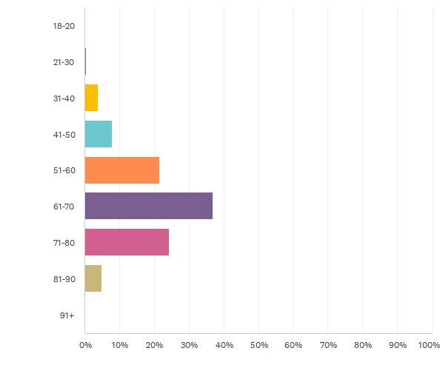
Survey Stats-Age
Survey Participants Skewed
Older, but Likely
Similar to
OP Property Owner
Demographics*
* Committee is attempting to confirm with
census data

Slide 10
Overall Satisfaction
Ocean Pines Residents are Very Satisfied
& are Very Likely to
Recommend Ocean Pines to Others

Slide 11
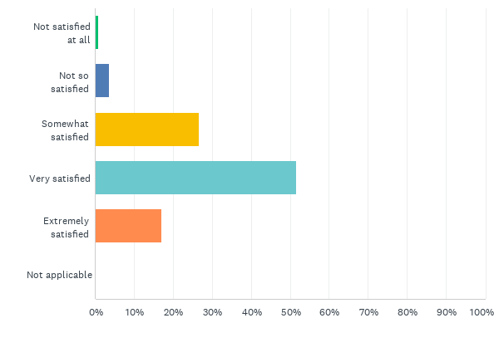
Q3: Overall, how satisfied are you being an Ocean Pines property owner or resident?(1 = Not Satisfied at All; 5 = Extremely Satisfied)
Answered: 1,838 Skipped: 0
95.2%
68.5%
Overall, 95.2% of Property Owners were Satisfied with
68.5% Being Either Very or Extremely Satisfied and…..

Slide 12
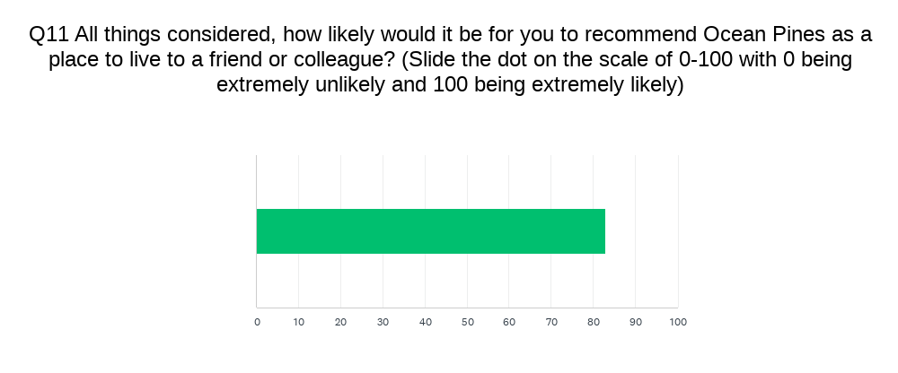
83%
Overall, 83%* of Property Owners Would Recommend
Ocean Pines as a Place to Live

Slide 13
What is Most Important & How is Ocean Pines Doing?
Safety, Maintenance of Infrastructure
& Community Appearance
Were Most Important to Property Owners
Largest Gap was in Maintenance
of Infrastructure

Slide 14
What is most important?
Q4: As an Ocean Pines property owner or resident, how important are each of the following to you? (1=Not Important at All; 5=Extremely Important)
Rank | Attribute | Weighted Average* | % Very Or Extremely Important (Top 2 Box)
#1 | Safety | 4.58 | 95.2
#2 | Maintenance of Infrastructure | 4.49 | 94.2
#3 | Community Appearance/Aesthetics | 4.32 | 89.8
#4 | Assessment Fee Value for the $ | 4.18 | 83.1
#5 | Ocean Pines Overall Customer Service | 4.13 | 83.2
Safety, Maintenance of Infrastructure &
Community Appearance had the Highest Importance

Slide 15

How is Ocean Pines Currently Meeting Expectations?
Q5. As a property owner or resident, please rate how Ocean Pines is currently meeting your expectations with regard to the following? (1=Significantly Below Expectations; 5=Significantly Above Expectations)
Rank (Importance) | Attribute | Importance (Weighted Average) | Satisfaction Weighted Avg. | % Slightly or Significantly Above Expectation
#1 | Safety | 4.58 | 3.83 | 58.0
#2 | Maintenance of Infrastructure | 4.49 | 2.78 | 23.6
#3 | Community Appearance/Aesthetics | 4.32 | 3.16 | 35.5
#4 | Assessment Fee Value for the $ | 4.18 | 2.95 | 24.7
#5 | Ocean Pines Customer Service | 4.13 | 3.15 | 34.0
Safety was Rated as Slightly Above Expectations
All Other top 4 Areas are Meeting Expectations

Slide 16
What is the gap between what is most important & how Ocean Pines is currently meeting expectations?
Rank (Importance) |  | Importance Weighted Average | Satisfaction Weighted Avg. | Gap
#1 | Safety | 4.58 | 3.83 | 0.68
#2 | Maintenance of Infrastructure | 4.49 | 2.78 | 1.71
#3 | Community Appearance/Aesthetics | 4.32 | 3.16 | 1.16
#4 | Assessment Fee Value for the $ | 4.18 | 2.95 | 1.23
#5 | Ocean Pines Overall Customer Service | 4.13 | 3.15 | 0.98
Largest Gap was in Maintenance of Infrastructure.

Slide 17
Core Values
All 4 Potential Core Values
Were Rated Very Important

Slide 18
Core Values
Q.6 Ocean Pines is considering developing a set of core values that will serve as principles and help guide future communications, decision making and culture for the community. Please indicate which of the following core values are most important to you. (1=Not important at all; 5=Extremely Important)
Rank | Core Value | Weighted Average | % Very or Extremely Important
#1 | Integrity | 4.48 | 86.4
#2 | Accountability | 4.34 | 82.2
#3 | Collaboration | 4.14 | 76.3
#4 | Sustainability | 4.10 | 74.0
All 4 Core Values Had High importance
(some of the highest average scores in the survey);
Integrity and Accountability were Ranked #1 and #2

Slide 19
Survey Objectives
  To obtain input and insights from OP Property Owners on the long-range plan for Ocean Pines
  Overall satisfaction
  What is most important to OPA owners and how is OPA doing
  Importance of core values
  Feedback on key issues and opportunities

Slide 20
Top Issues/Challenges to Address
Q7. Please rate how important the following Ocean Pines challenges/ opportunities are to you? (1=Not Important at All; 5= Extremely Important)
Rank | Issue/Challenge | Weighted Average | % Very Or Extremely Important
1 | Transparency between OPA & Members | 4.43 | 86.7
2 | Infrastructure Issues (e.g. drainage, roads, bh, etc.) | 4.31 | 84.5
3 | BOD & GM working collaboratively | 4.24 | 80.0
4 | Responsiveness of OPA to my Requests | 4.13 | 76.9
5 | Environmental & Sustainability Efforts | 4.11 | 76.0
6 | Enforcement of Rules & Regulations | 3.92 | 66.6
7 | BOD Continuity & Consistency | 3.84 | 80.0
Transparency, Infrastructure & Collaboration were top 3

Slide 21
Level of Agreement
Q-8. Please rate your level of agreement with the following statements.
(1=Strongly Disagree; 5=Strongly Agree)
Rank | Statement | Weighted Average | % Slightly or Strongly Agree
1 | Traffic on Route 589 is a concern | 3.81 | 62.5
2 | I support the use of electronic voting for BOD & Ref. | 3.75 | 64.7
3 | The premium paid for non-resident use of amenities is too low | 3.69 | 56.6
4 | OP should invest in improving current amenities | 3.62 | 58.7
5 | I would support an increased enforcement of covenants & regulations | 3.60 | 54.6
Owners Sightly Agree That Traffic on 589 is a Major Concern
& 64.7% Slightly or Strongly Support Electronic voting
* 3.0 = Neutral; 4.0 = Slightly Agree

Slide 22
New or Improved Amenities and Services
Q-10. Please rate your interest in the following possible new and/or improved amenities or services. (1=Not Interested at All; 5=Extremely Interested)
Rank | New/Improved Amenity or Service | Weighted Average | % Very or Extremely Interested
1 | Improved Walking and Bike Paths | 3.01 | 36.2
2 | Fitness Center | 2.99 | 41.1
3 | Improved Street Lighting | 2.90 | 38.6
4 | Updated Beach Club | 2.66 | 29.5
5 | Improved Disability Access to Amenities | 2.53 | 21.3
In General, Only Lukewarm Interest for any
New/Improved Amenities or Services.
Top 3 Were Improved Walking & Bike Paths,
Fitness Center and Improved Street Lighting

Slide 23
Preliminary Summary of Results
  In general, Ocean Pines Property Owners are very satisfied and would recommend Ocean Pines to others as a place to live
  Safety, infrastructure & community appearance are extremely important
  Gaps (0pportunities to improve) exist particularly in Infrastructure but also a few other areas
  Values of Accountability, Integrity, Collaboration and Sustainability were all very important
  Transparency, Infrastructure and Collaboration were the top 3 issues to focus on improving
  There was solid support (65% positive) for electronic voting….but also some strong disagreement
  Owners had a slight preference for improving current amenities vs. creating new amenities & services
  Owners, in general are against assessment fee increases, but feel fees for non-residents use of amenities is too low

Slide 24
Recommended Next Steps for Strategic Planning
Advisory Committee
  Timing
  Review summary results with BOD Dec/2021
  Share summary with Executive Council Dec/2021
  Include summary results in next OP Newsletter Jan/2022
  Break out survey data by full-time vs. part-time, etc. Jan/2022
  Continue to work on strategic plan recommendation Dec-Mar/2022
  Recommend Virtual Townhall with Property Owners Feb/2022
  Post Full Survey Results on OP Website Mar/2022
  Complete Strategic Plan Recommendation June/2022
  Present recommendation to BOD July/2022
All dates are target dates

Slide 25
Q&A
  Questions
  Comments/Requests
  Feedback

Slide 26
appendix

Slide 27
Previous Survey-Top Concerns
Drainage
Board Conduct
Communication
Unkempt Properties and Guidelines for Rental Properties
Upkeep of OPA Facilities
Road Repair and Maintenance
Mediacom

Slide 28
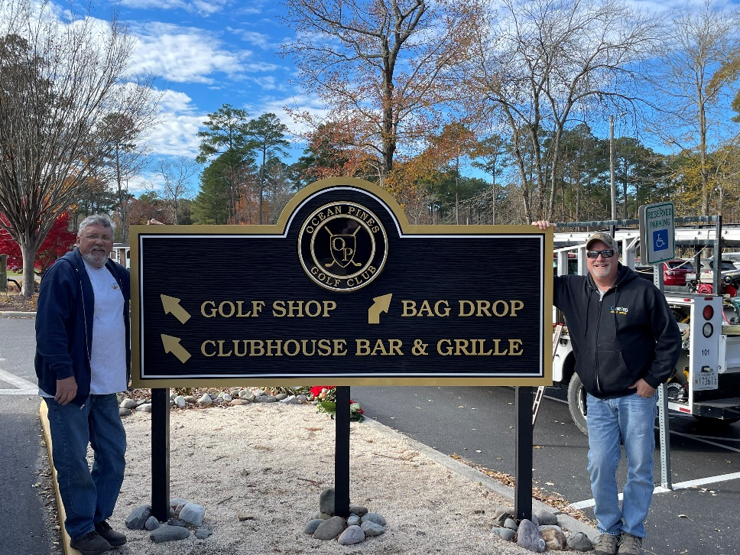
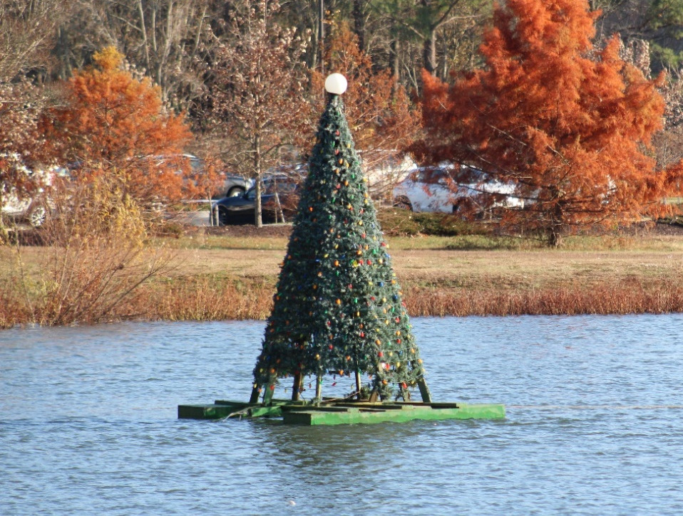
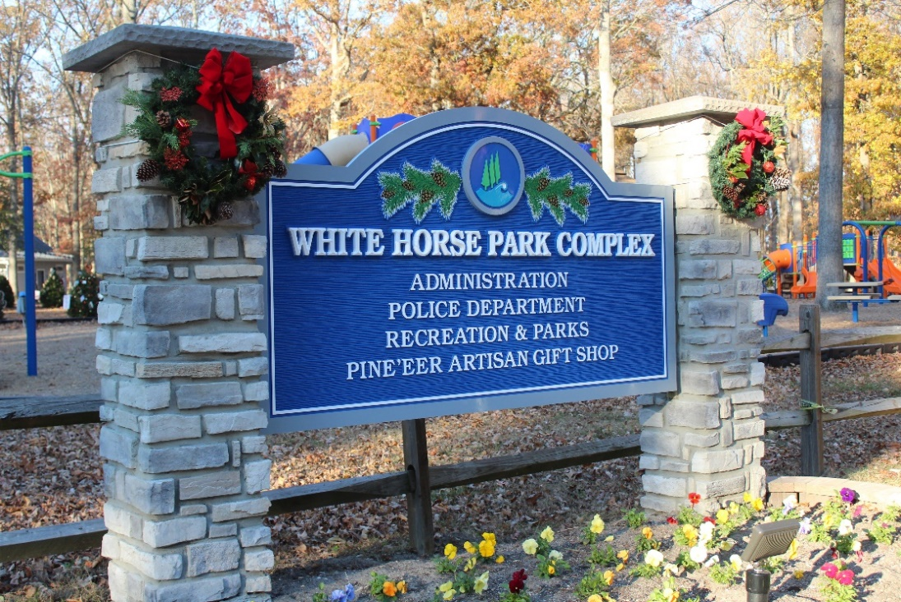
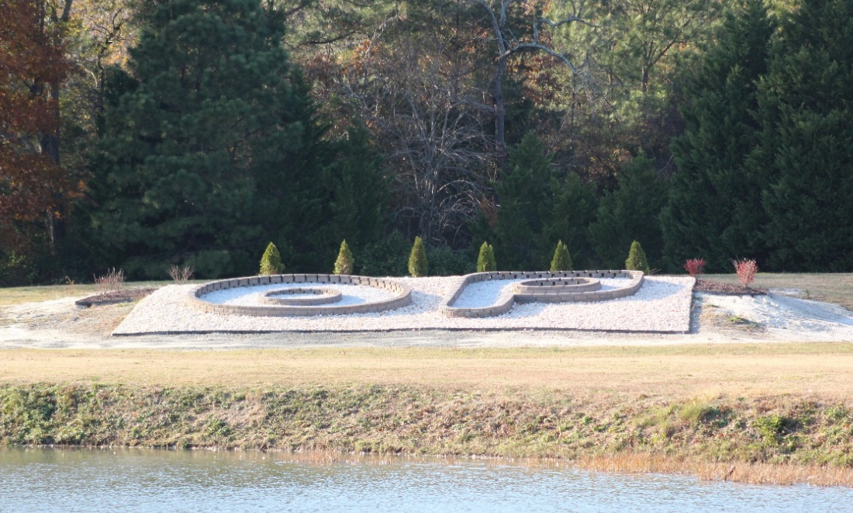
GM Leadership Report - John Viola

Slide 29
GM Report
Pickleball Courts
Proposed – FY 2022/2023 Budget
Audio System
Beautification
North Gate Bridge
Signs
Bulkheads
Drainage – Pinehurst, Sandyhook and Beacon Hill
Help Desk/Work Orders

Slide 30
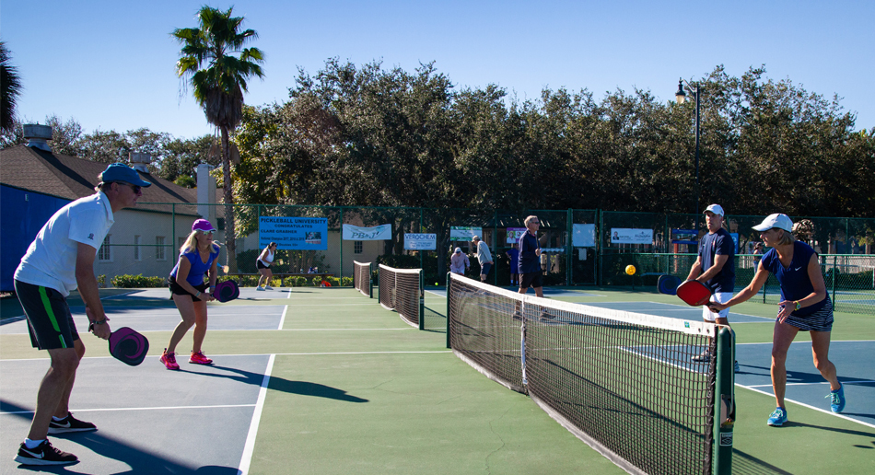
State permit received December 8, 2021.
Bid package being sent out to 4 contractors.
Estimated completion prior to Summer season.

Slide 31
Proposed FY 2022/2023 Budget Process
Received Guidance from B&F
Assigned a leader, met with all Department Heads
DMA Lite Study
Reviewed with all Department Heads and received sign-off
Agenda and dates prepared
Binders to be sent to B&F Committee and Board before Holidays

Slide 32
Proposed FY 2022/2023 Budget Process
Headwinds
Inflation
Minimum Wage
Mark to market
Proposed legislation
Insurance premiums
Tailwind
Improved performance in amenities and departments
Surplus

Slide 33
Audio System
Objective:
To install hybrid meeting functionality to the Assateague room or Clubhouse meeting room
Actions Taken:
Reached out to Mid-South Audio (preferred vendor) who already installed a successful hybrid meeting system in the Administration board room.
MSA will set up a custom table with built-in microphones, also install cameras and integrate existing audio system to work with Microsoft Teams
Estimated Cost:
Assateague Room - $15,000 plus projector/screen
Clubhouse Meeting Room - $15,000
Recommendation:
To move forward with MSA

Slide 34
North Gate Bridge
Objective:
Decorate for holidays and power wash (12/9/21)
Prepare estimates and options for the guard shack:
Options Estimate
Remove guard shack $2,500
Repair and maintain $2,500
Move to White Horse Park $12,000
Recommendation:
Repair and maintain in current position

Slide 35
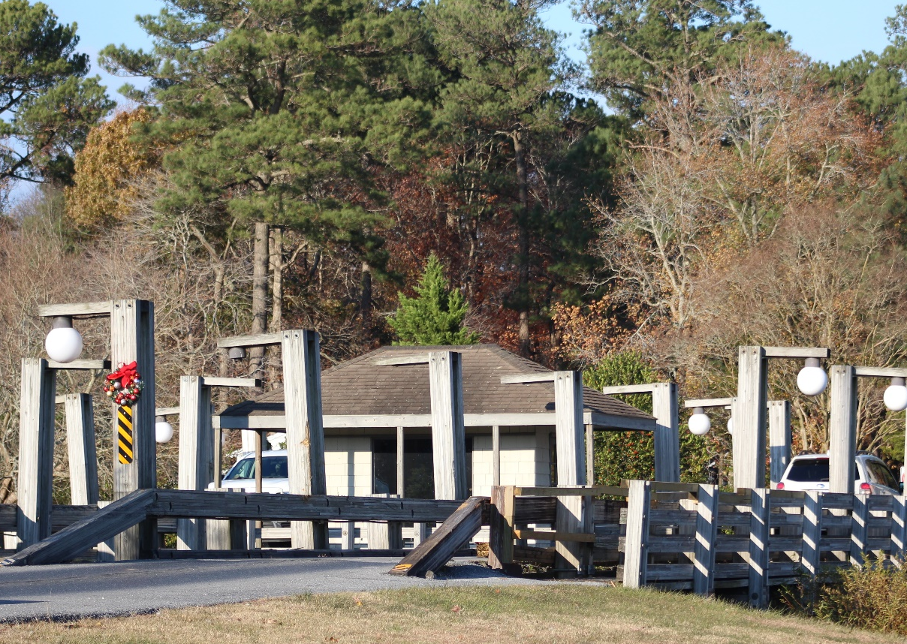
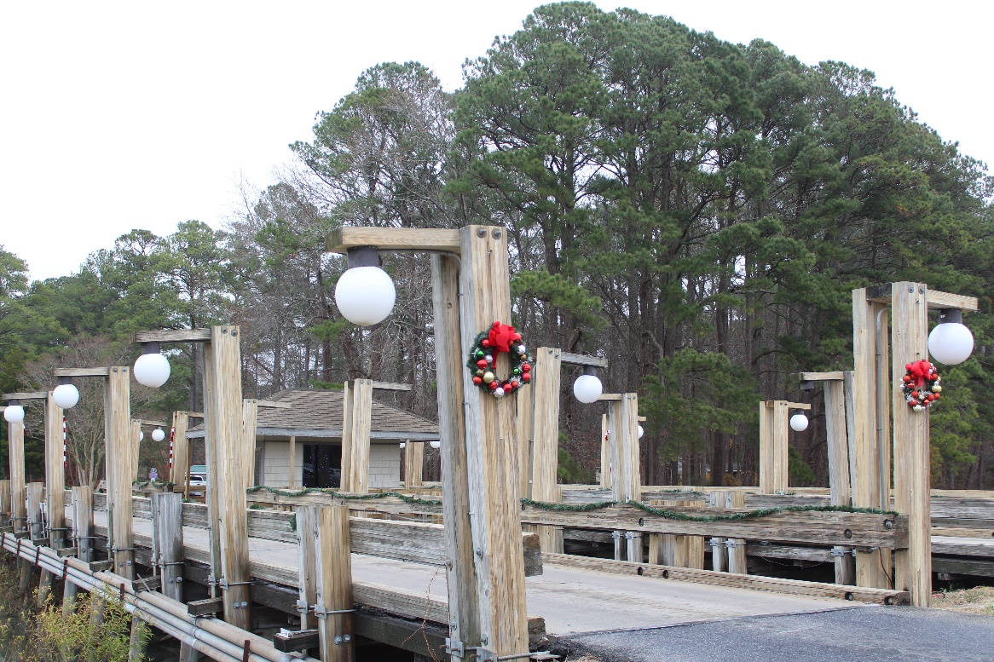
North Gate Bridge
Before
After

Slide 36

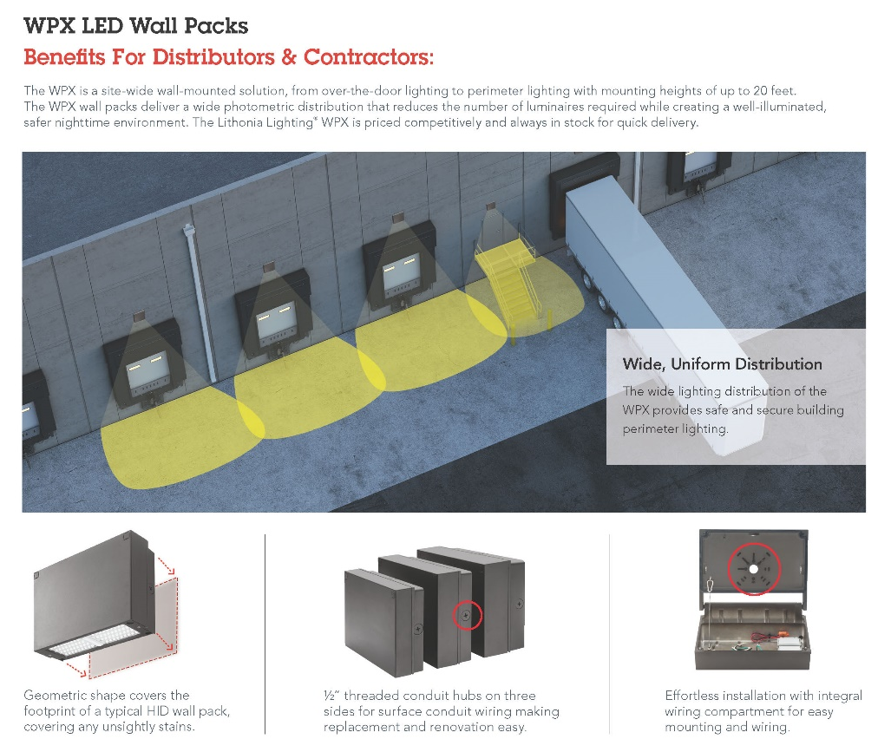
North Gate Bridge
Lighting
Suggested for the 4 corners of the bridge on poles
Suggested for the wooden beams

Slide 37
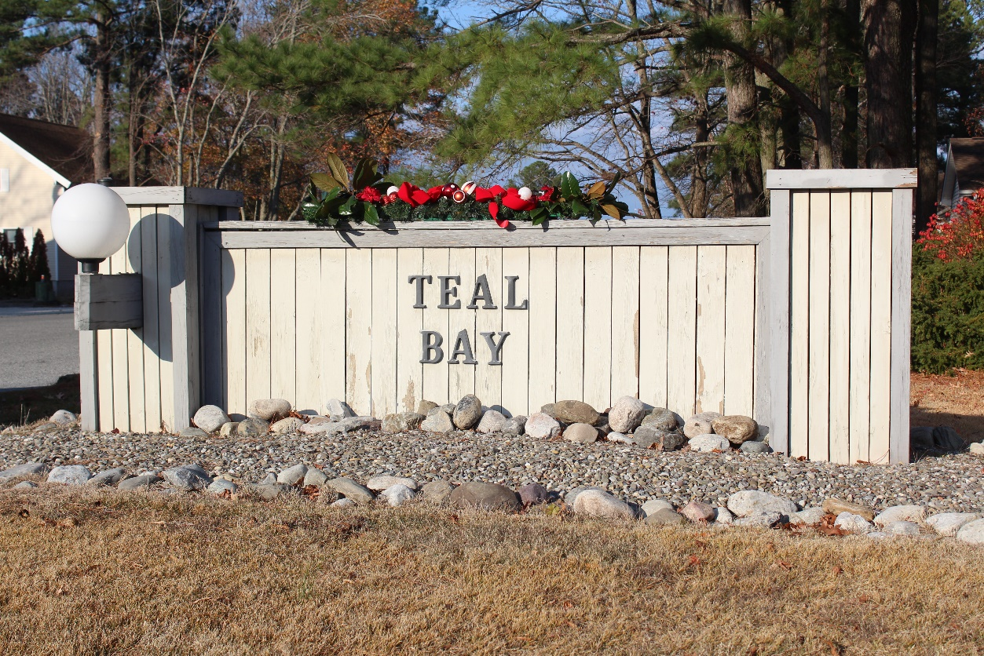
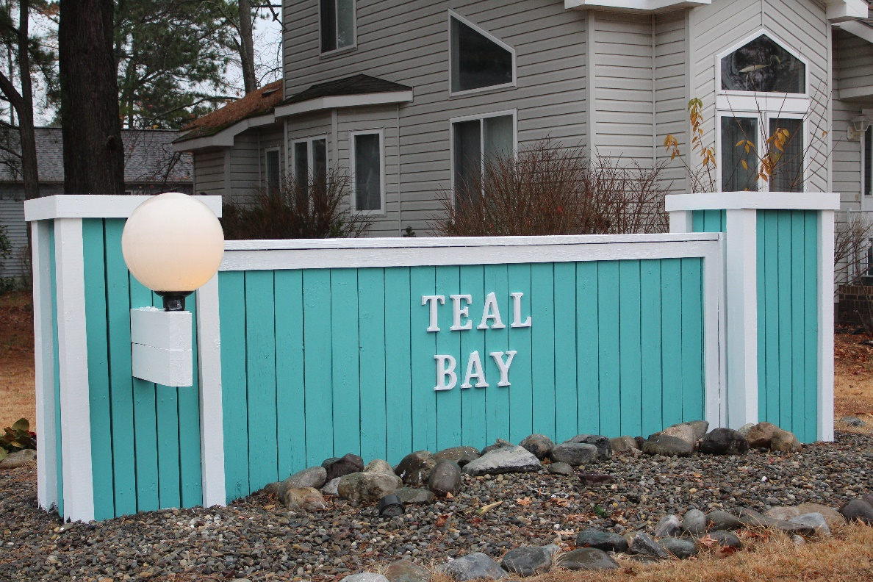
Teal Bay
Sign
Before
After

Slide 38
Bulkheads
Objective:
To lock in contractor and price for FY 2022-2023 bulkhead replacement (same as last year) as designed by Vista Engineers
Price $850,000
Deposit $85,000
1 Pintail Drive North
3 Pintail Drive North
5 Pintail Drive North
7 Pintail Drive North
9 Pintail Drive North
11 Pintail Drive North
13 Pintail Drive North
15 Pintail Drive North
17 Pintail Drive North
19 Pintail Drive North
Pintail Park
Total Sq. Ft. – 2,000
Total Cost (2,000 x $425) = $850,000

Slide 39

drainage Project
Beaconhill, Sandyhook and Pinehurst Crossings:
HDPE pipes and concrete box culverts required to complete the culvert replacements under all 3 roads are being stored on site.
OPA coordinated with Worcester County DPW to complete this phase of the project.
Utility issues under the road caused a delay in placing the pipes. Utility lines must be relocated for the pipes to be installed under the roads.
Received quote from Worcester County DPW for $76,230 to have the utility work completed.
Total for this portion of the project: $297,000
  This includes the utility work, additional pipes, and the installation of the pipes.
Material will arrive in about 3 months, with work being completed in early Spring.

Slide 40
CPI Violation Dashboard
NOVEMBER
Violations
As of 10/31/21 | New Violations | Closed Violations | As of 11/30/21
72 | 31 | 28 | 75
Legal Cases
As of 10/31/21 | New Violations to Legal | Closed Violations in Legal | As of 11/30/21
41 | 4 | 2 | 43

Slide 41
Financials

Slide 42
Financial Change month of October 2021
October (In 000’s)
 | Budget | Current Year | Favor/ (Unfavor) vs. Budget
Net Revenues | $436 | $585 | $149
Expenses + New Capital | 1,163 | 1,240 | (77)
Net Operating | ($727) | ($655) | $72

Slide 43
Financial Change
YEAR-TO-DATE October 2021
YTD October 2021 (In 000’s)
 | Budget | Current Year | Favor/ (Unfavor) vs. Budget
Net Revenues | $11,721 | $12,944 | $1,223
Expenses + New Capital | 7,365 | 7,215 | 150
Net Operating | $4,356 | $5,729 | $1,373

Slide 44
Detail for the Month of October
Favor/(Unfavorable) Vs. Budget (in 000’s)
Department/Amenity | Favorable/(Unfavorable)
Public Works/General Maint/CPI | 52.5
General Admin | 39.1
Golf Ops + Maintenance | 27.5
Finance | 15.5
Police | 14.2
Beach Club | (25.4)
Yacht Club | (61.6)
Other Net (Racquet, Clubhouse Grille, Marketing, Recreation, GM, Beach Parking) | 10.1
TOTAL | $71.9

Slide 45
Detail for year-to-date October
Favor/(Unfavorable) Vs. Budget (in 000’s)
Department/Amenity | Favorable/(Unfavorable)
Golf Ops + Maintenance | $271.8
Public Works/General Maint/CPI | 266.8
Aquatics | 204.4
Yacht Club | 198.7
Admin, Finance, GM, PR/Mktng | 112.4
Police | 91.9
Beach Parking | 54.4
Clubhouse Grille | 45.5
Beach Club | 45.3
Marinas | 42.2
Racquet Sports | 34.7
Recreation & Parks | 13.3
New Capital | (8.1)
TOTAL | $1,373.3

Slide 46

Treasurer’s Report -
Doug Parks

Slide 47

Cash & Short-Term Investments
Activity for Month of October
Overall Laddered Investment Rate of Return on CDAR’s for October Approx. 0.75%
As of October 31, 2021, the Association had approx. $15.8 million in cash
  Approx. $7.1 million invested in CDAR’s, fully FDIC insured
  Approx. $8.7 million in Money Market, and other operating accounts, fully insured

Slide 48
Unaudited Reserves october 2021 ($Millions)
 | GeneralReplace | Bulkheads | Roads | Drainage | New Capital | Total
4/30/21 Balance | $3.9 | $1.0 | $0.2 | $0.5 | $0.1 | $5.7
Contributions/ Interest | 1.6 | 1.1 | - | - | 0.2 | 2.9
Casino Funds + Grant Income | - | - | - | 0.7 | - | 0.7
Transfer (Spend) | (0.5) | (0.7) | (0.2) | (0.4) | - | (1.8)
10/31/21 Balance | $5.0 | $1.4 | $- | $0.8 | $0.3 | $7.5

Slide 49
Reserves year-end unaudited estimate
(in ooo’s)
 | Beginning Balance |  |  | Unaudited EST Balance
 | 4/30/21 | Additions | Expenditures | 4/30/2022
Major Maintenance & Replacement:
Public Works – Fleet Vehicles |  |  | (302)
Public Works Tractor in 21 Budget |  |  | (146)
Police Vehicles (x 3) |  |  | (133)
Aquatics (Furniture, Roof, Equip) |  |  | (75)
Golf Maintenance Tri-plex Mower |  |  | (49)
Public Works Boom Mower |  |  | (36)
Yacht Club Kitchen Equipment |  |  | (20)
Golf Ops (Ball Dispenser/Washer) |  |  | (14)
Racquet (Lighting,Fountains) |  |  | (10)
Other |  |  | (50)
Total | 3,853 | 1,685 | (835) | 4,703
Bulkheads & Waterways | 1,010 | 1,070 | (1,908) | 172
Roads | 216 | 3 | (209) | 10
Drainage | 469 | 835 | (800) | 504
New Capital | 102 | 183 | (190) | 95
TOTAL 4/30/22 ESTIMATE | 5,650 | 3,776 | (3,942) | 5,484

Slide 50

Public Comments

Slide 51
PURCHASE REQUESTS-
2022/23 Bulkhead replacement
Requesting Authorization to go forward with Staff Recommendation of $850,000 for Fisher Marine Services

Slide 52

CPI Violations-
None

Slide 53
Unfinished Business
None

Slide 54
New Business
Discussion – Live video for Board meetings/Town Halls – Amy Peck
Discussion – By-Laws & Resolutions Committee - Search Committee Recommendations – Colette Horn

Slide 55
Appointments
William Barnard – 1st Term – Recreation & Parks

Slide 56
Adjournment

