Slide 1

Board of Directors Meeting
December 16, 2023

Slide 2
Approval of Agenda

Slide 3
Approval of Minutes
November 18, 2023 – Regular Meeting

Slide 4

President’s Remarks
Rick Farr

Slide 5
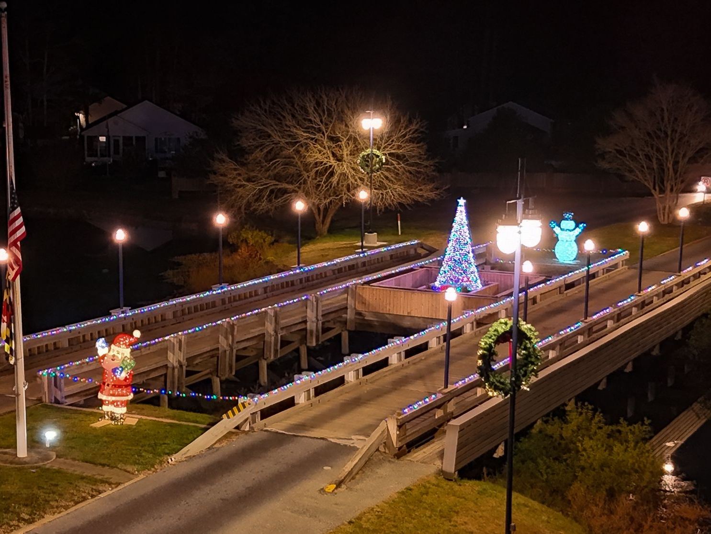
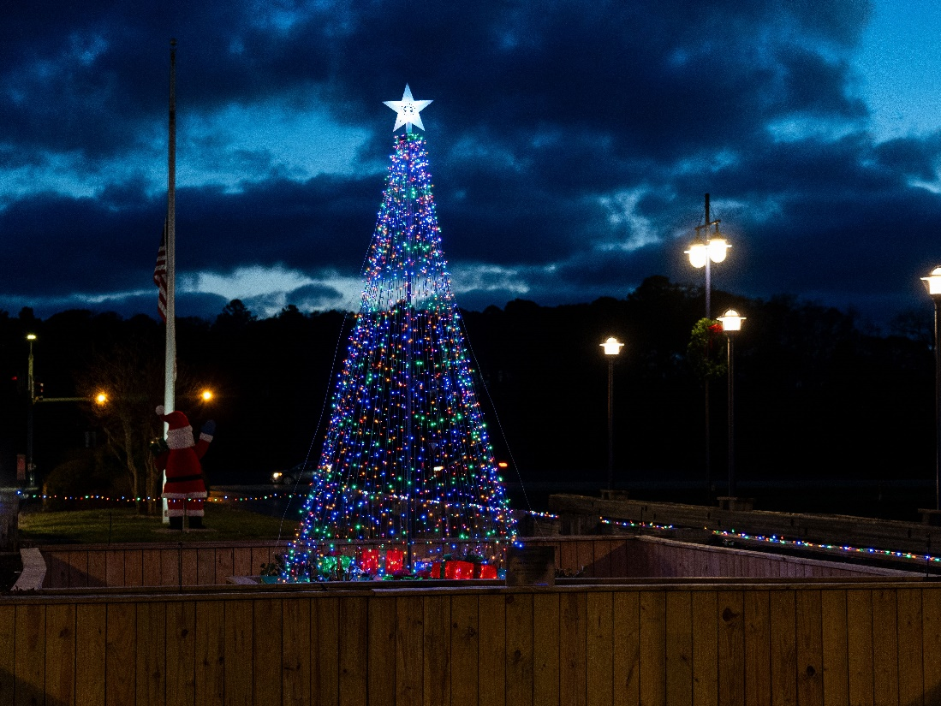
GM Leadership Report –
John Viola

Slide 6
Initiatives
  Irrigation System
  Electronic Sign
  Banners
  Renovations:
    Racquet Sports Building
    Tiki Bar
    Pavilion – Veterans Memorial
  Walking Trails
  Budget 2024/2025
  Beach Club
  Trash RFP
  Holiday
  Metrics

Slide 7
Irrigation System
Going forward today in Capital Requests with recommendation for irrigation system
Phase I of project
Pump station fairways 1 and 9 plus range
Prepare and sign contract over next several months
Start work around November 2024 (majority of work from November 2024 – March 2025)

Slide 8
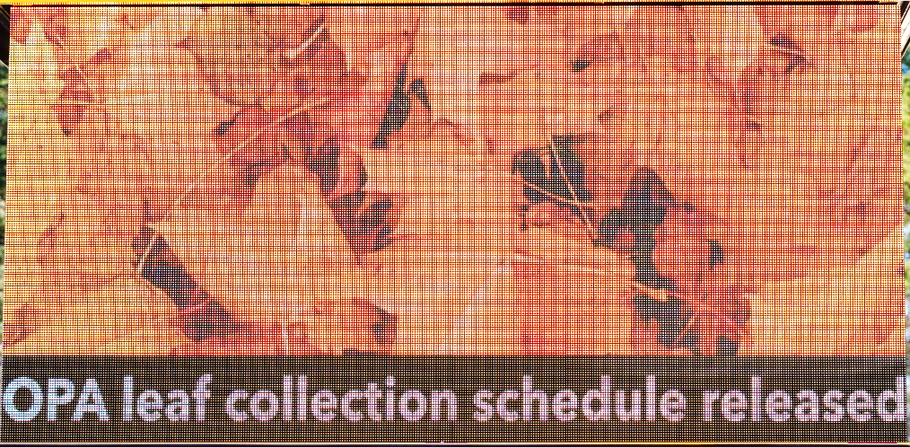
Electronic Signs
Per Board instructions, General Manager to move forward for pricing for electronic signage
A work group formed including GM, Josh Davis, Eddie Wells, Keith Calabrese, and Linda Martin met to discuss staff next steps for electronic signs
RFP went out to contractors on November 22nd for an electronic sign and bids at north gate – 3 bids received back
We will present team recommendation in New Business today

Slide 9
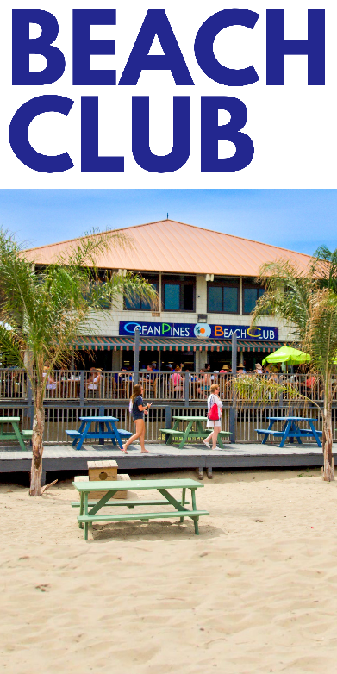

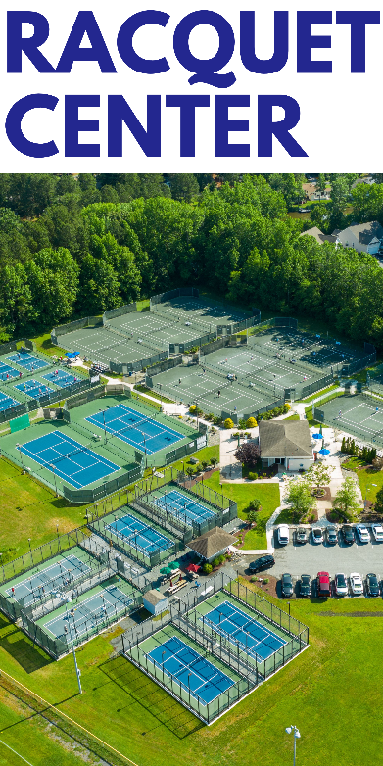
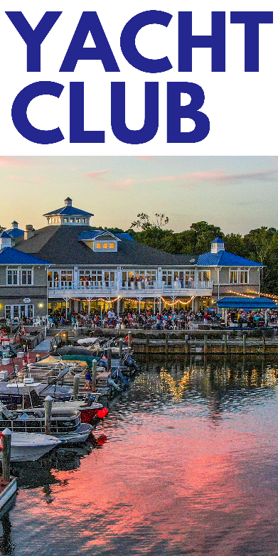
Banners
The banners the GM instructed Public Works to install on the light posts for the holiday have received positive feedback
GM instructed Public Relations/ Marketing to work on seasonal banners and amenity banners to be displayed year-round

Slide 10
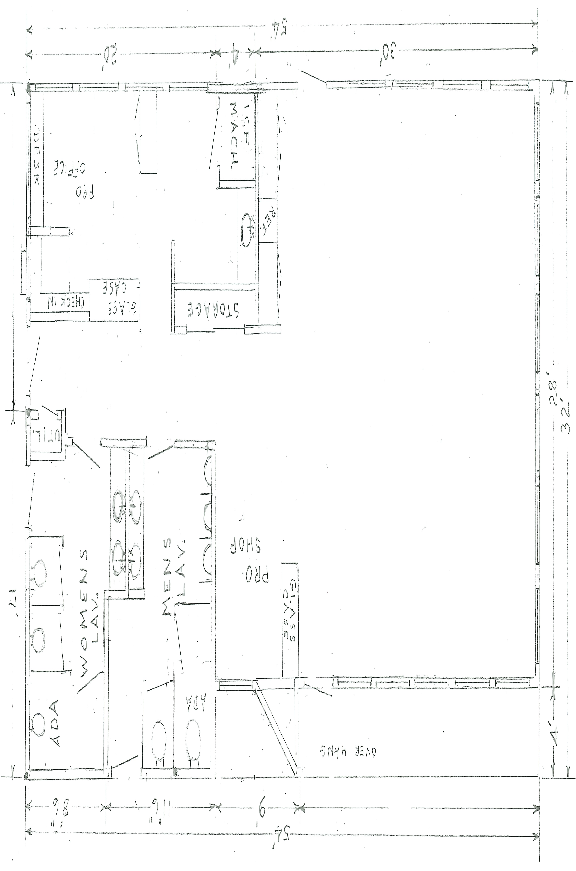
Racquet Sports Building
Focus on pro shop and restrooms
Received feedback from Racquet Sports community
Frank Brown prepared sketches
Restrooms and pro shop improvements at top of the list (agreed to by Director of Racquet Sports)
Working with outside contractors who have been utilized in past along with Public Works
Timeframe: January – May 2024

Slide 11
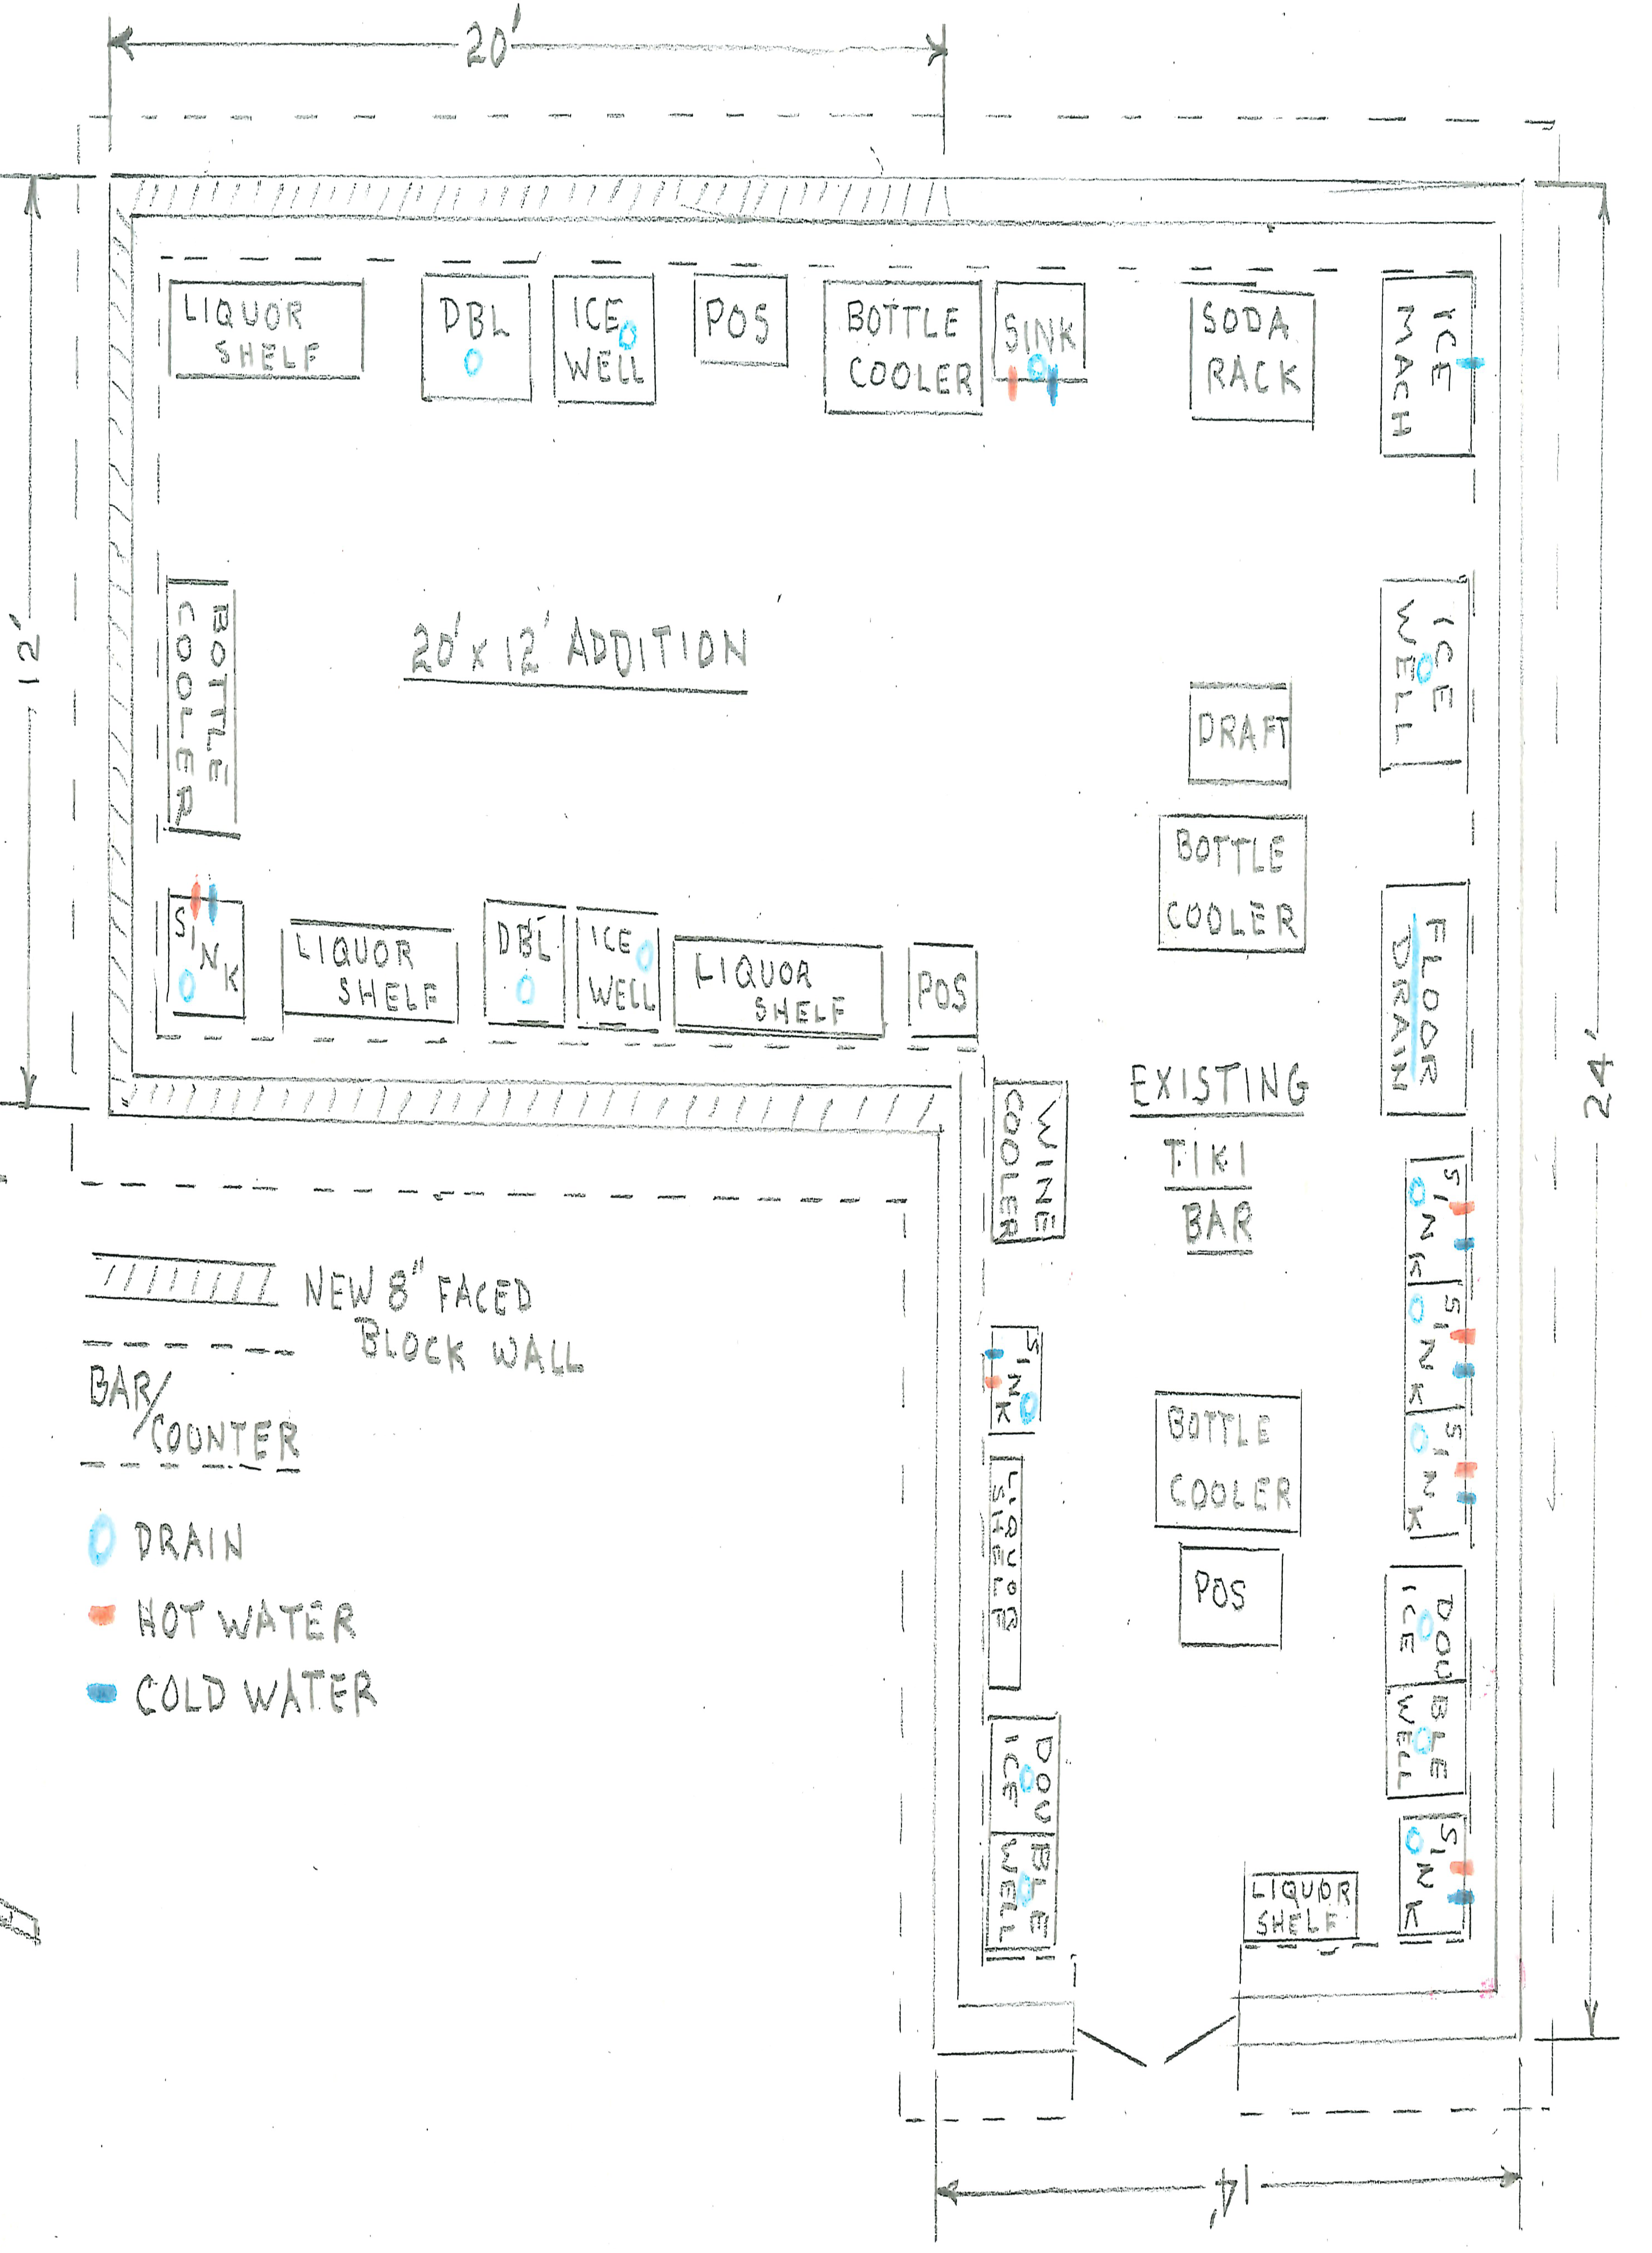
Tiki Bar
Objective to enhance customer service
Work to be performed by Public Works and contracted vendor
Plan to be completed by Memorial Day
Will request during the Capital Request segment of today’s meeting

Slide 12
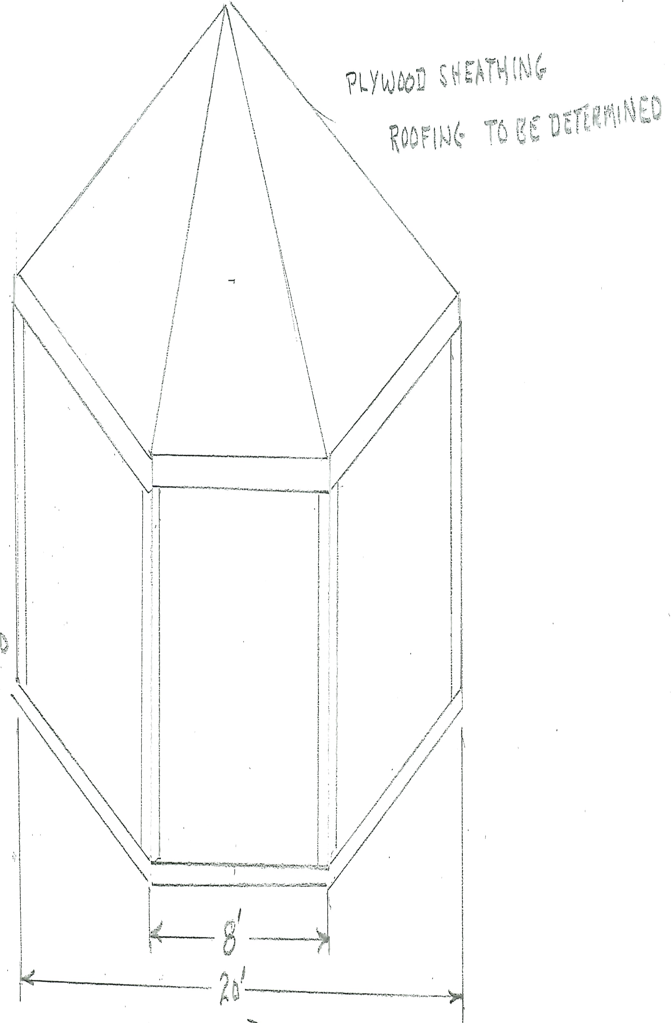
Pavilion – Veterans Memorial
Shade structure to replace existing gazebo
Work to be performed with contracted service partner
Veterans Memorial Foundation to provide $50,000 and OPA proposed $50,000

Slide 13
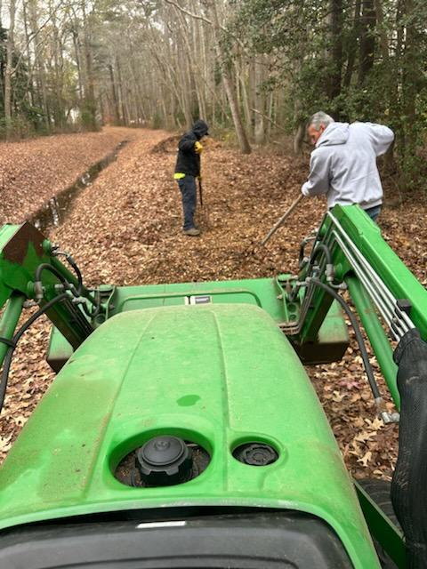

Walking Trails
Evaluated Robin Hood bike/walking trail with Patti Stevens, Chair, Worcester County Bike and Pedestrian Coalition, on November 30th
Walking trails currently being worked on:
  Roots being removed, trails being mulched, and stone dust added to road edges
5 signs ordered to be placed on walking paths that cross over streets notifying motorists of hikers or bikers crossing the roadways (signs recommended by MD State law)
Roads will also be striped similar to golf cart crossings:
  King Richard, Castle, Camelot (2 locations) and Robin Hood

Slide 14
Budget 2024/2025
Dates for review:
  B & F Review – January 3-4, 2024
  Board Review – January 11-12, 2024
  Town Hall – February 7, 2024 (tentatively)
Continue robust bulkhead, drainage, and road programs
Address infrastructure well overdue
  Irrigation system
Statutory wage increases, 401K Police enhanced program, medical costs, and liability insurance increases
Budget binders to be available to B & F and Board December 22, 2023

Slide 15
Beach Club
After discussion with Board President, researched ideas for entrance to Beach Club bathrooms for members only
IT received bids for door controls, card readers (scanner), intercom, and cameras
Recommendation to use Verkada product – Blue Cap IT to install
Total cost: $5,430.82

Slide 16
Trash RFP
Going forward today requesting approval for trash/recycling contract
Three bids received
All three bids include options for yearly and seasonal pick ups
Inclusive contract

Slide 17
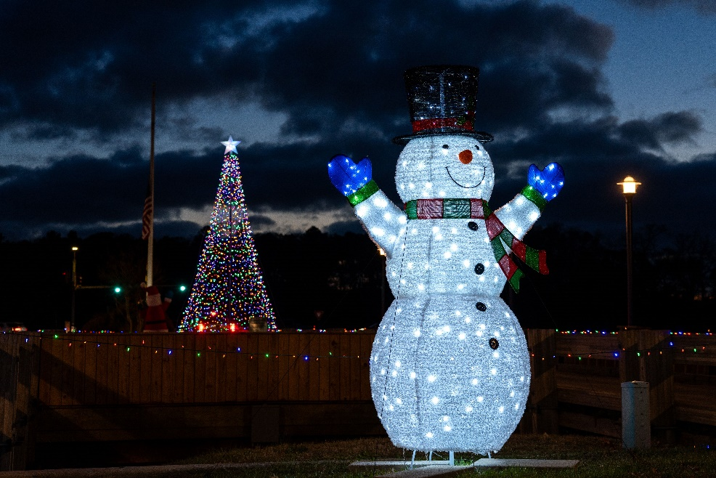
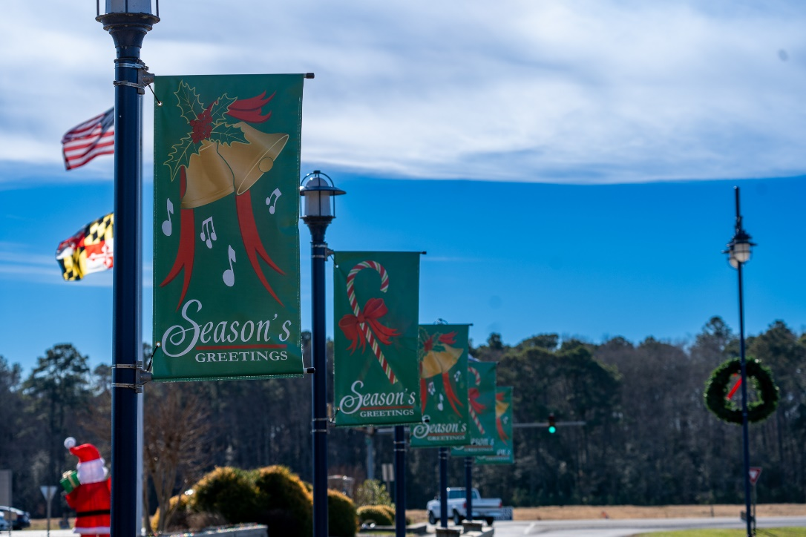
Holiday
Additional holiday decorations:
  7 trees total (5 artificial; 2 live)
  Additional lighting added to north gate bridge
  Wreaths and flags put on street light poles
  Approximately 25,000 lights throughout the community

Slide 18
CPI Violation Dashboard
November
Violations
As of 10/31/23 | New Violations | Closed Violations | As of 11/30/23
200 | 41 | 103 | 138
41 violations initiated in November: 3 maintenance/trash/debris; 14 no permit; 24 miscellaneous
  Miscellaneous violations includes signs, stop work orders, trailers, unregistered/junk vehicles, and vehicle parking
103 violations complied out; 138 remain open
  39 maintenance/trash/debris; 40 no permit; 59 miscellaneous

Slide 19
Work Orders
November
Open Work Orders as of 10/31/23 | New Work Orders | Closed Work Orders | Open Work Orders as of 11/30/23
129 | 59 | 77 | 111
59 work orders initiated in November: 3 bulkhead; 9 drainage; 3 grounds/landscaping; 11 roads; 6 signs; 27 general maintenance
Majority still open in drainage (55):
  8 – over 30 days; 41 – over 60 days
    Average 1-4 work orders a day to complete depending upon severity

Slide 20
Customer Service Dashboard
(from info@oceanpines.org)
November
Type | # Received – Nov.
Amenities | 9
CPI | 5
Drainage | 0
General | 30
Public Works | 18
TOTAL | 62

Slide 21
Financials

Slide 22
UNAUDITED FINANCIAL CHANGE
PRELIMINARY FLASH - MONTH OF NOVEMBER 2023
November (In 000’s)
 | Budget | Current Year | Favor/ (Unfavor) vs. Budget
Net Revenues | $290 | $358 | $68
Expenses | 1,117 | 1,073 | 44
Net Operating | ($588) | ($495) | $93

Slide 23
UNAUDITED PRELIMINARY FLASH MONTH OF NOVEMBER FAVOR/(UNFAVORABLE) VS. BUDGET (IN 000’s)
Department/Amenity | Favorable/(Unfavorable)
Police | 48
Public Works/Gen Maint/CPI | 39
Golf Ops + Maintenance | 24
Aquatics | 12
Clubhouse Grille | 10
Yacht Club | 5
Other Net (Admin, GM Office, Finance, Public Relations, Racquet Sports, Beach Club, Beach Parking, Recreation, Marinas) | (1)
TOTAL | $137

Slide 24

Treasurer’s Report -
Monica Rakowski

Slide 25

Preliminary Cash & Short-Term Investments
Month of November
As of November 30, 2023, the Association had Approximately (~) $16.8M in Cash
  Cash Increased ~ $0.8M from the Same Time Period Last Year
  Cash Decreased ~ ($600)K from October 2023
  $11.3M Invested in CDAR’s
  $50K in Interest Income Recognized for the Month
  Remaining $5.5M in Insured Cash Sweep, Treasury Bills, Money Market and Other Operating Accounts (Diversified Between 2 Local Banks)

Slide 26


Public Comments
Members wishing to make comments must state their name and address

Slide 27
Capital Requests
Golf Maintenance – Irrigation System
Public Relations – Electronic Sign
Yacht Club – Tike Bar Expansion
Racquet Sports – Pro Shop Renovations
Veterans Memorial - Gazebo

Slide 28
Capital Requests
Irrigation System
Requesting authorization to go forward with staff recommendation of $934,000 for Irrigation Services Inc.

Slide 29
Capital Requests
Electronic Sign
Requesting authorization to go forward with staff recommendation of $22,118.06 for Phillips Signs

Slide 30
Capital Requests
Tiki Bar Expansion
Requesting authorization to go forward with staff recommendation of $197,500 for Whayland Company

Slide 31
Capital Requests
Racquet Center Renovations
Requesting authorization to go forward with staff recommendation of $140,000 for Whayland Company

Slide 32
Capital Requests
Veterans Memorial Gazebo
Requesting authorization to go forward with staff recommendation of $50,000 for Whayland Company

Slide 33
New Business
Second reading of revisions to Resolution M-04 (Maintenance of Lots) – Elaine Brady
Motion to approve trash removal contract – John Viola
Discussion on easements – Elaine Brady

Slide 34
Appointments
Robert Keesling – Chair – Strategic Planning
Linda Yurche – Chair – Communications

Slide 35
Adjournment

