Slide 1

Board of Directors Meeting
December 17, 2022

Slide 2
Approval of Agenda

Slide 3
Approval of Minutes
November 19, 2022 – Regular Meeting
December 9, 2022 – Special Meeting

Slide 4


President’s Remarks
Doug Parks

Slide 5
OPVFD Work Group Presentation –
John Viola & Ted Moroney

Slide 6
OPVFD Work Group
John Viola - Sponsor
Ocean Pines OPVFD
Ted Moroney – leader Steve Grunewald
Frank Brown Dave Van Gasbeck
Josh Davis
Pete Gomsack
Marvin Steen
Eddie Wells

Slide 7
OPVFD Initiative
Recommended a Fundraising Program to bridge the gap to fund a new building
Received endorsement from the Board on July 27, 2022, to move forward
Formed a work group with individuals who I believe are professional and constructive, including OPVFD
Our objectives were:
  Hire an individual or firm with knowledge of this area with a proven track record in fundraising
  The team recognized early on that we needed to bring on board an individual who specialized in grant writing with a strong background
  The scope of today’s presentation is fundraising
Ted Moroney will give you all a detailed update on the progress of the team.

Slide 8
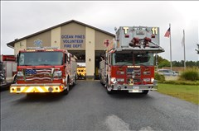
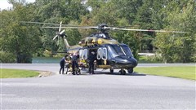
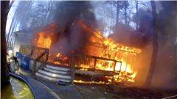
OPVFD Work Group
Established by GM John Viola on July 22, 2022

Slide 9
Three primary responsibilities/tasking
Develop and execute a plan to meet OPA Board direction to work in concert with OPVFD to organize fundraising in accordance with the current MOU.
Concurrently, review the plan provided by OPVFD, examine location options, and other recent Eastern Shore fire department construction, and explore future department needs both in size and fundamental organizational evolvement, to develop a plan in concert with OPVFD that can be used to obtain competitive pricing from contractors.
Last, after substantive execution of responsibilities 1 and 2 above, prepare a framework for OPA and OPVFD Boards to consider in developing a new simplified, and forward-looking MOU.

Slide 10
Task One - Develop and execute a plan to meet OPA Board direction to assist OPVFD with fundraising in accordance with the current MOU
  OPVFD has no real capital fund-raising experience or depth of knowledge.
  OPVFD recent efforts are basically selling raffle tickets netting about $40,000 to $70,000 to support apparatus replacement.
  OPA has no in-house expertise in fundraising, however, we have a community of highly dedicated volunteers to tap into, some of whom might have that expertise, or at the very least, we can count on to maximize effort from our volunteers to execute our program going forward.

Slide 11
  We intended to issue an RFP to find a capital campaign consultant/contractor.
  Based on the points made previously related to experience and expertise, Team Members questioned our readiness to conduct such a campaign and suggested a Feasibility study as a pre-requisite. After discussion, we all agreed.
  We developed a Feasibility study RFP and solicited additional expertise to review, provide input and validate our RFP.
    1. We reached out to several fundraising experts and met with the head of fundraising for the Wilmington diocese of the Catholic Church. She provided high-level advice as to structure, and opportunities while validating our RFP.

Slide 12
    Through a lot of work and being tuned into many Eastern Shore contacts, a Team Member was able to arrange a meeting between our team and several experienced fundraising individuals. Through those meetings these individuals were able to:
        validate our approach and RFP.
        encourage our continued path to obtain additional grants.
        provide us with the names of many key stakeholders within and around Ocean Pines.
        expressed a willingness to assist us in the review and interviews with RFP respondents.
        potentially could supply ongoing assistance depending on the feasibility results.

Slide 13
  We sent nine RFPs out and met with nearly all the potential bidders prior to accepting proposals.
  We received a total of six proposals that varied greatly in scope and price and in some cases were simply sales pitches for future or other services.
  Pricing varied from $28,000 to $60,000 plus out-of-pocket expenses.
  Based on research we had anticipated this to be closer to $20,000 plus out-of-pocket expenses.
  Our in-depth review indicated an alternate path to success, and we requested a formal proposal from a respected fundraiser who has raised millions of dollars for the Salisbury Zoo and the Delmarva Discovery Museum.

Slide 14
  Our feeling throughout had been that we needed a hybrid campaign with three distinct levels of solicitation. After reviewing the proposal, we were convinced that is the correct approach. Let’s explore our three-prong approach:
  The first prong - Key Donors:
  One of our goals was to limit risk to OPVFD and OPA. The proposal we adopted does just that by setting a percentage of the amount raised as a basis for payment.
  Normally firms charge a fixed fee which equates to around 10% of the amount you EXPECT to raise with no guarantee of success. We will pay 8% of the amount actually collected and in the bank. That limits our risk to the cost of published materials and other incidental costs.
  Our consultant, in concert with key OP/OPVFD individuals, will be involved in all the major donor solicitations.

Slide 15
  Timeline for Capital Campaign
    First Month
      Develop a Case for Support with a brochure
      Develop a Dedication & Naming Opportunity List
      Develop and maintain donor database
      Wealth analytics
      Identify keystone gifts & honorary chairs of campaign
      Identify 50 potential major donors ($10,000)
      Identify 5 potential business owners as major donors
      Interview Board members, key OPVFD members & staff
      Assistance with introductions will be needed

Slide 16
    Second & Third Months
      Identify influential leaders who are willing to donate time for the campaign
      Identify possible hosts for meetings at their home or the Fire Department
      Continue to cultivate lists of donors, after meetings and interviews
      Review relevant Fire Department fire/accident call records
      Identify other local capital campaigns, especially fire departments
      Review Ocean Pines' demographics in detail
    Fourth Month to Eleventh Month
      Mail letter and brochure to property owners
      Continue research and conduct asks
      Review status every sixty days and adjust as necessary based on results

Slide 17
  Twelfth Month
      Hopefully, celebrate the successful completion of the Capital Campaign!!
  The second prong - Grants:
  OPVFD has secured and received in hand approximately $1.35 million in a grant from the state. We owe State Senator Mary Beth Carozza and State Delegate Wayne Hartman our gratitude for making this happen.
  OPVFD has also been authorized $350,000 in bonds from the State of Maryland.
  We interviewed a respected Eastern Shore grant writer with 46 years of experience whose name came to us from multiple fundraising sources. Based on the results of that interview process we:

Slide 18
        Determined she had vast experience in grant writing for both fire departments as well as grant expertise in multiple other areas
        Entered into an agreement to allow the research to be conducted and a report will be provided to the workgroup of available grants, the chances of obtaining the grant, the cost and effort in applying for the grant
        The report and next phase of decision-making should be complete no later than 12/31
  The third prong - Community Fundraising:
  This is where we need community volunteers to help with the organization and execution of a community-based fundraising effort. We will be setting up a special form to volunteer to help. This is in its infancy, and we are looking for organizers and leaders as well as volunteers.
  There are hundreds of ideas available to include door-to-door solicitation and general areas that include:
    Competitive activities – fundraising runs, trivia nights, poker tournaments, etc.
    Traditional activities – car wash, bake sale, etc.
    Social/recreational – silent auction, auction of free meals at local restaurants, etc.
    Combinations of the above including Fire Equipment displays, etc.

Slide 19
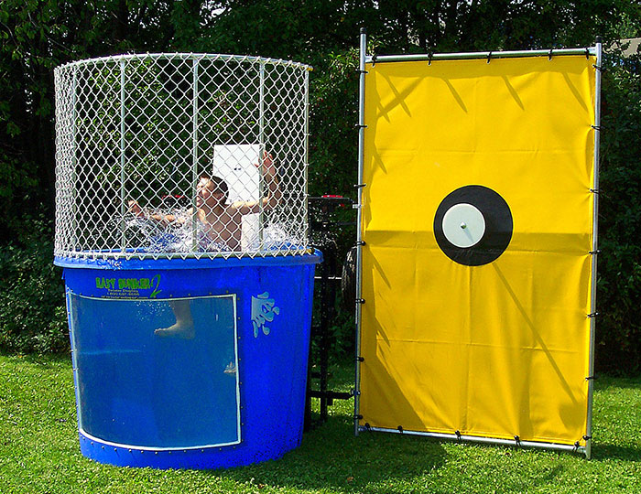
      The Ocean Pines Dunk Tank
Possible Dunk “Volunteers!”
Doug Parks
Rick Farr
Colette Horn
Frank Daly
Steve Jacobs
Monica Rakowski
Stuart Lakernick
And other “well-loved” Association members!! ☺

Slide 20
  Status Summary
  OPVFD and OPA are proceeding as follows:
    Key Donor program starting in January.
    Grants starting in January
    Community Fundraising – soliciting volunteers and leaders, organizing in January/February timeframe.
  OPA and OPVFD will continue to jointly partner through the execution of this fundraising program.
  Questions?????????

Slide 21
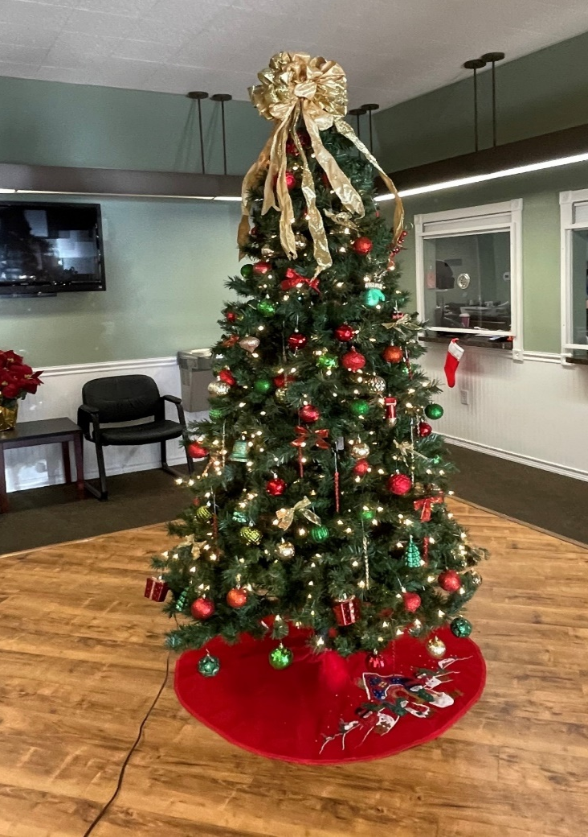
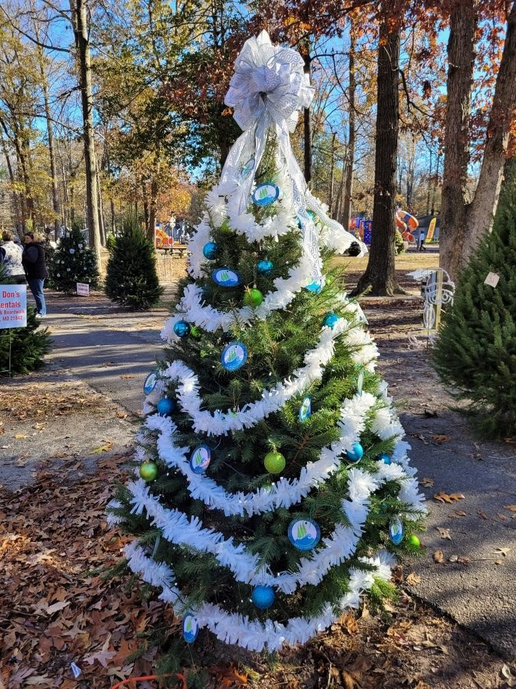
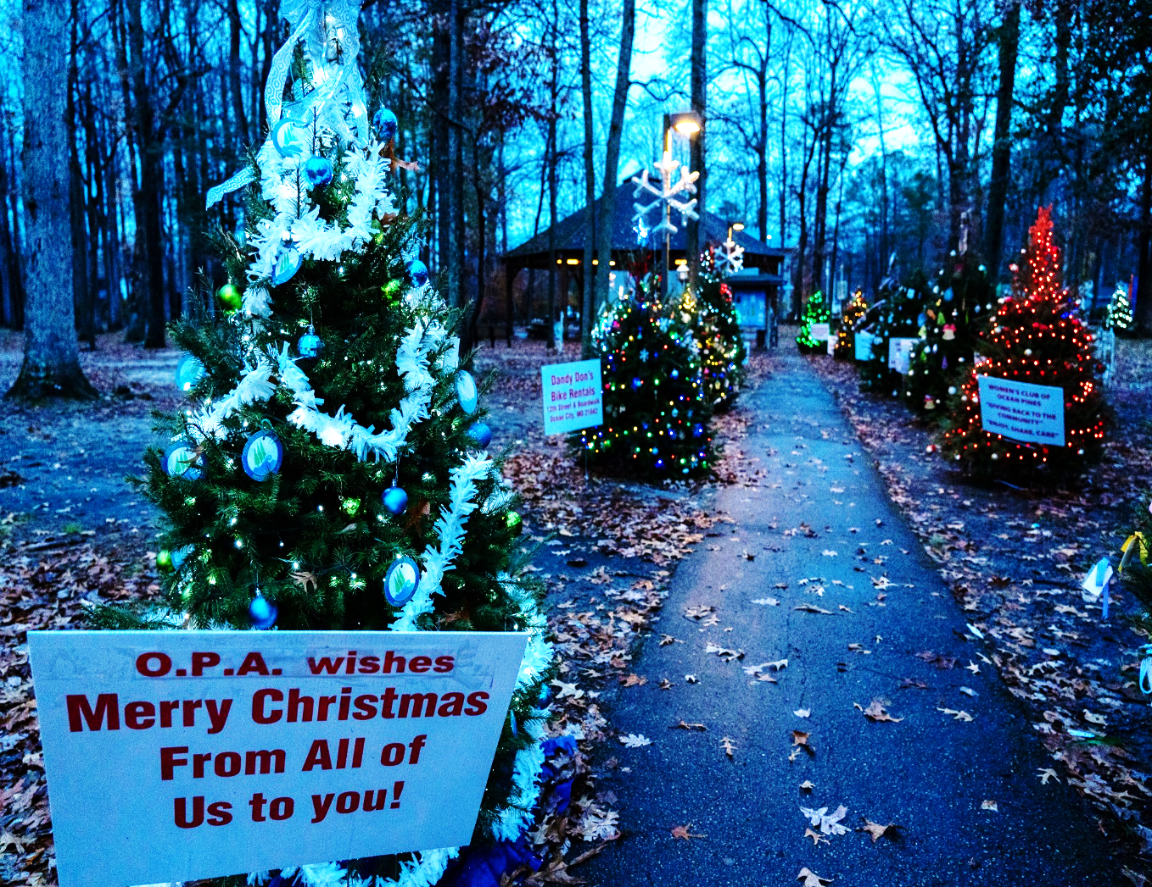
GM Leadership Report –
John Viola

Slide 22
Initiatives
Drainage
Budget
Kayak/Recreation Pier
Acoustic Panels
Metrics
Mailboxes
Bulkheads
Aquatics
Golf
Ocean Pines Association Paperless Project
Roads
DMA Reserves
Yacht Club

Slide 23
Proposed FY 2023/2024 Budget Process
Received guidance from B & F
DMA Lite Study – discussed with B & F on 11/30/22
Worked with all department heads (bottom – up)
Packet prepared (all department heads signed off)
Agenda and dates prepared
  B & F Review - January 4-6, 2023
  Board Review – January 18-19, 2023
Binders of the proposed budget to be sent to B & F Committee and Board before Holidays

Slide 24
Proposed FY 2023/2024 Budget Process
Headwinds
  Inflation
  Minimum Wage
  Mark to market
  Labor pool
  Insurance premiums
Tailwind
  Improved performance in amenities and departments

Slide 25
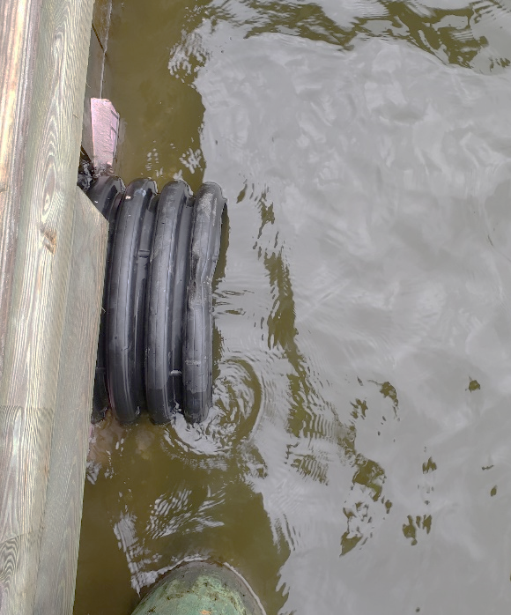
Drainage
  Secondary Pipes – to be completed by Deppe Bros.:
  Birdnest Drive and Abbyshire Road drainage pipe
    $10,200.00
  Ocean Parkway – Wood Duck bulkhead pipe
    $9,625.60
  Teal Circle bulkhead stormwater pipe
    $10,200.00
  Teal Circle road pipe
    $7,800.00
  Total forecasted spend for the year:
  Per reserves: $550,000.00
  Drainage maintenance: $175,000.00

Slide 26
Bulkheads
Objective: to lock in contractor and price for FY 2023-2024 bulkhead replacement (same as last year) to enable cost savings
Locations:
  Watergreen Lane (2 - 20)
  Goldeneye Court (2 - 24)
  Wood Duck Drive (20 - 42)
Total Sq. Ft.: 2,300
Total Cost (2,300 sq. ft. x $425.00) = $977,500.00

Slide 27
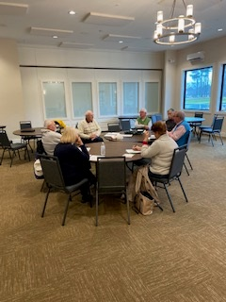
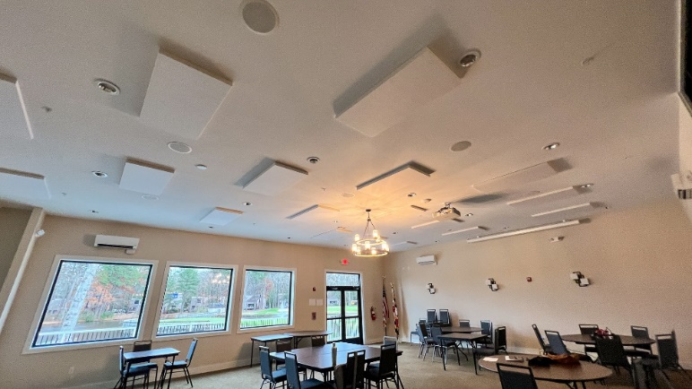
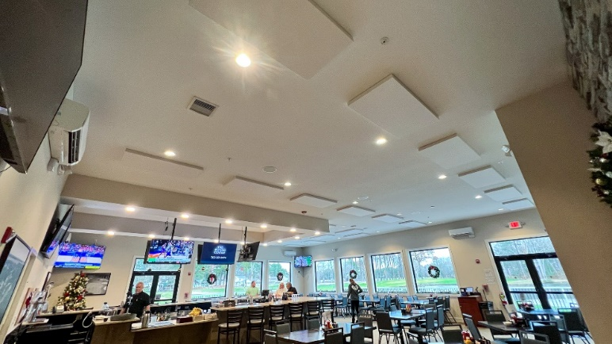
Acoustic Panels
Installation of acoustic panels to adjust noise to acceptable levels
Installed 30 panels in each room
The contractor was Mid South Audio, a preferred vendor who installed A/V systems at the Clubhouse, Yacht Club and Admin Building.
Cost:
  Clubhouse Bar & Grille: $12,273.20
  Community Room: $7,235.60
Golf Advisory Committee met on December 15th in room – positive comments received by GM

Slide 28
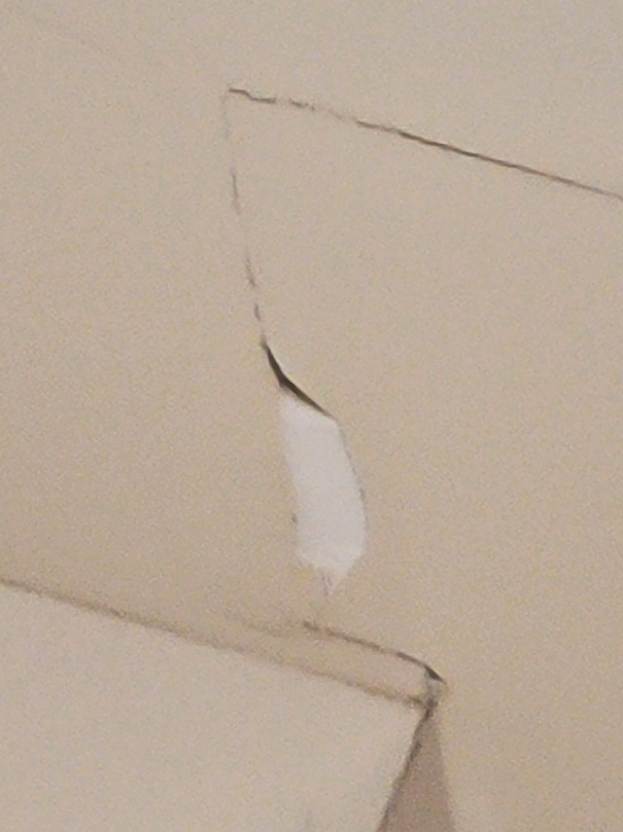
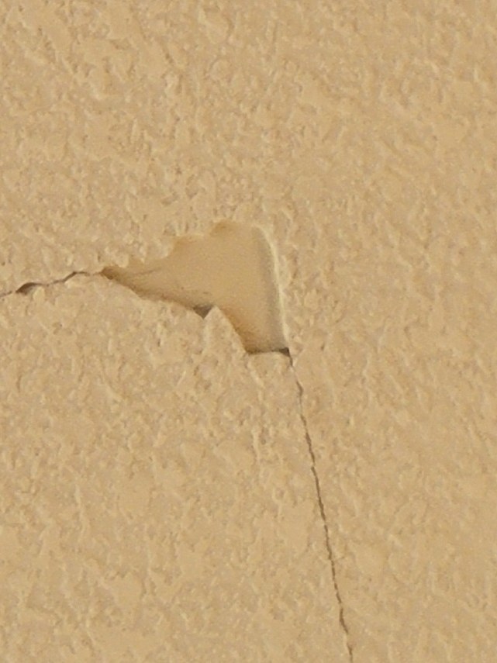
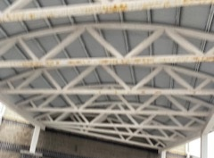
Yacht Club
(Deferred Maintenance)
Work to start in January
Total Cost: $10,800.00

Slide 29
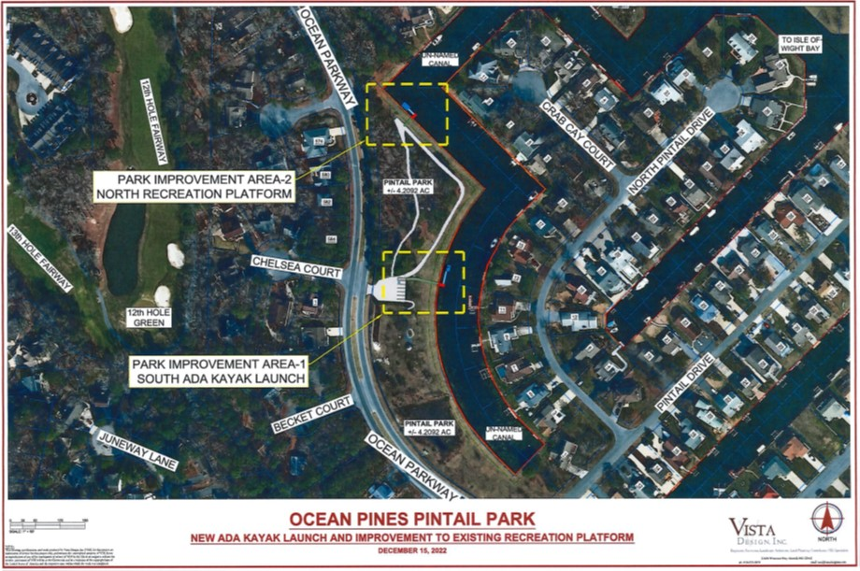
Kayak/Recreation Pier
Pintail Park chosen as location by the Recreation and Parks Advisory Committee
Approved from Feds, State, and County
Waiting for signature from Maryland Department of Environment (MDE)
Once signed County will release construction permit
Estimated Cost: $100,000

Slide 30
Kayak Pier

Slide 31
Recreation Pier / Parking Lot

Slide 32

Aquatics
New afternoon water fitness class
Class begins January 10th
Requested by Aquatics Committee and demand of members

Slide 33
Golf
December 10th – Santa’s Open
  Co-sponsored by Shorebirds Baseball and Big Brothers & Big Sisters
  32 teams registered
  Big Brothers & Big Sisters raise thousands of dollars with this event each year
Clean up underway
  Re-opening driving range shelter and teeing area
  Reorganizing other areas
  Sale of older merchandise to make room for next years products (currently ordering)

Slide 34
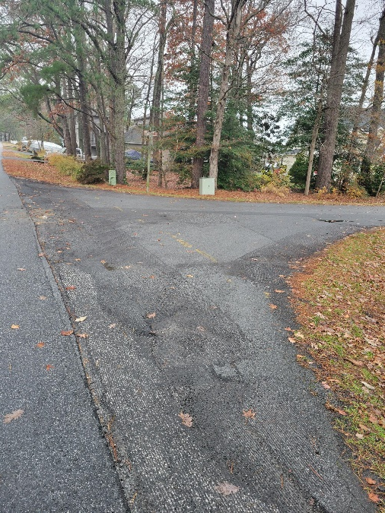
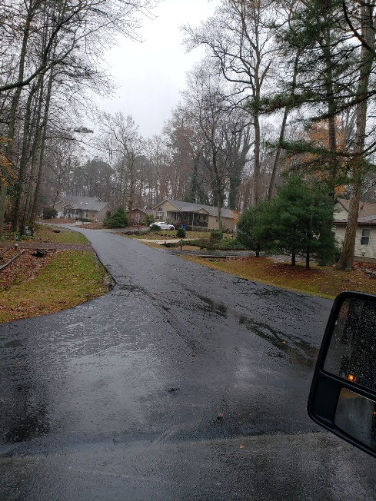
Roads
Barnacle Court
Beach Court
Birdnest Court
Fosse Grange
Garrett Drive
Ivanhoe
Liberty Bell Court
Little John Court
Moonshell Drive
Rabbit Run Lane
Surfers Way
Watergreen Lane
Willow Way
  3+ miles of roads
  Approved cost is $363,122.90

Slide 35

Ocean Pines Association Paperless Project
Rubex/eFileCabinet Document Management and Cloud Storage
Provides OPA staff with robust document management system (DMS)
Provides ability to index, share outside OPA, and create workflows
Moves file storage from local storage to cloud storage
Amazon Web Services (AWS) Backend provides redundancy and security
Vendor offering up to three-year contract term
Ocean Pines is going paperless!

Slide 36
DMA Reserves
Met with department heads to review next 5 years general replacement reserves
Evaluated proposed budget as well as 4 subsequent years
Were some reclasses between the years; will work with Finance on the 5-year B&F recommended and Board approved percentage of replacement
Highlight of adjustments:
  Golf irrigation replacement to begin next year (previously to begin in 2022)
  Golf cart originally due for replacement purchased in 2022
  Admin renovation originally in 2025 occurring now
  Marina dock and gas lines occurring now
To be reviewed with B & F during the budget review first week of January

Slide 37
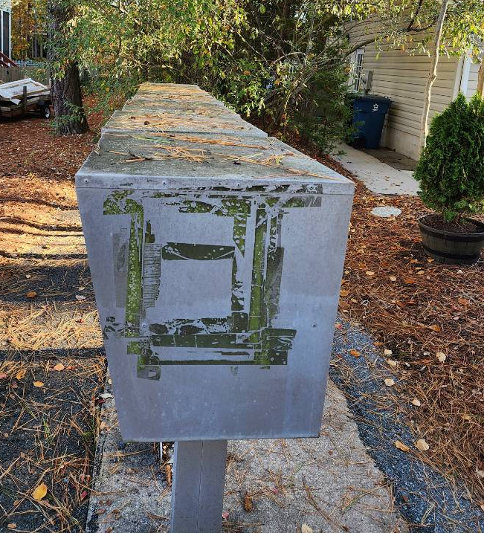
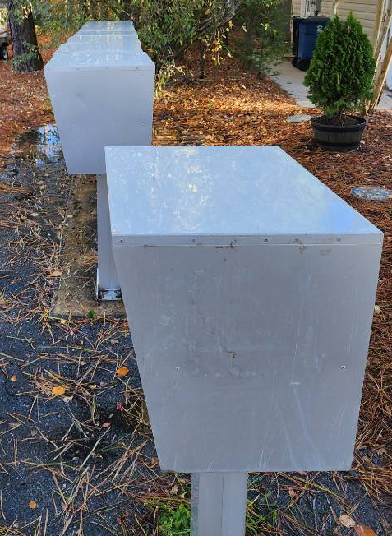
Mailboxes
Mailboxes
Mailbox replacement project began in July
  Replacement boxes and pedestals ordered through Salisbury Industries: $54,953.72
Still conferring with Postmaster to schedule installation of pedestals and mailboxes
Cleaning of mailboxes continue
  12 additional locations completed over the last month
ROAD | PEDESTALS | MAILBOXES
SECTION 1
Newport Drive | 1 | parcels (2)
Sandpiper Lane | 2
White Horse Park | 4
SECTION 2
Capetown Road |  | 4
White Horse Drive | 5
SECTION 3
Beaconhill Road | 2
Pinehurst Road | 4 | parcels (3)
SECTION 4
Lookout Point | 1 | parcel (1)
Sundial Circle | 2
Teal Circle | 1
Windward Court | 1
SECTION 5
Drawbridge Road | 1 | 3
SECTION 6
Abbyshire Road | 8 | 2
Sandyhook Road |  | 3
Seafarer Lane | 6
SECTION 9
Breezeway Lane | 2
Crest Haven Drive | 3
Offshore Lane | 4
Tail of the Fox Drive | 1
ROAD | PEDESTALS | MAILBOXES
SECTION 10
Camelot Circle | 5 | 3
Castle Drive | 2
King Richard Road | 2 | parcel (1)
Knight Terrace | 1
Royal Oaks Drive | 7 | parcel (1)
SECTION 11
Boston Drive |  | 1
Ocean Parkway/Boston | 5
Bridgewater Road | 1
SECTION 13
Brandywine Drive | 1
Cannon Drive | 2 | 1
Fairway Lane | 1
Hingham Lane | 2
SECTION 14A
Pintail Drive | 1
SECTION 14D
Ocean Parkway/Wood Duck | 7
SECTION 15A
Salt Grass Road | 1
SECTION 15B
Charleston Road | 1
SECTION 19
Shore Lane | 4 | parcel (1)
SECTION 30
Borderlinks | 1
BEFORE AFTER
 | PEDESTALS | MAILBOXES
Ordered | 92 | 17
Replaced as of Nov. 2022 | 36 | 5
Remaining | 56 | 12

Slide 38
CPI Violation Dashboard
November
Violations (includes legal)
As of 10/31/22 | New Violations | Closed Violations | As of 11/30/22
83 | 32 | 10 | 105
Legal Cases
As of 10/31/22 | New Violations to Legal | Closed Violations in Legal | As of 11/30/22
56 | 0 | 2 | 54

Slide 39
Work Orders
November
Open Work Orders as of 10/31/22 | New Work Orders | Closed Work Orders | Open Work Orders as of 11/30/22
79 | 57 | 67 | 69
57 work orders initiated in November: 6 bulkhead; 14 drainage; 7 grounds/landscaping; 2 roads; 2 signs; 26 general maintenance
Majority still open in drainage (44):
  Drainage (14 – over 30 days; 10 – over 60 days; 9 – over 90 days
    Average 1-4 work orders a day to complete depending upon severity

Slide 40
Customer Service Dashboard
(from info@oceanpines.org)
November
Type | # Received – Nov.
Amenities | 13
CPI | 9
Drainage | 0
General | 37
Public Works | 22
TOTAL | 81

Slide 41
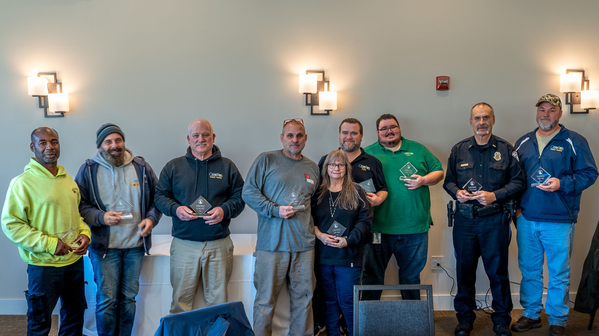
Annual Service Awards
During the holiday party on Friday, December 16th, the Association honored 11 employees for their combined 150 years of service. They are:
  Travis Brittingham – 5 years
  Kyle Dalton – 5 years
  Anthony Howard – 5 years
  Clarence Rounds – 5 years
  Billie Tragle – 5 years
  Matthew Wallace – 5 years
  Josh Vickers – 10 years
  Eddie Wells – 20 years
  Ruth Ann Meyer – 25 years
  Clint Parks – 25 Years
  Lt. Greg Schoepf – 40 years
Thank you all for your service to the Ocean Pines Association!

Slide 42
Financials

Slide 43
Financial Change
Month of November 2022
November (In 000’s)
 | Budget | Current Year | Favor/ (Unfavor) vs. Budget
Net Revenues | $281 | $336 | $55
Expenses | 1,045 | 986 | 59
Net Operating | ($764) | ($650) | $114

Slide 44
Financial Change
Year-to-Date November 2022
YTD November 2022 (In 000’s)
 | Budget | Current Year | Favor/ (Unfavor) vs. Budget
Net Revenues | $12,677 | $13,585 | $908
Expenses | 8,889 | 8,859 | 30
Net Operating | $3,788 | $4,726 | $938

Slide 45
Month of November
Favor/(Unfavorable) vs. Budget (in 000’s)
Department/Amenity | Favorable/(Unfavorable)
Public Works, Gen Maint, CPI | 52
Aquatics | 22
Yacht Club | 19
Police | 17
Golf Ops & Maintenance | 16
Recreation & Parks | 10
Racquet Sports | (14)
Other Net (Clubhouse Grille, Marinas, Beach Club, Beach Parking, Admin, Finance, GM Office, Marketing) | (8)
TOTAL | $114

Slide 46
Year-to-Date November
Favor/(Unfavorable) vs. Budget (in 000’s)
Department/Amenity | Favorable/(Unfavorable)
Golf Ops & Maintenance | 198
Public Works, Gen Maint, CPI | 165
Aquatics | 148
Yacht Club | 102
Beach Club | 88
Police | 72
Rec & Parks | 60
Marinas | 34
Racquet Sports | 29
Beach Parking | 23
Admin/GM Office/Finance/PR&Marketing | 19
TOTAL | $938

Slide 47
Unaudited Reserves November 2022 ($Millions)
 | General Replace | Bulkheads | Roads | Drainage | New Capital | Total
4/30/22 Balance | $4.8 | $0.5 | $0.0 | $0.7 | $0.1 | $6.1
Contributions/ Interest | 1.8 | 1.1 | 0.7 | - | 0.2 | 3.8
Casino Funds | - | - | 0.4 | 0.1 | - | 0.5
Transfer (Spend) | (0.7) | (0.3) | - | (0.6) | (0.2) | (1.8)
11/30/22 Balance | $5.9 | $1.3 | $1.1 | $0.2 | $0.1 | $8.6

Slide 48
Reserves Year-End Unaudited Estimate
(in ooo’s)
 | Beginning Balance |  |  | Unaudited EST Balance
 | 4/30/22 | Additions | Expenditures | 4/30/2023
Major Maintenance & Replacement:
Marina Fuel Lines/Pumps/C Deck |  |  | (500)
Police Vehicles |  |  | (165)
Golf Maint Mowers/Sprayer |  |  | (145)
Admin Building Renovation |  |  | (125)
Aquatics Furniture, Equipment |  |  | (100)
Public Works Utility Vehicle |  |  | (75)
North Gate Bridge |  |  | (75)
Court Renovations |  |  | (75)
Other |  |  | (100)
Total | 4,769 | 1,925 | (1,360) | 5,334
Bulkheads & Waterways | 536 | 1,084 | (1,253) | 367
Roads | 5 | 1,055 | (365) | 695
Drainage | 687 | 120 | (580) | 227
New Capital | 150 | 215 | (335) | 30
TOTAL 4/30/23 ESTIMATE | 6,147 | 4,395 | (3,796) | 6,746

Slide 49
Treasurer’s Report
Monica Rakowski

Slide 50

Cash & Short-Term Investments
Activity for Month of November
As of November 30, 2022, the Association had approx. ~ $16.0M in cash
  Cash increased ~ $1.2M from the same time period last year
  Cash decreased ~($0.7M) from October 2022
  $11.1M invested in CDAR’s
  Remaining $4.9M in Insured Cash Sweep, Money Market and Other Operating Accounts
Note: With Interest Rates continuing to increase in the marketplace, there will be an upward trend of interest income realized within the Reserve Accounts in the coming months

Slide 51

Public Comments
Members wishing to make comments must state their name and address.

Slide 52
Capital Requests

Slide 53
Capital Requests
Finance –
Document Management Software (DMS)
Requesting authorization to go forward with staff recommendation of $9,448.65 (1st year) and $6,999.00 (2nd and 3rd year) for Rubex/eFileCabinet

Slide 54
Capital Requests
Public Works –
2023 Bulkhead Replacement
Requesting authorization to go forward with staff recommendation of $977,500.00 for Fisher Marine

Slide 55
CPI Violations
None

Slide 56
Unfinished Business
None

Slide 57
New Business
First reading of revisions to Resolution C-14 (Racquet Sports Advisory Committee) – Colette Horn
Elections Committee Update – Rick Farr

Slide 58
Appointments
Karen Baldwin – 1st Term – Environmental & Natural Assets Committee
Pam McGregor – 1st Term – Recreation & Parks Committee

Slide 59
Adjournment

