Slide 1

Board of Directors Meeting
February 17, 2024

Slide 2
Approval of Agenda

Slide 3
Approval of Minutes
January 20, 2024 – Regular Meeting

Slide 4

President’s Remarks
Rick Farr

Slide 5
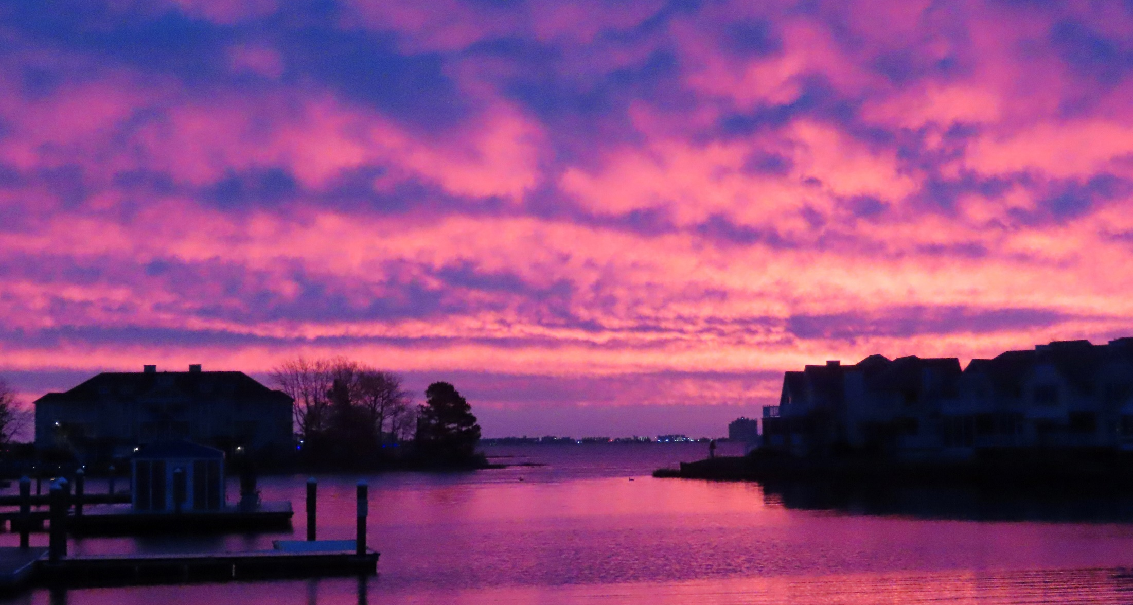
GM Leadership Report –
John Viola
Photo by Bob McKinley

Slide 6
Initiatives
  Safety
    Painted Crosswalks
  Racquet Sports
    Prototype Fence
  Maintenance
    Bridge
    Ditches
    Yacht Club
    Beach Club
    Community Center
    Sports Core
  Projects
    Tiki Bar
    Racquet Sports Building
    Pavilion at Veteran’s Memorial
  Bulkhead Replacement
  Electronic Sign
  Signs
  Metrics

Slide 7
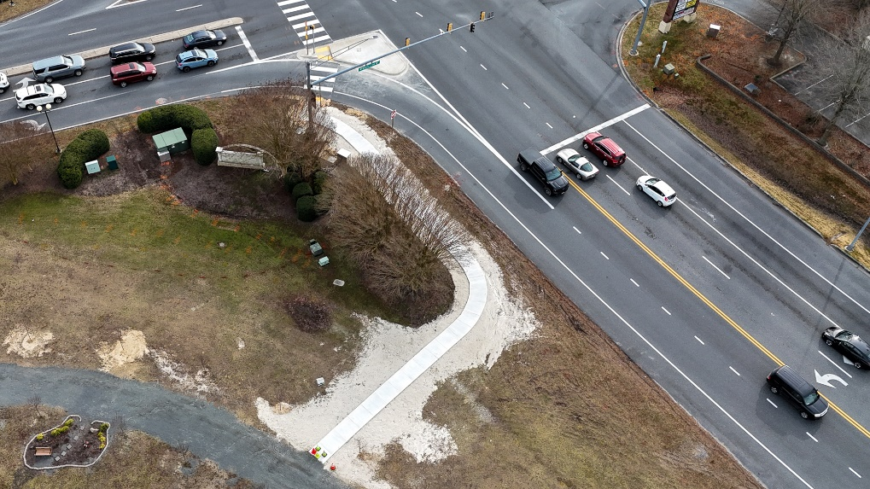
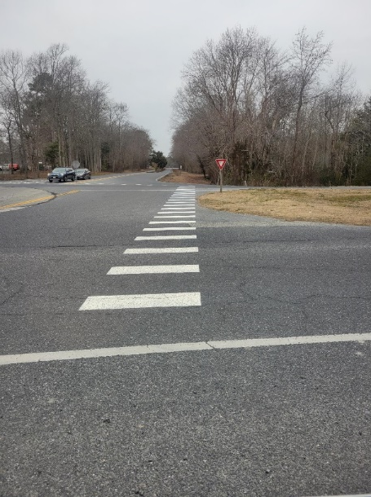
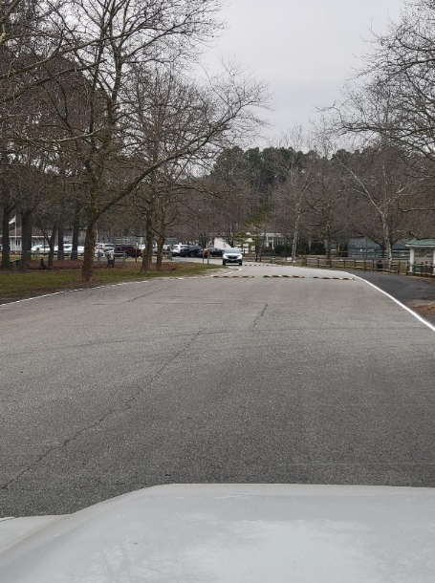
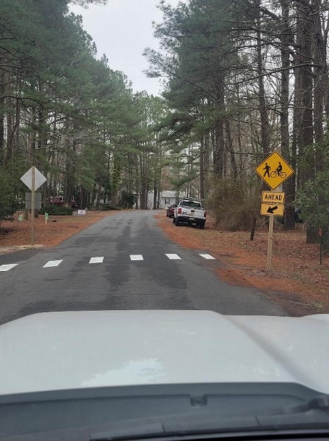
Safety
New Crosswalks and painted edge of road for Safety
Cathell and Ocean Parkway Cross walk
Manklin Racquet center White lines
Camelot Walking trail Crosswalk

Slide 8
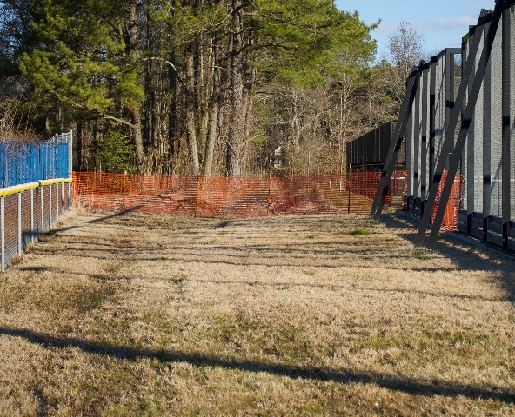
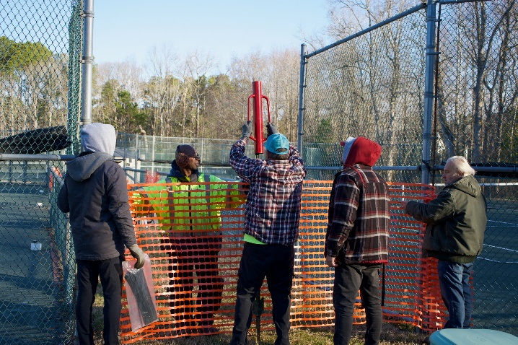
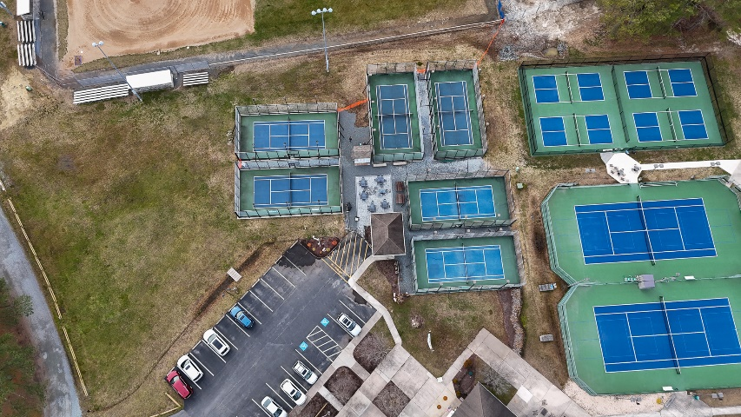
Racquet Sports
Staffing:
  Ruth Ann Meyer will manage the front desk/pro shop
  Nobie Violante to manage the maintenance of the facility
  Debbie Donahue will continue to manage tournaments as she has done in the past
  We will have instructors in place for lessons (under Terry Underkoffer)
Fencing:
  Prototype fence was installed to prevent trespassers from entering along the fence line by the Manklin Creek baseball field to the Pickleball Courts – we will evaluate
  Team will present fencing option to RSAC for feedback
  Estimated cost: $17,000-$22,000

Slide 9
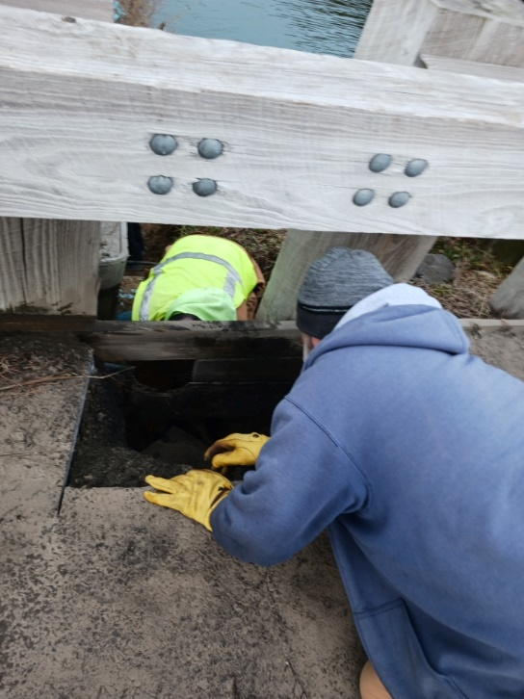
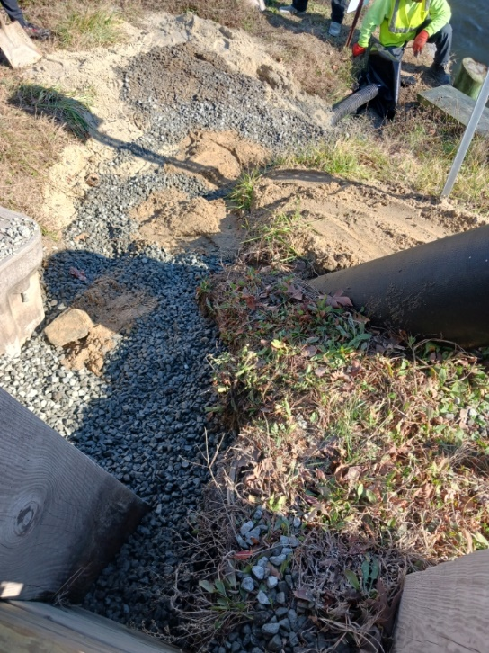
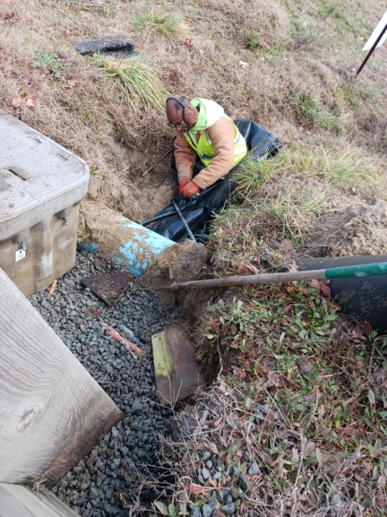
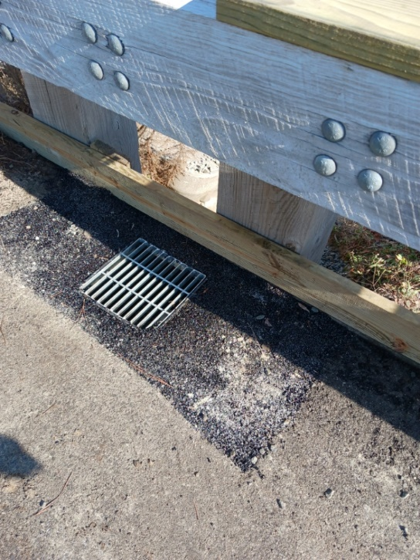
Bridge Maintenance
Addressed drainage issue on Ocean Parkway bridge (erosion)
  Done in-house by Public Works
  Work completed January 26th

Slide 10
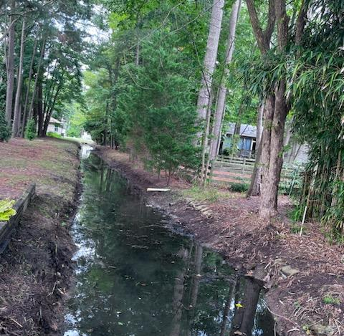
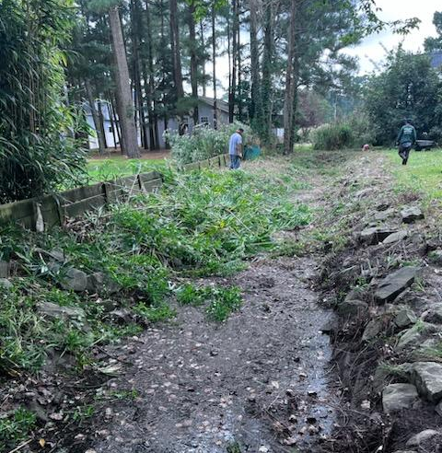
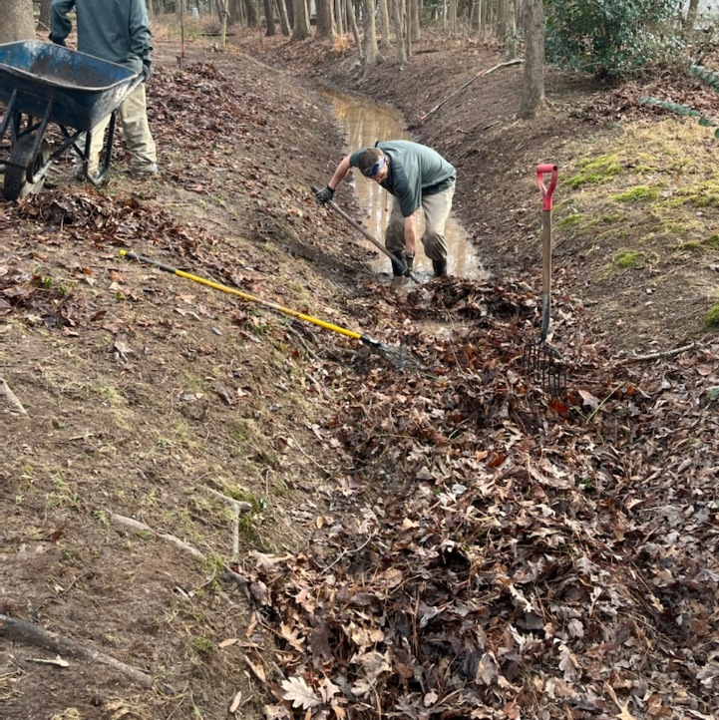
Ditch Maintenance
35 sections of “ditches” cleaned fiscal 2023/2024
Outside contractors - $102,210.00

Slide 11
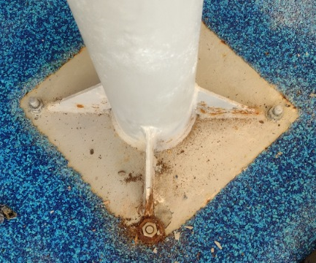
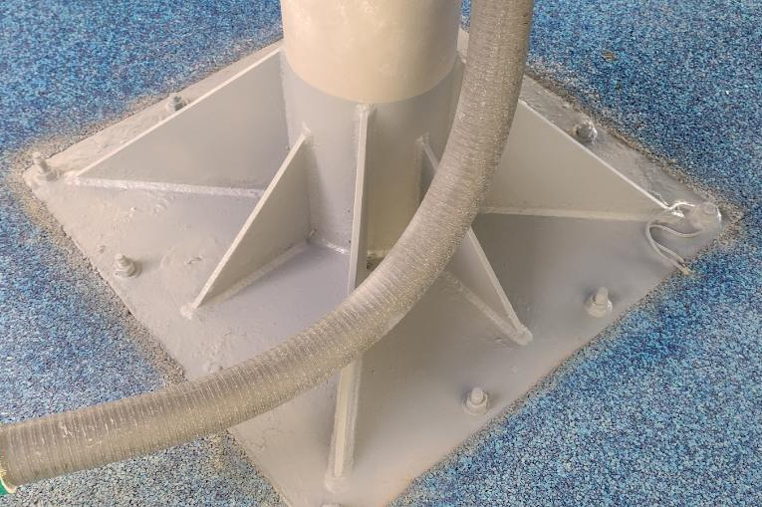
Maintenance
Yacht Club (see addendum)
  Completed “punch list” provided by Matt Ortt Company (17 items – 14 in house; 3 outside contractors)
Beach Club
  Refinished bar top (in house)
  Repaired tile behind bar in snack area (in house)
Community Center
  Filled in gaps in gym floor (in house)
  Marlin/Foultz Floor – to be redone 2/26
  Restrooms – new countertops; stall doors sanded and painted (in house)
  Hallway indoor restrooms and kitchen – outside cleaning company)
  Next steps – Public Works to address White Horse Park maintenance
Parks
  Additional kayak racks installed at Pintail Park
Pools
  Reported by Aquatics Advisory Committee Chair of potential safety hazard at pool slide – Public Works immediately addressed the issue

Slide 12
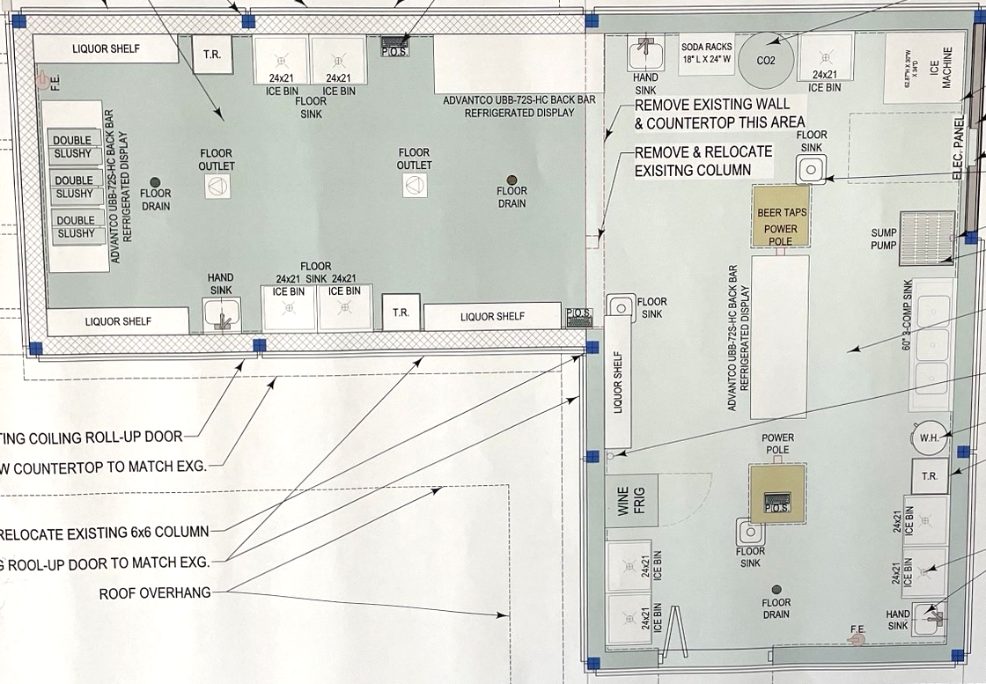
Tiki Bar
Tiki bar emptied in preparation of construction
Public Works running conduit for new electrical service for the tiki bar extension
Choptank to install new transformer
County reviewing plans, with permit to be submitted after plan review

Slide 13
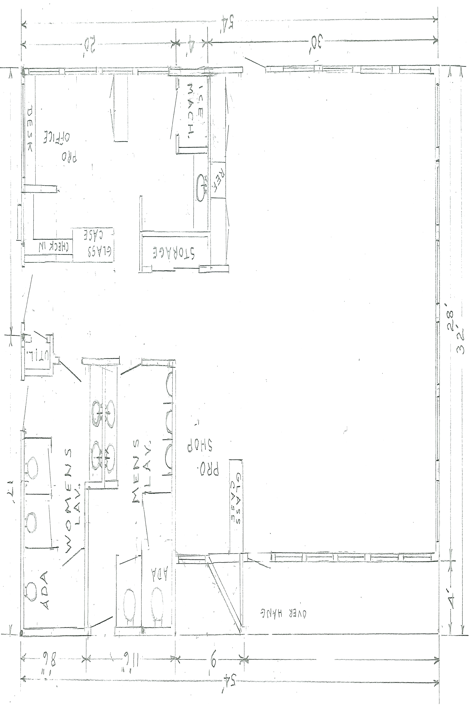
Racquet Sports Building
Vista preparing sketches
Will meet with contractor once completed

Slide 14
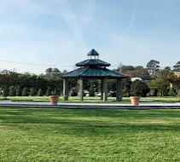
Pavilion at Veterans Memorial
GM and Team met with Whayland (contractor) on January 30th on design options
Next steps: permit and build
Scheduled to be completed by May 10th

Slide 15
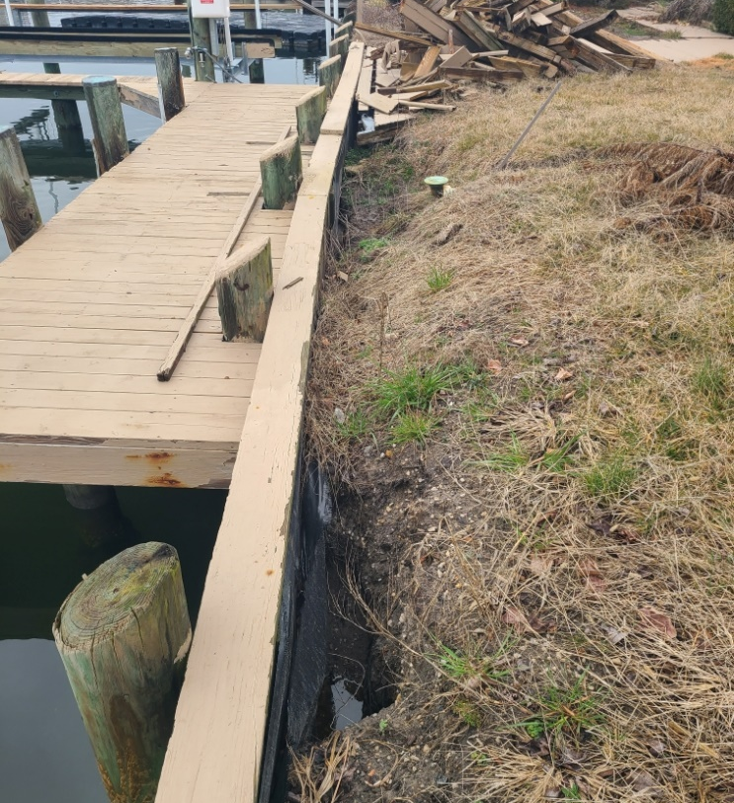
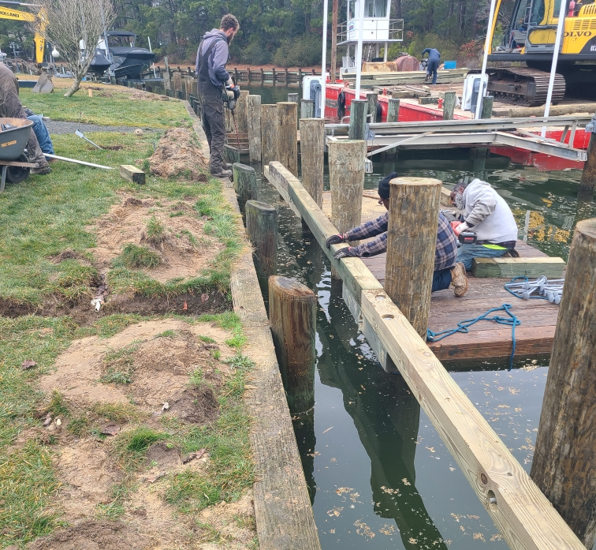
Bulkhead Replacement
Fisher Marine finishing up on 2023-2024 Bulkhead Replacement
Emergency bulkhead replacement at 35 & 82 Wood Duck

Slide 16
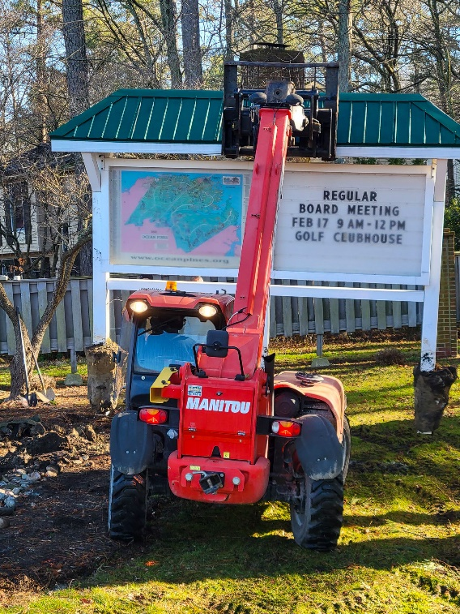
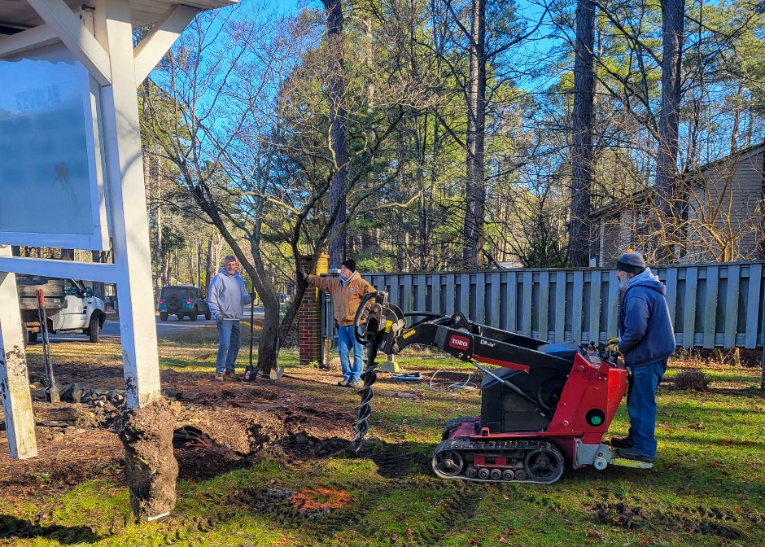
Electronic Sign
Public Works moved the sign about six feet to satisfy permitting requirements
Photos of the new location were sent to the county for final approval
Once permitting is completed, the vendor estimates 4-6 weeks to have the sign installed

Slide 17
Signs
GM forming work group to create a standard for signage on OPA-owned property
Current signage to be evaluated for mandate/policy on signs, possible replacement of signs, and if permits would be needed
Recommendations to be presented to the Board

Slide 18
ADDENDUM
Ditch Maintenance

Slide 19
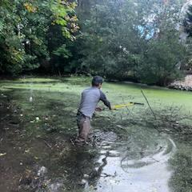
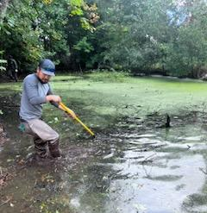
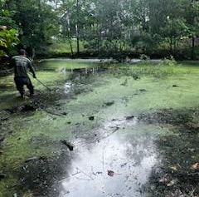
Stormwater pond cleaned out

Slide 20
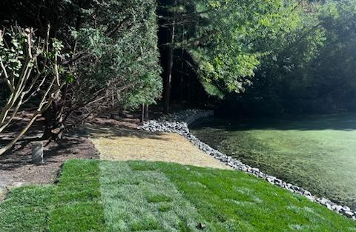
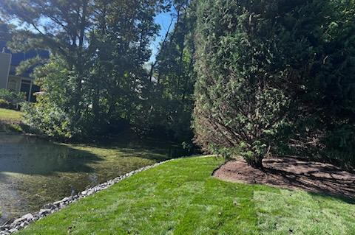
Storm Water pond
Stormwater Pond

Slide 21
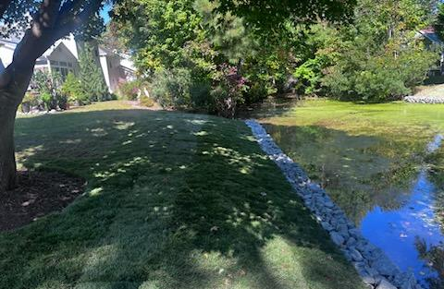
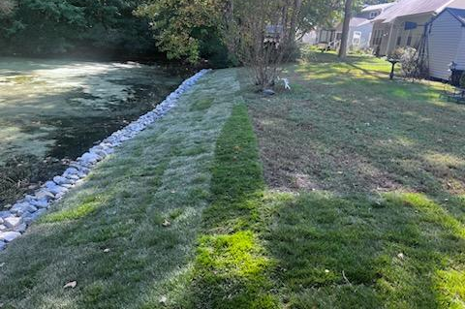
Storm Water pond
Stormwater Pond

Slide 22
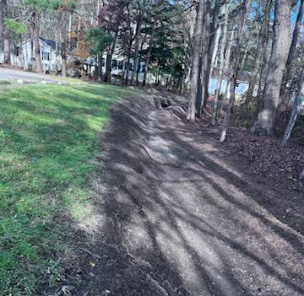
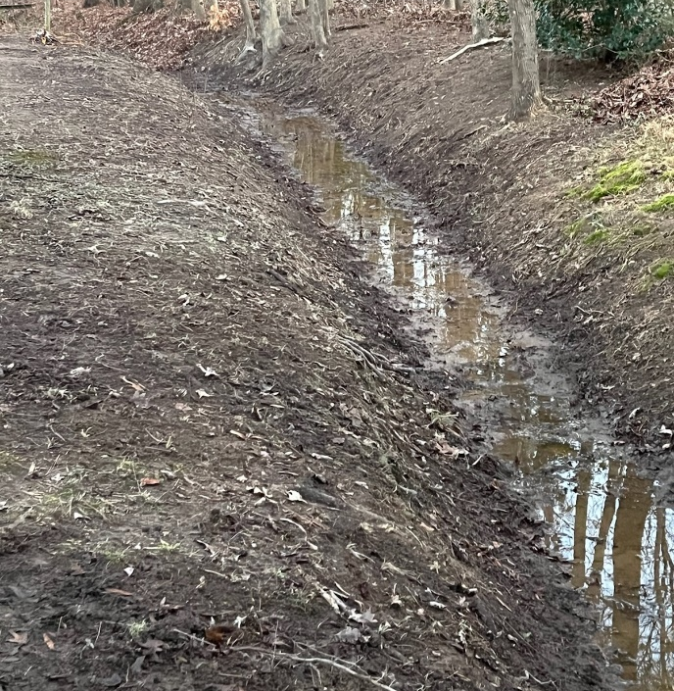
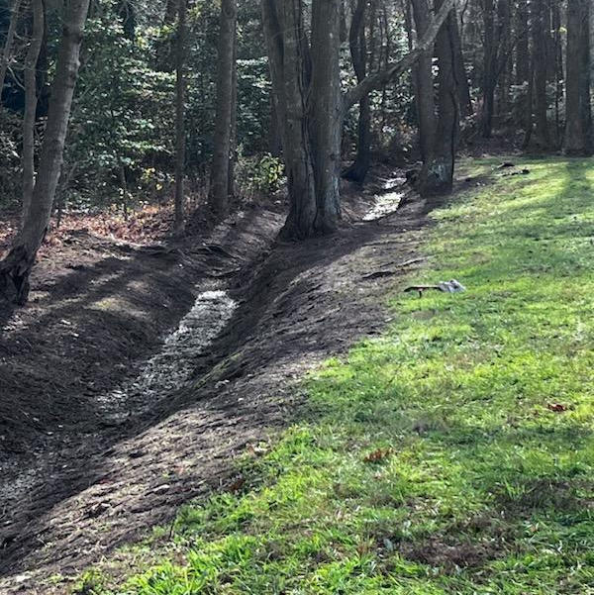
Ditches
Ditches

Slide 23
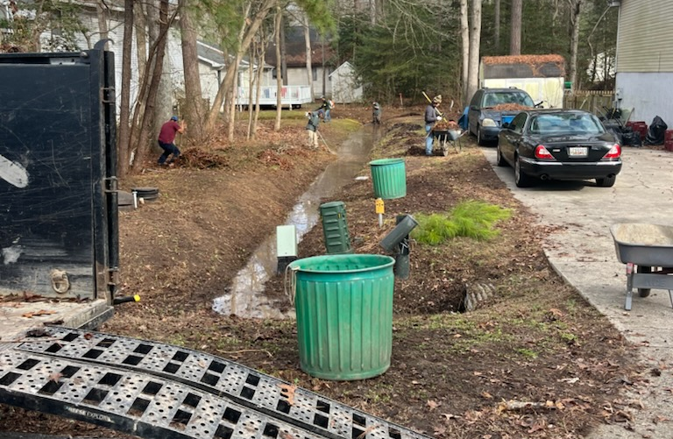
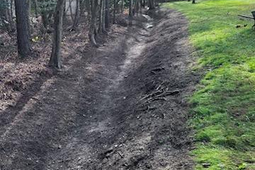
Ditches

Slide 24
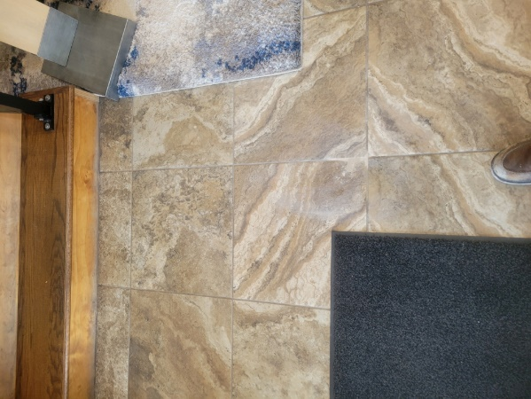
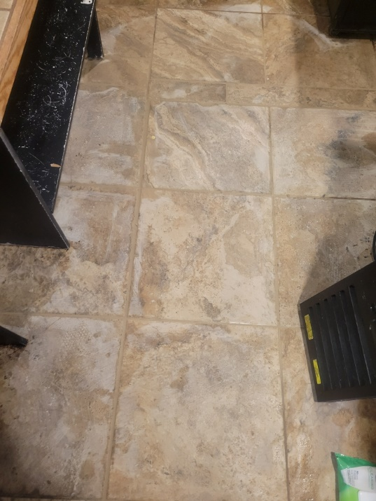
ADDENDUM
Yacht Club Maintenance
Painting Dining area and remainer of downstairs not completed this fall. Contractor 2/12
Replaced Tile by loading dock hallway Completed in-house
Replaced floor and tiles in upstairs storage room Completed in-house
Repaired cracks in drywall in stairwells in the lobby Completed in-house
Repaired grout throughout the dinning area Completed in-house
Replaced signs on bride and groom suite to gender neutral signs. Completed in-house
Touch up paint in bridal and ball room Contractor 2/12
Professionally had all flooring cleaned except kitchen Completed by contractor
Had ventilation and filters cleaned Completed in-house
Repaired flooring in Cove lounge behind bar. Completed in-house
Repaired rotten wall section in loading dock. Completed in-house
Removed broken tiles and repaired by kitchen floor drain. Completed in-house
Replaced all the ceiling tiles in foyer and all stained throughout the building. To be completed
Minin Splits have been cleaned and serviced Completed by Public Works and contractor
All ice makers filters have been changed. Completed in-house
Fire Sprinklers have been inspected and checked Contractor 2/12
Fire Marshall is scheduled for annual inspection. Within the next week or two

Slide 25
CPI Violation Dashboard
January
Violations
As of 12/31/23 | New Violations | Closed Violations | As of 1/1/24
140 | 93 | 97 | 140
93 violations initiated in January: 10 maintenance/trash/debris; 29 leaf placement; 19 no permit; 35 miscellaneous
  Miscellaneous violations includes signs, stop work orders, trailers, unregistered/junk vehicles, and vehicle parking
97 violations complied out; 140 remain open
  37 maintenance/trash/debris; 16 leaf placement; 35 no permit; 52 miscellaneous

Slide 26
Work Orders
January
Open Work Orders as of 12/31/23 | New Work Orders | Closed Work Orders | Open Work Orders as of 1/31/24
125 | 98 | 106 | 117
98 work orders initiated in January: 4 bulkhead; 40 drainage; 17 grounds/landscaping; 6 roads; 3 signs; 28 general maintenance
Majority still open in drainage (69):
  23 – over 30 days; 12 – over 60 days
    Average 1-4 work orders a day to complete depending upon severity

Slide 27
Customer Service Dashboard
(from info@oceanpines.org)
January
Type | # Received – Jan.
Amenities | 29
CPI | 11
Drainage | 1
General | 49
Public Works | 19
TOTAL | 109

Slide 28
Financials

Slide 29
“FLASH” UNAUDITED
MONTH OF JANUARY 2024
January (In 000’s)
 | Budget | Current Year | Favor/ (Unfavor) vs. Budget
Net Revenues | $167 | $179 | $12
Expenses | 957 | 943 | 14
Net Operating | ($790) | ($764) | $26

Slide 30
“FLASH” UNAUDITED MONTH OF JANUARY
FAVOR/(UNFAVORABLE) VS. BUDGET (IN 000’s)
Department/Amenity | Favorable/(Unfavorable)
Police | 36
Golf Ops + Maintenance | 16
Public Works/CPI/Gen Maintenance | (29)
Yacht Club | (6)
Other Net (Administration, Clubhouse Grille, Beach Club, Parking, Aquatics, Rec & Parks, Racquet Sports, Marinas) | 9
TOTAL | $26

Slide 31
UNAUDITED RESERVES JANUARY 2024 ($ MILLIONS)
 | GeneralReplace | Bulkheads | Roads | Drainage | New Capital | Total
4/30/23 Balance | $5.1 | $0.5 | $0.7 | $0.2 | $0.1 | $6.6
Contributions/ Interest | 2.1 | 1.1 | - | 0.1 | 0.1 | 3.4
Casino Funds | - | - | 0.4 | 0.1 | - | 0.5
Transfer (Spend) | (1.0) | (0.9) | - | - | (0.1) | (2.0)
1/31/24 Balance | $6.2 | $0.7 | $1.1 | $0.4 | $0.1 | $8.5

Slide 32

Treasurer’s Report -
Monica Rakowski

Slide 33

Cash & Short-Term Investments
Month of January
As of January 31, 2023, the Association had Approximately (~) $14.9M in Cash
  Cash Increased ~ $1.0M from the Same Time Period Last Year
  Cash Decreased ~ ($0.8)M from December 2023
  $10.4M Invested in CDAR’s
  $53K in Interest Income Recognized for the Month
  Remaining $4.5M in Insured Cash Sweep, Treasury Bills, Money Market and Other Operating Accounts (Diversified Between 2 Local Banks)

Slide 34


Public Comments
Members wishing to make comments must state their name and address

Slide 35
CPI Violations
26 Carriage Lane
147 Teal Circle
268 Windjammer Road
79 Crest Haven Drive
48 King Richard Road
298 Ocean Parkway
75 Ocean Parkway
29 Boston Drive

Slide 36
New Business
Motion to approve the FY 2024-2025 Fiscal Budget – Monica Rakowski
First Reading of revisions to Resolution B-08 (Director Ethics and Conduct) – Steve Jacobs
Corporate Resolutions to change the resident agent and signees on liquor licenses for Ocean Pines – Rick Farr

Slide 37
Appointments
Don Bonafede – 2nd Term – Budget & Finance
John Cacchio – 1st Term – Marine Activities
Connie Corbett – 1st Term – Communications
Cindy Hoffman – 1st Term – Communications
Camilla Rogers – 1st Term – Bylaws & Resolutions

Slide 38
Adjournment

