Slide 1

Board of Directors Meeting
February 18, 2023

Slide 2
Approval of Agenda

Slide 3
Approval of Minutes
January 21, 2023 – Regular Meeting
February 7, 2023 – Special Meeting

Slide 4


President’s Remarks
Doug Parks

Slide 5
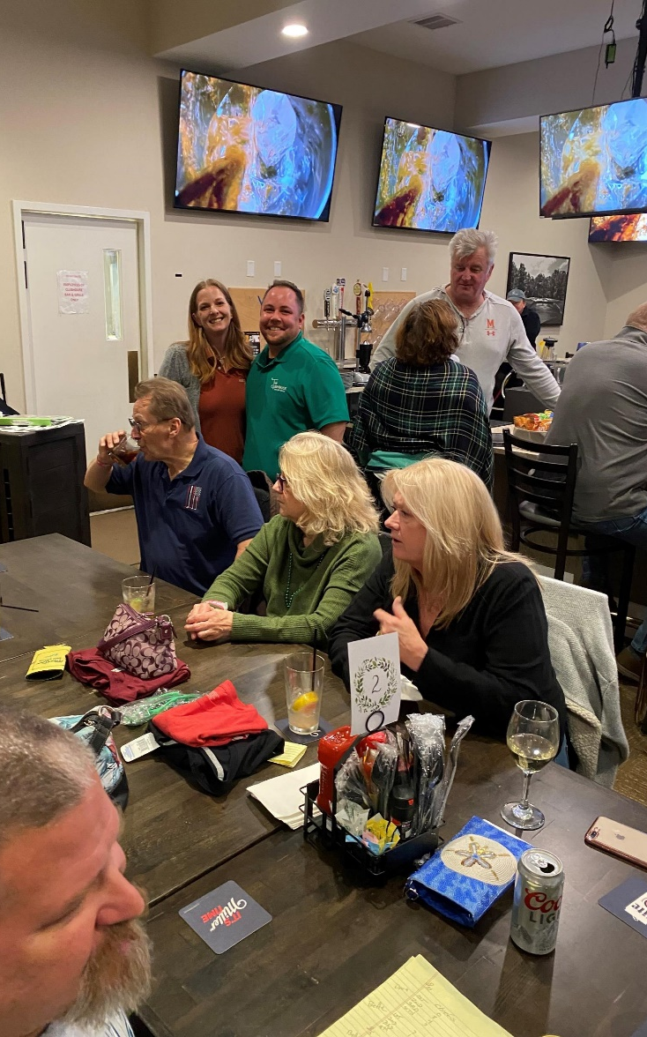
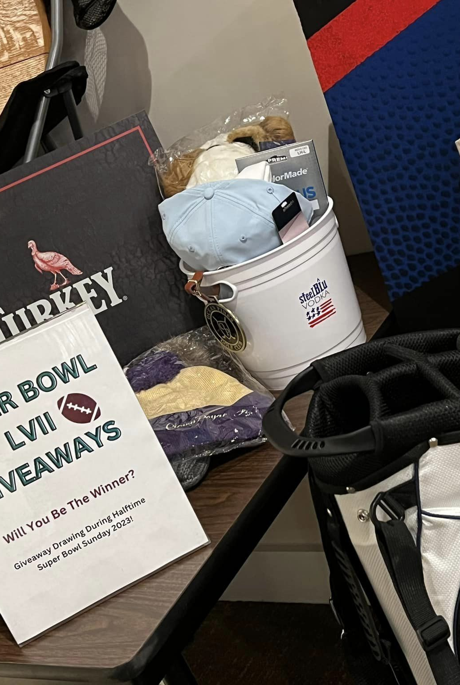
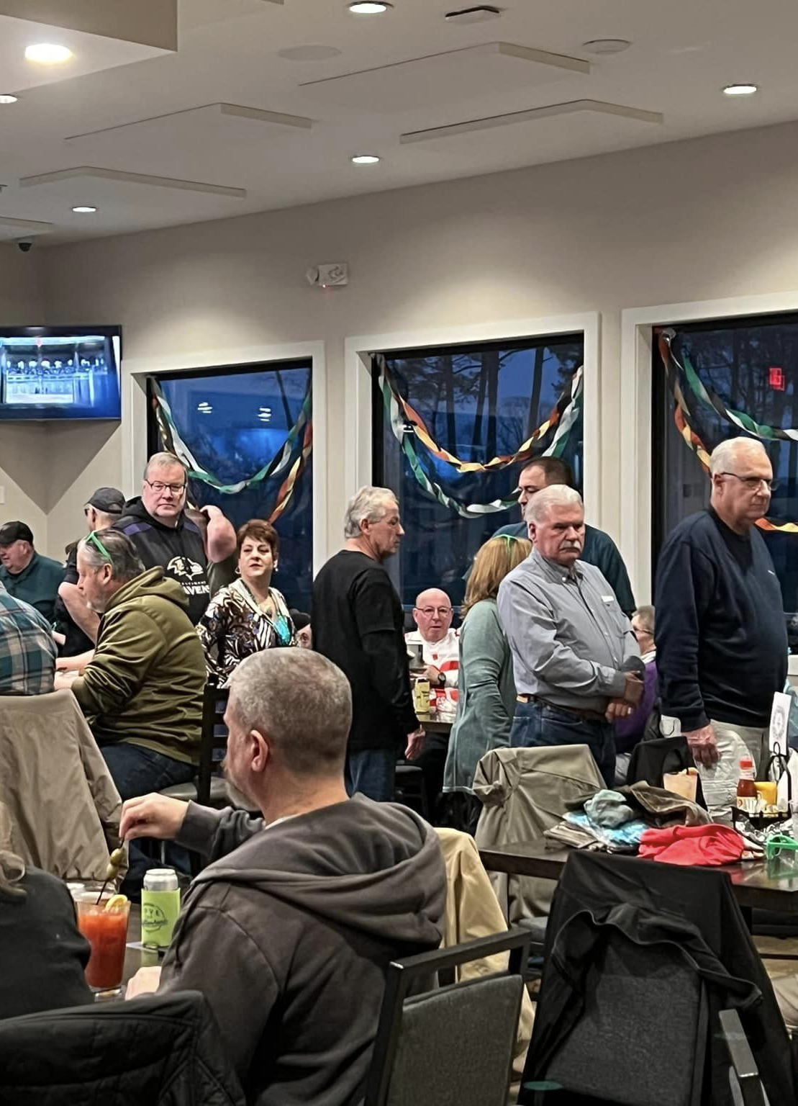
GM Leadership Report –
John Viola

Slide 6
Initiatives
Yacht Club Maintenance
Golf Academy
Basketball Court Lights
Admin Renovation
Metrics
What Are We Doing To Fill Positions?
Headwinds and Tailwinds

Slide 7
Proposed FY 2023-2024
Headwinds
  Safety – Fire, EMS, Police
  Inflation
  Minimum wage
  Mark to Market
  Labor pool
  Insurance premiums
Tailwinds
  Improved performance in amenities and departments

Slide 8
What Are We Doing To Fill Positions?
Public Works, Racquet Sports, Aquatics, and Police Department are posted on Indeed, and the State of Maryland.
Police have had 5 inquiries. They have 6 openings.
Racquet Sports Manager has had 5 inquiries and are currently conducting interviews.
Aquatics has hired 2 new lifeguards. An additional person is in the background/drug testing phase. Currently we have 1 full time and 17 part time lifeguards. Need 40 lifeguards for summer, 10 front desk and 4 bathroom attendants.
Public Works has 3 openings. They have had 32 inquiries,1 new employee and 1 in background/drug testing phase.
All online inquiries are sent an email via HR requesting that they complete the online application at www.oceanpines.org. As applications arrive, they are forwarded to the hiring manager for review of skills.
Ocean Pines Job Fair is scheduled for March 11 from 9am – 12pm

Slide 9
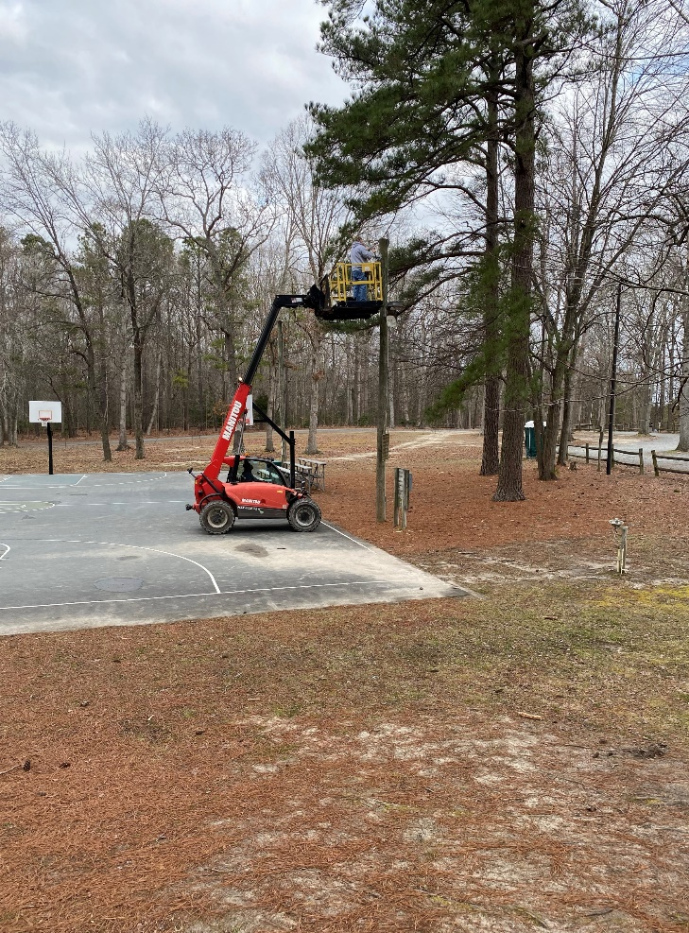
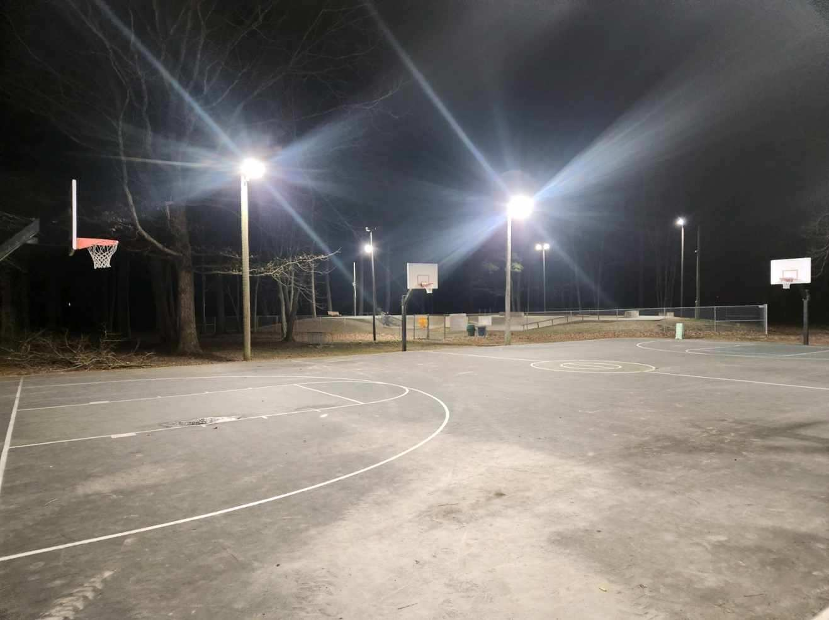
Basketball Court
4 lights have been replaced with LED bulbs.
Cost was $1,859.00 for lights and brackets.

Slide 10
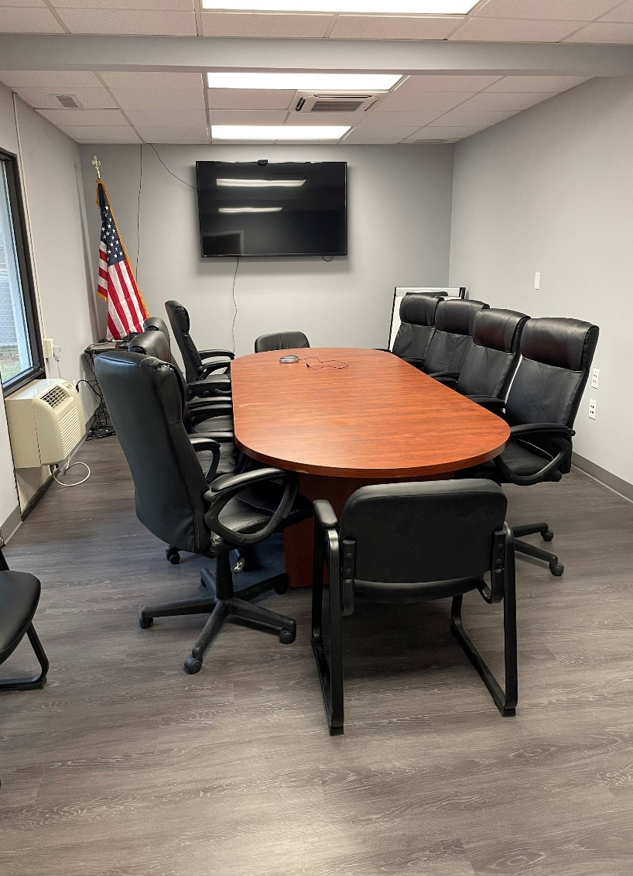
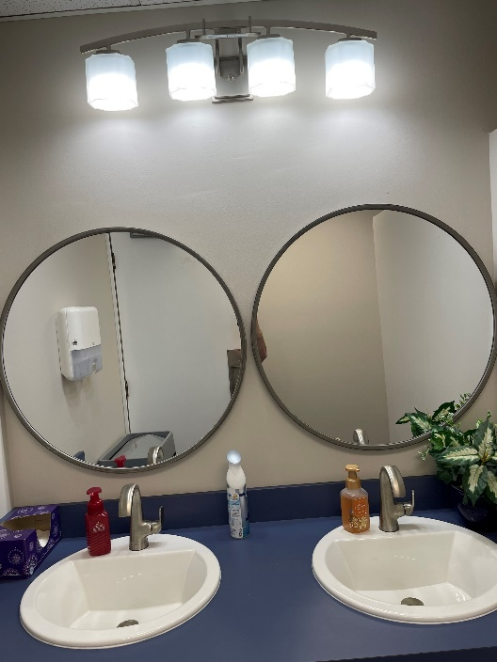
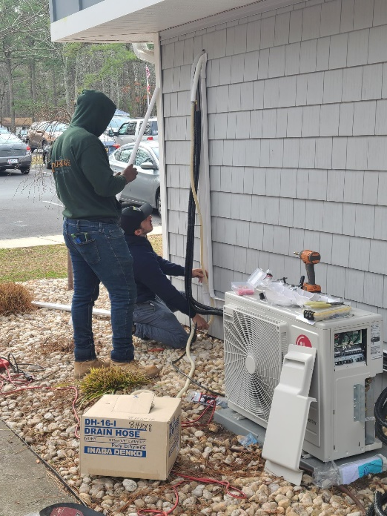
Administration Building Renovation
Outside Preferred Vendors
  HVAC & Plumbing
  Design, Painting, Restrooms
  Floors
Public Works – Maintenance Team

Slide 11
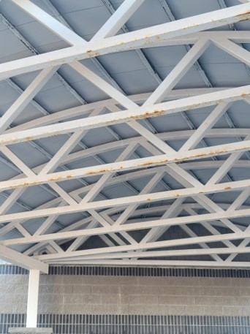
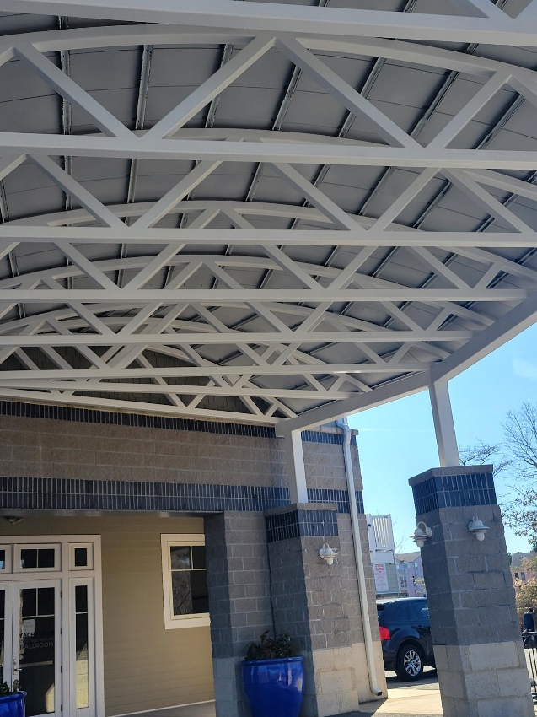
Yacht Club Maintenance
Before
After
Outside Contractors
  Overhang was sanded, primed and painted
  Cost $3,100
  Completed about two weeks ago.
  The ceiling has been completed in the ball room as well. It had all the lose plaster cut out, patched and sanded. Then the whole ceiling was painted.

Slide 12

Golf Academy
Homegrown talent to lead new Golf Academy at Ocean Pines
New Golf Pro, Matt Ruggeire, PGA
Starting March 7, 2023
Offering Private & Group Instruction
Ruggieregolf.com

Slide 13
CPI Violation Dashboard
January
Violations (includes legal)
As of 12/31/22 | New Violations | Closed Violations | As of 1/31/23
128 | 27 | 26 | 129
Legal Cases
As of 12/31/22 | New Violations to Legal | Closed Violations in Legal | As of 1/31/23
62 | 0 | 5 | 57
27 violations initiated in January; 26 complied out; 129 remain open (includes the 57 violations in legal)
Legal violations:
  7 of the 57 violations in legal (from 2019) will be heard in court on March 15, 2023

Slide 14
Work Orders
January
Open Work Orders as of 12/31/22 | New Work Orders | Closed Work Orders | Open Work Orders as of 1/31/23
54 | 71 | 52 | 73
71 work orders initiated in January: 3 bulkhead; 27 drainage; 8 grounds/landscaping; 9 roads; 2 signs; 22 general maintenance
Majority still open in drainage (50):
  8 – over 30 days; 10 – over 60 days; 13 – over 90 days
    Average 1-4 work orders a day to complete depending upon severity

Slide 15
Customer Service Dashboard
(from info@oceanpines.org)
January
Type | # Received – Jan.
Amenities | 28
CPI | 17
Drainage | 0
General | 48
Public Works | 16
TOTAL | 109

Slide 16
Financials

Slide 17
Financial Change
Month of January 2023
January (In 000’s)
 | Budget | Current Year | Favor/ (Unfavor) vs. Budget
Net Revenues | $159 | $177 | $18
Expenses | 897 | 872 | 25
Net Operating | ($738) | ($695) | $43

Slide 18
Financial Change
Year-to-Date January 2023
YTD January 2023 (In 000’s)
 | Budget | Current Year | Favor/ (Unfavor) vs. Budget
Net Revenues | $13,076 | $14,023 | $947
Expenses | 10,791 | 10,659 | 132
Net Operating | $2,285 | $3,364 | $1,079

Slide 19
Month of January
Favor/(Unfavorable) vs. Budget (in 000’s)
Department/Amenity | Favorable/ (Unfavorable)
Public Works, Gen Maint, CPI | 17
Administration | 14
Recreation & Parks | 11
Public Relations/Marketing | 9
Police | 7
Golf Ops & Maintenance | 6
Clubhouse Grille | (8)
Yacht Club | (7)
Other Net (Racquet Sports, Marinas, Beach Club, Beach Parking, Finance, GM Office) | (6)
TOTAL | $43

Slide 20
Year-to-Date January
Favor/(Unfavorable) vs. Budget (in 000’s)
Department/Amenity | Favorable/(Unfavorable)
Public Works, Gen Maint, CPI | 241
Golf Ops & Maintenance | 209
Aquatics | 138
Police | 98
Rec & Parks | 96
Yacht Club | 92
Beach Club | 88
Marinas | 35
Racquet Sports | 34
Beach Parking | 23
Finance | 18
Other Net (Admin, GM Office, PR/Marketing, Clubhouse Grille) | 7
TOTAL | $1,036

Slide 21
Unaudited Reserves January 2023 ($ Millions)
 | GeneralReplace | Bulkheads | Roads | Drainage | New Capital | Total
4/30/22 Balance | $4.8 | $0.5 | $0.0 | $0.7 | $0.1 | $6.1
Contributions/ Interest | 1.9 | 1.1 | 0.7 | - | 0.2 | 3.9
Casino Funds | - | - | 0.3 | 0.1 | - | 0.4
Transfer (Spend) | (0.9) | (0.6) | (0.2) | (0.6) | (0.2) | (2.5)
1/31/23 Balance | $5.8 | $1.0 | $0.8 | $0.2 | $0.1 | $7.9

Slide 22
Reserves Year-End Unaudited Estimate
(in ooo’s)
 | Beginning Balance |  |  | Unaudited EST Balance
 | 4/30/22 | Additions | Expenditures | 4/30/2023
Major Maintenance & Replacement:
Marina Fuel Lines/Pumps/C Deck |  |  | (500)
Police Vehicles |  |  | (165)
Golf Maint Mowers/Sprayer |  |  | (145)
Admin Building Renovation |  |  | (125)
Aquatics Furniture, Equipment |  |  | (100)
Public Works Utility Vehicle |  |  | (75)
North Gate Bridge |  |  | (75)
Court Renovations |  |  | (75)
Other |  |  | (100)
Total | 4,769 | 1,925 | (1,360) | 5,334
Bulkheads & Waterways | 536 | 1,084 | (1,253) | 367
Roads | 5 | 1,055 | (365) | 695
Drainage | 687 | 120 | (610) | 197
New Capital | 150 | 215 | (335) | 30
TOTAL 4/30/23 ESTIMATE | 6,147 | 4,399 | (3,923) | 6,623

Slide 23
Treasurer’s Report
Monica Rakowski

Slide 24

Cash & Short-Term Investments
Activity for Month of January
As of January 31, 2023, the Association had approx. ~ $13.9M in cash
  Cash increased ~ $0.9M from the same time period last year
  Cash decreased ~($1.2M) from December 2022
  $11.1M invested in CDAR’s
  Remaining $2.8M in Insured Cash Sweep, Money Market and Other Operating Accounts
Note: With Interest Rates continuing to increase in the marketplace, there will continue to be an upward trend of interest income realized within the Reserve Accounts in the coming months

Slide 25

Public Comments
Members wishing to make comments must state their name and address.

Slide 26
Capital Requests

Slide 27
Capital Requests
Public Works – Swim & Racquet Pool Roof Replacement
Racquet Sports – Resurfacing of Har Tru Courts

Slide 28
Capital Requests
Public Works – Swim & Racquet Pool Clubhouse, Pool House & Gazebo (Roof Replacement)
Requesting authorization to go forward with staff recommendation of $29,200.00 for roofing.

Slide 29
Capital Requests
Racquet Sports – Resurfacing 8 Har Tru Tennis Courts
Requesting authorization to go forward with staff recommendation of $19,580.00 for resurfacing courts.

Slide 30
CPI Violations
None

Slide 31
Unfinished Business
None

Slide 32
New Business
Election Committee Update – Rick Farr
Licensed Contractor Registry – Colette Horn
Second reading of amending Resolution B-01 (Book of Resolutions) – Steve Jacobs
Second reading of revisions to Resolution M-08 (Association Manuals) – Steve Jacobs
Motion to establish interest rate for delinquent assessment fees – Monica Rakowski

Slide 33

Ocean Pines Association Compliance, Permits, Inspections (CPI)
Proposed
“Licensed Contractor Registry”
Benefits everyone within the Ocean Pines Community
Members, HOA & Licensed Contractors
Serving the OPA community

Slide 34
Statement of the Problem
OPA/CPI desiring to conform with Maryland State and Worcester County license requirements when issuing OPA/CPI required permits.
Unlicensed trades people working in the community in violation of ARC standards.
Homeowners bearing the burden of expense that results when the work of unlicensed and uninsured trades people produce sub-standard work.
OPA/CPI desiring to increase efficiency in the permit-approval process.

Slide 35
Background
ARC Guidelines, revision 2020, Introduction, page 3, establishes responsibilities of and relationship between (ECC) ARC and CPI to “address permit requests, formulate guidelines, and monitor compliance with the Declaration(s) of Restrictions and these Guidelines.”

Slide 36
Background
The introduction statement within the ARC Guidelines establishes that the BOD appointed and tasked ARC members and staff within OPA/CPI with the responsibility of reviewing applications and issuing permits for various projects within the OPA community. Projects vary within four general categories: new construction, home improvements, docks/lifts, and tree services. OPA/CPI is tasked, specifically, with issuing permit(s) and approvals for each of these respective categories. Permit and licensure is addressed within the ARC Guidelines and Permit applications are on the OPA webpage.

Slide 37
Background
It should be noted that in ARC Guidelines (Section 100: General Provisions, and Section 100.1: Purpose, paragraph B, Public Health, Safety, and Welfare) it addresses, in part, “The primary considerations” to “protect, preserve, enhance, and perpetuate maximum property values and aesthetic character consistent with health, safety, and general welfare of the owners within the community.”

Slide 38
Background
It is incumbent upon OPA, ARC, and CPI to operate within the requirements of the applicable Maryland State agencies regarding required licensure and addressing permit requests, applications, and permit issuance.

Slide 39
Maryland essentially establishes requirements for contractor licensure and registration for the various industries mentioned below. Specific requirements can be viewed on the webpages listed.
New Home Construction
Agency: Maryland General Attorney, Registered Home Builders
https://www.marylandattorneygeneral.gov/Pages/CPD/Homebuilder/index.aspx
Renovation or Home Improvements
Agency: Maryland Department of Labor, Maryland Home Improvement Commission
License Categories and Requirements - Home Improvement Commission
https://www.dllr.state.md.us/license/mhic/mhiclicreq.shtml
What is Home Improvement? - Home Improvement Commission
https://www.dllr.state.md.us/license/mhic/mhicwhatishi.shtml
FAQs - Do You Need a License to Do That? - Home Improvement Commission
https://www.dllr.state.md.us/license/mhic/mhicfaq.shtml
Guaranty Fund FAQs - Home Improvement Commission
https://www.dllr.state.md.us/license/mhic/mhicfaqgf.shtml#gfdef
Dock/Lifts
Agency: Maryland Department of the Environment, The Marine Contractors Licensing Board
https://mde.maryland.gov/programs/water/wetlandsandwaterways/pages/marinecontractors.aspx
Tree Services
Agency: Department of Natural Resources, Licensed Tree Expert
https://dnr.maryland.gov/forests/pages/programapps/newtreeexpert.aspx

Slide 40
Review of Maryland State Web Pages
As exhibited, there are multiple agencies with various requirements including education, trainings, experience, and certifications. In addition, there are requirements for financial solvency, insurance liability minimums, and bonding. All are necessary to meet the credentialling requirements for licensure of such experts within their respective fields.
In summary, it would be advantageous for OPA/CPI to establish and maintain a central listing for “properly credentialed” contractors wishing to provide services to the OPA HOA. This list would become a “Contractor Registry” restricted to contractors who are licensed and insured as required by the applicable agencies of the State of Maryland.

Slide 41
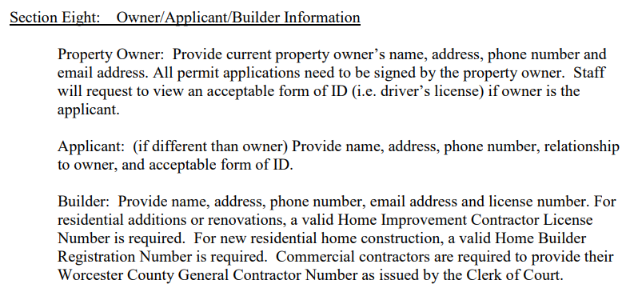
Proposal (the what) CPI will compile a “Licensed Contractor Registry.”
OPA/CPI will compile a registry (database) of “properly credentialed” contractors wishing to perform work on projects requiring CPI issued permits within the OPA Community. *(“properly credentialed,” meeting Maryland State and Worcester County licensure requirements)
Contractors choosing to provide services requiring issuance of a CPI permit(s) would provide respective information regarding the entity and license information like that required by Worcester County (section eight, paragraph 3 of the “How to Complete a Permit Application
https://www.co.worcester.md.us/sites/default/files/How_to_Permit_App.pdf)

Slide 42
Properly credentialed Contractors will be assigned a “Licensed Contractor Registry” number (LCR#) that is unique to and for the exclusive use of their respective companies.
These registered contractors would use this LCR# on OPA/CPI permit application. Contractors will also include their Maryland State agency issued license number on permit applications when applying for permits from CPI.
This LCR# would speed the process for both CPI and the respective contractors as they will have previously provided valid copies for record of all required licenses and certificates of insurance.
This registry would essentially become a quick reference of pre-validated contractors on file with OPA.
It should be noted that CURRENT ARC Guidelines, Section 200.2: Plan Review, paragraph A. and Section 200.3: Additions/Alterations to Existing Houses, paragraph A. General (requirements) states that “Contractors performing work must have a Maryland Home Improvement license, and the license number shall be included on the (permit) application.”
Multiple references to permits (requirement) appears in various other sections of the ARC Guidelines.
It should also be noted that OPA Tree Service permits CURRENTLY require the Contractor Name and Contractor License number be listed on the application before permit issuance.

Slide 43
Purpose (the why) “LCR,” serves as a quick reference affirmation instrument for Compliance Permitting and Inspections (CPI), the HOA and its members.
This registry would serve to validate the contractors applying for Ocean Pines permits.
It would also eliminate any claims of complicity and culpability on the part of OPA issuing permits to unlicensed and uninsured contractors not meeting Maryland State requirements.
Ocean Pines Association members will benefit from using Licensed Contractors with required credentials including liability insurance.
Members would also have the added benefit of access to the Maryland Home Improvement Commissions Guaranty Fund.

Slide 44
Place (the where) CPI
This registry would essentially be a list (database) of contractors that have provided copies of their applicable credentials, including current certificates of insurance and general business information. It would include valid credentials from one of the following agencies.
Maryland Registered Home Builder, Registration number.
Maryland Home Improvement License (MHIC)
Maryland Department of the Environment, The Marine Contractors License
Department of Natural Resources Licensed Tree Expert (LTE)

Slide 45
Progress (the when) CPI issues permits or a regular basis.
CPI does not currently have resources (database) for determining “properly credentialed” or licensed or insured status of contractors applying for permits.
As a result, and before issuance of permits, CPI needs contractors to provide, prior to or upon application:
A VALID AND UP-TO-DATE, Maryland Home Builders Registry NUMBER
A VALID AND UP-TO-DATE, Maryland Home Improvement Contractors License, MHIC NUMBER
A VALID AND UP-TO-DATE, Maryland Department of Environment, MARINE CONTRACTORS LICENSE, NUMBER
A VALID AND UP-TO-DATE, Maryland Department of Natural Resources, Licensed Tree Expert, LTE NUMBER, OR A MD REGISTRATION NUMBER
ALL APPLICATIONS and associated paperwork MUST BE COMPLETED in full, at time of application. Incomplete applications will not result in a permit issuance. Also, contractors must have provided certificates of insurance issued to and submitted to OPA/CPI.

Slide 46
People (the Who)
Everyone would benefit from having a registry of compliant State Licensed contractors.
Property Owners
Ocean Pines is composed of both part-time and full-time property owners (residents), Property owners come from a variety of states other than Maryland and, subsequently, may not be familiar with Maryland State law requiring contractors to be licensed. They may also be unaware of all associated requirements regarding property owner’s rights and rules. Use of an MHIC Licensed Contractor also gives access to the Maryland Home Improvement Guaranty Fund
Contractors
Contractors would benefit from having their credentials pre-submitted, pre-verified and on record with OPA/CPI. Pre-registered Contractors would benefit by being placed in an advantageous position regarding fast permit issuance and community familiarity and recognition.
OPA/CPI
CPI would benefit from having pre-validated contractors and reduce time for issuance of permits. CPI will also benefit from having official credentials detailing the contractor(s) business and contact information. Ultimately, OPA/CPI will have exercised due diligence and be operating within the frameworks required by Maryland State agencies regarding “properly credentialed” and licensed contractors.

Slide 47

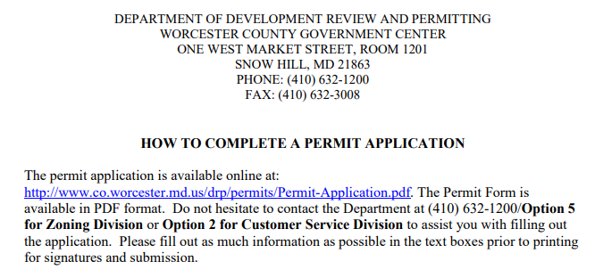
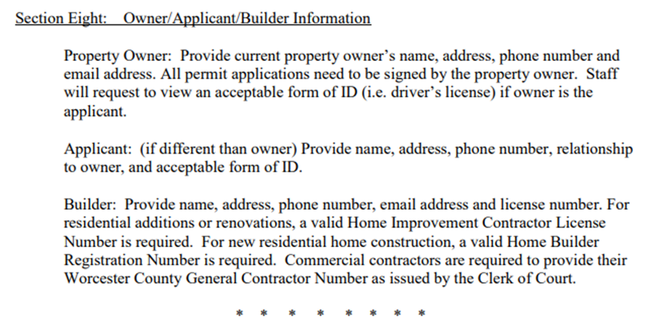



https://www.co.worcester.md.us/sites/default/files/How_to_Permit_App.pdf

Slide 48
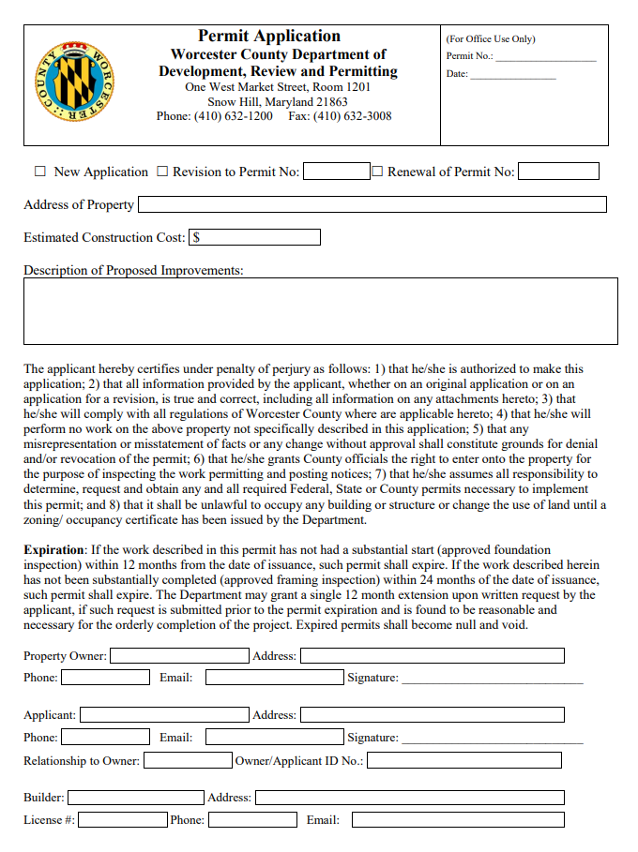


Worcester County Permit Application

Slide 49
Appointments
John Lynch – 1st Term – Strategic Planning Committee
John Maziuk – 2nd Term – Environmental & Natural Assets Committee

Slide 50
Adjournment

