Slide 1
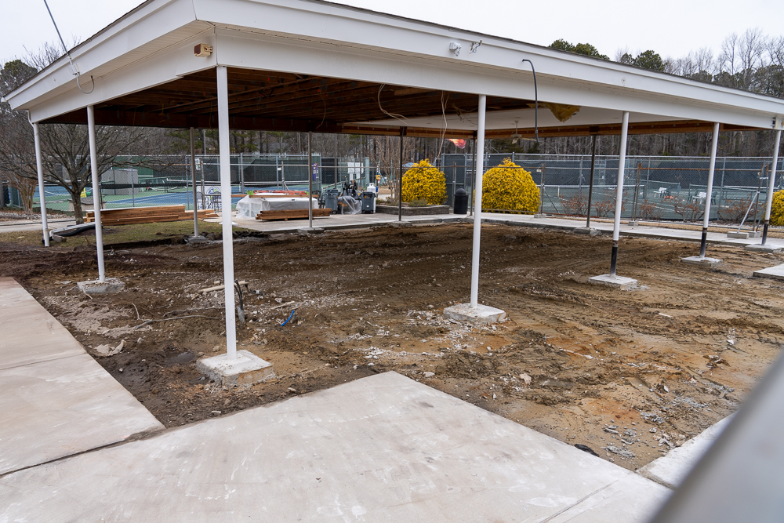
GM Leadership Report –
John Viola
February 22, 2025

Slide 2
  Initiatives
    Firehouse
      Joe Enste, President, OPVFD
    Racquet Center
    Irrigation
    Canal Bridge
    Bocce Ball Courts
  Street Brining
  Telephones
  Northstar
  Yard Waste
  Leaf Maintenance
  Metrics

Slide 3
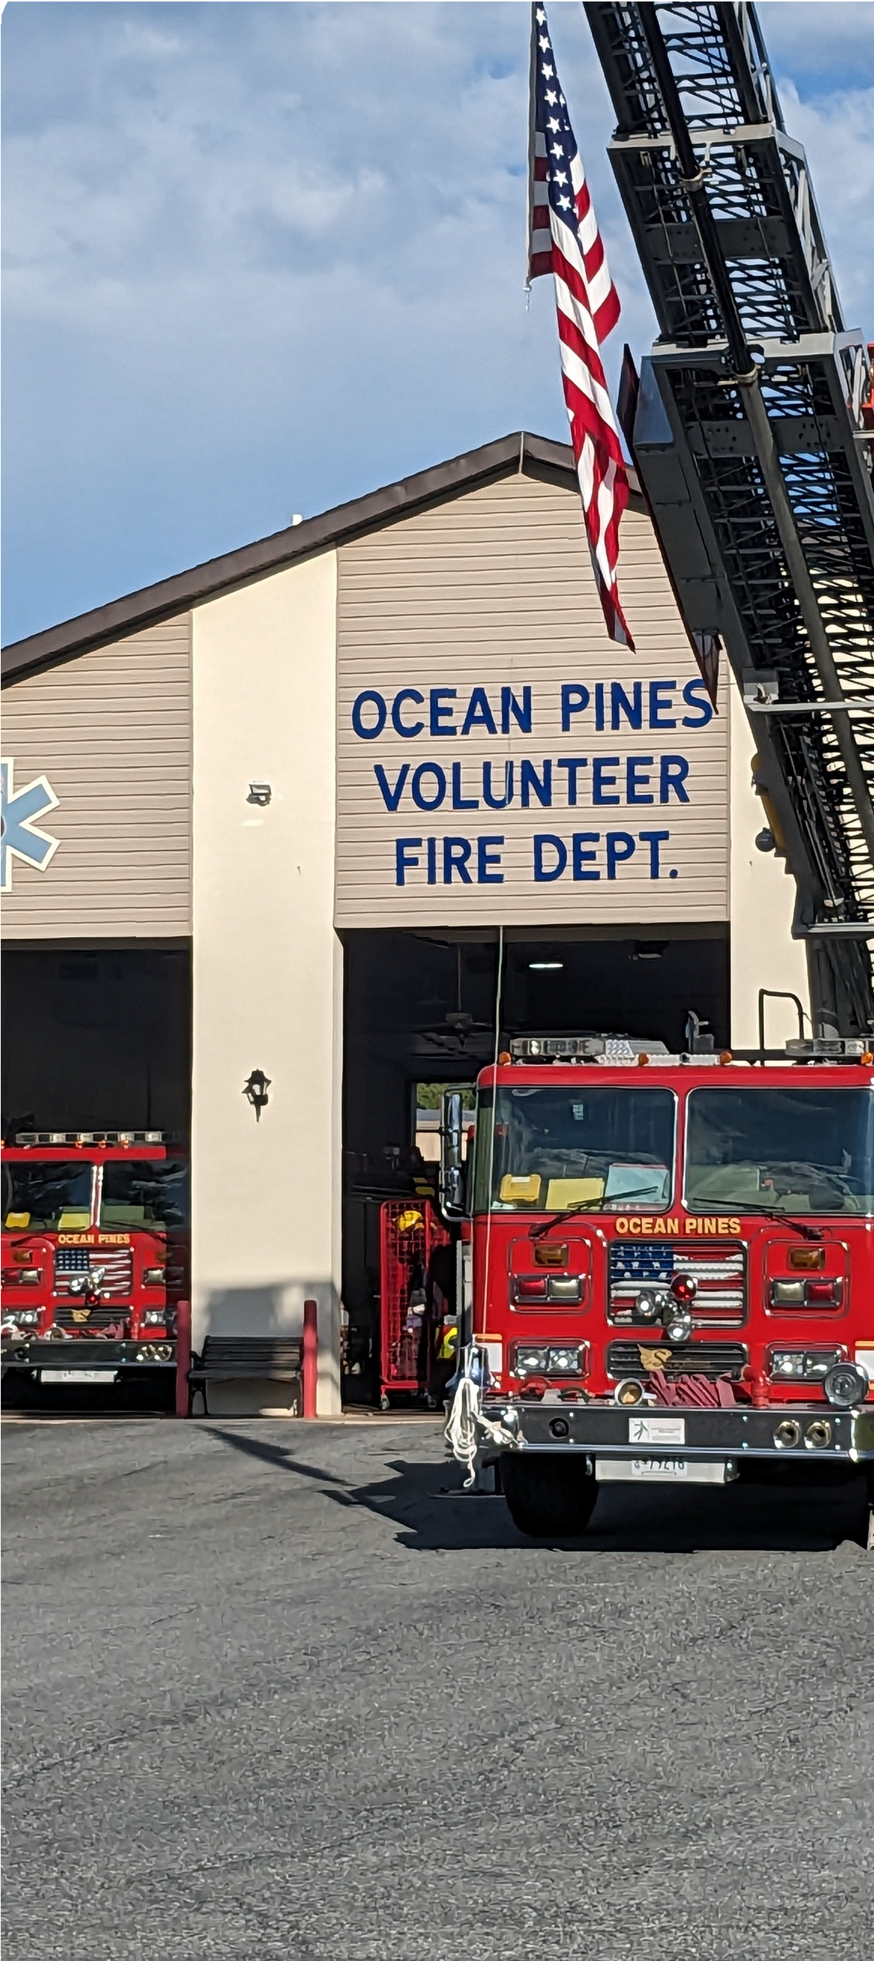

Ocean Pines Volunteer Fire Department: South Station Update
February 22, 2025
Presented by:
Joe Enste, President Joey Widgeon, Fire Chief

Slide 4
OPVFD Building Funding Sources
$1,700,000 in Grants and Bonds
$750,000 from fundraising/savings

Slide 5
Pre-Planning Process
Reviewed preliminary sketches to: fine tune interior fit out costs
Insure compliance w/State/Local and National (NFPA) standards
Estimate transition costs

Slide 6
Pre-Planning Outcomes
Increased design – approx. 760sqft Confirmed Pricing for Fire Suppression System, Vehicle Exhaust Extraction, and Station Alerting
Eliminated some transition costs to account for addition to project

Slide 7
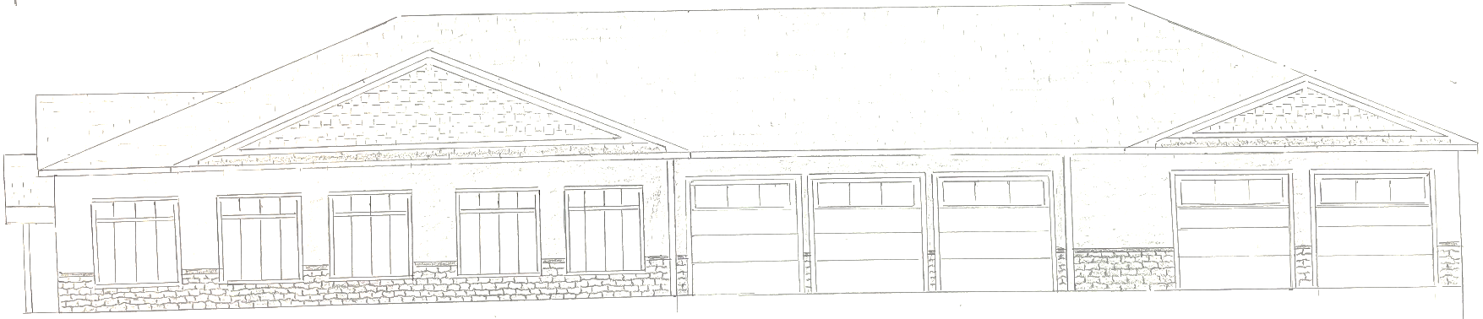
OPVFD Firehouse
Where were we:
  Reevaluated initial proposal
    19,100 sq. ft to 14,610 sq. ft.
Where are we now:
  Set up new work group
  Fine tuned the interior costs
  Safety and NFPA requirements
  Transition costs
  We have an architect

Slide 8
OPVFD Firehouse
Next steps – at this time:
  Go to Board with changes – 2/22/25
  Architectural drawings – 2/28/25
  Final architectural plans (est. April)
  Funding – deliver options to the Board
  Approval to move forward from Board
  How much money (ballpark) to go forward with referendum (June/August)
  Bids or award
  Timeline
  Project plan
Shovel in ground: estimate October 2025
Completion estimate – 65 weeks

Slide 9
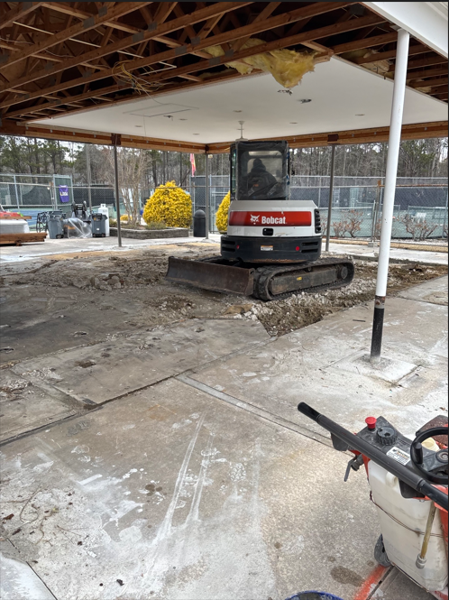
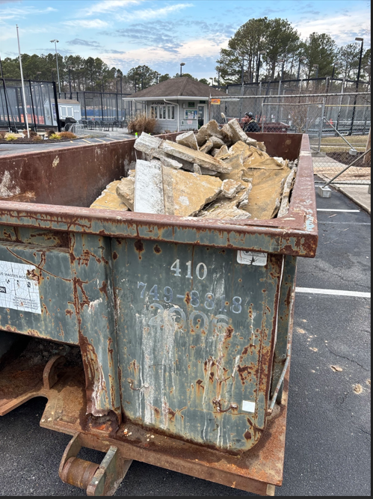
Racquet Center
Approved by the Board at the 12/16/23 Board Meeting for $140,000
Change orders:
  Upon removal of flooring, found structure was built on top of a sidewalk – new concrete needed
  New windows needed as current are outdated
  Estimated additional cost of $50,000

Slide 10
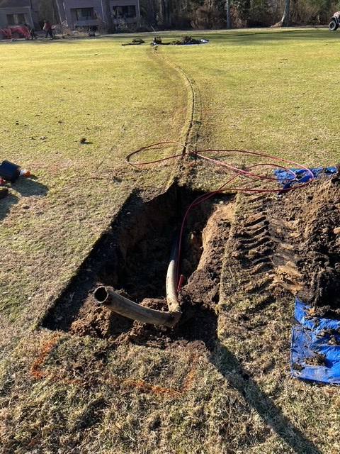
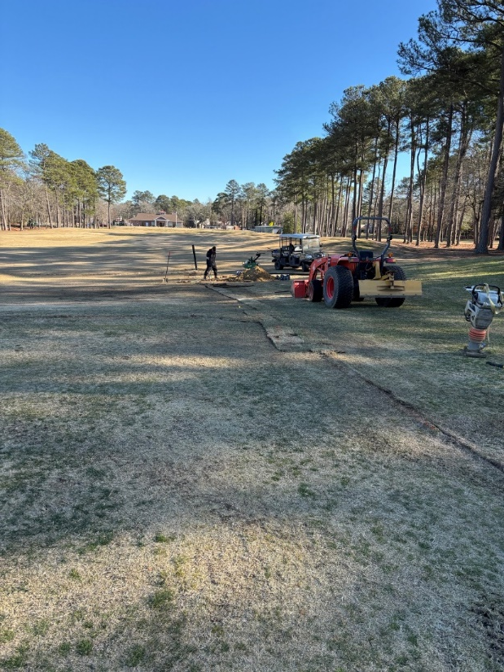
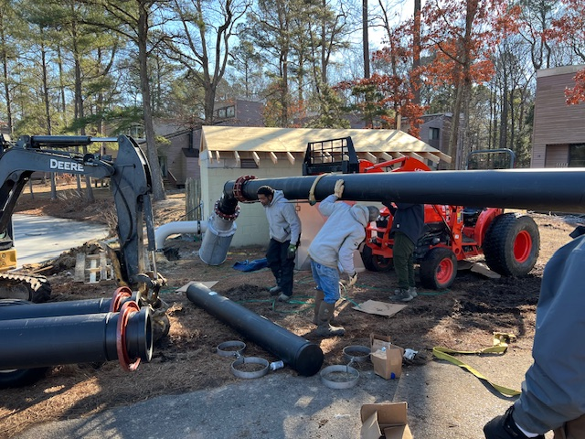
Irrigation
Finishing installing new irrigation on the driving range
Material received for holes 2 and 3 – will begin installing the main lines next week

Slide 11
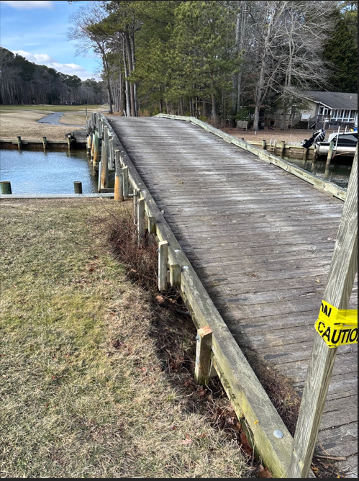
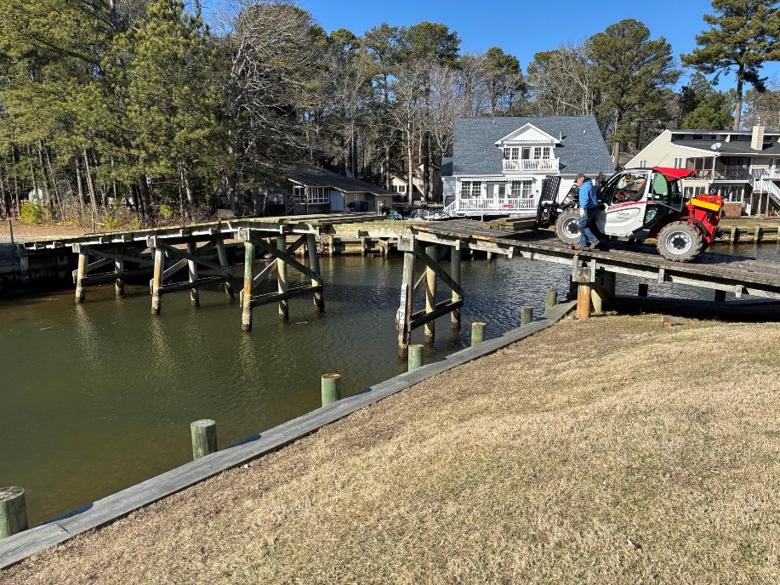
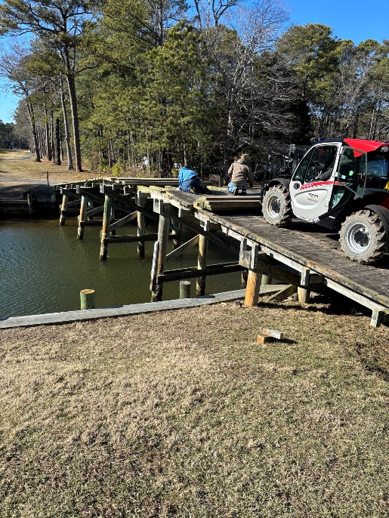
Canal Bridge
Repairs began on 4th fairway bridge week of 2/3
  Railings removed and deck boards to be replaced
  Bridge closed for carts – play to begin on back 9
Approved by Board on 12/21/24
  Total cost: $40,000

Slide 12
Bocce Ball Courts
Approval by Board needed for expansion of Bocce Ball Court area
  Projected cost: $15,000 per court
2 courts proposed to be within club standards (76 x 13)
Membership begins this Spring - $10 per member
  Sign up at the Recreation Department
  Projected membership revenue: $1,300 (1st year)
  Projected payback over 5 years

Slide 13
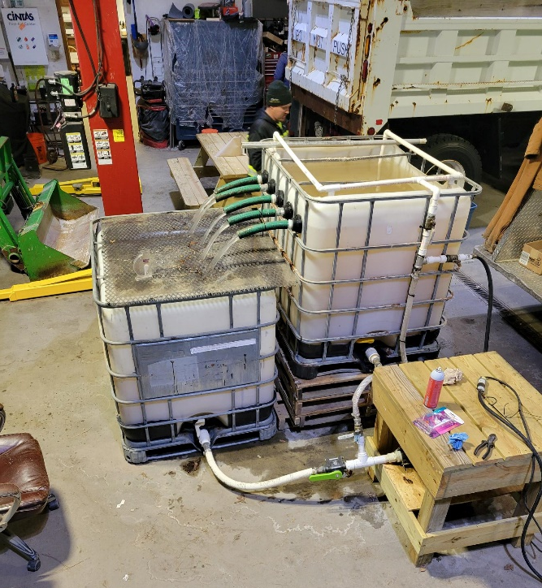
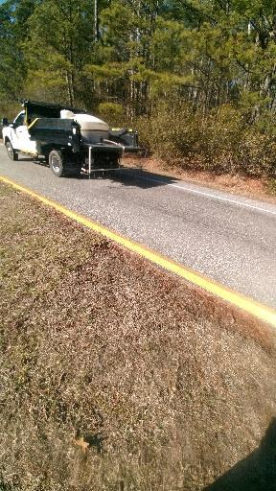
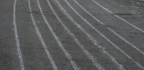
Street Brining
Machine built by Public Works
To be successful, can only be used during storms that do not start out as rain
Making brine solution
Applying brine solution to the road

Slide 14

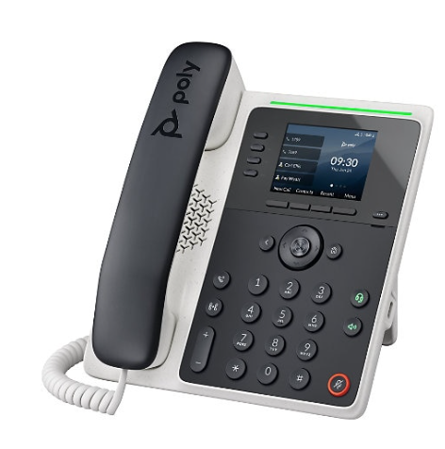
Telephones
New telephone vendor and consolidation
  Retiring all legacy lines and transitioning to VOIP network (will cellular backup)
Consolidation will see a net savings around 20-25% per year on telephone costs
Replacing outdated Cisco phones with new Poly Edge E220 – VoIP Phone
Roll out to new system over the next six months

Slide 15

Northstar
Golf NorthStar integration rollout February 28 and March 1, 2025
New version of NorthStar release March 24, 2025 (“Nexus”)
  Major upgrade implementing new user interface and many additions
NorthStar team onsite March 24, 25, and 26, 2025 for Nexus upgrade and annual review

Slide 16
Director of Business Administration –
Linda Martin

Slide 17
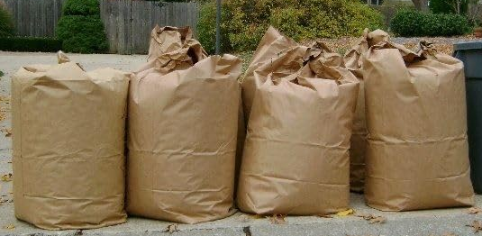
Yard Waste
Questions received regarding Republic and yard waste
  Confirmed with Republic that yard waste will still be picked up on the same day as trash pick up per our contract
Yard waste rules:
  No more than 4 bags at a time
  Tree limbs/shrub trimmings need to be cut into 4-foot lengths and tied into bundles weighing no more than 50 pounds
Public Works yard will reopen in the Spring for yard waste drop off

Slide 18
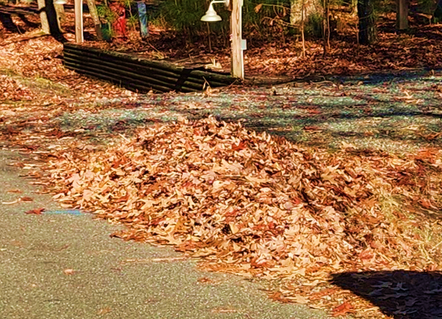
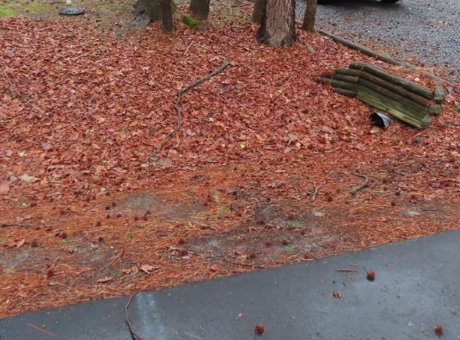
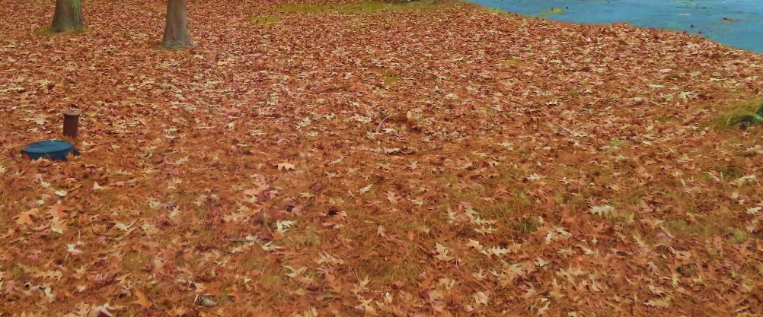
Leaf Maintenance
Section 10.D. of the Declaration of Restrictions:
  On each lot, the rights-of-way and easement areas reserved by Declarant or dedicated to public utilities purposes shall be maintained continuously by the lot owner.
  Ditches are to be clear of debris
    …which may change the direction of flow of drainage channels in the easements, which may obstruct or retard the flow of water through drainage channels in the easements
Section 8.A.l. of the Declaration of Restrictions:
  All lots…shall at all times be maintained in such manner as to prevent their becoming unsightly by reason of unattractive growth on such lot or the accumulation of rubbish or debris thereon
Resolution M-04 gives OPA the authority to clear leaves and debris from the property with a two-third vote of the Board

Slide 19
CPI Violation Dashboard
January
Violations
As of 1/1/25 | New Violations | Closed Violations | As of 1/31/25
302 | 99 | 91 | 310
99 violations initiated in January: 72 maintenance/trash/debris; 12 no permit; 5 signs; 10 miscellaneous
  Miscellaneous violations includes permit expiration, trailers, unregistered/junk vehicles, vehicle parking, and wire/metal fencing
91 violations complied out; 310 remain open
  116 maintenance/trash/debris; 56 no permit; 11 signs; 127 miscellaneous
73 of 310 violations still open are in legal

Slide 20
Work Orders
January
Open Work Orders as of 1/1/25 | New Work Orders | Closed Work Orders | Open Work Orders as of 1/31/25
42 | 33 | 35 | 40
33 work orders initiated in January: 2 bulkhead; 1 drainage; 4 grounds/landscaping; 3 roads; 2 signs; 21 general maintenance
Majority still open in drainage (24):
  7 – over 30 days; 14 – over 60 days
    Average 1-4 work orders a day to complete depending upon severity

Slide 21
Customer Service Dashboard
(from info@oceanpines.org)
January
Type | # Received – Jan.
Amenities | 15
CPI | 10
Drainage | 0
General | 31
Public Works | 5
TOTAL | 61

Slide 22
Financials

Slide 23
MONTH OF JANUARY 2025
FINANCIAL RESULTS

Slide 24
JANUARY 2025 YTD
FINANCIAL RESULTS

Slide 25
UNAUDITED RESERVE SUMMARY
JANUARY 2025 ($ MILLIONS)
 | General Replace | Bulkheads | Roads | Drainage | New Capital | Total
4/30/24 Balance | $5.5 | $0.3 | $0.8 | $0.4 | $0.1 | $7.1
Contributions/ Interest | 2.1 | 1.1 | 0.1 | - | - | 3.3
Casino Funds | - | - | 0.3 | 0.1 | - | 0.4
Transfer (Spend) | (2.1) | (0.7) | - | (0.3) | - | (3.1)
1/31/25 Balance | $5.5 | $0.7 | $1.2 | $0.2 | $0.1 | $7.7

Slide 26

Treasurer’s Report -
Monica Rakowski

Slide 27

Cash & Short-Term Investments
Month of January
As of January 31, 2025, the Association had Approximately (~) $14.3M in Cash
  Cash Decreased ~ ($0.6)M from the Same Time Period Last Year
  Cash Decreased ~ ($0.8M) from December 2024
  $8.7M Invested in CDAR’s
  $50K in Interest Income Recognized for the Month
  Remaining $5.6M in Insured Cash Sweep, Treasury Bills, Money Market and Other Operating Accounts (Diversified Between 2 Local Banks)

