Slide 1


Board of Directors Meeting
February 5, 2020

Slide 2
Approval of Agenda

Slide 3
Approval of Minutes
January 4, 2020 – Regular Meeting

Slide 4
President’s Remarks
Doug Parks

Slide 5
Announcement of Email Votes/Motions – Colette Horn

Slide 6

2020-2021 Budget Review

Slide 7

Ocean Pines Drainage
February 5th, 2020
Presented by Colby Phillips,
Director of Amenities & Operational Logistics

Slide 8
Recap of 2019 Goals & Budget:
PW Drainage Team, Vista, Commissioners, County, Drainage Ad-Hoc Group, Coastal Bays, Board, GM, Community
Completed Pipe/Drainage Improvements:
Boston Drive:
Replacement of Failing Culverts
Mumfords Landing Road:
Repair of Damaged Culverts
Blue Bill Court:
Inlet lowering, pavement milling and repaving to help with standing drainage issues
Watertown:
Replacement of Culvert Pipe & Catch Basins
Borderlinks Road:
Replacement of Failed Culvert
Harborview Drive:
New Culvert to Alleviate Existing Flooding
In process now.

Slide 9
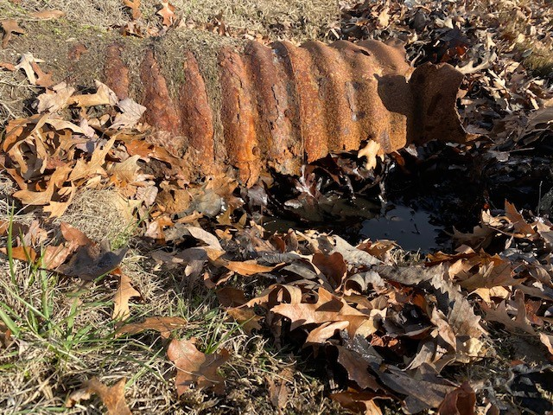
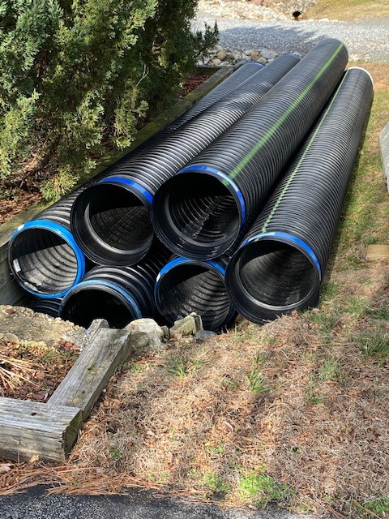
Pipes:
HDPE Pipe
Metal Pipe

Slide 10
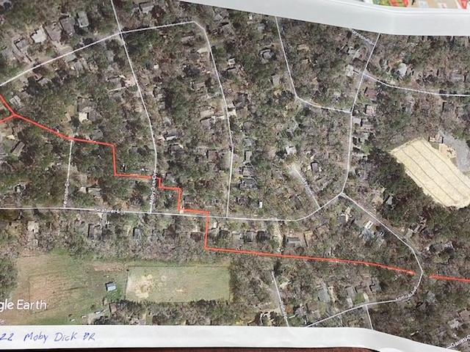
Completed Swale
Clearing/Re-establishment
 |  | Ditch/Swale Maintenance Schedule
Section | Location |  | Date Cleaned |  | Staff/Contractor
1 | Frigate Run (#1)
2 | Burr Hill/Sandy Hook (#1) |  | June 2019 |  | Contractor
2 | Mayflower (#2)
2 | Somerset Park Ditch (#3) |  | June 2019 |  | Contractor
2 | Salty Way Cul de Sac (#4)
2 | Moonraker (#5)
3 | BB Pond Inlet 1 (#1) |  | August 2019 |  | Contractor
3 | BB Pond Inlet 2 (#2) |  | August 2019 |  | Contractor
3 | BB Pond Outfall (#3)
3 | Sandy Hook Outfall (#4)
3 | Ivy Lane (#5)
4 | Watergreen Lane (#1)
5 | Drawbridge 6 Golf Course (#1)
5 | #8 Golf Course (#2)
6-A | Seafarer Lane (#1) |  | August 2019 |  | Contractor
6-A | Huntington Park (#2)
6-B | Windjammer (#1) |  | August 2019 |  | Contractor
6-B | Darby Court (#2)
6-B | Windjammer 23/24 (#3)
6-B | Rabbit Run (#4)
6-B | Windjammer 40/41 (#5)
7 | Nortgate Pond (#1)
7 | Edgewood (#2)
7 | Whisper Lane (#3)
7 | Bramblewood (#4)
8 | Admiral (#1) |  | August 2019 |  | Contractor
Ditch/Swale Maintenance List Established for all sections.
Highlighted area of what was done.
Larger ditches contracted on 5 year rotation with upkeep done in house.

Slide 11
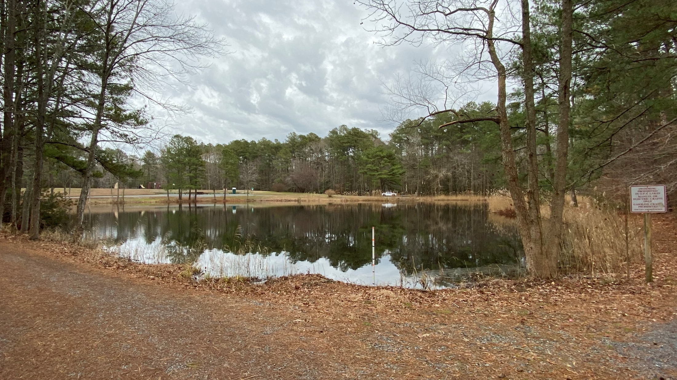
OP Section 2 & 3
History
  Studies have suggested sections 2 & 3 to be the worst areas in OP regarding drainage.
  761 lots and 3 parks or approximately 10% of Ocean Pines, drains through the main culvert under Beauchamp Road.
  Drainage Improvements at Bainbridge Pond will be the starting point for future projects.

Slide 12
2020 Planned Improvements
Bainbridge Pond Retrofit & Outfall Improvements ~ Beauchamp Road
Retrofit Bainbridge Pond to meet current MDE standards and improve downstream swales & 3 road crossings to Beauchamp Road.
Add additional Culvert under Beauchamp Road to increase runoff conveyance capacity.
Remove high points on Southern Beauchamp Road Swale to allow trapped runoff to access new Beauchamp Road Culverts.
Possible off-site improvements will also aid this effort.
Possible DNR Grant funding for water quality improvement components.

Slide 13
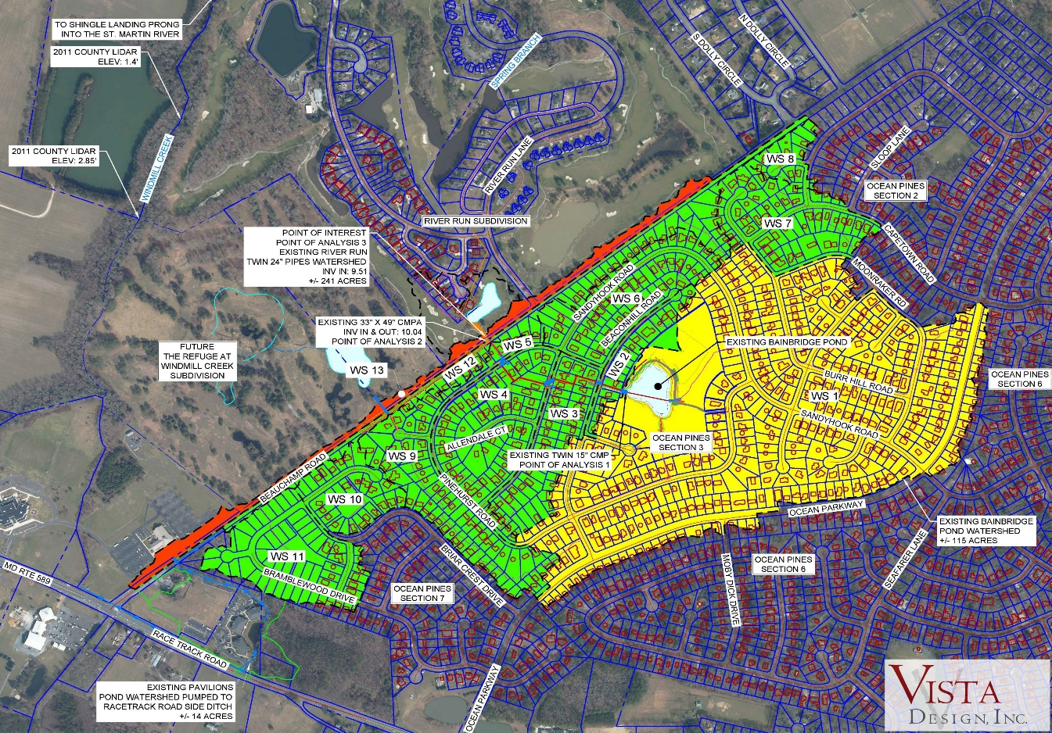
Yellow Area: *Drainage to Bainbridge Pond. (115 acres, 391 lots)
Green Area: *Additional drainage from Ocean Pines to Beauchamp Road Culvert. (233 acres, 370 lots)
Red Area: *Additional drainage captured by & conveyed via the existing ditch on the northside of Beauchamp Road.

Slide 14
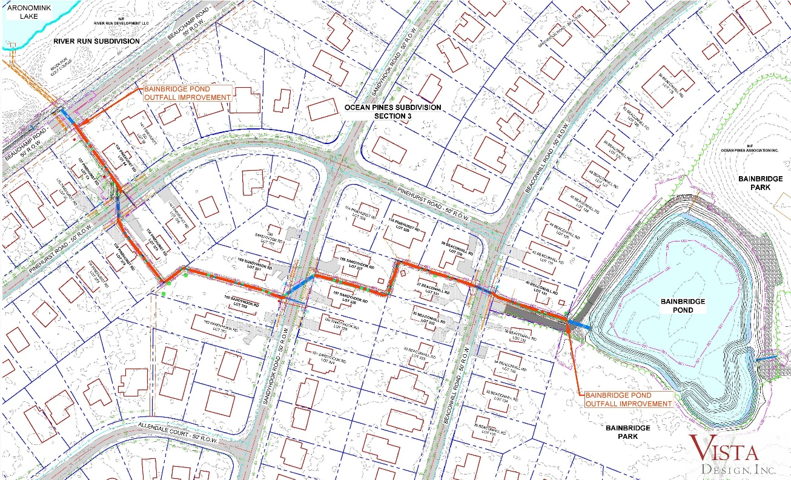
Bainbridge Pond Retrofit & Outfall Improvements ~
Bainbridge Pond/Ocean Pines
Pond Improvements ~ Increasing water quality & outfall capacity by:
Retrofit pond to meet current standards.
Improving downstream of Swales/Ditches.
Raise road around pond to increase pond storage & improve protection of houses.
Pipe/Culvert replacements on:
  Beacon hill
  Sandyhook
  Pinehurst

Slide 15

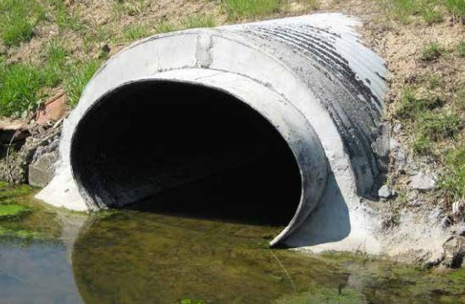
Snap-Tite System
New HDPE Culvert will have same or greater flow than existing cmp culvert. Space between new & old pipes is filled with cellular grout.
Possible solution to
some of our larger
culverts we need to
replace so we do not
need to dig up the road or disturb traffic.
EX: Cathell Road.
Installation is easier, safer and less disruptive to traffic & property.
The joints are watertight and secure, and the HDPE delivers a nearly indefinite service life.

Slide 16
Community Wide
Educational Seminars on Drainage Issues & Solutions:
Jennifer Dindinger ~
Watershed restoration specialist
March 2nd
6pm-7:30pm ~ Community Center
Yard Waste/Lawn Fertilization.
April 20th
6pm-7:30pm ~ Community Center
Hands on seminar on making rain barrels and rain gardens.
Kevin Wagner ~
MD Dept of Environment ~ FEMA
Jalessa Tate ~
MD Emergency Management ~ MEMA
May 12th
5:30-7pm ~ Community Center
FEMA floodplain mapping and Flood Insurance options
Elevation Certificates/Flood Openings
Low cost things property owners can do
Disaster Risk Reduction
Vendors

Slide 17

GM Report
John Viola

Slide 18
OP Dashboard
Month of December 2019 & January 2020 |  | Explanations
# of Customer Service Calls | Dec: 21 Jan: 38 | Drainage, Bulkheads, Homeowner issues. These were done by Director of Ops, PW Director and Operations manager through visits, calls & emails.
# of Customer Service Call Responded to | Dec: 21 Jan: 38
# of CPI Violations Reported/Visited | Dec: 27 Jan: 30 | Slower month.
# of CPI Violations Complied | Dec: 21 Jan: 11
# of Work Orders Entered | Dec: 120 Jan: 57 | Drainage, Staff requested
# of Work Orders Completed | Dec: 89 Jan: 8 | Some Carried over; Leaf pick up, holidays and Employees PTO has slowed down some WO

Slide 19
GM Report
February 5, 2020
John Viola
Initiatives | Construction Status | Projects Completion Date | Estimated Cost | As of 1/31/20 Spend YTD
Clubhouse | On Track | May 2020 | $1.6 mil | $583,909
Cart Barn | On Track | *February 2020 | $400,000 | $193,922
Police Building | On Track | June 2020 | $1.3 mil | $125,535
Northstar (Software Project) | On Track | **May 2020 | $400,000 | $306,332
Recommended Budget FY 2020/21 | Posted | January 24, 2020
*Extended
**Extended

Slide 20
FY 2020-2021 Recommended Budget Overview
Where Are We Today?
February 5, 2020
Proposed Budget Binders were delivered to the Board and B&F Committee on Thursday, December 19, 2019.
Prepared based upon B&F and Board guidance utilizing a bottoms up approach. Every Department Head was involved in their budgets and were a part of the presentation to the B&F Committee and the Board.
B&F Committee presentation was completed January 6th – 8th.
Board conducted a Work Session on the budget on January 15th.
GM published recommended Budget on January 24th.

Slide 21
FY 2020-2021 Recommended Budget Overview
Next Steps
(Continued)
Key Dates
*Feb. 5th – Board conducts hearing on recommended budget
Feb. 11th – Treasurer & GM provide Board with any final recommendations
Feb. 7th – 14th – Board provides GM with any motions to amend. GM will calculate any assessment impact
*Feb. 18th – Board hears final comments on the budget; Board considers any motions to amend and votes to adopt final budget
* Denotes meetings for member comment

Slide 22
County Exploring Ocean Pines Golf Course Irrigation
The Ocean Pines Water and Wastewater Advisory Board (a Worcester County panel) proposed using highly treated effluent to irrigate the Ocean Pines Golf Course
County officials approached OPA GM John Viola in December for preliminary talks
On Jan. 7, the Worcester County Commissioners approved a request from the Advisory Board to evaluate the project
In a local newspaper (The Dispatch), County Public Works Director John Tustin said the project “would produce both practical and environmental benefits”
Tustin said the preliminary evaluation would include costs, funding sources and possible regulatory hurdles
Three area golf courses – Eagle's Landing, River Run and Glen Riddle – already use county effluent in their irrigation systems
The project would require a new irrigation system, with funding to come from county grants and/or slight increases to county water/sewer bills, estimated to go up $2-$3 per quarter, according to county officials. This would not impact the OPA assessment
The current Golf irrigation system is more than 50 years old and needs to be replaced during next several years, at a potential cost of $1 - $3 million
Tustin said effluent nitrogen content would be at or below 3 milligrams per liter (or three parts per million), and phosphorus at or below 1 milligram per liter (one part per million)
“Highly treated effluent” refers to the water meeting current Bay Restoration standards of the Maryland Department of the Environment
Next Step – Feasibility Study by County

Slide 23
Financial Change for the
Month of December 2019
(Thousands)
 | Month Prior Year | Month Budget | Month Current Year | Increase/ (Decrease) Month vs. Prior Year | Increase/ (Decrease) Month vs. Budget
Net Operating | $(573.0) | $(668.9) | $(633.3) | $(60.3) | $35.6

Slide 24
Month: December 2019
Month Actual vs. Prior Year & Budget Variations
(Thousands)
(5 months)
 | Month Prior Year | Month Budget | Month Current Year | Increase/ (Decrease)Month VS Prior Year | Increase/ (Decrease) Month VS Budget
Amenities
Yacht Club | $(38.7) | $(47.7) | $(36.3) | $2.4 | $11.4
Beach Parking | - | - | (0.5) | (0.5) | (0.5)
Beach Club | (12.5) | (3.4) | (3.3) | 9.2 | 0.1
Marinas | (2.6) | (4.6) | (3.2) | (0.6) | 1.4
Golf Ops/Maint. | (27.5) | (42.7) | (60.9) | (33.4) | (18.2)
Tern’s Grill | 1.7 | (1.1) | (1.5) | (3.2) | (0.4)
Racquet Sports | (3.8) | (2.0) | (2.2) | 1.6 | (0.2)
Aquatics | (15.2) | (29.7) | (36.0) | (20.8) | (6.3)
Sub-Total Amenities | $(98.6) | $(131.2) | $(143.9) | $(45.3) | $(12.7)

Slide 25
Month: December 2019
Month Actual vs. Prior Year & Budget Variations
(Thousands)
(5 months)
 | Month Prior Year | Month Budget | Month Current Year | Increase/ Decrease Month VS Prior Year | Increase/ Decrease Month VS Budget
Sub-Total Amenities | $(98.6) | $(131.2) | $(143.9) | $(45.3) | $(12.7)
Recreation & Parks | (34.4) | (35.3) | (24.5) | 9.9 | 10.8
Fire/EMS/Police | (178.1) | (196.0) | (196.7) | (18.6) | (0.7)
PW/Gen. Maint./CPI | (167.2) | (200.5) | (176.3) | (9.1) | 24.2
Public Relations | (14.9) | (19.9) | (7.9) | 7.0 | 12.0
Gen. Admin./GM Office | (31.3) | (27.2) | (32.9) | (1.6) | (5.7)
Finance/Membership | (48.5) | (58.8) | (51.1) | (2.6) | 7.7
New Capital | - | - | - | - | -
 | $(573.0) | $(668.9) | $(633.3) | $(60.3) | $35.6

Slide 26
Financial Change Year to Date
5/1/19 – 12/31/19
(8 months)
(Thousands)
 | YTD Prior Year | YTD Budget | YTD Current Year | Increase/ (Decrease) YTD VS Prior Year | Increase/ (Decrease) YTD VS Budget
Net Operating | $2,735.8 | $2,889.9 | $3,512.9 | $777.1 | $623.0

Slide 27
YTD: December 2019
YTD Actual vs. Prior Year & Budget Variations
(5 months)
 | YTD Prior Year | YTD Budget | YTD Current Year | Increase/ DecreaseYTD VS Prior Year | Increase/ Decrease YTD VS Budget
Amenities
Yacht Club | $90.3 | $54.6 | $241.3 | $151.0 | $186.7
Beach Parking | 342.1 | 335.1 | 382.4 | 40.3 | 47.3
Beach Club | 117.9 | 116.7 | 147.7 | 29.8 | 31.0
Marinas | 225.0 | 201.6 | 247.8 | 22.8 | 46.2
Golf Ops/Maint. | 12.9 | 128.1 | 88.1 | 75.2 | (40.0)
Tern’s Grill | 9.9 | (0.3) | 19.8 | 9.9 | 20.1
Racquet Sports | 4.2 | 9.2 | 14.7 | 10.5 | 5.5
Aquatics | 219.4 | 178.3 | 141.5 | (77.9) | (36.8)
Sub-Total Amenities | $1,021.7 | $1,023.3 | $1,283.3 | $261.6 | $260.0

Slide 28
YTD: December 2019
YTD Actual vs. Prior Year & Budget Variations
(5 months)
 | YTD Prior Year | YTD Budget | YTD Current Year | Increase/ Decrease YTD VS Prior Year | Increase/ Decrease YTD VS Budget
Sub-Total Amenities | $1,021.7 | $1,023.3 | $1,283.3 | $261.6 | $260.0
Recreation & Parks | (285.2) | (352.4) | (285.7) | (0.5) | 66.7
Fire/EMS/Police | (1,043.0) | (1,174.3) | (1,183.5) | (140.5) | (9.2)
PW/Gen. Maint./CPI | (1,440.2) | (1,619.1) | (1,415.3) | 24.9 | 203.8
Public Relations | (165.1) | (141.7) | (135.7) | 29.4 | 6.0
Gen. Admin./GM Office | 5,074.5 | 5,658.1 | 5,697.7 | 623.2 | 39.6
Finance/Membership | (407.3) | (504.0) | (447.9) | (40.6) | 56.1
New Capital | (19.6) | - | - | 19.6 | -
 | $2,735.8 | $2,889.9 | $3,512.9 | $777.1 | $623.0

Slide 29
Treasurer’s Report
Larry Perrone

Slide 30
Financial Information with GM and Finance Lead
Monthly Bank Reconciliation
Cash & Short-Term Investments
Large Disbursement
Reserves (Forecasts)
Financial Oversight

Slide 31

Cash & Short-Term Investments
Activity for Month of December
Overall Laddered Investment Rate of Return for December Approx. 2.5%
At December 31, 2019, the Association had approx. $12.1 million in cash
  Approx. $6.8 million invested in CDAR’s fully FDIC insured
  Approx. $5.3 million in Money Market (earning 2%) and other operating accounts, fully insured

Slide 32
Reserves December 2019 ($Millions)
 | Replacement | Bulkheads | Roads | Total
4/30/19 Balance | $5.2 | $2.5 | $1.1 | $8.8
Assessments/Interest | 2.0 | 0.7 | - | 2.7
Casino Funds | - | - | 0.3 | 0.3
Transfer (Spend) | (1.6) | (0.8) | (0.5) | (2.9)
12/31/19 Balance | $5.6 | $2.4 | $0.9 | $8.9

Slide 33
Reserves 4/30/20 Forecasted
(in thousands)
 | Balance |  |  | Projected Balance
 | 4/30/2019 | Additions | Expenditures | 4/30/2020
Major Maintenance & Replacement:
Admin Police Renovation |  |  | (1,300)
Country Club Renovation |  |  | (1,600)
Cart Barn |  |  | (430)
Northstar |  |  | (275)
WHP Playground Equip |  |  | (150)
Craft Building |  |  | (100)
Yacht Club + Beach Club |  |  | (120)
Golf Ops/Maintenance |  |  | (185)
Aquatics/Rec/Other |  |  | (245)
Total | $5,257 | $1,980 | $(4,405) | $2,832
Bulkheads & Waterways | 2,478 | 720 | (1,913) | 1,285
Roads | 1,101 | 350 | (882) | 569
TOTAL 4/30/20 | $8,836 | $3,050 | $(7,200) | $4,686

Slide 34
Public Comments

Slide 35
Capital Purchase Requests –
Aquatics – Replace shingles on roof at Sports Core Pool
P/R & Marketing – Golf Clubhouse Audio System
P/R & Marketing – Yacht Club Audio System

Slide 36
CPI Violations
3 Lord Guy Terrace
84 Sandyhook Rd.

Slide 37
Unfinished Business
Second Reading – Resolution
M-06 – Steve Tuttle

Slide 38
New Business
Discussion - Process for Earmarking Projects for the New Capital Reserve Fund – Colette Horn
Motion - Move to approve the request by Worcester County to occupy an office at the Public Library for Treasury operations – Doug Parks
Motion - Move to establish a 6% interest rate for delinquent fees for the fiscal 2020/2021 budget. – Doug Parks
Motion – To approve the lease agreement with Pin’eer Craft Club – Larry Perrone

Slide 39
Appointments -
John Reeves – 1st Term – Aquatics
Ellen Hench – 1st Term – Aquatics
Kim Meekins – 1st Term – Aquatics
Paul Fohner – 2nd Term – Environment & Natural Assets
John Maziuk – 1st Term - Environment & Natural Assets
Steve Cohen – Chair – Recreation & Parks
Mary Corddry – 1st Term - Recreation & Parks
John Bussard – 1st Term – Recreation & Parks
Kathi Gottesman – 1st Term – Recreation & Parks
Laura Scharle – 1st Term – Recreation & Parks

Slide 40

Adjournment

