Slide 1

Board of Directors Meeting
February 23, 2022

Slide 3
Approval of Agenda

Slide 4
Approval of Minutes
January 22, 2022 – Regular Meeting
February 7, 2o22 – Special Meeting

Slide 5

President’s Remarks colette horn

Slide 6
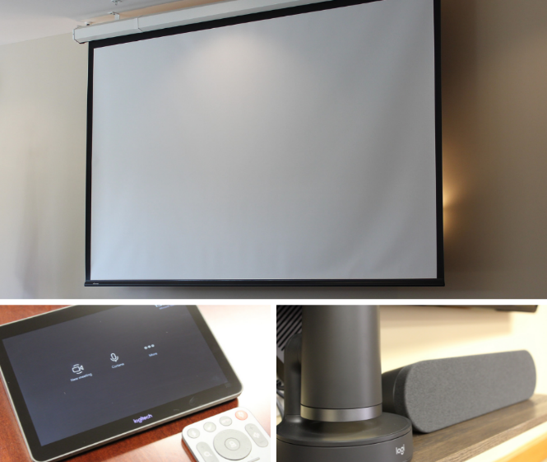
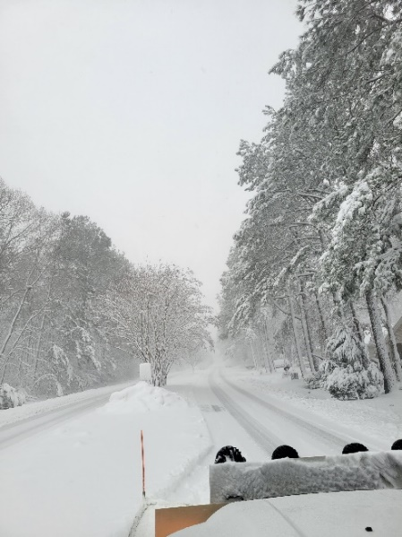
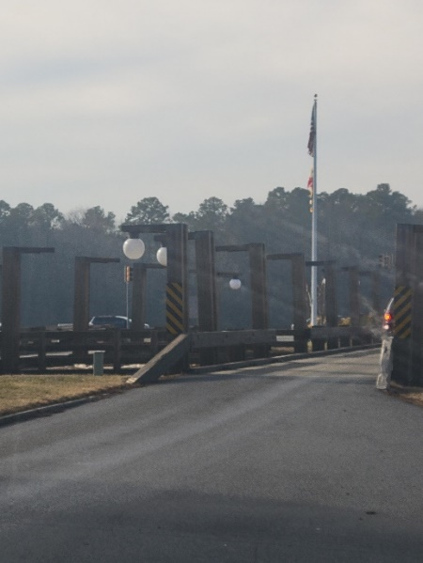
GM Leadership Report –
John Viola

Slide 7
Initiatives
Pickleball New Courts
North Gate Bridge
Lights
Guard Shack
Clubhouse
Wall and Door
Other
Debranching
Cherry Trees / Palm Trees
Mulching Walking Trails
Snow Storm Cost
Payroll “Lite” Study
Bulkheads
CPI
Mailboxes
Recommended FY 2022/2023 Budget
Financials
Audio System
Northstar

Slide 8
North Gate Bridge
Lights:
  Received estimate of $45,707.35 for materials
  Install cost and labor: approximately $10,000
  Estimated lead time to receive materials: 12 weeks
Guard Shack:
  Decision made to remove guard shack at estimated cost of $2,500 (in-house)
  Final shack removal completed on February 8, 2022
  Guard rail to be extended on both sides to cover openings
  Exploring possibility of adding 3rd lane of widening current lanes

Slide 9
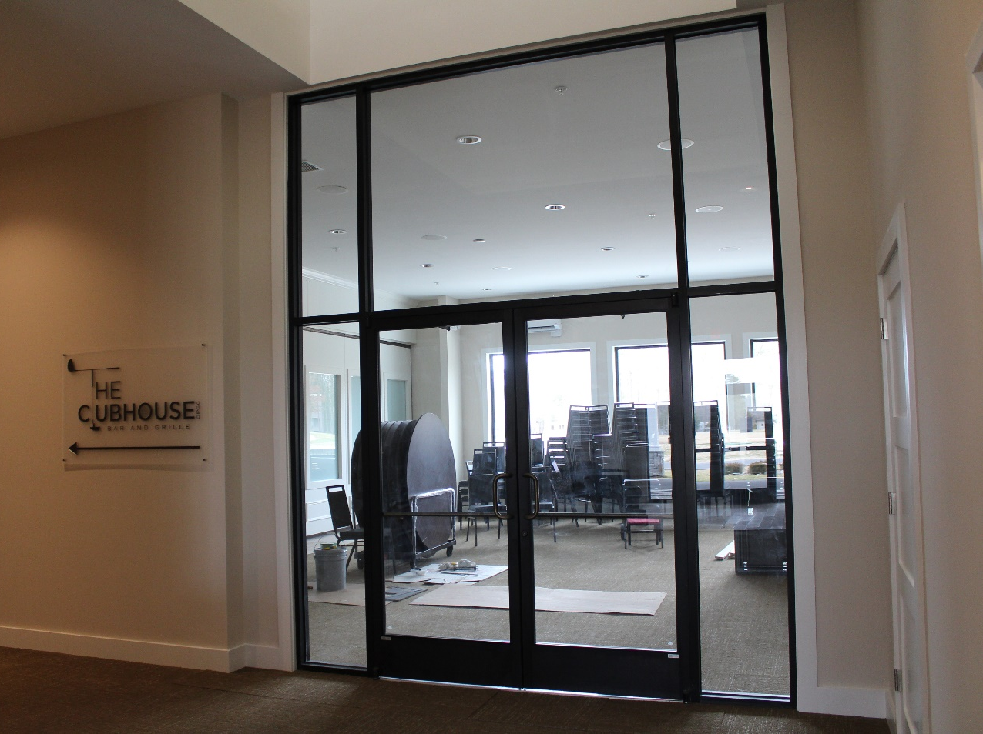
Clubhouse
Wall and door:
  Estimated cost for entire project is $12,000-$15,000
Audio System:
  Hybrid meeting functionality to be installed in the Clubhouse Meeting Room
  Mid-South Audio to install the system, which will include a custom table with built-in microphones and cameras (will integrate into the existing audio system to work with Microsoft Teams)
  Estimated Cost: approximately $14,000
  We believe we will have ability to move system to Assateague Room

Slide 10
Pickleball Courts
Bid packet sent 1/21/22; bids were to be returned on 2/18/22
Need to revisit with contractors

Slide 11
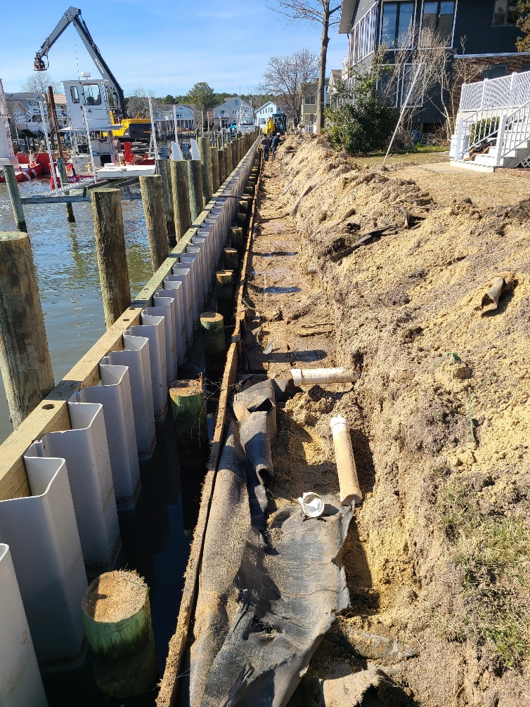
Bulkheads
Addresses Started in September:
8, 10, 12, 14, 16, 18, 20, 22, 24, 26, 28, 30, 32, 34, 36, 38, 40, 42, 44, 46, 48 50 Pintail Drive
3, 4, 5, 6, 7, 8, 9, 10, 11, 12 Crab Cay Court
Current Status:
Vinyl bulkhead installed at all location
Contractor backfilling bulkheads
Proposed for 2022/2023:
Replacing approximately 2,045 sq. ft. of bulkhead ($425.00 per sq. ft.)
Budgeted Amount:
$919,125.00
Addresses to be replaced:
1, 3, 5, 7, 9, 11, 13, 15, 17, 19 Pintail Drive North
4, 6, 8, 10, 12, 14, 16, 20 Ebb Tide Court
Pintail Park

Slide 12
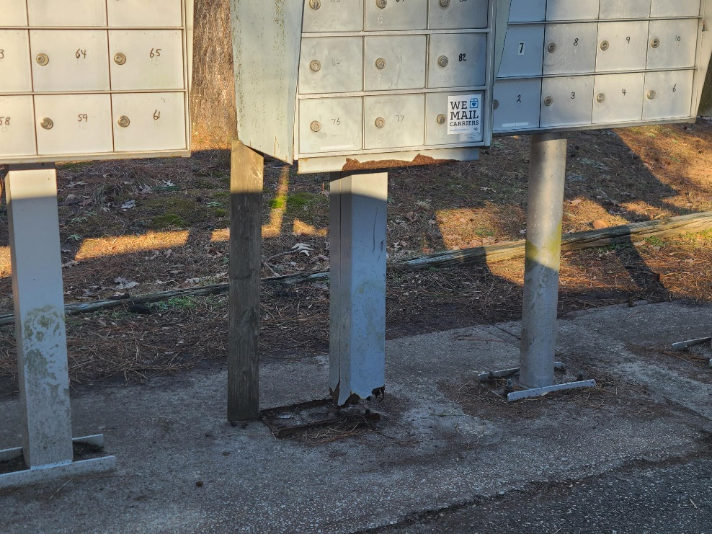
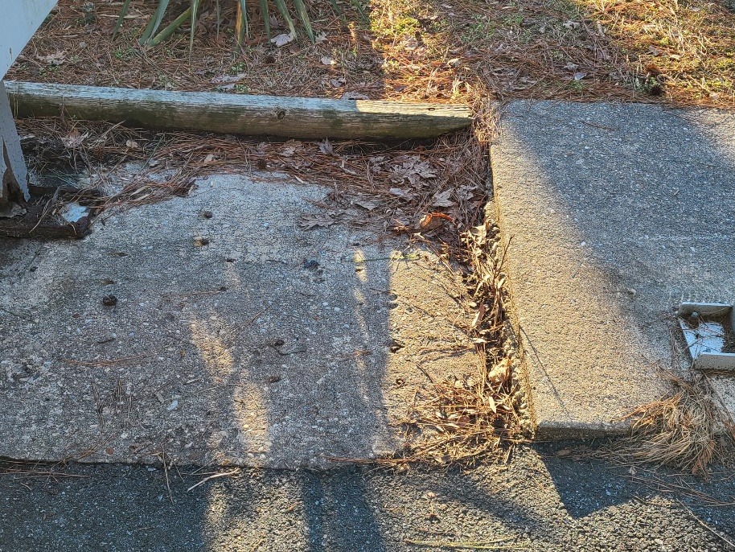
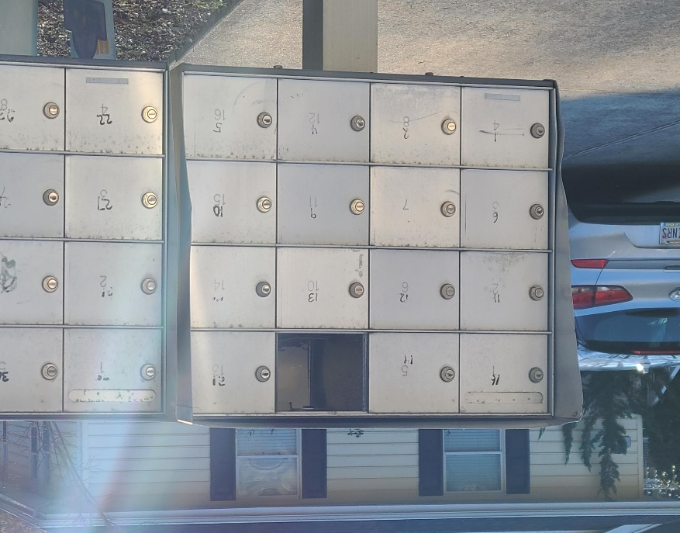
Mailboxes
10 high-priority locations have been determined to begin work on
100 pedestals have been ordered
  waiting on delivery to begin replacement
    Will coordinate with post office on replacement dates
Received bid for $75 each to clean each mailbox location, including concrete
  Total: $4,125 (55 locations)

Slide 13
CPI Violation Dashboard
JANUARY
Violations
As of 12/31/21 | New Violations | Closed Violations | As of 1/31/22
78 | 17 | 15 | 80
Legal Cases
As of 12/31/21 | New Violations to Legal | Closed Violations in Legal | As of 1/31/22
47 | 5 | 1 | 51

Slide 14
Other
Debranching
  Currently on hole 11
Cherry trees and palm trees
  Will be ordered and installed by the beginning of the season
Mulching walking trails
  Branches picked up from storm are currently being chipped and will be used to mulch the walking trails
Snow storm cost:
  Approximately $31,000
Payroll “lite” study
Northstar:
  Staff currently testing online payments with Northstar
  Online payments will be tentatively accepted beginning on March 15th
    3.5% convenience fee for credit card payments
    Anyone with a lien on their property will be blocked from online payments

Slide 15
Financials

Slide 16
Financial Change month of january 2022
January (In 000’s)
 | Budget | Current Year | Favor/ (Unfavor) vs. Budget
Net Revenues | $133 | $189 | $56
Expenses + New Capital | 856 | 875 | (19)
Net Operating | ($723) | ($686) | $37

Slide 17
Financial Change
YEAR-TO-DATE january 2022
YTD January 2022 (In 000’s)
 | Budget | Current Year | Favor/ (Unfavor) vs. Budget
Net Revenues | $12,364 | $13,709 | $1,345
Expenses + New Capital | 10,088 | 9,949 | 139
Net Operating | $2,276 | $3,760 | $1,484

Slide 18
Detail for the Month of january
Favor/(Unfavorable) Vs. Budget (in 000’s)
Department/Amenity | Favorable/(Unfavorable)
General Admin | 48.0
Public Works/General Maint/CPI | 29.9
Golf Ops + Maintenance | 9.0
New Capital | (14.0)
Aquatics | (13.4)
Racquet Sports | (9.7)
Police | (8.4)
Other Net (Racquet, Clubhouse Grille, Marketing, Finance, GM Office, Beach Parking, Aquatics, Beach Club) | (4.6)
TOTAL | $36.8

Slide 19
Detail for year-to-date january
Favor/(Unfavorable) Vs. Budget (in 000’s)
Department/Amenity | Favorable/(Unfavorable)
Public Works/General Maint/CPI | $355.7
Golf Ops + Maintenance | $309.7
Admin, Finance, GM, PR/Mktng | 238.2
Aquatics | 194.2
Yacht Club | 99.0
Police | 83.4
Recreation & Parks | 57.4
Beach Parking | 55.9
Marinas | 43.8
Beach Club | 42.0
Racquet Sports | 24.5
Clubhouse Grille | 13.6
New Capital | (33.5)
TOTAL | $1,483.9

Slide 20
Unaudited Reserves January 2022 ($Millions)
 | GeneralReplace | Bulkheads | Roads | Drainage | New Capital | Total
4/30/21 Balance | $3.9 | $1.0 | $0.2 | $0.5 | $0.1 | $5.7
Contributions/ Interest | 1.6 | 1.1 | - | - | 0.2 | 2.9
Casino Funds + Grant Income | - | - | - | 0.7 | - | 0.7
Transfer (Spend) | (0.6) | (1.1) | (0.2) | (0.5) | - | (2.4)
1/31/22 Balance | $4.9 | $1.0 | $- | $0.7 | $0.3 | $6.9

Slide 21
Reserves year-end unaudited estimate
(in ooo’s)
 | Beginning Balance |  |  | Unaudited EST Balance
 | 4/30/21 | Additions | Expenditures | 4/30/2022
Major Maintenance & Replacement:
Public Works – Fleet Vehicles |  |  | (302)
Public Works Tractor in 21 Budget |  |  | (146)
Police Vehicles (x 3) |  |  | (140)
Aquatics (Furniture, Roof, Equip) |  |  | (75)
Golf Maintenance Mowers |  |  | (58)
Public Works Boom Mower |  |  | (37)
Golf Ops |  |  | (29)
Yacht Club Kitchen Equipment |  |  | (24)
Racquet (Lighting,Fountains) |  |  | (10)
Other |  |  | (25)
Total | 3,853 | 1,705 | (846) | 4,712
Bulkheads & Waterways | 1,010 | 1,070 | (1,708) | 372
Roads | 216 | 1 | (212) | 5
Drainage | 469 | 835 | (800) | 504
New Capital | 102 | 183 | (190) | 95
TOTAL 4/30/22 ESTIMATE | 5,650 | 3,794 | (3,756) | 5,688

Slide 22
FY23 RESERVES BUDGET

Slide 23
GENERAL REPLACEMENT RESERVE
5-YEAR PROJECTION

Slide 24
Recommended FY 2022/2023 Budget
Bulkhead differential $650
(no change from prior year)

Slide 26

Treasurer’s Report - larry Perrone

Slide 27

Cash & Short-Term Investments
Activity for Month of January
Overall Laddered Investment Rate of Return on CDAR’s for January Approx. 0.75%
As of January 31, 2022, the Association had approx. $13.0 million in cash
  Approx. $7.1 million invested in CDAR’s, fully FDIC insured
  Approx. $5.9 million in Money Market, and other operating accounts, fully insured

Slide 28

Public Comments

Slide 29
Public Comments
Members wishing to make comments must state their name and address. Time limit for comments is 5 minutes. Comments may be made on any topic of interest to the member that pertains to the mission of OPA. Order for comments for hybrid meetings: 1st – members in attendance in-person; 2nd – MS Teams Participants (use of “raise hand” function required to enter speaking queue); 3rd – members participating through the MS Teams call-in (audio only) function. To enter call-in queue, text Josh Davis at 443-377-1079. Chat function of MS Teams is for Public Comments only; all other comments in the chat function will be considered out of order, as will be speaking during the meeting without being given the floor by the Chair.

Slide 30
Purchase requests
Resurfacing tennis har tru courts
Pickleball courts
North gate bridge lights

Slide 31
CPI VIOLATIONS
None

Slide 32
Unfinished Business
Second reading – resolution m-09 – Colette horn
Second reading – resolution M-09, attachment b – Colette horn

Slide 33
New Business
Motion to approve the FY 2022-2023 Fiscal budget – Larry perrone resolutions to change the resident agent on the liquor licenses for ocean pines – Colette horn recreation and parks committee aarp grant application – rick farr electronic voting – Josette Wheatley

Slide 34
Exploring Online Voting
OPA Elections Committee
Bob Windsor
Mary Whitcomb
Joe Peloso
Jean Pennington
Carol Ludwig, Chair

Slide 35
Overview of Presentation
Background: Current Process and Issues
Advantages to Online Voting
Countering Resistance to Online Voting
General Online Voting Process
Estimates of Costs for Four Vendors
Summary and Next Steps

Slide 36
Current Process and Challenges
The current election process uses mail-in ballots with business reply envelopes for ballot return. Election materials, ballots and envelopes are printed by a vendor. Ballots returned by deadline are manually checked for duplicate ballots, manually fed into a scanner with results tabulated by a program on a laptop computer.
Issues with Current Process:
Bylaws provide a tight timeframe for mailing and receipt of ballots (eligibility dates are not confirmed until 35 days before voting deadline)
Process negatively impacted by USPS delays in sending and receipt of ballots
Numbers of late (invalid) ballots increased from 2020 (182) to 2021 (289)
Committee must manually search received ballots to check for duplicates.
Ballot scanning process is slow, ranging from 5 to 6 hours in recent elections.
Concern on about security of election (transparent envelopes)

Slide 37
General Online Voting Process
OPA provides electronic file of Property Owners
Each lot owner is assigned a random ID number
The ID number is provided to each owner via postal service
Owners login to website and create a password
Votes are entered via website
Email reminders are sent periodically to owners who provided email address
Voting open until day of deadline
OPA Single Point of Contact works with corrections as necessary
OPA (Elections Committee) provided with ballot results
With addition of a phone-in option, owners can call a central number, providing their unique id number and vote.

Slide 38
Advantages to Online Voting
Cost reduction on opaque Return Envelopes, Return Postage
PCs are available at local Libraries, if needed
Security Enhancement
Phone In Feature
No Equipment for IT Staff to maintain/purchase faster scanner
Cost reduction of Contractor collecting ballots
Eliminates current duplicate ballot challenge
Property Owners can vote up to the deadline date
Saves paper and storage needs
Addresses two OPA survey results that show a higher percentage in
favor of online voting

Slide 39
Countering Resistance to Online Voting
There will always be resistance to any change, There are also a number of benefits:
This is not new as The Parke Community has used online voting successfully
Online voting will help ensure that every vote counts as there will be no ineligible votes due to late USPS processing; property Owners can vote up to the deadline date
Surveys have shown that 93% of adults, including 75% of adults 65 and over are online
Phone-in option ensures that those not online can still vote easily.
Unique codes mean no duplicate ballots and conflicts are resolved quickly
Depending on provider and options selected there may be cost savings over current process.

Slide 40
Online Voting Vendor Estimates
Estimates of Various Services | Current | YES | Election | Simply | VOTE HOA
 |  | ELECTIONS | Trust | Voting | NOW
Election Management |  | $ 5,300 | $ 4,850 | $ 2,830 | $ 2,505
Clear Ballot (Host) |  |  | $ 1,250 | $ 1,695 | $ 909
Phone-in Feature |  | $ 1,500 |  | $ 859
Print and Mail Ballot and Instructions only |  | $ 3,111 | $ 7,727
Print and Mail Annual Mtg Notice/ballots/flyers | $ 7,772
Postage annual Meeting Notice/instructions | $ 3,454
Ballot return postage | $ 4,305
 | $ 15,531 | $ 9,911 | $ 13,827 | $ 5,384 | $ 3,414

Slide 41
Summary and Next Steps
The OPA Elections Committee strongly suggests that the Ocean Pines Board of
Directors vote in favor of online voting with a phone-in option.
  Association Members have generally been in favor of online voting through two
  surveys; it is already in use in the Parke.
  Online voting streamlines our voting process for both Board of Directors and
  Referendum elections; ensures every vote counts and results are available promptly
Next Steps
If the Board approves online voting, the GM or staff should identify specifications needed, and select a contractor in time for use at this year’s Board of Directors election.

Slide 42
appointments
Maria campione-Lawrence – 1st term – aquatics committee
Monica Rakowski – 1st term – aquatics committee
Kevin middleton – 1st term – arc
Frank brown – 1st term – golf committee
Robert long – 2nd term – golf committee
Donald mcmullen – 2nd term – golf committee
Andie davis – 2nd term – search committee
Thomas piatti – 2nd term – search committee
Frank brown – 1st term – strategic planning
Stuart lakernick – 1st term – strategic planning

Slide 43
NEXT MEETING DATE
Wednesday, march 23rd at 11:00 a.m.
(HYBRID MEETING AT clubhouse meeting room)

Slide 44
Adjourn to closed session

