Slide 1


Ocean Pines Association
Annual Membership Meeting
August 14, 2021

Slide 2
Call to order
Pledge of allegiance

Slide 3
Appointments
Recorder - Michelle Bennett
Parliamentarian – Jeremy Tucker
Timekeeper – Mary Ann Whitcomb
Sergeant-at-Arms – Chief Leo Ehrisman
Teller – Bob Windsor

Slide 4
Presentation –
Sam Wilkinson Volunteer Award
Carol Ludwig

Slide 5
Ascertainment of quorum
Larry Perrone

Slide 6
Approval of Agenda
Approval of Minutes of Annual Meeting – August 11, 2018

Slide 7
2021 legal
Report
Jeremy Tucker

Slide 8
2021
Financial Report
John Viola

Slide 9
SUMMARY OF OPERATING FUND AUDITED FINANCIAL RESULTS
FISCAL YEAR 2021 ACTUAL COMPARED TO BUDGET
 |  |  | FY2021
 |  |  | Budget | Actual | Variance
Assessment Revenue |  |  | $6,194,239 | $6,034,683 | $(159,556)
Operating Dept. & Expenses:
 | Police |  | (1,391,152) | (1,346,693) | 44,459
 | Fire/EMS |  | (698,725) | (697,525) | 1,200
 |  | Total Police + Fire/EMS | (2,089,877) | (2,044,218) | 45,659
Public Works/Maintenance/CPI |  |  | (2,481,621) | (1,914,817) | 566,804
Recreation & Parks |  |  | (526,471) | (430,266) | 96,205
Other |  |  | (1,783,649) | (1,511,064) | 113,346
 |  | Total Operating Depts. | (6,881,618) | (5,900,365) | 822,014
PPP |  |  | - | 1,375,238 | 1,375,238
Amenities |  |  | 687,379 | (30,829) | (718,208)
 | Total Departments, Amenities & PPP |  | (6,194,239) | (4,555,956) | 1,479,044
New Capital |  |  | - | (32,830) | (32,830)
 | Total Expenses |  | (6,194,239) | (4,588,786) | 1,446,214
Excess of Revenues (Expenses) |  |  | $- | 1,445,897 | 1,445,897

Slide 10
AMENITIES SUMMARY OF OPERATING FUND AUDITED FINANCIAL RESULTS
FISCAL YEAR 2021 ACTUAL COMPARED TO BUDGET
 |  |  | FY2021
 |  |  | Budget | Actual | Variance
Amenities:
Food & Beverage
 | Yacht Club |  | $88,014 | $(257,123) | $(345,137)
 | Beach Club |  | 97,742 | 92,687 | (5,055)
 | Clubhouse Grille |  | (11,310) | 12,140 | 23,450
 |  | Total Food & Beverage | 174,446 | (152,296) | (326,742)
Golf |  |  | (40,549) | (96,958) | (56,409)
Aquatics |  |  | (102,823) | (295,816) | (192,993)
Beach Club Parking |  |  | 489,942 | 331,035 | (158,907)
Marinas |  |  | 192,007 | 250,064 | 58,057
Racquet Sports |  |  | (25,644) | (66,858) | (41,214)
 |  | Total Non-Food & Beverage | 512,933 | 121,467 | (391,466)
 | Total Amenities, Net |  | $687,379 | $(30,829) | $(718,208)
8/13/2021
Pg. 10

Slide 11
SUMMARY OF OPERATING FUND AUDITED FINANCIAL RESULTS
FISCAL YEAR 2021 ACTUAL COMPARED TO FY 2020 ACTUAL
 |  |  | Actual
 |  |  | 2020 | 2021 | Variance
Assessment Revenue |  |  | $6,278,118 | $6,034,683 | $(243,435)
Operating Dept. & Expenses:
 | Police |  | (1,338,209) | (1,346,693) | (8,484)
 | Fire/EMS |  | (692,961) | (697,525) | (4,564)
 |  | Total Police + Fire/EMS | (2,031,170) | (2,044,218) | (13,048)
Public Works/Maintenance/CPI |  |  | (2,115,680) | (1,914,817) | 200,863
Recreation & Parks |  |  | (448,890) | (430,266) | 18,624
Other |  |  | (1,772,517) | (1,511,424) | 261,093
 |  | Total Operating Depts. | (6,368,257) | (5,900,725) | 467,532
PPP |  |  | - | 1,375,238 | 1,375,238
Amenities |  |  | 660,799 | (30,829) | (691,628)
 | Total Departments, Amenities & PPP |  | (5,707,458) | (4,556,316) | 1,151,142
New Capital |  |  | - | (32,470) | (32,470)
 | Total Expenses |  | (5,707,458) | (4,588,786) | 1,118,672
Excess of Revenues (Expenses) |  |  | $570,660 | $1,445,897 | $875,237
8/13/2021
Pg. 11

Slide 12
AMENITIES SUMMARY OF OPERATING FUND AUDITED FINANCIAL RESULTS
FISCAL YEAR 2021 ACTUAL COMPARED TO FY 2020 ACTUAL
 |  |  | Actual
 |  |  | 2020 | 2021 | Variance
Amenities:
Food & Beverage
 | Yacht Club |  | $100,562 | $(257,123) | $(357,685)
 | Beach Club |  | 124,960 | 92,687 | (32,273)
 | Clubhouse Grille |  | 10,711 | 12,140 | 1,429
 |  | Total Food & Beverage | 236,233 | (152,296) | (388,529)
Golf |  |  | (160,189) | (96,958) | 63,231
Aquatics |  |  | (8,683) | (295,816) | (287,133)
Beach Club Parking |  |  | 370,239 | 331,035 | (39,204)
Marinas |  |  | 230,254 | 250,064 | 19,810
Racquet Sports |  |  | (7,055) | (66,858) | (59,803)
 |  | Total Non-Food & Beverage | 424,566 | 121,467 | (303,099)
 | Total Amenities, Net |  | $660,799 | $(30,829) | $(691,628)
8/13/2021
Pg. 12

Slide 13
SUMMARY OF DISTRIBUTION OF ANNUAL BASE ASSESSMENT
FISCAL YEAR 2021 ACTUAL COMPARED TO BUDGET & 2020 ACTUAL
 |  |  | FY 2021 |  |  | FY 2020
 |  |  | Budget | Actual |  | Actual
Operating Expenses:
Police/Fire & EMS |  |  | $247 | $242 |  | $240
All Other Operating Departments |  |  | 571 | 449 |  | 506
 | Total Operating Departments |  | 818 | 691 |  | 746
Amenities, Net |  |  | (81) | 4 |  | (78)
PPP |  |  | - | (163)
New Capital |  |  | - | 4 |  | -
 |  | Total | 737 | 536 |  | 668
General Replacement Reserve |  |  | 211 | 211 |  | 220
Drainage Reserve |  |  | - | 30 |  | -
New Capital Reserve |  |  | 20 | 20 |  | -
Bulkhead Reserve |  |  | 19 | 19 |  | -
 | Total Replacement + Bulkheads |  | 250 | 279 |  | 220
 |  | Total Operating & Capital | 986 | 815 |  | 889
 | Transfer to Retained Earnings |  | - | 171 |  | 68
 | Contribution to Operating Fund Deficit |  | - | - |  | 30
 |  | Totals | $986 | $986 |  | $986
8/13/2021
Pg. 13

Slide 14
OPERATING DEPARTMENTS DISTRIBUTION OF ANNUAL BASE ASSESSMENT FISCAL YEAR 2021 ACTUAL TO BUDGET & 2020 ACTUAL
 |  |  | FY 2021 |  |  | FY 2020
 |  |  | Budget | Actual |  | Actual
Operating Departments:
 | Police |  | $165 | $159 |  | $158
 | Fire/EMS |  | 83 | 83 |  | 82
 |  | Total | 247 | 242 |  | 240
 | Public Works, Maintenance, CPI |  | 294 | 227 |  | 250
 | Recreation & Parks |  | 62 | 51 |  | 53
 | Finance/Membership/IT/HR |  | 94 | 84 |  | 82
 | GM Office |  | 35 | 36 |  | 37
 | Marketing |  | 30 | 23 |  | 25
 | General Admin, Net |  | 56 | 29 |  | 59
Total Operating Departments |  |  | $818 | $691 |  | $746
8/13/2021
Pg. 14

Slide 15
AMENITIES DISTRIBUTION OF ANNUAL BASE ASSESSMENT
FISCAL YEAR 2021 ACTUAL COMPARED TO BUDGET & 2020 ACTUAL
 |  |  | FY 2021 |  |  | FY 2020
 |  |  | Budget | Actual |  | Actual
Food & Beverage:
 | Yacht Club |  | $(10) | $30 |  | $(12)
 | Beach Club |  | (12) | (11) |  | (15)
 | Clubhouse Grille |  | 1 | (1) |  | (1)
 |  | Total | (21) | 18 |  | (28)
Golf |  |  | 5 | 11 |  | 19
Aquatics |  |  | 12 | 35 |  | 1
Beach Parking |  |  | (58) | (39) |  | (44)
Marinas |  |  | (23) | (30) |  | (27)
Racquet Sports |  |  | 3 | 8 |  | 1
 |  | Total Amenities, Net | $(81) | $4 |  | $(78)
8/13/2021
Pg. 15

Slide 16
OPERATING FUND PERFORMANCE HISTORY
FY 2017 – FY 2021
 |  |  | Amount
Operating Fund Balance, May 1, 2016 |  |  | $5,899
 | Operating Fund Surplus (Deficit):
 |  | FY17 | (369,539)
 |  | FY18 | (1,247,691)
 |  | FY19 | 115,795
 |  | FY20 | 570,660
 |  | FY21 | 1,445,897
 | FY19 Restricted Assessment Funds
 | to Reduce Operating Deficit:
 |  | FY19 | 600,265
 |  | FY20 | 252,779
 | Prior Period Adjustments (Aquatics):
 |  | FY20 | (88,811)
 |  | FY21 | (90,263)
Operating Fund Balance, April 30, 2021 |  |  | $1,194,991
8/13/2021
Pg. 16

Slide 17
ANNUAL ASSESSMENT INCREASE HISTORY
FY 2018 - 2022
FY 2022 ASSESSMENT | $996
FY 2018 ASSESSMENT | 921
5-YEAR INCREASE | $75
% INCREASE - TOTAL | 8.1%
% INCREASE – ANNUAL AVERAGE | 1.6%
RECENT HISTORY
 | 5-YEAR INCREASE (DECREASE)
FY | AMOUNT | % | NEW ASSESSMENT
2018 | 0 | 0 | 921
2019 | 30 | 3.3 | 951
2020 | 35 | 3.8 | 986
2021 | 0 | 0 | 986
2022 | 10 | 1.0 | 996
5-YEAR CUMULATIVE INCREASE | $75 | 8.1%
AVERAGE ANNUAL INCREASE | $15 | 1.6%
8/13/2021
Pg. 17

Slide 18
FIXED ASSETS SUMMARY
FY 2021
 |  |  |  | Accumulated | Net
 |  |  | Cost | Depreciation | Book Value
Depreciable Assets:
 | Land Improvements |  | $11,167 | $6,354 | $4,813
 | Building & Building Improvements |  | 17,628 | 5,903 | 11,725
 | Furniture & Equipment |  | 10,635 | 8,356 | 2,279
 | Roads |  | 8,906 | 7,824 | 1,082
 |  | Total | 48,336 | 28,437 | 19,899
Construction in Process |  |  | 7 | - | 7
 |  | Total | 48,343 | 28,437 | 19,906
Non-Depreciable Assets (Land) |  |  | 4,579 | - | 4,579
Totals |  |  | $52,922 | $28,437 | $24,485
8/13/2021
Pg. 18

Slide 19
UNAUDITED ESTIMATE OF FY 2022
RESERVES ACTIVITY
 |  |  |  | Projected
 | Balance |  |  | Balance
 | 4/30/2021 | Additions | Expenditures | 4/30/2022
Major Maintenance & Replacement:
Public Works (Fleet Vehicles) | $ | $ | $(302) | $
Aquatics (Roof, Furniture, Equip) |  |  | (75)
Police Vehicles |  |  | (75)
Golf Maintenance Tri-plex Mower |  |  | (49)
Public Works Boom Mower |  |  | (36)
Golf Ops |  |  | (14)
Other |  |  | (50)
Total | 3,853 | 1,685 | (601) | 4,937
Bulkheads & Waterways | 1,010 | 1,059 | (1,368) | 701
Drainage | 469 | 352 | (303) | 518
New Capital | 102 | 183 | (172) | 113
Roads | 216 | 3 | (208) | 11
TOTAL | $5,650 | $3,282 | $(2,652) | $6,280
8/13/2021
Pg. 19

Slide 20
From the Auditors
TGM Group LLC
Presented by Chris Hall

Slide 21
Summary of Audit and Results
TGM Group LLC as independent auditors is engaged to audit and render an opinion on the financial statements of the Association. The financial statement which is the responsibility of management consists of 45 pages. The components of the financial statement are as follows:
    Independent Audit report
    Basic financial statements
    Supplementary Information
    Required Supplementary Information

Slide 22
Audit Report
Audit report is on pages 3-5 and is on TGM letterhead as it is prepared by us and renders our opinion on the financial statement prepared by management
Components of the audit opinion:
    Discusses what year we audited, that management is responsible for the preparation and fair presentation
    The auditor responsibility is to perform procedures to obtain audit evidence to express an opinion on the financial statements. Audit was conducted in accordance with auditing standards generally accepted in the United States that require us to plan and perform the audit to obtain reasonable assurance that the financials are free from material misstatement
    Opinion – I’m pleased to report that the Association received a “clean” unmodified audit opinion

Slide 23
Quick overview of procedures
Timeline of procedures:
Late April – Planning, internal control documentation, risk assessments
April 30 - Perform sample test counts of inventory at various locations. Also, send out year end cash confirmations to financial institutions
End of May/early June – year end fieldwork, balance sheet and income statement testing of accounts and transactions
July/July – Wrap up procedures and financial statement preparation and review
Today’s annual meeting

Slide 24
President’s
Report
Larry Perrone

Slide 25
General Manager’s Team
Report
John Viola

Slide 26


info@oceanpines.org
CALL
410.641.7717
After hours, call Ocean Pines Police at 410.641.7747

Slide 27

Your assessment
dollars at work

Slide 28
Where are we today?
Operational Review
Successfully completed a Budget for FY 2021-22
Implemented level 1, 2 and 3 customer service
Implemented work groups to achieve results
Covid-19 communication plan and re-opening of Ocean Pines
Payroll Protection Plan Forgiveness
Other initiatives completed or in progress
  Bainbridge Initiative
  Drainage Pipes
  Northstar software
  Board meeting audio/visual upgrade
Assessment for FY 2021-2022 of $996 non-water lots (representing $10 increase over prior year or 1%)
A stronger management team (bench strength) for the Director level
8/13/2021
Pg. 28

Slide 29
Management Approach
Operational Review
Manage During the Pandemic
  Communication Plan
  Set Up Team to address Government mandates
  Keep Staff employed
  Review Budgets and have plans for each department and amenities to avoid major losses
Hired consultant to evaluate and set a gameplan for golf maintenance
Hired DMA consultant to review reserve study
Continued to utilize a “balanced” team approach
8/13/2021
Pg. 29

Slide 30
Initiatives
Drainage Pipe Liners
Bainbridge Pond filtration
Addressed golf course and racquet sports situations
Elimination of 7 vehicles
Gain on Sale ~ $53K and Annual savings ~ $80K (approx.).
DMA “Lite” study
Bulkhead and Road plans on track
Northstar
Amenities
8/13/2021
Pg. 30

Slide 31
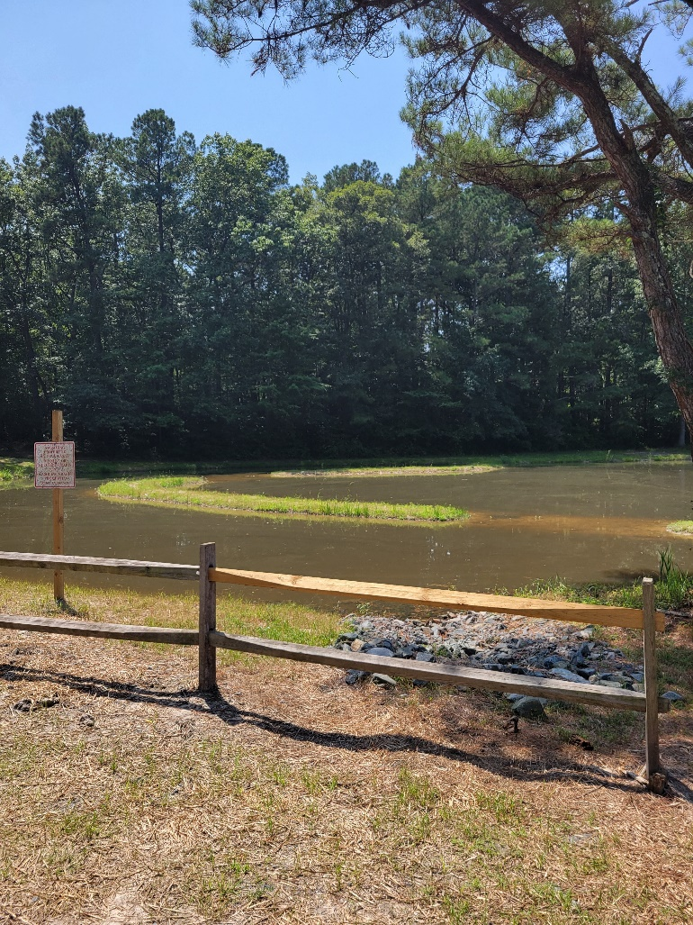
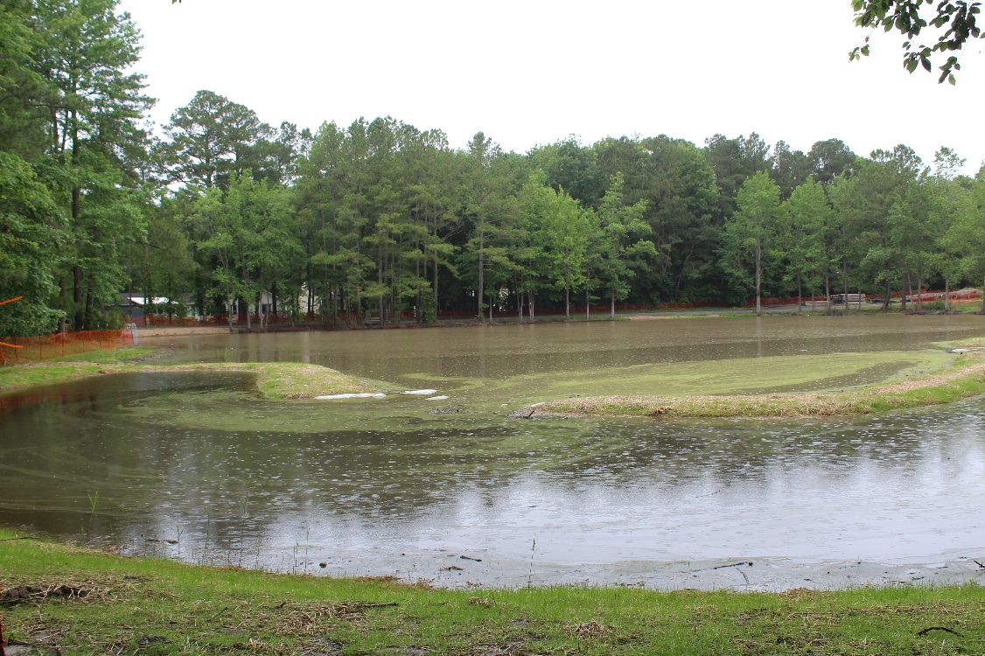
Bainbridge Filtration Initiative
Forebay - Inlet of the pond where filtration takes place before entering main pond. Separated by dirt berm, grasses and plants
Main Pond – benches for plants are located under the water.
$482,337 = Bainbridge Pond Grant Amount Awarded
8/13/2021
Pg. 31

Slide 32
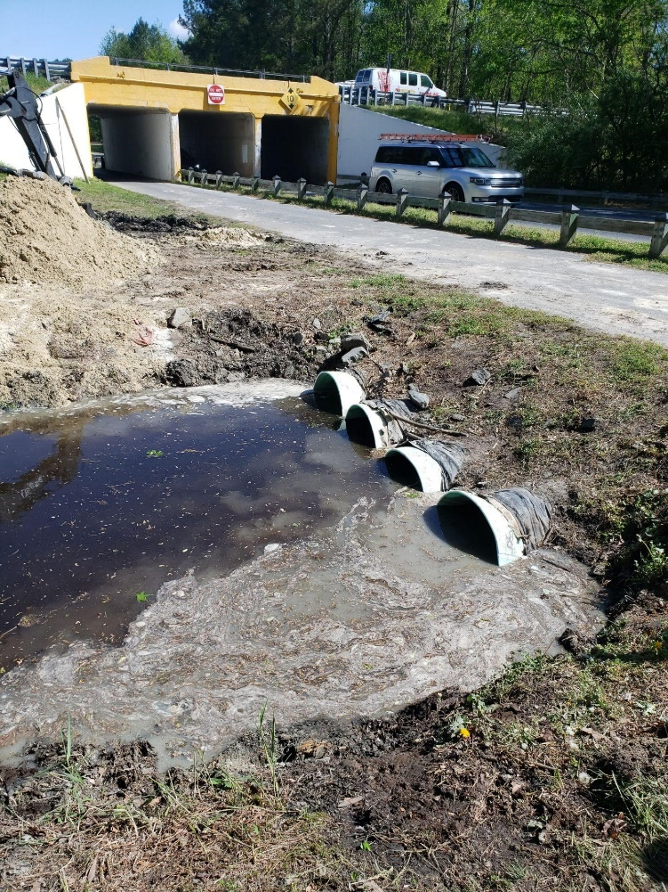

Drainage Pipe Replacement
Drainage Spend
FY 2018/19 $33,985
FY 2019/20 $611,983
FY 2020/21 $392,896
FY 2021/22 $477,500 budgeted
8/13/2021
Pg. 32

Slide 33
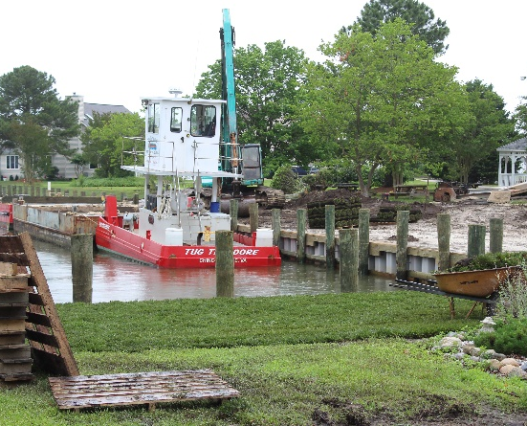
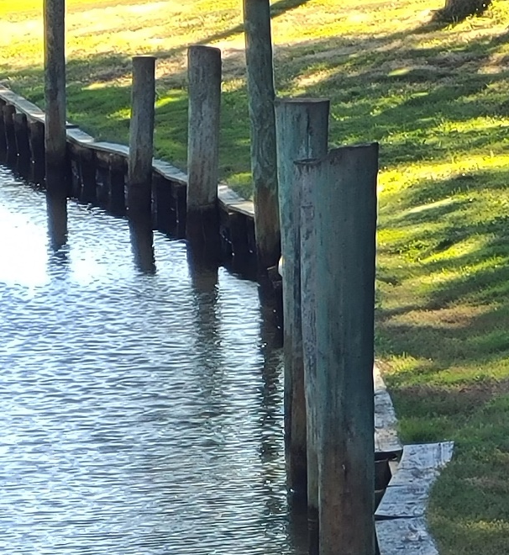
Bulkheads / Dredging
Bulkhead
FY 2018/19 $721,424
FY 2019/20 $1,559,188
FY 2020/21 $1,562,552
FY 2021/22 $1,368,221 budgeted
Dredging
FY 2018/19 $0
FY 2019/20 $19,660
FY 2020/21 $60,000 budgeted
FY 2021/22 $75,000 budgeted
8/13/2021
Pg. 33

Slide 34
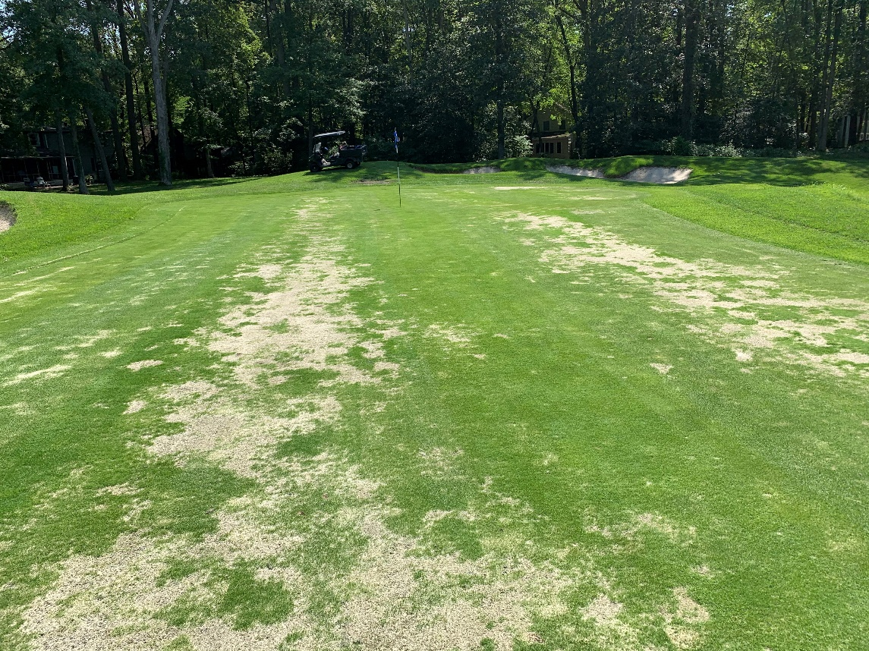
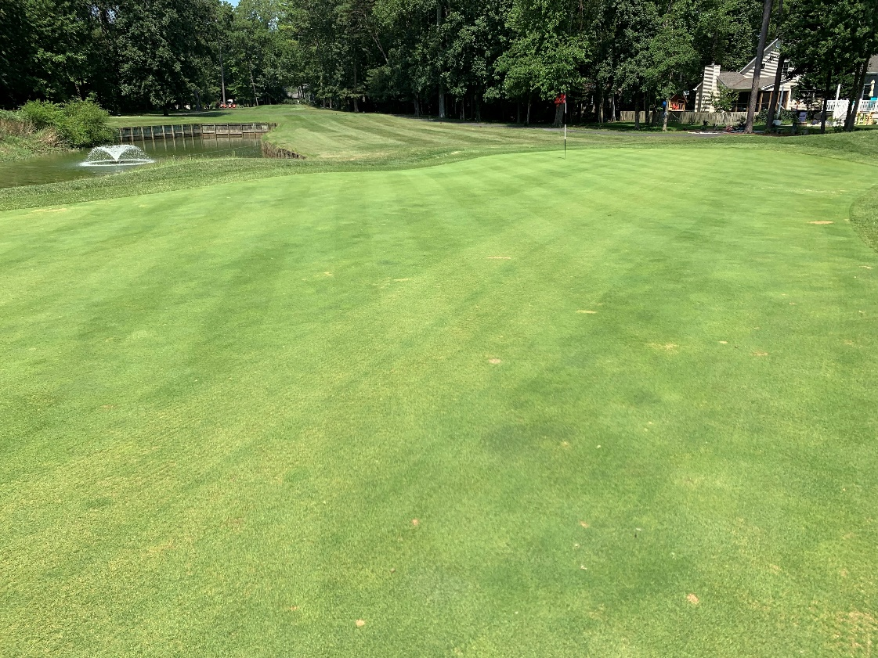
Golf Course Greens
July/August 2020
July/August 2021
Number of rounds and price per round trending to the upside
8/13/2021
Pg. 34

Slide 35
Summary
Where were we 3 years ago?
Operating deficit approx. $1.6 mil
Bulkheads, drainage and roads were not on track
Where are we today?
Operating surplus
Bulkheads, drainage and roads spend has increased
Completed major capital projects favorable to budget
How are we trending?
We are trending favorable to budget (as of June 30th $739,182)
Golf, Aquatics, Racquet Sports and Food & Beverage are all trending to the upside
We have an operating surplus
Bulkheads, drainage and roads programs

Slide 36
Unfinished
Business
None

Slide 37
New
Business
None

Slide 38
Election Committee
Report & Validation
Steve Habeger

Slide 39

Public comments

Slide 40

adjournment

