Slide 1

Ocean Pines Association
Annual Membership Meeting
August 13, 2022

Slide 2
Call to order
Pledge of allegiance

Slide 3
Appointments
Recorder – Linda Martin
Parliamentarian – Jeremy Tucker
Timekeeper – Mary Ann Whitcomb
Sergeant-at-Arms – Chief Leo Ehrisman
Teller – Bob Windsor

Slide 4
Presentation –
Sam Wilkinson Volunteer Award
Debbie Donahue

Slide 5
Ascertainment of Quorum
Colette Horn

Slide 6
Approval of Agenda
Approval of Minutes of Annual Meeting –
August 11, 2018

Slide 7
2022 Legal
Report
Jeremy Tucker

Slide 8
From the Auditors
UHY LLP
(formerly TGM Group LLC)
Presented by Chris Hall

Slide 9
Summary of Audit and Results
UHY LLP as independent auditors is engaged to audit and render an opinion on the financial statements of the Association. The financial statement which is the responsibility of management consists of 39 pages. The components of the financial statement are as follows:
    Independent Audit report
    Basic financial statements
    Supplementary Information
    Required Supplementary Information

Slide 10
Audit Report
Audit report is on pages 1-3 and is on UHY letterhead as it is prepared by us and renders our opinion on the financial statement prepared by management
Components of the audit opinion:
    Opinion and our basis for the opinion – I’m pleased to report that the Association received a “clean” unmodified audit opinion
    Discusses what management is responsible for, including preparation and fair presentation
    The auditor responsibility is to perform procedures to obtain audit evidence to express an opinion on the financial statements. Audit was conducted in accordance with auditing standards generally accepted in the United States that require us to plan and perform the audit to obtain reasonable assurance that the financials are free from material misstatement
    Procedures for supplementary information and required supplementary information

Slide 11
Quick overview of procedures
Timeline of procedures:
Late April – Planning, internal control documentation, risk assessments
April 30 - Perform sample test counts of inventory at various locations. Also, send out year end cash confirmations to financial institutions.
End of May/early June – year end fieldwork, balance sheet and income statement testing of accounts and transactions.
July/July – Wrap up procedures and financial statement preparation and review.
Today’s annual meeting.

Slide 12
2022 President’s Report
Ocean Pines Association – Annual Meeting of the Membership

Slide 13
Board Duties (Bylaws Section 5.14)
Governance
Policy Making
  Bylaws revisions
  Revisions to Declarations of Restrictions
  Electronic voting
  HR - Authorized hiring a consultant to bring our benefits and compensation in line with the market
  Strategic Planning: Homeowner survey completed by SPAC
    Top priorities:
      Safety
      Maintenance of infrastructure
      Community appearance & aesthetics

Slide 14
Board Duties
Budget Approval
  Approval of transfers from retained earnings
    $650K for historic $100 reduction to base assessment
    $350K for Roads Reserve
    $60K for New Capital Reserve to fund installation of T-docks at the Yacht Club

Slide 15
Board Duties
Approval of Expenditures
  Approval of equipment and contractors to complete GM’s initiatives related to drainage, beautification, and amenity conditions at the Racquet Sports complex and Golf Club

Slide 16
Board Duties
Employ a General Manager
  John Viola
    CPA, MBA, Team Leader, Visionary
    February 2019: Enlisted John’s help on a short-term volunteer basis
    April 2019: 2 ½ year contract
    February 2022: 2-year contract

Slide 17
Focus of Current Year:
Member Engagement
Hybrid meetings: Increase member access to Board meetings
Include information on agenda to help members participate meaningfully
Positive Messaging to the Membership

Slide 18
Regular Board Meeting Attendance Data

Slide 19
High and Low Regular Meeting Attendance by Year (Highest number of participants and lowest number of participants at a Regular Meeting for the year.)

Slide 20
Average Meeting Attendance 2013-2022

Slide 21
Number of Regular Meetings 2013-2022

Slide 22
Orderliness of Member Participation in Meetings
Provide information on Roberts Rules of Order on agendas and during meetings
Establish and adhere to ground rules for participation in the virtual environment

Slide 23
Give the membership a positive message:
Weekly President’s Column
  History of Ocean Pines: Founding mothers and fathers, pictorial, traditions
  Safety: Biking, swimming, golf course safety
  Environmental: Health of our waterways
  OPA Financials

Slide 24
Challenges for the
New Board
Legislation - Minimum requirements for reserve contributions
Legislation - Due process for restriction of membership privileges for continuing violations of our restrictive covenants
Southgate Fire House
Strategic plan to guide the Association into the future

Slide 25
General Manager’s
Report
John Viola

Slide 26


info@oceanpines.org
CALL
410-641-7717
After hours, call Ocean Pines Police at 410-641-7747

Slide 27

Your assessment
dollars at work

Slide 28
Where were we?
Deficit of $1.6 million
Bulkhead, drainage, dredging, and road programs needed to be jump-started
Needed to implement a plan and objectives
Need for compensation study
Needed to complete forensic audit and summarize
Identified a need for an RFP system
Identified a need to outsource food & beverage
8/13/2022
Pg. 28

Slide 29
What have we done?
2019:
  After $1.2M budget deficit from prior year, closed April 2019 with a $130,000 positive variance
  Workgroups formed to jump-started drainage and bulkhead programs
  Bullkhead program jump-started
  Sibson employee compensation study
  Improvements to Board meeting videos
  Transition to Northstar
  New website launched
  Ortt Companies contract extension signed (win-win)
2020:
  Secured PPP funding
  Installed safety protocols for COVID
  New Clubhouse and Cart Barn (under budget)
    Clubhouse: $1,483,562 ($1,600,000 budgeted)
    Cart Barn: $312,121 ($430,000 budgeted)
  Clubhouse Bar & Grille opened
  Police Department renovation (under budget)
    $1,195,000 ($1,300,000 budgeted)
8/13/2022
Pg. 29

Slide 30
What have we done?
2021:
  Set up successful communication plan and the team managed and executed during the COVID period, delivering positive results
  Budget favorability of $1.275 million
  Brought the operating account (retained earnings) out of the deficit position into a positive surplus balance
  Drainage projects, including pipe replacements and relining (a new process at a considerable savings)
  New playground at Robin Hood Park
  Ocean Pines Academy launched
  Golf course maintenance improved; starts showing results (outside consultant/strategic plan)
  Roads program jump-started
  Customer service initiative (info@oceanpines.org)
  Website streamlined and made more efficient
  New Craft Club building
  “DMA Lite” reserve study
  Deferred maintenance at Racquet Sports jump-started
  Record-breaking performance for food and beverage
  Community survey for strategic planning
  Beautification efforts (trees, bridge)
  Defibrillators purchased for all OPA facilities
8/13/2022
Pg. 30

Slide 31
Where are we today
(FY 2021/2022)?
Record-setting assessment reduction
Record-setting budget favorability
Racquet Sports improvements, including new pickleball courts
Golf operation profitable
Aquatics and Recreation & Parks thriving!
Marina slips have a wait list
North Gate Bridge improvements
More beautification efforts
High-priority mailboxes and pedestals being replaced
Online assessment payment for the first time
Online voting
Hybrid meetings
Improvements to allow for more spaces for hybrid meetings
Clubhouse improvements (acoustics)
Codifying strategic plan – updated process
Objectives prepared/presented to Board and cascaded to team
8/13/2022
Pg. 31

Slide 32
Current Initiatives
Drainage Pipe Liners
Bulkheads / Dredging
Landscaping
North Gate Bridge
  Cleaning
  Guard Shack
  Railing
  New Lights
Hybrid Meetings
  Clubhouse Acoustics
T-Docks
New Pickleball Courts and Existing Pickleball Court Renovation
Golf Course Maintenance
Facility Maintenance
  Golf
  Swim & Racquet
  Mumfords Boat Ramp
  Yacht Club
Addressing new legislation for HOA reserves
  Updating reports/analysis – will update Budget & Finance then review/update with DMA
8/13/2022
Pg. 32

Slide 33
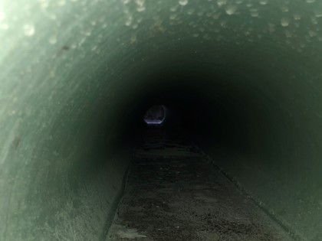
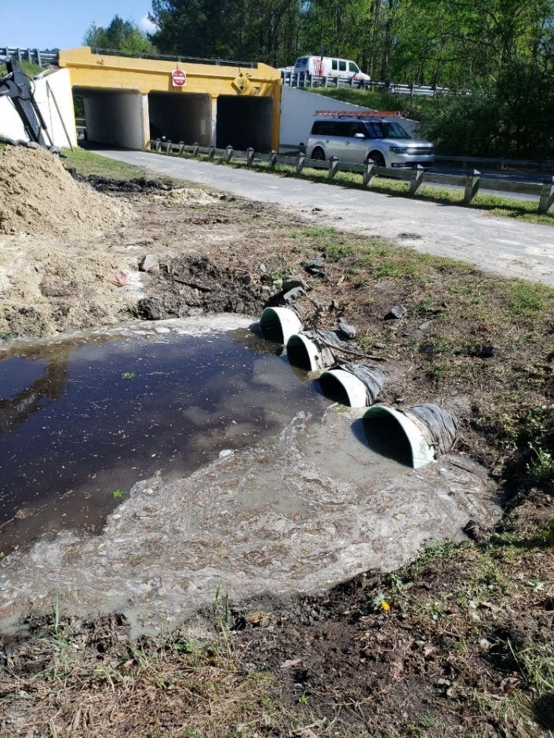
Drainage Pipe Liners

Slide 34
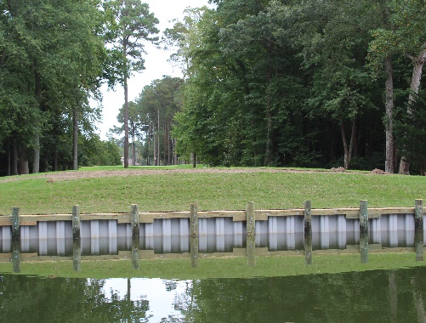
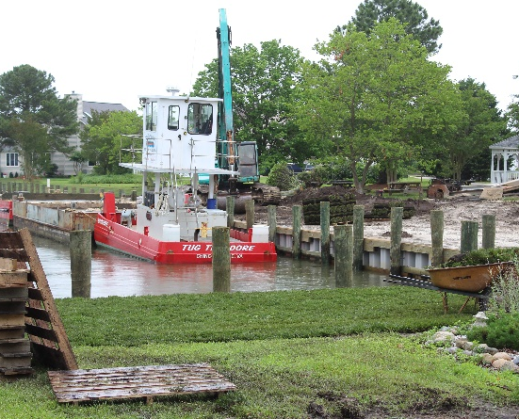
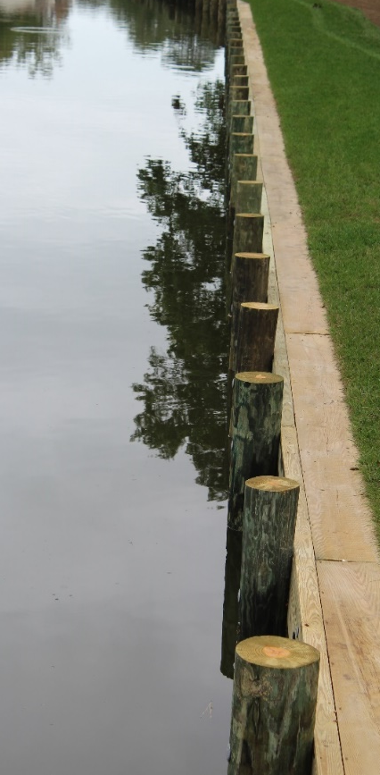
Bulkheads / Dredging

Slide 35
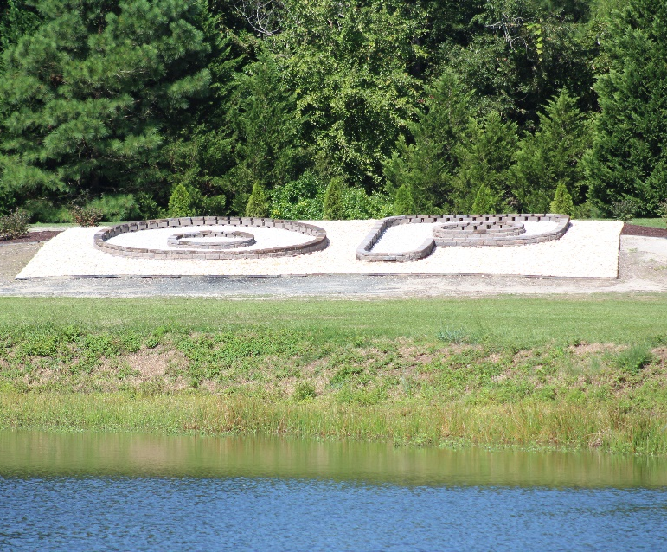

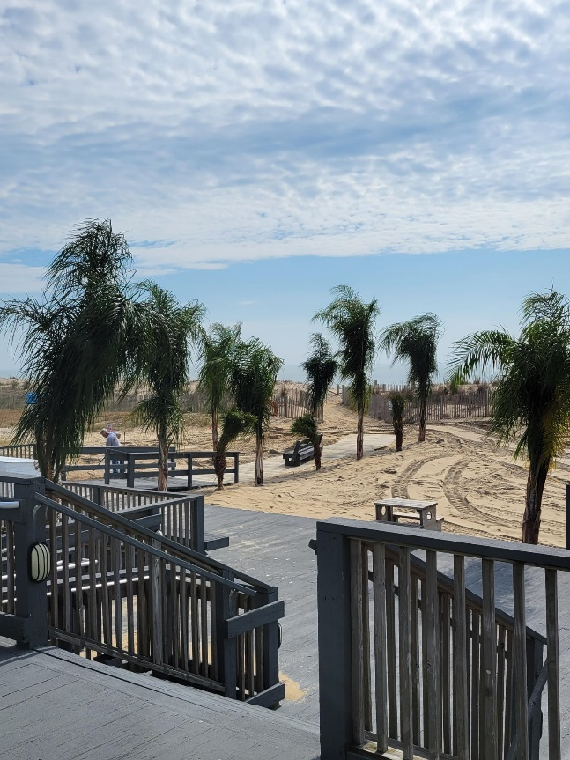
North Gate
New “OP” Layout
Floating Planters in
North Gate pond
Palm trees are back at
the Beach Club!
Landscaping

Slide 36
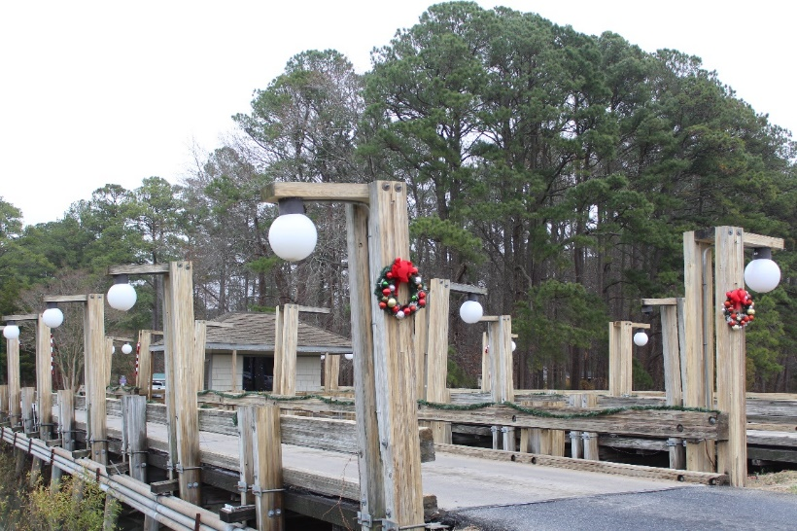
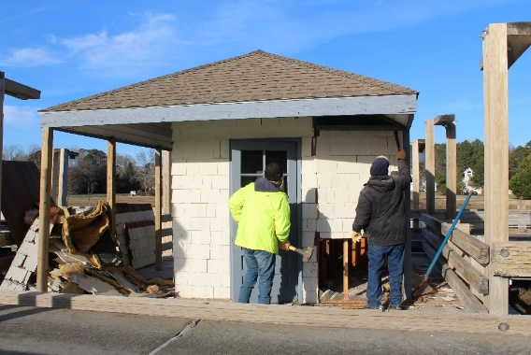
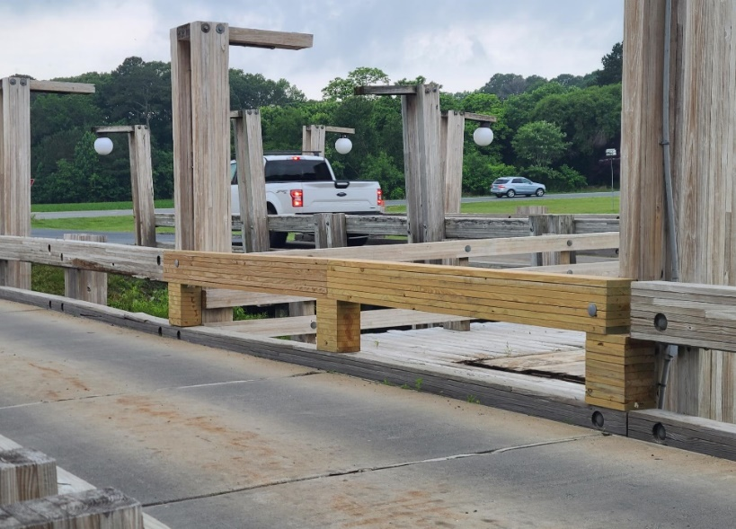
Bridge Cleaned –
December 2021
Guard Shack Removal – January 2022
New Lights –
To be installed
August 2022
North Gate Bridge

Slide 37
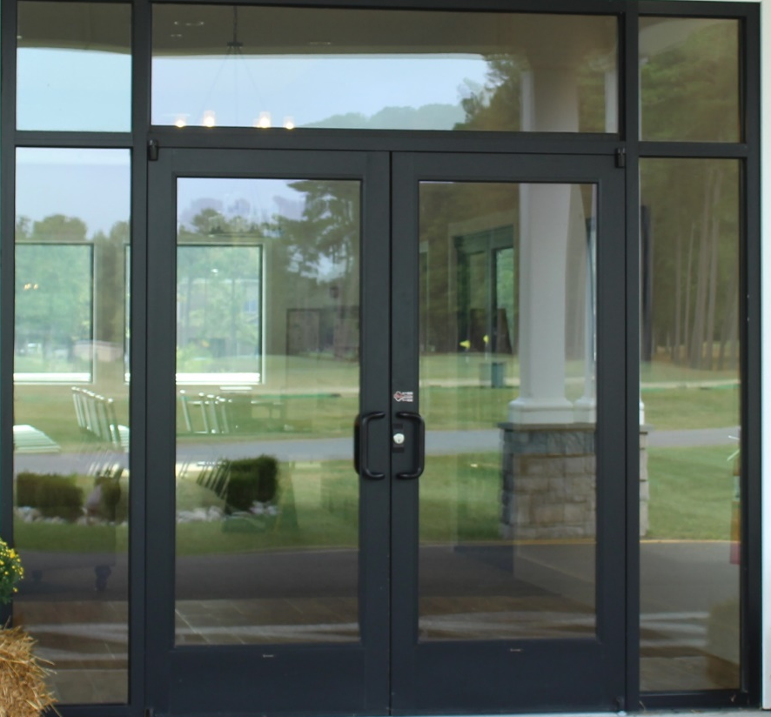
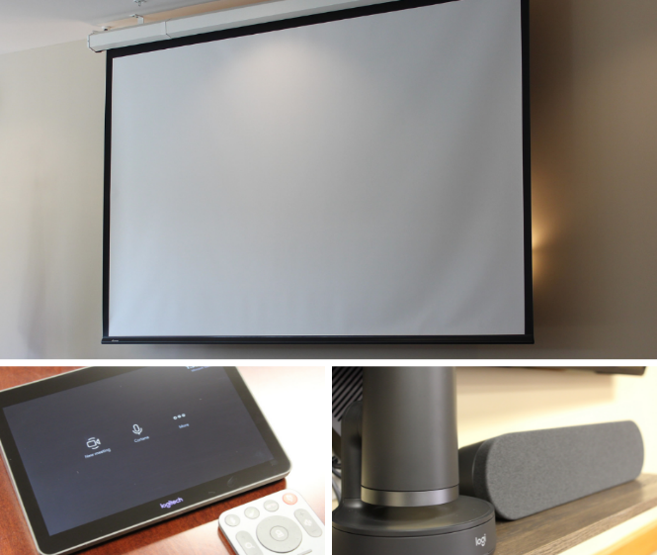
Clubhouse Meeting Room
New Hybrid System
Hybrid Meetings

Slide 38
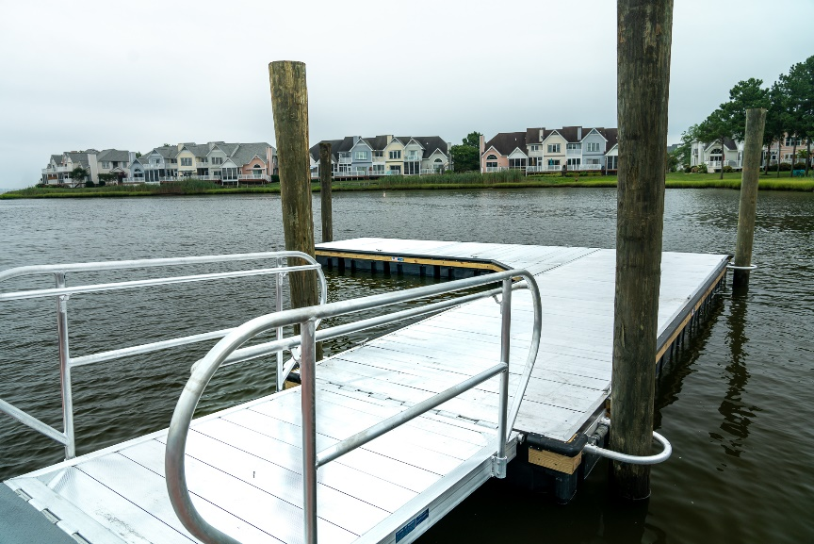
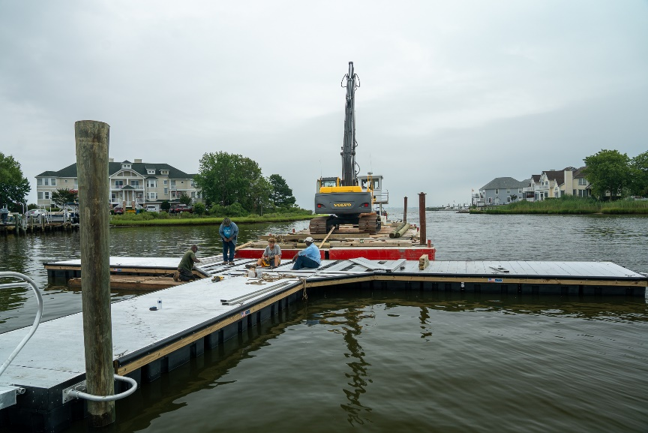
T-Docks

Slide 39
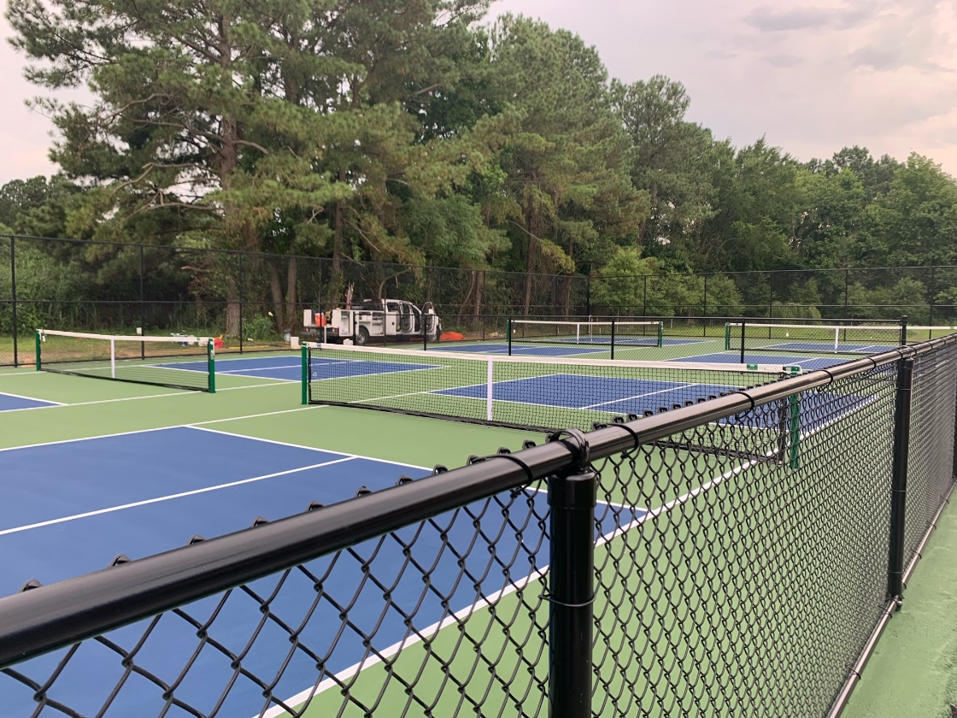
Pickleball Courts

Slide 40
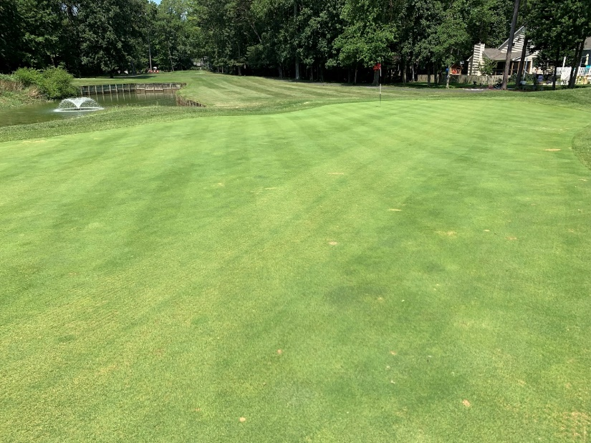
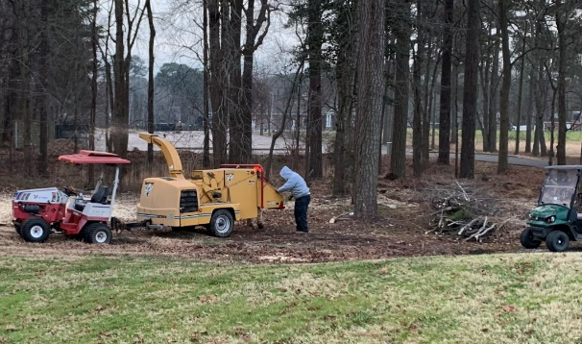
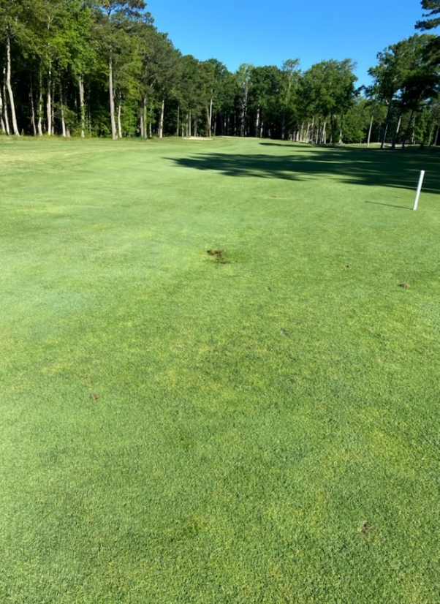
Greens
Number of rounds and
price per round
trending to the upside
Golf Debranching
Better airflow, better play
Team effort (Public Works and Golf Maintenance)
Golf Drainage Work
Golf Course Maintenance

Slide 41
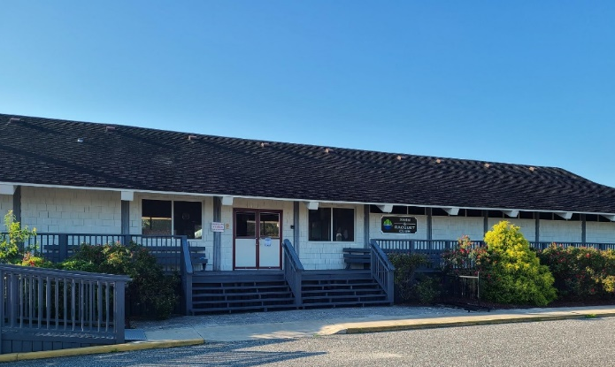
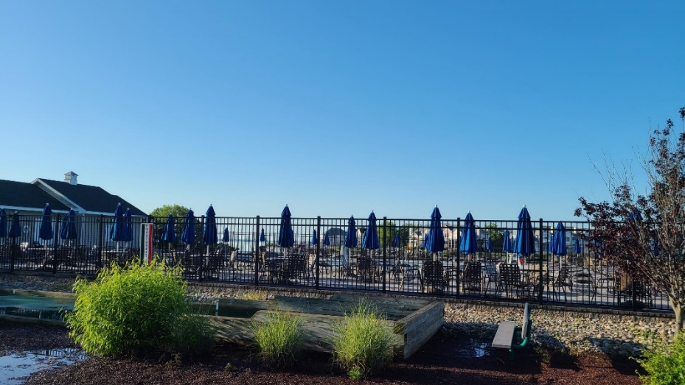
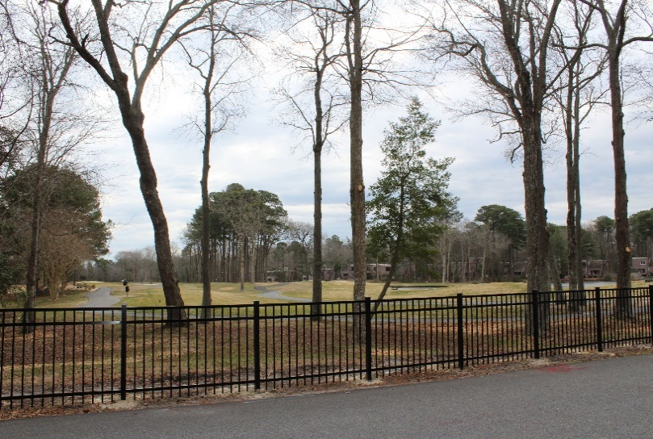
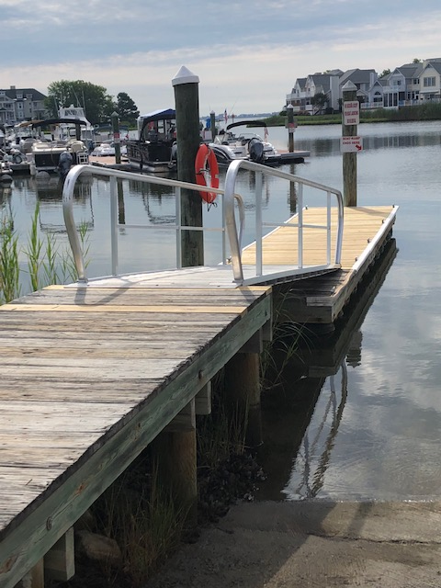
New Fences – Yacht Club Pool & Golf
Swim & Racquet
Building repaired and painted
New Ramp
Mumfords Landing
Facility Maintenance

Slide 42
Summary
Where were we prior to 3 years ago?
Operating deficit approx. $1.6 mil
Bulkheads, drainage and roads were not on track
Where are we today?
Operating surplus
Bulkheads, drainage and roads spend has increased
Safety – increased spend (Fire, EMS, Police)
Completed major capital projects favorable to budget
Assessments reduced due to allocation of surplus
How are we trending?
We are trending favorable to budget (as of June 30th $414,732)
Golf, Aquatics, Racquet Sports and Food & Beverage are all trending to the upside
We have an operating surplus
Bulkheads, drainage and roads programs
Addressing new legislation for HOA reserves

Slide 43
2022
Financial Report
John Viola & Steve Phillips

Slide 44
SUMMARY OF OPERATING FUND AUDITED FINANCIAL RESULTS
FISCAL YEAR 2022 ACTUAL COMPARED TO BUDGET

Slide 45
AMENITIES SUMMARY OF OPERATING FUND AUDITED FINANCIAL RESULTS
FISCAL YEAR 2022 ACTUAL COMPARED TO BUDGET

Slide 46
SUMMARY OF OPERATING FUND AUDITED FINANCIAL RESULTS
FISCAL YEAR 2022 ACTUAL COMPARED TO FY 2021 ACTUAL

Slide 47
AMENITIES SUMMARY OF OPERATING FUND AUDITED FINANCIAL RESULTS
FISCAL YEAR 2022 ACTUAL COMPARED TO FY 2021 ACTUAL

Slide 48
SUMMARY OF DISTRIBUTION OF ANNUAL BASE ASSESSMENT
FISCAL YEAR 2022 ACTUAL COMPARED TO BUDGET & 2021 ACTUAL

Slide 49
OPERATING DEPARTMENTS DISTRIBUTION OF ANNUAL BASE ASSESSMENT FISCAL YEAR 2022 ACTUAL TO BUDGET & 2021 ACTUAL

Slide 50
AMENITIES DISTRIBUTION OF ANNUAL BASE ASSESSMENT
FISCAL YEAR 2022 ACTUAL COMPARED TO BUDGET & 2021 ACTUAL

Slide 51
OPERATING FUND PERFORMANCE HISTORY
FY 2017 – FY 2022

Slide 52
ANNUAL ASSESSMENT HISTORY
FY 2019 - 2023
FY 2023 ASSESSMENT | $896
FY 2019 ASSESSMENT | 951
5-YEAR DECREASE | ($55)
% DECREASE – TOTAL | (5.8%)
% DECREASE – ANNUAL AVERAGE | (1.1%)
RECENT HISTORY
 | 5-YEAR INCREASE (DECREASE)
FY | AMOUNT | % | NEW ASSESSMENT
2019 | 0 | 0 | 951
2020 | 35 | 3.7 | 986
2021 | 0 | 0 | 986
2022 | 10 | 1.0 | 996
2023 | (100) | (10.0) | 896
5-YEAR CUMULATIVE DECREASE | ($55) | (5.3%)
AVERAGE ANNUAL DECREASE | ($11) | (1.1%)

Slide 53
FIXED ASSETS SUMMARY
FY 2022

Slide 54
UNAUDITED ESTIMATE OF FY 2023
RESERVES ACTIVITY

Slide 55
BALANCE OF RESERVES
 |  |  |  | FY 22/23 | FY 23/24 | FY 24/25 | FY 25/26 | FY 26/27
ESTIMATED STARTING BALANCE 5/1/XX |  |  |  | 4,769,395 | 5,980,561 | 6,073,056 | 5,947,397 | 5,947,397
 | NOTE: - BALANCE BASED ON AUDITED FINANCIAL STATEMENTS FOR THE PERIOD ENDED 4/30/22
ESTIMATED CONTRIBUTION
 | FUNDED CONTRIBUTION PER DMA STUDY WITH 3.08% INFLATION FACTOR INCLUDED |  |  | 1,710,166 | 1,775,152 | 1,842,608 | 1,912,627 | 1,985,307
 | TOTAL CONTRIBUTION |  |  | 1,710,166 | 1,775,152 | 1,842,608 | 1,912,627 | 1,985,307
 | SUBTOTAL FOR INTEREST CALCULATION |  |  | 6,479,561 | 7,755,713 | 7,915,664 | 7,860,024 | 7,932,704
 | INTEREST = FY 2022/2023 PER APPROVED BUDGET. FY 23/24 - FY 27/28 ESTIMATES BASED ON FORMULA THAT REFLECTS CHANGING BALANCES |  |  | 60,000 | 71,817 | 73,298 | 72,783 | 73,456
AVAILABLE FOR SPENDING |  |  |  | 6,539,561 | 7,827,530 | 7,988,962 | 7,932,807 | 8,006,160
 | ESTIMATED SPENDING - FY 22/23 FROM APPROVED BUDGET AND SUBSEQUENT CHANGES IN ESTIMATED SPENDING FOR INDIVIDUAL PROJECTS; FY 23/24 - FY 27/28 FROM DMA RESERVE STUDY |  |  | 559,000 | 1,754,474 | 2,041,565 | 1,688,987 | 1,458,246
ESTIMATED YEAR END BALANCE (4/30/XX) |  |  |  | 5,980,561 | 6,073,056 | 5,947,397 | 6,243,820 | 6,547,914
 | DMA CONTRIBUTION INFLATION FACTOR PERCENTAGE | 3.08%
 | Estimated Fully Funded Reserve Amount: FROM DMA STUDY |  |  | 22,281,323 | 22,281,323 | 22,281,323 | 22,281,323 | 22,281,323
 | Percent of Full Funding (Component Cost Reserve Projection Method) |  |  | 26.8% | 27.3% | 26.7% | 28.0% | 29.4%
 |  |  |  | FY 22/23 | FY 23/24 | FY 24/25 | FY 25/26 | FY 26/27
 | IS PERCENT OF FULL FUNDING AT LEAST 22% ? |  |  | YES | YES | YES | YES | YES

Slide 56
Unfinished
Business
None

Slide 57
New
Business
None

Slide 58
Election Committee
Report & Validation
Carol Ludwig

Slide 59

Public Comments

Slide 60

Adjournment

