Slide 1


Ocean Pines Association
Annual Membership Meeting
August 9, 2025

Slide 2
Call to order
Pledge of Allegiance

Slide 3
Appointments
Recorder – Linda Martin
Parliamentarian – Bruce Bright
Timekeeper – John Latham
Sergeant-at-Arms – Chief Tim Robinson
Teller – Steve Ransdell

Slide 4
Presentation –
Sam Wilkinson
Volunteer Award
Debbie donahue

Slide 5
Ascertainment of
Quorum
Dr. STUART LAKERNICK

Slide 6
Approval of Agenda
Approval of Minutes of Annual Meeting –
August 26, 2023

Slide 7
2025 Legal Report
BRUCE BRIGHT

Slide 8
From the Auditors
UHY LLP
Presented by chris hall

Slide 9




UHY LLP as independent auditors is engaged to audit and render an opinion on the financial statements of the Association. The financial statement which is the responsibility of management consists of 44 pages. The components of the financial statement are as follows:
      Independent Audit report
      Basic financial statements
      Supplementary Information
      Required Supplementary Information
Summary of Audit and Results

Slide 10
Audit report is on pages 3-5 and is on UHY letterhead as it is prepared by us and renders our opinion on the financial statement prepared by management
Components of the audit opinion:
      Opinion and our basis for the opinion – I’m pleased to report that the Association received a “clean” unmodified audit opinion
      Discusses what management is responsible for, including preparation and fair presentation
      The auditor responsibility is to perform procedures to obtain audit evidence to express an opinion on the financial statements. Audit was conducted in accordance with auditing standards generally accepted in the United States that require us to plan and perform the audit to obtain reasonable assurance that the financials are free from material misstatement
      Procedures for supplementary information and required supplementary information
Audit
Report

Slide 11
Timeline of procedures:
  Late April – Planning, internal control documentation, risk assessments
  April 30 - Perform sample test counts of inventory at various locations. Also, send out year end cash confirmations to financial institutions
  End of May/early June – year end fieldwork, balance sheet and income statement testing of accounts and transactions
  July/July – Wrap up procedures and financial statement preparation and review
  Today’s annual meeting
Quick overview of procedures

Slide 12

2025
President’s Annual Report
Dr. Stuart Lakernick

Slide 13
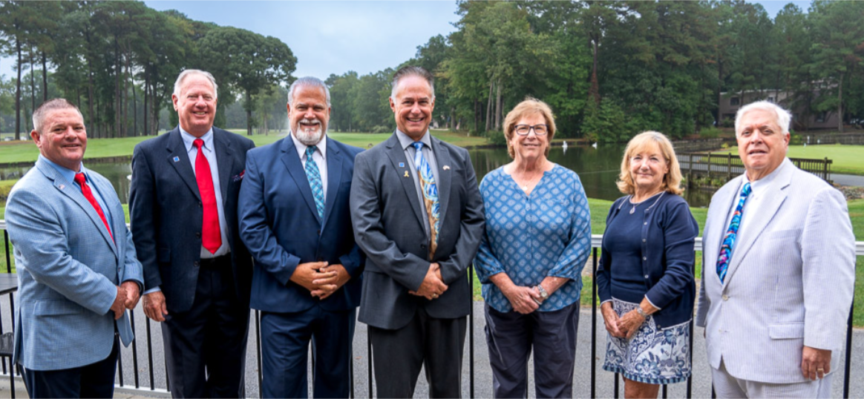
Significant Board Accomplishments

Slide 14
- Keeping our annual assessments low while increasing our Police Department and upgrading all our amenities
- New Golf Course Irrigation – New Pump Station
- Brought in Touch of Italy – our new restaurateur
- Referendum to build the new southside firehouse – HISTORIC
- Brought forth a BRAND NEW Racquet Sports Center Building
- Renovated courts at Racquet Center – landscaping refreshed at Racquet Center
- Refresh of Beach Club interior, painting, landscaping with increased palm trees (also at Yacht Club, Beach Club, and north gate; updated landscaping including cherry trees, north gate flowers (sunflowers), and enhanced holiday decorations (Menorah and Kwanzaa)
- Electric sign expansion at the Yacht Club and south gate
- Increased safety – now have 13 full-time police officers
- Handicap accessibility for children at our parks
- Dog Park rain enclosure scheduled to be installed
- Increased beautification throughout Ocean Pines
- Aggressive in collection of past unpaid assessments
- Driving range building renovation
- Brand new Veterans Memorial Pavilion
- Fully staffed lifeguards at ALL pools
- Brand new bocce ball courts
- Annual road resurfacing
- Continued funding for water pipes lining
- Our hit podcast hosted by Tony Russo (PinesCast)
- New gym floor in the Community Center
- On track to be positive to budget approximately $1 million after depreciation

Slide 15
Special thanks to the following for their service to the Ocean Pines Association:
- Previous Board President and current Parliamentarian Doug Parks
- Senior Director of Administration Linda Martin for her support to the board
- All current board members for their outstanding service to our Ocean Pines community
- All volunteers that serve on our Advisory Committees
- All the Administrative Staff of Ocean Pines Association

Slide 16
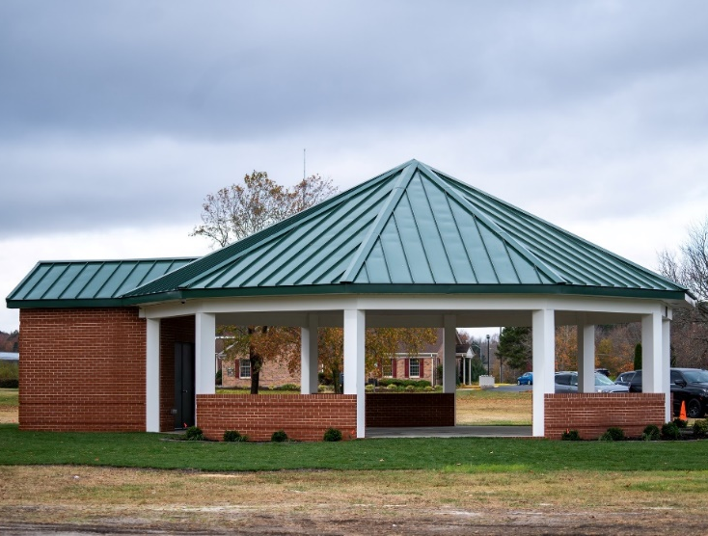
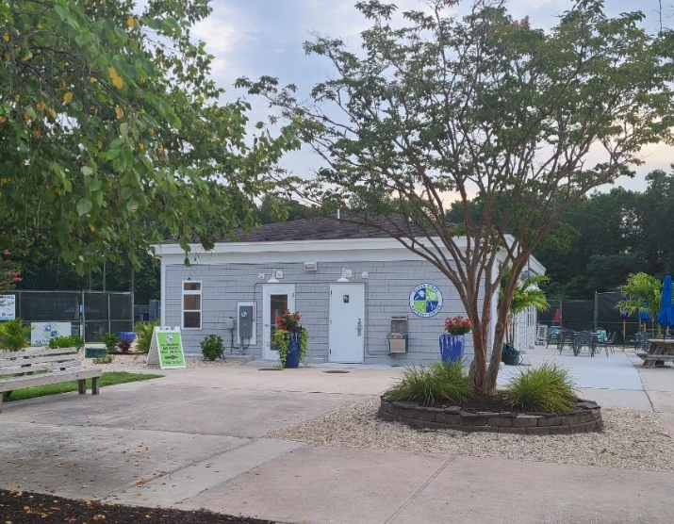

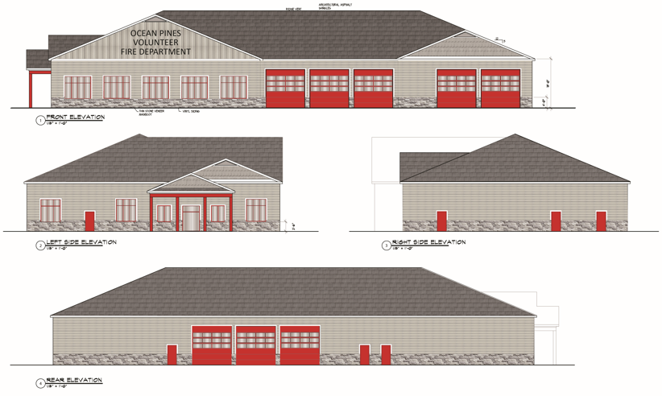
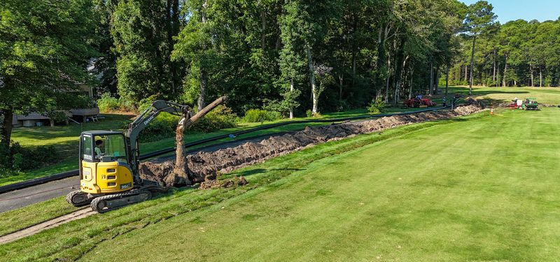
General Manager’s
(Team) Report
John Viola
Linda martin

Slide 17
Our Approach
Overview
Amenities
  Aquatics
  Beach Club
  Golf
  Marina
  Racquet Sports
  Recreation & Parks
    Bocce Ball Courts
    Gym Floor
    Dog Park
  Veterans Memorial
  Food & Beverage
Safety
  OPVFD
  Police
Infrastructure
  Bulkheads & Waterways
  Mailboxes
  Drainage
  Roads
  Landscaping & Beautification
  Metrics
Initiatives

Slide 18
Enhancing the customer experience
Investing in amenities
Investing in infrastructure
  Drainage
  Mailboxes
  Roads
  Bulkheads
Drive efficiencies
Reallocate costs
Organic revenue
Providing excellent customer service
Our Approach

Slide 19
Where were we?
Operating deficit approx. $1.6M
Assessments at an all-time high of $996
Drainage, bulkheads, and roads not funded
All amenities had operating losses
Where are we today?
Operating surplus of $3.1M at end of fiscal year 24/25
Estimated $200 of savings on assessments ($40 per year over the last 5 years)
The current and prior year assessments of $875 and $850 are lower than any year since FY 2013
Continue controlling expenses while funding safety
Robust drainage, bulkhead, and road programs
Amenities continue to show improvement over prior years
What is next?
We are positioned well going into major construction initiatives:
  Firehouse construction
  Golf course irrigation phase III
  Continued drainage and mailbox replacement
  We are scheduled for the reserve study in the Fall
We believe we have a “goldilocks situation”
Overview

Slide 20
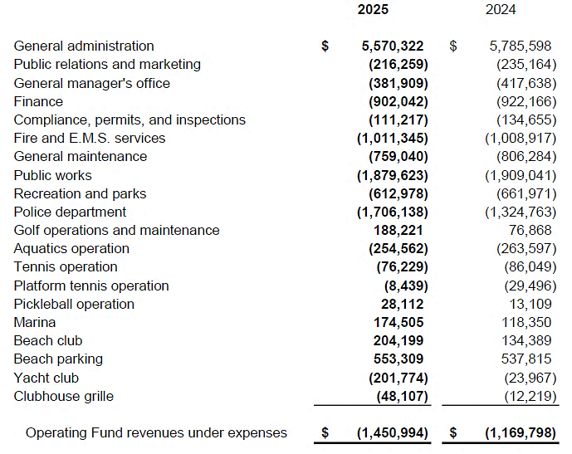
SCHEDULE OF NET REVENUES AND EXPENSES
(INCLUDING DEPRECIATION) BY DEPARTMENT

Slide 21
Aquatics
Enhancements to customer experience:
  Yacht Club Pool open until 7:00 p.m. on Friday, Saturday, and Sunday
  Swim & Racquet Pool open until 8:00 p.m. on Friday, Saturday, and Sunday
  Self-taught aerobics class added at Mumfords Pool
  Safety issue with ladder at the Yacht Club Pool addressed
    Aquatics Advisory Committee requesting same for Mumfords Pool – requires a redesign of the pool; also have received no complaints regarding any safety issues with the current steps at the pool
  Next to be addressed:
    Painting of restrooms at Swim & Racquet (to be done in off-season)

Slide 22
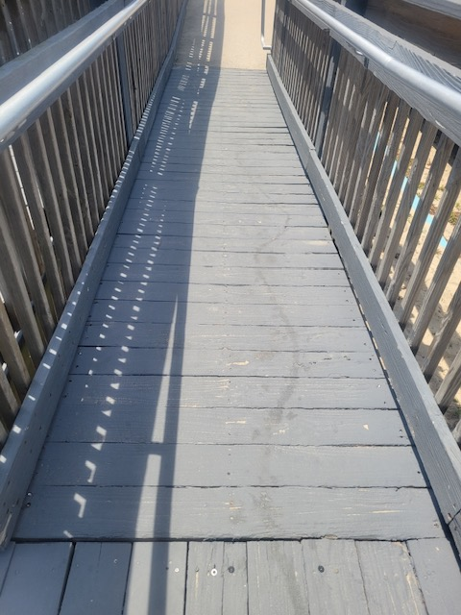
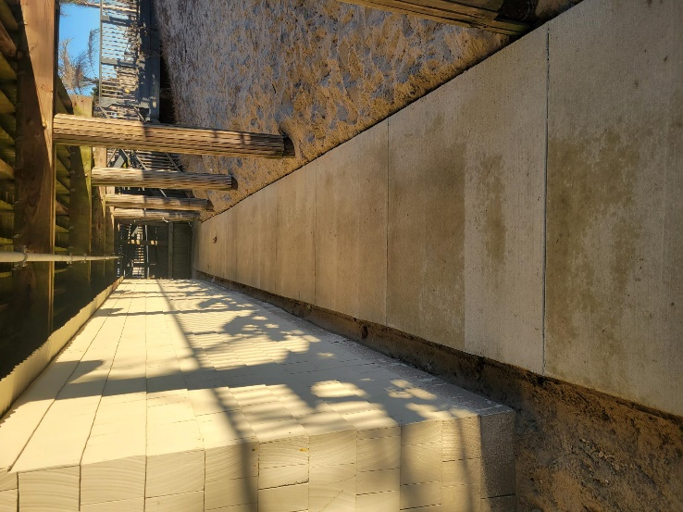
Beach Club
Maintenance:
  Ongoing repairs to decking as needed
  Exterior decking painted at the beginning of the season
  Wood walkway replaced with concrete for safety

Slide 23
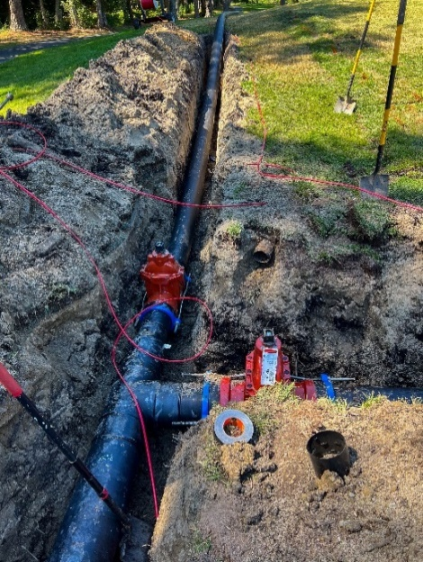
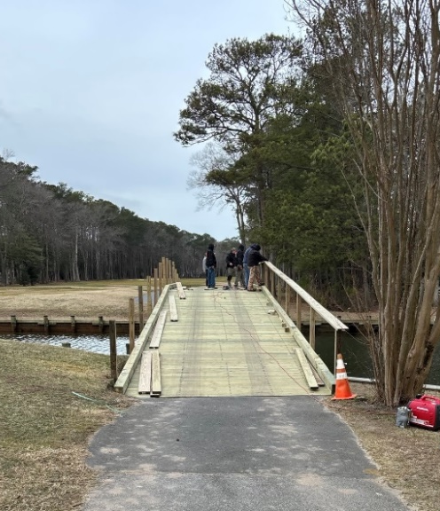
Golf
Ocean Pines Golf Club voted as best golf course (The Best of Ocean City 2025)
Irrigation Project:
  Phase I: hole #1, 4th tee, hole #9, practice range, & pump station
  Emergency phase: holes #2, #3, and #19
  Phase II (current): holes #4-8
          Maintenance:
            Bridge on 4th fairway repaired

Slide 24
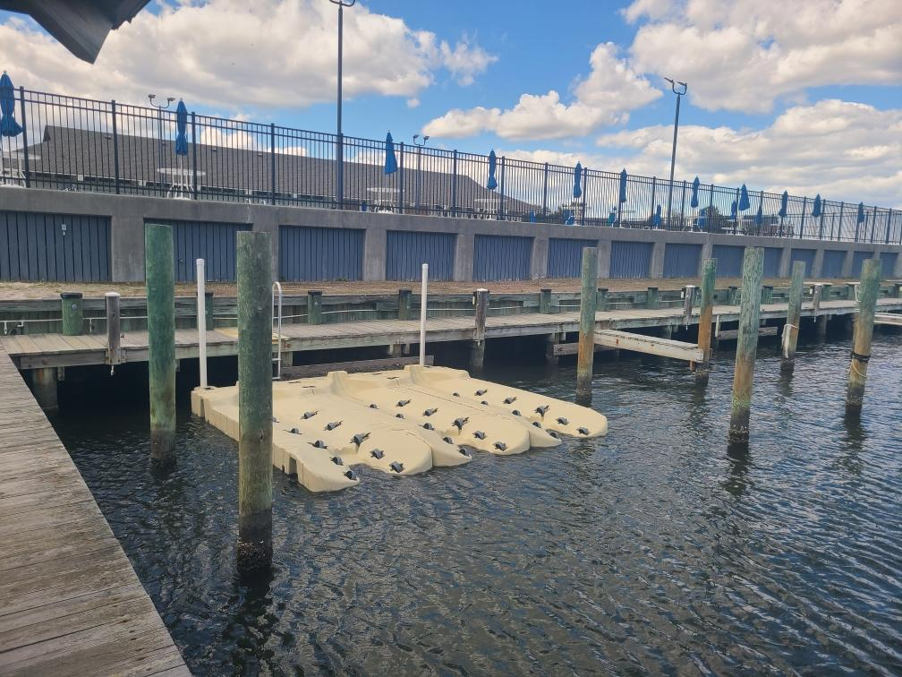
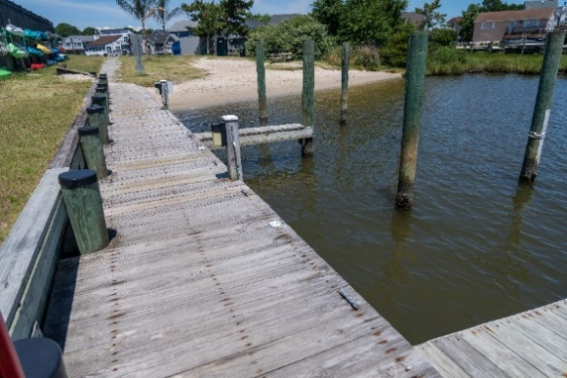
Marina
Yacht Club Marina: voted a Maryland Clean Marina for the third year in a row!
Enhancements to Swim & Racquet Marina:
  6 jet ski launches installed
  Slips: $1,200 each; 5 currently taken
  ROI in 3-4 years
Maintenance:
  Repaired docks and decks at both Yacht Club and Swim & Racquet Marina

Slide 25
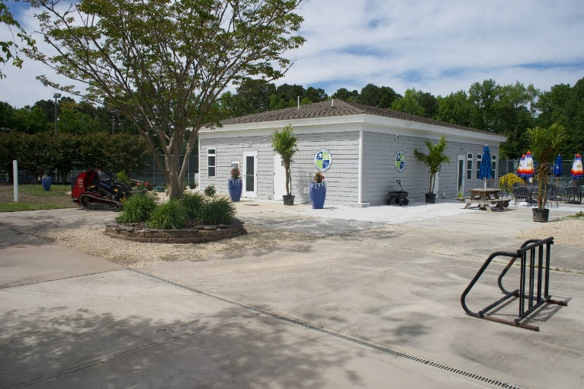
Racquet Sports
Renovation:
  Based upon guidance of Racquet Sports community, building was renovated and opened in May
Maintenance:
  Within the last year, around $50,000 spent on maintenance at the racquet center
  Cracks on tennis hard courts and pickleball courts scheduled to be repaired

Slide 26
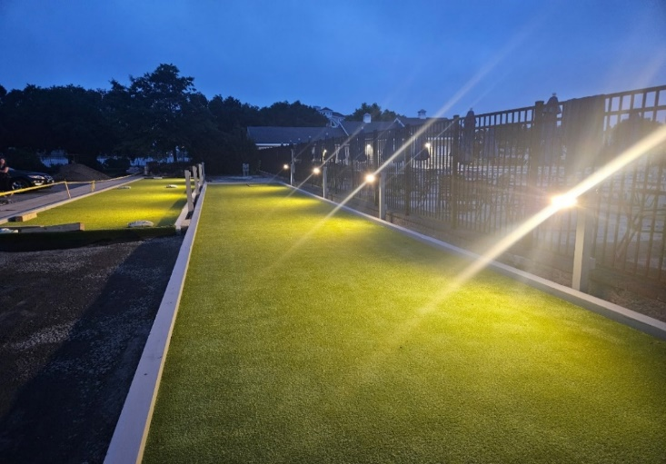
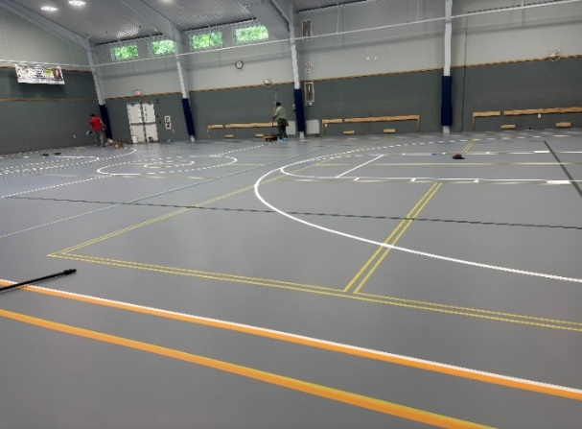
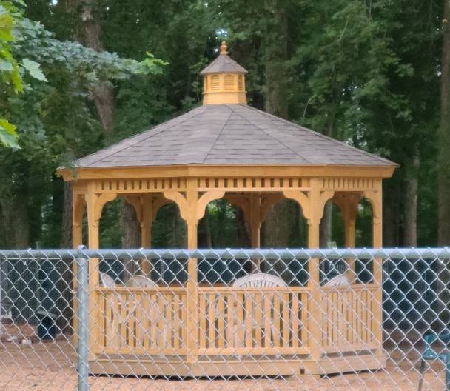
Recreation & Parks
Enhancement to bocce ball courts at the Yacht Club:
  Opened for play June 19th
  Projected membership revenue of $1,500 (1st year)
  Projected ROI of $85,343 by FY 2027 (includes membership fees and food & beverage)
Community Center: gym floor replaced
Dog Park: shade/rain structure installed

Slide 27
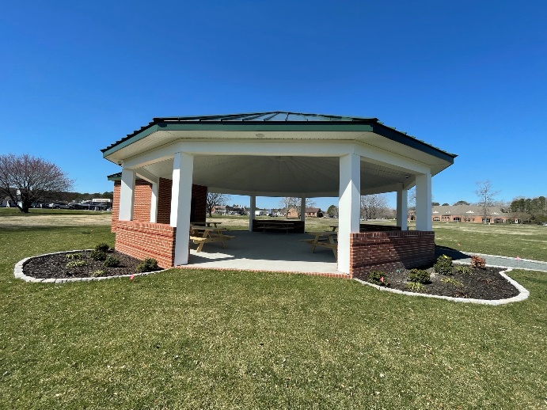
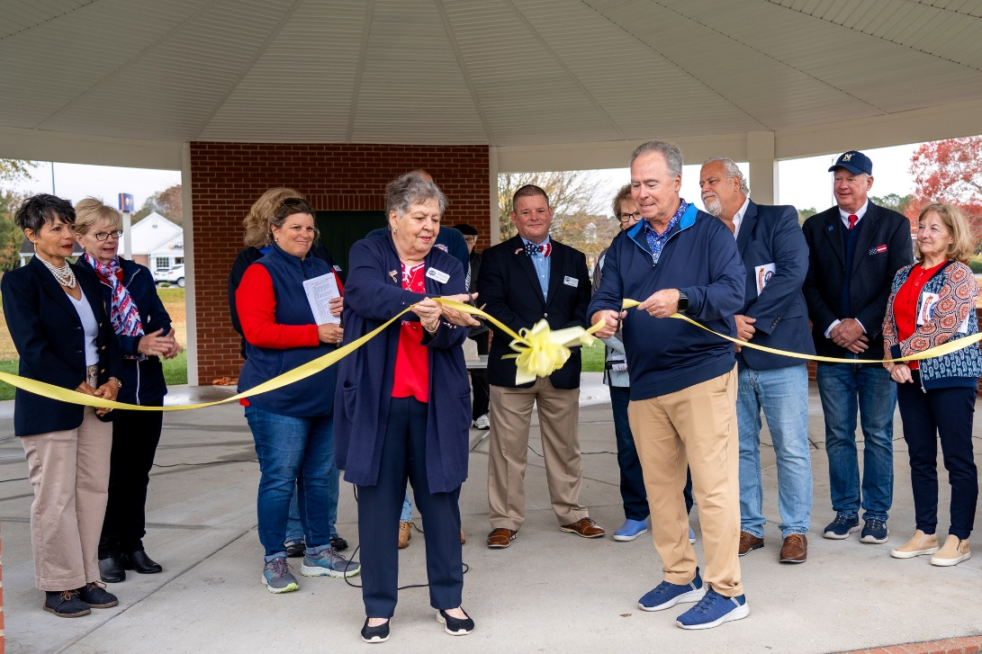
Veterans Memorial
Upon request of Veterans Memorial Foundation members, received feedback on gazebo design
Gazebo to be utilized for educational field trips and other events
Ribbon cutting ceremony held on Veterans Day

Slide 28
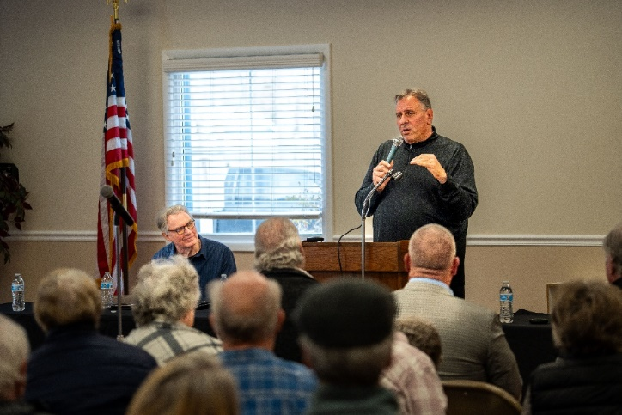

Food & Beverage
5-year lease agreement recommended by senior management and approved by the Board on January 8, 2025
Town hall held on January 16, 2025

Slide 29
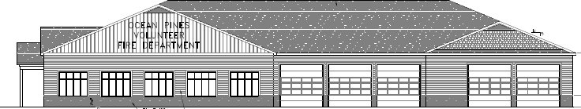

Safety
OPVFD:
  New south station firehouse
  Recommended to fund through balance sheet with a focus on reserves
  Estimated $3.7 million with a 10% contingency
Police:
  Staffing of department on track
  Cell tower proposed to be installed near golf maintenance building

Slide 30
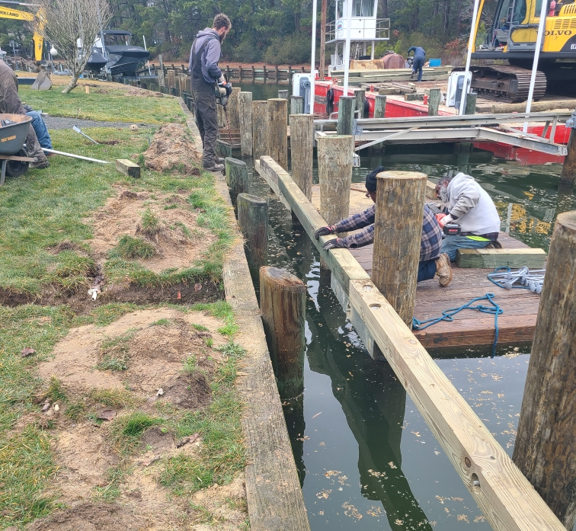
Bulkheads & Waterways
Bulkhead Replacement:
  2024/2025 replacement included Wood Duck Drive, Mallard Drive East, and Ebb Tide Court
  Board approved next two years bulkhead replacement at the March 29, 2025 meeting
    Locked in price of $450 per linear foot
    1,500 linear feet to be completed each year

Slide 31
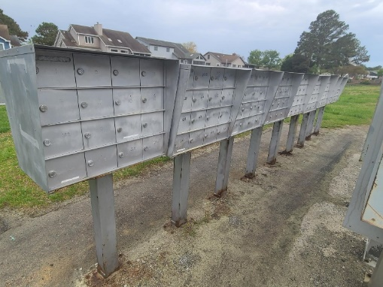
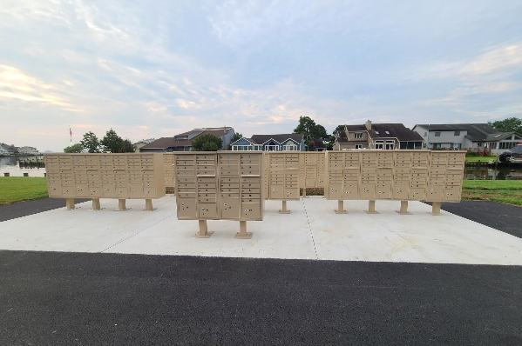
Mailboxes
Maintenance/Replacement:
  Repairs to existing mailboxes made by Public Works (cost savings)
    2021-2024 repairs: $8,685
  Pedestals & mailboxes ordered and replaced:
    2022-2025: $152,748
    This year replacement:
      Wood Duck replaced in July; Cannon Drive scheduled for the Fall
  Concrete & paving work:
    2022-2025: $39,852
Wood Duck - Before
Wood Duck - After

Slide 32

Drainage
Introduction of “Bag It We Will Grab It”
  Paper bags only – to be picked up by Public Works and Republic Services
Total spent on drainage (2021-2025) – $2,258,647.75:
  Includes repairs, pipe replacements, excavating, and CIPP liners
    Total CIPP liners ($863,840.97) from drainage reserves:
      2020/2021: $207,167.47
      2022/2023: $446,036.50
      2024/2025: $210,637.00

Slide 33
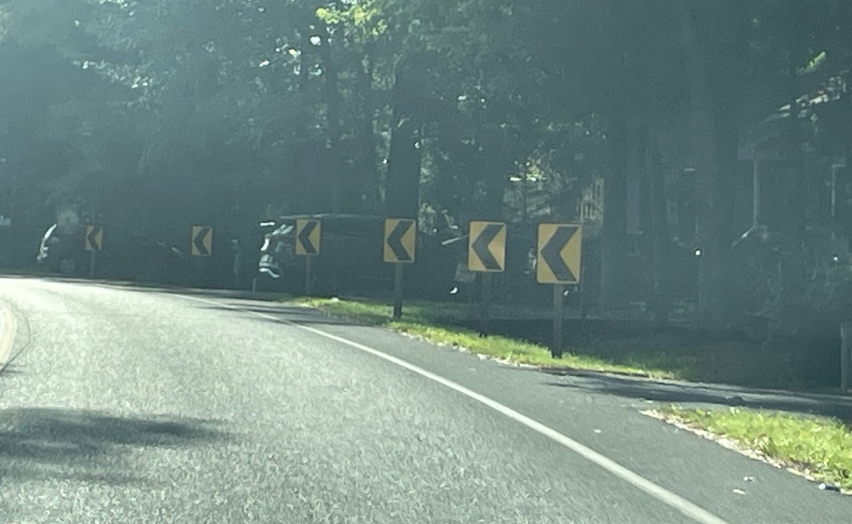
Roads
Maintenance:
  Road paving completed in May
  Total cost: $170,173.50
  Roads completed: Commodore Court, Dinghy Court, Fairhaven Court, Juneway Lane, Portside Court, Riverside Court, & Weeping Willow Court
Safety:
  Curve signs added to Ocean Parkway

Slide 34
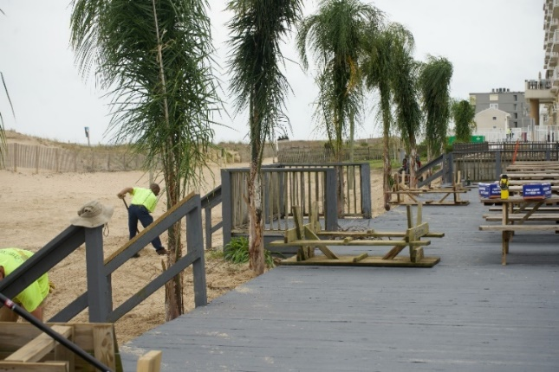
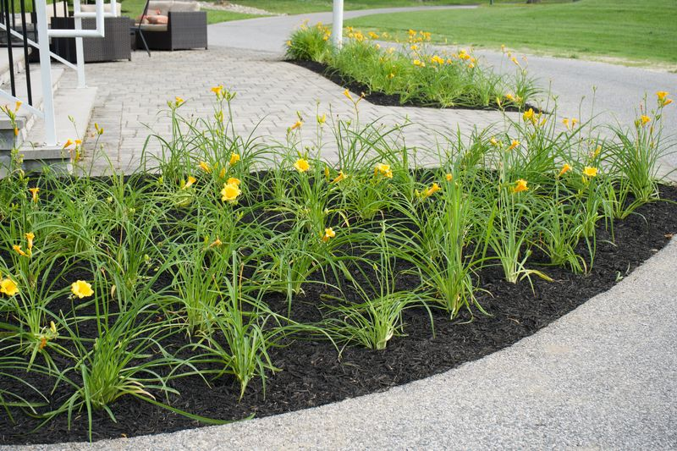


Landscaping &
Beautification
Landscaping added to enhance the beautification of Ocean Pines
Increased displays during the holidays

Slide 35
Metrics –
CPI Violations
New/Existing Violations | Closed Violations | Still Open as of 4/30/25
2,581 | 2,226 | 355
A total of 2,287 violations initiated in the last year – 907 more than the previous year!
  Maintenance and trash/debris: 20% of the violations initiated
  Leaf placement/leaf maintenance: 22% of the violations initiated
2,226 total violations complied out; 355 remain open
Thank you to those that report violations to us, and thank you to those that comply their violations in a timely manner

Slide 36
Metrics –
Work Orders
New/Existing Work Orders | Closed Work Orders | Still Open as of 4/30/25
1,108 | 964 | 144
Work orders can be called in to Public Works (410-641-7425) or by emailing info@oceanpines.org
Majority of open work order are for drainage (92):
  44 – over 30 days; 6 – over 60 days
    Average 1-4 work orders a day to complete depending upon severity

Slide 37
Metrics –
Customer Service
(from info@oceanpines.org)
Type | # Received
Amenities | 272
CPI | 228
Drainage | 18
General | 477
Public Works | 122
TOTAL | 1,117

Slide 38
2025
Financial Report
John Viola

Slide 39
SUMMARY OF OPERATING FUND AUDITED FINANCIAL RESULTS
FISCAL YEAR 2025 ACTUAL COMPARED TO BUDGET AND PRIOR YEAR

Slide 40
OPERATING FUND ANALYSIS

Slide 41
SUMMARY OF FISCAL YEAR 2025 AUDITED RESERVES ACTIVITY

Slide 42
ANNUAL ASSESSMENT HISTORY
FY 2013 - 2026

Slide 43
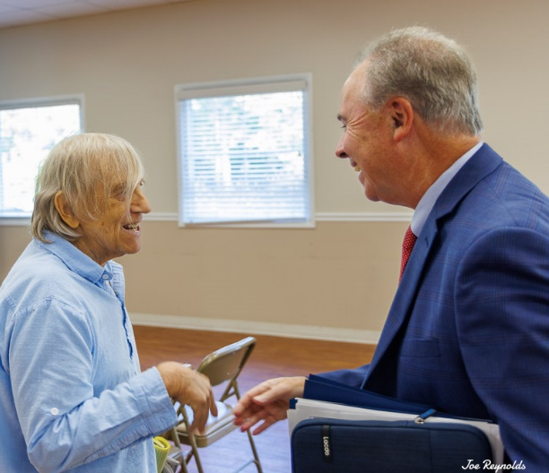

Slide 44
Unfinished
Business
None

Slide 45
New
Business
None

Slide 46
Election Committee Report & Validation
Steve ransdell

Slide 47

Public Comments

Slide 48
Adjournment

Slide 49
Supplemental
Financial Reports

Slide 50
SUMMARY OF OPERATING FUND AUDITED FINANCIAL RESULTS
FISCAL YEAR 2025 ACTUAL COMPARED TO BUDGET (SUPPLEMENTAL)

Slide 51
AMENITIES SUMMARY OF OPERATING FUND AUDITED FINANCIAL RESULTS
FISCAL YEAR 2025 ACTUAL COMPARED TO BUDGET (SUPPLEMENTAL)

Slide 52
SUMMARY OF OPERATING FUND AUDITED FINANCIAL RESULTS
FISCAL YEAR 2025 ACTUAL COMPARED TO FY 2024 ACTUAL (SUPPLEMENTAL)

Slide 53
AMENITIES SUMMARY OF OPERATING FUND AUDITED FINANCIAL RESULTS
FISCAL YEAR 2025 ACTUAL COMPARED TO FY 2024 ACTUAL (SUPPLEMENTAL)

Slide 54
SUMMARY OF DISTRIBUTION OF ANNUAL BASE ASSESSMENT
FISCAL YEAR 2025 ACTUAL COMPARED TO BUDGET & 2024 ACTUAL (SUPPLEMENTAL)

Slide 55
OPERATING DEPARTMENTS DISTRIBUTION OF ANNUAL BASE ASSESSMENT FISCAL YEAR 2025 ACTUAL TO BUDGET & 2024 ACTUAL (SUPPLEMENTAL)

Slide 56
AMENITIES DISTRIBUTION OF ANNUAL BASE ASSESSMENT
FISCAL YEAR 2025 ACTUAL COMPARED TO BUDGET & 2024 ACTUAL (SUPPLEMENTAL)

Slide 57
FIXED ASSETS SUMMARY
FY 2025 (SUPPLEMENTAL)

