Slide 1

Board of Directors Meeting
march 23, 2022

Slide 3
Approval of Agenda

Slide 4
Approval of Minutes
February 23, 2022 – Regular Meeting march 12, 2o22 – Town hall Meeting

Slide 5

President’s Remarks colette horn

Slide 6
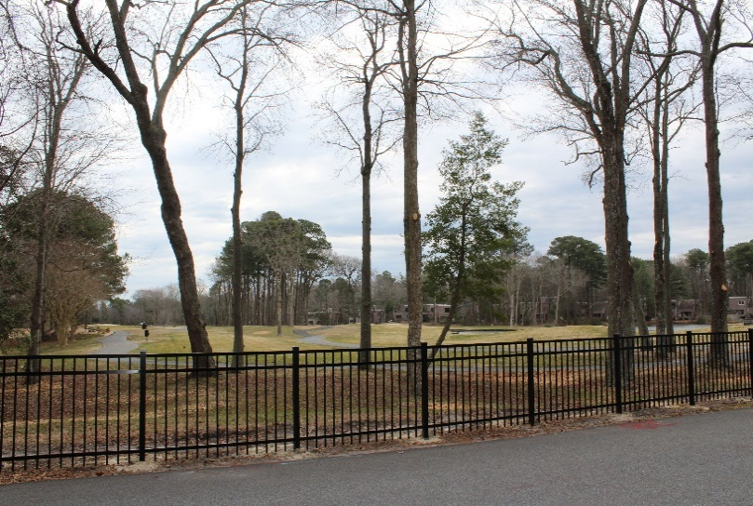
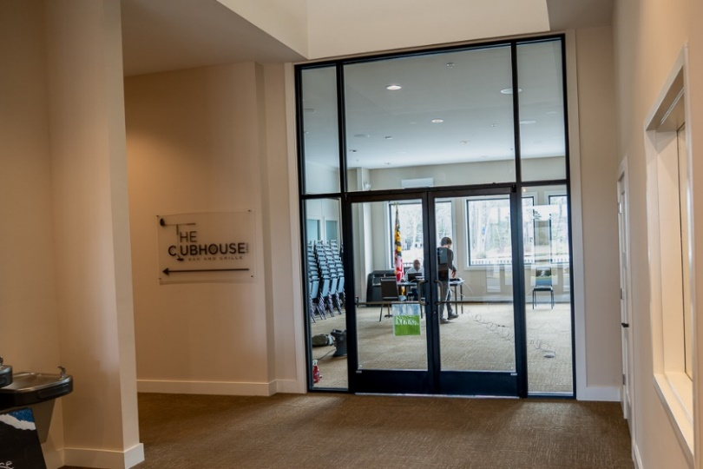
GM Leadership Report –
John Viola

Slide 7
Initiatives
North Gate Bridge Lights
New Business
Metrics
info@oceanpines.org
CPI Violations
Other
Northstar
Work Orders
Audio/Visual
Clubhouse
Pickleball Courts
Racquet Sports
Ballfield
Yacht Club
Clubhouse
Aquatics
Swim & Racquet
Beach Club
Marina
New Business
Golf Carts
South Gate Pond Lights

Slide 8
North Gate Bridge Lights
Received 3 bids for materials
Install cost and labor: approximately $5,000-$10,000 (internal)
Estimated lead time to receive materials: 12 weeks

Slide 9
Pickleball Courts
Resent RFP’s to 7 companies
Court construction and site work
New Business

Slide 10
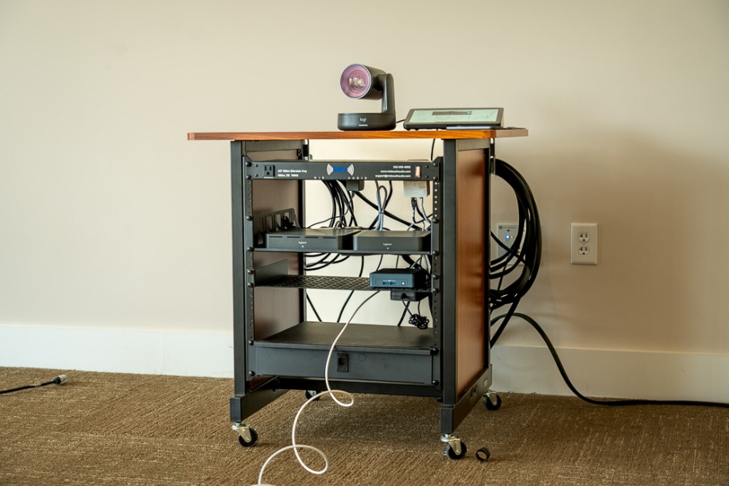
Audio/Visual
Hybrid meeting system used in Clubhouse Meeting Room for the first time on March 12th
Mid-South Audio put together a portable system; IT and PR vetted the system
Allows for true virtual participation by membership during Board meetings and town halls
System can also be used in other locations
Final cost: $13,157
IT and PR also vetted a “budget system” for the Administration Conference Room for committee use
  System will be installed in-house for less than $1,000

Slide 11
Golf Carts
76 golf carts purchased in 2016 for $369,436 after trade-in of old fleet
Sixth year of a seven year depreciation schedule (fully depreciated in 2023)
Warranty has expired and carts are starting to show wear (seats, panels, windshields, tires, etc.)
Recommending trade-in carts now and purchase new fleet for $110,000 less than 2016
  Depreciation will drop from $52,777 to $37,300
  New carts are more full-efficient, are quieter, and will have lower maintenance costs
  Delivery of new carts could take up to 18 months.
  Purchase price: $260,908 ($5,800 each; $2,000-$2,500 trade in for each cart)
New Business

Slide 12
CUSTOMER SERVICE DASHBOARD
(FROM INFO@OCEANPINES.ORG) febrUARY
Type | # Received – February
Amenities | 18
CPI | 44
Drainage | 3
General | 41
Public Works | 9
TOTAL | 115

Slide 13
CPI Violation Dashboard febrUARY
Violations
As of 1/31/22 | New Violations | Closed Violations | As of 2/28/22
83 | 24 | 19 | 88
Legal Cases
As of 1/31/22 | New Violations to Legal | Closed Violations in Legal | As of 2/28/22
51 | 3 | 2 | 52

Slide 14
WORK ORDERS february
Open Work Orders as of 1/31/22 | New Work Orders | Closed Work Orders | Open Work Orders as of 2/28/22
108 | 57 | 60 | 105

Slide 15
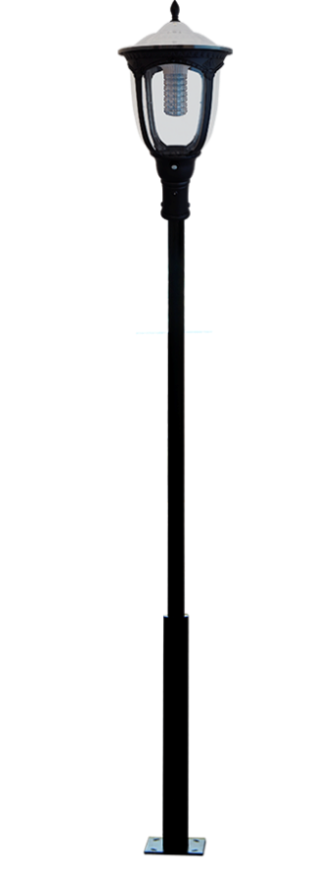
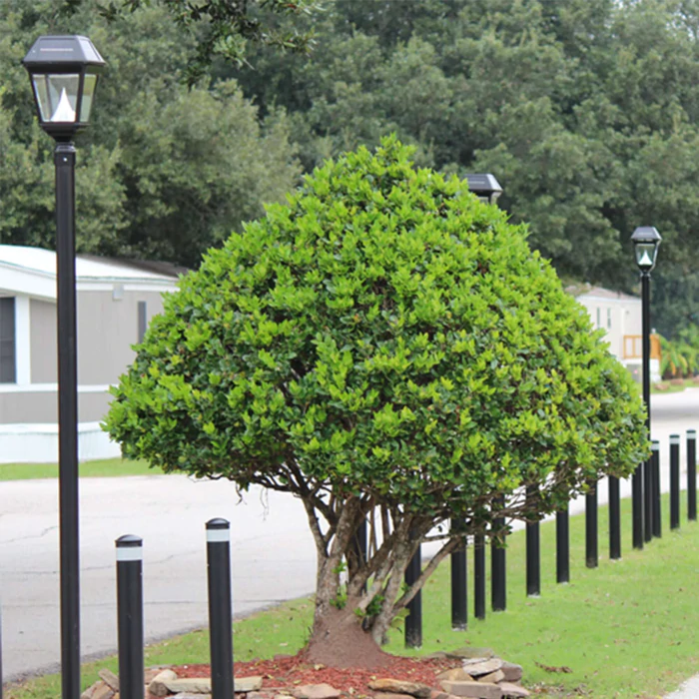
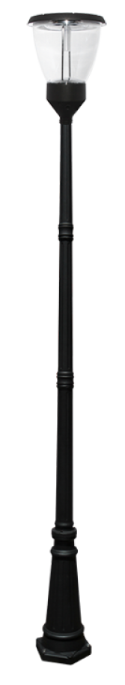
South Gate Pond Lights
Will be placed around the walking path at the south gate pond
4W-3,000W / 300-100,000 lumens
Pricing
  With Pole: $699-$4,399
  Without Pole: $165-$1,175
Lights can be obtained online
Only one local company carries solar street lights (Wire Works – Fruitland, MD) – reaching out to them for a quote

Slide 16
Northstar
Online Payments
  Launched live on March 21, 2022
  Member can login with their member ID and make payments for their assessments
    Credit/Debit – 3.5% fee; ACH (checking account) – no fee
  Will monitor and take lessons learned for added options for additional online payments next off season
Support
  Weekly standing meetings and additional sessions, as needed, to address issues
  Monthly management oversight meeting

Slide 17
Other
Aquatics
  Handicap shower stall in men’s room has been repaired
  Seats have been repaired
  New/replacement HVAC unit installed in lobby
  Ladies room HVAC has been wired and completed
  Opening of the outdoor pools will begin in April
Racquet Sports
Ballfield
Yacht Club
  2 bids received for loading dock doors
  MasterJack will be installing new frame and doors – total cost: $4,213.50
Clubhouse
  The new closet and doors are completed. Project finalized by Worcester County.
  Wire to be run behind he wall inside the closet
  We’re going to glue RFP panels along the bottom 48” of the closet to protect the walls.
  Rail for around the bar has been ordered
Swim & Racquet
  Kayak racks to be installed in April along side of the building

Slide 18
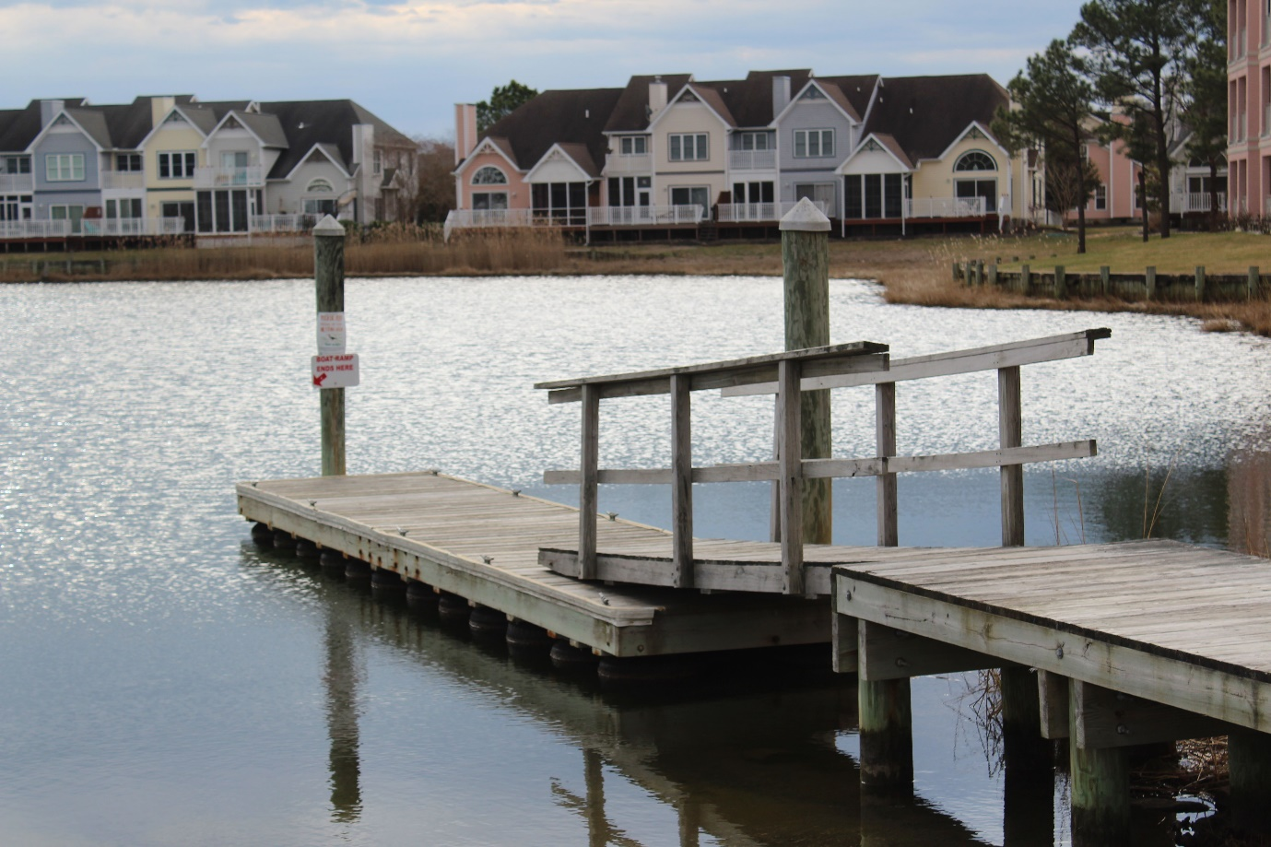
Other
Marina
  The water will be turned back on in April and any repairs to be done then
  The shower will be fixed in the Marina bathrooms when we do the repairs to the water lines
  Replace ramps, railings, bumpers, and u-rings to pilings on the boat ramp at Mumford’s (in-house: $5,000)

Slide 19
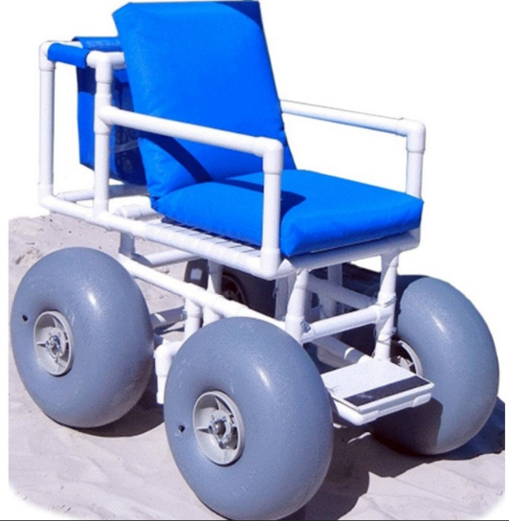
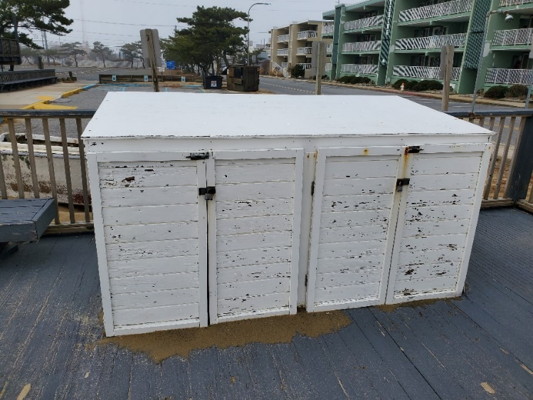
Other
Beach Club
  Replacement equipment has been ordered
  We are replacing the flooring in the bar area (removing broken tile and replacing)
  The hood Ansel system needs to be replaced
    Work to be done by Fire Protective Services for $4,390
  The water will be turned back on to the building in April
  Palm trees are due the second week of May
  Beach wheelchair storage at 50th Street

Slide 20
Financials

Slide 21
Financial Change month of february 2022
February (In 000’s)
 | Budget | Current Year | Favor/ (Unfavor) vs. Budget
Net Revenues | $186 | $249 | $63
Expenses + New Capital | 848 | 877 | (29)
Net Operating | ($662) | ($628) | $34

Slide 22
Financial Change
YEAR-TO-DATE February 2022
YTD February 2022 (In 000’s)
 | Budget | Current Year | Favor/ (Unfavor) vs. Budget
Net Revenues | $12,549 | $13,961 | $1,412
Expenses + New Capital | 10,937 | 10,829 | 108
Net Operating | $1,612 | $3,132 | $1,520

Slide 23
Detail for the Month of february
Favor/(Unfavorable) Vs. Budget (in 000’s)
Department/Amenity | Favorable/(Unfavorable)
Public Works/General Maint/CPI | 26.5
GM/Finance/Admin | 17.0
Golf Ops + Maintenance | 7.0
Racquet Sports | (7.8)
Clubhouse Grille | (7.0)
Other Net (Police, Marketing, Recreation, Beach Parking, Aquatics, Beach Club, Yacht Club, Marinas) | (1.5)
TOTAL | $34.2

Slide 24
Detail for year-to-date february
Favor/(Unfavorable) Vs. Budget (in 000’s)
Department/Amenity | Favorable/(Unfavorable)
Public Works/General Maint/CPI | $382.1
Golf Ops + Maintenance | $316.6
Admin, Finance, GM, PR/Mktng | 255.0
Aquatics | 193.8
Yacht Club | 96.5
Police | 85.9
Recreation & Parks | 58.5
Beach Parking | 56.5
Marinas | 43.2
Beach Club | 42.3
Racquet Sports | 16.9
Clubhouse Grille | 6.6
New Capital | (33.5)
TOTAL | $1,520.4

Slide 25
Unaudited Reserves february 2022 ($Millions)
 | GeneralReplace | Bulkheads | Roads | Drainage | New Capital | Total
4/30/21 Balance | $3.9 | $1.0 | $0.2 | $0.5 | $0.1 | $5.7
Contributions/ Interest | 1.6 | 1.1 | - | - | 0.2 | 2.9
Casino Funds + Grant Income | - | - | - | 0.7 | - | 0.7
Transfer (Spend) | (0.7) | (1.2) | (0.2) | (0.5) | - | (2.6)
2/28/22 Balance | $4.8 | $0.9 | $- | $0.7 | $0.3 | $6.7

Slide 26
Reserves year-end unaudited estimate
(in ooo’s)
 | Beginning Balance |  |  | Unaudited EST Balance
 | 4/30/21 | Additions | Expenditures | 4/30/2022
Major Maintenance & Replacement:
Public Works – Fleet Vehicles |  |  | (200)
Public Works Tractor in 21 Budget |  |  | (146)
Police Vehicles (x 3) |  |  | (146)
Aquatics (Furniture, Roof, Equip) |  |  | (75)
Golf Maintenance Mowers |  |  | (58)
Public Works Boom Mower |  |  | (37)
Golf Ops |  |  | (42)
Yacht Club Kitchen Equipment |  |  | (43)
Racquet (Lighting,Fountains) |  |  | (10)
Other |  |  | (25)
Total | 3,853 | 1,705 | (782) | 4,776
Bulkheads & Waterways | 1,010 | 1,070 | (1,708) | 372
Roads | 216 | 1 | (212) | 5
Drainage | 469 | 835 | (800) | 504
New Capital | 102 | 183 | (190) | 95
TOTAL 4/30/22 ESTIMATE | 5,650 | 3,794 | (3,692) | 5,752

Slide 27

Treasurer’s Report - larry Perrone

Slide 28

Cash & Short-Term Investments
Activity for Month of February
Overall Laddered Investment Rate of Return on CDAR’s for February Approx. 0.75%
As of February 28, 2022, the Association had approx. $12.3 million in cash
  Approx. $7.1 million invested in CDAR’s, fully FDIC insured
  Approx. $5.2 million in Money Market, and other operating accounts, fully insured

Slide 29

Public Comments

Slide 30
Public Comments
Members wishing to make comments must state their name and address. Time limit for comments is 5 minutes. Comments may be made on any topic of interest to the member that pertains to the mission of OPA. Order for comments for hybrid meetings: 1st – members in attendance in-person; 2nd – MS Teams Participants (use of “raise hand” function required to enter speaking queue); 3rd – members participating through the MS Teams call-in (audio only) function. To enter call-in queue, text Josh Davis at 443-377-1079. Chat function of MS Teams is for Public Comments only; all other comments in the chat function will be considered out of order, as will be speaking during the meeting without being given the floor by the Chair.

Slide 31
Purchase requests
North gate bridge lights
Pickleball courts
Golf carts

Slide 32
PURCHASE REQUESTS
North Gate Bridge Lights
Requesting authorization to go forward with staff recommendation of $39,995.00
for Denney Electric Supply

Slide 33
PURCHASE REQUESTS
Pickleball Courts
Requesting authorization to go forward with staff recommendation of $175,244.50
for ATC Corporation
&
Site work to be completed in-house: $40,000.00

Slide 34
PURCHASE REQUESTS
Golf Carts (76 Carts)
Requesting authorization to go forward with staff recommendation of $260,908
for Yamaha

Slide 35
CPI VIOLATIONS
None

Slide 36
Unfinished Business
Second reading – resolution m-09 – Colette horn
Second reading – resolution M-09, attachment B – Colette horn

Slide 37
New Business
Review of resolution B-07 petitions – Colette horn review of resolution m-05 animal control – Colette horn review of resolution m-07 bulkhead and waterway maintenance – Colette horn review of opa mission and vision statement – Colette horn discussion on social media policy – doug parks discussion on tree removal policy – rick farr discussion on hb 882 – doug parks motion for mailbox investigation and field test – Josette Wheatley motion for intersection lighting test – frank daly motion for revision to owner of record referendum question – Colette horn motion for revision to candidate eligibility referendum question – Colette horn motion for revision of bylaws section 5.02(a) employee – Colette horn

Slide 38
appointments
Sherrie Clifford – 1st term – search committee
Stuart lakernick – 1st term – search committee
Michelle stewarT – 1st term – search committee
Vicki eckenrode – 1st term – strategic planning committee

Slide 39
NEXT MEETING DATE
Wednesday, April 20th at 11:00 a.m.
(HYBRID MEETING AT clubhouse meeting room)

Slide 40
AdjournMent

