Slide 1

Board of Directors Meeting
March 23, 2024

Slide 2
Approval of Agenda

Slide 3
Approval of Minutes
February 17, 2024 – Regular Meeting
February 29, 2024 – Special Meeting

Slide 4

President’s Remarks
Rick Farr

Slide 5
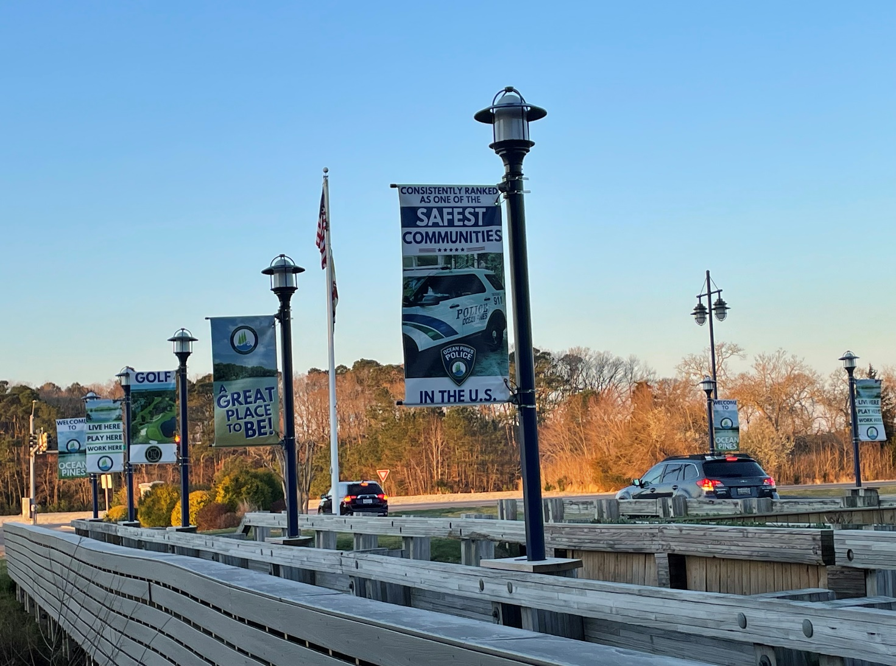
GM Leadership Report –
John Viola

Slide 6
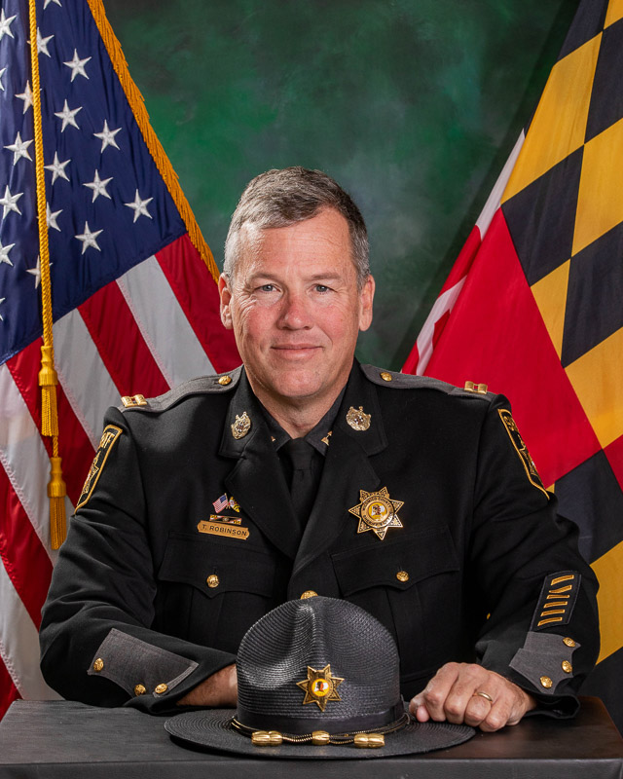
Chief Tim Robinson
OPPD

Slide 7
Ocean Pines Police Department
Speed Surveys
Ocean Parkway at Briarcrest
Feb. 21-24, 2024 (3 days)
9,145 vehicles
1.5% at 40-45 mph
88% at 39 mph or less
Average Speed: 32 mph

Slide 8
Ocean Pines Police Department
Speed Surveys
Ocean Parkway at Sandyhook
Feb 29-Mar 7, 2024 (8 days)
17,971 vehicles
3.5% at 40-44 mph
96% at 39 mph or less
Average Speed is 33 mph

Slide 9
Ocean Pines Police Department
Speed Surveys
300 Block of Ocean Parkway
March 7- March 13, 2024
9,693 vehicles
13% at 40-45 mph
85% at 39 mph or less
Average Speed: 33 mph

Slide 10
Ocean Pines Police Department
Speed Surveys
Ocean Parkway at Wareham
March 14 – March 20, 2024
11,303 vehicles
19 % at 40-45 mph
78% at 39 mph or less
Average Speed: 36 mph

Slide 11
Ocean Pines Police Department
Speed Surveys
All Done on Ocean Parkway
Briarcrest
Sandyhook
300 Block
Wareham
48,112 total vehicles
53 over 50 mph

Slide 12
Initiatives
  Promotions
  Electronic Sign
  Landscaping
  Worcester County Tourism
  Golf
  Tiki Bar
  Pavilion
  Racquet Sports
  Safety
  Dog Park
  Soft Shoreline
  OP Day
  Metrics

Slide 13
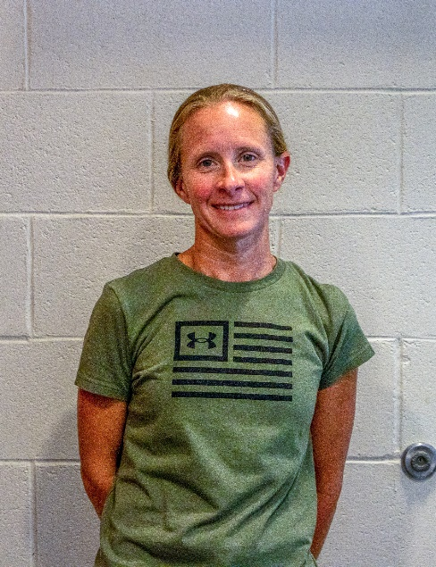
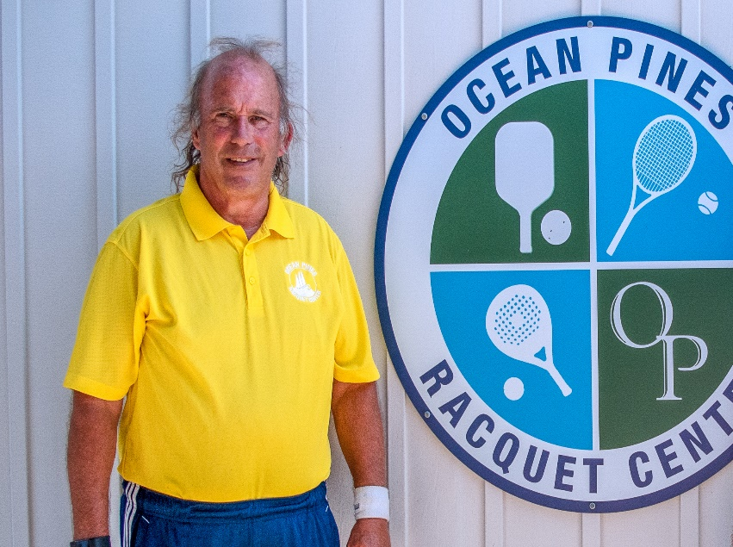
Promotions
Michelle Hitchens promoted to Aquatics Director effective March 1st
Already re-established swim lessons and many events that have not been done for several years (“Eggstravagansa” and “Santa Swim”, originally established in 2010)
“We want everything to run as smoothly as possible, so everyone has a fun and relaxing time at the pools”
Terry Underkoffler promoted to Racquet Sports Director effective March 14th
Been involved in Ocean Pines Racquet Sports for roughly a decade
“My vision is that we’re looked at as a premiere destination for pickleball, tennis, platform tennis, Timeless Tennis and Spec Tennis, and all kinds of recreation that families can enjoy”

Slide 14
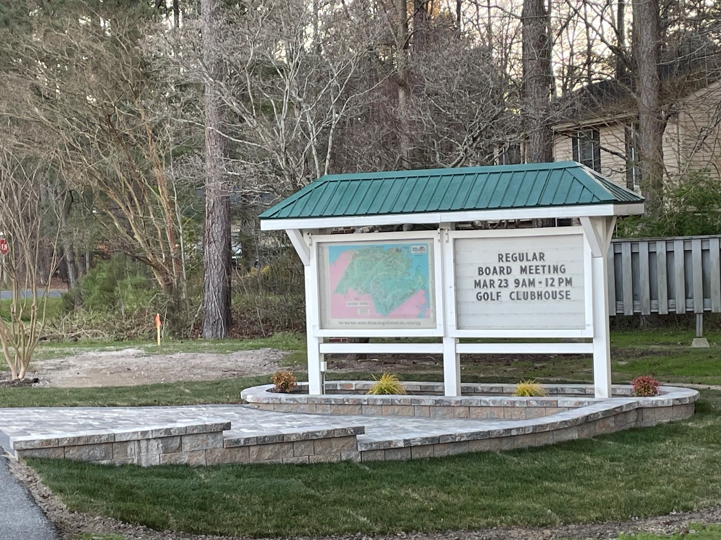
Electronic Sign
Worcester County approved sign location
Public Works reinstalled landscaping
Electronic sign has been ordered and deposit made
Public Relations to be trained next week on sign operations/updating
Estimated to be installed in April

Slide 15
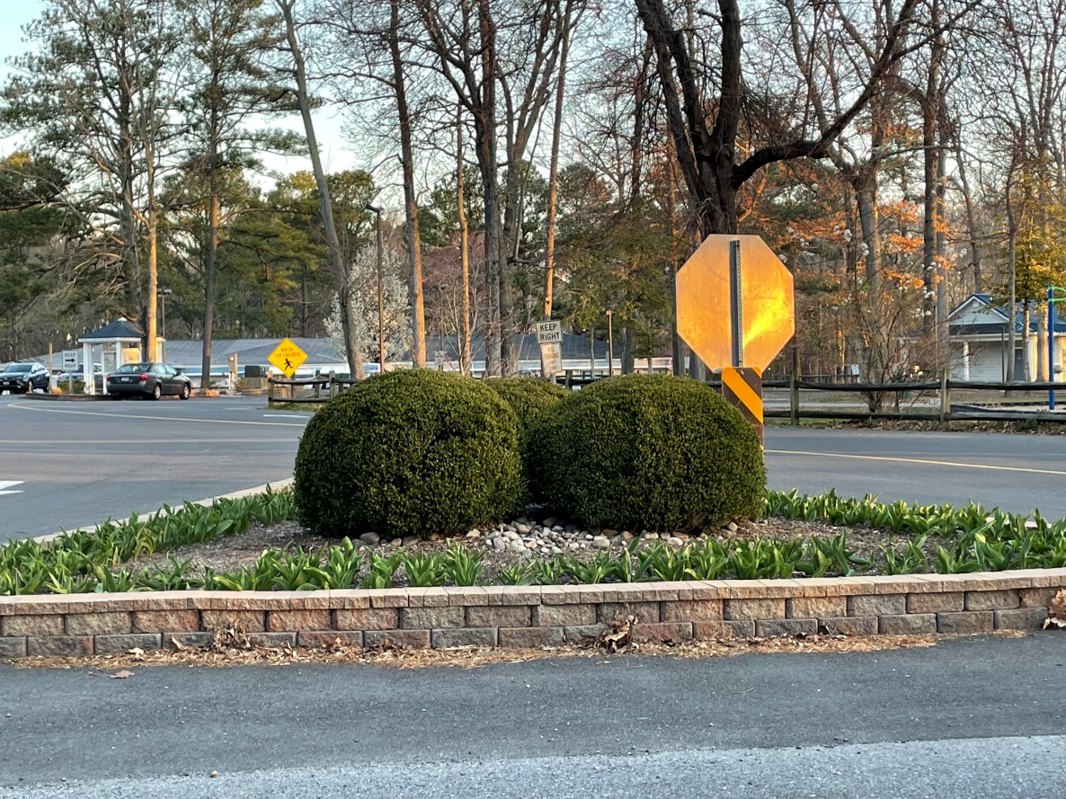
Landscaping
Bulbs planted at entrances
Spring flowers have been ordered and will be installed late April
Mulching around trees to begin soon
Banners:
  Seasonal banners will be rotated every few months

Slide 16
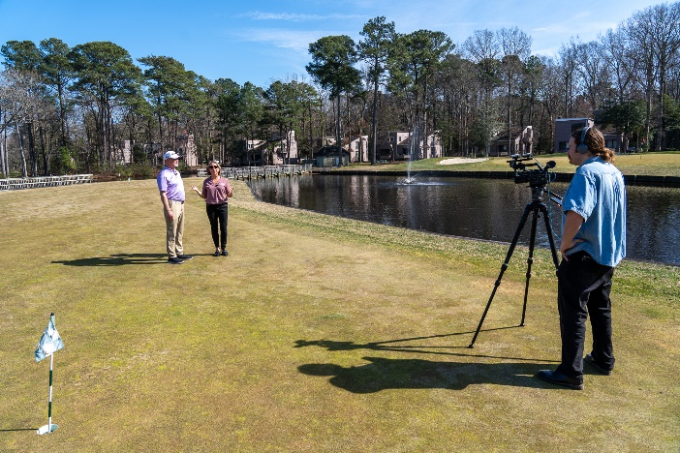
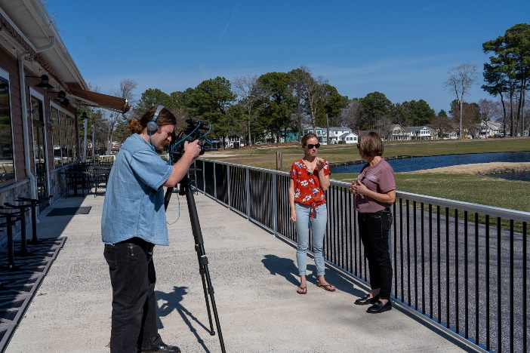
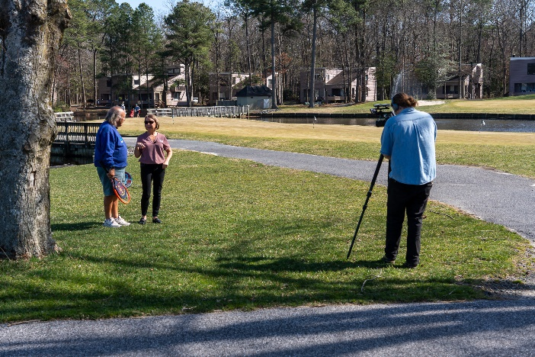
Worcester County Tourism
On March 14th, Bob Beckelman, Michelle Hitchens, and Terry Underkoffer met with Worcester County Tourism Director Melanie Pursel for a video shoot
Each Director talked about their departments and what homeowners, residents and visitors can expect this Spring and Summer
Video will be released on April 6th and be part of an upcoming Worcester County Tourism promotional efforts

Slide 17
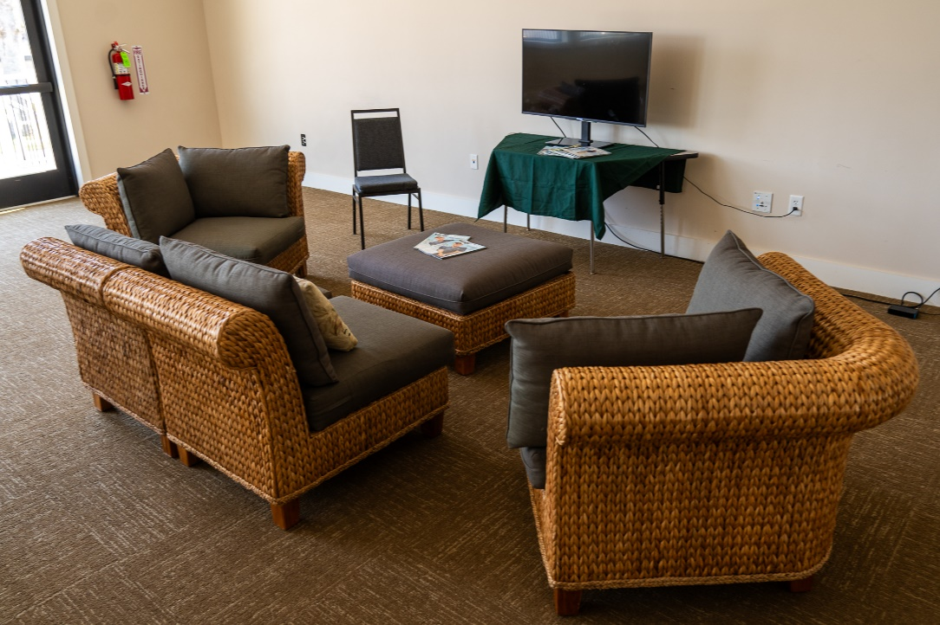
Golf
“Golfer’s Lounge” created in the Clubhouse Meeting Room using furniture donated by a golfer
Furniture and television
Make the space more inviting for the golf community

Slide 18
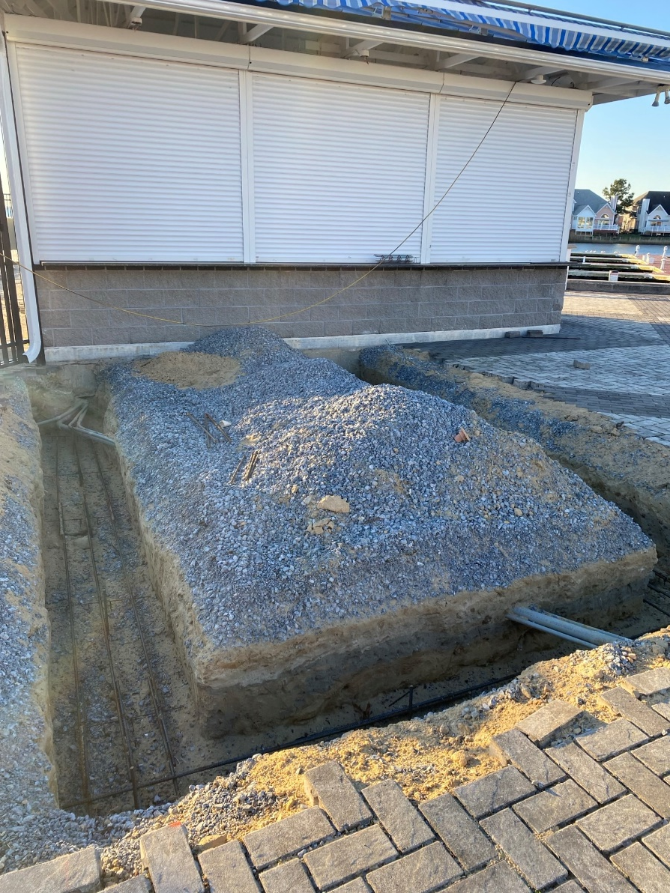
Tiki Bar
Permit received March 14th
Project status: green
Public Works removed dock boards for new power lines and removed pavers for tiki bar addition
Whayland working on tresses for addition
Scheduled to be completed prior to Memorial Day

Slide 19
Pavilion
Met with Marie Gilmore of the Vets Memorial Foundation regarding pavilion
Feedback received; working with contractor for different styles and options
Will match as close as possible to style of existing Veterans Memorial, to include roof color and brick work
Project status: green
To be installed by Veterans Day

Slide 20
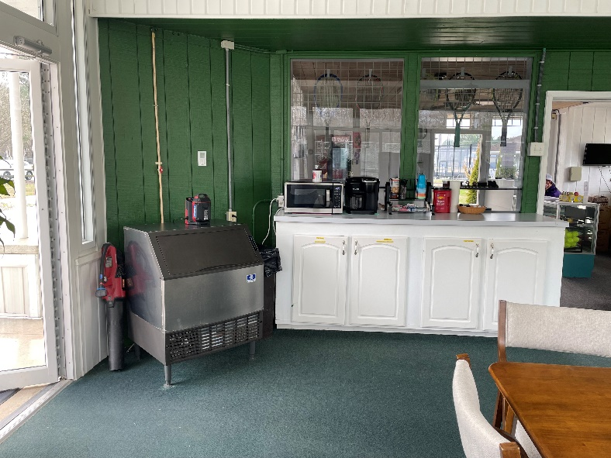
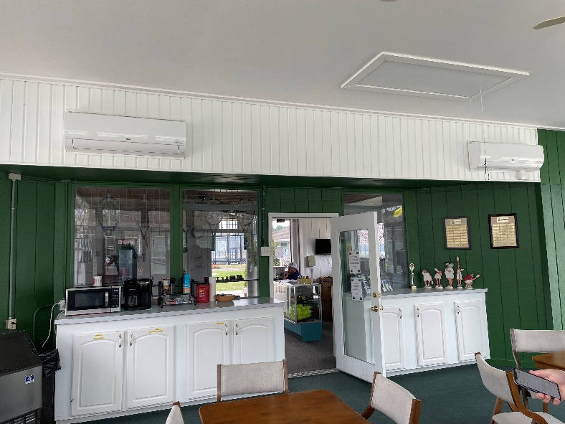
Racquet Sports
Within the last year, approximately $25,000 spent on maintenance to pro shop building (materials and labor)
  Repairs/additions include new HVAC system, ice machine, office furniture, gutters, water fountains, dehumidifier, window repairs, lock changes, painting inside building
Per request of RSAC, water fountains being dewinterized earlier than normal – GM had water bottles placed on site on March 15th until fountains can be turned on
Building alterations – project status: yellow
  Appears there are other individual(s) discussing plans with County
5 tables ordered with chairs to enhance shade availability for pickleball players. This is similar to what the GM provided platform tennis.
With Ruth Ann Meyer, tags to be distributed to identify racquet players

Slide 21
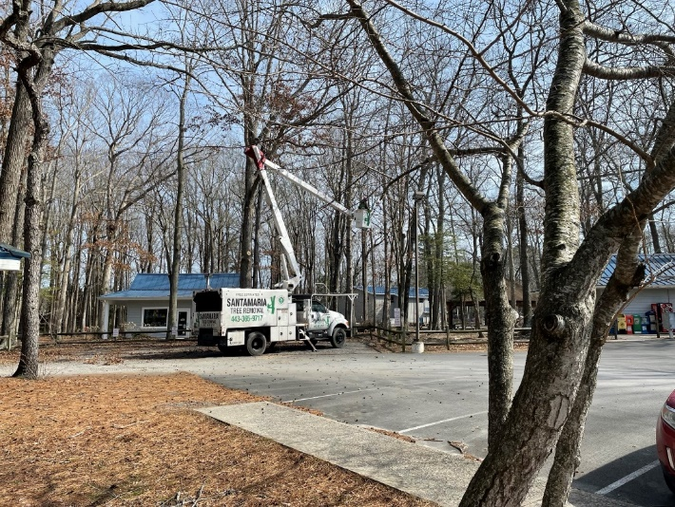
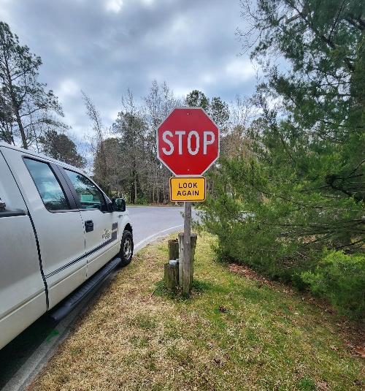
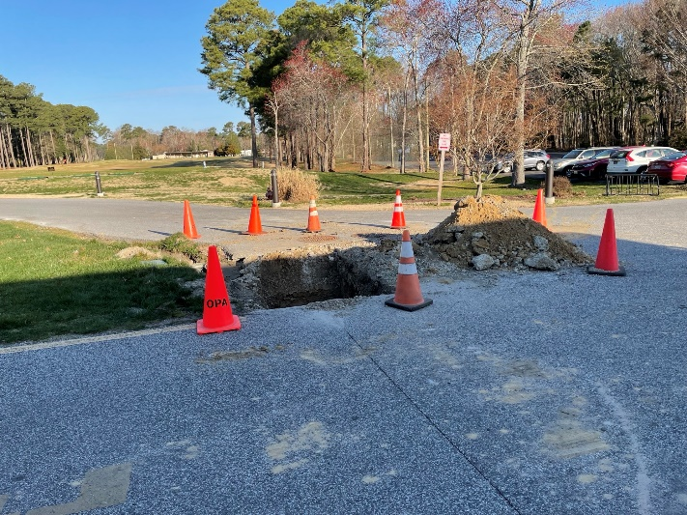
Safety
Trees:
  10 trees removed in White Horse Park
  Other trees with “widowmaker” limbs trimmed
  This was also recommended by the Recreation & Parks Committee to address
Signs:
  Per request of homeowner, sign ordered and placed by Josh Vickers at the intersection of Mumfords Landing Road and Yacht Club Drive
Water Leak:
  Leak at Clubhouse addressed by Public Works

Slide 22
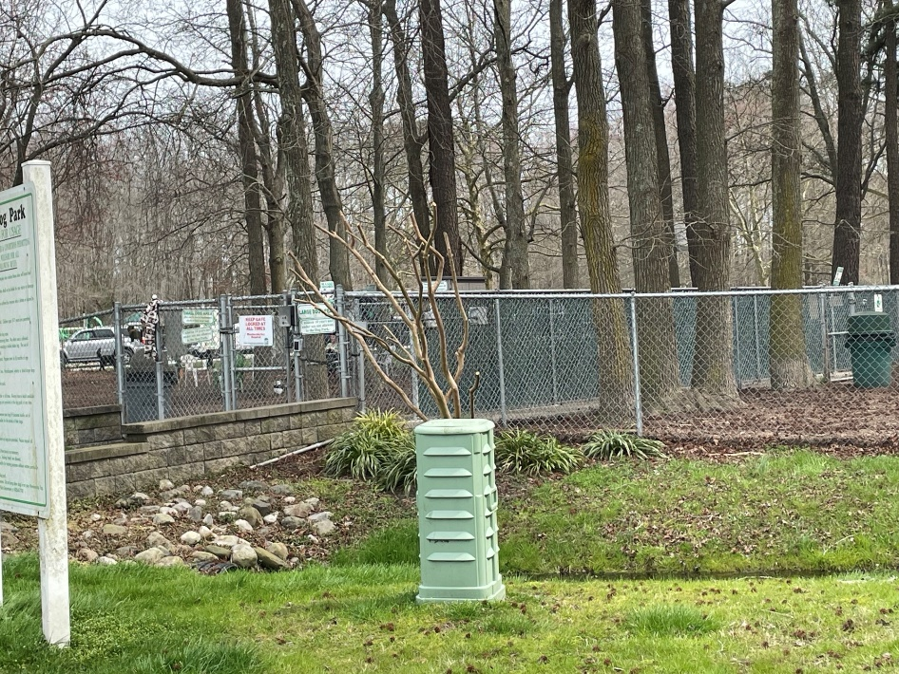
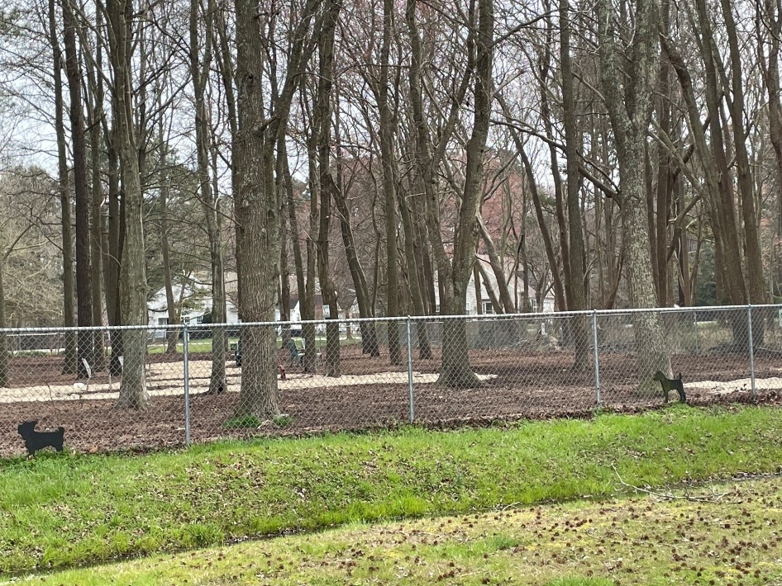
Dog Park
Fence at dog park repaired
Received approval from County to add sand to low lying areas of the dog park
Looking into rain shelter and what is allowable by County

Slide 23
Soft Shoreline
Received grant of $150,000 from Maryland Coastal Bays for soft shoreline project at the south gate pond
RFP sent to potential bidders on February 21st; bids due March 21st
Bids received; will review and summarized by next week

Slide 24

OP Day
OP Season Kickoff Event to be held on Saturday, April 20th (rain date: Saturday, April 27th)
3:00-7:00 p.m. in White Horse Park
Being organized by the OP Day work group
Celebrate and learn about all that Ocean Pines has to offer while enjoying music, demonstrations, and interactive exhibits

Slide 25
CPI Violation Dashboard
February
Violations
As of 2/1/24 | New Violations | Closed Violations | As of 2/29/24
140 | 104 | 61 | 183
104 violations initiated in February: 38 maintenance/trash/debris; 4 leaf placement; 16 no permit; 46 miscellaneous
  Miscellaneous violations includes signs, stop work orders, trailers, unregistered/junk vehicles, and vehicle parking
61 violations complied out; 183 remain open
  63 maintenance/trash/debris; 5 leaf placement; 42 no permit; 73 miscellaneous

Slide 26
Work Orders
February
Open Work Orders as of 2/1/24 | New Work Orders | Closed Work Orders | Open Work Orders as of 2/29/24
117 | 96 | 98 | 115
96 work orders initiated in February: 1 bulkhead; 29 drainage; 11 grounds/landscaping; 5 roads; 4 signs; 46 general maintenance
Majority still open in drainage (76):
  33 – over 30 days; 17 – over 60 days
    Average 1-4 work orders a day to complete depending upon severity

Slide 27
Customer Service Dashboard
(from info@oceanpines.org)
February
Type | # Received – Feb.
Amenities | 51
CPI | 26
Drainage | 1
General | 54
Public Works | 10
TOTAL | 142

Slide 28
Financials

Slide 29
UNAUDITED FINANCIAL CHANGE
MONTH OF FEBRUARY 2024
February (In 000’s)
 | Budget | Current Year | Favor/ (Unfavor) vs. Budget
Net Revenues | $184 | $193 | $9
Expenses | 968 | 929 | 39
Net Operating | ($784) | ($736) | $48

Slide 30
UNAUDITED MONTH OF FEBRUARY
FAVOR/(UNFAVORABLE) VS. BUDGET (IN 000’s)
Department/Amenity | Favorable/(Unfavorable)
Police | 40
General Admin | 13
Aquatics | 11
Golf Ops + Maintenance | 10
Yacht Club | (10)
Public Works | (15)
Other Net (GM Office, Beach Club, Marinas) | (1)
TOTAL | $48

Slide 31
UNAUDITED FINANCIAL CHANGE
YTD FEBRUARY 2023
February YTD (In 000’s)
 | Budget | Current Year | Favor/ (Unfavor) vs. Budget
Net Revenues | $13,680 | $14,434 | $754
Expenses | 12,209 | 12,055 | 154
Net Operating | $1,471 | $2,379 | $908

Slide 32
UNAUDITED YTD FEBRUARY
FAVOR/(UNFAVORABLE) VS. BUDGET (IN 000’s)
Department/Amenity | Favorable/(Unfavorable)
Police | $277
Golf Ops + Maintenance | 197
Admin/Finance/GM/Public Relations | 128
Public Works/Gen Maint/CPI | 98
Aquatics | 62
Beach Club | 57
Beach Parking | 52
Clubhouse Grille | 38
Recreation & Parks | 37
Yacht Club | 12
Marinas | (28)
Racquet Sports | (22)
TOTAL | $908

Slide 33
UNAUDITED RESERVES FEBRUARY 2024 ($ MILLIONS)
 | GeneralReplace | Bulkheads | Roads | Drainage | New Capital | Total
4/30/23 Balance | $5.1 | $0.5 | $0.7 | $0.2 | $0.1 | $6.6
Contributions/ Interest | 2.2 | 1.1 | - | 0.1 | 0.1 | 3.5
Casino Funds | - | - | 0.4 | 0.1 | - | 0.5
Transfer (Spend) | (1.2) | (1.0) | - | - | (0.1) | (2.3)
2/29/24 Balance | $6.1 | $0.6 | $1.1 | $0.4 | $0.1 | $8.3

Slide 34

Treasurer’s Report -
Monica Rakowski

Slide 35

Cash & Short-Term Investments
Month of February
As of February 29, 2024, the Association had Approximately (~) $14.0M in Cash
  Cash Increased ~ $1.0M from the Same Time Period Last Year
  Cash Decreased ~ ($0.9)M from January 2024
  $10.4M Invested in CDAR’s
  $46K in Interest Income Recognized for the Month
  Remaining $3.6M in Insured Cash Sweep, Treasury Bills, Money Market and Other Operating Accounts (Diversified Between 2 Local Banks)

Slide 36


Public Comments
Members wishing to make comments must state their name and address

Slide 37
Capital Requests
Public Works – Cured In Place Pipes (CIPP)
Police Department – Police Vehicles

Slide 38
Capital Requests
Cured In Place Pipes (CIPP)
Requesting authorization to go forward with staff recommendation of $210,637 for Pelican Underground

Slide 39
Capital Requests
Police Vehicles
Requesting authorization to go forward with staff recommendation of $83,698 for Hertrich Fleet Services

Slide 40
CPI Violations
26 Carriage Lane
147 Teal Circle
268 Windjammer Road
79 Crest Haven Drive
48 King Richard Road
298 Ocean Parkway
75 Ocean Parkway
29 Boston Drive

Slide 41
New Business
Motion to establish interest rate for delinquent assessment fees – Monica Rakowski
First reading of changes to Resolution C-01 (Committee General Policy) – John Latham
First reading of changes to Resolution C-03 (Budget and Finance Advisory Committee) – John Latham
First reading of changes to Resolution M-06 (Elections and Referendum Procedures) – John Latham

Slide 42
Appointments
Lora Pangratz – 2nd Term – Bylaws & Resolutions
Gary Schnell – 1st Term – Recreation & Parks

Slide 43
Adjournment

