Slide 1
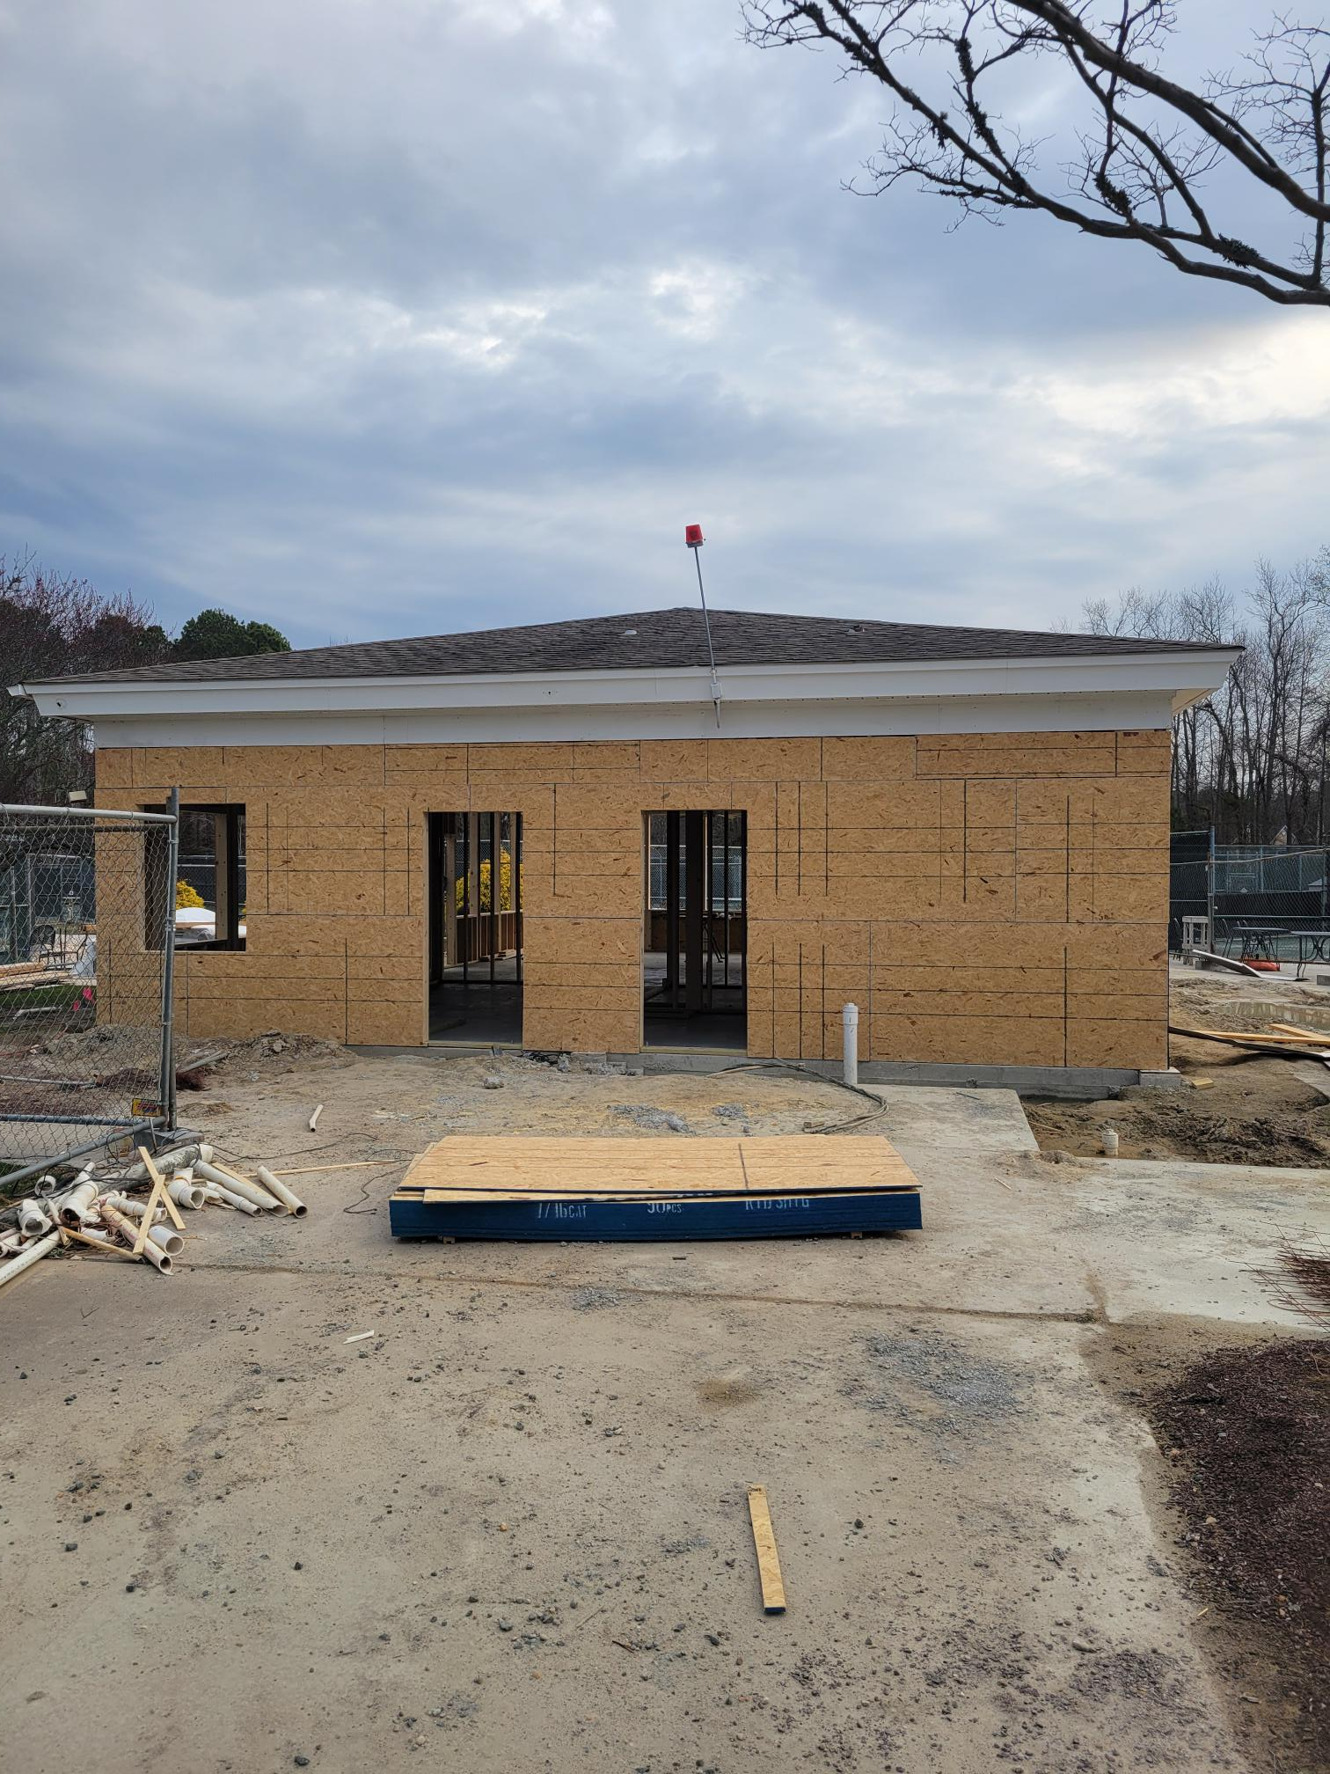
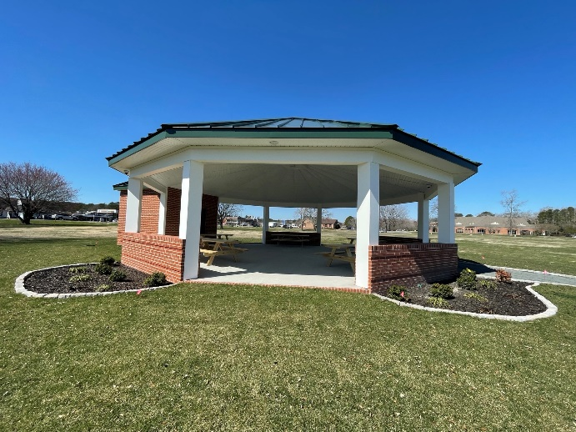
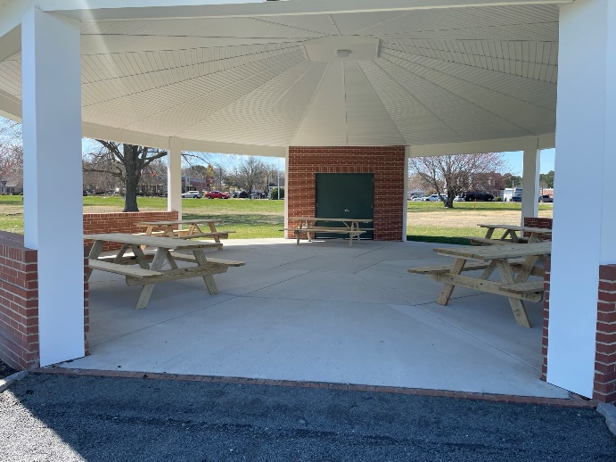
GM
Leadership Report –
John Viola
March 29, 2025

Slide 2
Community Issues
Water & Wastewater
Initiatives
  Golf Course Irrigation
  Racquet Sports Building
  Dog Park Structure
  Firehouse
  Bocce Ball Courts
  Bulkheads
  Operations
  Gym Floor
  Recreation & Parks
  Aquatics
  Leaf Maintenance
  Metrics

Slide 3
Water & Wastewater
  What have we done:
  Shared Commissioner Bertino’s statement from the March 20 Special Board Meeting in a press release sent to local media, posted on the OPA website and social media, and featured at the top of the March 24 eblast sent to approximately 9,000 homeowners and residents
  Invited local media to cover the March 29 OPA Board Meeting, where Commissioner Bertino and Bunting will further discuss the issue
  Committed to follow up on any new statements with additional press releases and communication across all available OPA channels
Josh Davis

Slide 4
Water & Wastewater
  What we are planning to do:
  Continue sharing updates on the County’s financial report and repayment plan (expected to be available after the April 1 County meeting)
  Promote and prepare for town hall meetings with County Commissioners Bertino and Bunting, which will provide further information and updates
  Encourage community participation in the May 6 Worcester County public hearing to ensure Ocean Pines homeowners’ concerns are heard
Josh Davis

Slide 5
Water & Wastewater
  Next steps:
  Post the County’s financial report and repayment details on the OPA website (once available)
  Provide continued press outreach and updates to keep the community informed
  Mobilize community engagement and prepare residents for the May 6 public hearing
  Monitor County decisions and respond swiftly to protect the interests of Ocean Pines ratepayers
Josh Davis

Slide 6
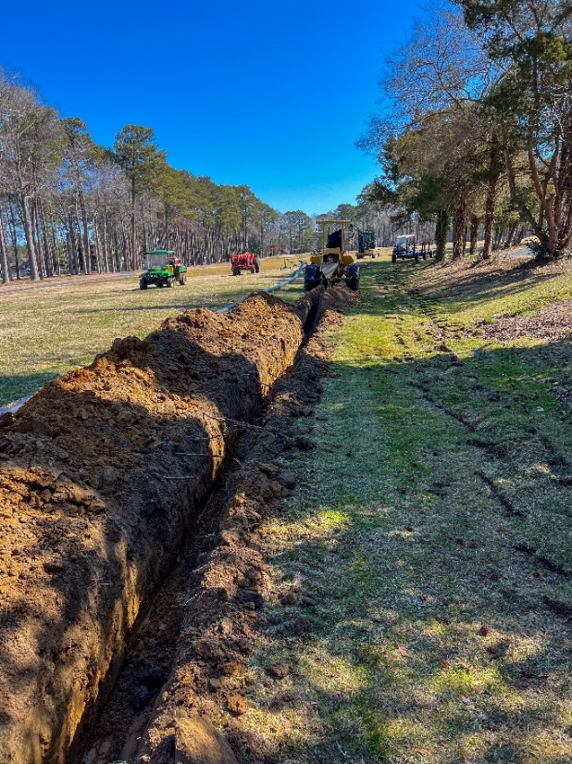
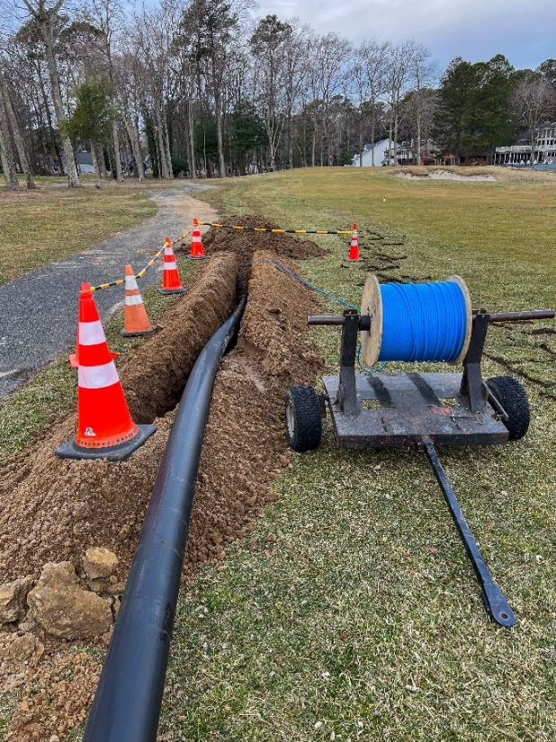
Golf Course Irrigation
  Phase 1 completed (holes #1, #9, and driving range)
  Phase 2 still in process
    Working on hole #2 and #3 and work around pumpstation
    On track to be completed in April
Hole #2
Hole #3

Slide 7
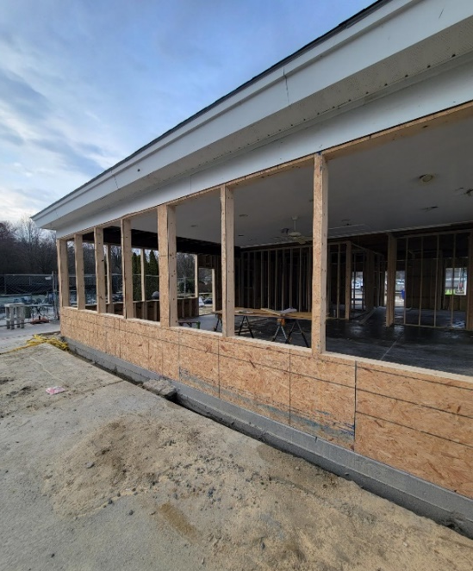
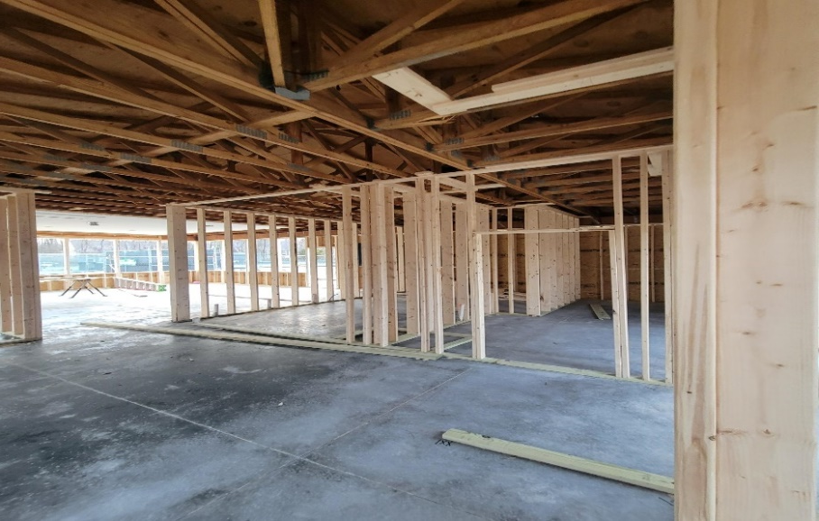
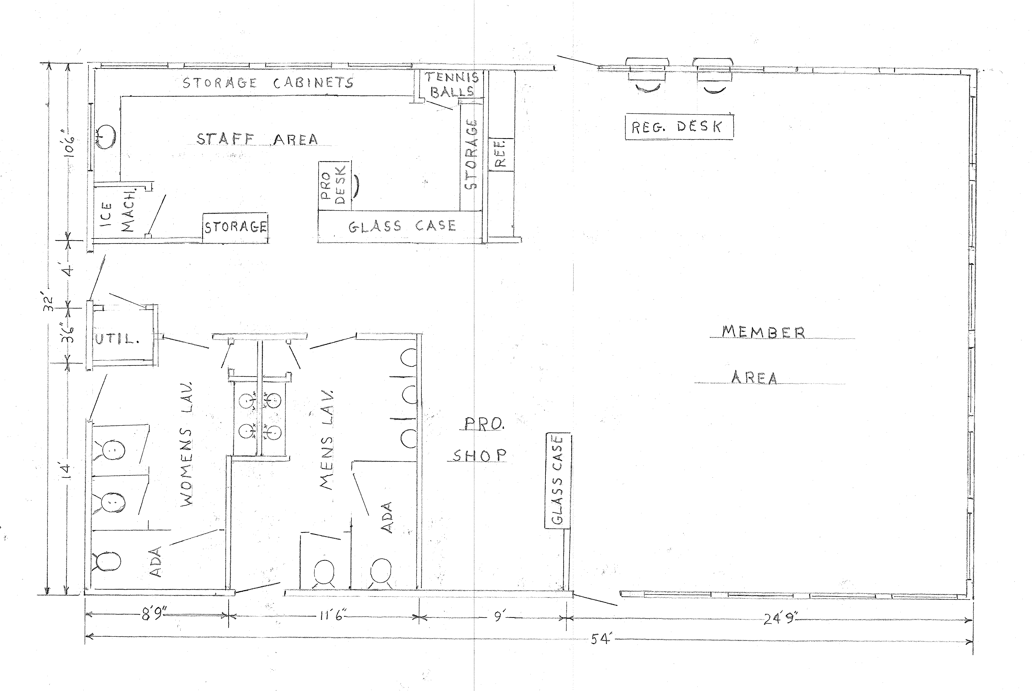
Racquet Sports Building
  Work began in February
  March highlights:
    Plumbing work completed and inspected
    Concrete poured
    Framing completed
  Cost: $250,000-$300,000 (original estimate $150,000-$200,000)
    Changes to original included updated demolition costs, concrete and framing (pricing) and new windows

Slide 8
Dog Park Structure
  Received approval from Worcester County for requested shade structure for dog park
  Cost: to be determined
  Work to begin after completion of Racquet Sports building

Slide 9
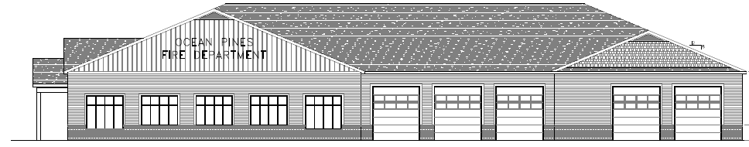
Firehouse
  Status: Green (planning stage)
  Timeline: shovel in the ground estimate October 2025; 65 weeks for completion
  Cost: TBD
  Plans reviewed on March 14th; architect to make minor changes
  Week of March 23rd: Met with Vista on site plans, mechanical drawings, permit process
  Working on mechanical plans
  Referendum to be sent out with election material in July
Joe Enste
Joey Widgeon
John Viola
Eddie Wells
Frank Brown

Slide 10
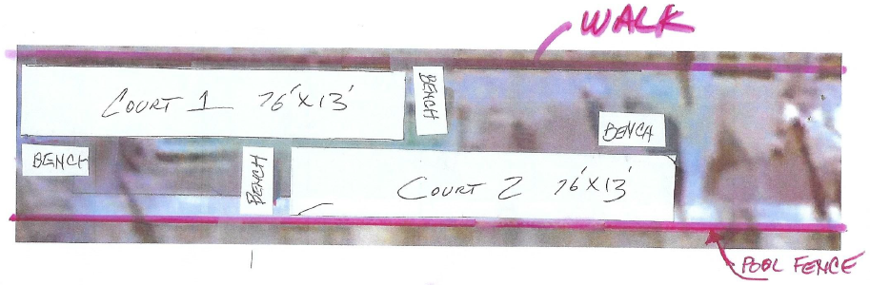
Bocce Ball Courts
  Leagues forming – play to begin in May
  Request to replace bocce ball courts
  Two club size courts to be installed; requesting approval today
  Projected ROI of $85,343 by FY 2027 (Mike Galello)

Slide 11
Bulkheads
  Requesting approval today during capital requests
  Locking in price of $450 per linear foot for bulkhead replacement for the next two years
  1,500 linear feet to be completed each year
    2026: Clubhouse side bulkheads
    2027: Borderlinks and golf course

Slide 12
Director of Business Administration –
Linda Martin

Slide 13
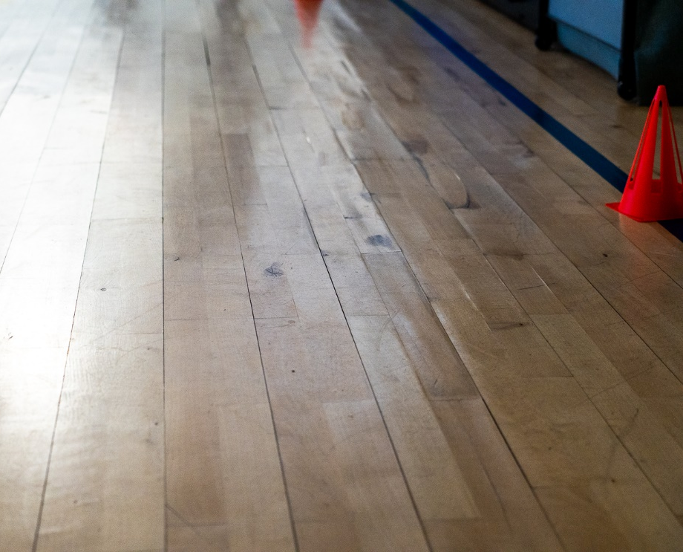

Gym Floor
  Pipe break in February lead to damage to gym floor
  Staff reviewed options on repair or replacement
  Recommended to replace floor with DynaForce System

Slide 14
Recreation & Parks
  Activity Guide released this month
    New activities/events including: ballet, yoga, pilates, fusion fitness, tai chi, P.E.P. (people enjoying people) social club, birding class, bike rodeo, Ocean Pines Got Talent, Bark on the Beach, Family Sand Castle Building Contest
    Spring Flea Market: April 5th
    Breakfast with the Easter Bunny: April 12th
    Easter Celebration/Easter Egg Hunt: April 19th
  Camps sold out after 1st week of registration – wait list availability only

Slide 15
Aquatics
  Swim & Racquet
    Confirming with attorneys if liquor license can be obtained
  Beach Club
    Extended pool hours to accommodate for live music (Friday & Saturday) – pool will be open until 7:00 p.m.

Slide 16
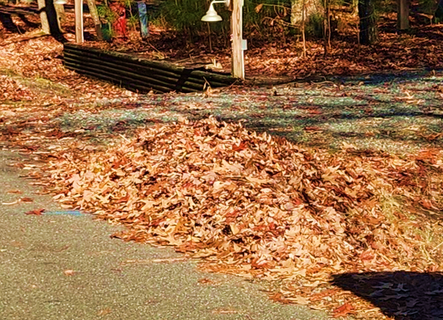
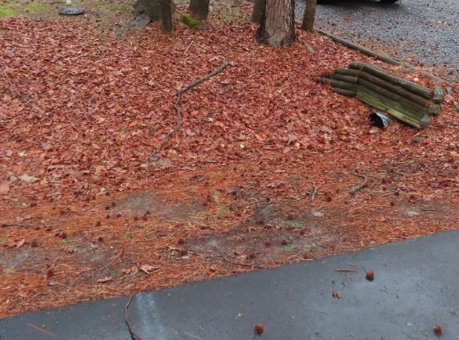
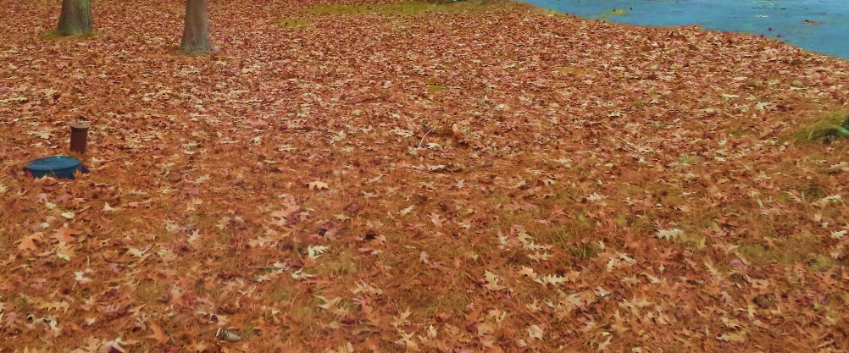
Leaf Maintenance
Leaf placement & maintenance:
  Section 10.D. of the Declaration of Restrictions:
    Easement shall be maintained continuously by the lot owner and ditches are to be clear of debris
  Section 8.A.l. of the Declaration of Restrictions:
    Lots shall at all times be maintained in such manner as to prevent their becoming unsightly by accumulation of debris thereon
491 violations issued; 180 violations resolved
Thank you to the owners who have complied or have contacted CPI requesting an extension

Slide 17
CPI Violation Dashboard
February
Violations
As of 2/1/25 | New Violations | Closed Violations | As of 2/28/25
310 | 212 | 114 | 408
212 violations initiated in February: 133 maintenance/trash/debris; 18 no permit; 16 signs; 45 miscellaneous
  Miscellaneous violations includes permit expirations, trailers, trailers, unregistered/junk vehicles, vehicle parking, and wire/metal fencing
114 violations complied out; 408 remain open
  197 maintenance/trash/debris; 61 no permit; 14 signs; 136 miscellaneous
73 of the 410 violations still open are in legal

Slide 18
Work Orders
February
Open Work Orders as of 2/1/25 | New Work Orders | Closed Work Orders | Open Work Orders as of 2/28/25
40 | 61 | 49 | 52
61 work orders initiated in February: 3 bulkhead; 12 drainage; 11 grounds/landscaping; 3 roads; 5 signs; 27 general maintenance
Majority still open in drainage (24):
  1 – over 30 days; 11 – over 60 days
    Average 1-4 work orders a day to complete depending upon severity

Slide 19
Customer Service Dashboard
(from info@oceanpines.org)
February
Type | # Received – Feb.
Amenities | 17
CPI | 9
Drainage | 0
General | 31
Public Works | 9
TOTAL | 66

Slide 20
Financials

Slide 21
MONTH OF FEBRUARY 2025
FINANCIAL RESULTS

Slide 22
FEBRUARY 2025 YTD
FINANCIAL RESULTS

Slide 23
UNAUDITED RESERVE SUMMARY
FEBRUARY 2025 ($ MILLIONS)
 | General Replace | Bulkheads | Roads | Drainage | New Capital | Total
4/30/24 Balance | $5.5 | $0.3 | $0.8 | $0.4 | $0.1 | $7.1
Contributions/ Interest | 2.1 | 1.1 | 0.1 | - | - | 3.3
Casino Funds | - | - | 0.3 | 0.2 | - | 0.5
Transfer (Spend) | (2.5) | (0.8) | - | (0.4) | - | (3.7)
2/28/25 Balance | $5.1 | $0.6 | $1.2 | $0.2 | $0.1 | $7.2

Slide 24

Treasurer’s Report -
Monica Rakowski

Slide 25

Cash & Short-Term Investments
Month of February
As of February 28, 2025, the Association had Approximately (~) $13.5M in Cash
  Cash Decreased ~ ($0.5)M from the Same Time Period Last Year
  Cash Decreased ~ ($0.8M) from February 2025
  $8.7M Invested in CDAR’s
  $44K in Interest Income Recognized for the Month
  Remaining $4.8M in Insured Cash Sweep, Treasury Bills, Money Market and Other Operating Accounts (Diversified Between 2 Local Banks)

Slide 26
Capital Requests
Police Vehicle
Requesting authorization to go forward with staff recommendation of $62,812 for Hertrich Fleet Services

Slide 27
Capital Requests
2025-2026 Bulkhead Replacement
and
2026-2027 Bulkhead Replacement
Requesting authorization to go forward with staff recommendation of $675,000 per year for Fisher Marine

Slide 28
Capital Requests
Bocce Ball Courts
Requesting authorization to go forward with staff recommendation of $50,692 for Southwest Greens Delaware Valley

Slide 29
Capital Requests
Community Center Gym Floor
Requesting authorization to go forward with staff recommendation of $62,300 for Dynamic Sports Construction

Slide 30
Ocean Pines Strategic Planning & Advisory Committee
2024 Property Owner Survey Results
3.29.2025

Slide 31
Agenda
SPAC Mission
SPAC Functions
Survey Statistics
Summary of Results
Next Steps
Q & A

Slide 32
Strategic Planning & Advisory Committee
Mission
To serve as a working and advisory group with the GM and BOD to create a Strategic Plan for the Association. The SPAC advises the GM and BOD on how best to align the mission and vision of the OPA by anticipating future needs and assisting in the development of a strategic plan that would support and enhance the lifestyles of its owners, residents and guests.

Slide 33
Strategic Planning & Advisory Committee
Functions
Gathers facts, investigates alternatives, evaluates issues upon request from BOD and/or GM
Performs studies of community needs upon request from BOD and/or GM relating to the development, evaluating and/or updating of Strategic Plan
Solicits information from pertinent sources within and outside of OPA regarding HOA “Best Practices” for the consideration of the BOD and GM in developing and implementing Strategic Plan

Slide 34
Survey Stats
Current Property Owner/Resident Status
  Full Time Residents 687
  Part Time Residents 308
  Rent Their Property Full Time 7
    TOTAL 1002
      41% indicated they did not participate in 2021 survey
Notes:
417 respondents (41%) responded to 2021 Survey

Slide 35
Q 4:Overall, how satisfied are you being an Ocean Pines Property Owner/Resident?
Extremely Unsatisfied 4.89%
Very Unsatisfied 13.76%
Satisfied 32.2%
Very Satisfied 31.61%
Extremely Satisfied 17.45%
Notes:
Overall Satisfaction is Positive, but slightly below 2021 results. 81.26% vs. 95.2%

Slide 36
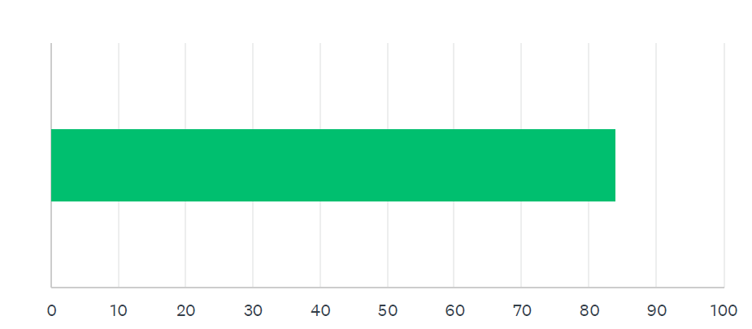
Q 12:All things considered, how likely would it be for you to recommend Ocean Pines as a place to live to a friend or colleague? ( Scale of 0-100)
Notes:
2021 = 83

Slide 37
Q 5: What are most important issues? (1=Not Important; 5= Very Important)
% Somewhat Important & Above
Safety 98.11%
Maintenance of Infrastructure 97.81%
Community Appearance 97.80%
Annual Assessment Fee value 97.00%
OPA Customer Service 96.21%

Slide 38
Q6:How is Ocean Pines Currently Meeting Expectations? (1=Signifcantly Below; 5 =Extremely Above)
% Meets Expectations & Above
Safety 90.03%
Maintenance of Infrastructure 66.50%
Community Appearance 76.47%
Annual Assessment Fee Value 81.95%
OPA Customer Service 81.76%
Notes:
Safety down from 58% in 2021. Customer Service up from 34% in 2021. Others consistent

Slide 39
Q7:Ocean Pines has included a set of core values in it’s Strategic Plan. How do you feel Ocean Pines is currently doing with regard to these Core Values? (1= Significantly Below; 5= Significantly Above
% Meets Expectations & Above
  Integrity 66.7%
  Accountability 70.04%
  Collaboration 72.49%
  Sustainability 77.26%
  Respect 76.47%
  Transparency 62.61%
Notes:
This is CONCERNING

Slide 40
Q8: Please rate how important the following Challenges/Opportunities facing Ocean Pines are? (1=Not Important; 5=Extremely Important)
% Important and Above
OPA Board & GM working collaboratively 96.11%
Pedestrian & Bike Safety 94.91%
Route 589 Traffic & Street Safety 94.61%
OP environmental & sustainability efforts 94.02%
Reponsivness of OPA to my requests/needs 92.03%

Slide 41
Q9:Rate you level agreement with the following statements (1=Strongly Disagree; 5=Strongly Agree)
% Slightly agree + Strongly agree
Support for non-resident fee for OP Boat Ramp 76.47%
Invest in improving existing amenities 66.7%
Support use of Electronic Voting 63.31%
Support increased enforcement of property covenants 56.63%
OP offers programs to meet my needs 53.63%

Slide 42
Q 11:Rate your interest in New or Improved Ammenities (1=Not interested; 5=Extremely Interested)
% Moderately Interested & Above
Improved Cell Phone Service 88.71%
Improved Internet Access 88.1%
Improved walking & biking paths 78.72%
Improved Street lighting 64.87%
Fitness Center 63.12%

Slide 43
Q 13:What would be the one recommendation you have for Ocean Pines to improve on in the next 3-5 years?
Improve Street Lighting
  Ocean Parkway
    Median
    Explore Solar
  Mailboxes
Enhance Beach Club
  Improvements to bathroom/shower areas

Slide 44
Q 13:What would be the one recommendation you have for Ocean Pines to improve on in the next 3-5 years? (continued)
Fitness Center
  Similar to what is in The Park, but larger
  Possible location-Next to Sports Core Pool
Enforcement of Property Covenants
  Consistent enforcement as per OPA regulations
  Consider adding “Inspectors” to staff as opposed to relying on residents to report infractions

Slide 45
Next Steps
(Included but not limited to the following)
  Identify Opportunities
    Strengthen support of core values
    Improving Street Lighting
    Potential for Fitness Club
    Bike paths

Slide 46
Next Steps (continued)
    Develop strategies to address opportunities
      Form targeted focus groups
      Benchmark similar communities
      Collaboration with other committees

Slide 47
THANK YOU
Questions & Answers

