Slide 1

Board of Directors Meeting
April 20, 2024

Slide 2
Approval of Agenda

Slide 3
Approval of Minutes
March 23, 2024 – Regular Meeting

Slide 4

President’s Remarks
Rick Farr

Slide 5
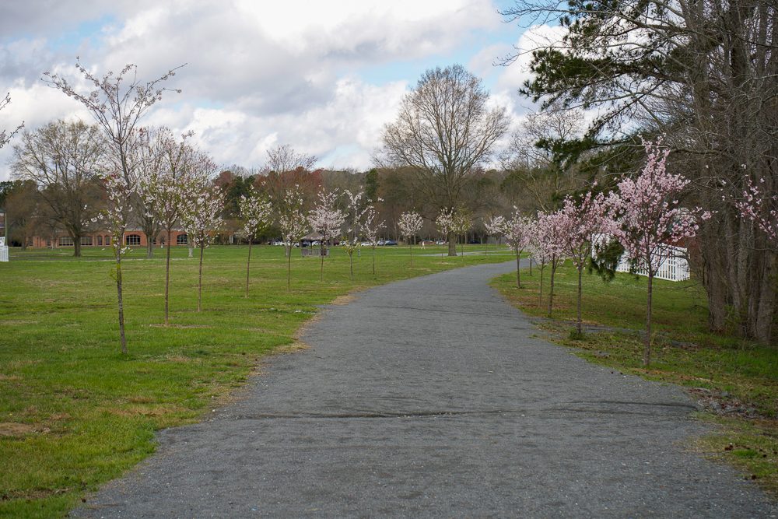
GM Leadership Report –
John Viola

Slide 6
Initiatives
  Police – Chief Tim Robinson
  Projects
    Tiki Bar
    Soft Shoreline
    Veterans Pavilion
    Racquet Sports Building
  Electronic Sign
  Reserve Study
  Maintenance
  Landscaping
  Safety
  Drainage
  Golf
  Racquet Sports
  Aquatics
  Recreation & Parks
  I.T.
  Waterways
  Road Paving
  Metrics

Slide 7
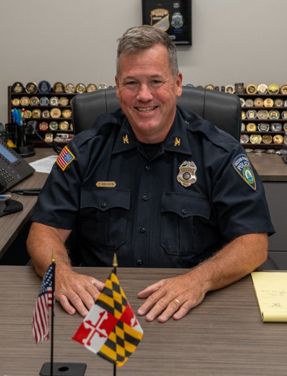
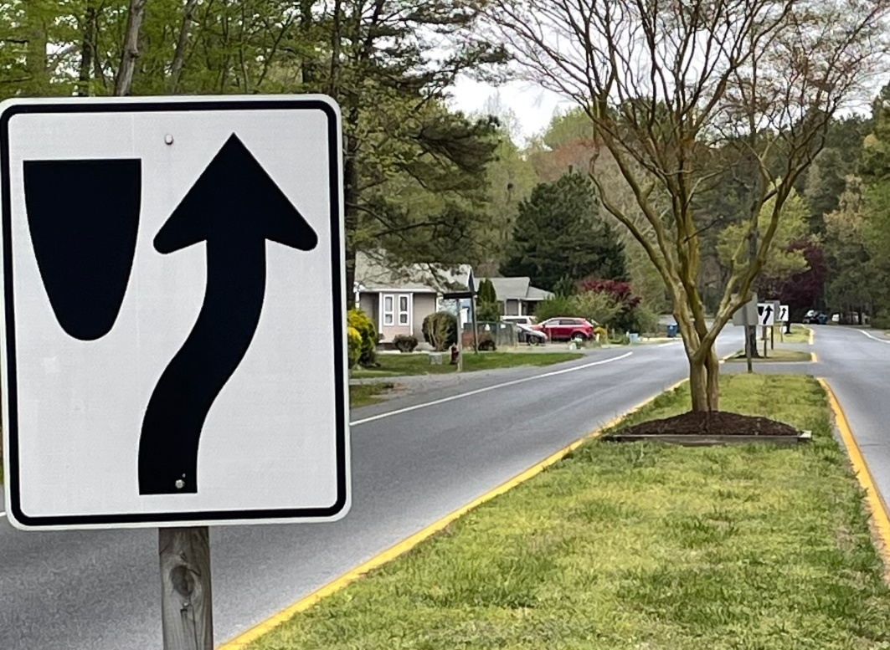
Chief Tim Robinson

Slide 8
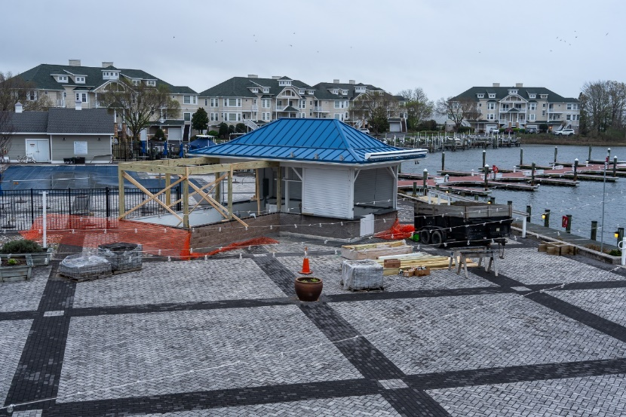
Projects
Tiki Bar:
  Project status: Green
  Concrete work finished
  Framing started
  Working on electric for inside tiki bar
  Replacement equipment ordered
  Completion date: mid-May
Soft Shoreline:
  Bids received and reviewed for design work of soft shoreline
  Met with Vista and Maryland Coastal Bays on April 16th to review plans
Veterans Pavilion:
  Met with Marie Gilmore
  Pavilion to be in line with Vets Memorial
  Change in timeline – Veterans Day completion
Racquet Sports:
  Project status: Yellow
  Approach is to still go with prior presentation to Board that was approved
  Focus on bathrooms, pro shop, directors office, and more visibility

Slide 9
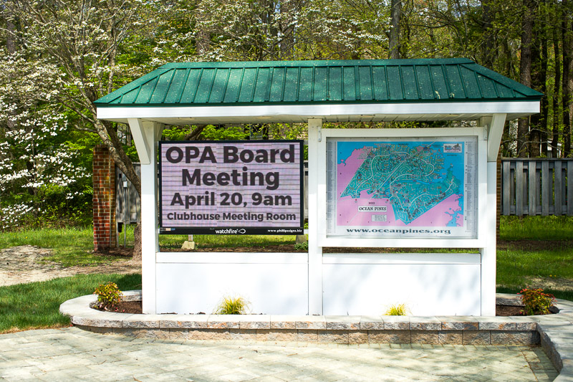
Electronic Sign
Electronic sign installed on April 16th by Phillips Signs
Will display rotating images of important events
Total cost: $26,558 ($22,118 for sign and $4,440 for surveys, permits, and new pavers/landscaping)

Slide 10
Reserve Study
Senate Judiciary Proceedings Committee held a hearing held on Maryland Senate Bill 1157 which is proposing an extension from three years to five years the duration to comply with a certain funding requirement related to reserve accounts
Based upon the fact we were already adhering to an independent 3rd party, we are positioned better than 5 years ago
Senate bill also requires reserve study to be reviewed annually, by OPA, which we currently have been doing
We are setting up a follow up with DMA for the end of the year

Slide 11
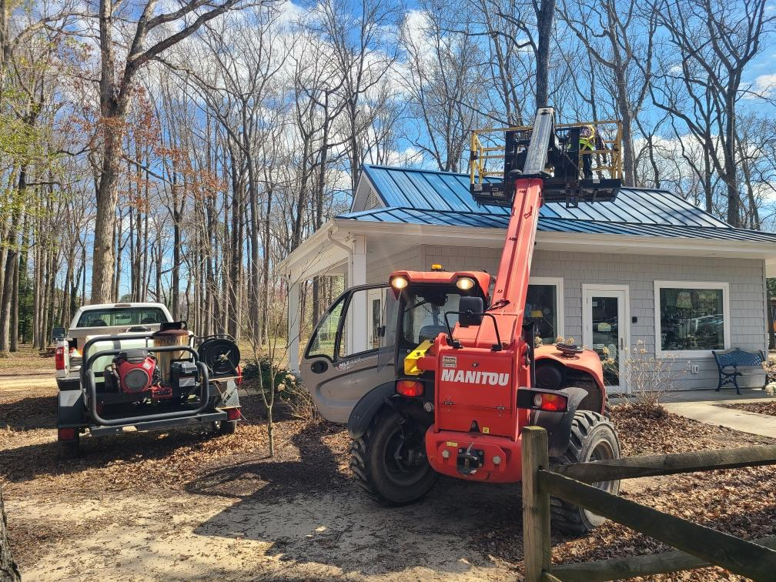
Maintenance
Beach Club:
  Received request through info@oceanpines regarding Maintenance at Beach Club
    Bathrooms renovated in 2018
    After walk-through conducted in the Fall, painted interior grill area and sanded/stained counters
    Boards replaced annually around Beach Club building; Public Works scheduled to review next week for areas that need replacing
Power washing buildings

Slide 12
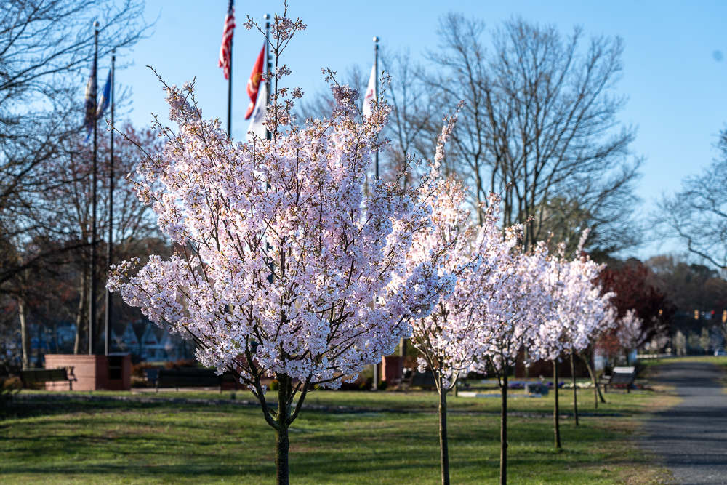
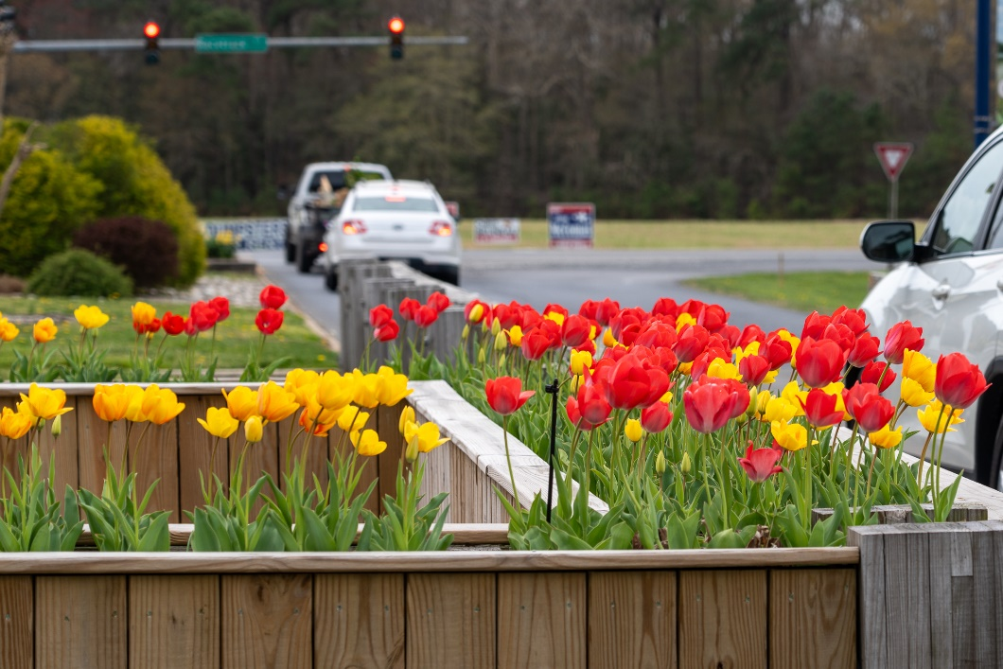
Landscaping
Landscaping crew continuing with mulching and applying pre-emergence herbicide
Palm trees are coming

Slide 13
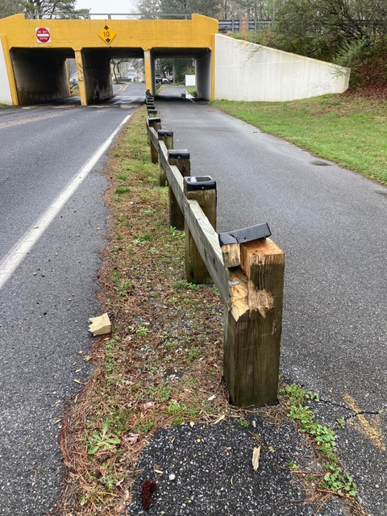
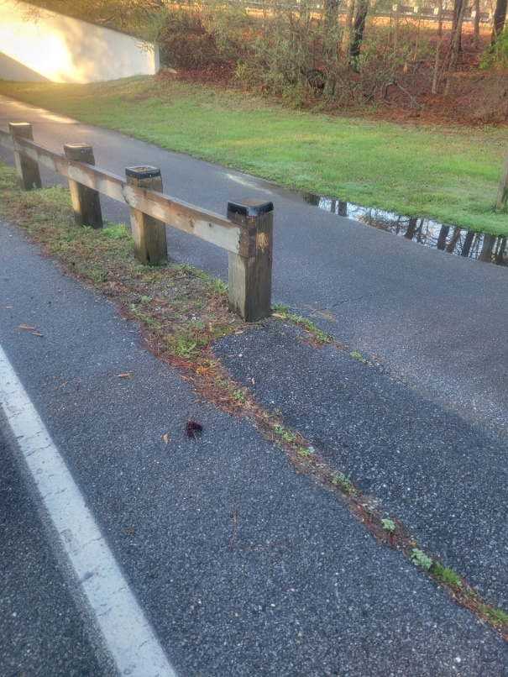
Safety
Someone hit median on Ocean Parkway near Route 90 overpass (reported by Jeff Heavner)
Once reported to GM, Public Works immediately addressed by fixing the guard rail

Slide 14
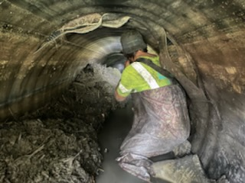
Drainage
Cured In Place Pipes (CIPP) project to begin soon by Pelican Underground
  1221 & 1223 Carrollton Lane, Golf Course, White Horse Drive, Capetown Road, 57 Ocean Parkway, 7 & 52 Pinehurst Road, 192 Teal Circle, 34, 44, & 84 Lookout Point, 27 & 48 Seafarer Lane, 28 Admiral Avenue, and 22 Harpoon Road
Approved by Board at February Board Meeting
Total cost: $210,637

Slide 15
Golf
Residents Golf Day: Sunday, April 21st
  Free greens fees for Ocean Pines Residents (pay only for cart)
  Free range 2:00-5:00 p.m.
  Free instruction times 2:00-5:00 p.m.
  Free closest to the pin and putting contest
Memberships (trending)
Clubhouse Grille
  Driven by golf number of rounds

Slide 16
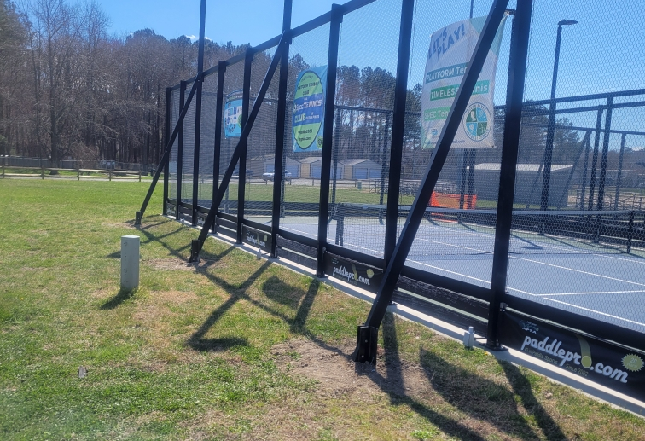
Racquet Sports
After last Board Meeting, we inspected the building and bought in an independent service to evaluate
Results – no mold issues
Clay court renovations started this week
  Work being performed by ATC
  Removing the old clay and replacing with new; grading and rolling courts and installing new tape lines
New support beams at platform courts per request

Slide 17
Aquatics
Getting pools ready for the season (maintenance and cleaning)
Class certification of lifeguards April 19-22; 50 lifeguards on roster
Swim lessons continuing – full through May; reserving summer lessons now (7 years and older open; younger children already full).
Junior Lifeguard Program returning this summer
Snack bar at Swim & Racquet returning
Presenting today bid for resurfacing Swim & Racquet Splash Pad

Slide 18
Recreation & Parks
New programs offered this year:
  Yoga
  Chair Yoga
  Bodyweight Bootcamp
  Martial Arts
  Skateboard Class
  Paint classes for adults and children
  Cornhole league
  Disk golf league
Indoor/outdoor yard sale held April 13th – all vendor spots filled (68 vendors)
Summer camps are completely filled – hiring camp counselors
Reminder of Community Bike Ride May 11th!

Slide 19
I.T.
Yacht Club:
  After the Board Meeting held outside last year at the Yacht Club, IT has upgraded the wi-fi
  Invested in new quad band wi-fi 6 system
  5 additional wi-fi points added
  System also expandable if any other wi-fi issues arise
  Total cost: $2,000
Clubhouse:
  New microphones ordered to improve sound
  Video: slide presentation being taken down earlier for view of attendees

Slide 20
Waterways
Aerators:
  Aerators placed in Bay Colony (Drawbridge canal) not working
  Two replacement aerators ordered – will be installed as soon as they arrive
Buoys:
  Replacement buoys ordered and were installed this week
Bulkhead Replacement:
  Finishing up on 2023/2024 bulkhead replacement project in the next few weeks
  Emergency bulkhead repairs at 6 & 8 Liberty Bell Court and 25-28 Heron Isle Court to take place after normal bulkhead replacement

Slide 21
Road Paving
Road paving started week of April 8th
Approved by Board at the 10/28/23 Board Meeting
Total cost: $356,618.20
Road paving being done by Asphalt Maintenance LLC
Affected streets:
  Battersea Road
  Canal Road
  Deerfield Court
  Driftwood Lane
  Moonraker Road
  St. Martins Lane
  Waters Edge Court
  Wharf Court

Slide 22
CPI Violation Dashboard
March
Violations
As of 3/1/24 | New Violations | Closed Violations | As of 3/31/24
183 | 119 | 84 | 218
119 violations initiated in March: 18 maintenance/trash/debris; 9 leaf placement; 16 no permit; 76 miscellaneous
  Miscellaneous violations includes signs, stop work orders, trailers, unregistered/junk vehicles, and vehicle parking
84 violations complied out; 218 remain open
  52 maintenance/trash/debris; 16 leaf placement; 49 no permit; 101 miscellaneous

Slide 23
Work Orders
March
Open Work Orders as of 3/1/24 | New Work Orders | Closed Work Orders | Open Work Orders as of 3/31/24
115 | 138 | 83 | 170
138 work orders initiated in March: 5 bulkhead; 74 drainage; 18 grounds/landscaping; 8 roads; 4 signs; 29 general maintenance
Majority still open in drainage (103):
  23 – over 30 days; 32 – over 60 days
    Average 1-4 work orders a day to complete depending upon severity

Slide 24
Customer Service Dashboard
(from info@oceanpines.org)
March
Type | # Received – Mar.
Amenities | 45
CPI | 28
Drainage | 5
General | 71
Public Works | 12
TOTAL | 161

Slide 25
Financials

Slide 26
UNAUDITED FINANCIAL CHANGE
MONTH OF MARCH 2024
March (In 000’s)
 | Budget | Current Year | Favor/ (Unfavor) vs. Budget
Net Revenues | $283 | $327 | $44
Expenses | 1,042 | 938 | 104
Net Operating | ($759) | ($611) | $148

Slide 27
UNAUDITED MONTH OF MARCH
FAVOR/(UNFAVORABLE) VS. BUDGET (IN 000’s)
Department/Amenity | Favorable/(Unfavorable)
Police | 44
Aquatics | 39
Yacht Club | 16
Public Works/Gen Maint/CPI | 12
Golf Ops + Maintenance | 12
Recreation & Parks | 11
Racquet Sports | 8
Other Net (GM Office, Beach Club, Marinas) | 6
TOTAL | $148

Slide 28
UNAUDITED FINANCIAL CHANGE
YTD MARCH 2023
March YTD (In 000’s)
 | Budget | Current Year | Favor/ (Unfavor) vs. Budget
Net Revenues | $13,963 | $14,760 | $797
Expenses | 13,252 | 12,993 | 259
Net Operating | $711 | $1,767 | $1,056

Slide 29
UNAUDITED YTD MARCH
FAVOR/(UNFAVORABLE) VS. BUDGET (IN 000’s)
Department/Amenity | Favorable/(Unfavorable)
Police | $320
Golf Ops + Maintenance | 209
Admin/Finance/GM/Public Relations | 129
Public Works/Gen Maint/CPI | 109
Aquatics | 101
Beach Club | 57
Beach Parking | 53
Recreation & Parks | 48
Clubhouse Grille | 37
Yacht Club | 28
Marinas | (22)
Racquet Sports | (13)
TOTAL | $1,056

Slide 30
UNAUDITED RESERVES FEBRUARY 2024 ($ MILLIONS)
 | GeneralReplace | Bulkheads | Roads | Drainage | New Capital | Total
4/30/23 Balance | $5.1 | $0.5 | $0.7 | $0.2 | $0.1 | $6.6
Contributions/ Interest | 2.2 | 1.1 | - | 0.1 | 0.1 | 3.5
Casino Funds | - | - | 0.4 | 0.1 | - | 0.5
Transfer (Spend) | (1.5) | (1.2) | - | - | (0.1) | (2.8)
3/31/24 Balance | $5.8 | $0.4 | $1.1 | $0.4 | $0.1 | $7.8

Slide 31

Treasurer’s Report -
Monica Rakowski

Slide 32

Cash & Short-Term Investments
Month of March
As of March 31, 2024, the Association had Approximately (~) $15.0M in Cash
  Cash Increased ~ $0.6M from the Same Time Period Last Year
  Cash Increased ~ $1.0M from February 2024
  $10.5M Invested in CDAR’s
  $46K in Interest Income Recognized for the Month
  Remaining $4.5M in Insured Cash Sweep, Treasury Bills, Money Market and Other Operating Accounts (Diversified Between 2 Local Banks)

Slide 33


Public Comments
Members wishing to make comments must state their name and address

Slide 34
Capital Requests
Aquatics – Swim & Racquet Pool Splash Pad

Slide 35
Capital Requests
Swim & Racquet Splash Pad
Requesting authorization to go forward with staff recommendation of $36,040 for Aqua Seal Resurfacing

Slide 36
CPI Violations
14 Widows Watch Court
12 Whaler Lane
56 Lookout Point
43 Moonshell Drive
13 Riverside Court
31 Sundial Circle
39 Abbyshire Road
158 Seafarer Lane
10 Royal Oaks Drive
26 Gloucester Road
13 Boston Drive
865 Ocean Parkway
795 Ocean Parkway
53 Fairway Lane
2 Mist Flower Road
74 White Horse Drive
76 White Horse Drive
87 White Horse Drive
61 Falconbridge Road

Slide 37
New Business
Second reading of changes to Resolution C-01 (Committee General Policy) – John Latham
Second reading of changes to Resolution C-03 (Budget and Finance Advisory Committee) – John Latham
Second reading of changes to Resolution M-06 (Elections and Referendum Procedures) – John Latham
Second reading of revisions to the Architectural Review Committee Guidelines – Elaine Brady
Motion to repeal Resolution C-14 (Racquet Sports Committee) – Rick Farr
Discussion on establishing a historical work group – Elaine Brady
Discussion on East Room and Anna Foultz Room – Elaine Brady

Slide 38
Appointments
Wesley Blakeslee – 2nd Term – Strategic Planning
Michael Galello – 1st Term – Architectural Review
Robert Long – 3rd Term – Golf

Slide 39
Adjournment

