Slide 1

Board of Directors Meeting
April 21, 2021

Slide 2
Approval of Agenda

Slide 3
Approval of Minutes
March 20, 2021 – Regular Meeting
March 26, 2021 - Special Meeting

Slide 4

President’s Remarks
Larry Perrone

Slide 5
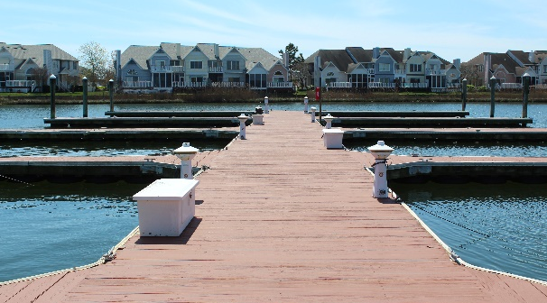
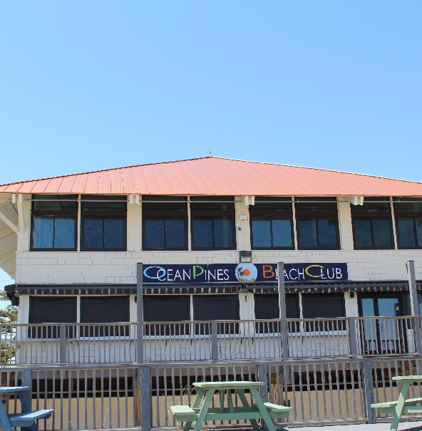
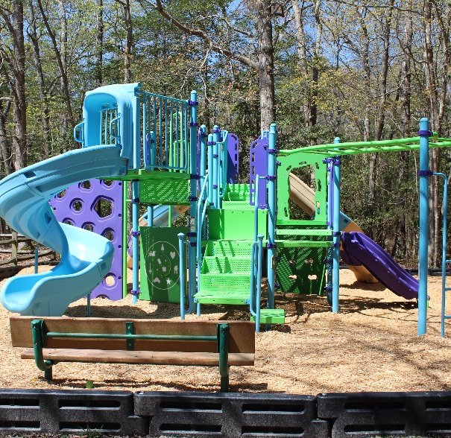
GM Leadership Report
John Viola

Slide 6
Your assessment
dollars at work

Slide 7
GM Report
Administration Board Conference Room – Audio Video set up
Proposed Irrigation System for effluent water – status
Beach Club Maintenance
Drainage Project – status
Northstar – status
Director -Debbie Donahue
Recreation & Parks
Marina
Beautification
Bulkhead – status
Capital Projects-
Robinhood Park Playground
Racquet Sports Maintenance
Roads Resurfacing
Mumfords Roof Replacement

Slide 8
Administration Building Board Room
Audio/Video set up end of April
Josh received 3 bids – Mid-South bid $10,992 was accepted
Training Kyle Jarmon as back up
With the push of a button, users will be able to join a true hybrid meeting
Proposed Irrigation System for effluent water status
Project is initiated by wastewater treatment
Received preliminary concept plans, Team discussed with designer consultant and John Malinowski
Next step on my end will be to set up a Town Hall to discuss this proposed project

Slide 9
Beach Club Maintenance - Green
Tracking favorable to Budget
Painting exterior of building - $14,950
Paint decks upper and lower - $6,600
Replace bad deck boards - $5,594
Bulkhead Status - Green
Started construction 9/8/20
Construction of walls completed by 4/30/21
Backfilling completed by 1st week of May
Final grade/topsoil 1st week of May
Sod 1st week of May
Completion date May 7th
The completion dates are estimates and could change due to weather conditions and availability of materials.

Slide 10
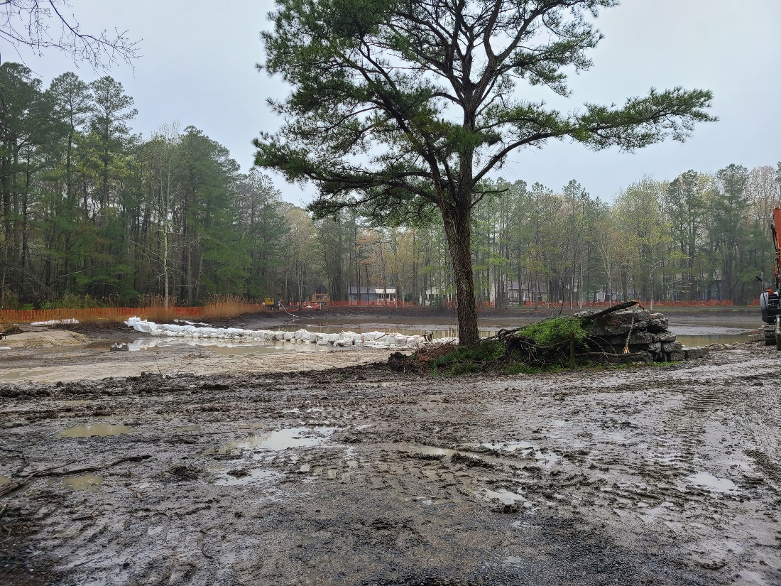
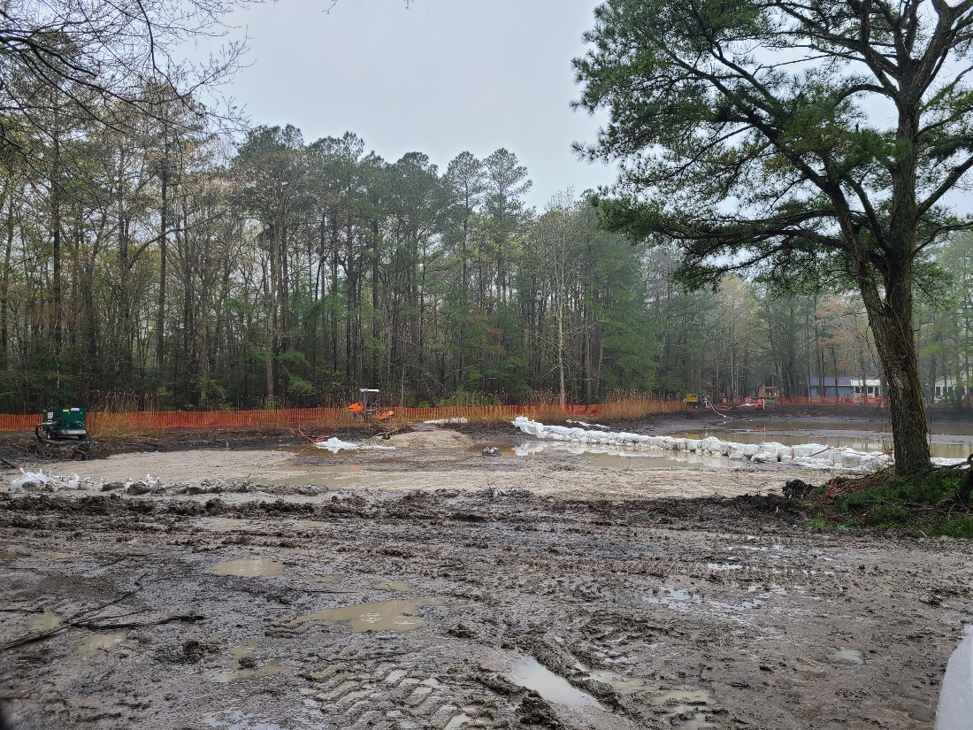
Bainbridge
Drainage
Project

Slide 11
Bainbridge Drainage Project Status
Timeline – March 15 – June 30
Status - Green
Budget $800,000 / Grant $482,337
Payment to Vendor To Date -$53,465
Dept of Natural Resources is the “Keeper of the Funds” and will disburse as invoiced by Worcester County
OPA can submit invoices, along with cancelled check and payment application for reimbursement to County monthly or as needed. The County then submits to Dept of Natural Resources, and they will cut check directly to OPA.
Reimbursement is expected to take approx. 3 weeks from date of submittal
OPA submitted vendor invoice (Environmental Quality Resources, LLC) for $53,465. We are still waiting on funds as of 4/19

Slide 12
Northstar Status
Overall:
Moving in the right direction with new Account Manager
Efficiencies gained in Departments (less rework). Improvements made in areas on instability improvement in reporting/budget visibility. Bank reconciliation.
Website:
Improvements since migration to new hardware by Northstar
POS:
Working on final punch list from F&B
Basic issues and capacity issues. This system was built for a country club fine dining establishment (need more capacity).
No end date for implementation

Slide 13
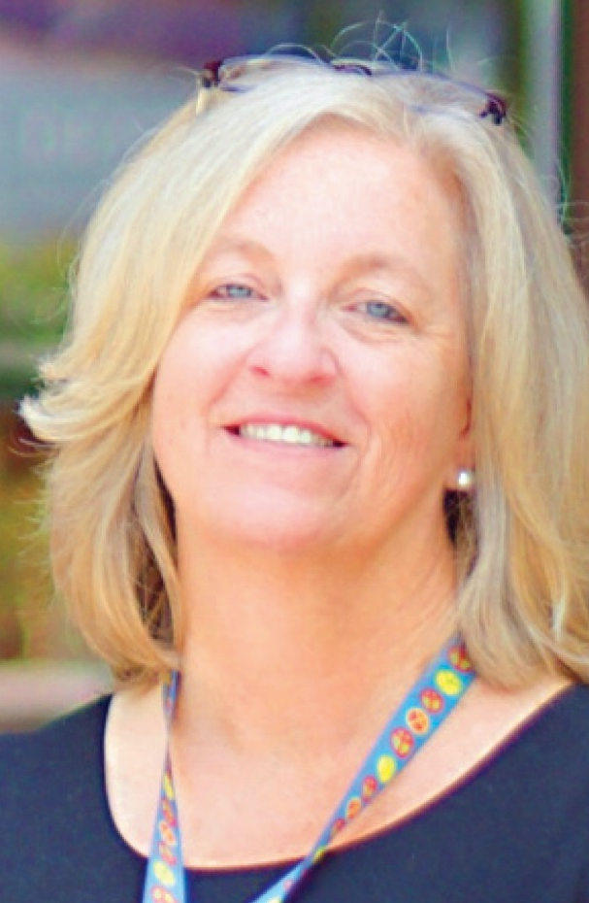
Director Debbie Donahue

Slide 14
RECREATION AND PARKS
Robinhood playground – equipment installed
The basketball courts have been resurfaced and lines painted and new back board
Fencing repairs will be complete week of April 25th
All parks will also get a fresh upgrade of mulch and any equipment repairs
Manklin basketball court will also be resurfaced, and new lines painted and new back board
Camp Ocean Pines – Full – will begin on June 21st at half capacity – per State Regulations. Following all COVID regulations that have been discussed with the General Manager.
Dog Park –Eddie has spoken with the county about other options to handle standing water
White Horse Park Parking Lot: paving will begin Tuesday, April 27th
White Horse Park Sign is also a part of this project that will be replaced by June 1.
Gym Light Replacement will take place by June 1st, this make better lighting for the gym as well as more efficient lighting system. LED Lights

Slide 15
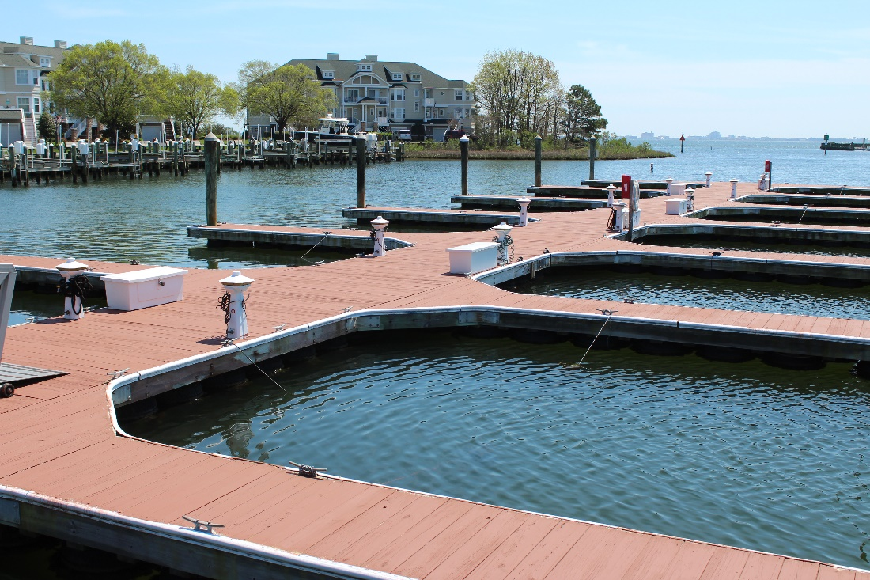
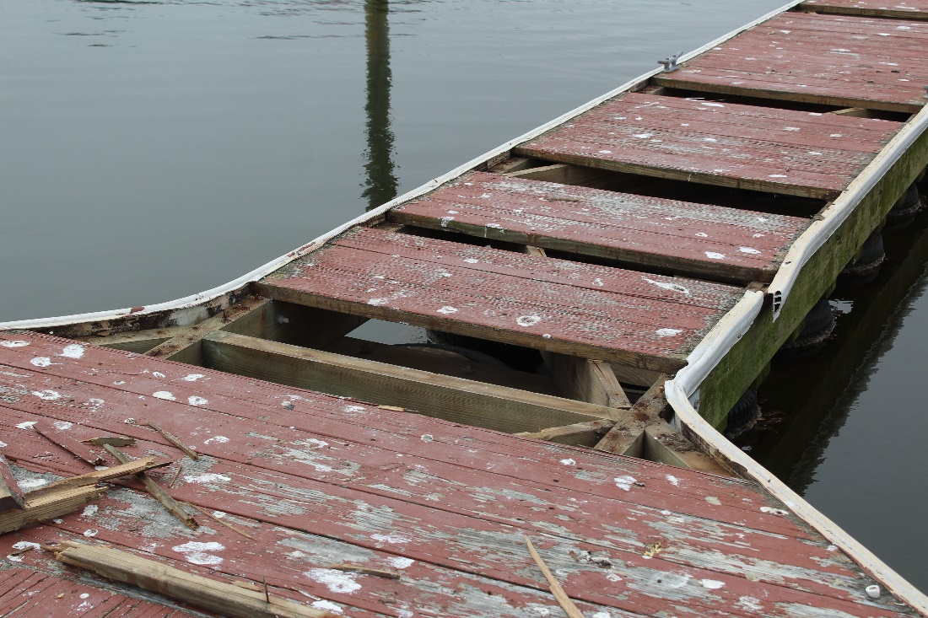
Yacht Club
Marina
Deck boards replaced
and painted
After
Before

Slide 16
RACQUET SPORTS
Har-Tru Court resurfacing started April 15 – completion by Thursday April
Terra Firma – Pickleball crack repairs starting April 20 - completion by Monday April 26
New Pickleball Court Project – Vista Design is working on plans and design work for the new courts
Jr. Tennis Courts – Vista Design working on plans and designs for the new courts and placement
MARINA
Dock Boards have been replaced and painted
The boat slips for both the YC Marina and the Swim & Racquet Marina have all been rented
The Marina will be open for slip holders to put the boats in their slips on May 1st
The fuel dock will also be open with limited hours
BEAUTIFICATION OF OCEAN PINES
Cherry blossom trees have been planted on Cathell Road and will also be planted around the South Gate Pond. Tony and his crew from public works are waiting for delivery of more trees.
He is also working on landscaping for all of Ocean Pines.
More beautification will be taking place in Ocean Pines in different locations very soon.

Slide 17
Financial Change month of MARCH 2021
March (In 000’s)
 | Budget | Current Year | Favor/ (Unfavor) vs. Budget
Net Revenues | $192 | $283 | $91
Expenses | 923 | 815 | 108
Net Operating | ($731) | ($532) | $199

Slide 18
Financial Change ytd MARCH 2021
March YTD (In 000’s)
 | Budget | Current Year | Favor/ (Unfavor) vs. Budget
Net Revenues | $12,737 | $12,958 | $221
Expenses | 11,866 | 10,758 | 1,108
Net Operating | $871 | $2,200 | $1,329

Slide 19
Detail for the Month of march
Favor/(Unfavorable) Vs. Budget (in 000’s)
Department/Amenity | Favorable/(Unfavorable)
Public Works | $92.0
Recreation & Parks | 28.4
General Maintenance | 26.3
Yacht Club | 21.2
Public Relations | 13.5
Aquatics | 5.8
Other (Admin, Police, Finance, Mgr Office) | 11.9
TOTAL | $199.1

Slide 20
Detail for march ytd
Favor/(Unfavorable) Vs. Budget (in 000’S)
General Admin. & Other | $1,092.2
Public Works/Gen Maintenance/CPI | 369.4
Finance | 92.8
Marinas | 63.5
Public Relations | 61.7
Recreation & Parks | 78.1
Police | 29.5
Clubhouse Grille | 13.8
Aquatics | (198.2)
Beach Parking | (178.0)
Yacht Club | (59.0)
Racquet Sports Golf Ops & Maintenance | (28.3) (8.1)
Net Operating | $1,329.4

Slide 21
FORECAST
VARIANCE TO BUDGET (in 000’S)
Forecast 4/30/21 | $1,150
Deduct:
Ocean Pines PPP | (1,143)
Food & Beverage PPP | (271)
Coronavirus Relief (estimate) | (105)
Forecasted Operations without Stimulus | (369)
Note:
1- At this time $70 has been forgiven
2- All Ocean Pines PPP went to fund salaries

Slide 22

Treasurer’s Report -
Doug Parks

Slide 23

Cash & Short-Term Investments
Activity for Month of March
Overall Laddered Investment Rate of Return on CDAR’s for March Approx. 0.85%
As of March 31, 2021, the Association had approx. $11.9 million in cash
  Approx. $6.0 million invested in CDAR’s, fully FDIC insured
  Approx. $5.9 million in Money Market and other operating accounts, fully insured

Slide 24
Unaudited Reserves march 2021 ($Millions)
 | GeneralReplace | Bulkheads | Roads | Drainage | New Capital | Total
4/30/20 Balance | $3.5 | $1.6 | $0 | $0.5 | $0 | $5.6
Contributions/ Interest | 1.8 | 0.9 | - | 0.3 | 0.2 | 3.2
Casino Funds | - | - | 0.3 | - | - | 0.3
Transfer (Spend) | (1.3) | (1.4) | (0.1) | (0.2) | (0.1) | (3.1)
4/30/21 Balance | $4.0 | $1.1 | $0.2 | $0.6 | $0.1 | $6.0

Slide 25
Reserves 4/30/21 unaudited estimate
(in ooo’s)
 | Beginning Balance |  |  | Projected Balance
 | 4/30/2020 | Additions | Expenditures | 4/30/2021
Major Maintenance & Replacement:
Police Renovation |  |  | (610)
Northstar |  |  | (75)
Admin Siding-Roof |  |  | (73)
Aquatics (Splash Pads, etc) |  |  | (50)
Yacht Club + Beach Club |  |  | (40)
Racquet Sports Sidewalks |  |  | (65)
Tractor for Ditch Maintenance |  |  | (150)
Rough Mower |  |  | (67)
Police Vehicles |  |  | (90)
Playground Equipment/Other |  |  | (205)
Total | 3,481 | 1,840 | (1,425) | 3,896
Bulkheads & Waterways | 1,653 | 920 | (1,550) | 1,023
Roads | 0 | 326 | (110) | 216
Drainage | 506 | 260 | (400) | 366
New Capital | 0 | 167 | (66) | 101
TOTAL 4/30/21 | 5,640 | 3,517 | (3,571) | 5,602

Slide 26

Public Comments

Slide 27
Capital Purchase Requests
Public Works – Roof Replacement on Mumford Pool House & Shed
Public Works – 2021 Secondary Road Rehabilitation

Slide 28
Public Works
Roof Replacement on Mumford
Pool House & Shed
Requesting Authorization to go forward with Staff Recommendation of $15,100 for Arroyo Roofing

Slide 29
Public Works
2021 Secondary Road Rehabilitation
Requesting Authorization to go forward with Staff Recommendation of $208,579 for Chesapeake Paving & Sealing

Slide 30
CPI Violations
None

Slide 31
Unfinished Business
None

Slide 32
New Business
None

Slide 33
Appointments
Lisa Romersa – 1st Term – By-Laws & Resolutions

Slide 34
Adjournment

