Slide 1
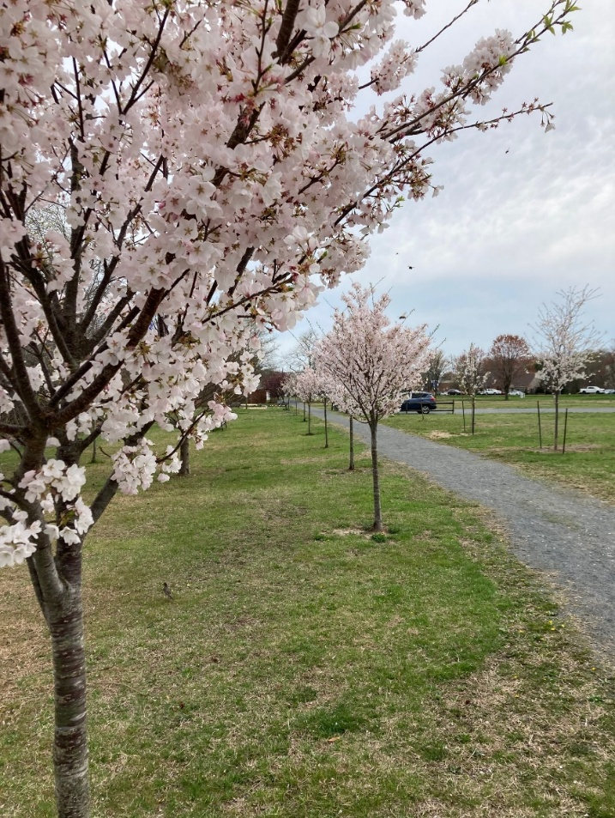
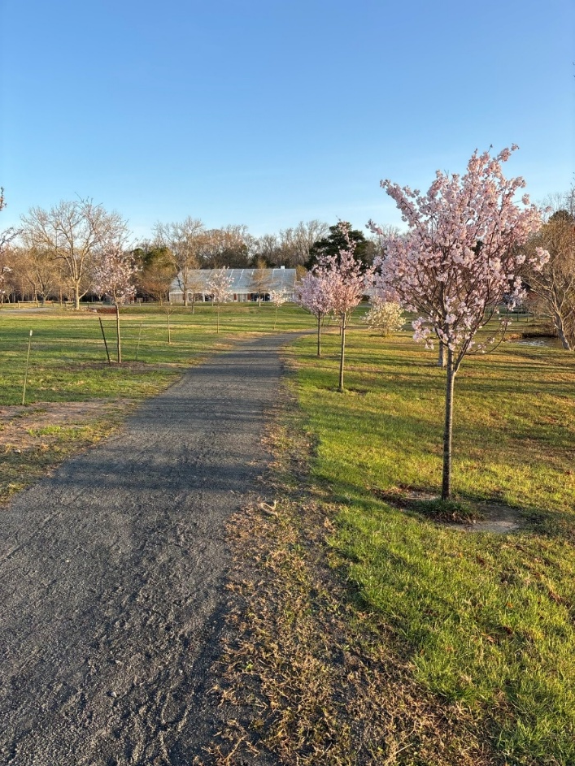
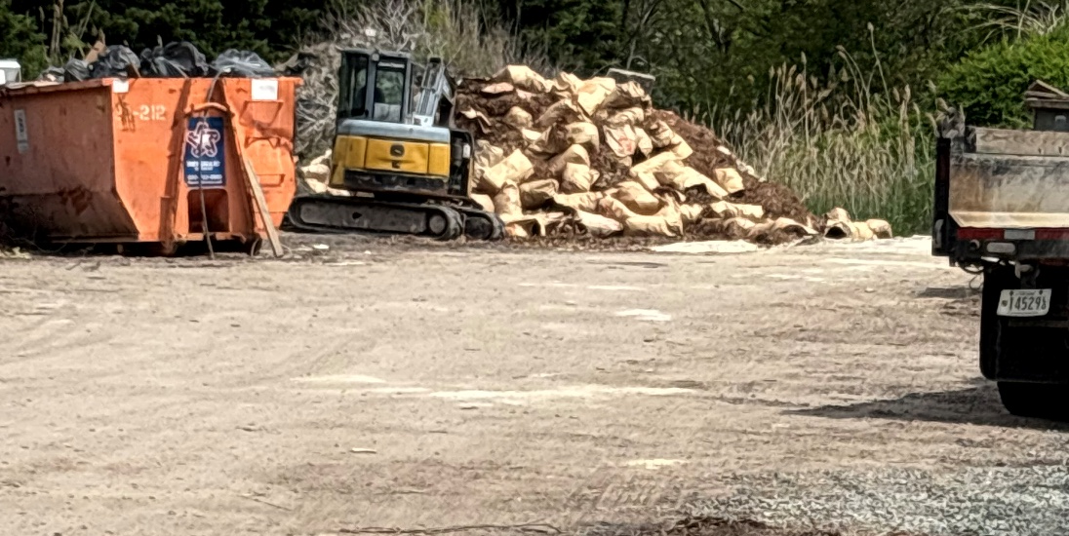
GM Leadership Report –
John Viola – General Manager
Linda Martin – Director of Business Administration
April 26, 2025

Slide 2
Initiatives
  Watch Party
  Golf
  Racquet Sports Building
  Bocce Ball Courts
  Jet Ski Lifts
  Kayak Racks
  Maintenance
  Landscaping
  Gym Floor
  Roads
  Soft Shoreline Project
  Mailboxes
  Metrics

Slide 3

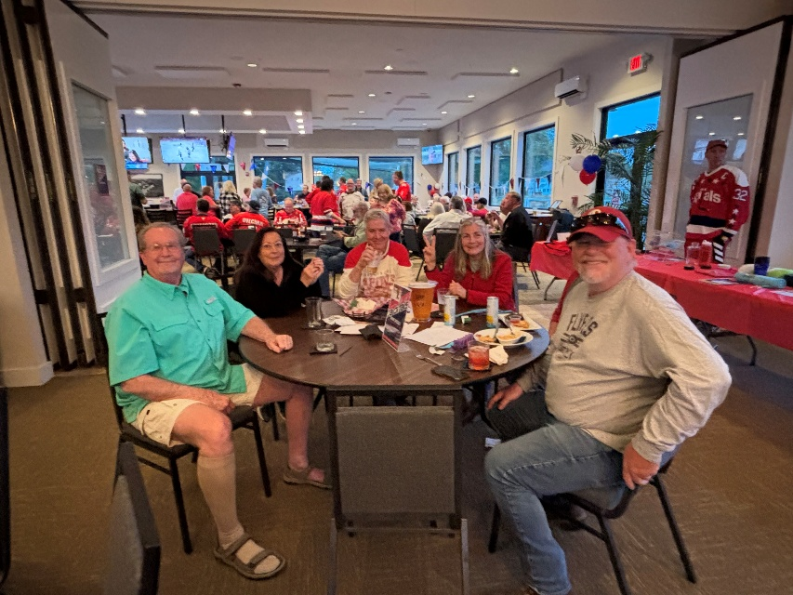
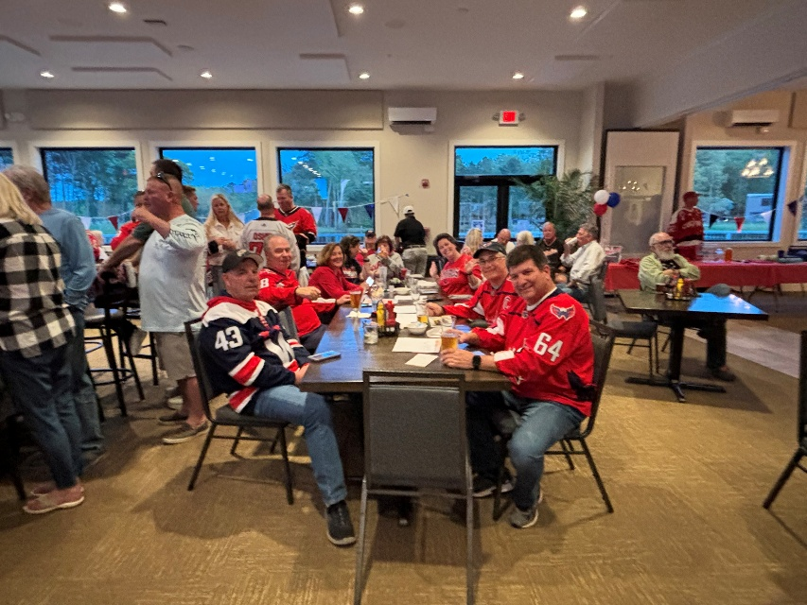
Watch Party
  Over 110 people
  Food and drink specials
  50/50 raffles
  Trivia
  Thanks to everyone who attended and for the Recreation Department for making this event happen!

Slide 4
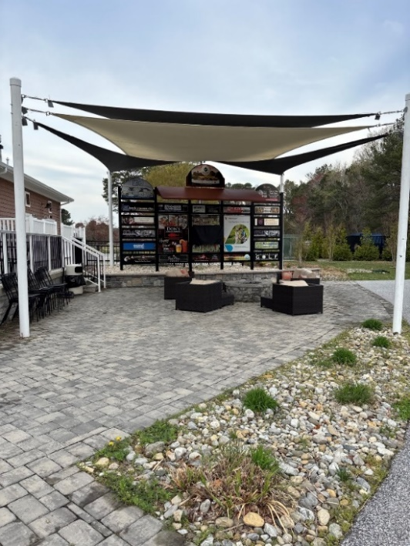
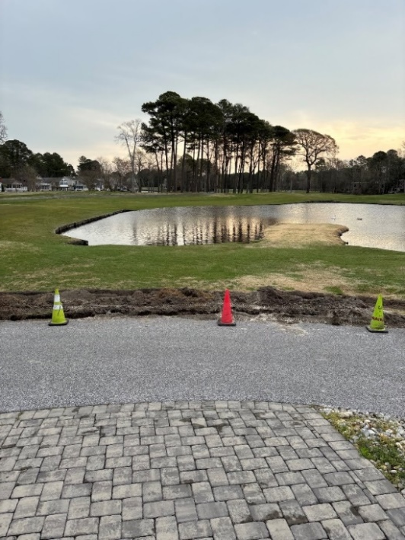
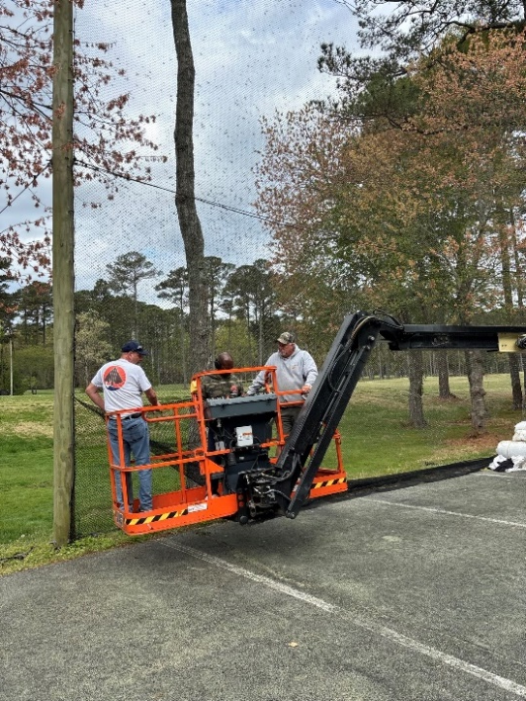
Golf
  Outdoor paved area updated for expanded canopy and upgraded television
  Service bar area installed for “grab and go” refreshments for golfers
  Irrigation project continuing – hook up to pump station by mid-May
  Public Works replacing netting on driving range
  Pond patio to be enhanced for TOI concepts to enhance customer experience (stay tuned)

Slide 5
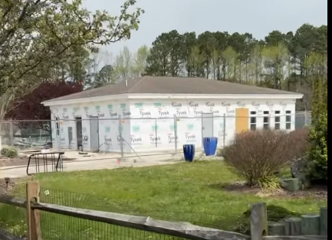
Racquet Sports Building
  Basically a new building project continuing at the Racquet Center
  Original plans and budget adjusted and approved
  Highlighted by expanded restrooms as requested by Racquet Sports
  Cost: approximately $250,000-$275,000
  Estimated completion still before Memorial Day

Slide 6
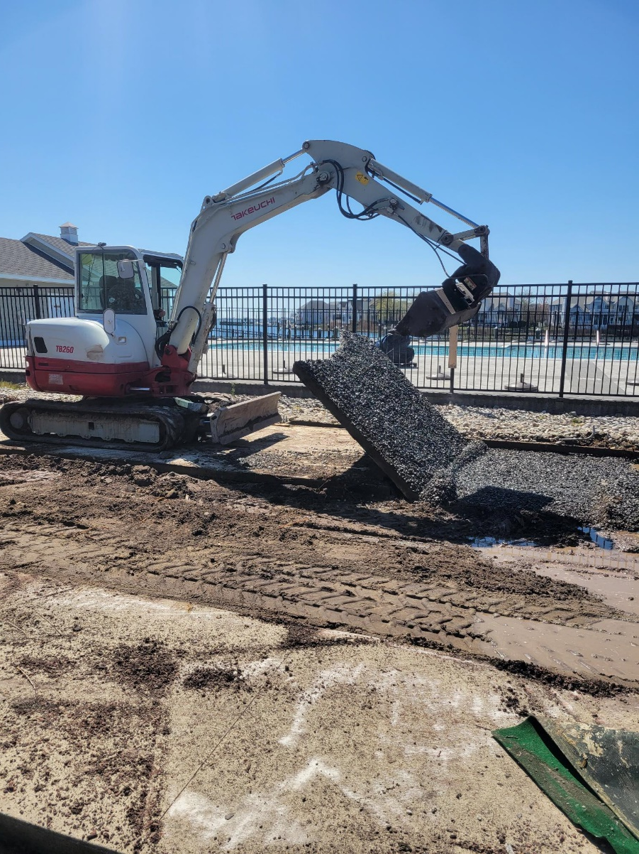
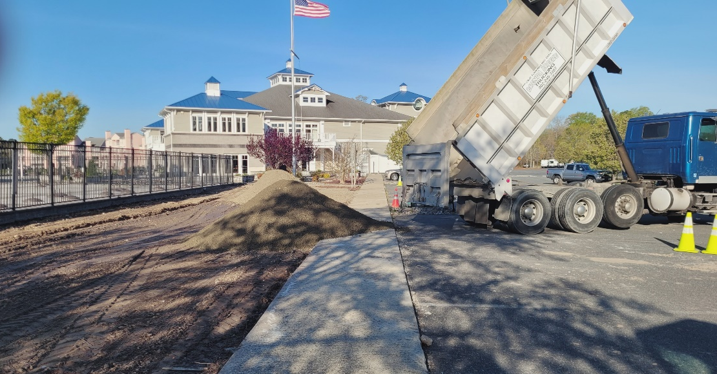
Bocce Ball Courts
  Public Works prepared area for new bocce ball courts beginning on April 18th
  Courts to be installed by Southwest Greens Delaware Valley beginning May 12th
  Total cost: $50,692
  Over 100 members estimated to start

Slide 7
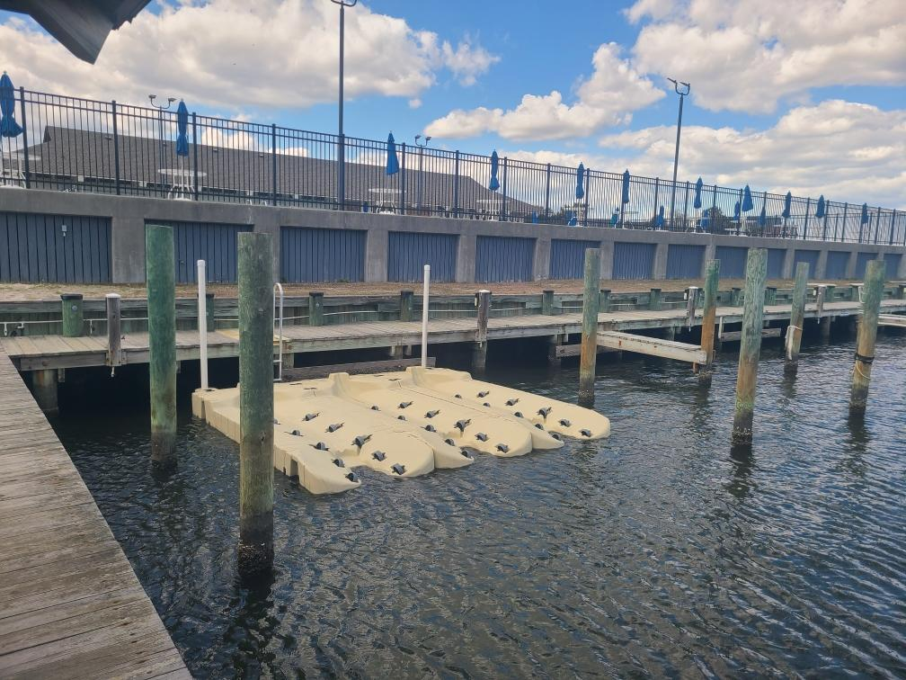
Jet Ski Lifts
  6 floating slips installed last week at Swim & Racquet
  Total cost: $20,000
  There is a list if interested – call or see Ruth Ann at Admin

Slide 8
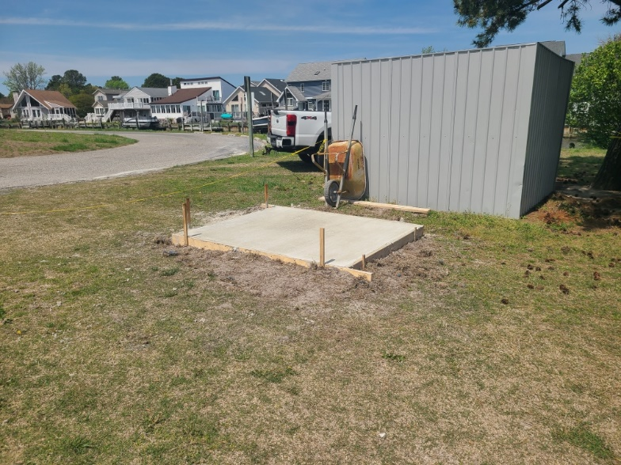
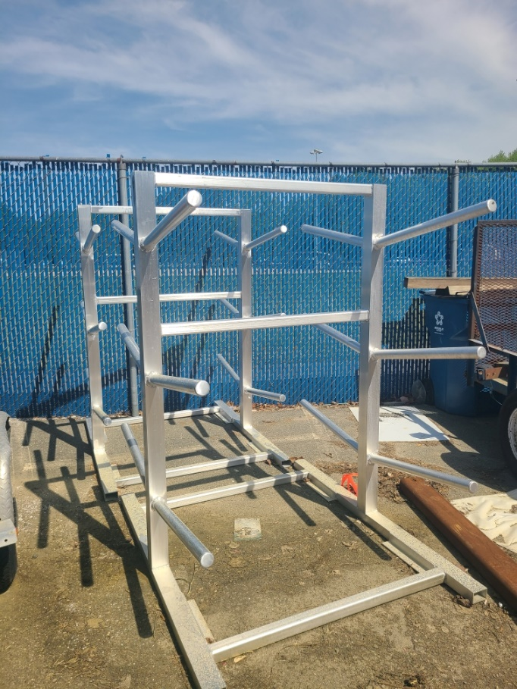
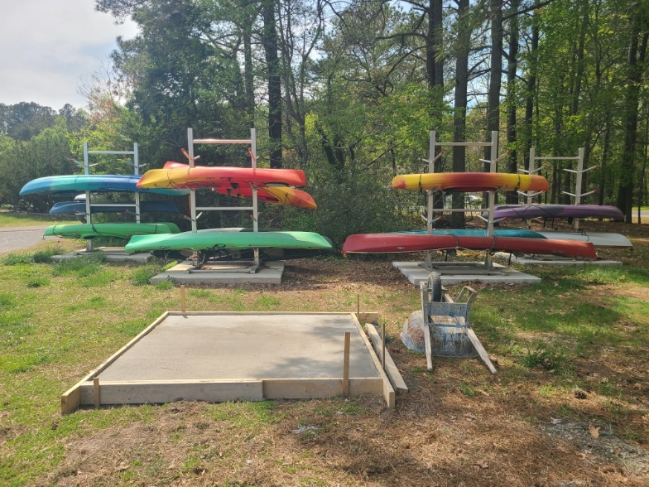
Kayak Racks
  Additional kayak racks to be installed at both Pintail Park and Swim & Racquet
  6 additional spaces at each location
  Total cost (racks and concrete): $3,627

Slide 9
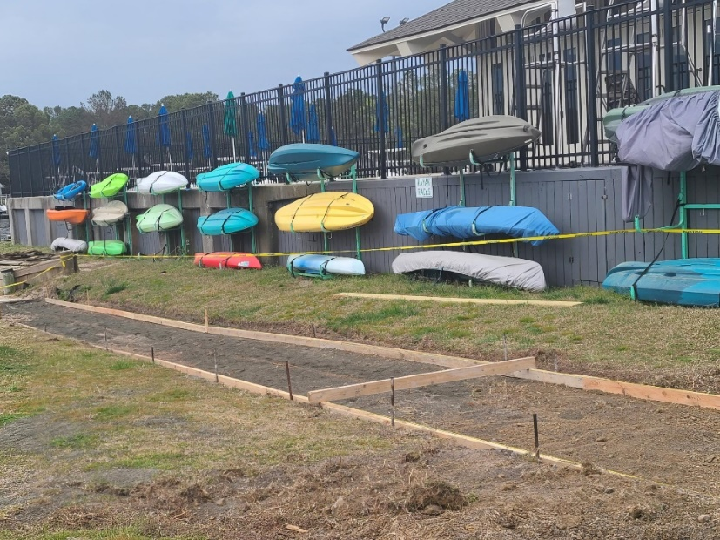
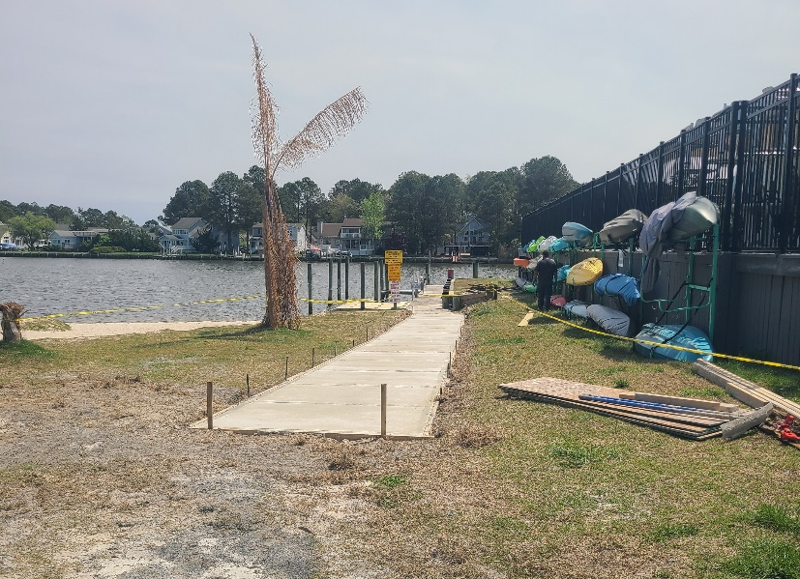
Maintenance
  Pools:
    Chemicals orders – all pools getting ready for season
  Beach Club:
    Public Works in the process of replacing worn boards – once complete, contractor will be painting the outside deck
  Concrete Work:
    Mumfords Pool pad and walkway around Swim & Racquet to have new concrete installed
  Parking Lots:
    Striping to be redone at Yacht Club, Swim & Racquet, and the Administration Building

Slide 10
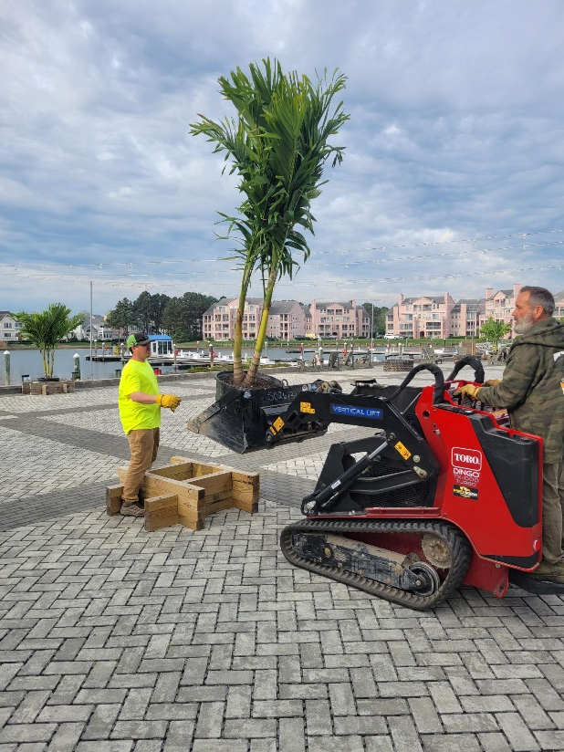
Landscaping
  Landscaping crew doing the annual mulching including the playgrounds
  Spring flowers and cherry trees are in full bloom
  Additional palm trees being installed
  Return of sunflower garden at north gate

Slide 11
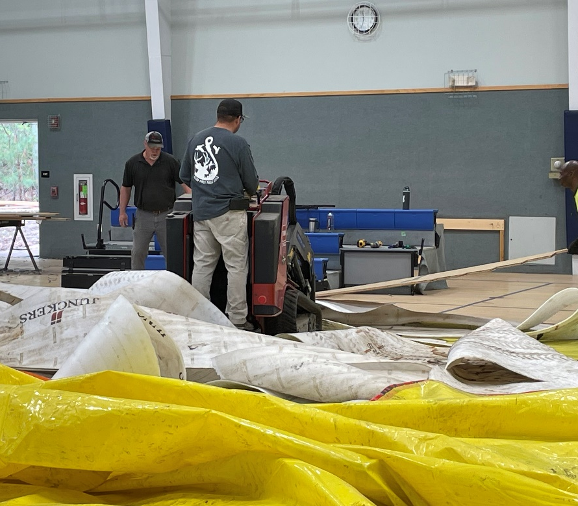
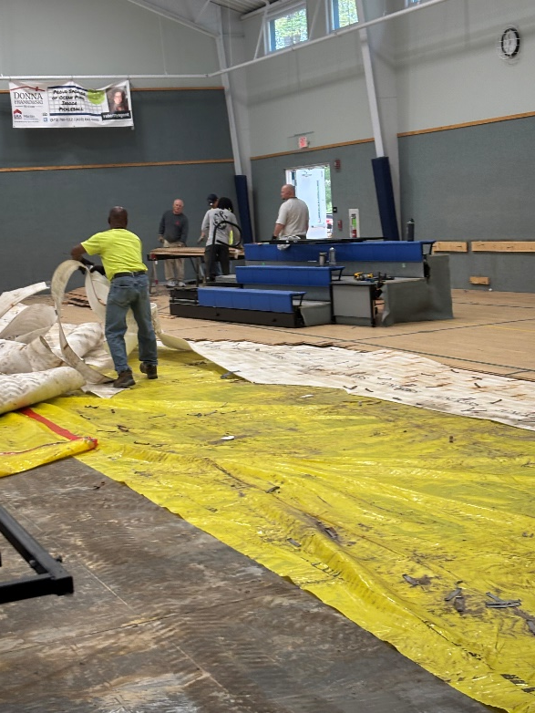
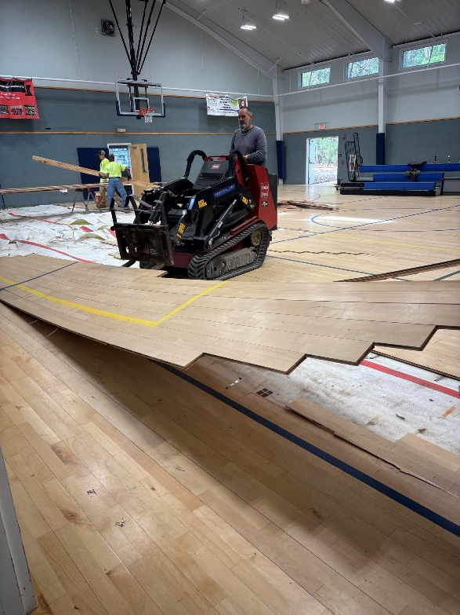
Gym Floor
  Public Works started ripping gym floor up on April 21st in preparation for new floor installation
  New floor to be installed by Dynamic Sports Construction - $62,300
    To begin May 5th and be completed by June 2nd

Slide 12
Roads
  Road paving began this week
  Roads to be completed:
    Canal Road, Commodore Court, Dinghy Court, Fairhaven Court, Juneway Lane, Portside Court, Riverside Drive, and Weeping Willow Court
    Work to be done by Asphalt Maintenance
    Approved by Board on September 28, 2024 - total cost: $170,173.50
  Paving of Manklin Creek and Cathell Roads also began this week
    Work being completed by Allan Myers Contractor (County contractor)

Slide 13
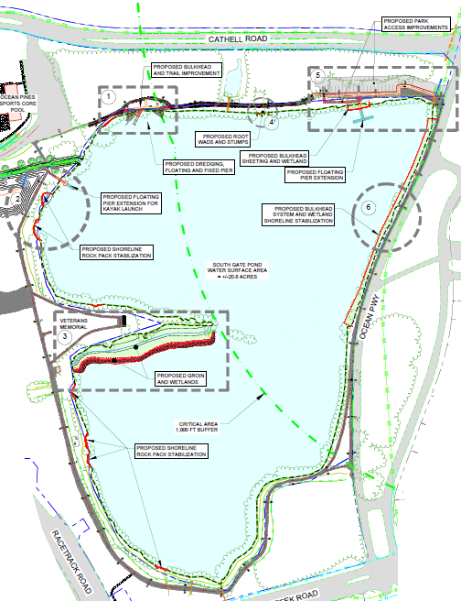
Soft Shoreline Project
  What has been done:
    $150,000 grant received by Maryland Coastal Bays
      Funds went for planning and design of the south gate pond project
      Final conceptual drawings received 11/4/24
  Cost estimates of project - $500K:
    Submerged gravel wetland: $200-$250K
    Fishing area: $100K
    Landscaping: $100-$150K
  Status:
    Due to federal hold on grant funding, MCB has postponed the project until next year

Slide 14
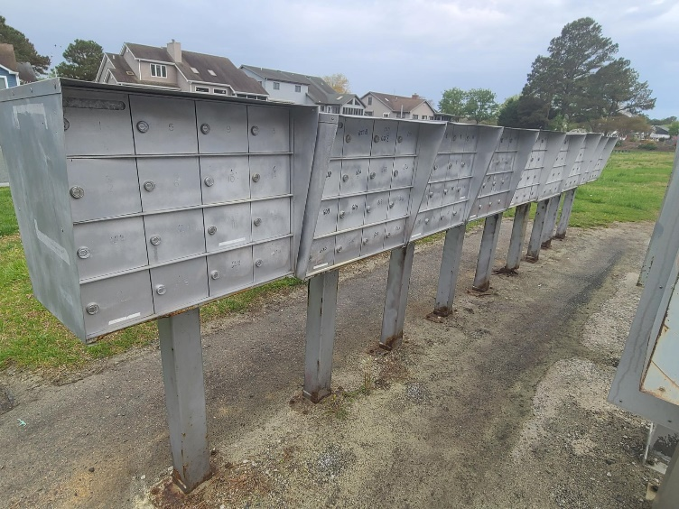
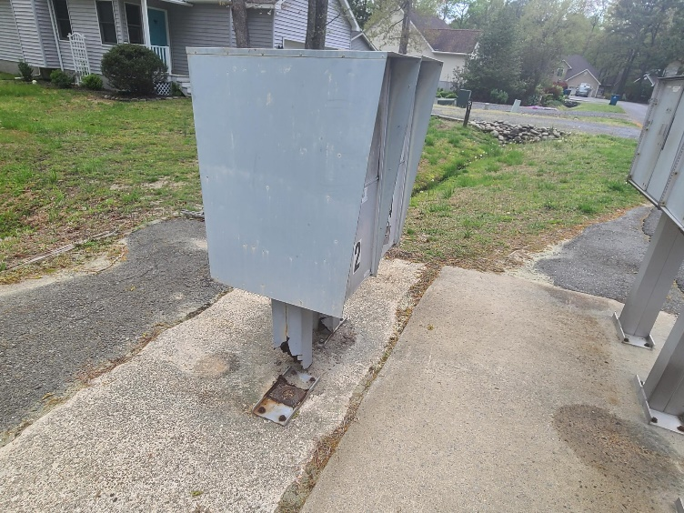
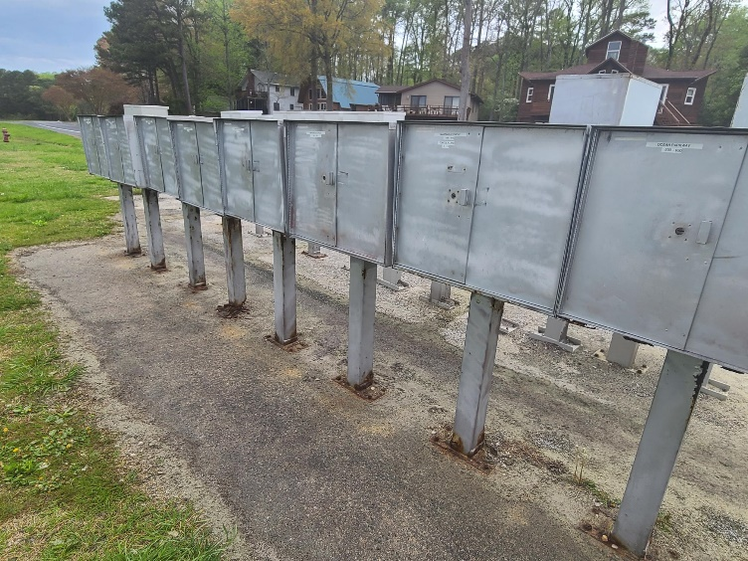
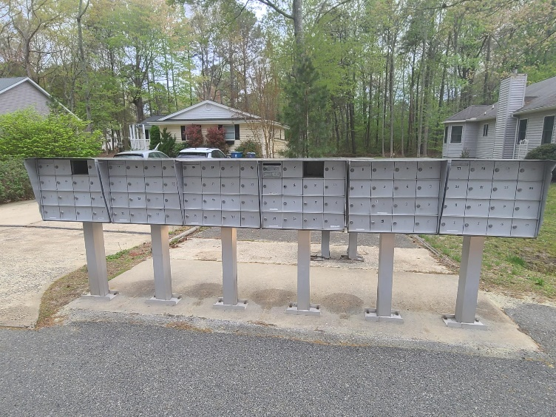
Mailboxes
  Phase I of mailbox repair/replacement completed
  Phase II beginning in May
    Wood Duck and Cannon Drive mailboxes to be replaced
    Total cost (including boxes, pedestals, and paving): $72,519 (Wood Duck); $25,933 (Cannon)

Slide 15
CPI Violation Dashboard
March
Violations
As of 3/1/25 | New Violations | Closed Violations | As of 3/31/25
408 | 435 | 316 | 527
435 violations initiated in March: 330 maintenance/trash/debris; 29 no permit; 6 signs; 70 miscellaneous
  Miscellaneous violations includes easements, permit expiration, trailers, unregistered/junk vehicles, vehicle parking, and wire/metal fencing
316 violations complied out; 527 remain open
  290 maintenance/trash/debris; 78 no permit; 8 signs; 151 miscellaneous
82 of the 527 violations still open are in legal

Slide 16
Work Orders
March
Open Work Orders as of 3/1/25 | New Work Orders | Closed Work Orders | Open Work Orders as of 3/31/25
52 | 118 | 50 | 120
118 work orders initiated in March: 8 bulkhead; 61 drainage; 15 grounds/landscaping; 6 roads; 3 signs; 25 general maintenance
Majority still open in drainage (65):
  10 – over 30 days; 1 – over 60 days
    Average 1-4 work orders a day to complete depending upon severity

Slide 17
Customer Service Dashboard
(from info@oceanpines.org)
March
Type | # Received – Mar.
Amenities | 28
CPI | 14
Drainage | 5
General | 22
Public Works | 11
TOTAL | 80

Slide 18
Financials

Slide 19
MONTH OF MARCH 2025
FINANCIAL RESULTS

Slide 20
MARCH 2025 YTD
FINANCIAL RESULTS

Slide 21
UNAUDITED RESERVE SUMMARY
MARCH 2025 ($ MILLIONS)
 | General Replace | Bulkheads | Roads | Drainage | New Capital | Total
4/30/24 Balance | $5.5 | $0.3 | $0.8 | $0.4 | $0.1 | $7.1
Contributions/ Interest | 2.1 | 1.1 | 0.1 | 0.1 | - | 3.4
Casino Funds | - | - | 0.3 | 0.1 | - | 0.4
Transfer (Spend) | (2.7) | (0.9) | - | (0.4) | (0.1) | (4.1)
3/31/25 Balance | $4.9 | $0.5 | $1.2 | $0.2 | - | $6.8

Slide 22

Treasurer’s Report -
Monica Rakowski

Slide 23

Cash & Short-Term Investments
Month of March
As of March 31, 2025, the Association had Approximately (~) $14.3M in Cash
  Cash Decreased ~ ($0.6)M from the Same Time Period Last Year
  Cash Increased ~ $0.9M from February 2025
  $8.8M Invested in CDAR’s
  $46K in Interest Income Recognized for the Month
  Remaining $5.5M in Insured Cash Sweep, Treasury Bills, Money Market and Other Operating Accounts (Diversified Between 2 Local Banks)

Slide 24

Ocean Pines Association
Summary of ARC Guideline Revisions
Architectural Review Committee 2024

Slide 25
Information regarding Property Maintenance and Leaf Concerns
The purpose of this presentation is intended to bring clarity to concerns regarding language of ARC Guideline 400.2D., Declaration of Restrictions 8.L., and associated M04.
The presentation includes:
A summary of the resources used to clarify ARC Guideline 400.2 D., DR 8. L., and associated MO4.
Creditable sources and facts used in the crafting language for clarity and detail.
Validation as to why CPI is addressing property maintenance and specifically leaf and yard debris and at this specific time of year.
The motivation for the clearly identified language and how it is anchored to the overarching goal stated in, ARC Guidelines, Section 100. General Provisions, Section 100.1 Purpose, B. Public Health Safety and Welfare.

Slide 26
Information regarding Property Maintenance and Leaf Concerns
There has been misinformation on social media about DR 8.L., M04 & ARC Guidelines 400.2 D.
Violations related to DR 8.L., M04 & ARC Guidelines 400.2 D. have been issued.
Some have proposed the termination of CPI and its employees.
Allegations have arisen suggesting that ARC, CPI, and BOD collaborated to revise the Declaration of Restrictions without community input and in violation of the established procedures.
During the last BOD meeting, public comments and published letters highlighted misunderstandings about property maintenance and leaf debris issues.
I acknowledge the reported violations of DR 8.L. as valid and in line with the intent of the Declarations, M04, and applicable ARC Guidelines.

Slide 27

New Architectural Review Committee guidelines available online
Monday, July 8, 2024
(July 8, 2024) The Ocean Pines Association on Monday announced that the updated Architectural Review Committee (ARC) guidelines are now available to the community. Homeowners and residents can access the updated guidelines on the Ocean Pines website under Applications and Documents at https://www.oceanpines.org/web/pages/cpi.
The updated ARC guidelines have been meticulously re-crafted to enhance the community's aesthetic appeal, while ensuring that all property modifications comply with the highest standards to maintain maximized property values. These guidelines are based upon the original Declaration of Restrictions as well as current federal, state, and Worcester County requirements, and provide clear, concise, and comprehensive instructions for property owners planning any exterior changes, renovations, or improvements.
Homeowners and residents are encouraged to visit the website to review the guidelines and ensure compliance with the new standards. Copies of the Association’s restrictive covenants and the ARC guidelines are also available at the Compliance, Permits & Inspections office in the Public Works Building.
For more information, contact Director of Business Administration Linda Martin at 410-641-7717 ext. 3002 or lmartin@oceanpines.org.
https://www.oceanpines.org/web/pages/news_content?announcementId=2282&backURL=%2Fblogs1&_jsfBridgeRedirect=true

Slide 28
ARC GUIDELINES
Section 100. General Provisions
Section 100.1 Purpose
A. Authority. The Declaration of Restrictions for each Section of Ocean Pines empowers the Architectural Review Committee (ARC) to certain portions of the Restrictions, and these Guidelines. The ARC has formulated and recommended, and the Board of Directors has adopted these Guidelines. Reasonable consideration has been given to the character of each separate Subdivision (Section) of the Community and to the requirement of orderly development of the Community as a whole.
B. Public Health, Safety, and Welfare. The primary consideration in the formulation of these Guidelines is to promote, consistent with the Declarations of Restrictions, maximum enjoyment from the use of the common elements and protect, preserve, enhance, and perpetuate maximum property values and aesthetic character consistent with the health, safety, and general welfare of all owners within the community.
The Guidelines are subject to change by the ARC, with approval of the Board of Directors at any time, with thirty (30) days prior notice so long as the changes are consistent with the Declarations of Restrictions, OPA Charter, OPA By-Laws, recorded plats, and applicable Maryland law.
https://www.oceanpines.org/documents/20124/117959/ARC+Guidelines+April+2024.pdf/4f86b9c3-cd07-3730-abb2-fbc9bc85a464?t=1715177595647

Slide 29
ARC GUIDELINES
Section 400.2 Landscape Plan
D. The location and design of the proposed landscaped areas, including the varieties and sizes of plant materials shall be shown. Annuals and perennials that die back each fall shall not be a part of the permanent landscaping plan. Landscaping shall be provided along all street sides and rear, and side foundations facing the golf course or waterfront. All raised decks and porches require landscaping. Shrubbery planted as screening must be of an evergreen variety. Lattice or planking may be substituted for shrubbery. Landscaping is recommended around the balance of the foundation, deck, and porch. Any bare lands shall be mulched, seeded or sodded. Leaves are not considered to be acceptable ground cover.
https://www.oceanpines.org/documents/20124/117959/ARC+Guidelines+April+2024.pdf/4f86b9c3-cd07-3730-abb2-fbc9bc85a464?t=1715177595647

Slide 30

MARYLAND DEPARTMENT OF NATURAL RESOURCES WILDLIFE & HERITAGE SERVICE
Creating a Wild Backyard – Ground Covers
Sprawling across the ground an​d spreading patches of green or gold is a job reserved not only for grasses. Ground covers are exactly what their name implies - plants that spread to form a carpet over the ground. Ground covers are gaining in popularity as an alternative over traditional lawn grasses and for good reason. Why? Well, traditional lawn grasses need lots of mowing, watering, fertilizing and weeding to be kept healthy and attractive. Most ground covering plants, on the other hand, need almost no maintenance once they have taken hold in your yard.
https://dnr.maryland.gov/wildlife/Pages/habitat/wagroundcovers.aspx

Slide 31

MARYLAND DEPARTMENT OF NATURAL RESOURCES FOREST SERVICE
Fire Behavior
“Most wildfires in Maryland are surface fires, which burn fallen leaves, twigs, and debris on the ground. Under this fallen debris is often a layer of partially decomposed leaves and humus, called “duff.” During dry periods, fires can burn underground in this duff layer and be very difficult to extinguish. These duff fires can burn for weeks, or even months, and cause smoke issues.“
https://dnr.maryland.gov/forests/pages/wfm.aspx

Slide 32
MARYLAND DEPARTMENT OF NATURAL RESOURCES FOREST SERVICE
Wildland Fire Management
Wildfires in Maryland
In Maryland, the busiest wildfires seasons typically occur in the spring and the fall of the year. These are the transition times for natural cover fuels. In spring, with the absence of moist deciduous vegetation and forest canopy shade, the sun warms the forest floor pre-heating the fuels. In fall, an abundance of new fuel accumulates with leaf fall. Given adequate rainfall amounts throughout the state, wildfires are mostly suppressed on initial attack and can be intense but of short duration. However, unusually hot and dry conditions or drought can turn a mild fire season into a serious problem that often requires extended attack operations to completely suppress wildfires.
https://dnr.maryland.gov/forests/Pages/fire/index.aspx

Slide 33
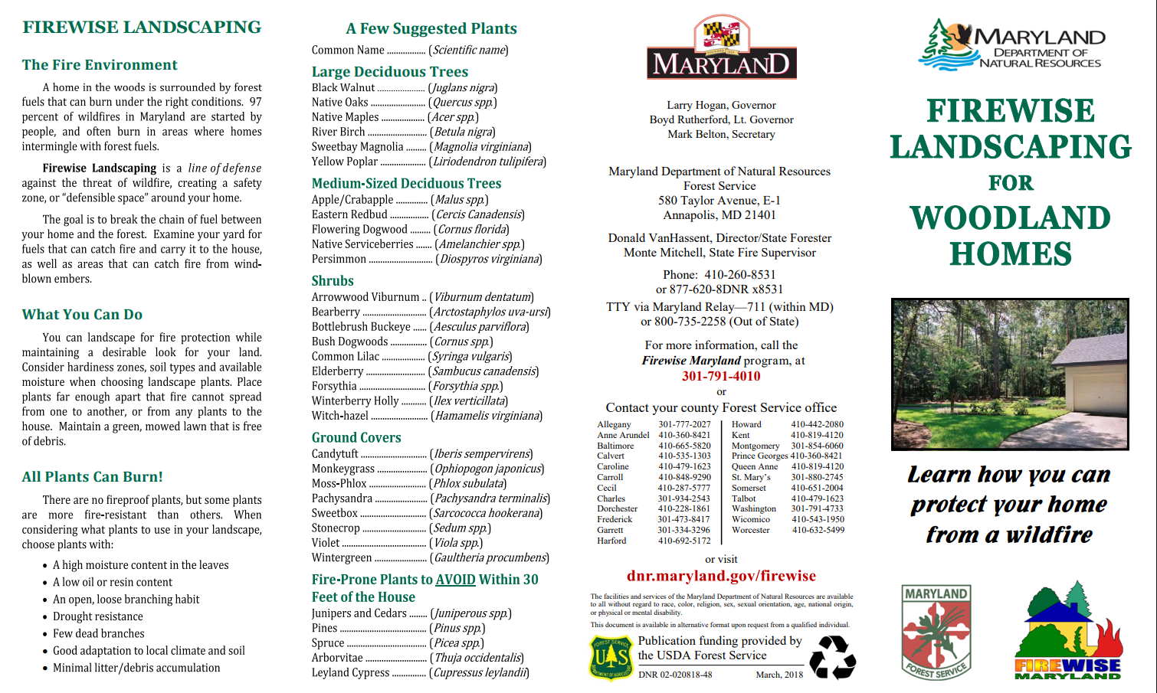








https://dnr.maryland.gov/forests/Documents/fire/Firewise_LandscapingWoodlandsBrochure.pdf

Slide 34
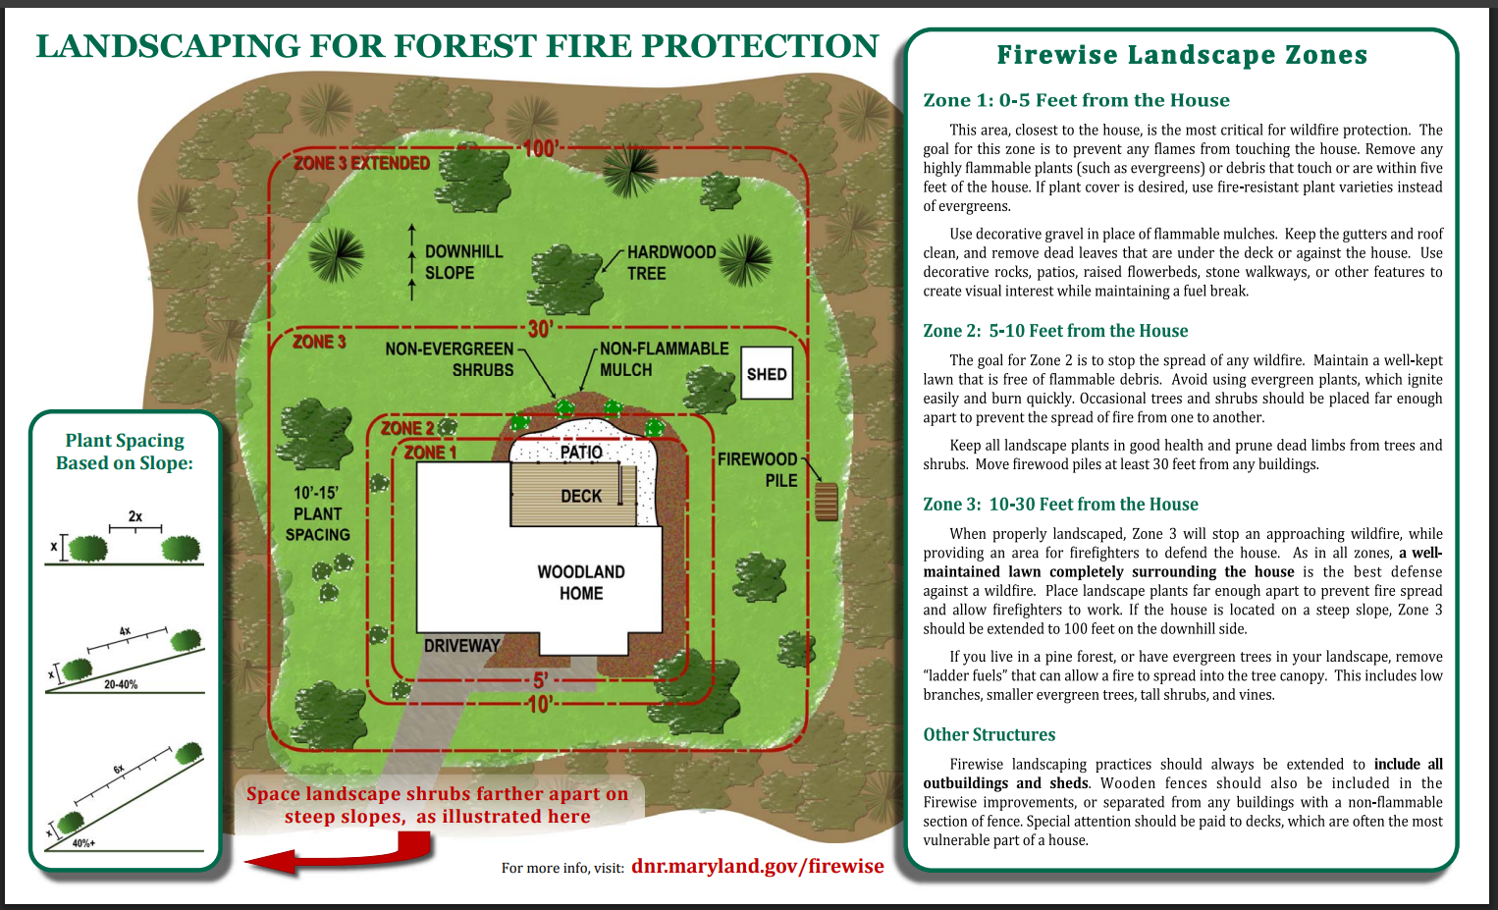







https://dnr.maryland.gov/forests/Documents/fire/Firewise_LandscapingWoodlandsBrochure.pdf

Slide 35
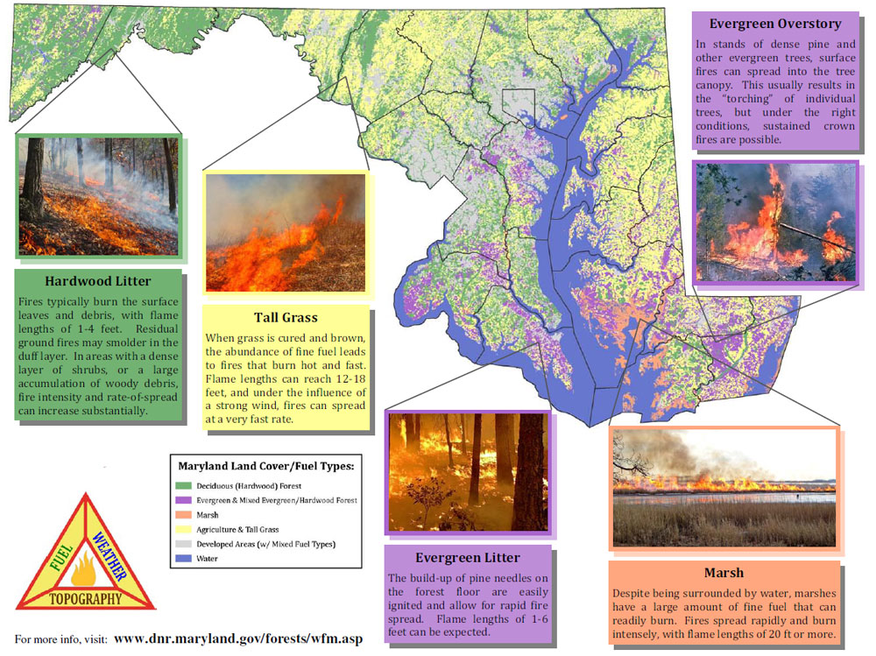
https://dnr.maryland.gov/forests/PublishingImages/fire_facts3.jpg

Slide 36
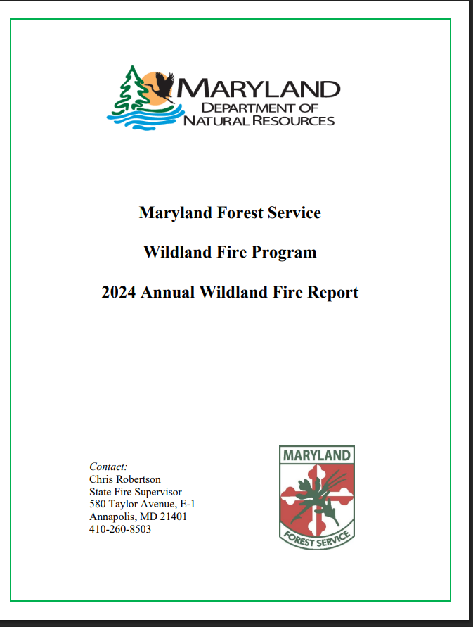
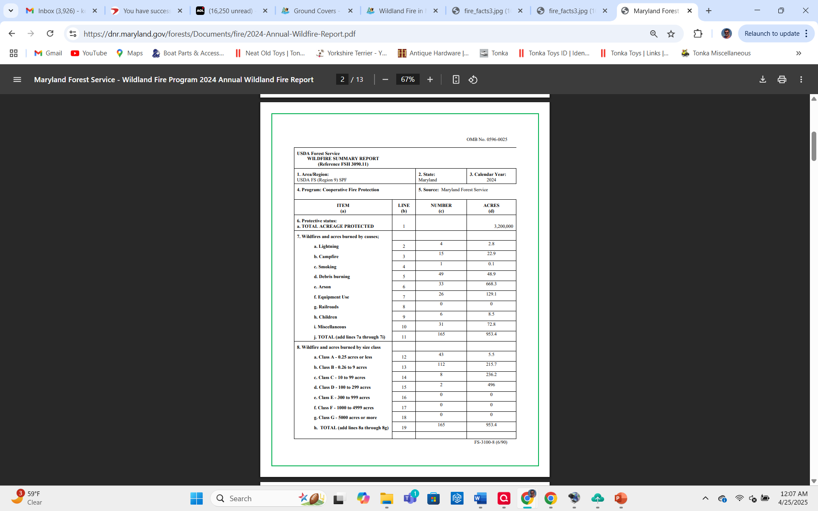


https://dnr.maryland.gov/forests/Documents/fire/2024-Annual-Wildfire-Report.pdf

Slide 37
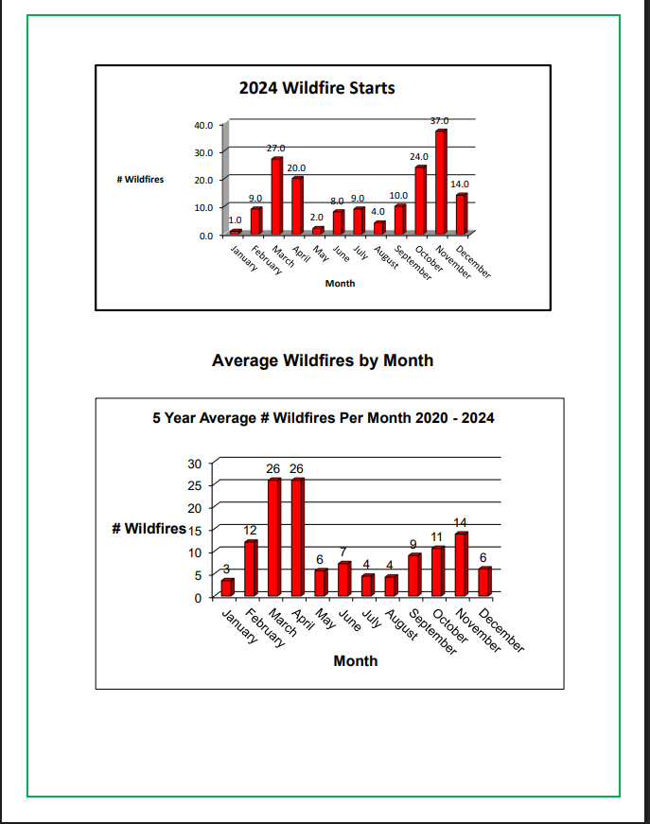
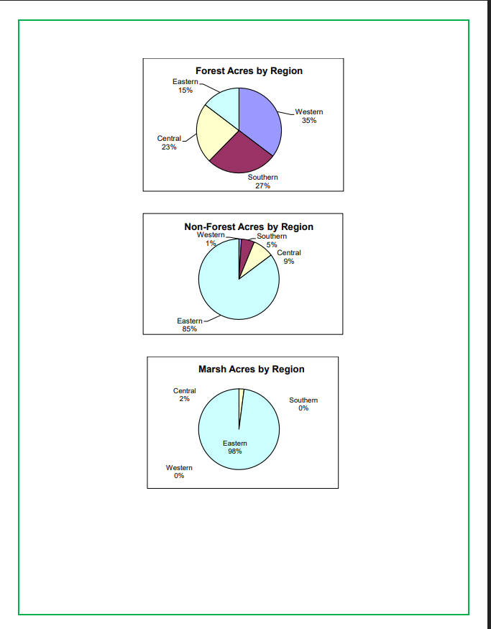
https://dnr.maryland.gov/forests/Documents/fire/2024-Annual-Wildfire-Report.pdf

Slide 38
In summary:
This presentation has validated the purpose of bringing clarity to concerns regarding language revisions of ARC Guideline 400.2D., and contemporary understanding of the Declaration of Restrictions 8.L., via associated M04.
The presentation addressed :
A summary of various Maryland State resources used to clarify ARC Guideline 400.2 D. and better understand DR 8. L., via clarification in associated MO4.
Creditable sources and facts were presented for clarity and detail.
CPI’s primary mission to secure public health, safety and welfare of both property and human treasure is validated in addressing potentially hazardous property maintenance and specifically leaf and yard debris and especially during this statistically increased risk period of the year. And most especially during this abnormally extreme drought period that Maryland is currently experiencing.
The motivation for clarifying language contributes to the overarching goal stated in, ARC Guidelines, Section 100. General Provisions, Section 100.1 Purpose, B. Public Health Safety and Welfare.

Slide 39
Thank you and have a wonderful day!

