Slide 1

Board of Directors Meeting
May 18, 2024

Slide 2
Approval of Agenda

Slide 3
Approval of Minutes
April 20, 2024 – Regular Meeting
April 24, 2024 – Special Meeting

Slide 4

President’s Remarks
Rick Farr

Slide 5
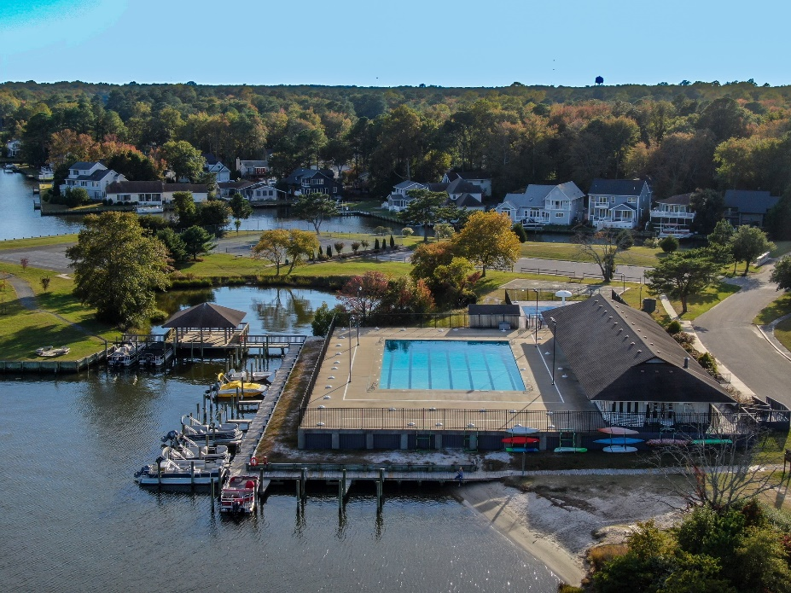
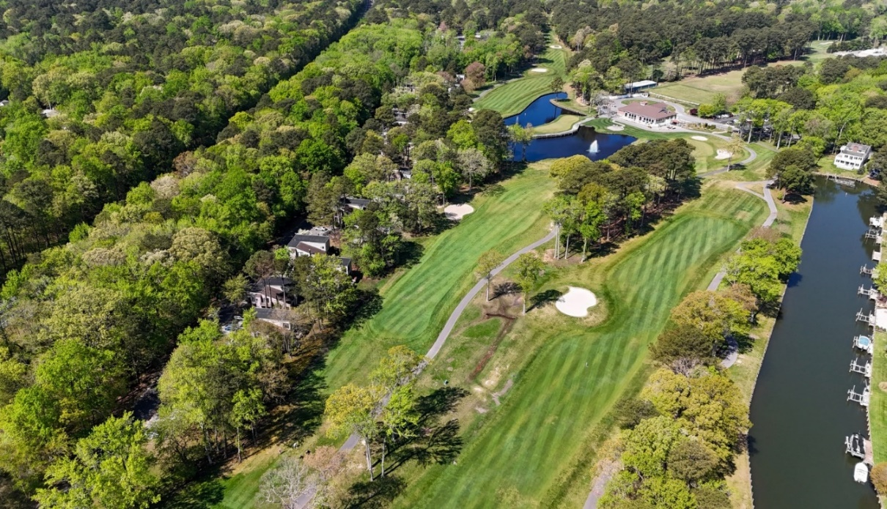
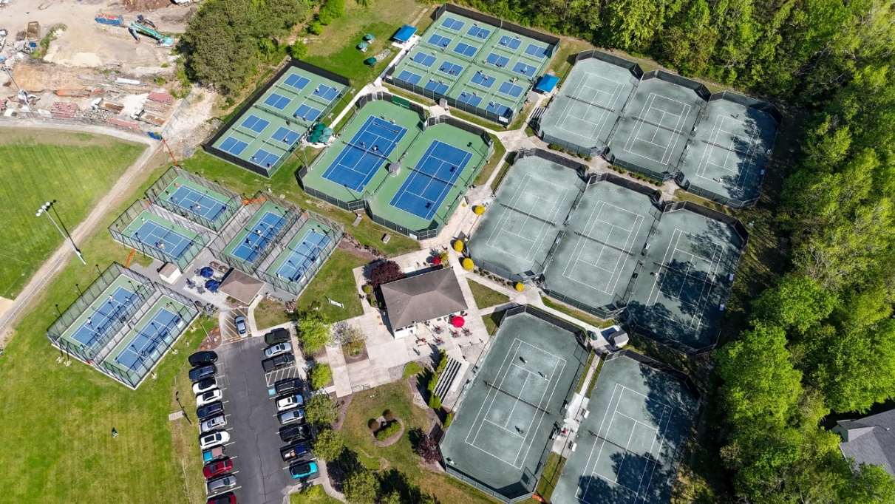
GM Leadership Report –
John Viola

Slide 6
Initiatives
  Fire Department
  Police – Chief Tim Robinson
  Racquet Sports – Terry Underkoffler
  Headwinds & Tailwinds
  Tiki Bar
  Podcast
  Landscaping
  North Gate
  Soft Shoreline
  Maintenance
  Amenities
  Roads
  Mailboxes
  Metrics

Slide 7

Fire Department

Slide 8
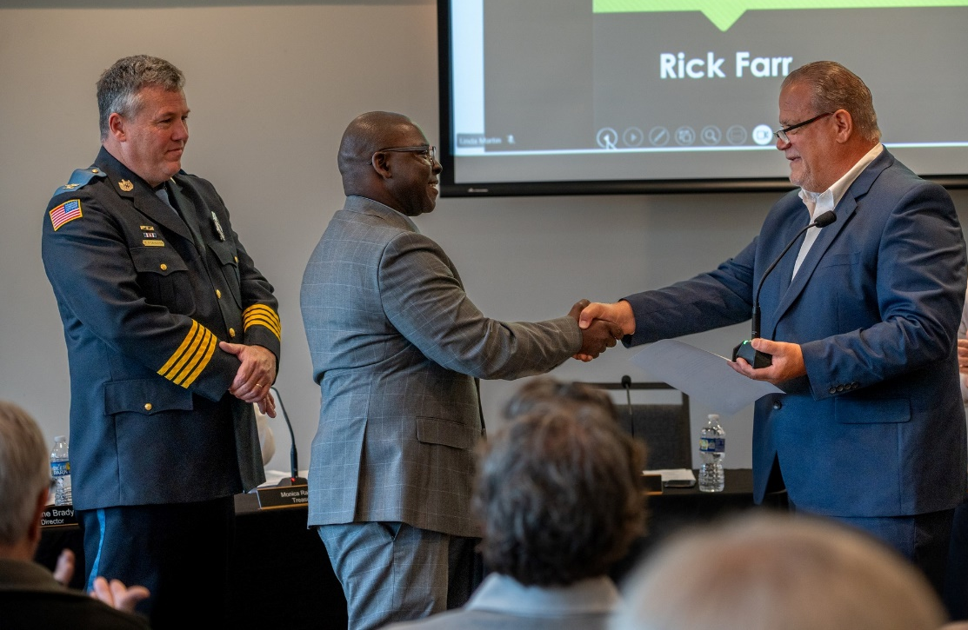
Chief Tim Robinson

Slide 9

Racquet Sports
2024 Racquet Center Focus
  Operated and communicate under the new organizational TEAM structure
  Improve our site infrastructure and operations
  Expand our programming

Slide 10
Headwinds & Tailwinds
Headwinds
  Increased costs to maintain infrastructure/amenities
    Pricing
  Competitive salaries
  Statutory hourly increases
  Reserve study
    Unchartered waters
Tailwinds
  Condition of our amenities
  Motivated staff
  Reserve study
    Reviews already have taken place
    Positioned better than 5 years ago

Slide 11
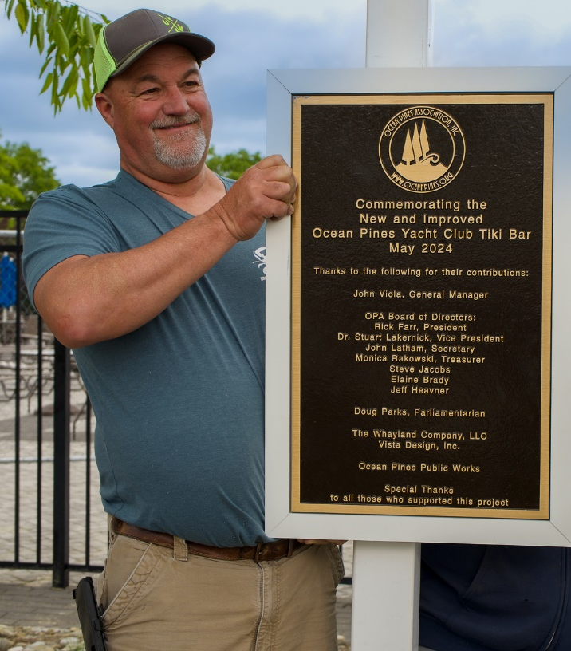
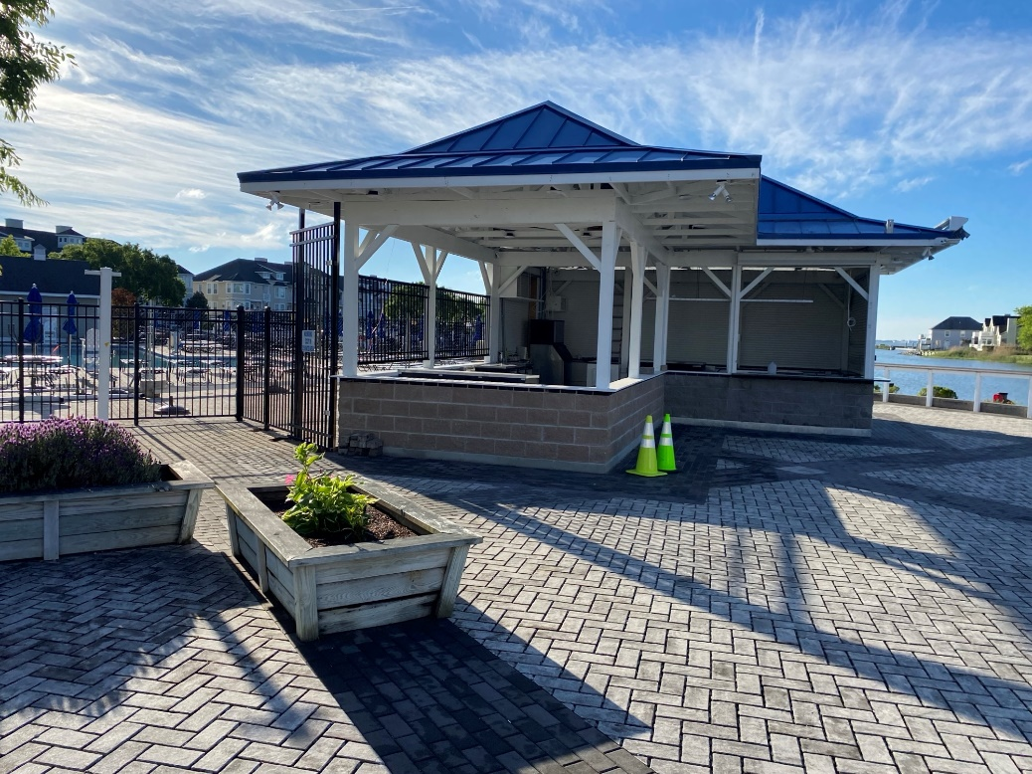
Tiki Bar
“A promise made is a promise kept” (Rick Farr)
  Tiki Bar originally scheduled to open Memorial Day weekend – finished ahead of schedule
  Tiki Bar ribbon cutting scheduled for Sunday, May 19th at 12:00 p.m.

Slide 12

Podcast
Ocean Pines operations team now has a podcast – The “PinesCast” (hybrid team)
Inaugural podcast, released on May 7th, contains an interview with Bob Beckelman regarding the golf amenity (the early years)
Future podcasts scheduled – continue to check oceanpines.org for a list of podcasts

Slide 13
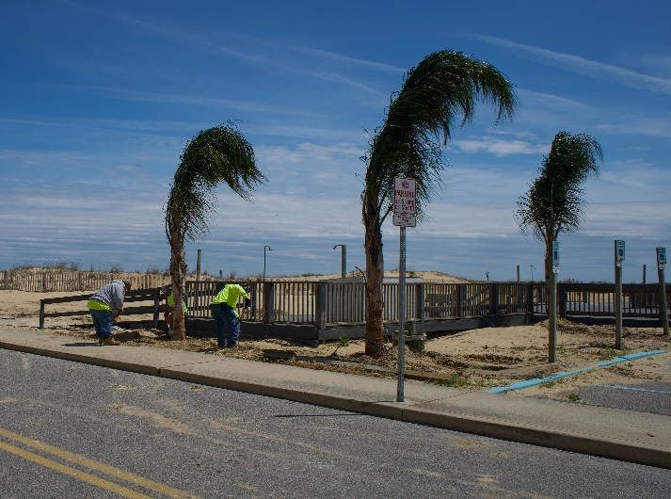
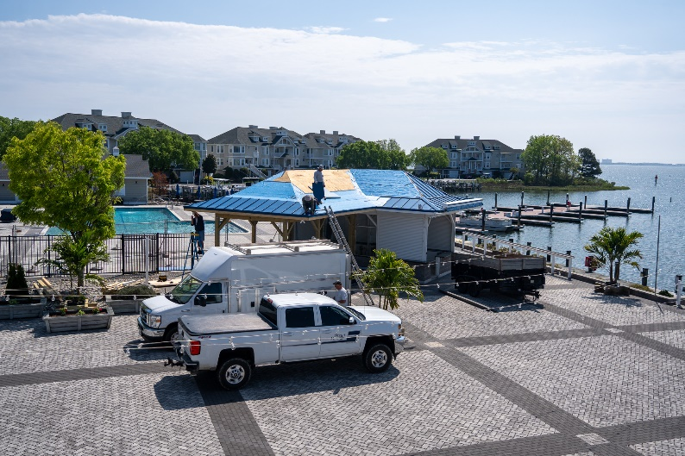
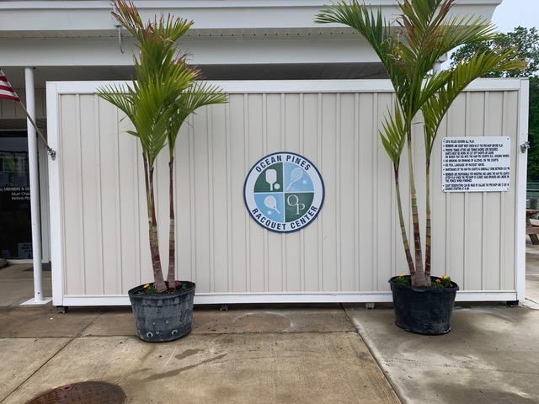
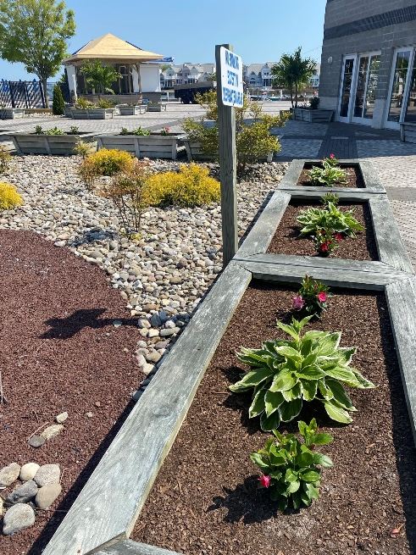
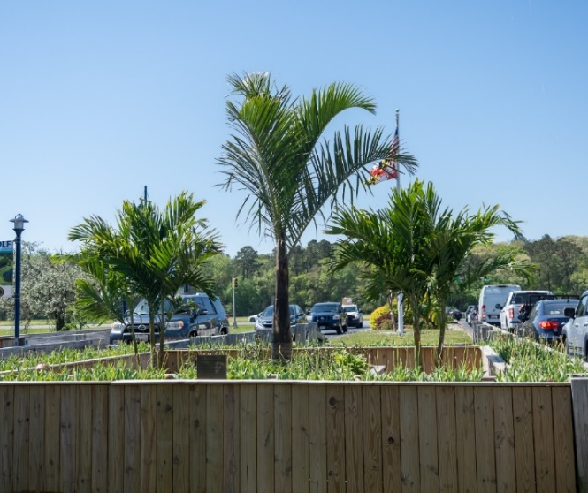
Landscaping
Additional palm trees ordered and installed per Board President’s request
Spring flowers planted
Beach Club
Yacht Club
Racquet Center
Landscaping
North Gate Bridge

Slide 14
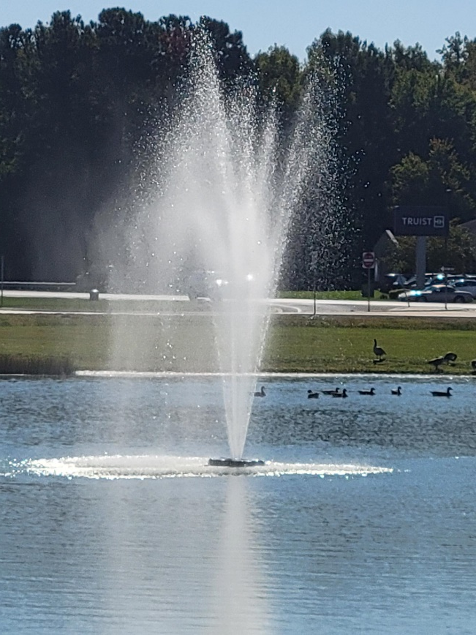
North Gate
Overgrowth of algae in north gate pond caused fountain not to work
Pond treated for algae week of May 6th
Fountain back in operation May 9th

Slide 15

Soft Shoreline
Follow up meeting scheduled for May 14th with Atlantic Coastal Bays rescheduled
Will have more information next month

Slide 16
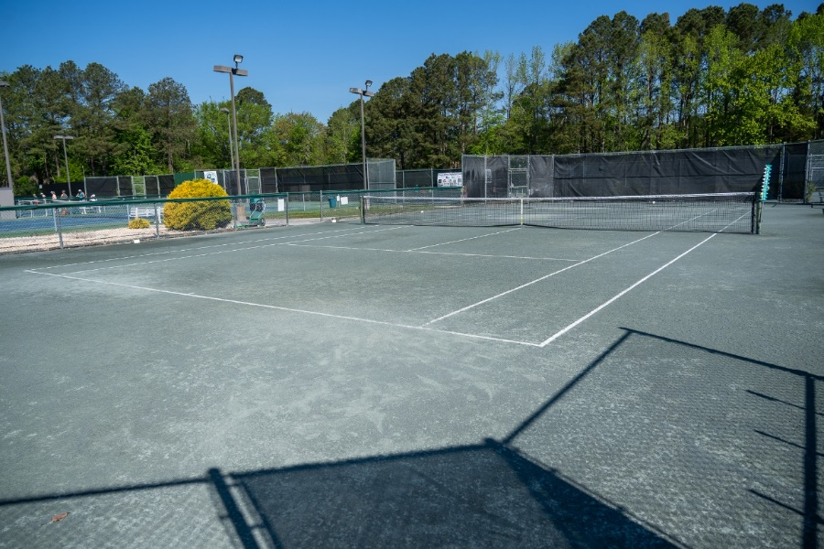
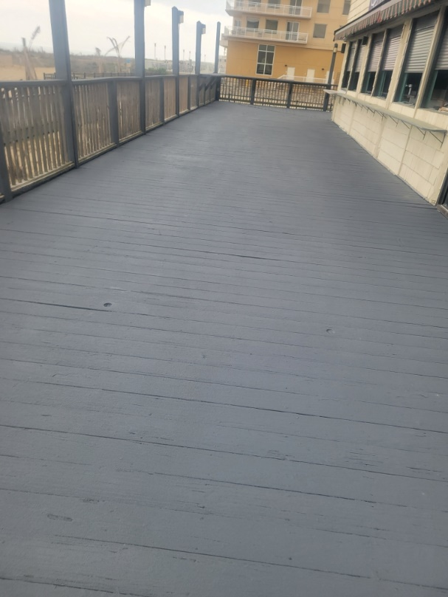
Maintenance
Racquet Sports
  Clay courts resurfaced
  ATC to evaluate cracks on pickleball courts in June
Beach Club
  Replaced board and railings where they needed to be replaced
  Deck painted
  All items on checklist completed

Slide 17
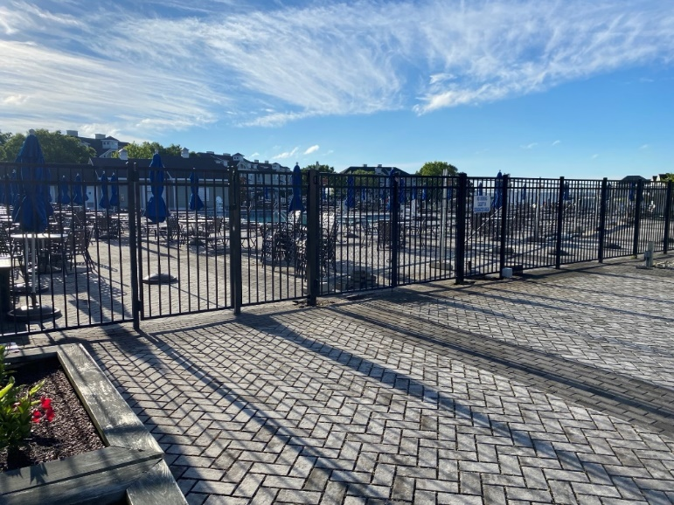
Amenities – Aquatics
Pools getting ready for season – all scheduled to be open on May 25th
  All pools cleaned and furniture out
  Maintenance being done inside buildings (painting, repairs, cleaning)
Training staff:
  Lifeguard orientation scheduled for June when all lifeguards are all on staff
  Conducting front desk training this week and next
Staffing
  Fully-staffed lifeguards; need employees for Beach Parking and Front Desk at pools
Classes/Events
  Classes and lessons are filling up for summer
  New Classes: Bike/Tramp, Water Volleyball
  Private parties at Sports Core booked up to July
  Junior Lifeguard returning this year
  School’s Out Splash Party: June 15th
  Family Splash Nights: July 6th, Aug. 3rd, Aug. 31st

Slide 18


Amenities – Recreation & Parks
  Annual community bike ride a success
  Bay Day to be held on Sunday, May 19th from 10:00 a.m. – 3:00 p.m.
  New classes being offered: yoga, chair yoga, Fit4Core (injury prevention), body boot camp, and girls flag football
  Park sign upgrades to Racquet Center, Community Gardens, and installation of communication sign (non-verbal) at Bainbridge, Manklin, and White Horse Park

Slide 19
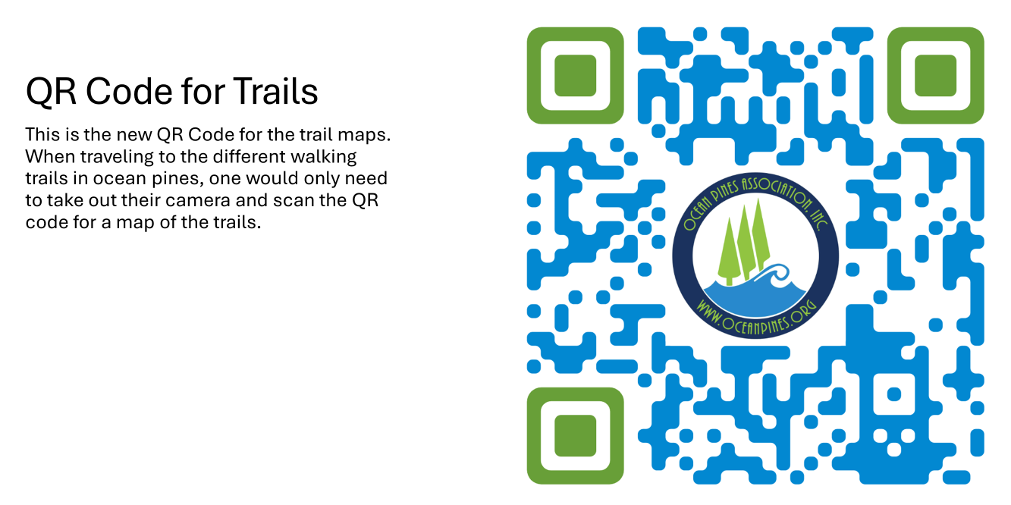
Amenities – Recreation & Parks
(continued)

Slide 20
Roads
  Road paving completed on approximately 3 miles of road
  Work done by Asphalt Maintenance LLC
  Total cost: $356,618.20
  Roads completed:
    Battersea Road, Canal Road, Deerfield Court, Driftwood Lane Moonraker Road, St. Martins Lane, Waters Edge Court, Wharf Court
  Minor patching remains

Slide 21
Mailboxes
  Still working on Phase 1 of the mailbox replacement project
    12 mailboxes and 23 pedestals still need to be replaced
  Public Works was able to do repairs on some of the mailboxes instead of replacing them
  Cleaning of mailboxes completed, but received complaints on two mailboxes (Customs Way and Sandyhook Road) that had damaged the mailboxes due to taping flyers onto mailboxes
    Customs Way cleaned by Public Works; Sandyhook Road will need to be power washed again to get the tape off of the mailbox
    Mailboxes are private property and not to be used for personal display

Slide 22
CPI Violation Dashboard
April
Violations
As of 4/1/24 | New Violations | Closed Violations | As of 4/30/24
218 | 246 | 170 | 294
246 violations initiated in April: 65 maintenance/trash/debris; 4 leaf placement; 19 no permit; 86 signs; 72 miscellaneous
  Miscellaneous violations includes stop work orders, trailers, unregistered/junk vehicles, and vehicle parking
170 violations complied out; 294 remain open
  100 maintenance/trash/debris; 4 leaf placement; 44 no permit; 46 signs; 100 miscellaneous

Slide 23
Work Orders
April
Open Work Orders as of 4/1/24 | New Work Orders | Closed Work Orders | Open Work Orders as of 4/30/24
170 | 132 | 114 | 188
132 work orders initiated in April: 8 bulkhead; 41 drainage; 30 grounds/landscaping; 9 roads; 2 signs; 42 general maintenance
Majority still open in drainage (102):
  36 – over 30 days; 27 – over 60 days
    Average 1-4 work orders a day to complete depending upon severity

Slide 24
Customer Service Dashboard
(from info@oceanpines.org)
April
Type | # Received – Apr.
Amenities | 25
CPI | 37
Drainage | 3
General | 66
Public Works | 18
TOTAL | 149

Slide 25
Financials

Slide 26
UNAUDITED “FLASH” ESTIMATE
FINANCIAL CHANGE
MONTH OF APRIL 2024
April (In 000’s)
 | Budget | Current Year | Favor/ (Unfavor) vs. Budget
Net Revenues | $455 | $585 | $130
Expenses | 1,166 | 1,130 | 36
Net Operating | ($711) | ($545) | $166

Slide 27
UNAUDITED “FLASH” ESTIMATE APRIL
FAVOR/(UNFAVORABLE) VS. BUDGET (IN 000’s)
Department/Amenity | Favorable/(Unfavorable)
Administration (net) | 115
Police | 41
Rec & Parks | 21
Public Works/Gen Maint/CPI | 16
Golf Ops + Maintenance | 16
Aquatics | 10
Racquet Sports | (16)
Yacht Club | (21)
Beach Parking | (24)
Other Net (Clubhouse Grille, Beach Club, Marinas) | 8
TOTAL | $166

Slide 28
UNAUDITED “FLASH” ESTIMATE
YTD APRIL 2023
April YTD (In 000’s)
 | Budget | Current Year | Favor/ (Unfavor) vs. Budget
Net Revenues | $14,418 | $15,345 | $927
Expenses | 14,418 | 14,123 | 295
Net Operating | $0 | $1,222 | $1,222

Slide 29
UNAUDITED “FLASH” ESTIMATE YTD APRIL
FAVOR/(UNFAVORABLE) VS. BUDGET (IN 000’s)
Department/Amenity | Favorable/(Unfavorable)
Police | $361
Admin/Finance/GM/Public Relations | 243
Golf Ops + Maintenance | 225
Public Works/Gen Maint/CPI | 126
Aquatics | 111
Recreation & Parks | 68
Beach Club | 54
Clubhouse Grille | 45
Beach Parking | 28
Yacht Club | 7
Marinas | (18)
Racquet Sports | (28)
TOTAL | $1,222

Slide 30
UNAUDITED “FLASH” ESTIMATE RESERVES APRIL 2024 ($ MILLIONS)
 | GeneralReplace | Bulkheads | Roads | Drainage | New Capital | Total
4/30/23 Balance | $5.1 | $0.5 | $0.7 | $0.2 | $0.1 | $6.6
Contributions/ Interest | 2.2 | 1.1 | - | 0.1 | 0.1 | 3.5
Casino Funds | - | - | 0.4 | 0.1 | - | 0.5
Transfer (Spend) | (1.8) | (1.3) | (0.3) | - | (0.1) | (3.5)
4/30/24 Balance | $5.5 | $0.3 | $0.8 | $0.4 | $0.1 | $7.1

Slide 31

Treasurer’s Report -
Monica Rakowski

Slide 32

Cash & Short-Term Investments
“Flash” Estimate Month of April
As of April 30, 2024, the Association had Approximately (~) $18.7M in Cash
  Cash Increased ~ $40K from the Same Time Period Last Year
  Cash Increased ~ $3.8M from March 2024
  $10.5M Invested in CDAR’s
  $47K in Interest Income Recognized for the Month
  Remaining $8.2M in Insured Cash Sweep, Treasury Bills, Money Market and Other Operating Accounts (Diversified Between 2 Local Banks)

