Slide 1

GM Report
John Viola

Slide 2

Ocean Pines Association along with MD Dept. of Natural Resources, FEMA, MD Dept. of Planning, MD Emergency Management Agency, MD Insurance Administration & Salisbury University have been discussing weekly to bring together an informative live webinar on flooding & stormwater issues to our community.
Types of Flooding in Ocean Pines.
Flood Maps & how to use.
What is your risk?
What can you do to reduce the risk of flood damage to your home?
Does your homeowner's insurance cover flood risks?
Standing water issues around your home.
These are just a few of the topics being discussed. If you have questions you would like addressed, please email them ahead of time to cphillips@oceanpines.org
OP will be hosting a follow up live seminar on
making a rain garden and rain barrel with Jennifer
Dindinger from UMD Extension. This date will be
Provided during our live event on May 12th.

Slide 3
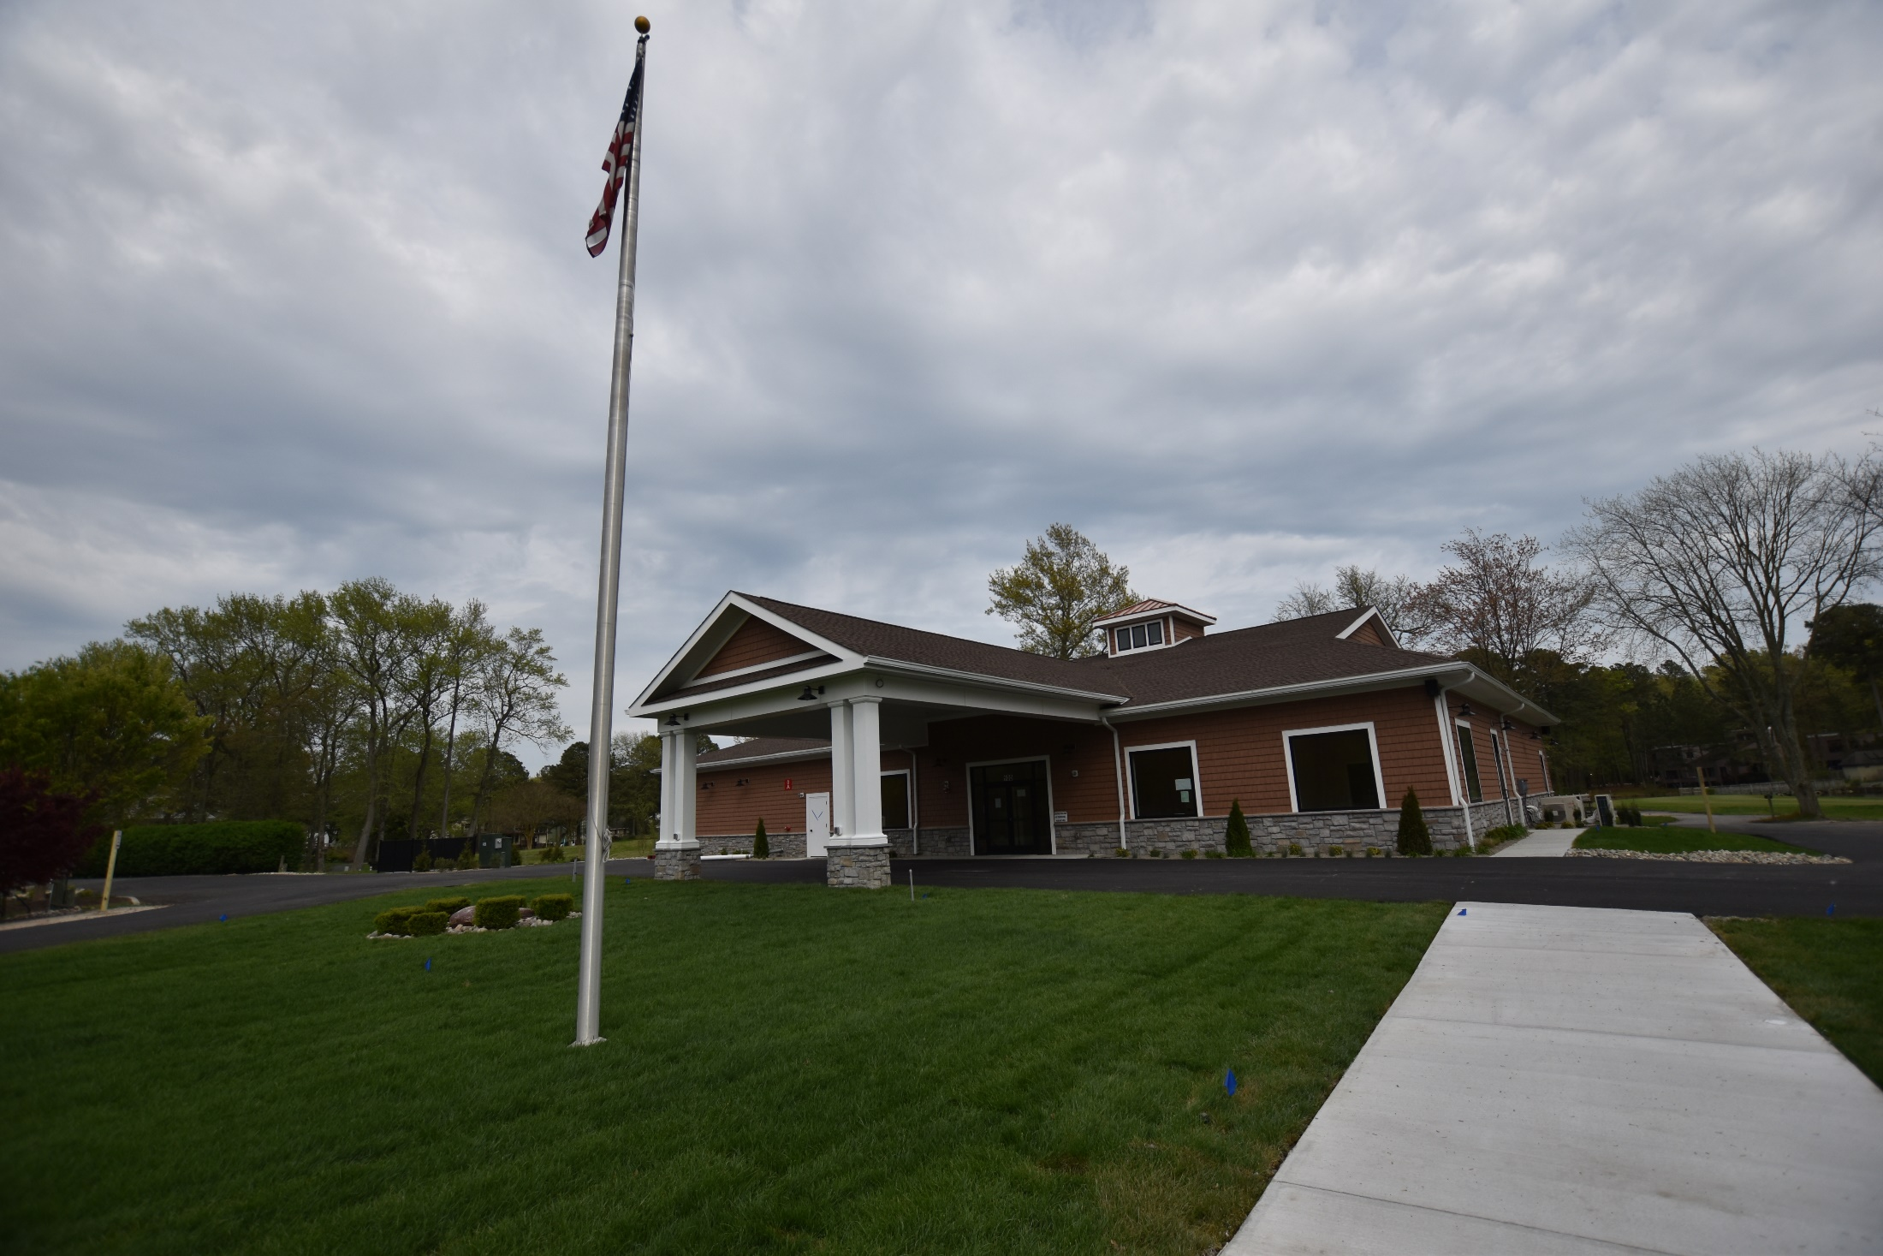

Slide 4
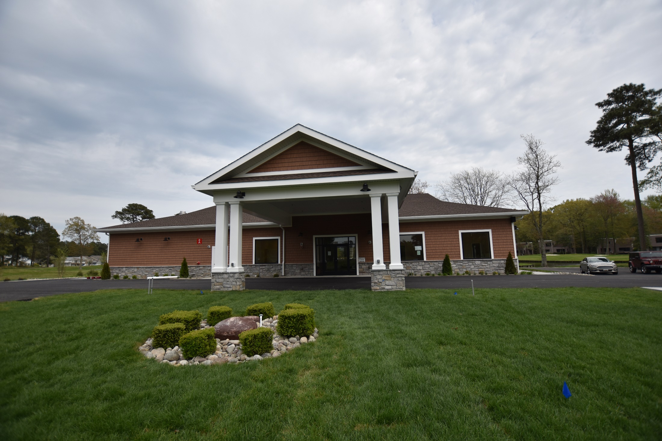

Slide 5
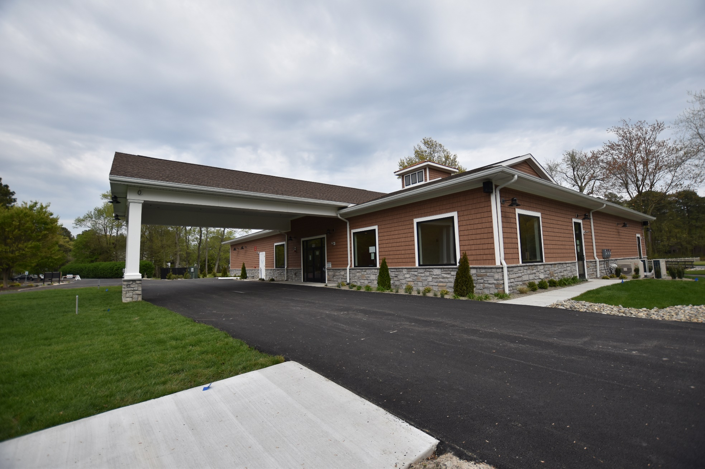

Slide 6
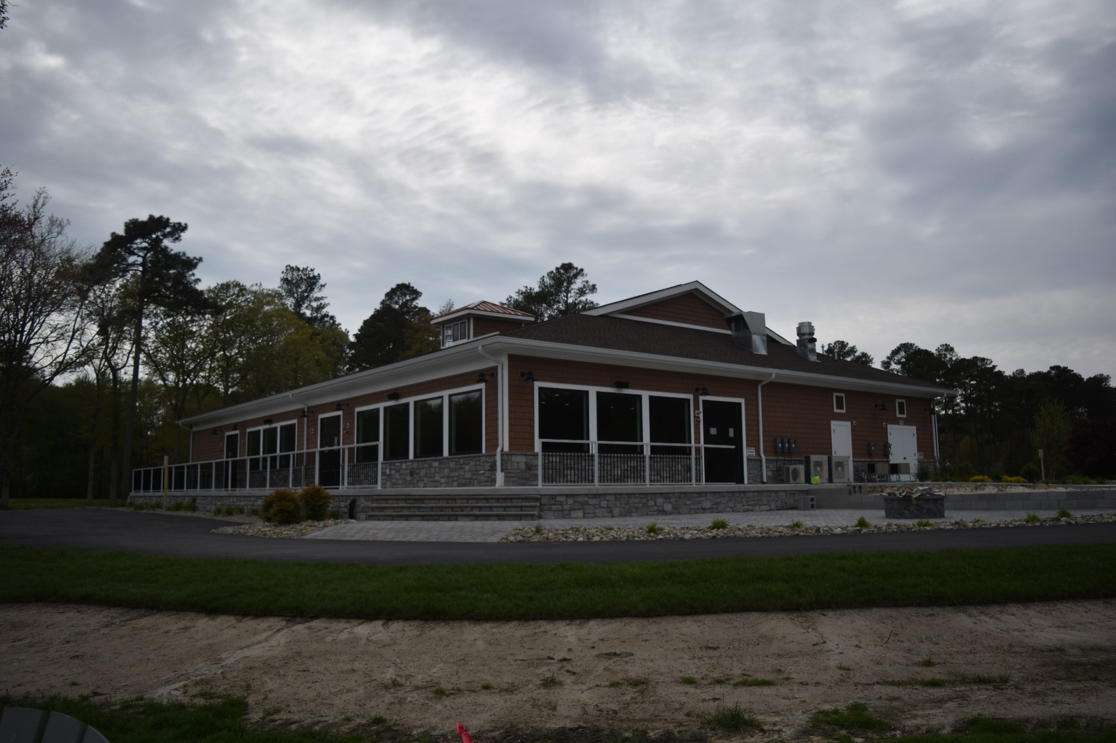

Slide 7
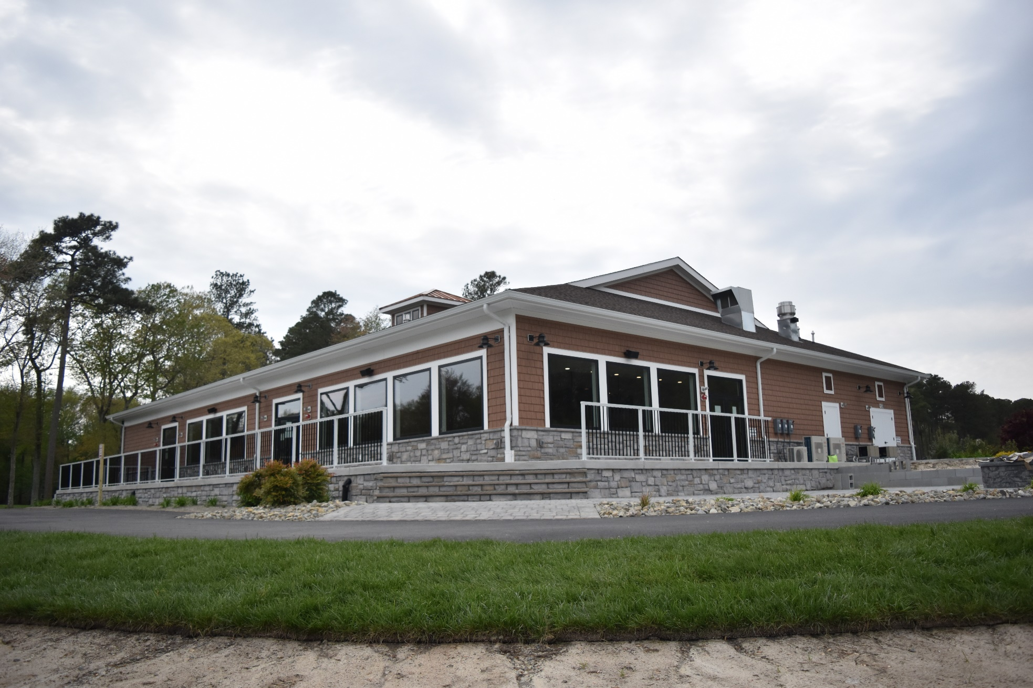

Slide 8
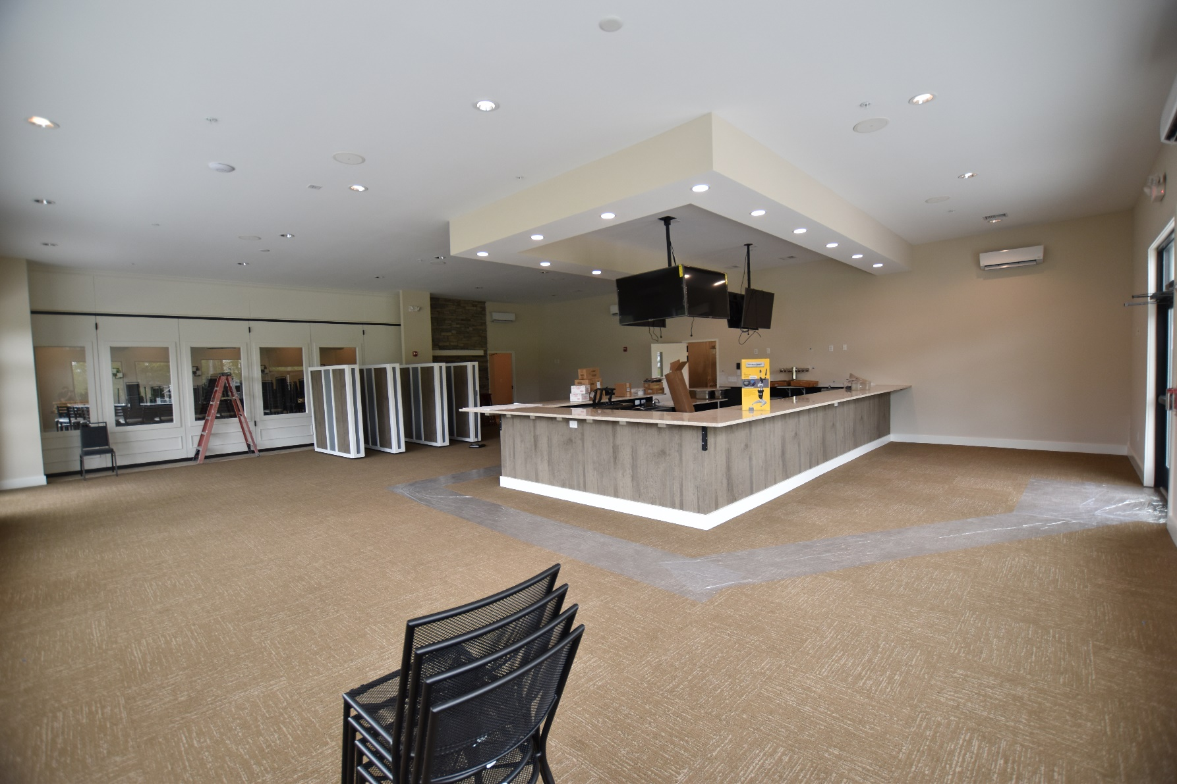

Slide 9
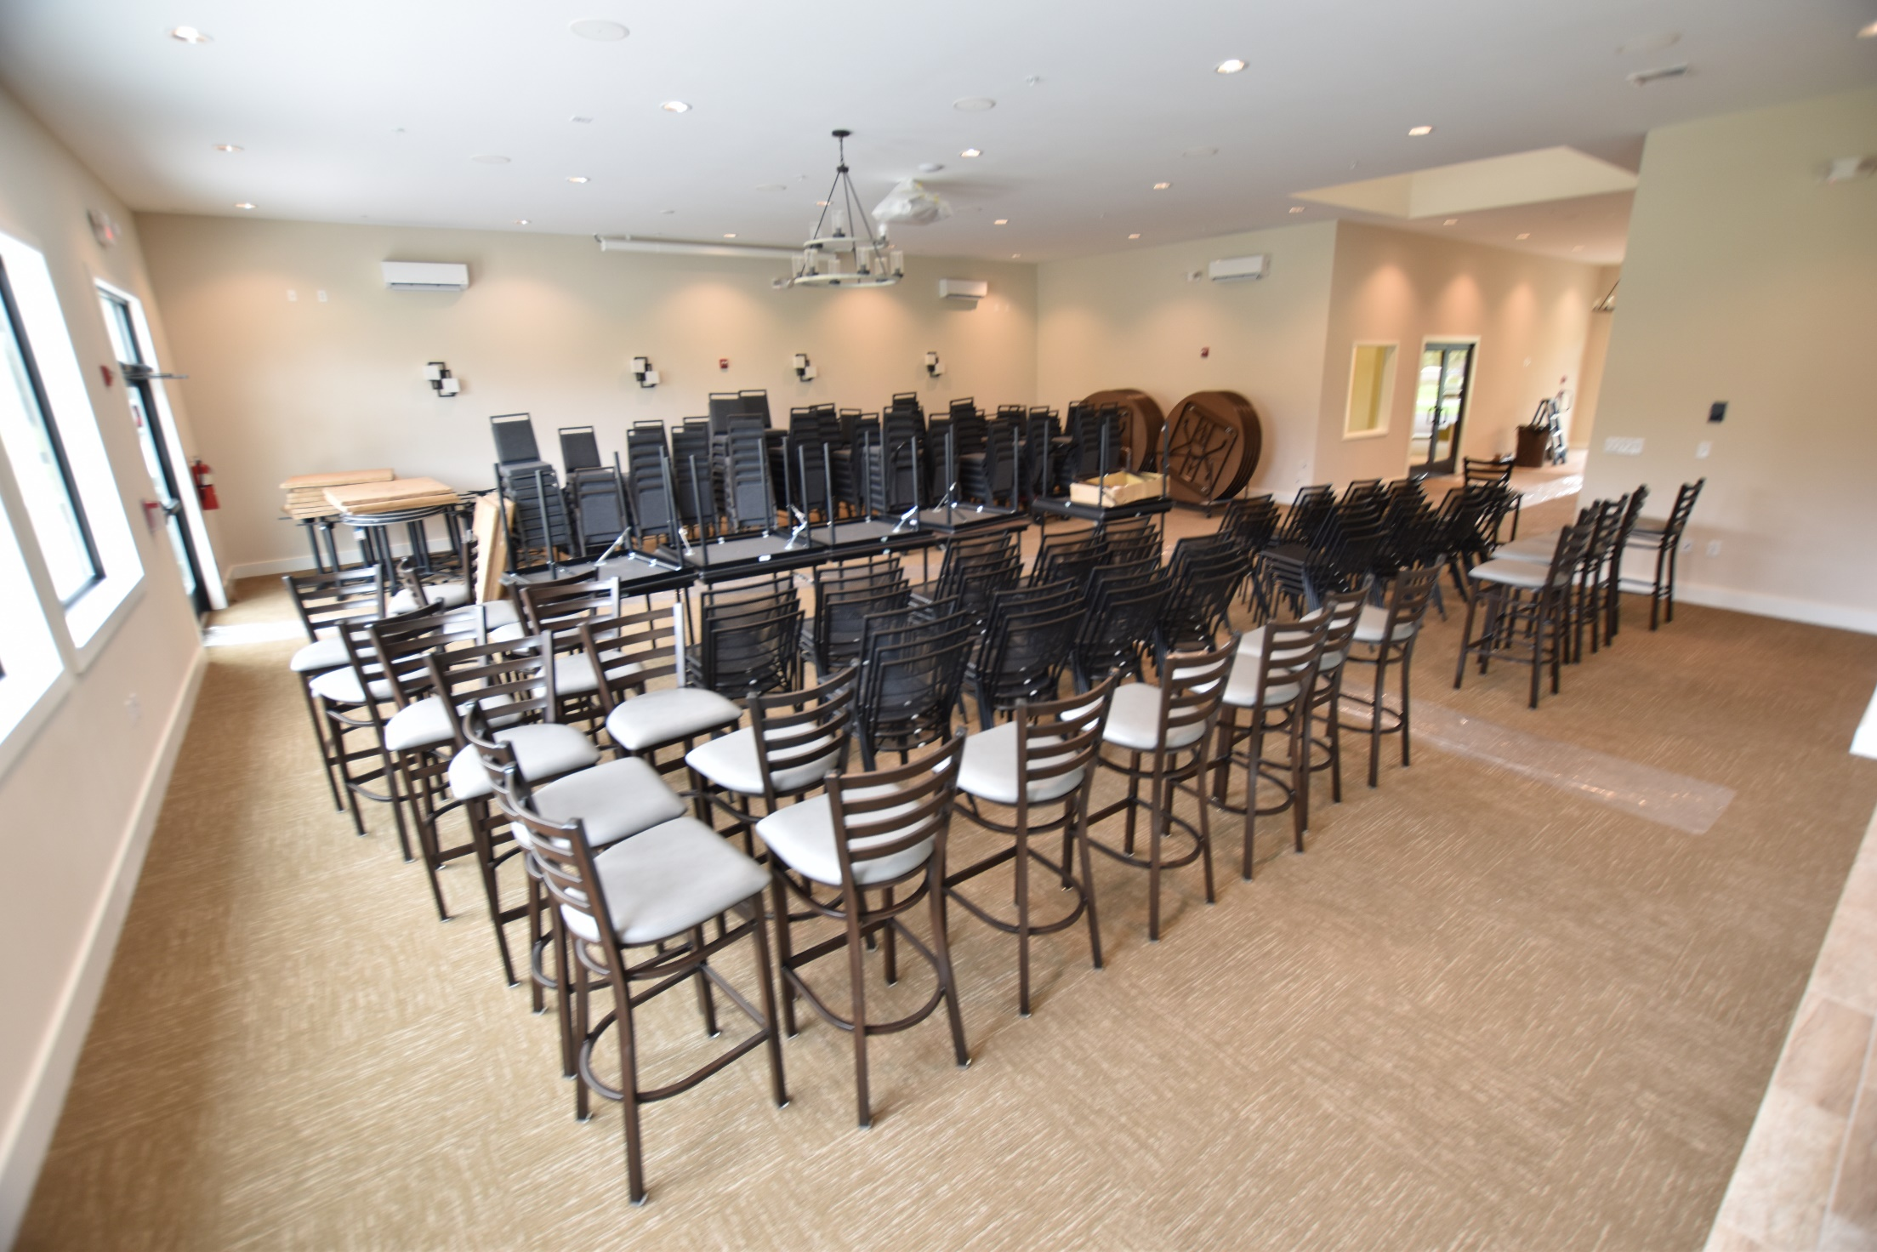

Slide 10
Covid-19 communications
                No Playbook (However)
                Communication Plan
                Monitor Federal Government and Governor Hogan updates
                Releases shared on www.oceanpines.org, social media and eblasts
                OP continues to share information with Worcester County, Ocean City, Berlin and others to supply benchmarking for closures
                Construction continues
                Financial situation
                Northstar
                Revenue Loss (60/40)
                Year End Audit
                We are a group of small businesses

Slide 11
GM REPORT
MAY 2, 2020
John Viola
Initiatives | Construction Status | Projects Completion Date | Budget Cost | As of 4/27/20 Paid YTD
Clubhouse | Green | *May 2020 | $1.6 mil | $1,284,698
Cart Barn | Completed | CO received | $430,000 | $310,396
Police Building | Green | September 2020 | $1.276 mil | $479,799
Northstar (Software Project) | Green/Yellow | **December 2020 | $400,000 | $383,107
Admin. Renovation | Green | September 2020 | $220,000 | $0
Borderlinks Drainage | Completed | April 2020 | $100,000 | $101,350
* Certificate of Occupancy expected week of May 4th
**Extended

Slide 12
Financial Change for the
Month of MARCH 2020
March
 | Budget | Current Year | Favor/ (Unfavor) vs. Budget
Revenues | $181,659 | $121,321 | ($60,338)
Expenses | 872,378 | 848,051 | 24,327
Net Operating | $(690,719) | $(726,730) | ($36,011)

Slide 13
Financial Change Year to Date
5/1/19 – 3/31/20
(11 months)
YTD
 | Budget | Current Year | Favor/ (Unfavor) vs. Budget
Revenues | $12,189,755 | $12,588,119 | $398,364
Expenses | 11,347,190 | 11,078,989 | 268,201
Net Operating | $842,565 | $1,509,130 | $666,565

Slide 14
Treasurer’s Report -
Larry Perrone

Slide 15

Cash & Short-Term Investments
Activity for Month of March
Overall Laddered Investment Rate of Return on CDAR’s for March Approx. 2.5%
At March 31, 2020, the Association had approx. $9.2 million in cash
  Approx. $4.8 million invested in CDAR’s fully FDIC insured
  Approx. $4.4 million in Money Market and other operating accounts, fully insured

Slide 16
Reserves March 2020 ($Millions)
 | Replacement | Bulkheads | Roads | Total
4/30/19 Balance | $5.2 | $2.5 | $1.1 | $8.8
Assessments/Interest | 2.0 | 0.7 | - | 2.7
Casino Funds | - | - | 0.3 | 0.3
Transfer (Spend) | (2.8) | (1.3) | (0.8) | (4.9)
3/31/20 Balance | $4.4 | $1.9 | $0.6 | $6.9

Slide 17
Reserves 4/30/20 Forecasted
(in thousands)
 | Balance |  |  | Projected Balance
 | 4/30/2019 | Additions | Expenditures | 4/30/2020
Major Maintenance & Replacement:
Police Renovation |  |  | (650)
Country Club Renovation |  |  | (1,400)
Cart Barn |  |  | (310)
Northstar |  |  | (275)
WHP Playground Equip |  |  | (153)
Craft Building |  |  | (98)
Yacht Club + Beach Club |  |  | (111)
Golf Ops/Maintenance |  |  | (215)
Aquatics/Rec/Other |  |  | (375)
Total | 5,257 | 2,025 | (3,587) | 3,695
Bulkheads & Waterways | 2,478 | 735 | (1,626) | 1,587
Roads | 1,101 | 355 | (1,033) | 423
TOTAL 4/30/20 | 8,836 | 3,115 | (6,246) | 5,705

