Slide 1

Board of Directors Meeting
May 20, 2023

Slide 2
Approval of Agenda

Slide 3
Approval of Minutes
April 15, 2023 – Regular Meeting

Slide 4


President’s Remarks
Doug Parks

Slide 5
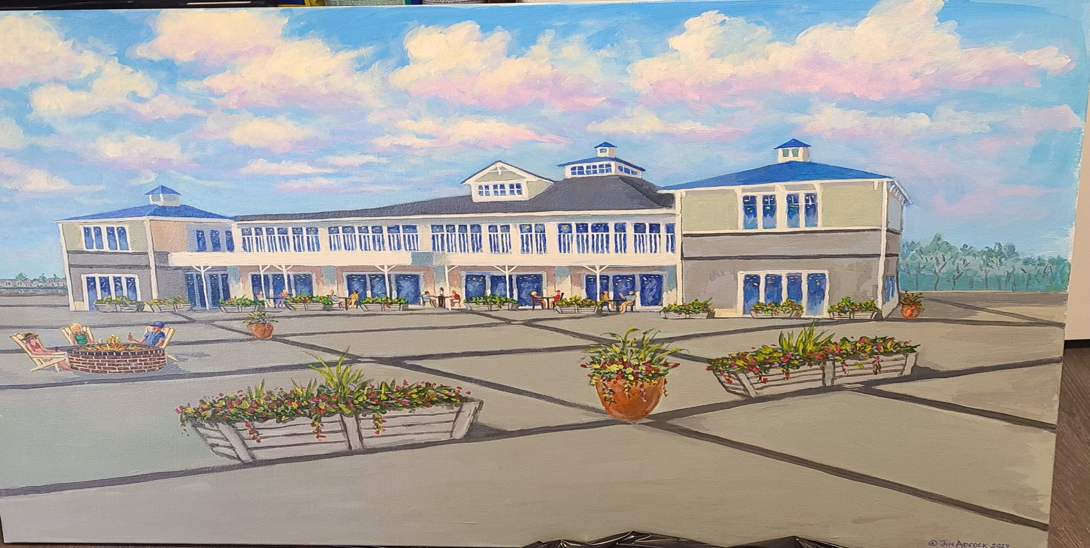
GM Leadership Report –
John Viola

Slide 6
Initiatives
Marina
Gas Dock
Showers
Golf
Public Works
Information Technology
Aquatics
Lifeguard Situation
Hiring
Certificates of Excellence
Metrics
Recreation & Parks Events
Bay Day
Bike Day
Northstar
Racquet Center
Strategic Plan
Maintenance Update
Clinics (Tim)

Slide 7
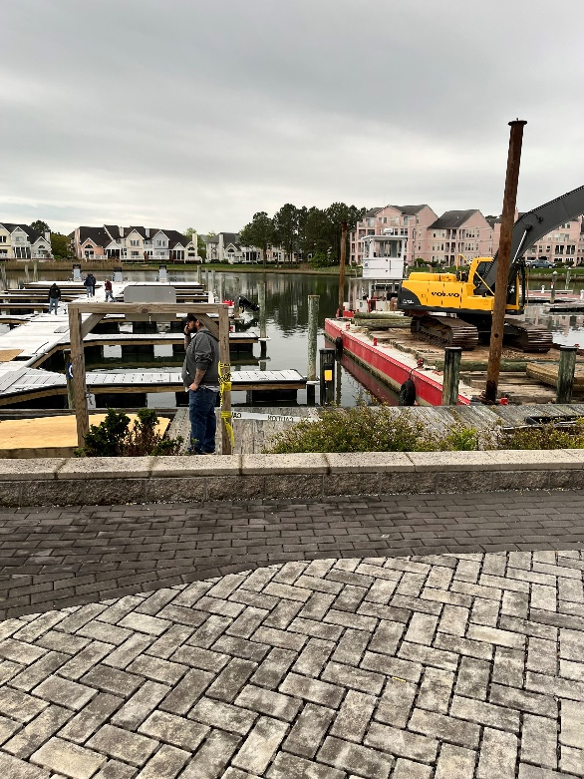
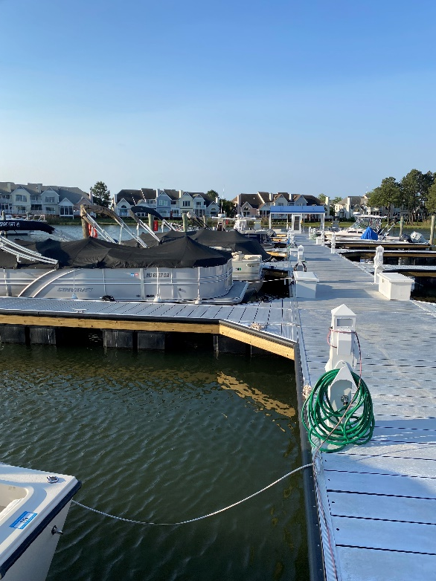
Marina
Gas Dock
All parts have been received by the contractor, to be onsite with team on Monday, May 22, 2023
Workplan and inspections are scheduled for Monday – Wednesday, May 22nd – May 24th, 2023.
Plan to pump on Friday, May 26, 2023

Slide 8
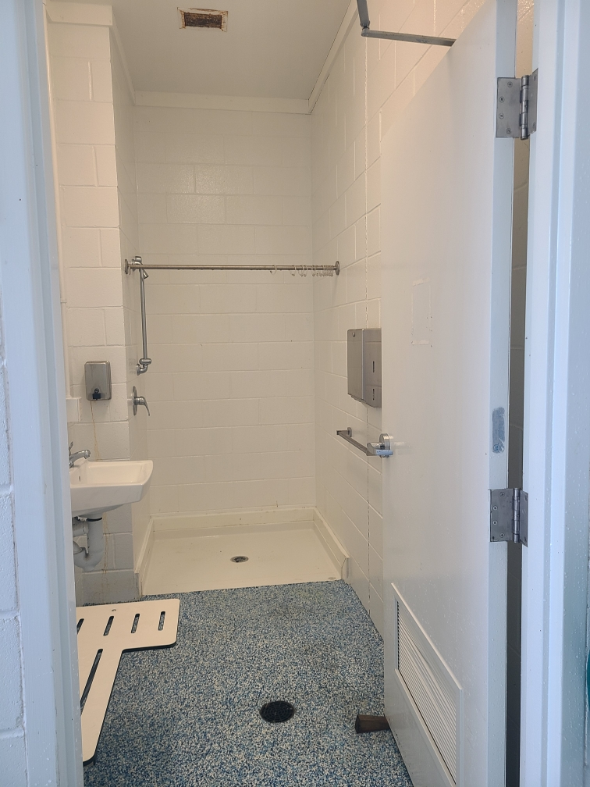
Marina Showers
Maintenance
Issue:
Out of 3 showers only one was operational
Situation was addressed and all 3 showers are now operational

Slide 9
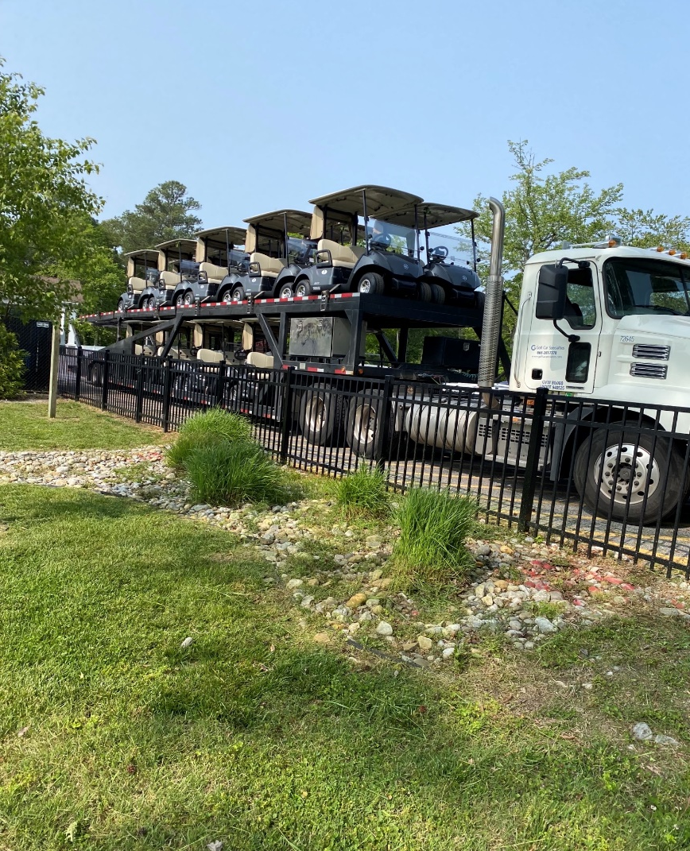
Golf
76 Golf Carts ordered have been delivered
Purchased from Yamaha
Approved by Board: March 23, 2022
Replacement Cost: $260,908.00

Slide 10
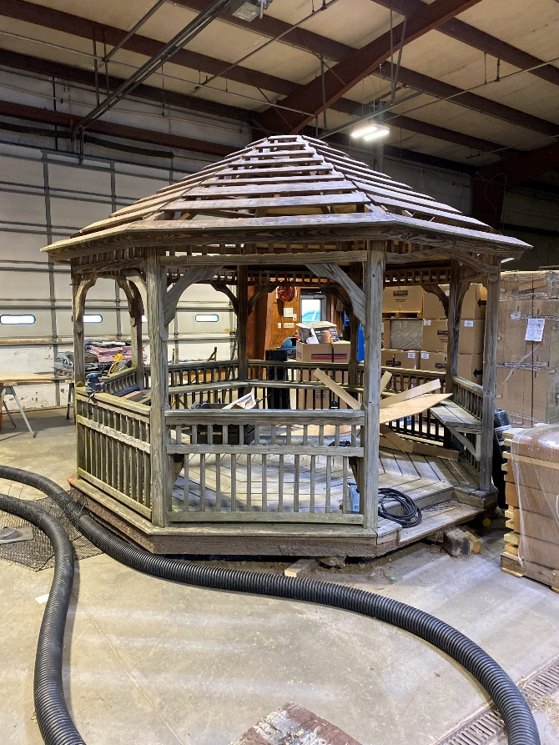
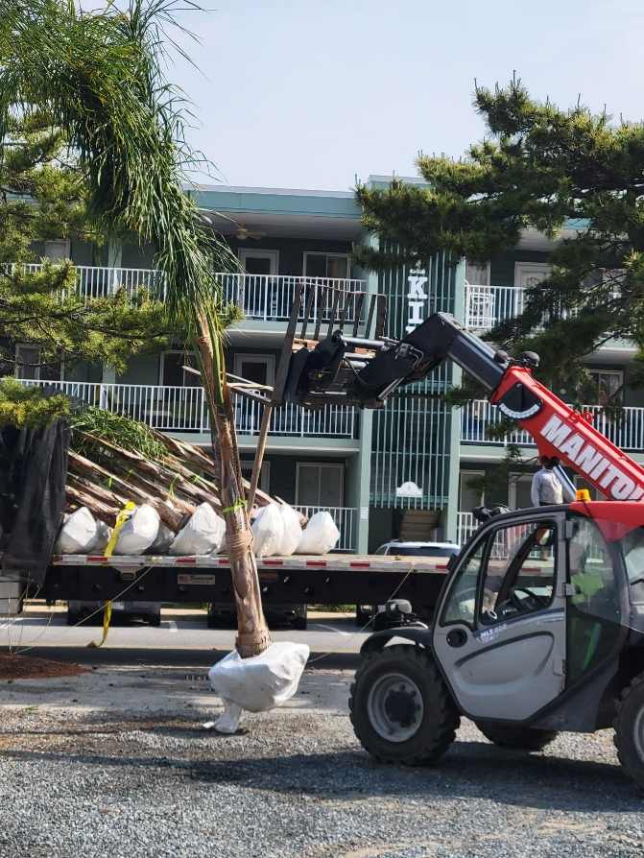
Public Works
Renovating “Iconic” Golf Course Gazebo
Estimated completion is the next two weeks
Estimated Cost: $1,000
Palm Trees installed yesterday at Beach Club

Slide 11

Northstar representative onsite: April 27 and 28, 2023
Key Northstar team now located on East Coast
Efficiencies
    Golf integration with EZ Links to be implemented FY 2024
    Making check in at Racquet Center easier, by using swipe cards and setting up online reservations for new classes, leagues, and courts

Slide 12
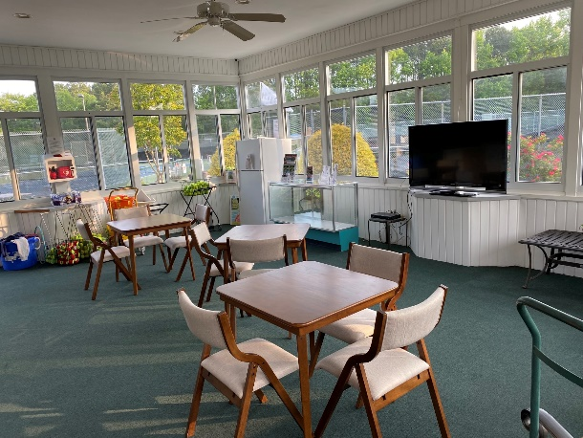
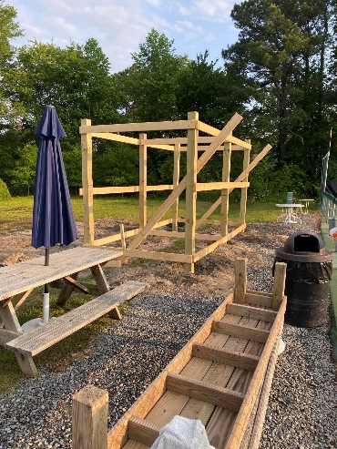
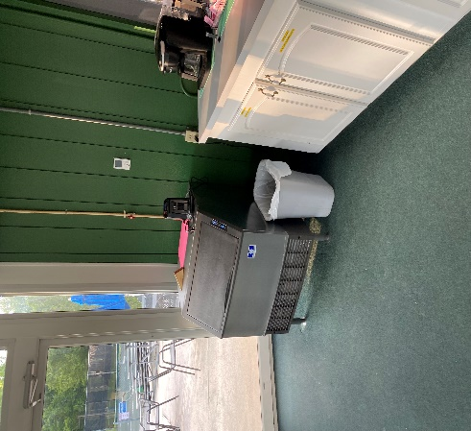
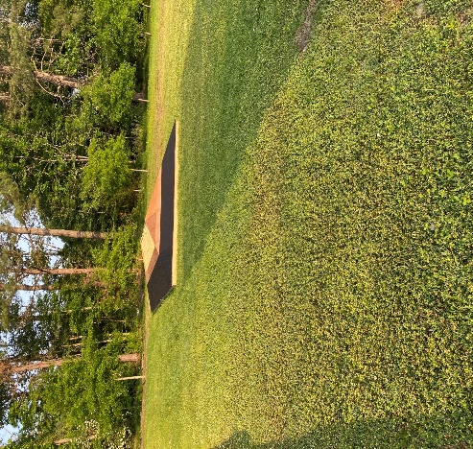
Racquet Center
Maintenance
Maintenance
Emergency alert detector
Lightning alert detector
New tables and chairs in lounge
Painted lounge
Painted restrooms
New lighting in restrooms
Storage being cleaned out to make room for other items
Platform
  Chairs painted as requested
Pickleball
  Squeegees/court broom purchased
  New shade structure being built

Slide 13
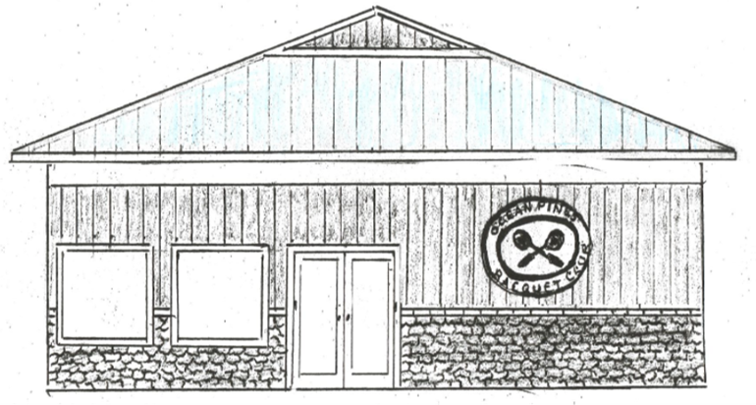
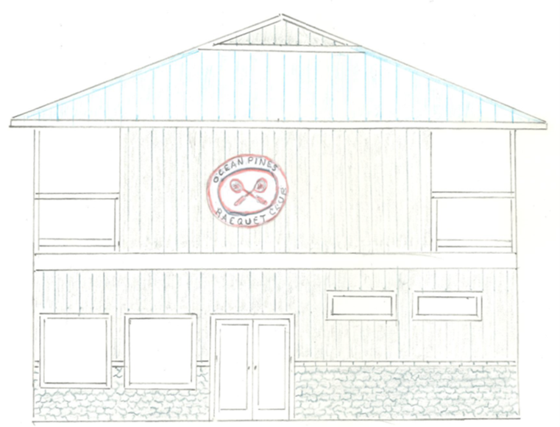
Racquet Center
Court Maintenance
Tennis
  Racquet Center has now acquired a full-time maintenance employee to maintain the racquet facility and grounds
Pickleball
  ATC will be addressing cracks on Pickleball Courts
Paddle Tennis
  ATC will also be addressing the cracks on Courts 1 & 2 of platform

Slide 14
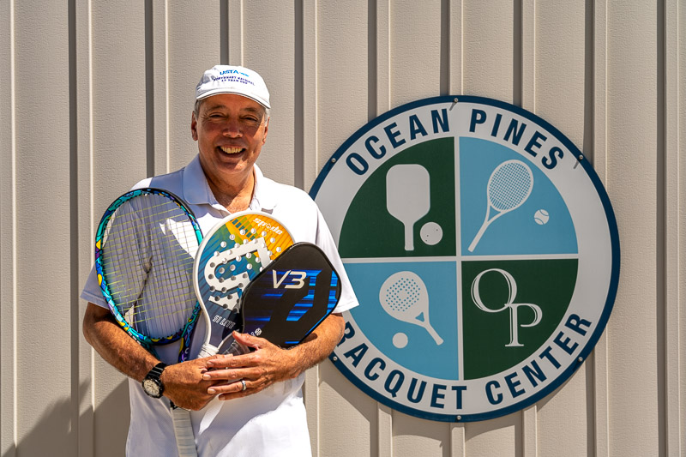
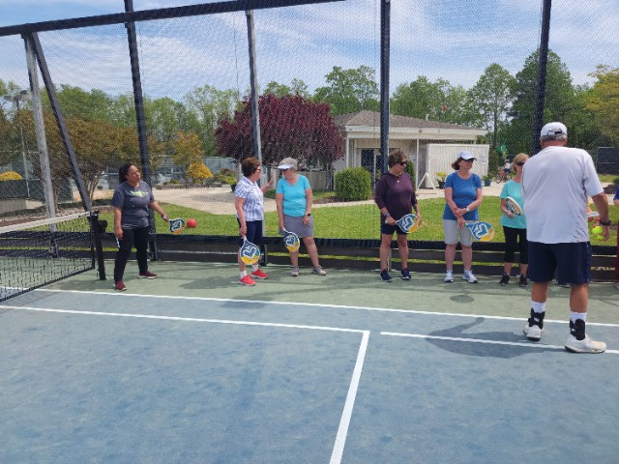
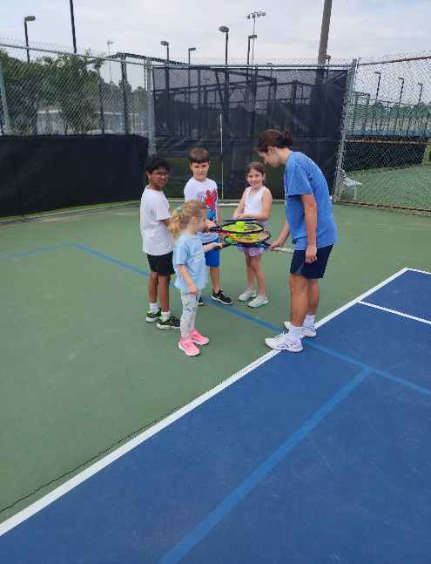
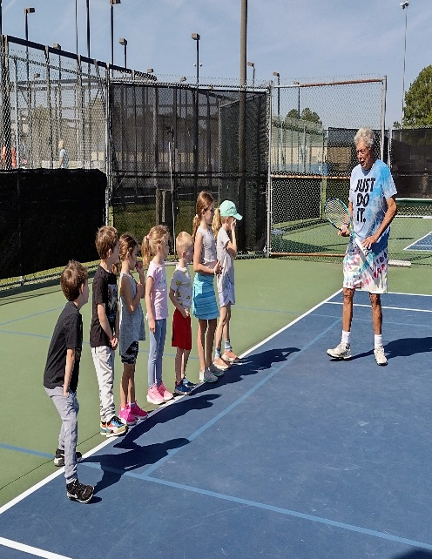
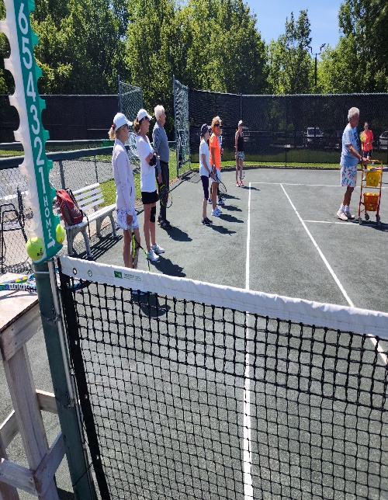
Racquet Center
Free Clinics
Spec Tennis FREE clinic – Tim Johnson
Held April 22,2023
17 attendees
9 on Tim's court never played before
6 new members from his 9 prospects
National Tennis Month FREE clinics for juniors and adults.
Held May 15, 2023, and May 16, 2023
17 junior participants
9 adult participants

Slide 15
Strategic Planning
Met with Strategic Planning Committee representatives Bernie McGorry and John Lynch on April 13, 2023
Feedback we received was minor editing to the goals which included highlighting the outcomes of each goal
Our team continues to be on track with the Strategic Plan that was approved and posted on October 31, 2022
We continue to reference the Plan as we address initiatives, objectives, and our day-to-day operations

Slide 16
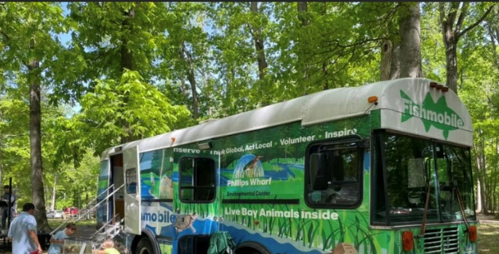
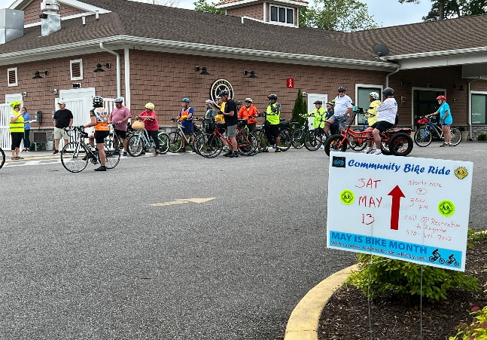
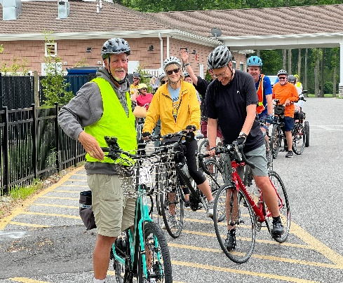
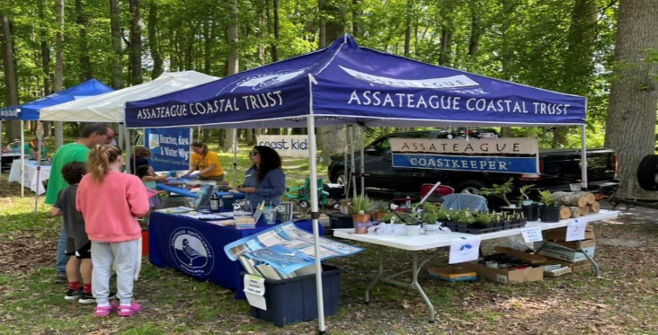
Recreation and Parks
Events
Bike
Day
Bay
Day
Held May 13, 2023
75 Registered participants
Due to the weather, we had 33 riders
Rode 7-mile course
Had a social after at the Clubhouse were everyone had a great time
Patti Stevens from the Worcester County Bike and Pedestrian Coalition handed out pamphlets on bike safety
Held May 7, 2023
Approximately 1000 people attended
Thanks to Maryland Coastal Bay for making this event a huge success again this year

Slide 17
Aquatics
Lifeguard Status
Summer pool hours likely to be limited, as lifeguard shortage continues
OPA will announce schedule in advance
Pool schedules are likely to be similar to the rotating hours announced last year.
The Association will announce the Monday-Sunday operating hours in advance, each Friday. Announcements will be posted on the front door of each Aquatics facility, and advertised on the Ocean Pines Association website, Facebook, and in a weekly email.
The likelihood of limited hours was previously publicized and listed on pool membership applications.

Slide 18
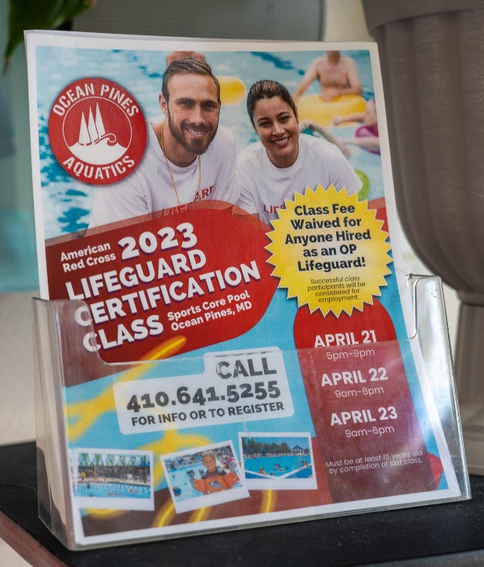
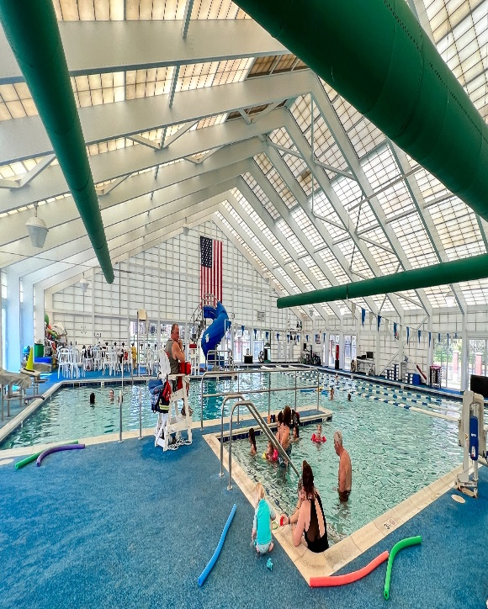
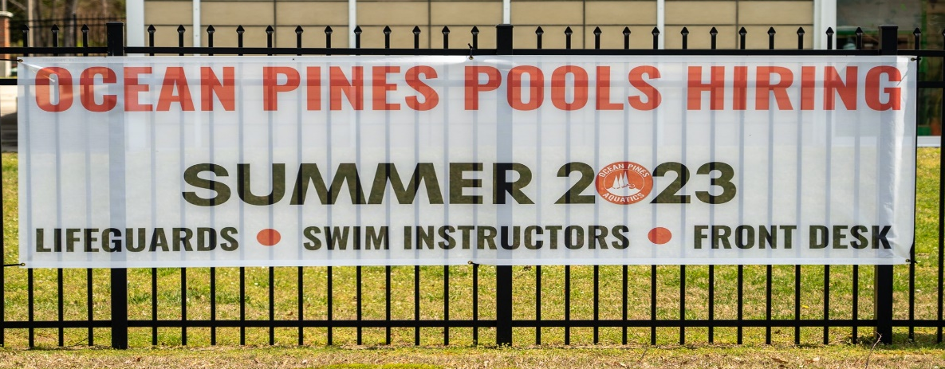
Aquatics
Lifeguard Hiring Efforts
Compensation:
  Increased pay
  OPA paying for training
  Outreach from Aquatics staff
Advertising
  Multiple ads in local newspapers
  In addition, Help Wanted ads
  Press releases to local media
  Coverage on local TV news
  Ads through local schools
  Multiple job fairs
  Posts on the website and social media
  Articles and flyers in the weekly e-blast, quarterly newsletter and twice-annual activity guide
  Flyers at the Sports Core Pool
  Banners at the Sports Core Pool

Slide 19


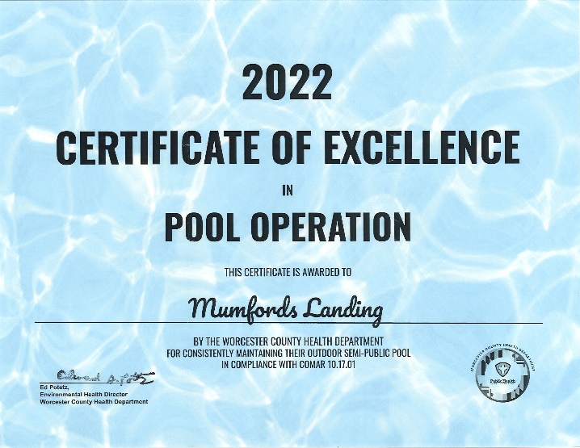

Aquatics
4 Pools
  Certificate in Excellence in Pool Operation
  From Worcester County Health Department
  Recognizes a spotless safety record and not easy to come by

Slide 20
CPI Violation Dashboard
April
Violations (includes legal)
As of 3/31/23 | New Violations | Closed Violations | As of 4/30/23
156 | 20 | 34 | 142
Legal Cases
As of 3/31/23 | New Violations to Legal | Closed Violations in Legl | As of 4/30/23
50 | 0 | 0 | 50
20 violations initiated in April: 6 maintenance/trash; 3 dangerous tree;
5 no permit; 4 miscellaneous
  Miscellaneous violations includes placement, screening, signs, stop work orders, tents, trailers, unregistered/junk vehicles, and vehicle parking
34 complied out; 142 remain open (includes the 50 violations in legal)
  40 maintenance/trash; 3 dangerous trees; 36 no permit; 63 miscellaneous

Slide 21
Work Orders
April
Open Work Orders as of 3/31/23 | New Work Orders | Closed Work Orders | Open Work Orders as of 4/30/23
95 | 80 | 69 | 106
80 work orders initiated in April: 4 bulkhead; 21 drainage; 17 grounds/landscaping; 7 roads; 4 signs; 27 general maintenance
Majority still open in drainage (34):
  14 – over 30 days
    Average 1-4 work orders a day to complete depending upon severity

Slide 22
Customer Service Dashboard
(from info@oceanpines.org)
April
Type | # Received – Apr.
Amenities | 21
CPI | 10
Drainage | 1
General | 60
Public Works | 16
TOTAL | 108

Slide 23
Financials

Slide 24
Financial Change
Month of March 2023
March (In 000’s)
 | Budget | Current Year | Favor/ (Unfavor) vs. Budget
Net Revenues | $277 | $347 | $70
Expenses | 1,129 | 1,197 | (68)
Net Operating | ($852) | ($850) | $2

Slide 25
Month of March
Favor/(Unfavorable) vs. Budget (in 000’s)
Department/Amenity | Favorable/ (Unfavorable)
Police | 33
Public Works | 24
F&B (Yacht + Clubhouse Grille) | 12
General Maintenance | (29)
Golf Ops + Maintenance | (12)
Aquatics | (7)
Recreation & Parks | (7)
Other Net (Marinas, Beach Club, Beach Parking, Racquet Sports, GM Office, CPI, Finance, Public Relations, Admin) | (12)
TOTAL | $2

Slide 26
Financial Change
Year-to-Date March 2023
YTD March 2023 (In 000’s)
 | Budget | Current Year | Favor/ (Unfavor) vs. Budget
Net Revenues | $13,562 | $14,577 | $1,015
Expenses | 12,855 | 12,755 | 100
Net Operating | $1,557 | $2,672 | $1,115

Slide 27
Year-to-Date March
Favor/(Unfavorable) vs. Budget (in 000’s)
Department/Amenity | Favorable/(Unfavorable)
Public Works, Gen Maint, CPI | 261
Golf Ops & Maintenance | 216
Police | 149
Aquatics | 127
Rec & Parks | 93
Yacht Club | 88
Beach Club | 86
Marinas | 29
Racquet Sports | 28
Beach Parking | 23
Other Net (Admin, GM Office,Finance, PR/Marketing, Clubhouse Grille) | 15
TOTAL | $1,115

Slide 28
Unaudited Reserves March 2023 ($ Millions)
 | GeneralReplace | Bulkheads | Roads | Drainage | New Capital | Total
4/30/22 Balance | $4.8 | $0.5 | $0.0 | $0.7 | $0.1 | $6.1
Contributions/ Interest | 1.9 | 1.1 | 0.7 | - | 0.2 | 3.9
Casino Funds | - | - | 0.4 | 0.1 | - | 0.5
Transfer (Spend) | (1.3) | (0.9) | (0.4) | (0.6) | (0.2) | (3.4)
3/31/23 Balance | $5.4 | $0.7 | $0.7 | $0.2 | $0.1 | $7.1

Slide 29
“Flash” Preliminary Estimate For
Month of April 2023
April (In 000’s)
 | Budget | Current Year | Favor/ (Unfavor) vs. Budget
Net Revenues | $398 | $445 | $47
Expenses | 1,106 | 1,087 | 19
Net Operating | ($708) | ($642) | $66

Slide 30
Treasurer’s Report
Monica Rakowski

Slide 31

Cash & Short-Term Investments
Preliminary Estimate for Month of April
As of April 30, 2023, the Association had approx. ~ $17.7M in cash
  Cash increased ~ $0.3M from the same time period last year
  Cash increased ~$3.3M from March 2023
  $9.1M invested in CDAR’s
  Remaining $8.6M in Insured Cash Sweep, Money Market and Other Operating Accounts (diversified between 2 local banks)

Slide 32

Public Comments
Members wishing to make comments must state their name and address.

Slide 33
Capital Requests

Slide 34
Capital Requests
Total Platform Tennis
Requesting authorization to go forward with staff recommendation of $26,394.00 for replacement of platform fence.

Slide 35
Adjournment

