Slide 1
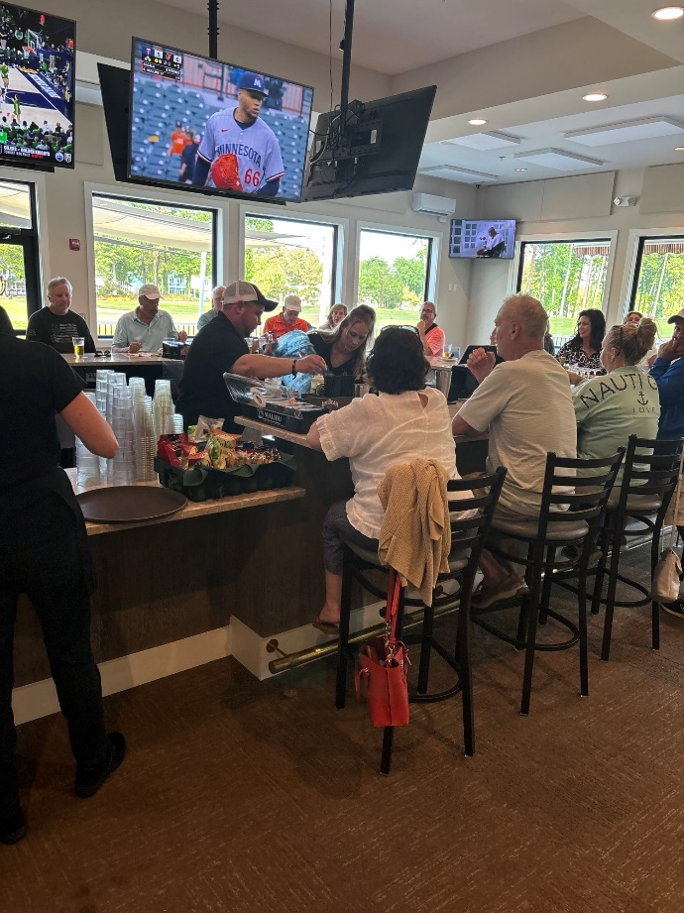
GM Leadership Report –
John Viola – General Manager
Linda Martin – Senior Director of Administration
May 24, 2025

Slide 2
Initiatives
  OPVFD Firehouse
  Racquet Sports Building
  Bocce Ball Courts
  Irrigation
  Safety
  Landscaping
  Dog Park Gazebo
  Gym Floor
  Strategic Plan
  Metrics

Slide 3
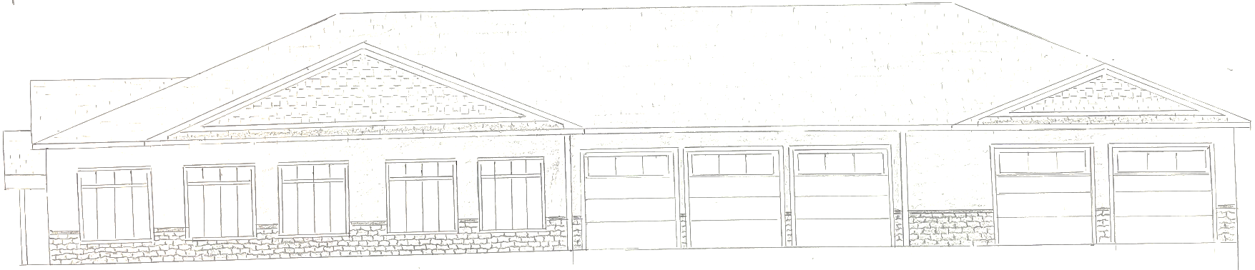
OPVFD Firehouse
Where were we:
  Reevaluated initial proposal
    19,100 sq. ft to 14,610 sq. ft.
  Set up new work group with OPVFD
  Fine tuned the interior costs
  Safety and NFPA requirements
  Transition costs
  Developed sketches to be utilized by architect
  Completed pre-planning stage

Slide 4
OPVFD Firehouse
Where are we today:
  Present motion for referendum
  Architectural drawings – end of May
  Funding – deliver options to the Board
  Approval to move forward from Board
  How much money (ballpark) to go forward with referendum (June)
Next steps:
  Bids or award
  Timeline
  Project plan
Shovel in ground: estimate October 2025
Completion estimate – 65 weeks

Slide 5
OPVFD Firehouse
DMA Study
  At this point today, I am recommending to the Board we fund our portion of the firehouse estimate out of general reserves
  We are managing our reserve balance in compliance with the DMA lite study of 2021 which reflects a balance in the vicinity of 22-24% of fully funded
  Since the funding of the building will not start until after October 2025, and the DMA study is scheduled for the August/September timeframe, our reserve funding will be evaluated and decided at that time
  I have updated this Board and the Association over the last several months and I am stating today that I believe we have “goldilocks situation”

Slide 6
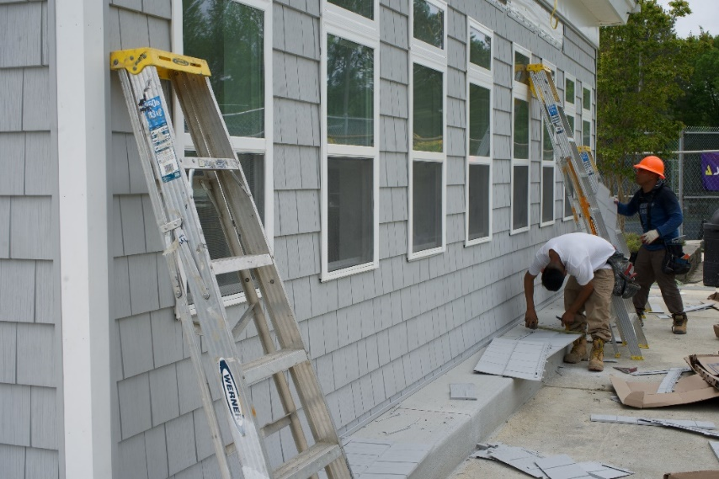
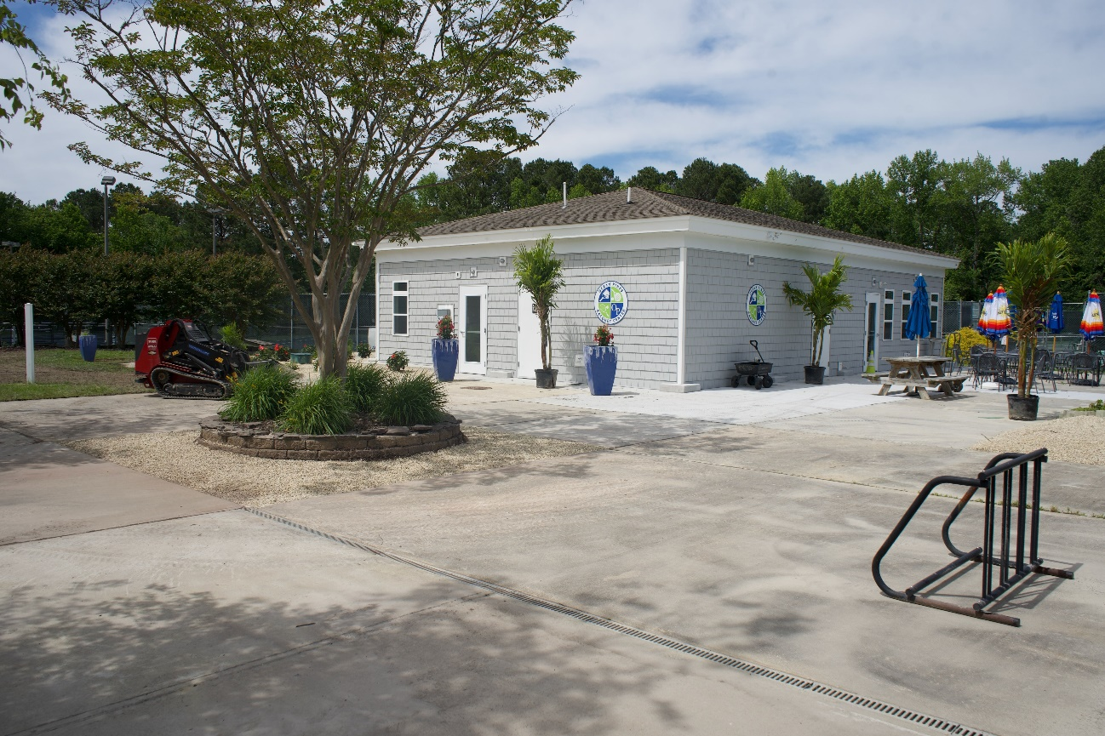
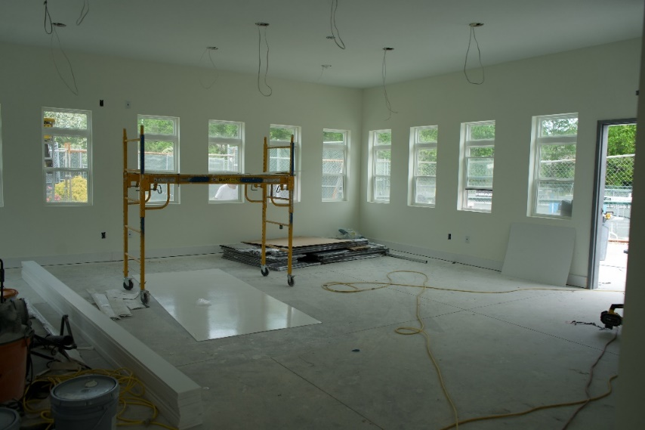
Racquet Sports Building
  Building finished before Memorial Day
  Cost: approximately $275,000

Slide 7
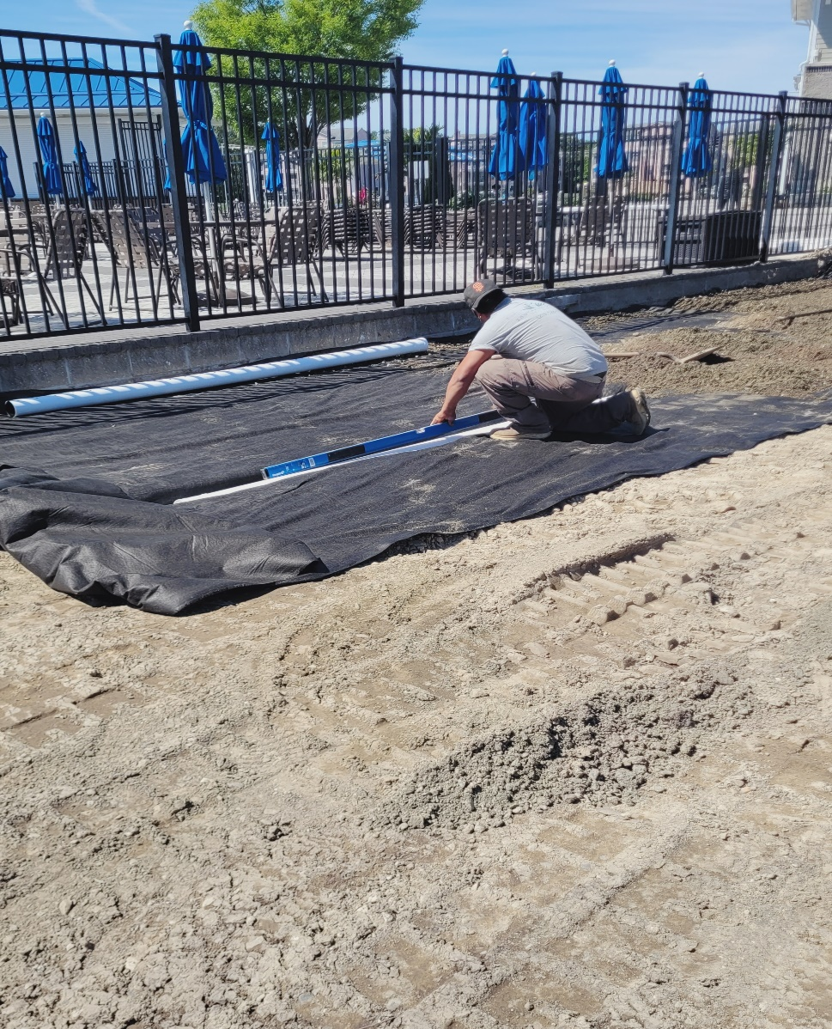
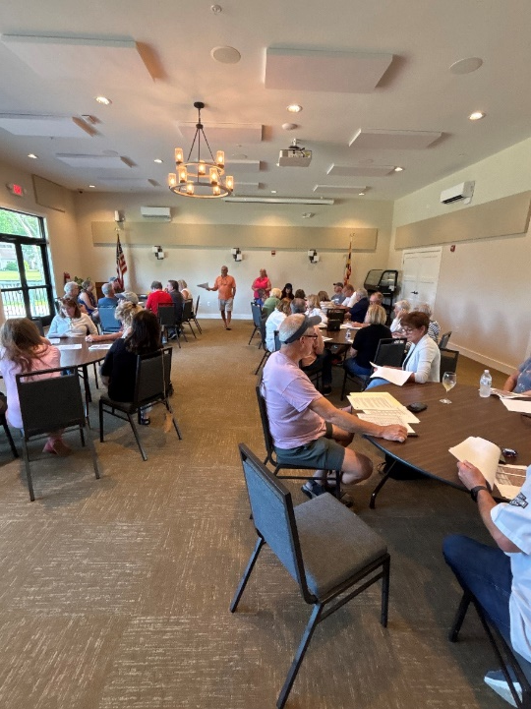
Bocce Ball Courts
  Southwest Greens Delaware Valley began installing courts on May 19th
  Total cost: $50,692
  League play starting in June
    Kickoff meeting of teams held on May 14th

Slide 8
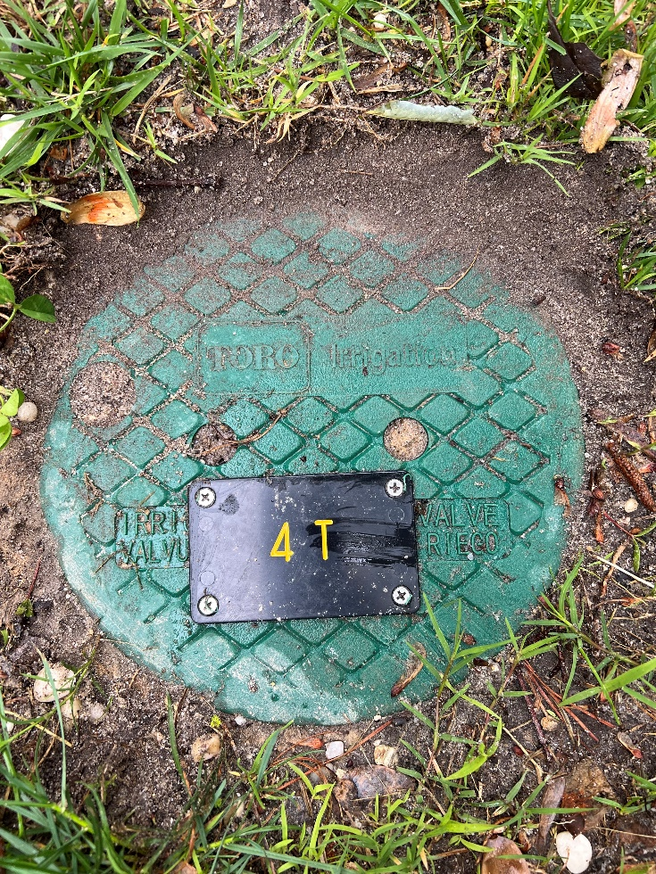
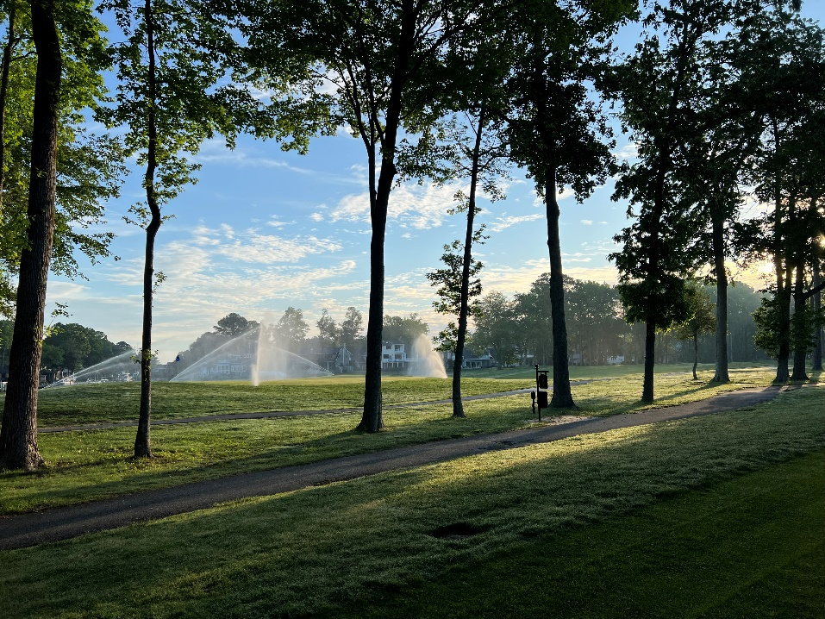
Irrigation
  Phase II being reviewed today for approval
    Holes 4-8 to be completed
  Total cost: $810,500
  Work to continue with same contractor (Irrigation Services Inc.)

Slide 9
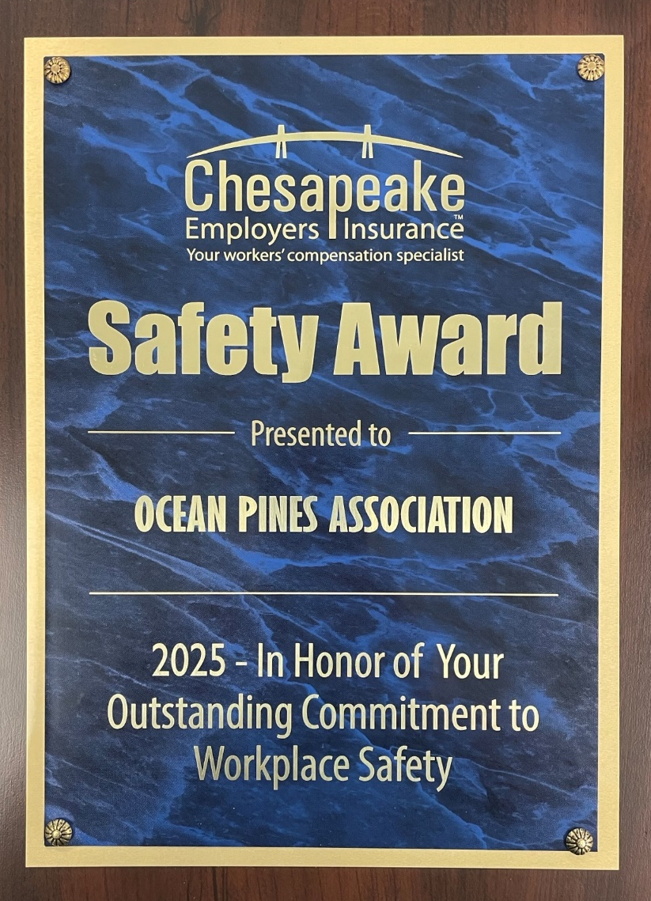

Safety
  Association received workplace safety award on May 7th from insurance agency
  5 consecutive years maintaining a loss ratio of 23.59%

Slide 10
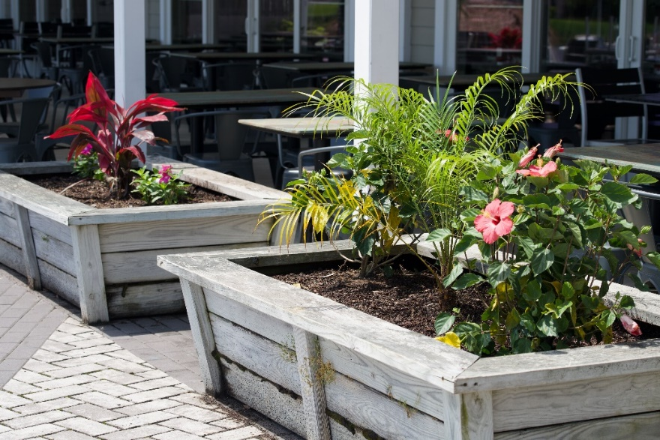
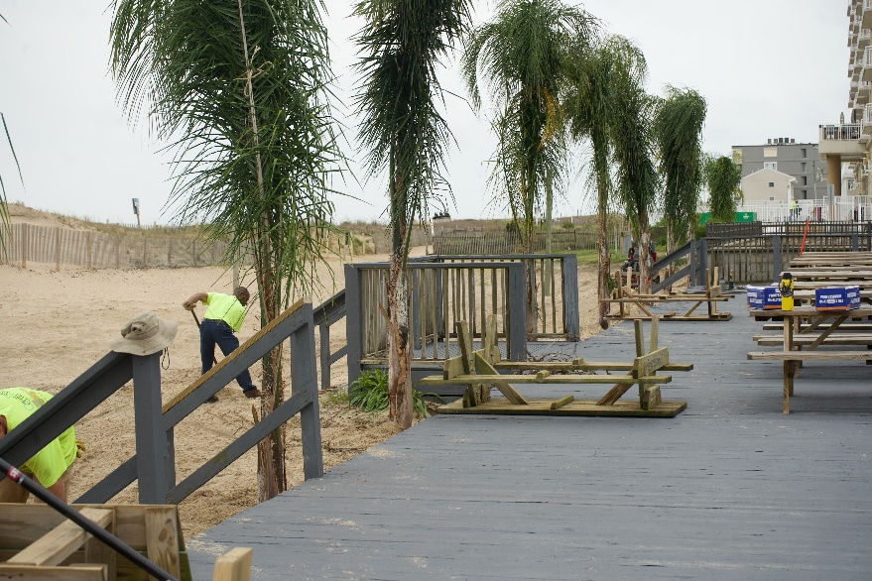
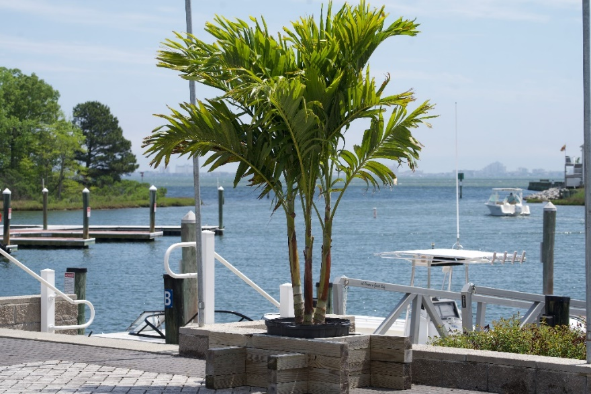
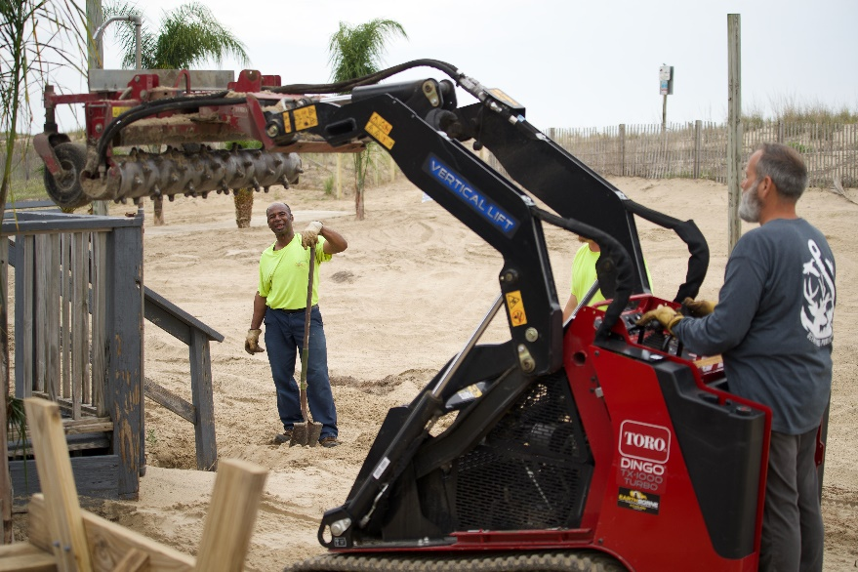
Landscaping
  Spring/Summer plants installed at all facilities and around Ocean Pines

Slide 11
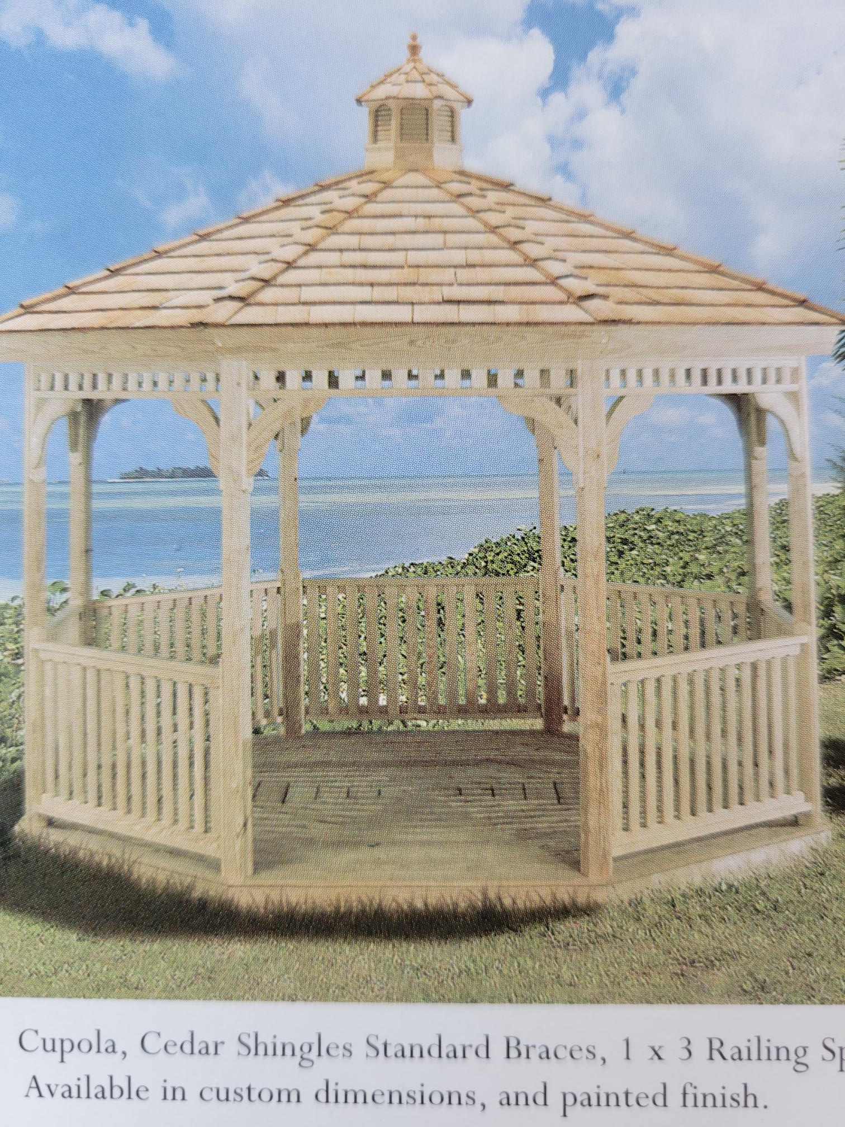
Dog Park Gazebo
  Per request, rain structure (gazebo) to be installed at dog park
  Seating for approximately 12-15 people
  To be installed on small dog side of park
  Approximate cost: $6,000
  Estimated delivery in 6-8 weeks (Woodland Sheds)

Slide 12
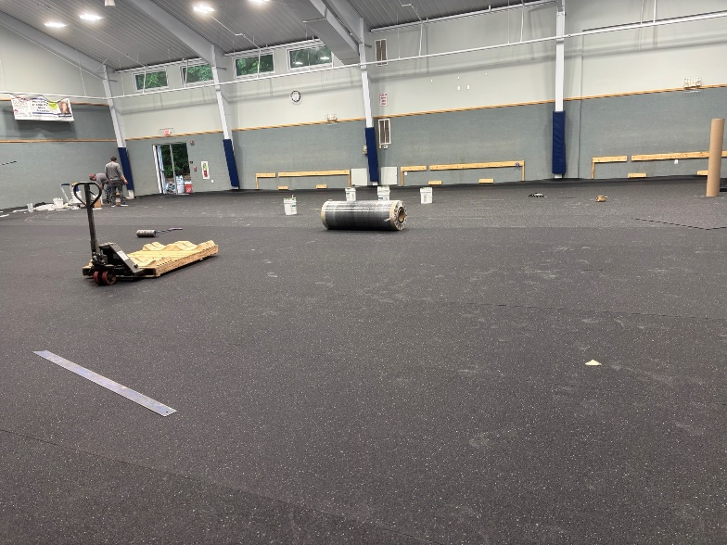
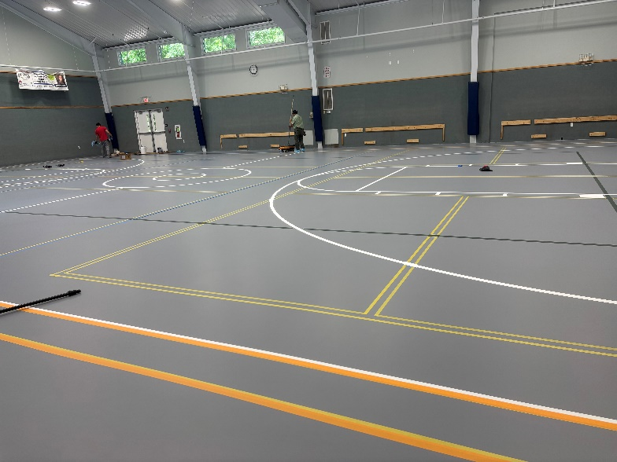
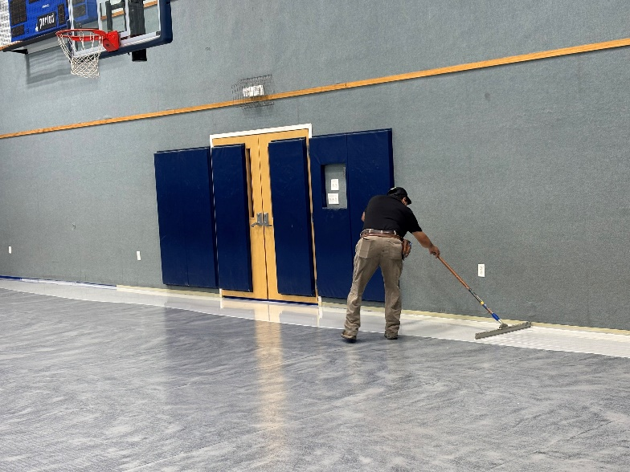
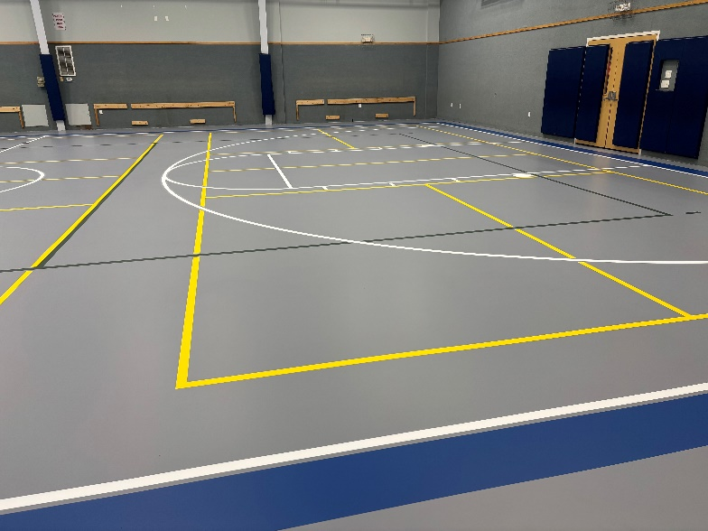
Gym Floor
  New floor installation began on May 12th by Dynamic Sports Construction
  Total cost: $62,300
  Completed May 17th – has to cure for a week

Slide 13

Strategic Plan
  Plan adopted 2022
  Fluid plan – updated regularly
    Last update posted in March 2025 to Drainage
  On target with rest of plan
  Where can I find the strategic plan?
    OPA Website: Departments – General Manager

Slide 14
CPI Violation Dashboard
April
Violations
As of 4/1/25 | New Violations | Closed Violations | As of 4/30/25
528 | 141 | 314 | 355
141 violations initiated in April: 40 maintenance/trash/debris; 12 leaf maintenance/placement; 24 no permit; 14 signs; 3 trees; 47 miscellaneous
  Miscellaneous violations includes easements, permit expiration, screening, trailers, unregistered/junk vehicles, vehicle parking, and wire/metal fencing
314 violations complied out; 355 remain open
  80 maintenance/trash/debris; 63 leaf maintenance/placement; 77 no permit; 12 signs; 8 trees; 115 miscellaneous
92 of the 355 violations still open are in legal

Slide 15
Work Orders
April
Open Work Orders as of 4/1/25 | New Work Orders | Closed Work Orders | Open Work Orders as of 4/30/25
120 | 134 | 110 | 144
134 work orders initiated in April: 12 bulkhead; 50 drainage; 18 grounds/landscaping; 12 roads; 6 signs; 36 general maintenance
Majority still open in drainage (92):
  44 – over 30 days; 6 – over 60 days
    Average 1-4 work orders a day to complete depending upon severity

Slide 16
Customer Service Dashboard
(from info@oceanpines.org)
April
Type | # Received – Apr.
Amenities | 17
CPI | 18
Drainage | 5
General | 40
Public Works | 10
TOTAL | 90

Slide 17
Financials

Slide 18
UNAUDITED “FLASH” ESTIMATE
FINANCIAL CHANGE
MONTH OF APRIL 2025
April (In 000’s)
 | Budget | Current Year | Favor/ (Unfavor) vs. Budget
Net Revenues | $457 | $517 | $60
Expenses | 1,388 | 1,377 | 11
Net Operating | ($931) | ($860) | $71

Slide 19
UNAUDITED “FLASH” ESTIMATE APRIL
FAVOR/(UNFAVORABLE) VS. BUDGET (IN 000’s)
Department/Amenity | Favorable/(Unfavorable)
Administration (net) | 27
Police | 77
Rec & Parks | 26
Public Works/Gen Maint/CPI | (72)
Golf Ops + Maintenance | 30
Aquatics | 15
Racquet Sports | (5)
Yacht Club | (22)
Beach Parking | 5
Other Net (Clubhouse Grille, Beach Club, Marinas) | (10)
TOTAL | $71

Slide 20
UNAUDITED “FLASH” ESTIMATE
YTD APRIL 2025
April YTD (In 000’s)
 | Budget | Current Year | Favor/ (Unfavor) vs. Budget
Net Revenues | $15,260 | $15,732 | $472
Expenses | 15,260 | 14,726 | 534
Net Operating | $0 | $1,006 | $1,006

Slide 21
UNAUDITED “FLASH” ESTIMATE YTD APRIL
FAVOR/(UNFAVORABLE) VS. BUDGET (IN 000’s)
Department/Amenity | Favorable/(Unfavorable)
Public Works/Gen Maint/CPI | $362
Admin/Finance/GM/Public Relations | 276
Golf Ops + Maintenance | 244
Beach Club | 77
Police | 73
Aquatics | 70
Marinas | 49
Recreation & Parks | 23
Beach Parking | 20
Racquet Sports | 18
Clubhouse Grille | (2)
Yacht Club | (204)
TOTAL | $1,006

Slide 22
UNAUDITED “FLASH” ESTIMATE RESERVES APRIL 2025 ($ MILLIONS)
 | GeneralReplace | Bulkheads | Roads | Drainage | New Capital | Total
4/30/24 Balance | $5.5 | $0.3 | $0.8 | $0.4 | $0.1 | $7.1
Contributions/ Interest | 2.1 | 1.1 | 0.1 | 0.1 | - | 3.4
Casino Funds | - | - | 0.3 | 0.1 | - | 0.4
Transfer (Spend) | (2.9) | (1.2) | (0.1) | (0.4) | (0.1) | (4.7)
4/30/25 Balance | $4.7 | $0.2 | $1.1 | $0.2 | - | $6.2

Slide 23
PUBLIC SAFETY PERCENTAGE OF ASSESSMENT

Slide 24
PUBLIC SAFETY INCREASES TO ASSESSMENT

Slide 25

Treasurer’s Report -
Monica Rakowski

Slide 26

Cash & Short-Term Investments
“Flash” Estimate Month of April
As of April 30, 2025, the Association had Approximately (~) $17.7M in Cash
  Cash Decreased ~ $1M from the Same Time Period Last Year
  Cash Increased ~ $3.4M from March 2025
  $8.8M Invested in CDAR’s
  $48K in Interest Income Recognized for the Month
  Remaining $8.9M in Insured Cash Sweep, Treasury Bills, Money Market and Other Operating Accounts (Diversified Between 2 Local Banks)

Slide 27
Capital Requests
Irrigation System
Requesting authorization to go forward with staff recommendation of $810,500 for Irrigation Services Inc.

Slide 28
Capital Requests
Crack Repairs – Tennis Courts and Pickleball Courts
Requesting authorization to go forward with staff recommendation of $33,395 for American Tennis Courts Corp.

