Slide 1
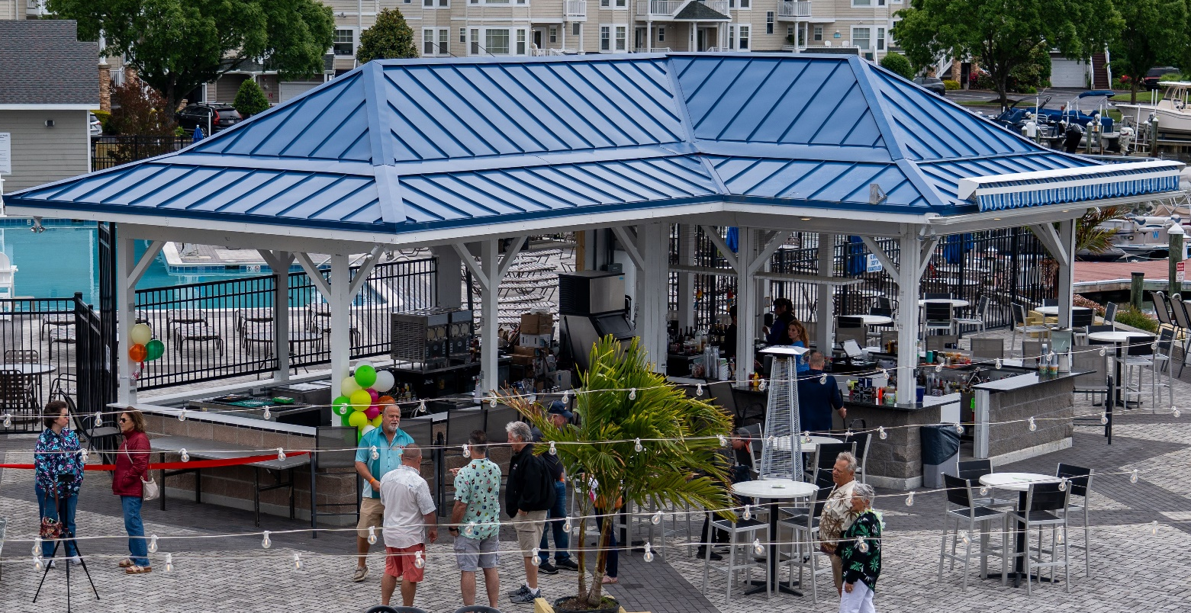
GM Leadership Report –
John Viola

Slide 2
Initiatives
  Police – Chief Tim Robinson
  Recreation & Parks – Debbie Donahue
  Skateboard Park
  Soft Shoreline
  Maintenance
  Landscaping
  Marina
  Irrigation
  Golf
  Memberships
  Racquet Sports
  Aquatics
  Phyllis East Room
  Signs
  I.T.
  Metrics

Slide 3
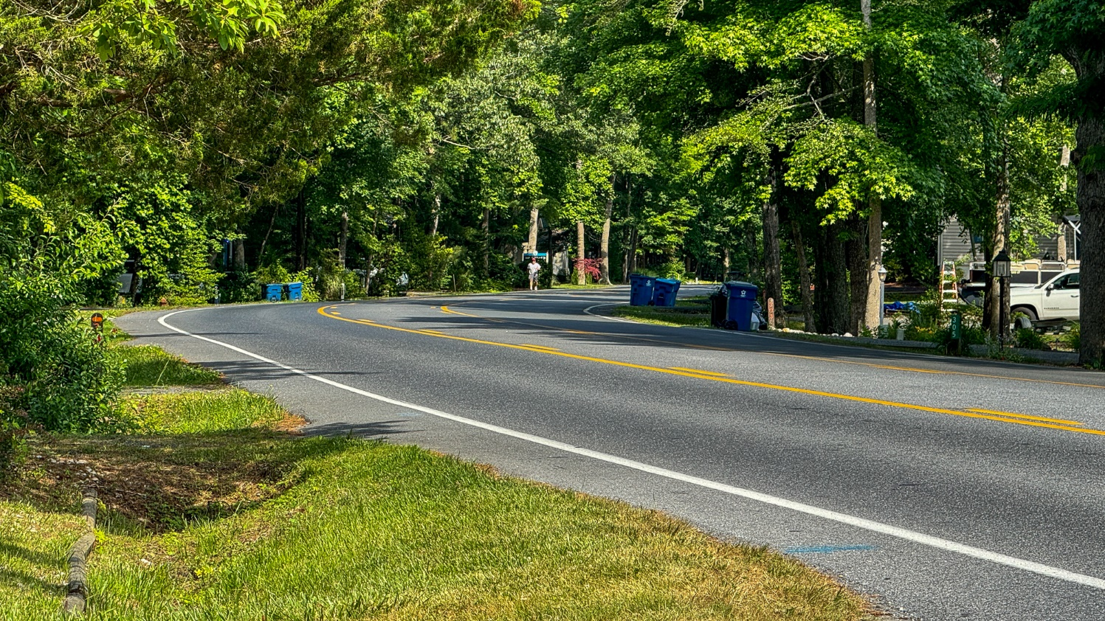
Chief Tim Robinson
  Road safety
  Residential house numbers
  July 4th

Slide 4


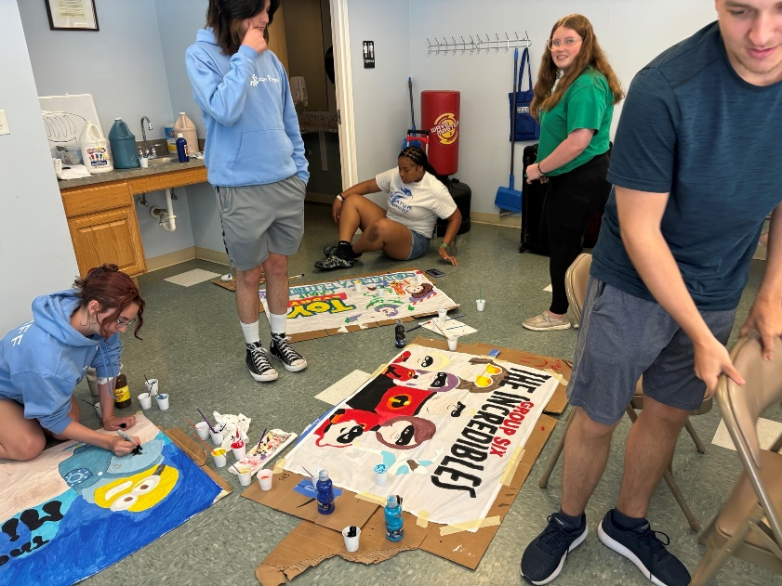


Recreation and Parks
Family Fun Nights
Concerts at the Park
Summer camp full and ready to start on June 17th – all counselor positions have been filled

Slide 5
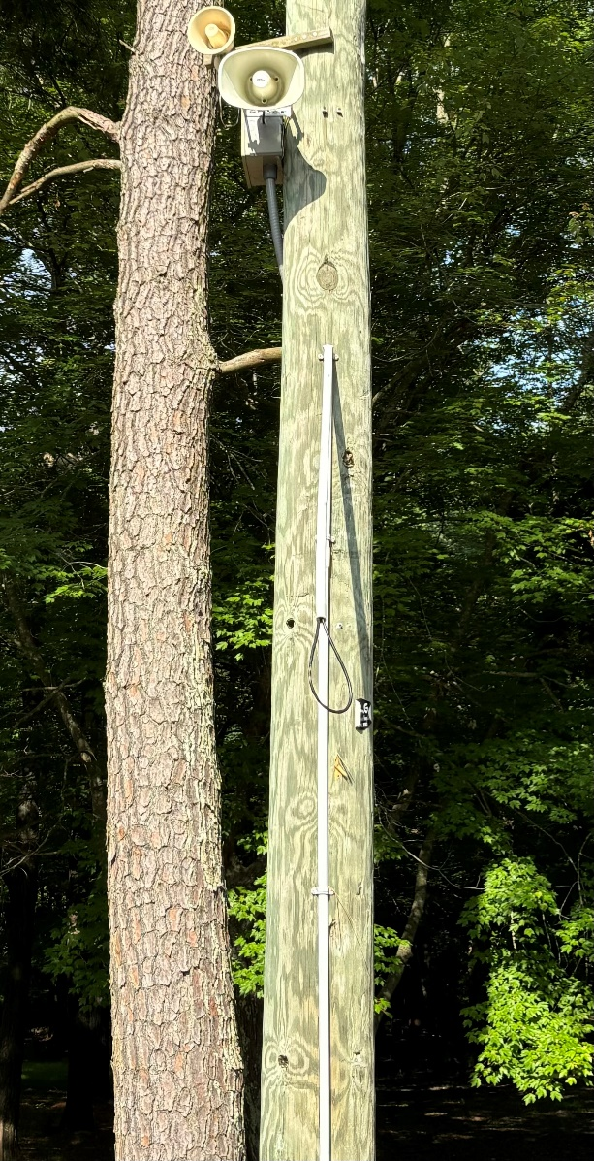
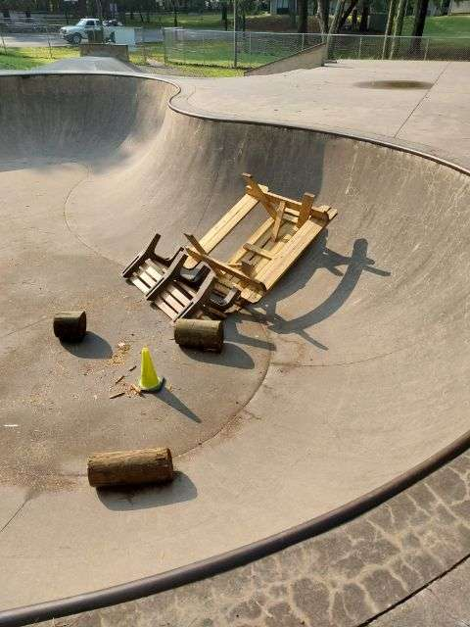
Skateboard Park
Brought up at May Board Meeting during public comments
Power washing
Crack repair
Looking into seating options
Camera installed at park

Slide 6
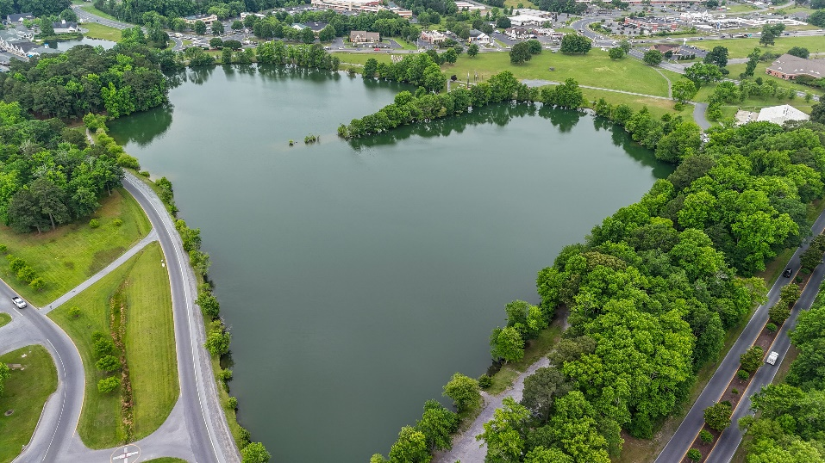
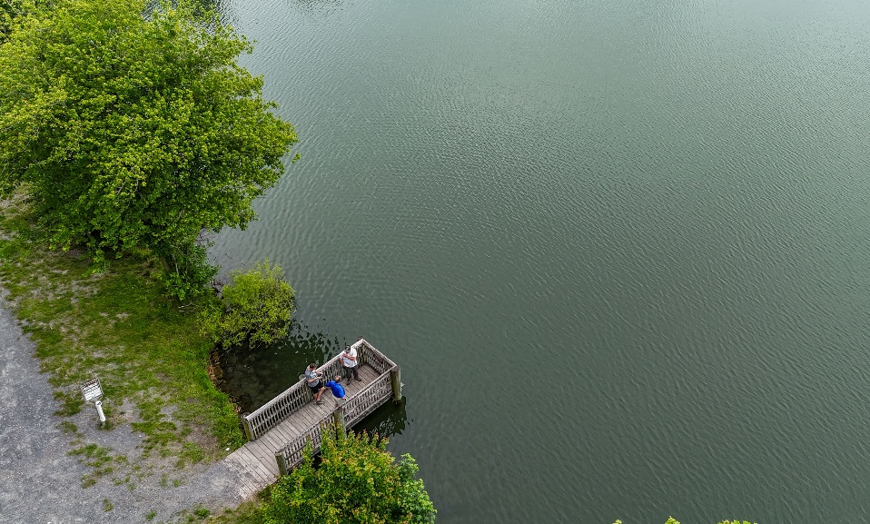
Soft Shoreline
Working with Maryland Coastal Bays
Received $150,000 grant (of which $50,000 allocated for site work)
5 priorities:
  Water quality
  Shoreline erosion
  Fishing access (enhance)
  Pond edge wetlands
  Parking lot (addressing issues)
Next steps:
  MOU reviewed by legal and signed - completed
  Vista to do another survey (25% design plan)
  Schedule a community meeting (possibly July)
  September deadline to pursue further funds (utilizing Vista plans)

Slide 7
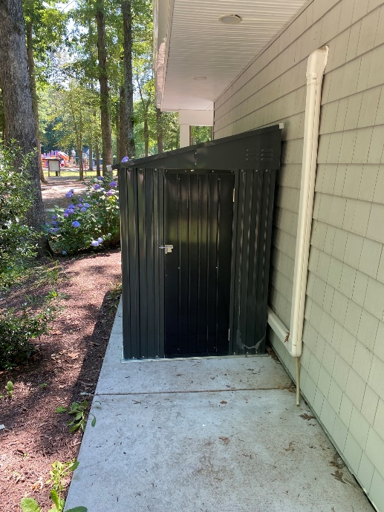
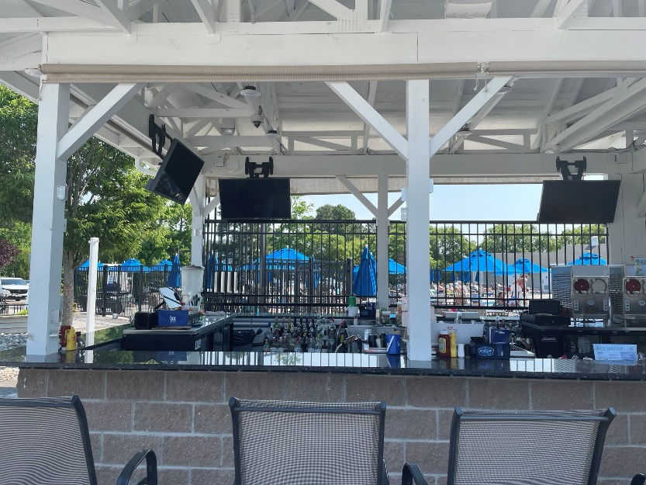
Maintenance
  Beach Club:
    Parking lot cleaned up and grounds maintenance
    Showers repaired
  Aquatics:
    Pools cleaned prior to Memorial Day weekend
    Daily inspections of any safety issues
  Recreation & Parks:
    Playground equipment at Bainbridge and Bridgewater parks to be power washed to remove oxidation
    Shed installed for Pine’eer Craft Club upon request
    Replacing parts and adding borders to ADA ramps
    Skateboard park maintenance
  Yacht Club:
    Work orders (cooler repair, tv installation at tiki bar)
  Clubhouse:
    Repairs to ice maker
    Closet leak repaired

Slide 8
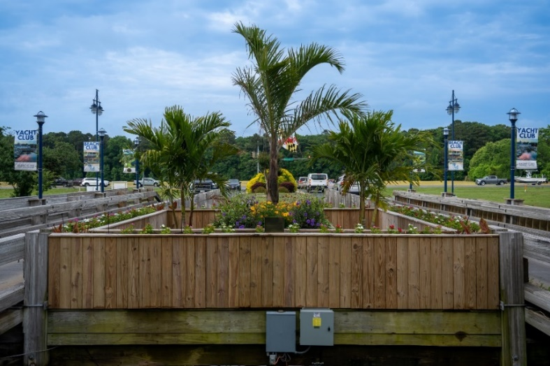
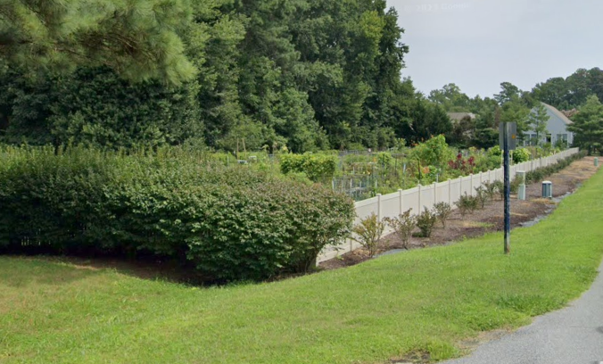
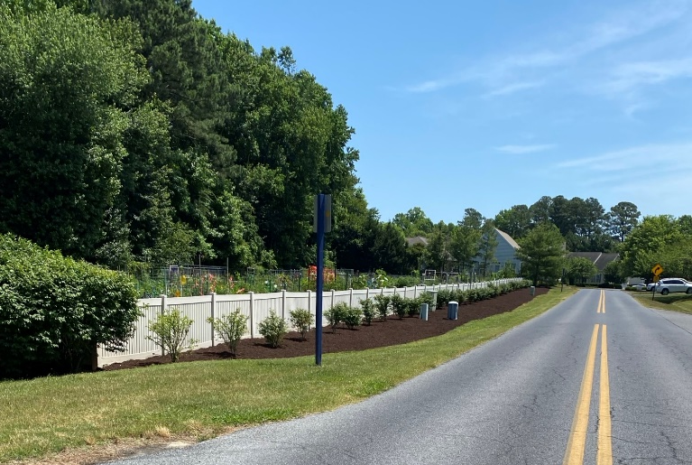
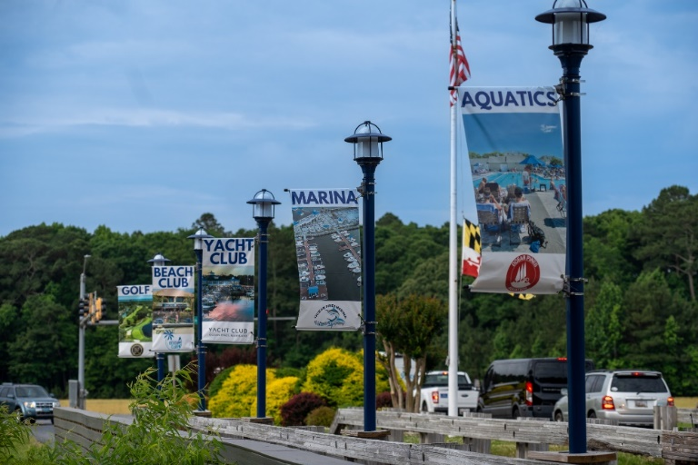
Landscaping
Before
  Public Works has placed spring/ summer flowers throughout Ocean Pines
  Landscaping crew has begun mulching
  Banners replaced at both north and south entrances
After

Slide 9
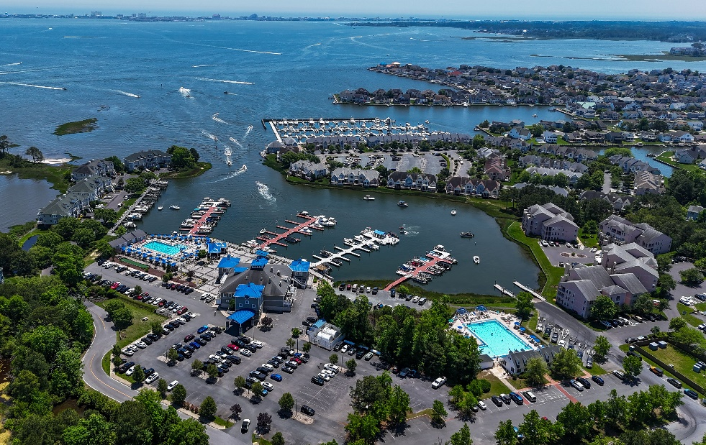
Marina
  The Marina has once again received the Clean Marina Award from the Department of Natural Resources
  Additional merchandise has been added:
    fishing tackle for flounder, rockfish, tog, and sea bass
    new selection of shirts
    Expansion of retail items (snacks, ice cream, and beverages)
  Currently have a waiting list of 90 boats requesting boat slips
  Fuel sales for month of May: $79,041
  Marina open 6:00 a.m. – 6:00 p.m.

Slide 10
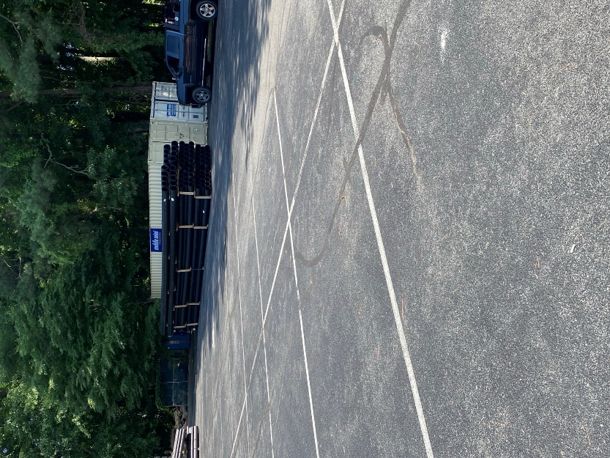
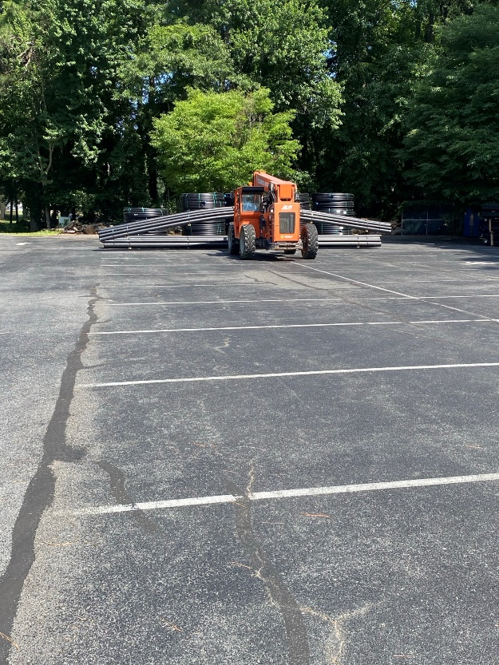
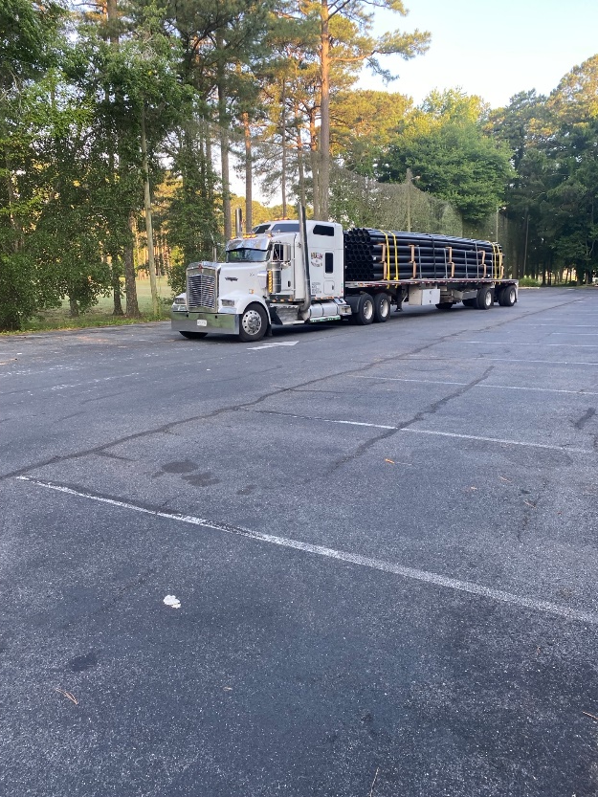
Irrigation
  Material for phase I of the irrigation project has arrived
  Project approved by the Board at the December 16, 2023 meeting
  Total cost of project: $934,000

Slide 11
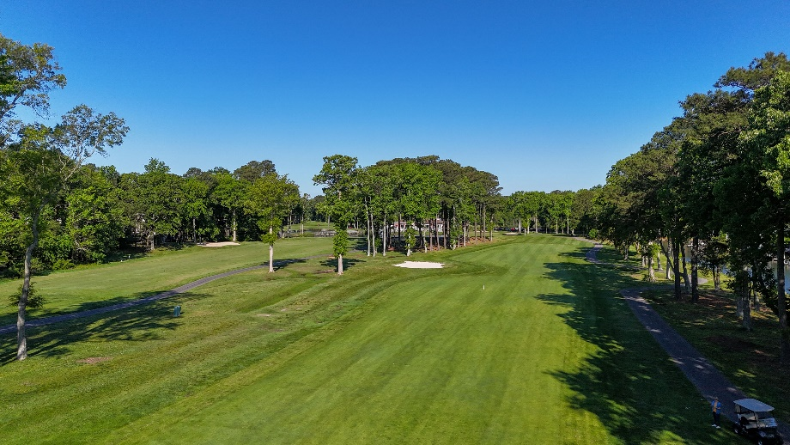
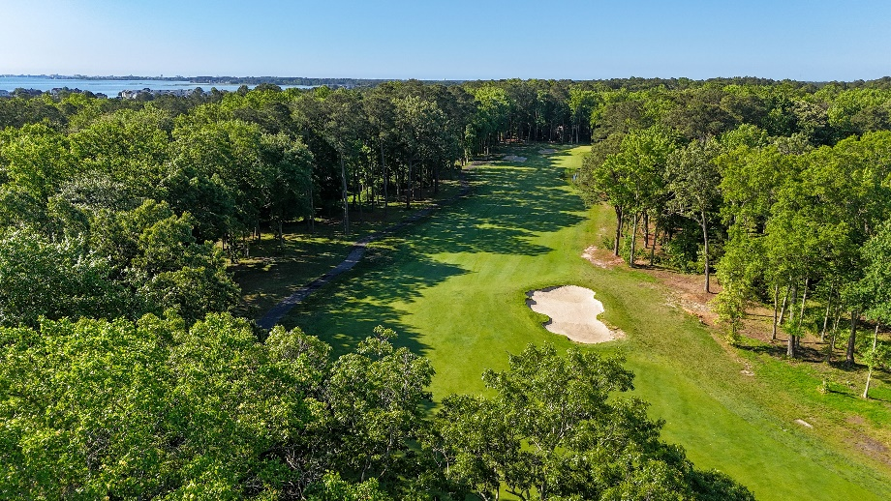
Golf
  Golf
  Raven’s Roost was a great success on May 31st, helping to finish the first month of the new budget year with sales ~$34,000 over last May
  Ocean Pines Club Championship scheduled for August 3rd and 4th
    Four flights (one for each set of tees) with both gross and net winners
  May numbers (not including memberships) up over 2023 (2024 = $271,000; 2023 = $236,000):
 | 2024 | 2023 | Variance
Greens Fees: | $162,000 | $139,000 | $23,000
Cart Fees: | $ 67,000 | $ 58,000 | $ 9,000
Driving Range: | $ 9,600 | $ 9,200 | $ 400
Merchandise: | $ 25,000 | $ 19,000 | $ 6,000
  Golf Maintenance
  Verticutting the fairways and greens as part of our thatch management program
  Continue to repair leaks in old irrigation system

Slide 12
Memberships
  Memberships up over last year
 | 2023 | 2024 | % Increase
Beach Parking | $ 343,430 | $ 364,036 | 6%
Aquatics | $ 270,780 | $ 303,754 | 12%
Golf | $ 172,350 | $ 234,309 | 36%
Cart | $ 70,100 | $ 90,850 | 30%
Tennis | $ 17,420 | $ 15,485 | -11%
Platform | $ 13,480 | $ 15,275 | 13%
Pickleball | $ 56,215 | $ 71,563 | 27%
Combo | $ 13,456 | $ 20,000 | 49%
Total | $ 957,231 | $ 1,115,272 | 17%

Slide 13
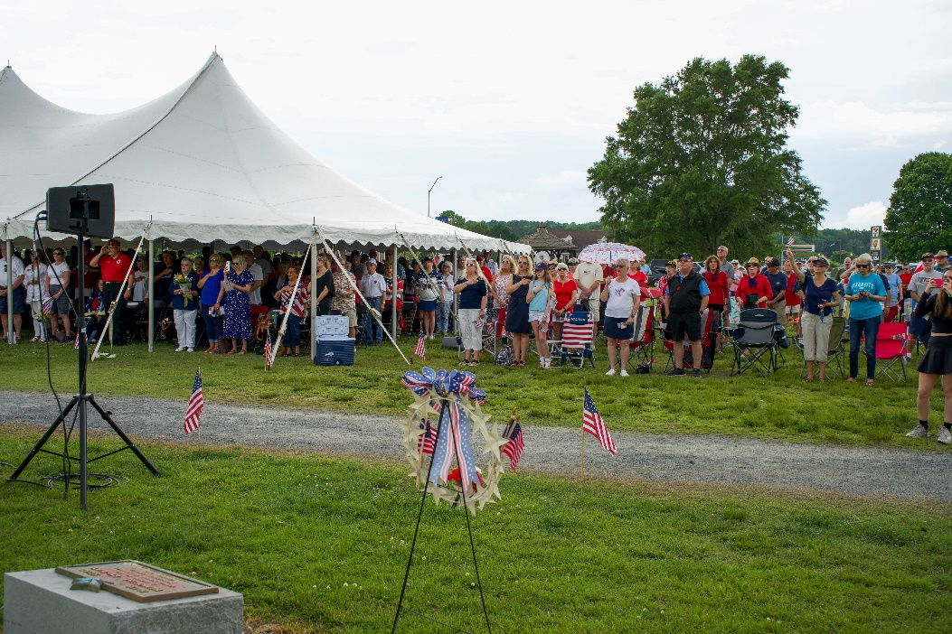
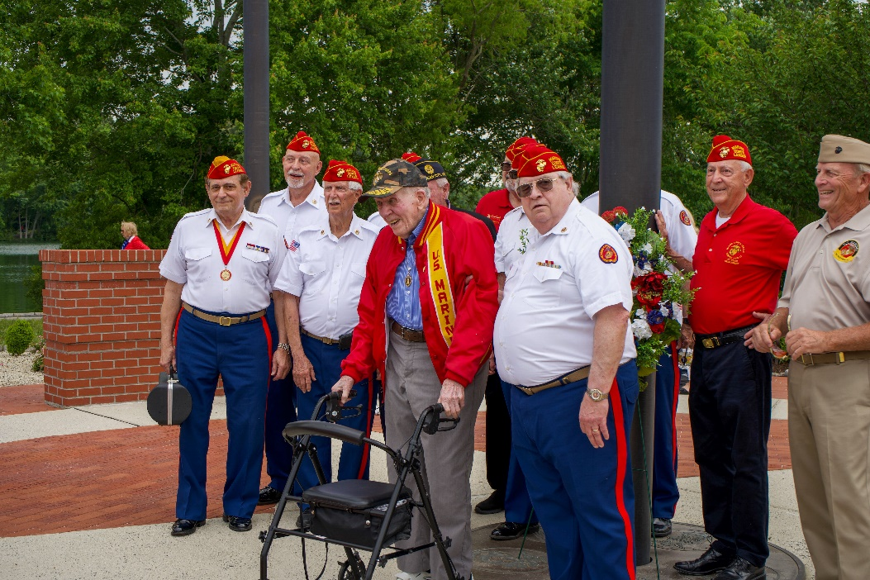
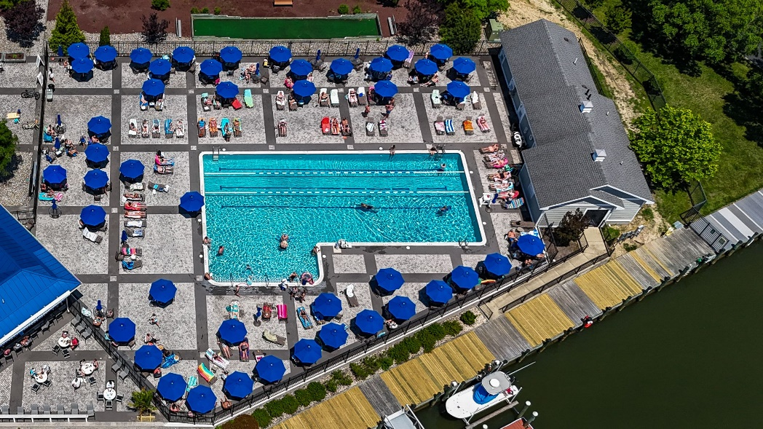
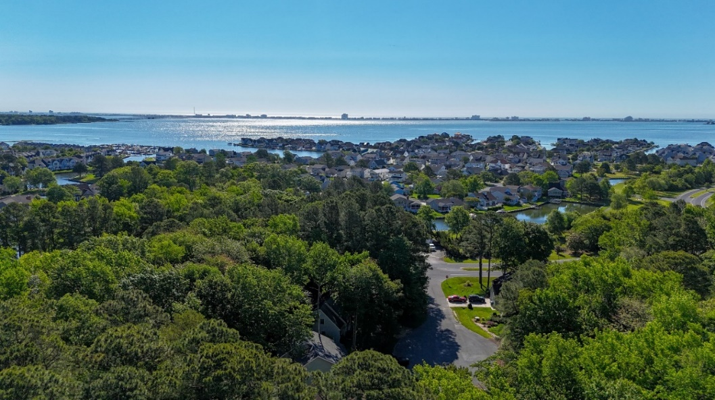
Director of Business Administration –
Linda Martin

Slide 14

Racquet Sports
Pickleball tournament held last weekend
Increase in play in pickleball and tennis; several days all courts were in use
Tree branches hanging over pickleball courts were cut by Public Works
Netting repaired on lower pickleball courts
Replacement chairs have arrived and are being placed around courts

Slide 15
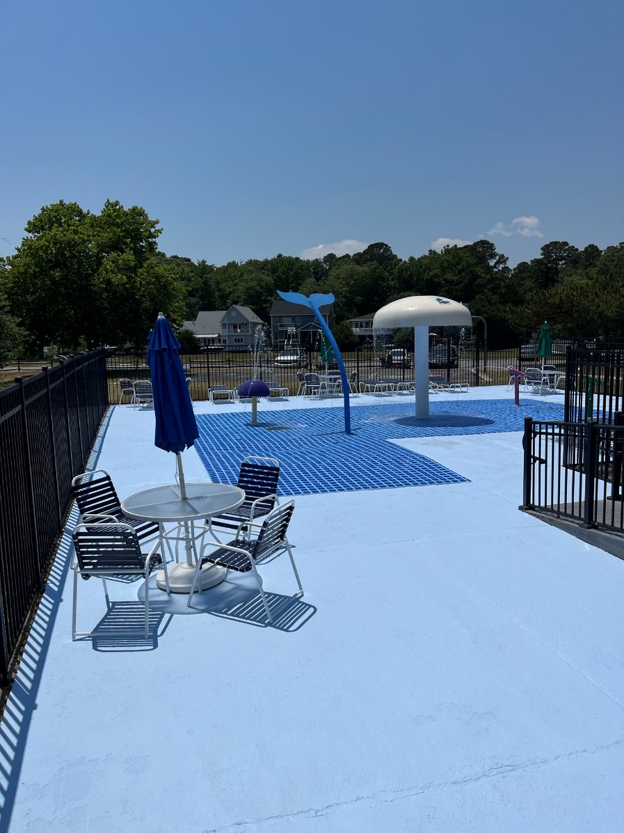
Aquatics
Good start to the season:
  Memorial day weekend up 51% over last year – total $11,808
Fully staffed lifeguards
New flooring at splash pad installed at Swim & Racquet on June 4th; concrete repairs done in-house by Public Works and the Aquatics team
Snack bar at Swim & Racquet snack bar scheduled to open this Monday for the season
School’s Out Splash Party this evening from 5:00-8:0 at Sports Core

Slide 16
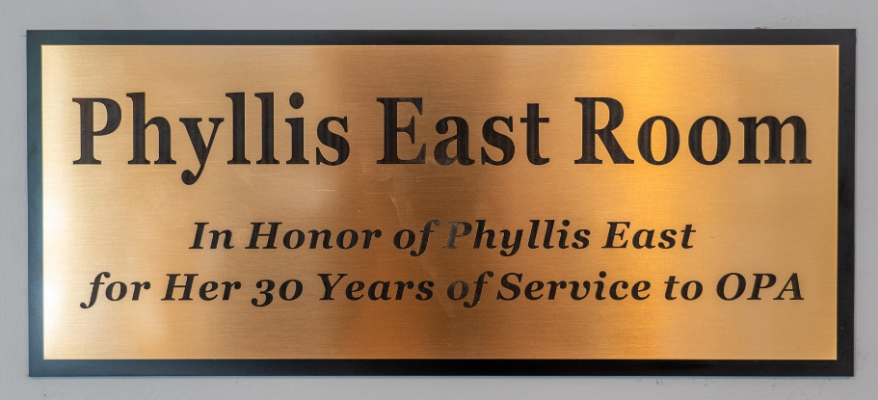
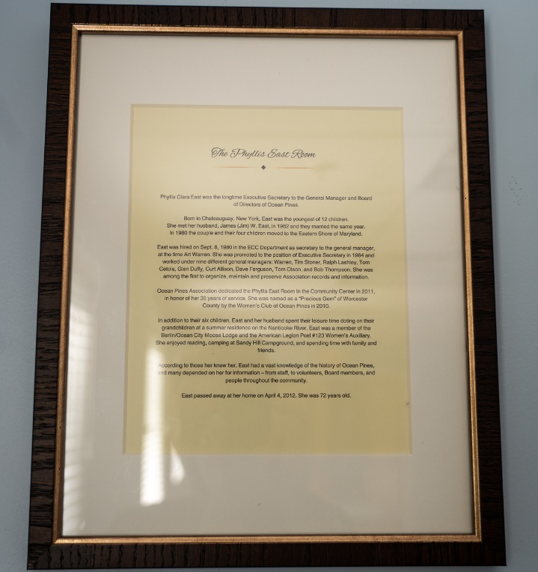
Phyllis East Room
  Requested at the April Board Meeting for a plaque and information document to be installed at the Community Center
  East Room is now officially the Phyllis East Room
  Plaque and bio on Phyllis installed

Slide 17

Signs
Signs ordered and will be placed soon at Manklin Meadows Complex and Community Gardens

Slide 18
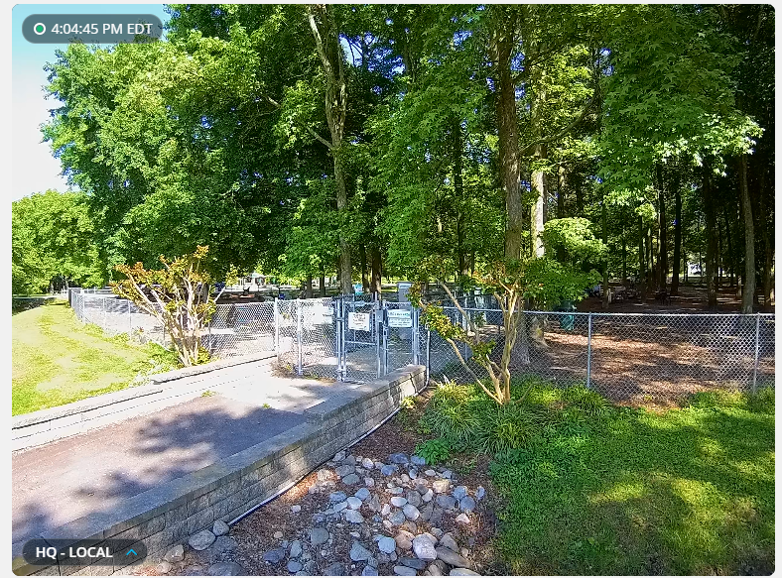
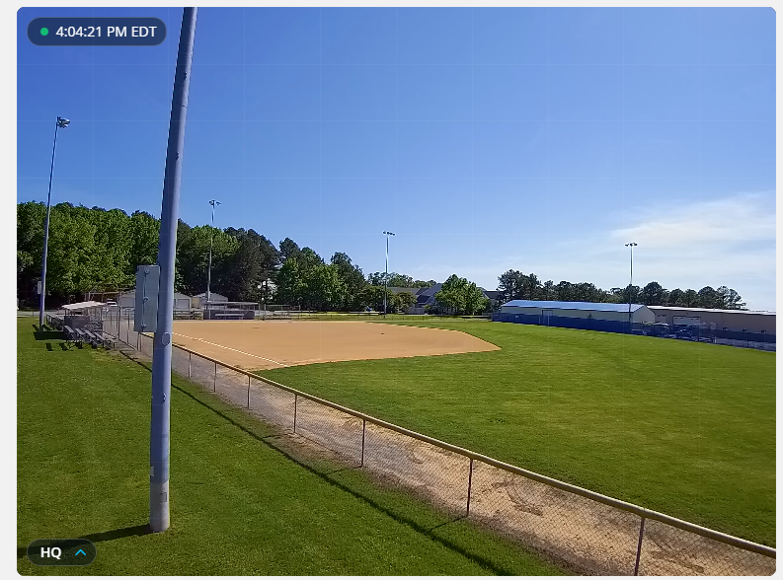
I.T.
Two new cameras installed at dog park and ballfield

Slide 19
CPI Violation Dashboard
May
Violations
As of 5/1/24 | New Violations | Closed Violations | As of 5/31/24
294 | 182 | 229 | 247
182 violations initiated in May: 39 maintenance/trash/debris; 6 leaf placement; 36 no permit; 9 signs; 92 miscellaneous
  Miscellaneous violations includes stop work orders, trailers, unregistered/junk vehicles, and vehicle parking
229 violations complied out; 247 remain open
  79 maintenance/trash/debris; 5 leaf placement; 52 no permit; 13 signs; 98 miscellaneous

Slide 20
Work Orders
May
Open Work Orders as of 5/1/24 | New Work Orders | Closed Work Orders | Open Work Orders as of 5/31/24
188 | 144 | 155 | 177
144 work orders initiated in May: 7 bulkhead; 33 drainage; 22 grounds/landscaping; 11 roads; 2 signs; 69 general maintenance
Majority still open in drainage (101):
  37 – over 30 days; 31 – over 60 days
    Average 1-4 work orders a day to complete depending upon severity

Slide 21
Customer Service Dashboard
(from info@oceanpines.org)
May
Type | # Received – May
Amenities | 45
CPI | 31
Drainage | 4
General | 59
Public Works | 16
TOTAL | 155

Slide 22
Financials

Slide 23
UNAUDITED “FLASH” ESTIMATE
FINANCIAL CHANGE
APRIL 2024 YTD

Slide 24
“FLASH” ESTIMATE
MAY 2024

Slide 25
UNAUDITED ESTIMATE RESERVES
MAY 2024 ($ MILLIONS)
 | General Replace | Bulkheads | Roads | Drainage | New Capital | Total
4/30/24 Balance | $5.5 | $0.3 | $0.8 | $0.4 | $0.1 | $7.1
Contributions/ Interest | 1.6 | 1.1 | - | - | - | 2.7
Casino Funds | - | - | 0.4 | 0.1 | - | 0.5
Transfer (Spend) | (0.3) | (0.1) | - | (0.1) | - | (0.5)
5/31/24 Balance | $6.8 | $1.3 | $1.2 | $0.4 | $0.1 | $9.8

Slide 26

Treasurer’s Report -
Monica Rakowski

Slide 27

Cash & Short-Term Investments
“Flash” Estimate Month of May
As of May 31, 2024, the Association had Approximately (~) $19.2M in Cash
  Cash Increased ~ $0.7M from the Same Time Period Last Year
  Cash Increased ~ $0.4M from April 2024
  $10.5M Invested in CDAR’s
  $80K in Interest Income Recognized for the Month
  Remaining $8.7M in Insured Cash Sweep, Treasury Bills, Money Market and Other Operating Accounts (Diversified Between 2 Local Banks)

