Slide 1
Board of Directors Meeting
June 16, 2021

Slide 2
Approval of Agenda

Slide 3
Approval of Minutes May 15, 2021 – Regular Meeting

Slide 4
President’s Remarks Larry Perrone

Slide 5
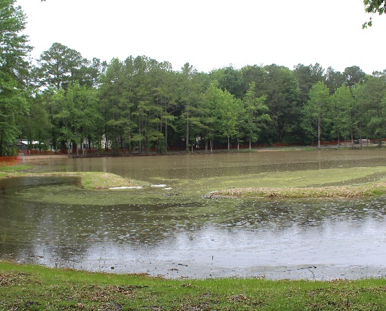
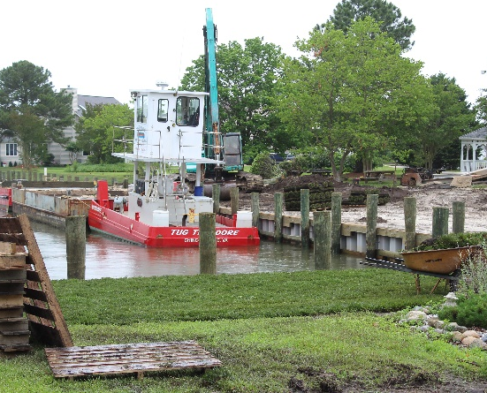
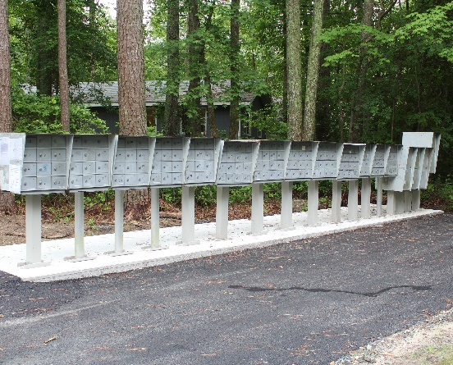
GM Leadership Report John Viola
Bainbridge Project
Bulkheads
High Sheriff Trail Mailboxes
WH Campus & CPI signage

Slide 6
General questions, complaints, or concerns should be sent to info@oceanpines.org, or contact 410-641-7717 during business hours, or 410-641-7747 after business hours and on weekends.
Level 1 - Marketing Coordinator Julie Malinowski and Public Works Office Manager Linda Martin will handle questions sent to that email address. General voicemails are handled by Ruth Ann Meyer. Issues will be addressed by these 3 staff members however, they will redirect them to the proper person or department, if needed.
Level 2 – Department Heads
Level 3 – General Manager

Slide 7
info@oceanpines.org
CALL
410.641.7717
After hours, call Ocean Pines Police at 410.641.7747

Slide 8
Information has and will continue to be distributed in the following ways-
Given a prominent spot on the homepage
Added to-
Newsletter
Eblast
Courier ad
Progress ad
Ch. 78 slide
Facebook posts
Forum posts
Will be a voicemail option

Slide 9
Your assessment
dollars at work

Slide 10
GM Report
Finance
Aquatics – Status of Pools
Public Works
Bulkheads
Bainbridge Project
Northstar
PPP
Racquet
Roads
High Sheriff Trail Mailbox Maintenance
Marina
Golf
Recreation & Parks
DMA Study

Slide 11
Aquatics
All pools have passed opening inspections and have been issued license to operate this summer.
We are operating without capacity limits or covid restrictions.
“We have turned the Corner”, fully staffed, No Closures
31 Lifeguards hired for 33 positions. Swim instructors have been hired and we are jumpstarting the program
Memorial weekend- Saturday and Sunday were a wash out for the outdoor pools. Sports Core hosted approximately 350 guest a day on both Saturday and Sunday.
Although initially very cold, all outdoor pools are warming up.

Slide 12
Public Works
Bulkheads
Finishing up the 2020-2021 bulkhead replacement program .
Finished the installation of the bulkheads and have back filled all areas .
They are in the process of finishing the last 7 lots with topsoil and sod.
They are doing final grading and sod in the park area.
All areas except for a small section should be completed by end of next week weather permitting.
2020-2021 Bulkhead Replacements: Budget: $1,405,000.00
Total spent to date to contractor. $1,136,265.62
Topsoil and sod installation to date $8461.00
Amount still due upon completion $73,804.00 +/ -
Total $1,218,530.62
We have one emergency bulkhead to be replaced in Goldeneye due to failure of tie rods.
The contractor should be starting this project in 2 weeks.
They should be able to complete in 2-3 weeks weather permitting.
Estimated Budget: $40,600.00
This is for 100 ln. ft. @ $ 355. ft. $35,500
Extra services sod placement, extras $ 5,100

Slide 13
Bainbridge Project update
Bainbridge
 | Budget
 |  | Grant | Grant | $482,337
 |  | OPA (budget) | OPA (budget) | 235,000
 |  | Project Budget | Project | $717,337
 |  | Contract EQR | Contract EQR |  | $534,650
 |  | Change Orders + Credit (net) | Change Orders + Credit (net) |  | 28,984
 |  |  |  |  | $561,998
 | First reimbursement from County of $52,046 received
 | Second payment of $128,674 currently being processed
 | How much we spent last year
 |  |  | Vista | $122,176
 |  |  | County (for review permits) | $ 32,474

Slide 14
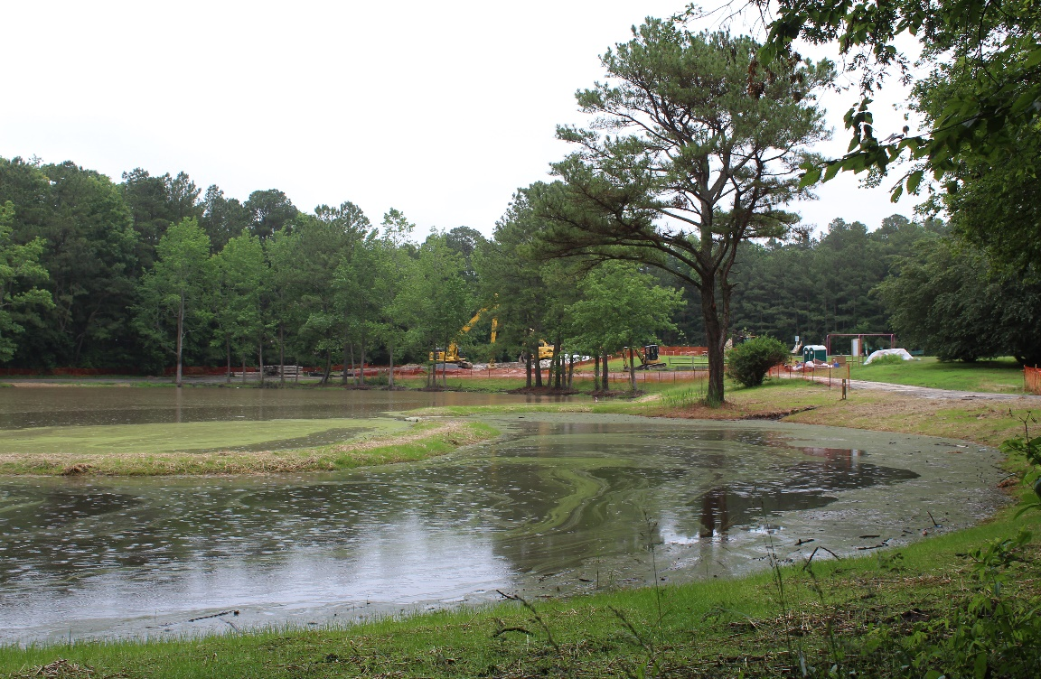
Bainbridge Project
Forebay - Inlet of the pond where filtration takes place before entering main pond, completed May 12th. Separated by dirt berm, grasses and plants
Main Pond – benches for planting are completed, located under the water. Next step is to purchase and install plants

Slide 15
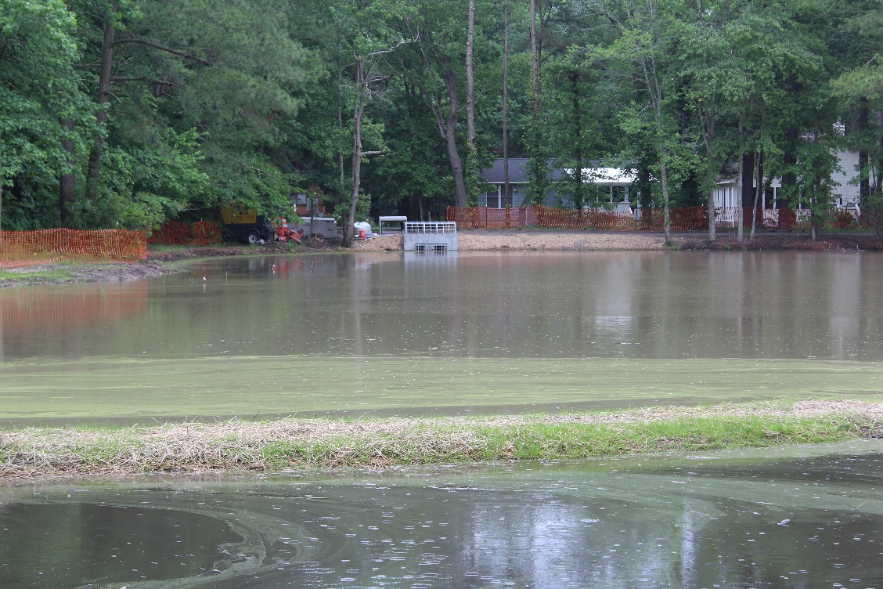
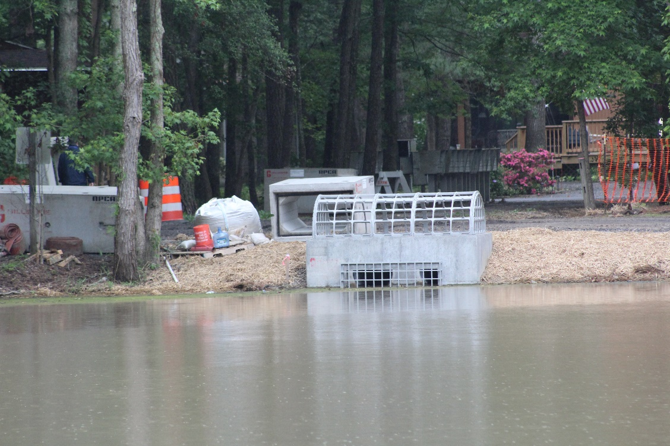
Bainbridge Project
Forebay - Inlet of the pond where filtration takes place before entering main pond. Separated by dirt berm (a closer look at the berm)
Pond outfall structure

Slide 16
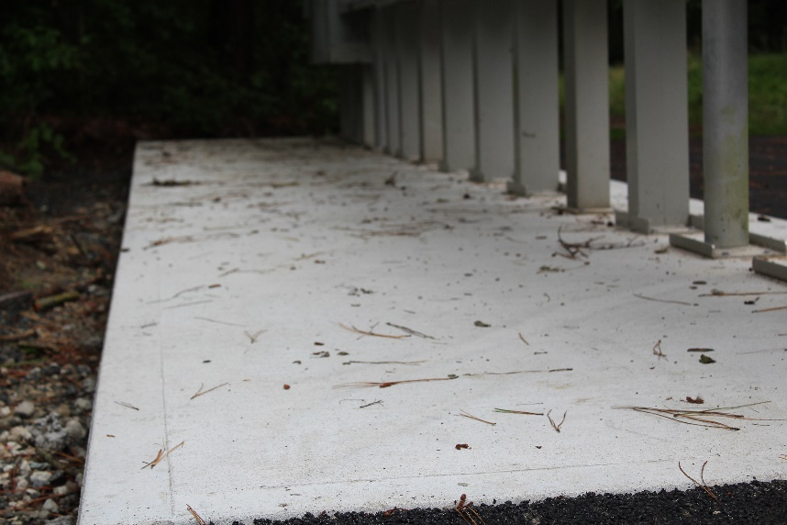
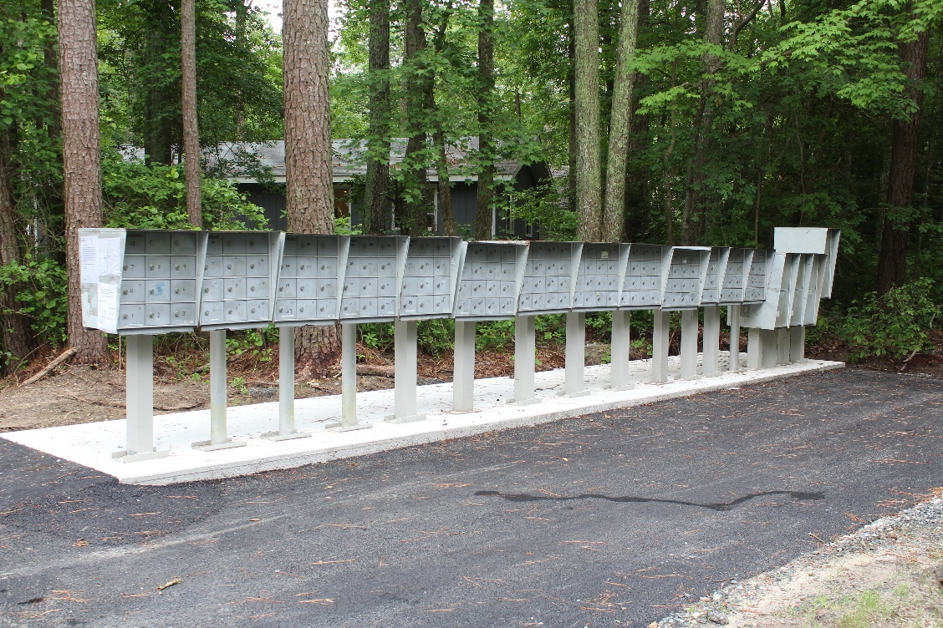
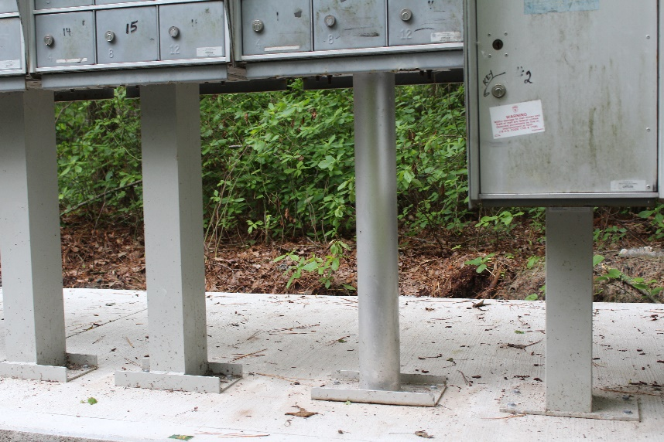
High sheriff trail mailbox maintenance
Concrete Pad - $2,800
One Cluster - $1,600
Paving - $2,500
Pedestal (Fabricated) - $156

Slide 17
Roads
Reserve balance at the end of April (20/21 budget) $220,000
Contract awarded to Chesapeake Paving in April for $208,579 / balance $11,421 (21/22 budget)
1 ½” overlay of the following roads (2.24 miles = approx. $93,115 per mile) will begin mid-June -
Admiral Avenue
Carriage Lane
Drawbridge Road
Harbormist Circle
Raft Road
Tail of the Fox Dr.
This price is $93/ton compared to $100/ton in 2019
DMA Study – Budget - $16,000
The final draft report was due the end of May but has been postponed – new target date is by the end of June.
Most likely the Budget & Finance presentation will be the beginning of July and the Board presentation to be done on July 21st
The drafts of the bulkheads and roads are completed

Slide 18
Finance
Northstar
Currently 23 Open Issues
Northstar Upgrade to v 6.4 (6/7/21)
We experience issues created by the update. Areas already addressed now need to be addressed again.
IT manager is working on a list of issues with Northstar.
PPP
Forgiveness application and back-up support provided to Bank of Ocean City in mid-March
Bank of Ocean City provided application and support to SBA on 3/16/2021
PPP – Bank of Ocean City contacted GM John Viola. Official letter of forgiveness sent by SBA received by Ocean Pines.

Slide 19
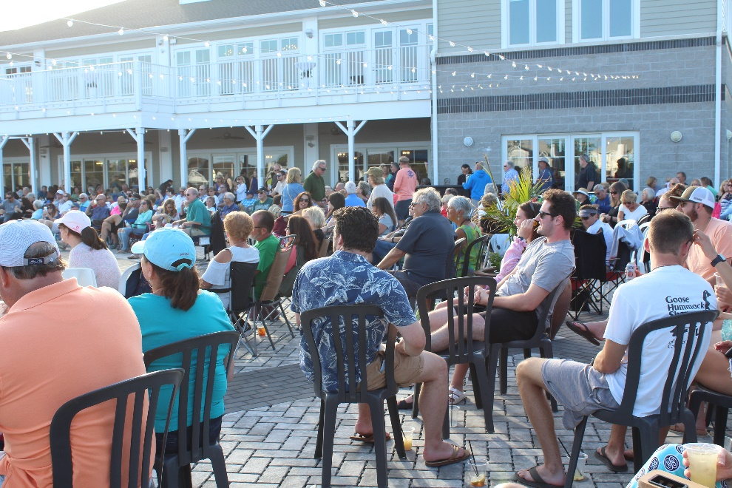
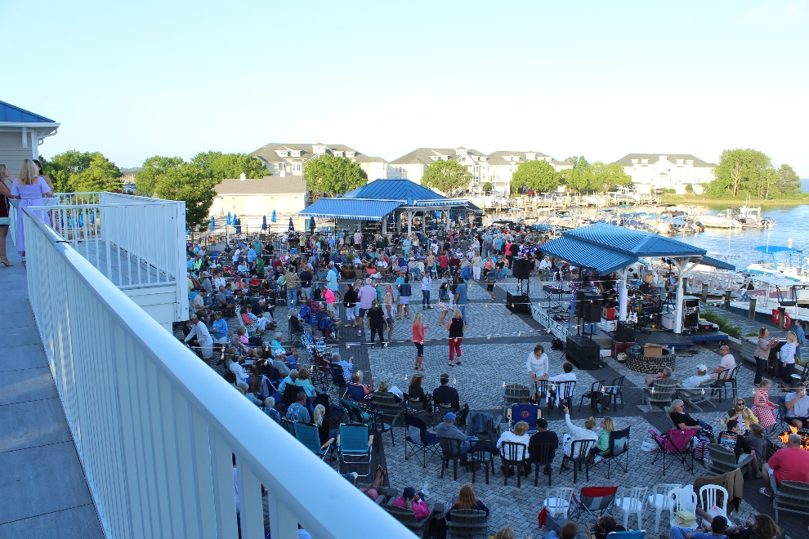
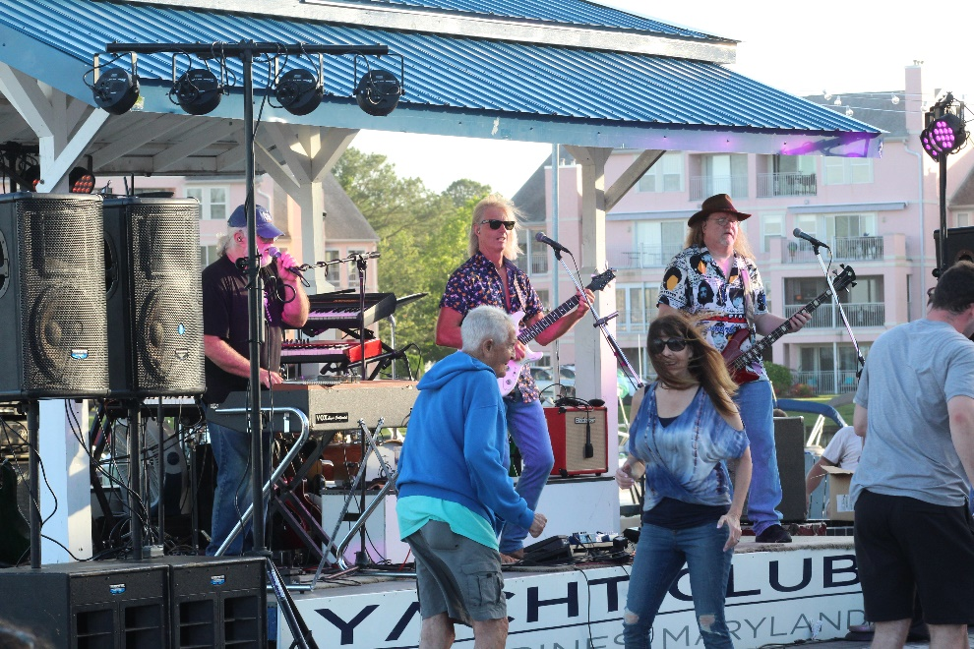
Yacht Club
Tranzfusion played at the Yacht Club on Saturday, June 13
The Matt Ortt Companies reported the highest grossing volumes of sales ever on that day.
Over $56,000 in sales on Saturday alone, including pool service, indoor restaurant operations, banquet room and outdoor band entertainment

Slide 20
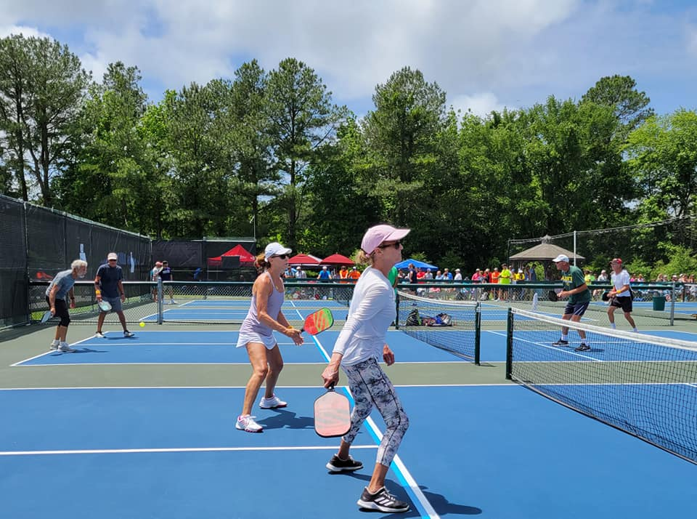
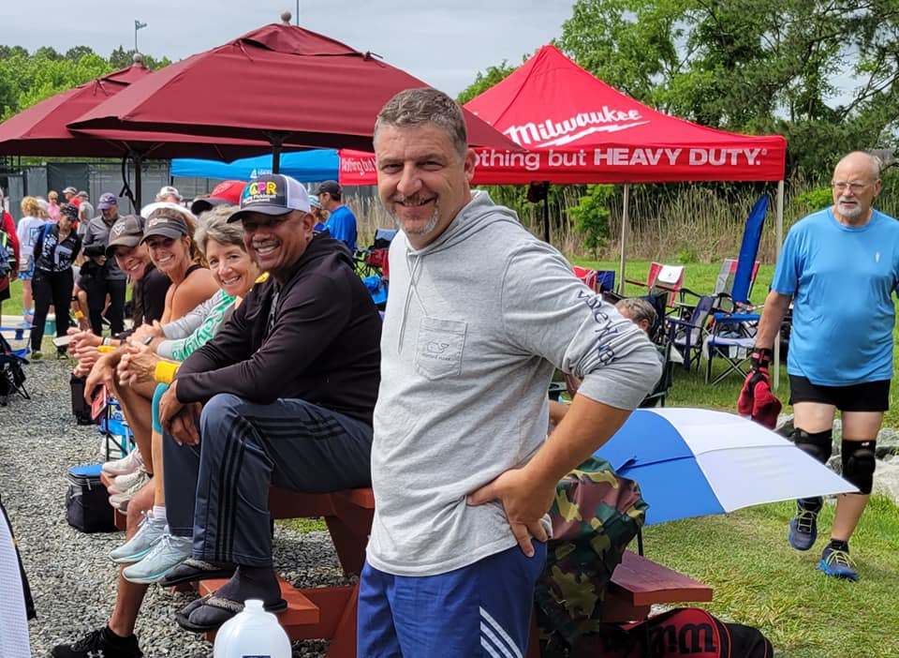
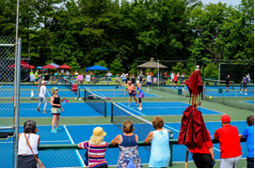
Racquet Sports
Ocean Pines Pickleball 2021 Summer Classic - June 12 & 13 - Ocean Pines Racquet Center
Approximately 240 players and an additional 150 spectators
Revenue to OPA:
Court rental $500.00 – as agreed by previous management
Concession $276.00
Expenses –
Concession $189.82
Banners $233.45 to be billed to pickleball
Revenue to pickleball club:
240 players @ $ 45.00 = 10,800
8 sponsors @ $500.00 = 4,000
A portion of the proceeds go to the pickleball club
A portion of the proceeds are donated to the American Cancer Society

Slide 21
Marina
Couple rain days during the Memorial Day weekend but still did well overall
Fuel pricing is still below the local Marina’s
Rec and Parks
Summer camp starts the 21 – Full staff of counselors – and camp is full
We were able to fit almost every request
Family Fun Night starts Wednesday June 23
Concerts start Thursday June 24 – First group is The Uptown Band
Preparing for July 4th Events
5K run
July 4th Celebration, carnival
Fireworks
Fireworks will be over the pond same as in 2019
Start time 9:15 pm
Parking at the library, Lot next to Taylor Bank, Racquet complex, side lot to Vets Memorial(off of Manklin Road)
Cathell road will be blocked off once fireworks truck arrives (time TBD)

Slide 22
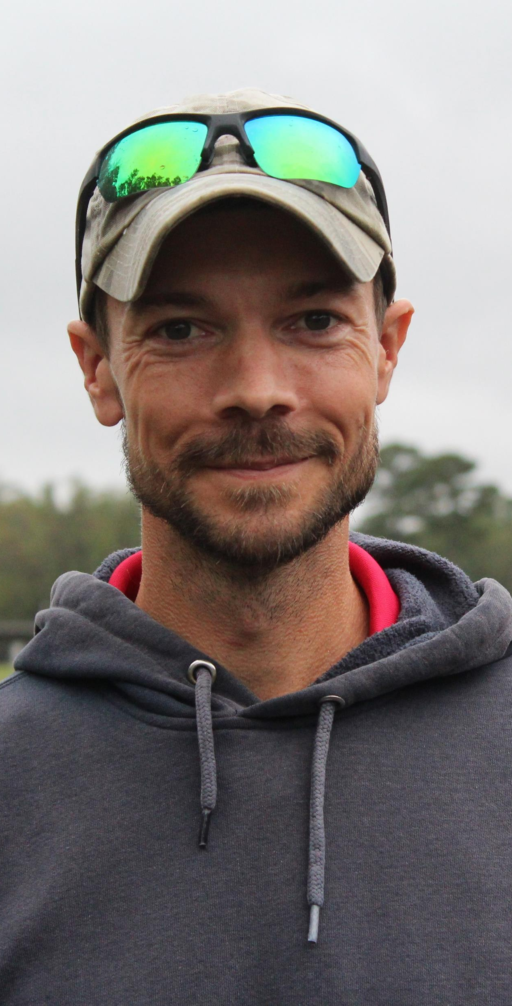
Superintendent Justin Hartshorne
19 Years of Golf Maintenance Experience
Graduated From Penn State University with a Bachelor’s Degree in Turf Grass Science.
Maryland Certifications include a Pesticide Applicator’s License and a Fertilizer Applicator’s License
Completed Links “Level Two” Irrigation Software Training.
Member of the Eastern Shore Association of golf course superintendents
Completed lynx level 2 central control software training
As Superintendent, Helps Oversee the Entire Golf Operation Including Managing Staff and Budget, Supervising Chemical and Fertilizer Applications, and Maintaining the Irrigation System
Tournament Experience: - 2010 Memorial Tournament hosted by Muirfield Village Golf Club -2014 U.S. Senior Open Sectional Qualifying Round -2015 79th PSWGA Women’s Amateur Championship, 46th PSWGA Senior Women’s Amateur Championship, 20th PSWGA Super Senior Women’s Amateur Championship

Slide 23
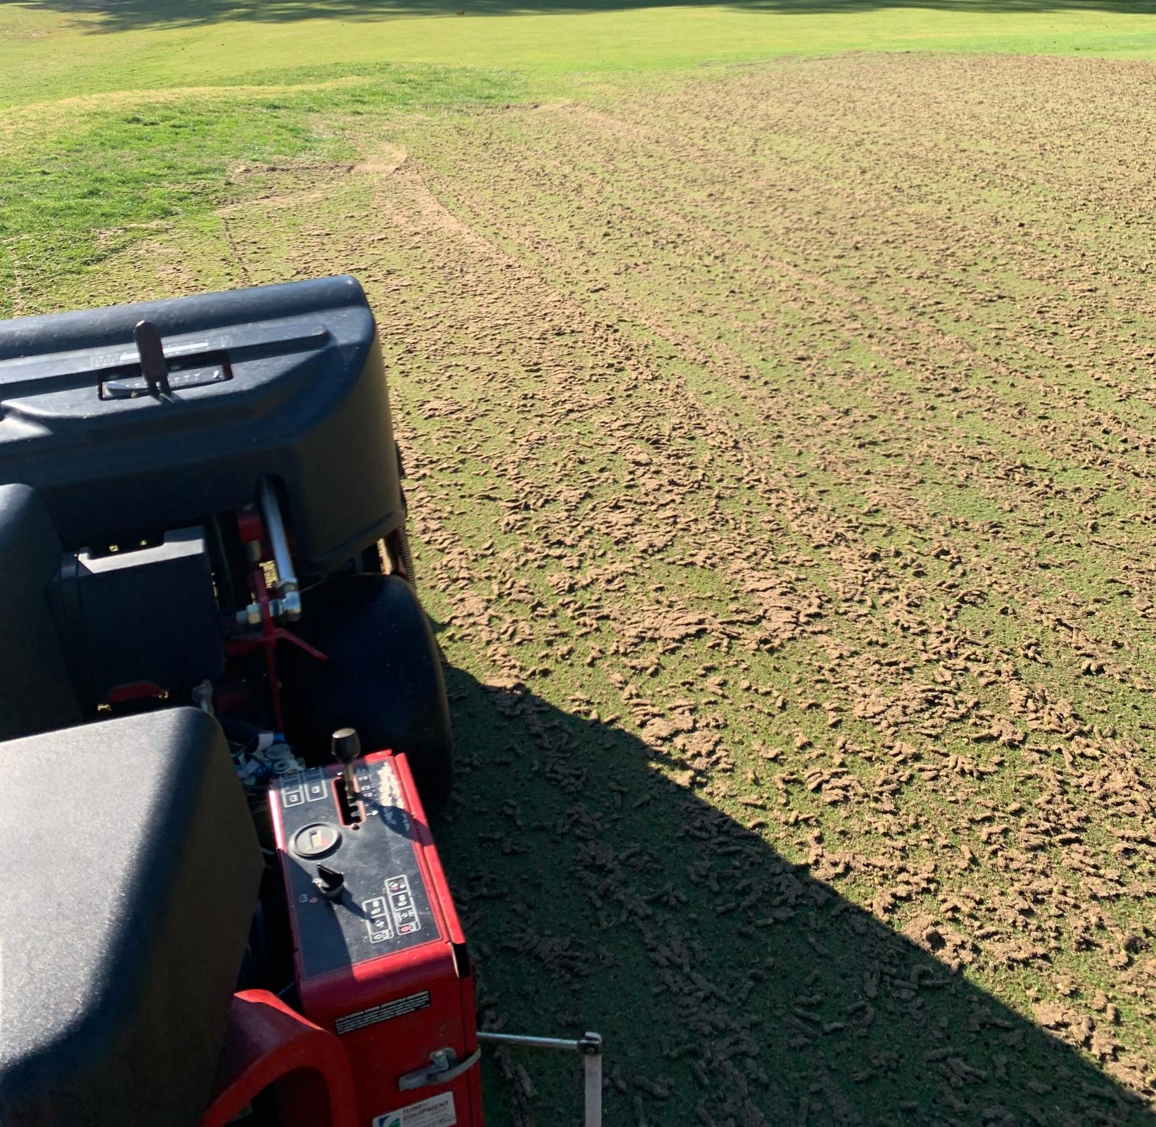
Aerification

Slide 24
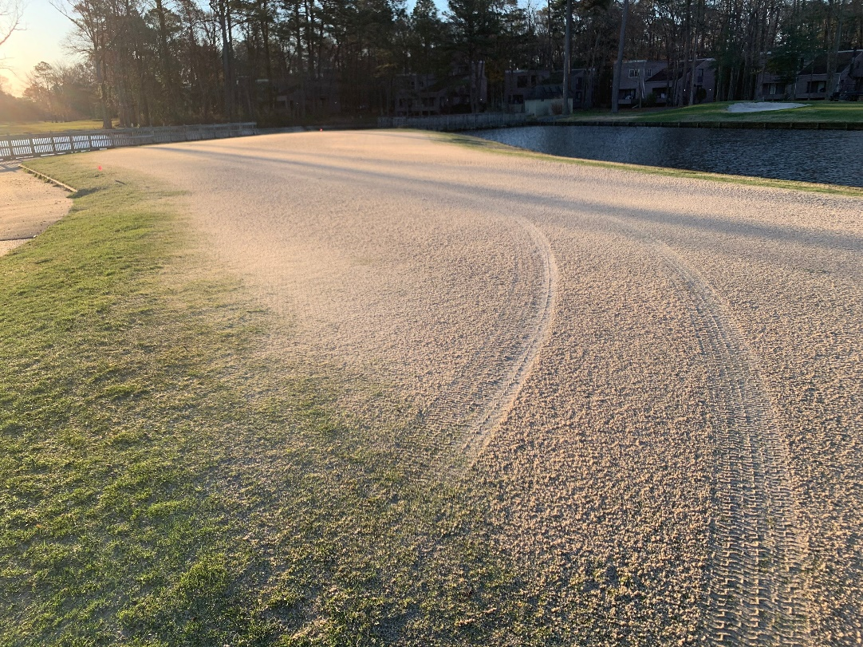
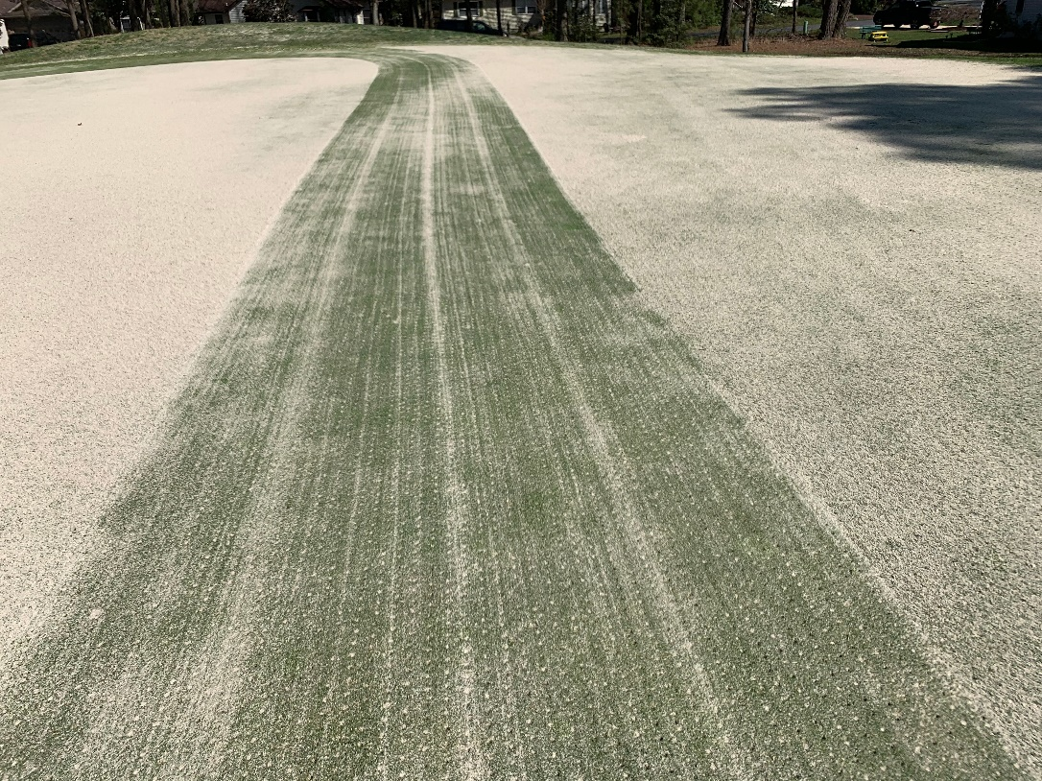
Aerification
Coring tines used to remove soil
Apply sand to fill holes
Drag sand into holes with a broom
Want to fill the holes to the surface to promote quicker recovery

Slide 25
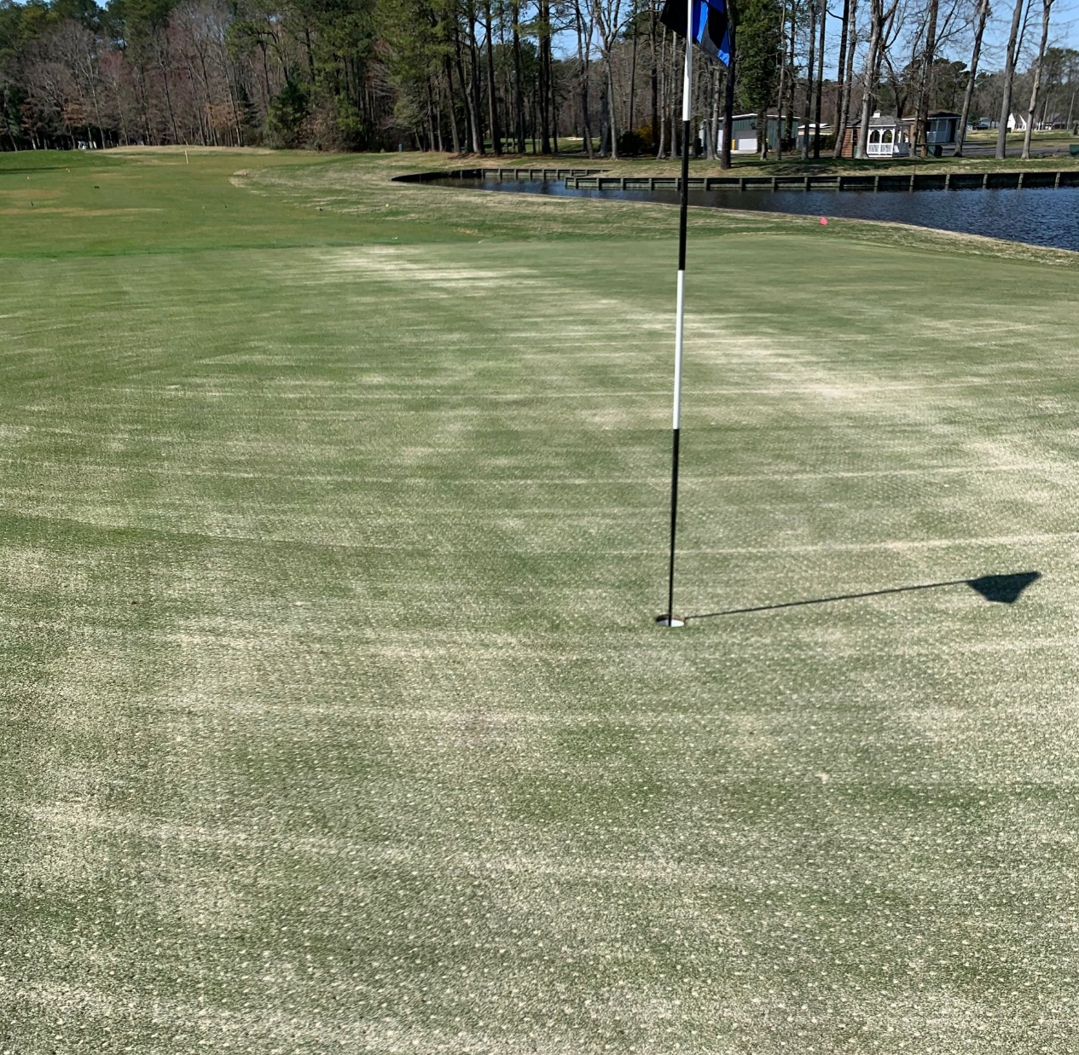
Aerification
Relieves compaction
Removes organic matter
Increased water and air movement
Only impacts less than 10% of the surface area

Slide 26
Topdressing

Slide 27
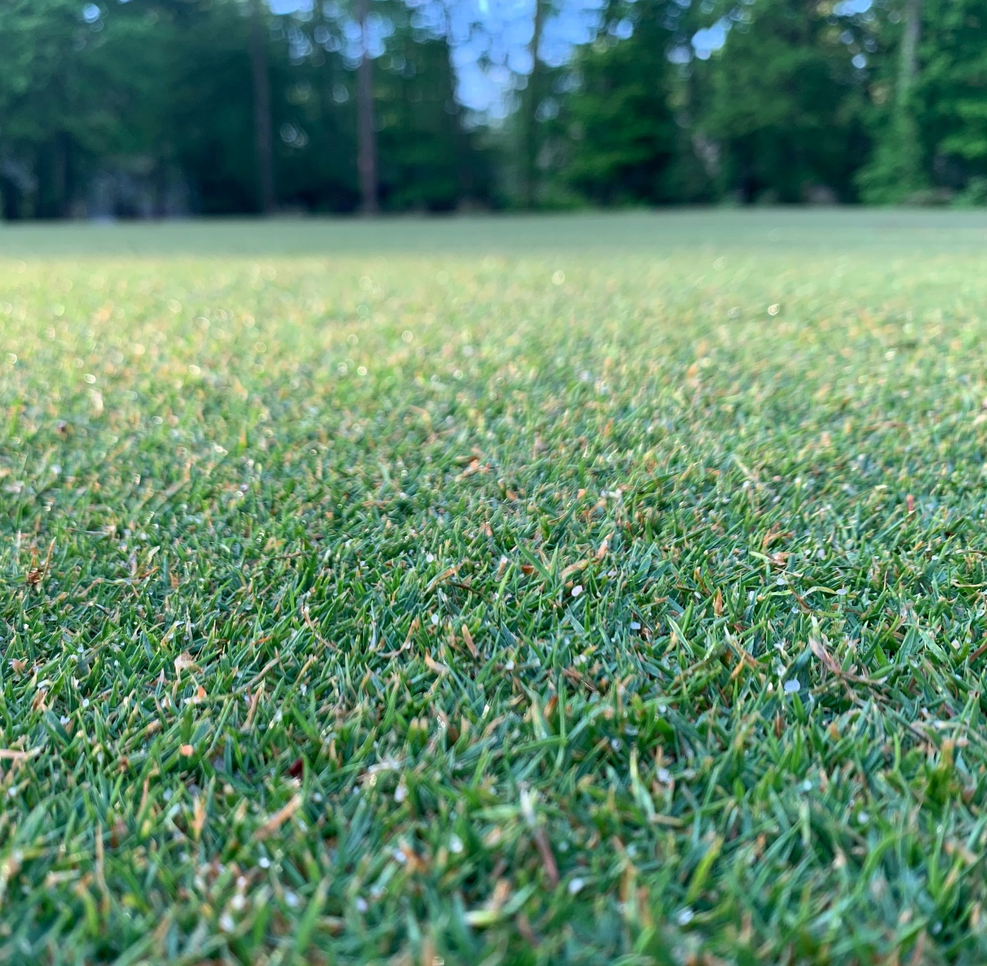
Topdressing
Process of applying light sand to surfaces
Dilutes organic matter
Improves smoothness and firmness of the putting surface
Improves plant growth and texture

Slide 28
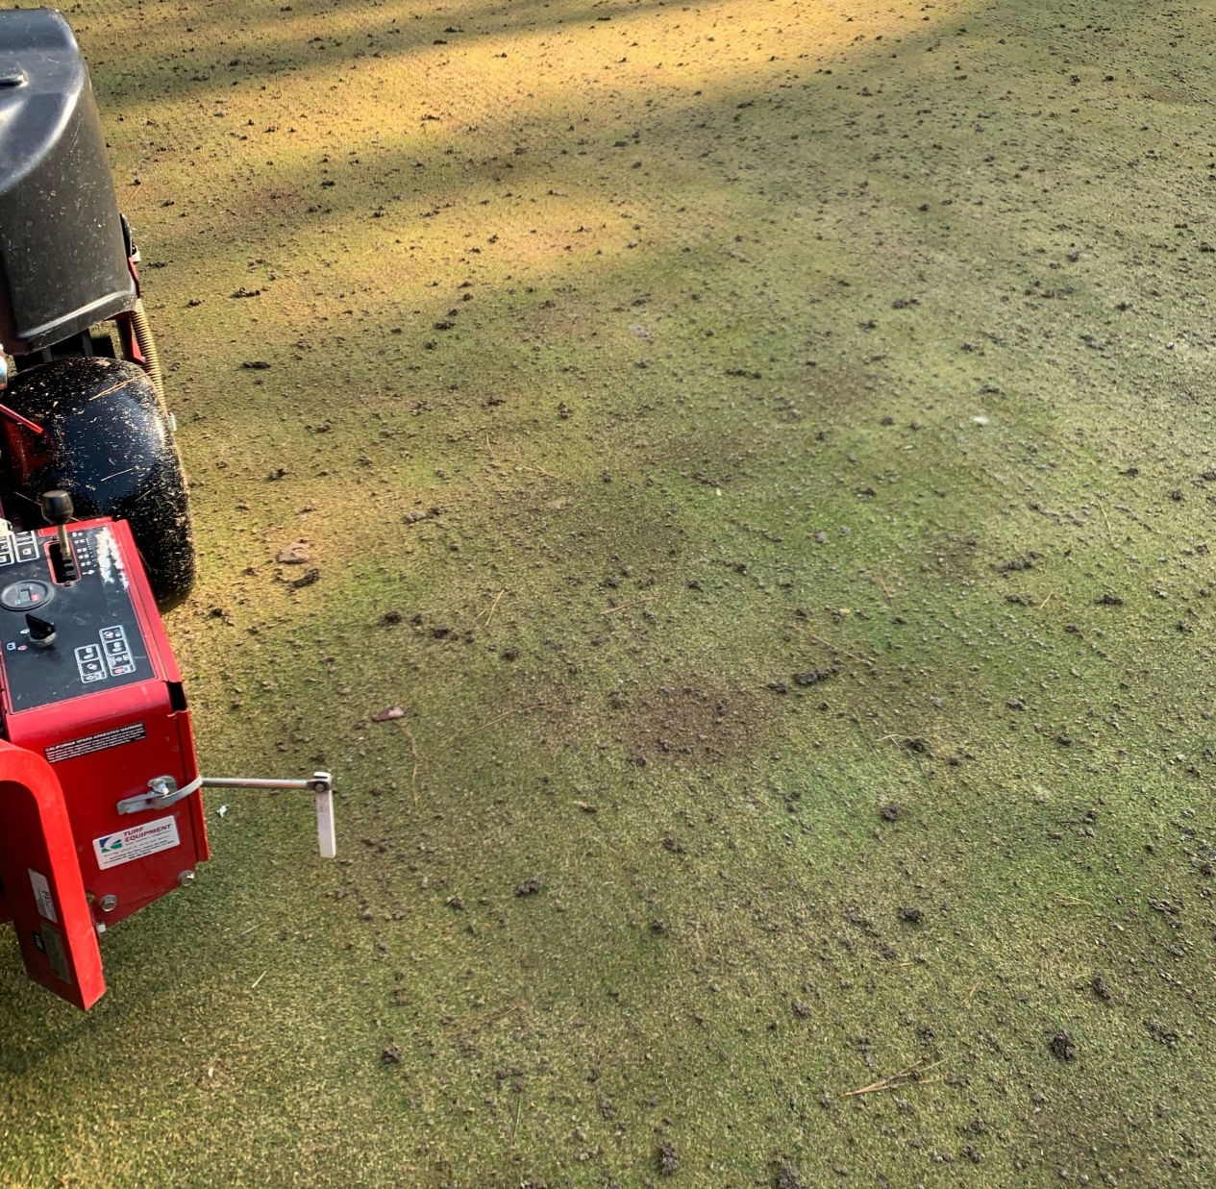
Ninja Tines
Shallow aerification with small tines
Remove material 1-2 inches deep
Topdress with sand behind

Slide 29
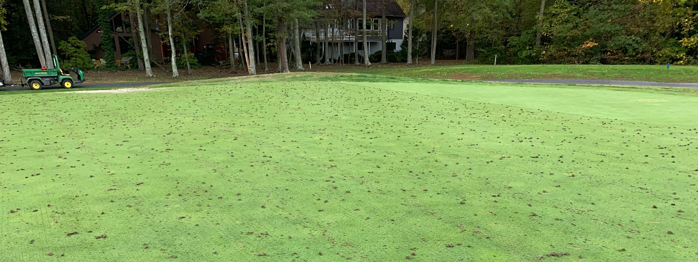
Ninja Tines
Reduces organic matter
Increased air and water movement
Sand added for smoothness and firmness

Slide 30
Verticutting

Slide 31
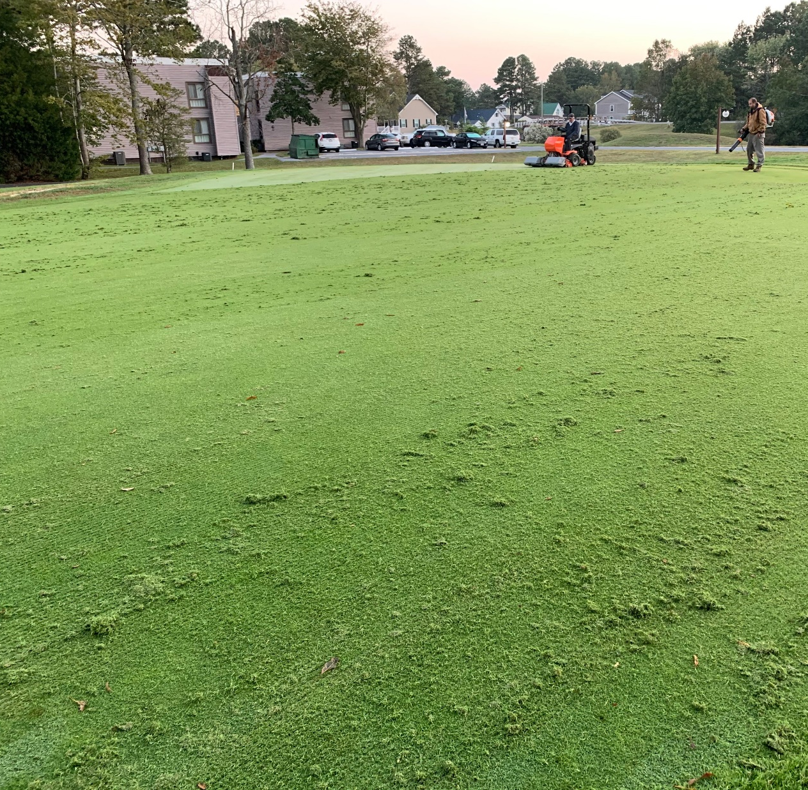
Verticutting
Cuts channels across the surface
Blow off debris
Apply sand topdressing

Slide 32
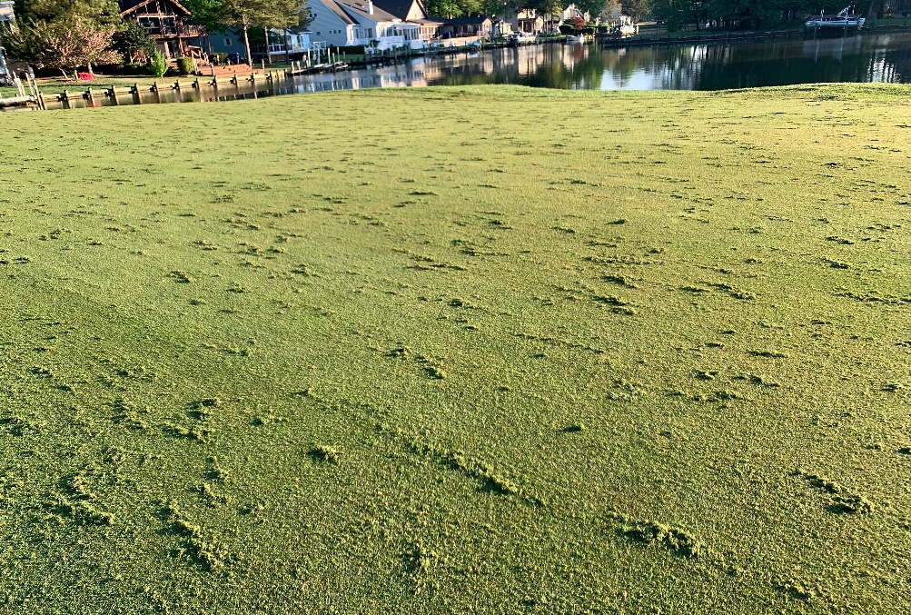
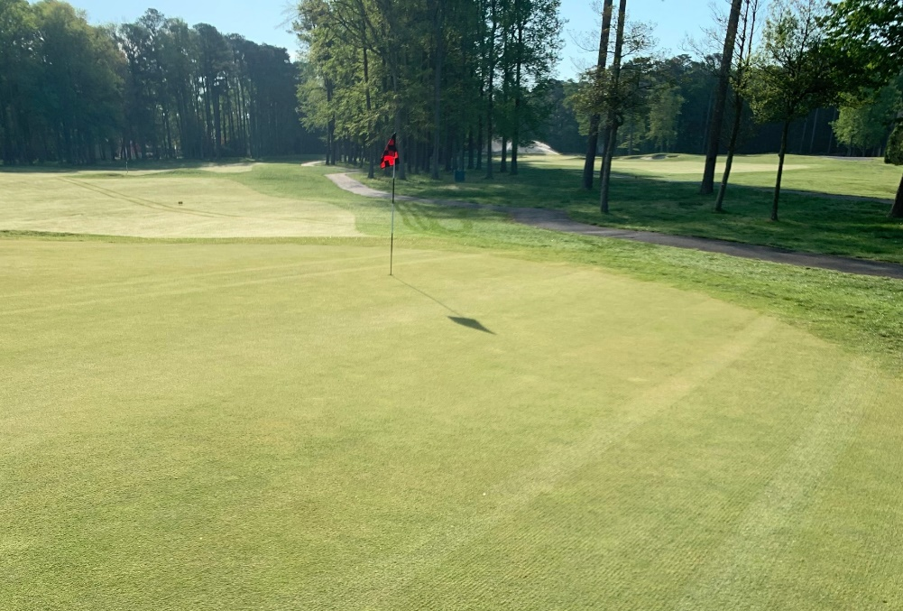
Verticutting
Removes Organic Material
Increased oxygen and water movement
Apply sand to improve smoothness and firmness

Slide 33
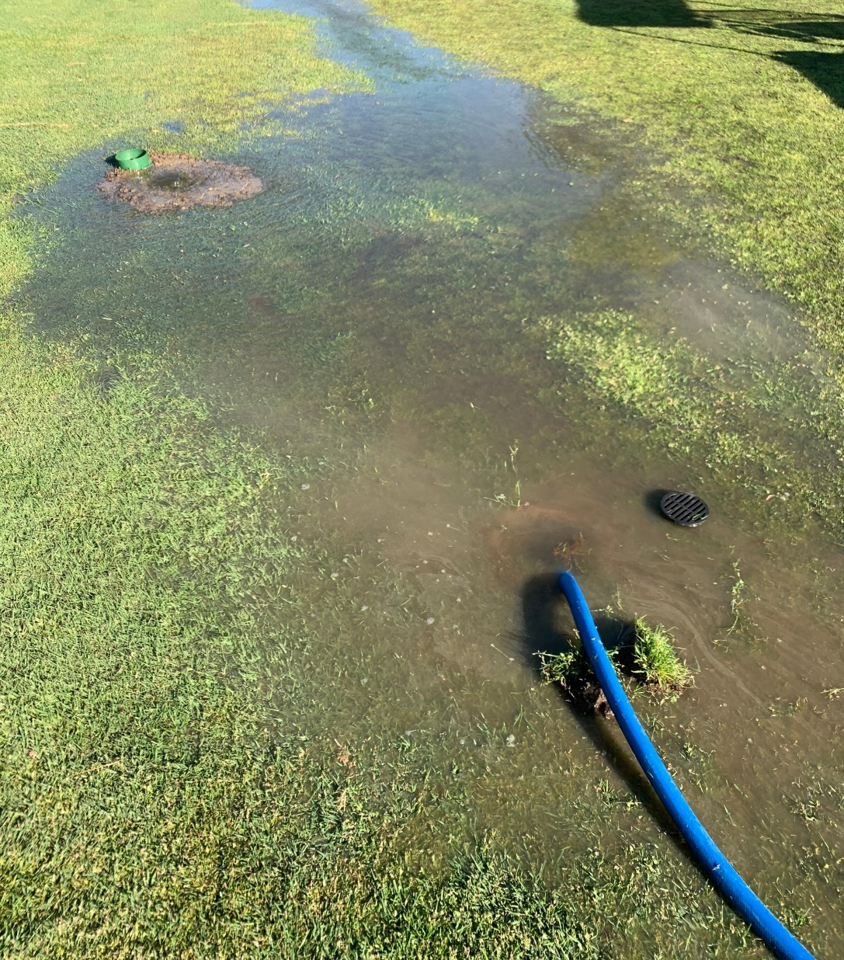
Drainage
Clean out existing drain lines to improve performance

Slide 34
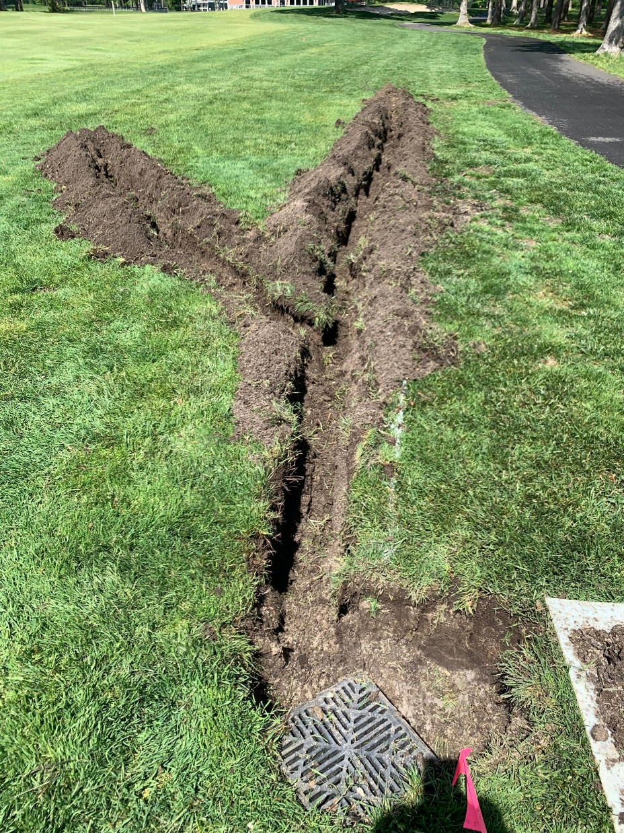
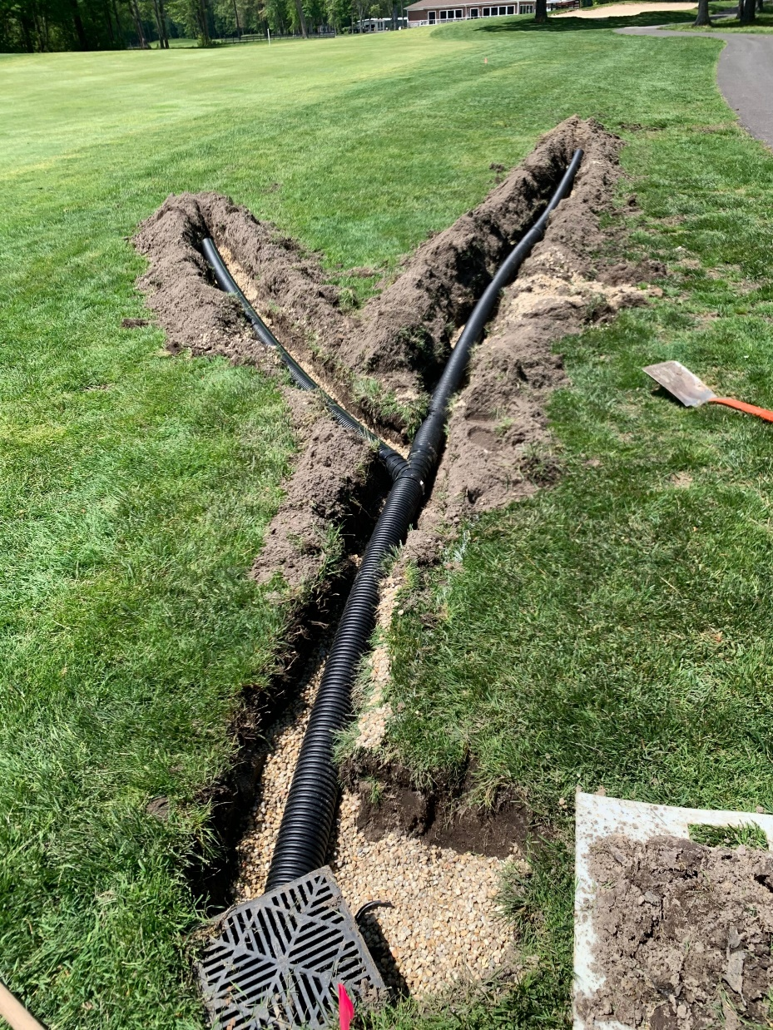
Drainage
Install new drain lines
Move water rapidly from wet areas to improve playability
Option to expand and add pipe as needed to wet areas

Slide 35
Additional agronomic/maintenance practices
Use of Wetting agents
Deep Tine Aerification
Irrigation operation / hand watering
Soil testing

Slide 36
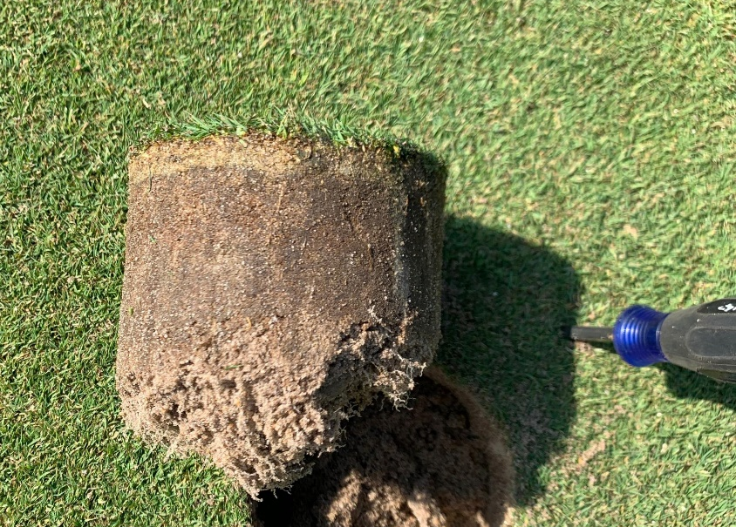
Overall Goal
Improved plant health
Increase ability to handle summer stress
Smooth and firm putting surface

Slide 37
Financial Change month of APRIL 2021
April (In 000’s)
 | Budget | Current Year | Favor/ (Unfavor) vs. Budget
Net Revenues | $266 | $414 | $148
Expenses | 1,138 | 1,340 | (202)
Net Operating | $(872) | $(926) | $(54)

Slide 38
Financial Change ytd april 2021
April YTD (In 000’s)
 | Budget | Current Year | Favor/ (Unfavor) vs. Budget
Net Revenues | $13,003 | $13,373 | $370
Expenses | 13,003 | 12,098 | 905
Net Operating | $0 | $1,275 | $1,275

Slide 39
Detail for the Month of april Favor/(Unfavorable) Vs. Budget (in 000’s)
Department/Amenity | Favorable/(Unfavorable)
Public Works | $28.7
Recreation & Parks | 19.0
Aquatics | 5.2
Golf Ops + Maintenance | (48.3)
General Maintenance | (35.2)
Yacht Club | (14.8)
Clubhouse Grille | 10.0
Beach Club | (4.1)
Beach Parking | 19.1
Tennis | (13.7)
Marinas | (5.5)
Other (Admin, Police, Finance, Mgr Office) | (14.8)
TOTAL | ($54.4)

Slide 40
Detail for April YTD Favor/(Unfavorable) Vs. Budget (in 000’s)
Department/Amenity | Favorable/(Unfavorable)
Public Works/General Maint/CPI | $364.2
Recreation & Parks | 97.1
Aquatics | (193.0)
Golf Ops + Maintenance | (56.4)
Yacht Club | (73.8)
Clubhouse Grille | 23.8
Beach Club | (5.1)
Beach Parking | (158.9)
Racquet Sports | (41.2)
Marinas | 58.1
Finance | 85.2
Public Relations | 58.5
Police | 44.5
General Admin & Other | 1,072.3
TOTAL | $1,275.3

Slide 41
Treasurer’s Report - Doug Parks

Slide 42
Cash & Short-Term Investments
Activity for Month of April
Overall Laddered Investment Rate of Return on CDAR’s for April Approx. 0.85%
As of April 30, 2021, the Association had approx. $15.5 million in cash
Approx. $9.5 million invested in CDAR’s, fully FDIC insured
Approx. $6.0 million in Money Market, and other operating accounts, fully insured

Slide 45
Unaudited Reserves APRIL 2021 ($Millions)
 | GeneralReplace | Bulkheads | Roads | Drainage | New Capital | Total
4/30/20 Balance | $3.5 | $1.6 | $0 | $0.5 | $0 | $5.6
Contributions/ Interest | 1.8 | 0.9 | - | 0.3 | 0.2 | 3.2
Casino Funds | - | - | 0.3 | - | - | 0.3
Transfer (Spend) | (1.5) | (1.5) | (0.1) | (0.3) | (0.1) | (3.5)
4/30/21 Balance | $3.8 | $1.0 | $0.2 | $0.5 | $0.1 | $5.6

Slide 46
Reserves 4/30/21 unaudited estimate (in ooo’s)
 | Beginning Balance |  |  | Unaudited Balance
 | 4/30/2020 | Additions | Expenditures | 4/30/2021
Major Maintenance & Replacement:
Police Renovation |  |  | (610)
Northstar |  |  | (75)
Admin Siding-Roof |  |  | (73)
Aquatics (Splash Pads, etc) |  |  | (50)
Yacht Club + Beach Club |  |  | (40)
Racquet Sports Sidewalks |  |  | (65)
Tractor for Ditch Maintenance |  |  | (150)
Rough Mower |  |  | (67)
Police Vehicles |  |  | (90)
Playground Equipment/Other |  |  | (253)
Total | 3,481 | 1,845 | (1,473) | 3,853
Bulkheads & Waterways | 1,653 | 920 | (1,559) | 1,014
Roads | 0 | 326 | (110) | 216
Drainage | 506 | 258 | (296) | 468
New Capital | 0 | 168 | (66) | 102
TOTAL 4/30/21 | 5,640 | 3,517 | (3,571) | 5,653

Slide 47
Public Comments

Slide 48
CAPITAL PURCHASE REQUESTS
Public Works –
Ventrac MA900 Boom Mower
2021 Ford Explorer 4WD XLT
2021 Ford Transit T350 HD
2022 Ford F250 Crewcab 4WD Truck
2022 Ford F550 Dump Truck
2022 Ford F550 Dump Truck
2022 Ford F250 Crewcab 4WD Truck
Recap –
We have eliminated 7 trucks from our fleet
Recognized $53,460 gain from auction
Annual run rate savings approx. $50,000 - $75,000

Slide 49
CAPITAL PURCHASE REQUESTS
OCEAN PINES ASSOCIATION REPLACEMENT OF FLEET VEHICLES JUNE 16, 2021 BOARD MEETING
 |  |  | (A) Estimated | Auction | Auction |  | Replacement
 |  | Replacing/ | Annual Cost | Revenue | Revenue | New | Cost Budgeted | Bid | Variance
Old Vehicle | Driver | NOT Replacing | Savings | Received | Estimate | Vehicle | for FY22 | Received | to Budget
2000 Ranger | Landscaping | NOT Replacing | 10,000 | 2,430
2007 Ford Van | Painter | NOT Replacing | 12,000 | 16,200
2008 Ford F150 4x4 | Mechanic | NOT Replacing | 11,000 | 5,490
2003 Chevy 2500 | Maintenance | NOT Replacing | 11,400 | 6,210
2008 Ford Ranger | Facility Manager | NOT Replacing | 10,000 | 6,750
2013 Ford Interceptor | Aquatics | NOT Replacing | 12,400 | 5,400
2014 Ford Interceptor | Rec & Parks | NOT Replacing | 12,400 | 5,490
2007 Ford F150 | Shared Labor | Replacing |  | 5,490 |  | 2021 Ford Explorer 4WD XLT | 32,000 | 35,441 | (3,441)
2007 Ford F250 Van | Electrician | Replacing |  |  | 15,000 | 2021 Ford Transit T350 HD | 56,000 | 51,397 | 4,603
2008 Ford F250 4x4 | Grounds | Replacing |  |  | 8,000 | 2022 Ford F250 Crewcab 4WD Truck | 40,000 | 36,551 | 3,449
2008 Ford F550 Dump | Drainage | Replacing |  |  | 20,000 | 2022 Ford F550 Dump Truck | 60,000 | 57,302 | 2,698
2001 Ford F450 Dump | Drainage | Replacing |  |  | 10,000 | 2022 Ford F550 Dump Truck | 60,000 | 57,302 | 2,698
2010 Ranger | Public Works | Replacing |  |  | 2,500 | 2022 Ford F250 Crewcab 4WD Truck | 40,000 | 36,551 | 3,449
 |  |  | 79,200 | 53,460 | 55,500 |  | 288,000 | 274,544 | 13,456
(A) Includes depreciation ($51K total), fuel ($12K total), repair & maintenance ($12K total), insurance ($8K), tags & registration
* Last time OPA purchased/replaced a truck was 2018

Slide 50
CAPITAL PURCHASE REQUESTS
Public Works – Ventrac MA900 Boom Mower
Requesting Authorization to go forward with Staff Recommendation of $37,016.90 for Iron Source

Slide 51
CAPITAL PURCHASE REQUESTS
Public Works – 2021 Ford Explorer 4WD XLT
Requesting Authorization to go forward with Staff Recommendation of $35,441.46 for Hertrich Fleet Services

Slide 52
CAPITAL PURCHASE REQUESTS
Public Works - 2021 Ford Transit T350 HD
Requesting Authorization to go forward with Staff Recommendation of $51,396.59 for Hertrich Fleet Services

Slide 53
CAPITAL PURCHASE REQUESTS
Public Works - 2022 Ford F250 Crewcab 4WD Truck
Requesting Authorization to go forward with Staff Recommendation of $36,551.29 for Hertrich Fleet Services

Slide 54
CAPITAL PURCHASE REQUESTS
Public Works - 2022 Ford F550 Dump Truck
Requesting Authorization to go forward with Staff Recommendation of $57,301.85 for Hertrich Fleet Services

Slide 55
CAPITAL PURCHASE REQUESTS
Public Works - 2022 Ford F550 Dump Truck
Requesting Authorization to go forward with Staff Recommendation of $57,301.85 for Hertrich Fleet Services

Slide 56
CAPITAL PURCHASE REQUESTS
Public Works - 2022 Ford F250 Crewcab 4WD Truck
Requesting Authorization to go forward with Staff Recommendation of $36,551.29 for Hertrich Fleet Services

Slide 57
CPI Violations None

Slide 58
Unfinished Business Motion - Move that the Board of Directors approves the recommended amended and restated bylaws as drafted to reflect the approved amendment to article v, section 5.13 (d) (1) of the by-laws. – Doug Parks Second Reading – Repeal of Resolution B-08 – Frank Daly Motion - To undertake any and all actions necessary to incorporate the Worcester County codes for short term rentals (ZS1-351), litter (PH1-106) and noise (ZS1: iii-46) into the declarations of restrictions in all sections of ocean pines and, for violations of these codes, to suspend a member’s ability to engage in short term rentals of their dwelling and to levy fines. – Frank Daly

Slide 59
New Business none

Slide 60
Appointments Brooks Ensor – Chair – Aquatics Annemarie Wolfsheimer – 3rd Term – Aquatic Steve Cohen – 1st Term – Aquatics Patti Stevens – 1st Term – Recreation & Parks Ellen Hench – 1st Term – Aquatics Gary Miller – 1st Term – Strategic Planning

Slide 61
Adjournment

