Slide 1
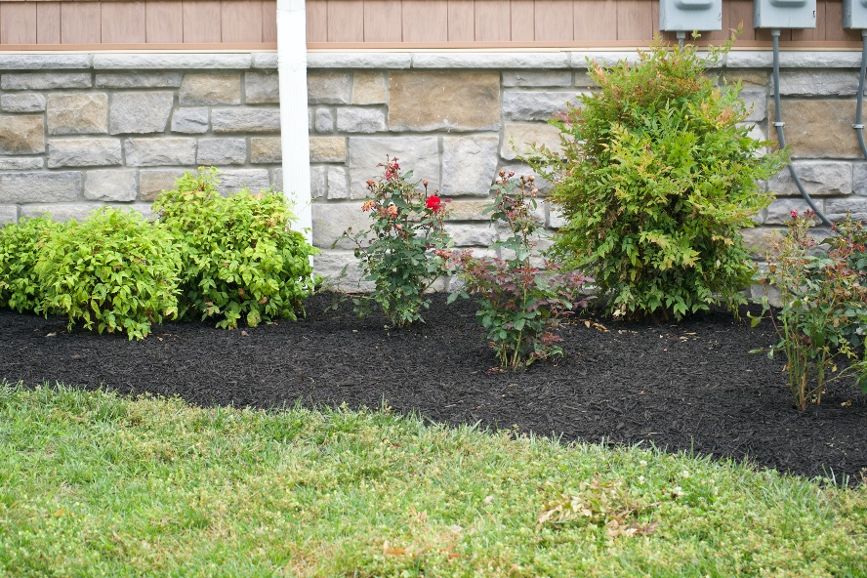
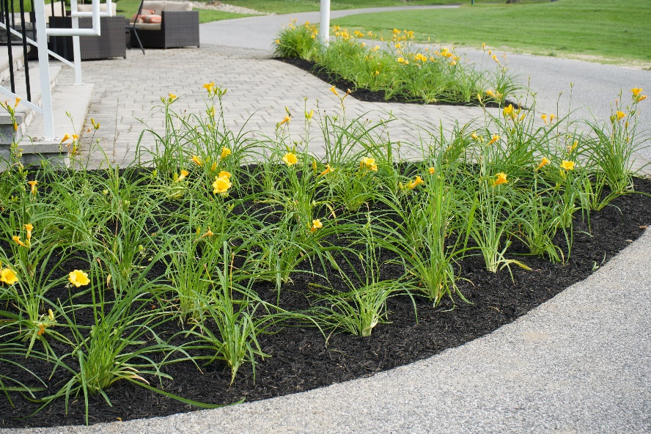
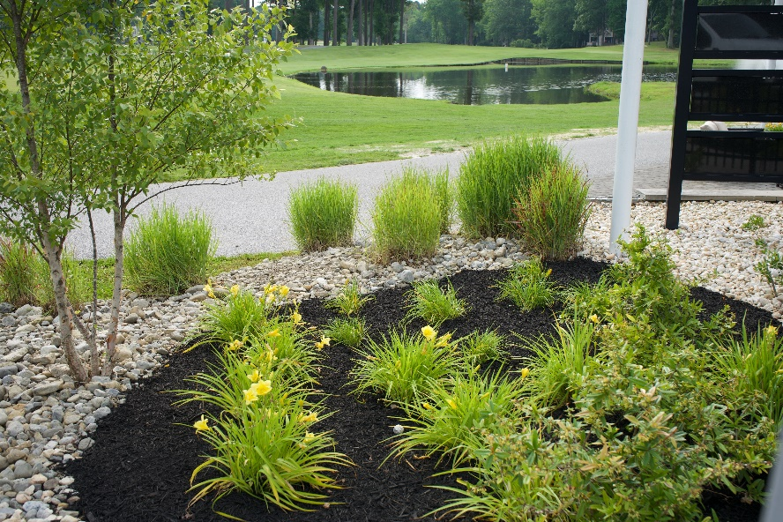
GM Leadership Report –
John Viola – General Manager
Linda Martin – Senior Director of Administration
Beautification
June 28, 2025

Slide 2
Initiatives
  Bocce Ball Courts
  OPVFD Firehouse
  Cell Tower
    Outside Contractor
    Chief
  Amenities
    Food & Beverage
    Golf
    Racquet Sports
    Aquatics
    Recreation & Parks
  Drainage – Ditches Only (Leaf Violations)
  Metrics
Financials

Slide 3
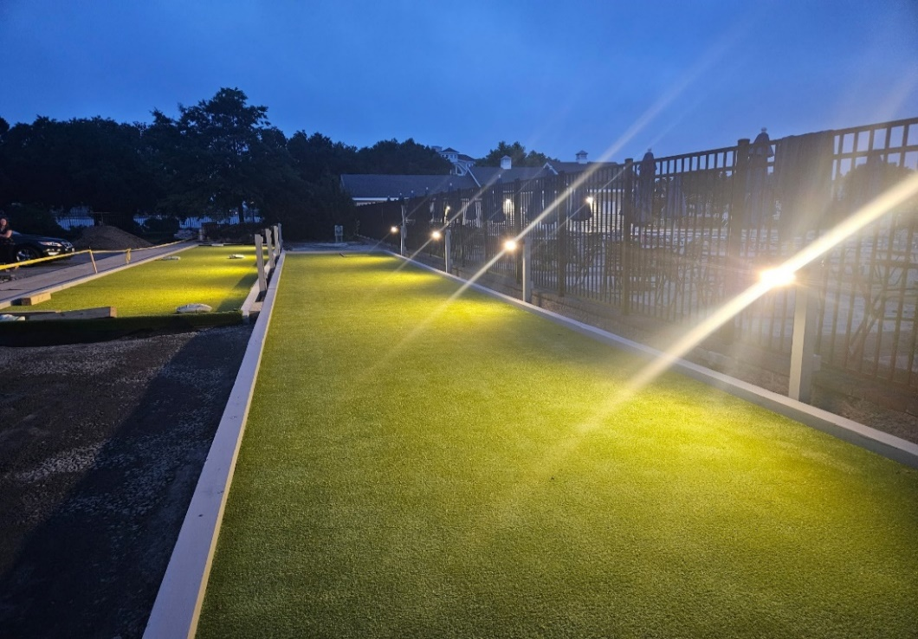
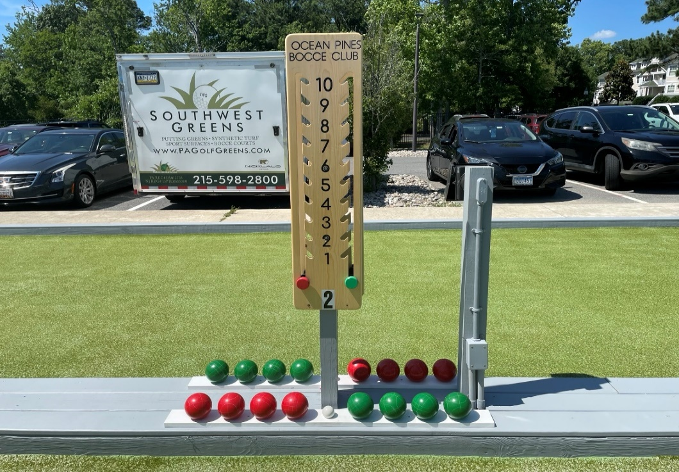
Bocce Ball Courts
Enhanced Ocean Pines Customer Experience
  Southwest Greens Delaware Valley finished courts on June 19th – just in time for the first day of league play!
  Total cost: $50,692
  Tournament has started
  Next, we will install a patio and more seating

Slide 4
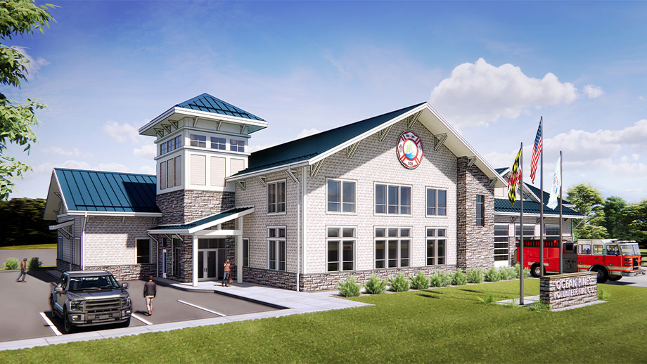
OPVFD Firehouse
Where were we:
  Reevaluated initial proposal
    19,100 sq. ft to 14,610 sq. ft.
  Work group completed preplanning stage
May not be exact colors

Slide 5
OPVFD Firehouse
Where are we today:
  We have prepared the referendum question
  Architectural drawings – delivered
  Funding – options have been discussed at Board meeting and Town Hall
  Approval to move forward from Board
  Town Hall meeting on June 27th at OPVFD Firehouse
Next steps:
  Referendum to be mailed with elections material on _________
  Bids or awarded
  Timeline
  Project plan
Shovel in ground: estimate October 2025
Completion estimate – 65 weeks
May not be exact colors

Slide 6
Food & Beverage
Weather affected numbers for May especially at the Beach Club
However, gross sales exceeded May of the prior year by approximately $150K led by Yacht Club ($426 vs $275)
June gross sales trending higher than prior year
Basically had one month to prepare for May 1st opening of new Fiscal Year

Slide 7
Golf
New irrigation system meeting the needs during this heat wave
Greens and course in very good condition
Golf memberships are up 29 memberships vs prior year (167 vs 138) at this time and at 103% of total budget dollars (276,555 vs 238,796)
As of 6/25 revenues at $203K, we are forecasting another $30K, $233K total for June vs budget of $221K
Number of rounds between 230-250+ during busy days

Slide 8
Racquet Sports
Racquet membership are down 98 membership vs prior year (338 vs 436) at this time and at 68% of total budget dollars (127,237 vs 188,215)
There are currently 2 working water fountains. Touchless water fountain needs to be replaced (on order). Racquet Sports Director/Pro puts out water bottles when heat index is over 100
New Racquet Center Clubhouse getting rave review from patrons (they love the new open look, larger community room, upgraded Pro-Shop, and expanded bathrooms
Ladies and Gentlemen’s day has reaped rewards in attracting players across the region, also resulting in new memberships

Slide 9
Aquatics
Aquatics membership are up 8 membership vs prior year (993 vs 985) at this time and at 93% of total budget dollars (388,882 vs 419,745)
We are projecting to meet or exceed budget
Yacht Club pool open until 7 pm on Friday, Saturday, and Sunday
Swim & Racquet pool open until 8 pm on Friday, Saturday, and Sunday
Caribbean Sea Family Splash, Swim & Raquet Club July 19th 5-8 pm
Working with TOI to enhance the customer experience at the Beach Club

Slide 10
Recreation
Summer Camp Underway
  Week 1 134 Campers Week 2 152 Campers
  Pool Days – Tuesday each week; Field Trips each week on Thursdays
Family Fun Night started this week - Pool Party at YC every Wednesday
Concerts in the Park – Every Thursday – White Horse Park 7-9 pm
July 4th Events include 5K race, Hometown Carnival, Fireworks
  Road closure will start on Cathell Road between 10 am and noon depending on when fireworks company arrives.
All information is available on the Recreation Facebook page and www.oceanpines.org

Slide 11
Drainage – Ditches Only
“TOGETHER WE ARE BETTER”
May 1st – Beginning Balance – 7
Additions 2
Resolved -5
Ending Balance 4
96 have been resolved since October 8, 2024

Slide 12
CPI Violation Dashboard
May
Violations
As of 5/1/25 | New Violations | Closed Violations | As of 5/31/25
355 | 207 | 97 | 465
207 violations initiated in May: 78 maintenance/trash/debris; 25 grass;13 leaf maintenance/placement; 18 no permit; 11 signs; 3 trees; 59 miscellaneous
  Miscellaneous violations includes easements, permit expiration, screening, trailers, unregistered/junk vehicles, vehicle parking, and wire/metal fencing
97 violations complied out; 465 remain open
  129 maintenance/trash/debris; 21 grass; 63 leaf maintenance/placement; 81 no permit; 11 signs; 9 trees; 151 miscellaneous
102 of the 465 violations still open are in legal

Slide 13
Work Orders
May
Open Work Orders as of 5/1/25 | New Work Orders | Closed Work Orders | Open Work Orders as of 5/31/25
144 | 92 | 94 | 142
92 work orders initiated in May: 9 bulkhead; 28 drainage; 24 grounds/landscaping; 4 roads; 1 signs; 26 general maintenance
Majority still open in drainage (82):
  38 – over 30 days; 13 – over 60 days
    Average 1-4 work orders a day to complete depending upon severity

Slide 14
Customer Service Dashboard
(from info@oceanpines.org)
May
Type | # Received – May
Amenities | 26
CPI | 18
Drainage | 2
General | 142
Public Works | 5
TOTAL | 223
NOTE:
The General 142 covers everything other than the categories listed. For May, mostly smaller trash can container requests.
100% of the questions/issues have been resolved.

Slide 15
Financials

Slide 16
UNAUDITED
MAY 2025

Slide 17
UNAUDITED RESERVES
MAY 2025 ($ MILLIONS)
 | General Replace | Bulkheads | Roads | Drainage | New Capital | Total
4/30/25 Balance | $4.7 | $0.2 | $1.1 | $0.2 | $0.0 | $6.2
Contributions/ Interest | 1.9 | 1.0 | - | - | 0.1 | 3.0
Casino Funds | - | - | 0.2 | 0.3 | - | 0.5
Transfer (Spend) | (0.5) | - | (0.1) | - | - | (0.6)
5/31/25 Balance | $6.1 | $1.2 | $1.2 | $0.5 | $0.1 | $9.1
FY26 Est. Spend | (1.1) | (1.2) | (0.2) | (0.2) | (0.1) | (2.8)
Est. FD Costs | (1.7) | - | - | - | - | (1.7)
4/30/26 Est. Bal. | $3.3 | - | $1.0 | $0.3 | - | $4.6

Slide 18

Treasurer’s Report -
Monica Rakowski

Slide 19

Cash & Short-Term Investments
Unaudited Month of May
As of May 31, 2025, the Association had Approximately (~) $20.9M in Cash
  Cash Increased ~ $1.7M from the Same Time Period Last Year
  Cash Increased ~ $3.2M from April 2025
  $8.8M Invested in CDAR’s
  $53K in Interest Income Recognized for the Month
  Remaining $12.1M in Insured Cash Sweep, Treasury Bills, Money Market and Other Operating Accounts (Diversified Between 2 Local Banks)

