Slide 1

Board of Directors Meeting
July 15, 2023

Slide 2
Approval of Agenda

Slide 3
Approval of Minutes
June 17, 2023 – Regular Meeting

Slide 4


President’s Remarks
Doug Parks

Slide 5
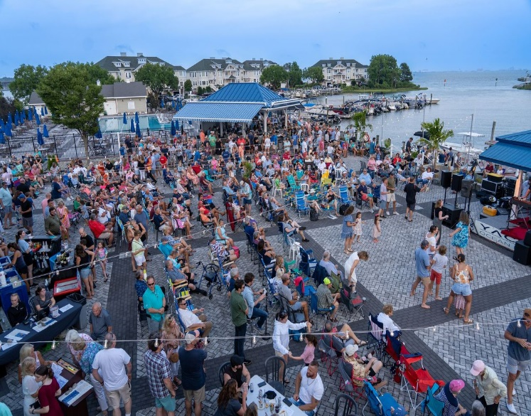
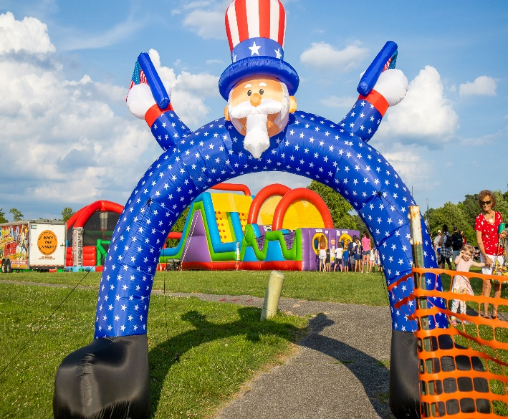
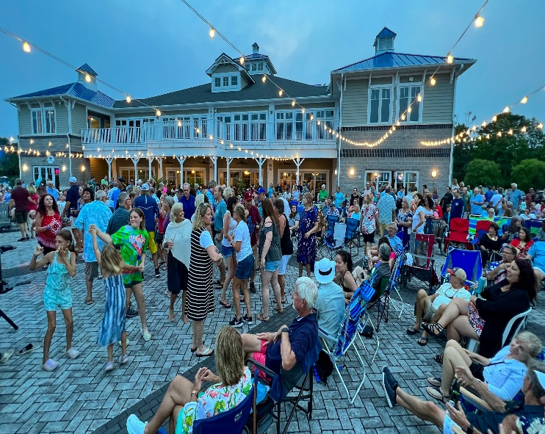
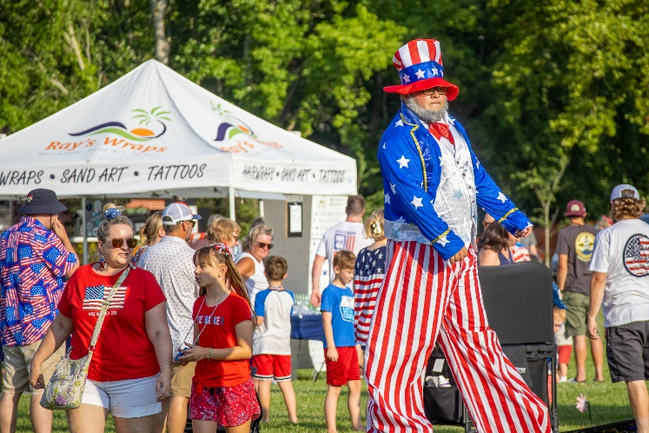
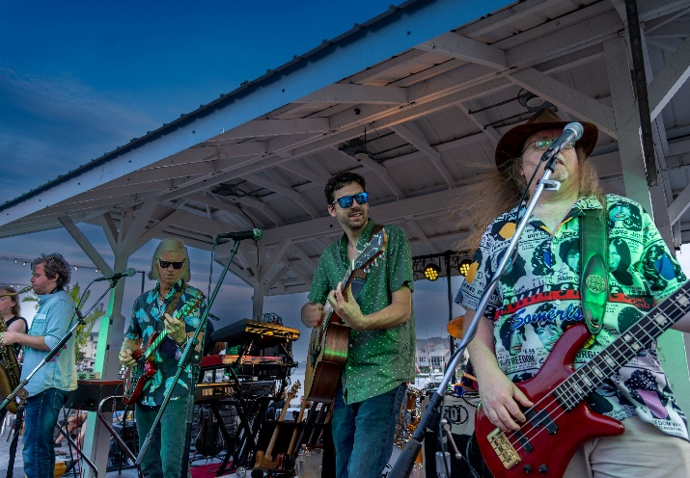
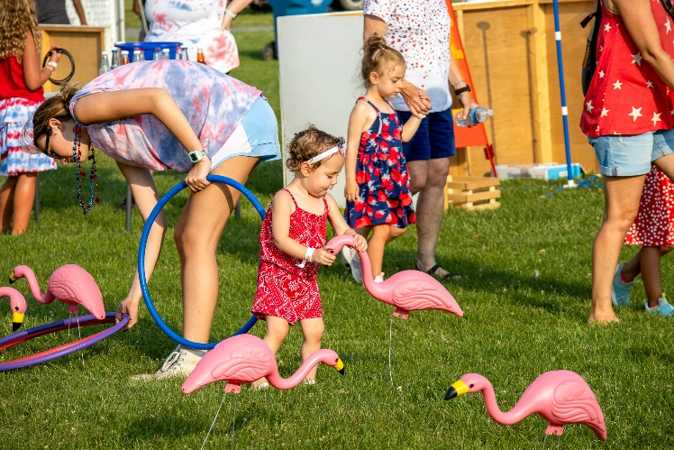
GM Leadership Report –
John Viola

Slide 6
Initiatives
North Gate
Metrics
Golf
Aquatics
Bridge Trim
Fountains
Iconic Gazebo
Maintenance/Renovation
Irrigation System
Fourth of July

Slide 7

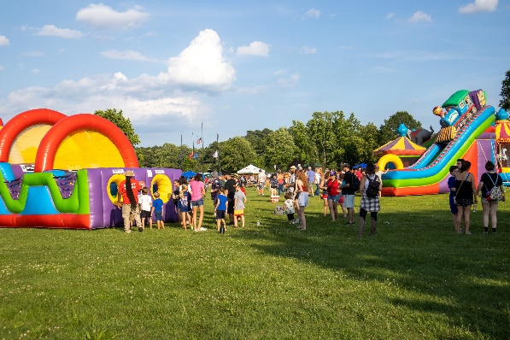
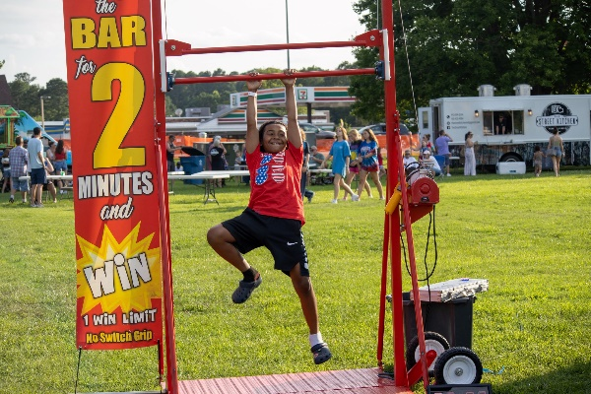
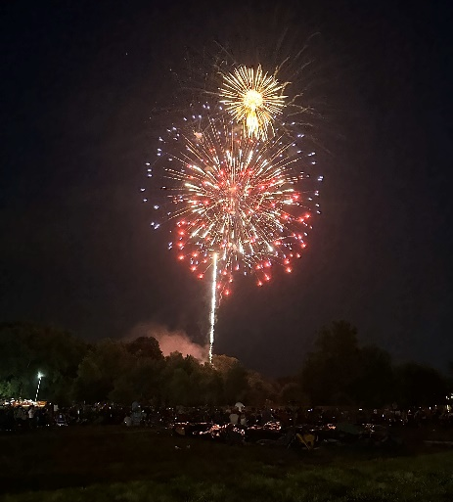
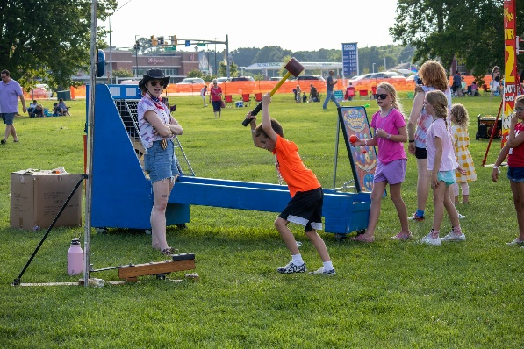
Carnival
Approximately 2500 visitors to the park
Inflatables by Fantasy World Entertainment (new this year)
Fireworks
Fireworks provided by SkyShooter Displays by ZY Pyrotechnics from Pennsylvania (new this year)
Cost: $14,460
Team Effort: Recreation and Parks, Public Works, Ocean Pines Police, Ocean Pines fire Department , Worcester County Sheriffs Dept. and Volunteers
Gross Revenue: $6,000
5K Cancelled – Low attendance
Photo by Jonathan Ross

Slide 8
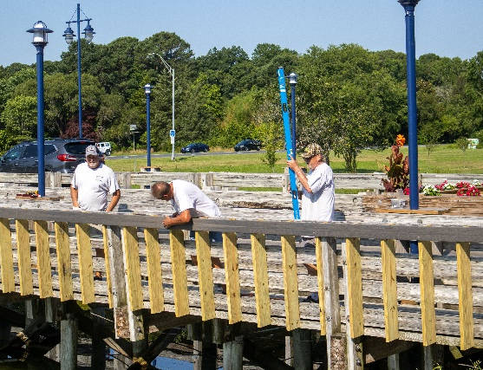
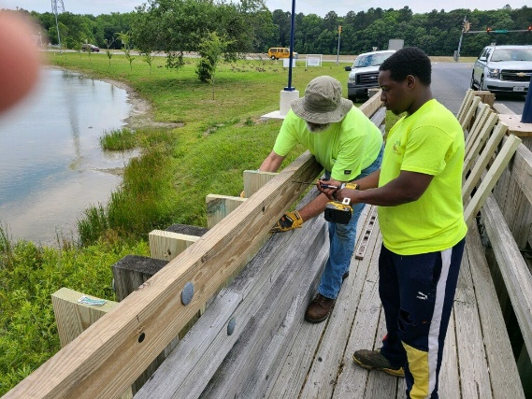
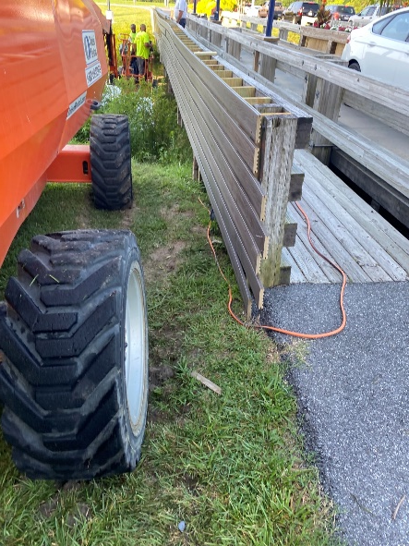
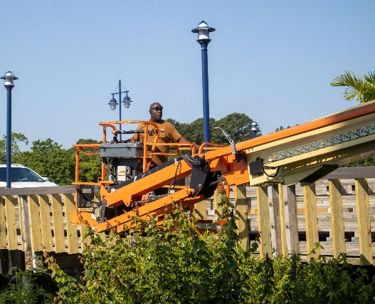
North Gate
North Gate Bridge Trim
  Currently working on the trim
  Rented a lift to work on framing this past week
  NO bridge closures during renovations/maintenance
North Gate Fountains
  Turf Equipment has completed the repairs on the old fountain and will be delivering it next week Public Works will install it as soon as they receive it
  Waiting for price on the new fountain

Slide 9
Aquatics
Lifeguard Status
Pool Hour Notifications
Sent to more than 9,000 people in a weekly e-blast
Posted on the door of each pool
Posted on the website, both in the "News" section and on the "Aquatics" page
Posted on OPA social media, on the Aquatics Facebook and OPA Facebook
What has happened
  Fully staffed Memorial weekend with all pools operating normal hours
  Week of May 29, 2023 – Swim & Racquet down 2 days and Mumford’s down 2 days (not on the same days). All other pools operated normal hours.
  Week of June 5, 2023 – Mumford’s down 2 days. All other pools operated normal hours.
  Weeks of June 12, 19, 26, July 3 – Operated all pools normal hours.
Rest of summer forward
  Aquatics should operate normal hours at all pools until second week of August. This is normal due to the college and high school sports kids returning to school. (Consistent with prior years)
  Aquatics is fully supporting Ocean Pines Camp and Family Fun Night.
  Aquatics currently has 38 guards on staff. Aquatics had 24 guards, at this time, last year. Normal years are 35–40 lifeguards.

Slide 10
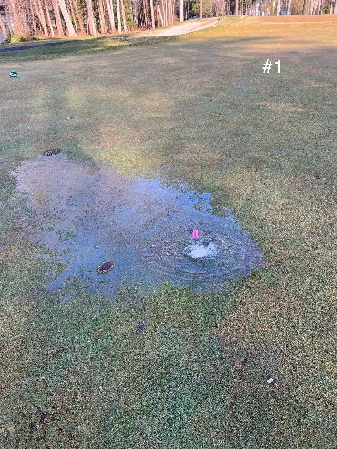
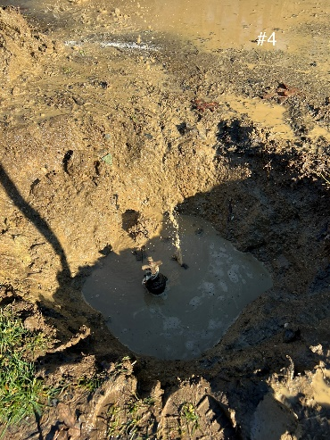
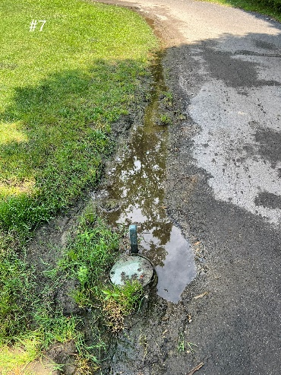
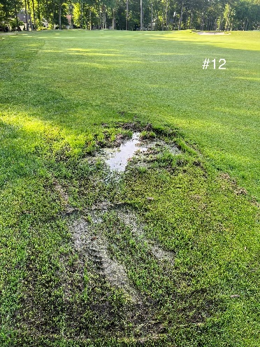
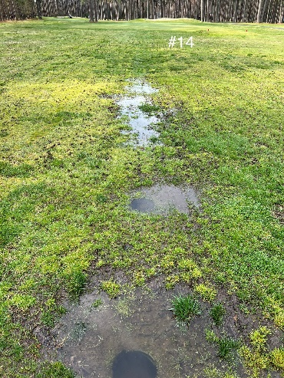
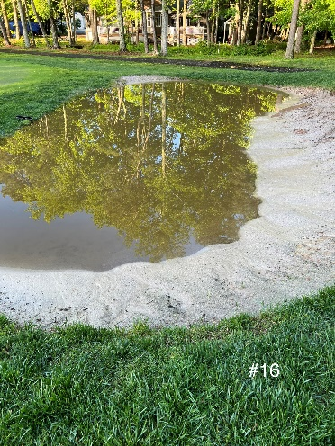
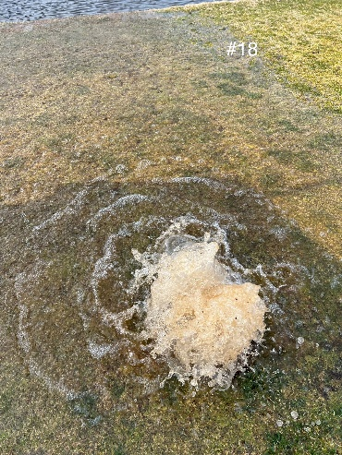
Golf Maintenance
Irrigation System
Design Phase
Hole #1
Hole #4
Hydro Designs
  Laying out entire design system
Design covers everything that will be put in the ground such as pipe, wire, valves, heads, controllers, weather stations, road crossings, lightning grounding etc.
Next step will be to get bids
Also working on new pumpstation plans
Design phase cost: $20,550
Hole #7
Hole #12
Hole #14
Hole #16
Hole #18

Slide 11
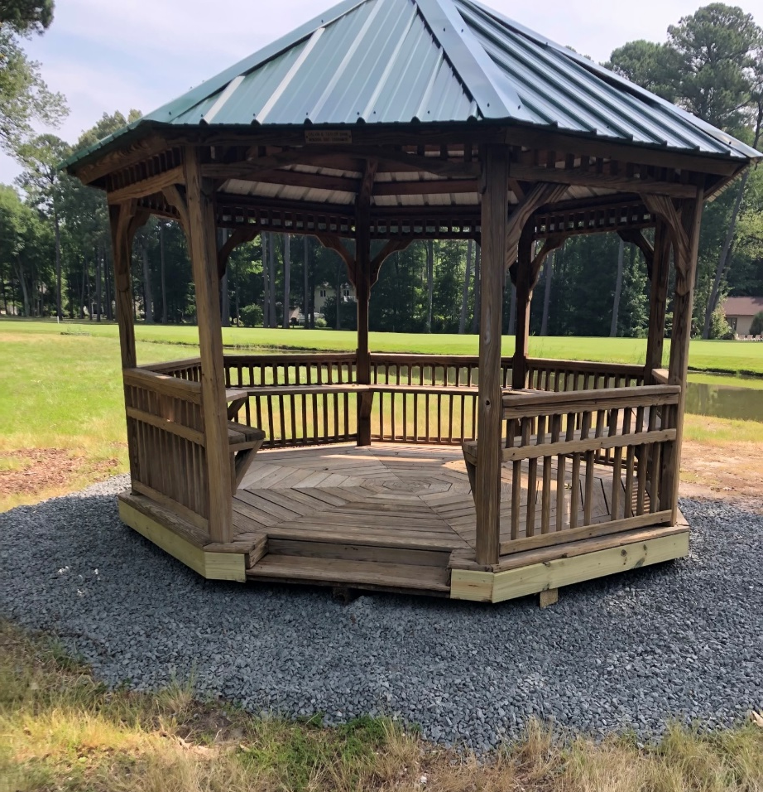
Historic Golf Gazebo
Restored
With almost four decades of history, the gazebo's restoration initiative took shape in response to feedback from the Golf Advisory Committee
The gazebo's origins were traced back, by Dom McMullen, to the inaugural Calvin B. Taylor Bank golf tournament that started 39 years ago.
Repaired:
  Railing and step as well as timbers replaced under the structure
  All the rafters
  Used leftover metal to cover the roof
  Ordered a new cupola
  Power washed the whole gazebo
  Added screws were needed

Slide 12
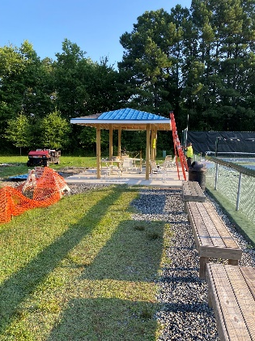
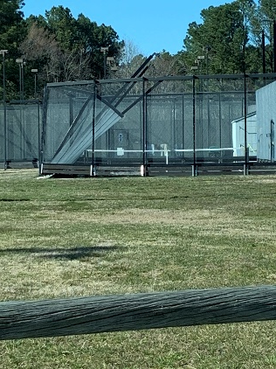
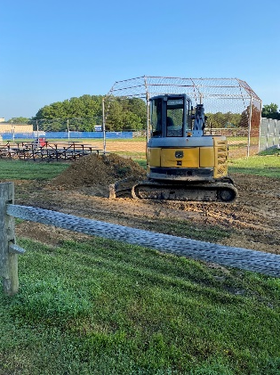
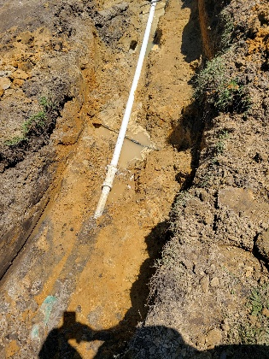
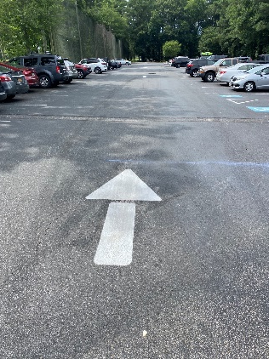
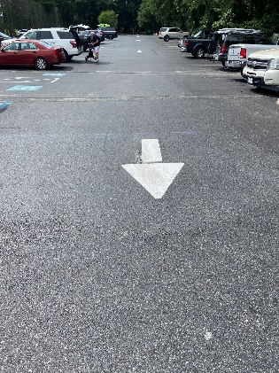
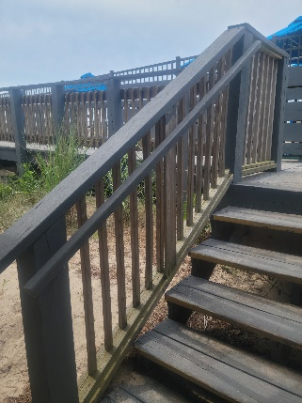
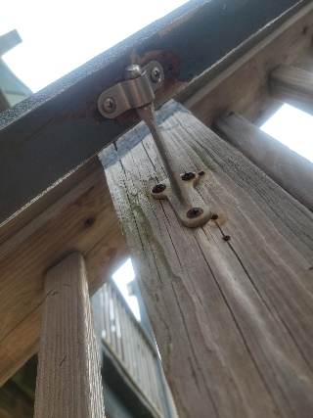
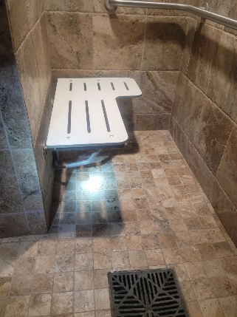
Maintenance & Renovation
Racquet Sports
  Shade Structure
  Platform Tennis Court #6 Fence which is scheduled for repair some time near the end of August
Ballfield Leak
  This area was always wet
  We excavated and found two breaks in the line
  One was an old break the second was hit by a utility company
  We repaired with the assistance of the county, checked for leaks and backfilled the area
Clubhouse Parking Lot
  Arrows recently painted
Beach Club
  Railing & handicap bench in ladies room repaired

Slide 13
CPI Violation Dashboard
June
Violations (includes legal)
As of 5/31/23 | New Violations | Closed Violations | As of 6/30/23
167 | 127 | 73 | 221
Legal Cases
As of 5/31/23 | New Violations to Legal | Closed Violations in Legl | As of 6/30/23
42 | 0 | 0 | 42
127 violations initiated in June: 66 maintenance/trash/grass; 3 dangerous tree; 21 no permit; 37 miscellaneous
  Miscellaneous violations includes signs, stop work orders, trailers, unregistered/junk vehicles, and vehicle parking
73 complied out; 221 remain open (includes the 42 violations in legal)
  59 maintenance/trash; 3 dangerous trees; 51 no permit; 108 miscellaneous

Slide 14
Work Orders
June
Open Work Orders as of 5/31/23 | New Work Orders | Closed Work Orders | Open Work Orders as of 6/30/23
110 | 147 | 141 | 116
147 work orders initiated in June: 6 bulkhead; 31 drainage; 28 grounds/landscaping; 7 roads; 3 signs; 72 general maintenance
Majority still open in drainage (55):
  14 – over 30 days; 14 – over 60 days
    Average 1-4 work orders a day to complete depending upon severity

Slide 15
Customer Service Dashboard
(from info@oceanpines.org)
June
Type | # Received – June
Amenities | 49
CPI | 11
Drainage | 1
General | 84
Public Works | 17
TOTAL | 162

Slide 16
Financials

Slide 17
UNAUDITED FINANCIAL CHANGE
MONTH OF MAY 2023
May (In 000’s)
 | Budget | Current Year | Favor/ (Unfavor) vs. Budget
Net Revenues | $7,555 | $7,640 | $85
Expenses | 1,150 | 1,085 | 65
Net Operating | $6,405 | $6,555 | $150

Slide 18
UNAUDITED MONTH OF MAY
FAVOR/(UNFAVORABLE) VS. BUDGET (IN 000’s)
Department/Amenity | Favorable/(Unfavorable)
Golf Ops + Maintenance | 45
Admin/GM/Finance/Marketing | 34
Aquatics | 32
Police | 32
Public Works, CPI + Gen Maintenance | 23
Racquet Sports | 14
Beach Parking | 10
Beach Club | (16)
Marinas | (15)
Yacht Club | (12)
Other Net (Rec & Parks, Clubhouse Grille) | 3
TOTAL | $150

Slide 19
UNAUDITED RESERVES MAY 2023 ($ MILLIONS)
 | GeneralReplace | Bulkheads | Roads | Drainage | New Capital | Total
4/30/23 Balance | $5.1 | $0.5 | $0.7 | $0.2 | $0.1 | $6.6
Contributions/ Interest | 1.8 | 1.1 | - | 0.1 | - | 3.0
Casino Funds | - | - | 0.4 | 0.1 | - | 0.5
Transfer (Spend) | (0.4) | (0.1) | - | - | - | (0.5)
5/31/23 Balance | $6.5 | $1.5 | $1.1 | $0.4 | $0.1 | $9.6

Slide 20
“flash” preliminary estimate for month of JUNE 2023
June (In 000’s)
 | Budget | Current Year | Favor/ (Unfavor) vs. Budget
Net Revenues | $1,011 | $1,072 | $61
Expenses | 1,315 | 1,365 | (50)
Net Operating | ($293) | ($304) | $11

Slide 21
“FLASH” PRELIMINARY ESTIMATE MONTH OF JUNE
FAVOR/(UNFAVORABLE) VS. BUDGET (IN 000’S)
Department/Amenity | Favorable/(Unfavorable)
Rec & Parks | 46
Police | 17
Beach Parking | 12
Golf Ops & Maintenance | 11
Yacht Club | (43)
Marinas | (9)
Admin/GM Office/Finance/Public Relations | (9)
Public Works, CPI + Gen Maintenance | (7)
Racquet Sports | (7)
TOTAL | $11

Slide 22

Treasurer’s Report -
Monica Rakowski

Slide 23

Cash & Short-Term Investments
Preliminary Estimate for Month of June
As of June 30, 2023, the Association had Approximately (~) $18.1M in Cash
  Cash Decreased ~ ($0.5M) from the Same Time Period Last Year
  Cash Decreased ~ ($0.4M) from May 2023
  $13.2M Invested in CDAR’s
  $41K in Interest Income Recognized for the Month
  Remaining $4.9M in Insured Cash Sweep, Treasury Bills, Money Market and Other Operating Accounts (Diversified Between 2 Local Banks)

Slide 24

Public Comments
Members wishing to make comments must state their name and address.

Slide 25
Adjournment

