Slide 1

GM Leadership Report –
John Viola – General Manager
Linda Martin – Senior Director of Administration
July 26, 2025

Slide 2
Initiatives
  Maintenance
    Racquet Sports
    Bay Colony Sign
    North Gate Bridge
  Drainage
  Firehouse
  Amenities
  Golf Course
  DMA Study
  Cell Tower
  Electronic Signs
  Mailboxes
  CPI
  Metrics

Slide 3
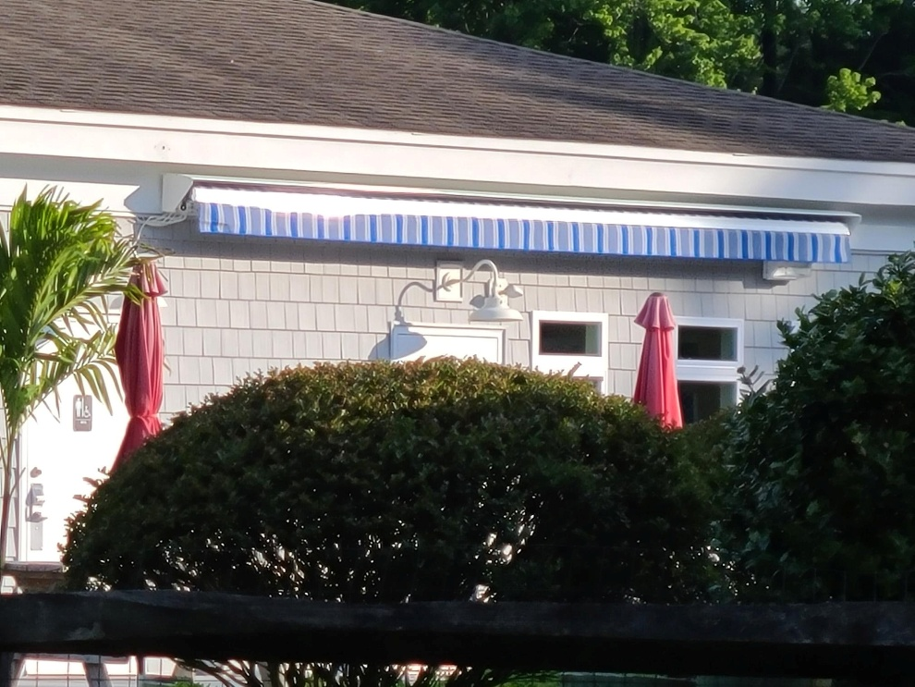
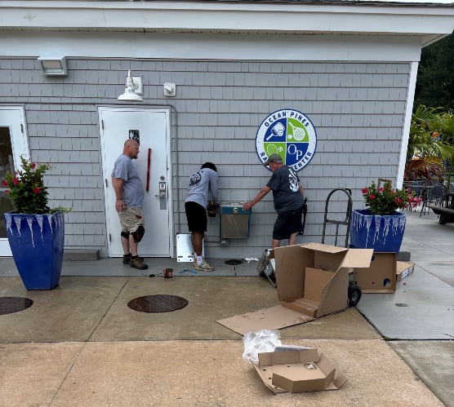
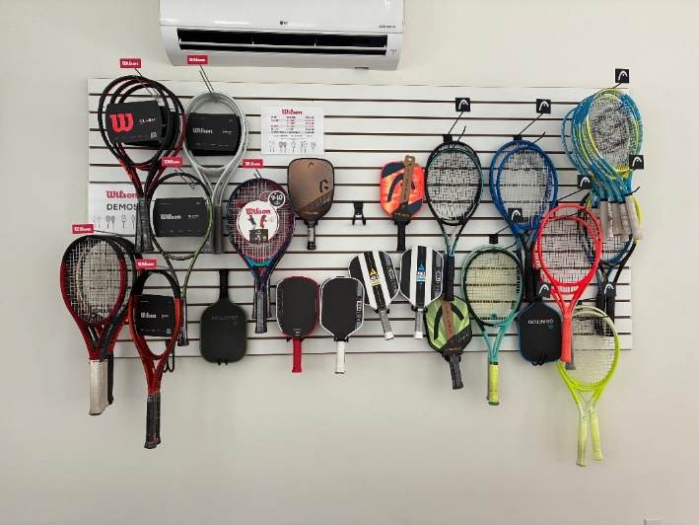
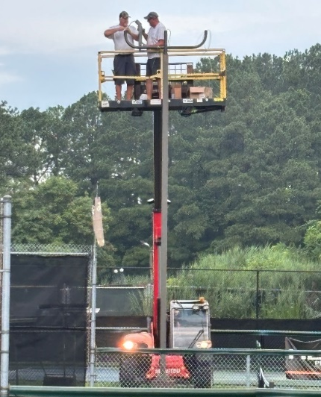
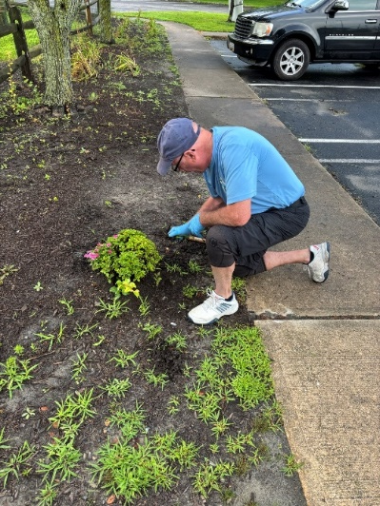
Maintenance
  Racquet Center:
    Touchless water fountain installed
    Lighting at new courts installed
    Landscaping upgrades including new mulch and plants
    Slat board updated upon receiving supplies
    Courts reevaluated and all open for play
      Cracks to be filled on pickleball courts in August – will take 5-7 days to complete repairs

Slide 4
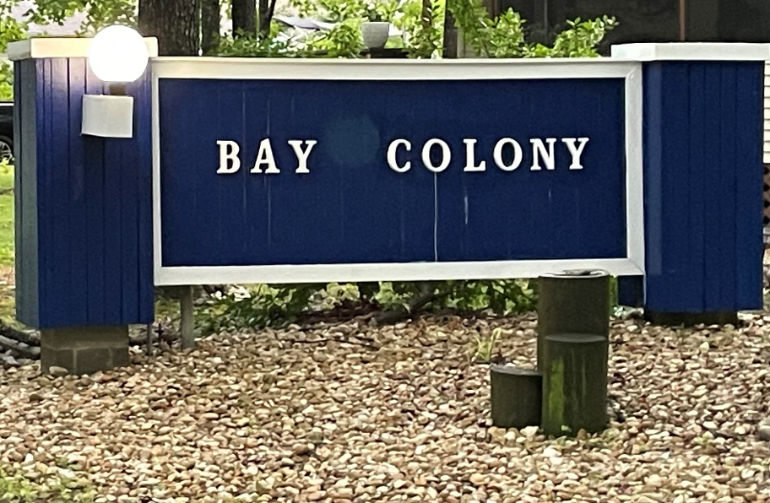
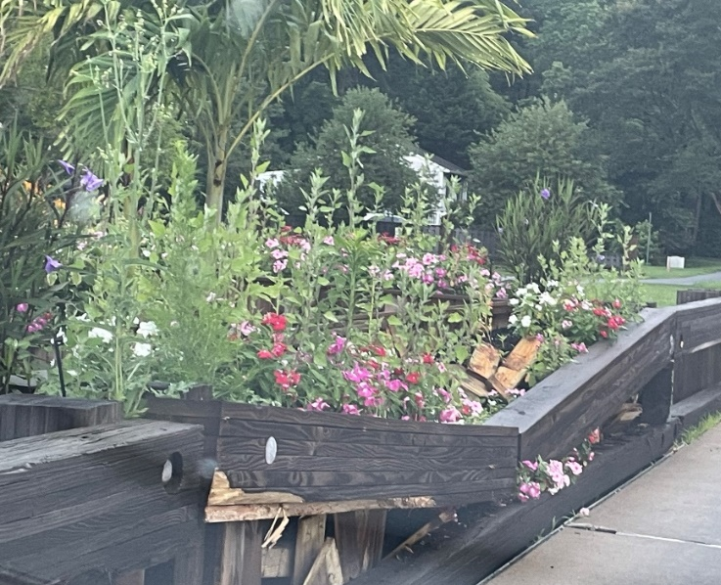
Maintenance
  Bay Colony Sign:
    Sign painted
    Lighting to be replaced (end of August) – to match style of north gate bridge lights
  North Gate Bridge:
    Bridge hit on July 10th – damage to flower box
    Public Works to make repairs in evening (week of July 28th)

Slide 5

Drainage
  Over 2” of rainfall on July 14th
  No reports of severe drainage issues
  “Together We Are Better”
    Owners are maintaining the ditches – “Bag It We Will Grab It” is effective

Slide 6
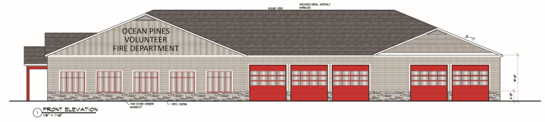
Firehouse
  Referendum mailed along with election material
    Mailed July 7th; due back by August 6th; results released on August 8th
  FAQs posted online (see addendum)
  Narrative:
    Estimated $3.7 million with 10% contingency
    Funding – as stated at Board Meetings, through our balance sheet with a focus on reserves (see addendum)
  Plans:
    Reviewed again with work group on July 15th

Slide 7
Amenities
  Recreation & Parks
    All 4th of July events well attended
    Total: ($20,604); budget: ($36,000)
      Revenue: $20,776
      Expenses: $41,380
  Golf
    Golf membership is up for the 3rd year in a row
    Pricing initiative shows positive results
    July 5th – record breaking 266 rounds!
    Golf club sales are on the increase (if interested, please see Bob for fitting)
    Continuing to work closely with both the hotel package groups and OC Golf Getaways in order to ensure future tourists and package golf rounds
  Aquatics
    All pools reached capacity by 11:00 a.m. July 4th & 5th

Slide 8
Amenities
  Marina
    Sales strong – well ahead of 2024 for the month
  Racquet Sports
    Junior pickleball camp started July 14th
  Bocce Courts
    First league game held on June 19th
    Play every Thursday, Sunday, and Monday
  Food & Beverage
    New menu released July 10th

Slide 9

Golf Course
  Ocean Pines Golf Course vote #1 golf course in the Best of Ocean City: Best Things To Do poll

Slide 10
DMA Study
  Current tasks:
    Linda Martin to lead initiative
    Departments updating information from prior study
    Once updated, data will be uploaded in DMA’s Navigator Portal
  Contract signed
    Total cost: $18,480
  Timeline:
    Will be on site end of August/beginning of September for field work
    Draft report to be released approximately 3 months after field work completed
    Working session with Budget & Finance and Board to be scheduled (estimate December)

Slide 11

Cell Tower
  Virtual town hall to be held this upcoming Monday, July 28th at 6:00 p.m.
  Details regarding the town hall and project can be found under “News” on the Ocean Pines website:
    Register for the event at https://events.teams.microsoft.com/event/662c0f5e-905f-405f-83e3-0ffc152d6fac@37ca2ed5-019e-4295-abbe-0f6663e955b9
    For more information regarding the project, visit https://www.oceanpineswireless.com/

Slide 12
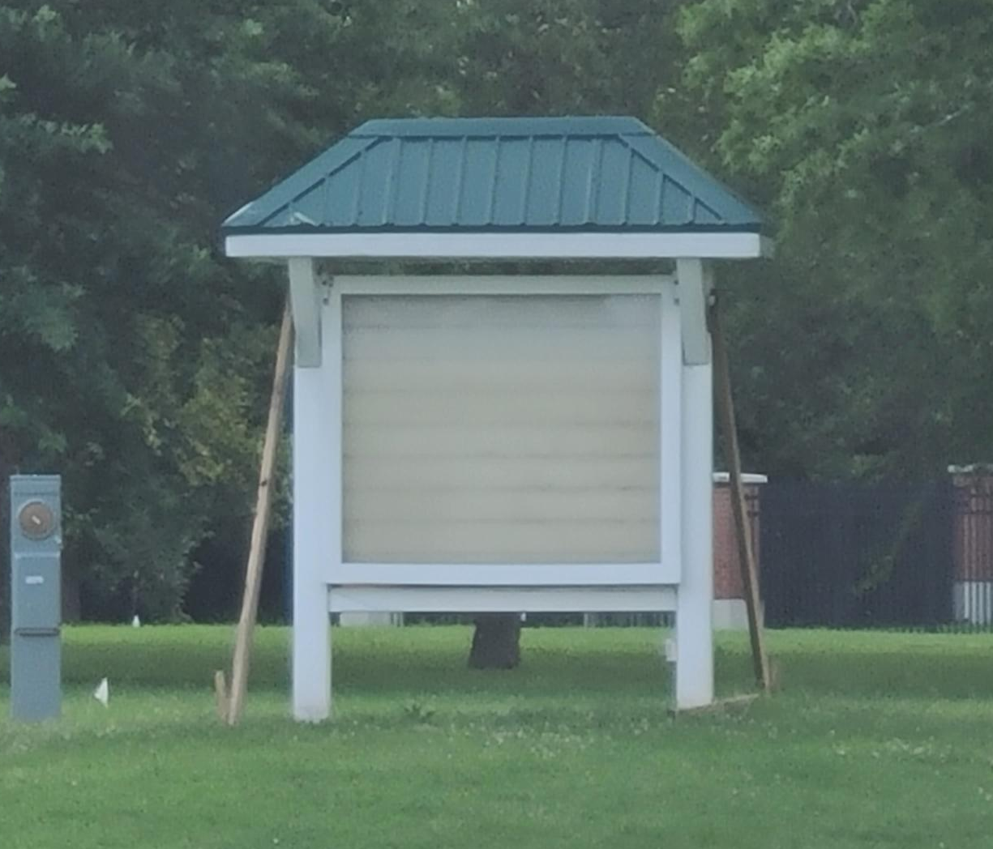
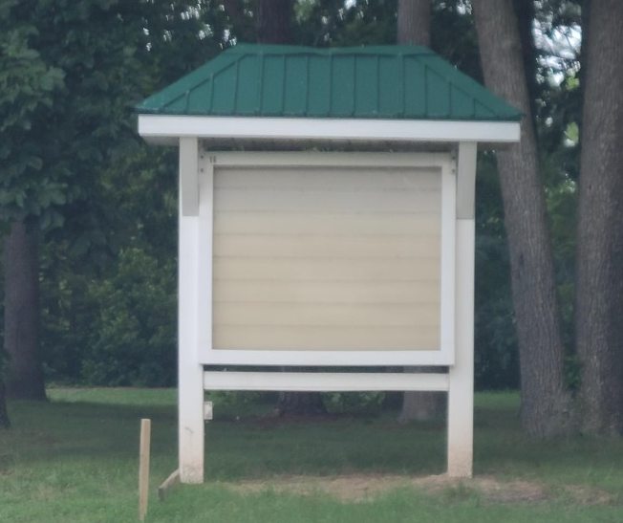
Electronic Signs
  Permits received in May from Worcester County for both locations
  Public Works moved existing marquees to approved locations
  Cathell Road:
    Waiting on Choptank to run the power
  Manklin Creek Road:
    Waiting on locate to be complete to trench wire to the sign
Cathell Road
On right – in front of Sports Core Pool fence
Manklin Creek Road
On right – heading towards 589

Slide 13
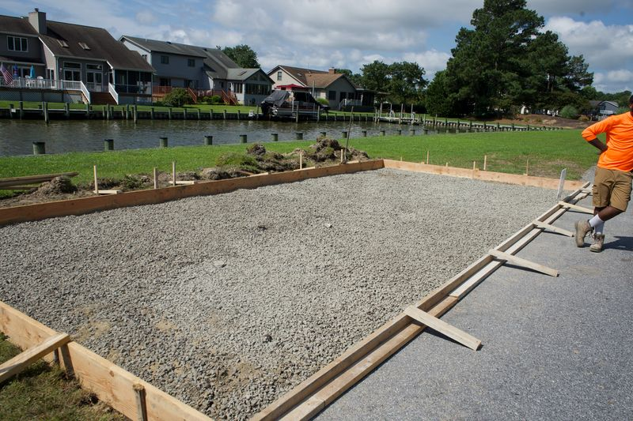
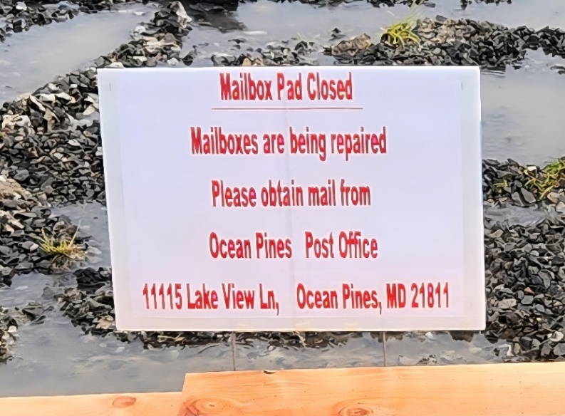
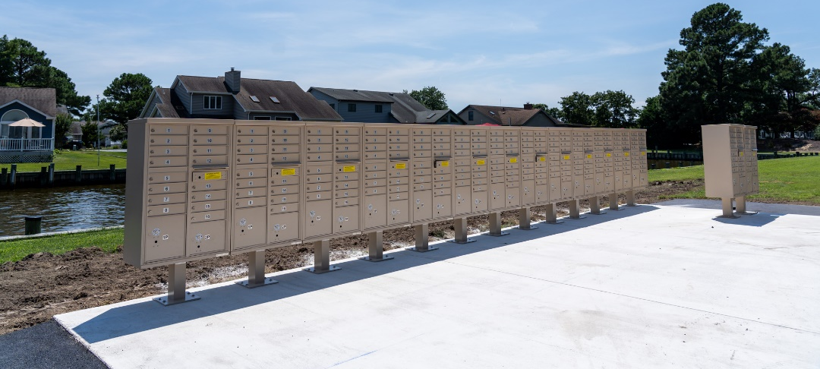
Mailboxes
  Reported at the April 26th Board Meeting that mailboxes would be replaced at both Wood Duck and Cannon Drive locations
  Wood Duck mailboxes disassembled on July 7th
    Concrete installation began July 15th
    Estimated 1-2 weeks for project
    Mail temporarily redirected to post office
  Total cost: $72,519 (Wood Duck); $25,933 (Cannon Drive)

Slide 14
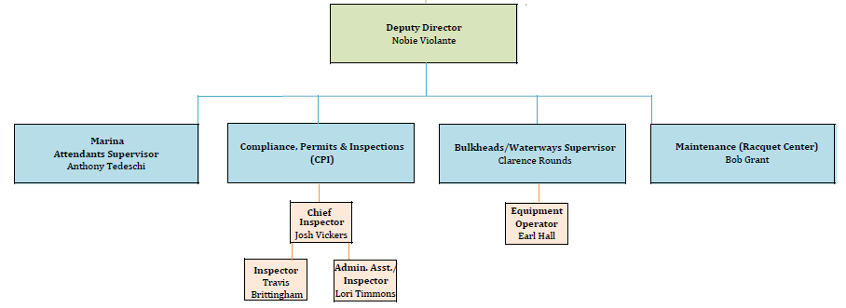
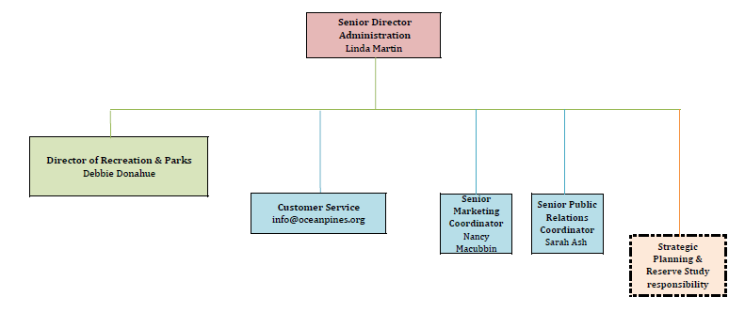
CPI
  Organization change:
    Press release sent out on July 10th notified that CPI now reports to Nobie Violante
  CPI office:
    Will be located at the Public Works building (week of July 21st)
    Marketing & Public Relations relocating to the Administration Building

Slide 15
CPI Violation Dashboard
June
Violations
As of 6/1/25 | New Violations | Closed Violations | As of 6/30/25
465 | 184 | 190 | 459
184 violations initiated in June: 71 maintenance/trash/debris; 25 grass; 3 leaf maintenance/placement; 29 no permit; 8 signs; 3 trees; 45 miscellaneous
  Miscellaneous violations includes easements, permit expiration, screening, trailers, unregistered/junk vehicles, vehicle parking, and wire/metal fencing
190 violations complied out; 459 remain open
  140 maintenance/trash/debris; 17 grass; 54 leaf maintenance/placement; 85 no permit; 11 signs; 9 trees; 144 miscellaneous
122 of the 459 violations still open are in legal

Slide 16
Work Orders
June
Open Work Orders as of 6/1/25 | New Work Orders | Closed Work Orders | Open Work Orders as of 6/30/25
142 | 127 | 92 | 177
127 work orders initiated in June: 7 bulkhead; 35 drainage; 21 grounds/landscaping; 10 roads; 3 signs; 51 general maintenance
Majority still open in drainage (94):
  24 – over 30 days; 36 – over 60 days
    Average 1-4 work orders a day to complete depending upon severity

Slide 17
Customer Service Dashboard
(from info@oceanpines.org)
June
Type | # Received – June
Amenities | 29
CPI | 20
Drainage | 0
General | 30
Public Works | 9
TOTAL | 87

Slide 18
Addendum

Slide 19
Addendum
  The following questions were presented to the Ocean Pines Volunteer Fire Department during the June 27, 2025, public hearing concerning the referendum for the South Fire Station. It was recommended that the information be posted for homeowners to review and gain background on the project.
  Q. How much square footage is needed for the new South Station?
  A. The New station would be 15,000 sq ft.
  Q. What is the timeline for completion?
  A. 65 Weeks
  Q: What is the estimated cost of the building?
  A: $6/+ Million
  Q: What is the cost responsibility of OPVFD and Ocean Pines Association?
  A: Ocean Pines Fire Department has secured $1,700,000 in Grants and Bonds as well as $750,000 from fundraising and savings. We are requesting approval through a referendum for $3.7 million plus a 10% contingency. This will be funded through our balance sheet with a focus on the replacement reserve.

Slide 20
Addendum
  Q: Would the proposed layout meet all the county requirements, including parking and stormwater management, or would there be additional costs to meet those needs?
  A: Yes
  Q: What will happen to the 6-minute response time once the project is underway?
  A: We are looking at a Presence at the South Side Location based upon feedback and the fact that we want to maintain the quickest response time for all of Ocean Pines during this time.
  Q: How much will the new firehouse cost on the assessment?
  A: It is estimated that the cost of the new firehouse on the assessment will be approximately $50-$60 per year.
  Q: Because OPVFD is responsible for protecting local businesses such as the AGH and Tidal Health centers in Ocean Pines, the Casino, and other businesses on Route 589, are there plans to approach those businesses for donations?
  A: The fire department is constantly evaluating funding opportunities and receiving funds from fundraising that will offset any request made by the association during the time of construction.
  Q: How will the funds be distributed throughout the project?
  A: The project is due to break ground (If approved) in October of 2025. The initial funding will be within the 2025/2026 budget with the payments being made within both 2025/2026 and 2026/2027 budget years.

Slide 21
Addendum
  Q: Did the fire department get bids to compare the costs?
  A: Raleigh, NC 18,000 sq ft $17 Million
  Fillmore, CA 15,000 sq ft $8.3 Million
  Norfolk, CT 10,000 sq ft $9+ Million
  As mentioned in updates over the past 2 years, we did request estimates so that we could get a ballpark figure for the project that we were proposing. We utilized the estimates to move forward to where we are today.
  Q: Will the fire department own the building and the land?
  A: The Ocean Pines Association will own the building, and the fire department will own the land.
  To view the presentation slide, visit
  https://drive.google.com/file/d/1fYdrAxmriA7wjoQxCfpRhFw1fv2G1fzl/view?usp=sharing
  To view the presentation video, visit
  https://youtu.be/0sc3jhSRjbc
  For additional info and questions, contact info@oceanpines.org.

Slide 22
Addendum
  OPVFD Firehouse – DMA Study (as presented at the May 24, 2025 Board Meeting)
  At this point, I am recommending to the Board we fund our portion of the firehouse estimate from our balance sheet
  We are managing our reserve balance in compliance with the DMA lite study of 2021 which reflects a balance in the vicinity of 22-24% of fully funded
  Since the funding of the building will not start until after October 2025, and the DMA study is scheduled for the August/September timeframe, our reserve funding will be evaluated and decided at that time
  I have updated this Board and the Association over the last several months and I am stating today that I believe we have a “goldilocks situation”

Slide 23
Addendum
  Firehouse Funding (as presented at the May 24, 2025 Board Meeting and reiterated at June 28, 2025 Board Meeting)
  Recommending to the Board we fund our portion of the firehouse out of general reserves based upon the DMA study
  We have a “goldilocks situation”
  We’re managing our reserve balance and are in compliance with the DMA lite study of 2021; we are fully funded but will no more after reserve study in August/September
  Fire department should cost $50 to the assessment over 10 years – you will not actually see that
  10% contingency is assumed for unplanned overruns that will come up during the construction process (possible tariffs on materials and no final plans at this time – there could be other items as well)

Slide 24
PUBLIC SAFETY PERCENTAGE OF ASSESSMENT
Addendum
Police – 26%
Fire/EMS – 16%

Slide 25
PUBLIC SAFETY INCREASES TO ASSESSMENT
Addendum

Slide 26
Financials

Slide 27
MONTH OF JUNE 2025
FINANCIAL RESULTS

Slide 28
JUNE 2025 YTD
FINANCIAL RESULTS

Slide 29
UNAUDITED RESERVE SUMMARY
JUNE 2025 ($ MILLIONS)
 | General Replace | Bulkheads | Roads | Drainage | New Capital | Total
4/30/25 Balance | $4.7 | $0.2 | $1.1 | $0.2 | $0.0 | $6.2
Contributions/ Interest | 2.0 | 1.0 | - | - | 0.1 | 3.1
Casino Funds | - | - | 0.2 | 0.3 | - | 0.5
Transfer (Spend) | (0.5) | (0.1) | (0.1) | - | - | (0.7)
6/30/25 Balance | $6.2 | $1.1 | $1.2 | $0.5 | $0.1 | $9.1
FY26 Est. Spend | (1.1) | (1.1) | (0.1) | (0.2) | (0.1) | (2.6)
Est. FD Costs | (1.7) | - | - | - | - | (1.7)
4/30/26 Est. Bal. | $3.4 | - | $1.1 | $0.3 | - | $4.8

Slide 30

Treasurer’s Report -
Monica Rakowski

Slide 31

Cash & Short-Term Investments
Month of June
As of June 30, 2025, the Association had Approximately (~) $17.7M in Cash
  Cash Decreased ~ $1.4M from the Same Time Period Last Year
  Cash Decreased ~ $3.2M from May 2025
  $8.9M Invested in CDAR’s
  $54K in Interest Income Recognized for the Month
  Remaining $8.8M in Insured Cash Sweep, Treasury Bills, Money Market and Other Operating Accounts (Diversified Between 2 Local Banks)

