Slide 1
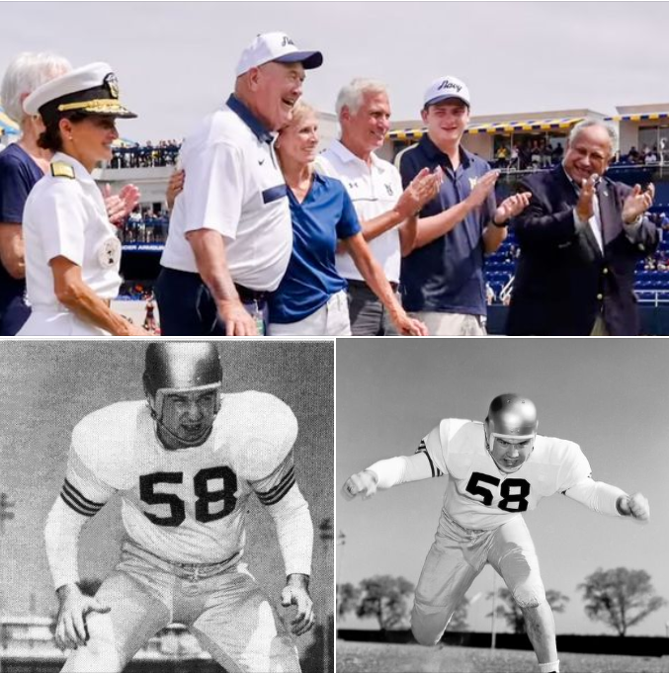
GM
Leadership Report –
John Viola

Slide 2
Chief Tim Robinson
  Grants
  Cell phone reception
  School buses

Slide 3
Initiatives
  Golf Course Irrigation
  Veterans Memorial Pavilion
  Racquet Sports Building
  Jet Ski Slips
  Firehouse
  Electric at Sports Core Pool
  RFP – Food & Beverage
  Operations
  Maintenance
  Drainage
  Roads
  Bulkheads
  Mailboxes
  Metrics

Slide 4
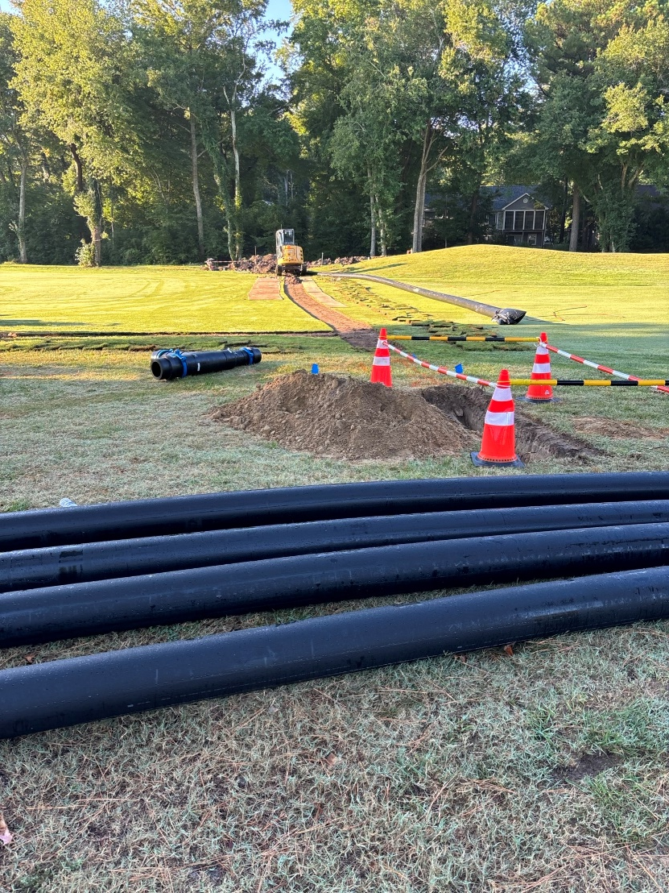
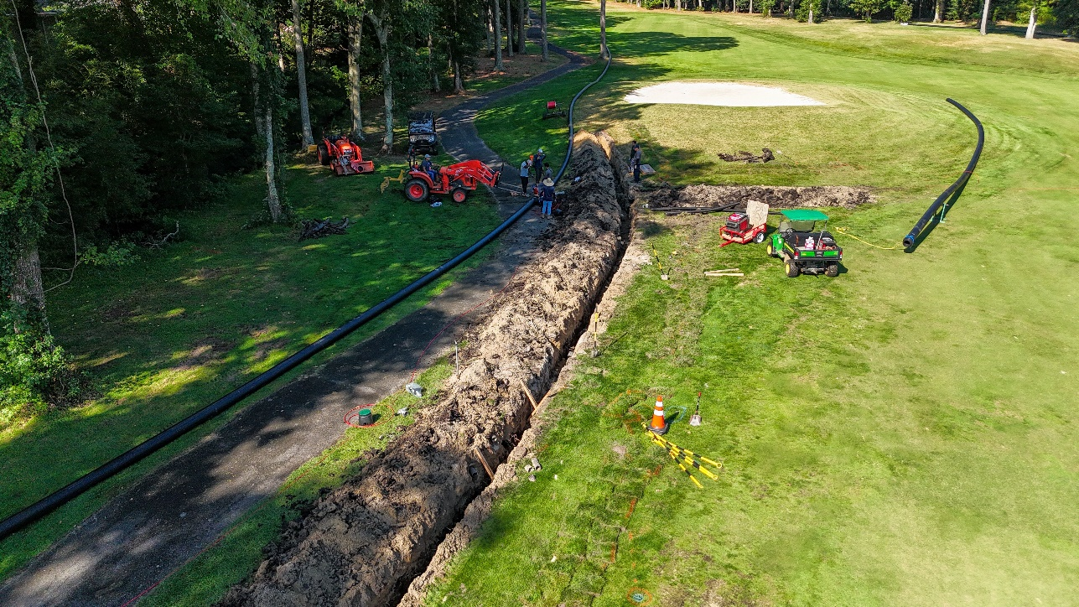
Golf Course Irrigation
  Phase I
  Timeline: started this month, to be completed by February/March
  Cost: $934,000
  Status: Green

Slide 5
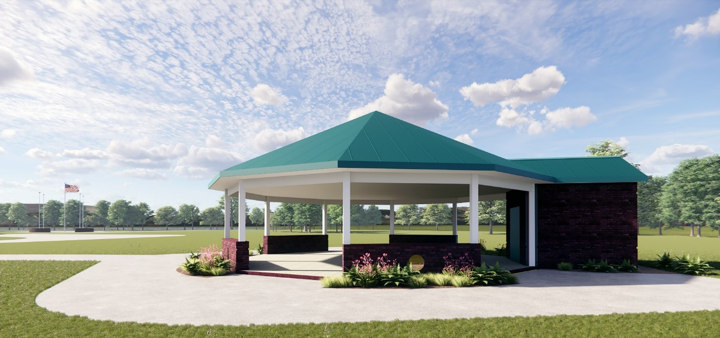
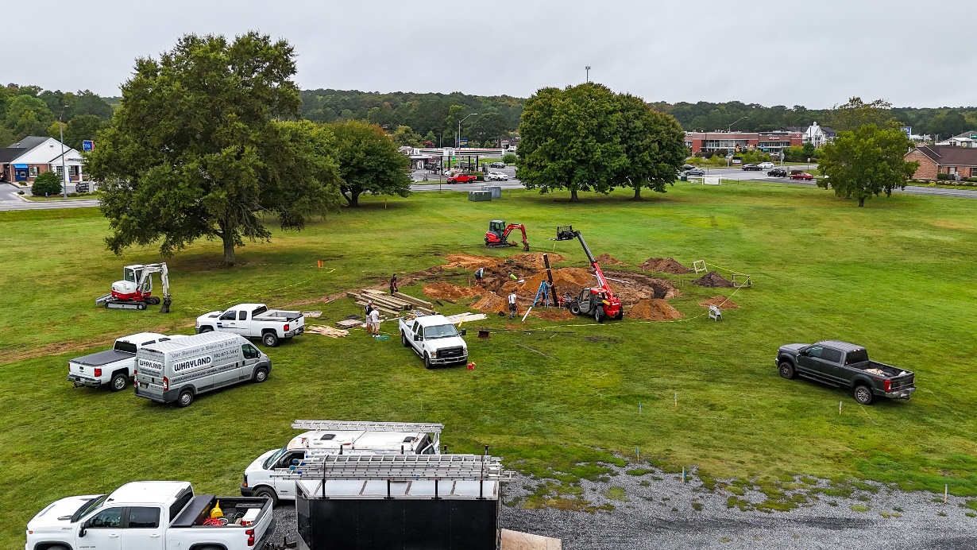
Veterans Memorial Pavilion
  Timeline: anticipated completion by Veterans Day
  Cost: $200,000
  Status: Green

Slide 6
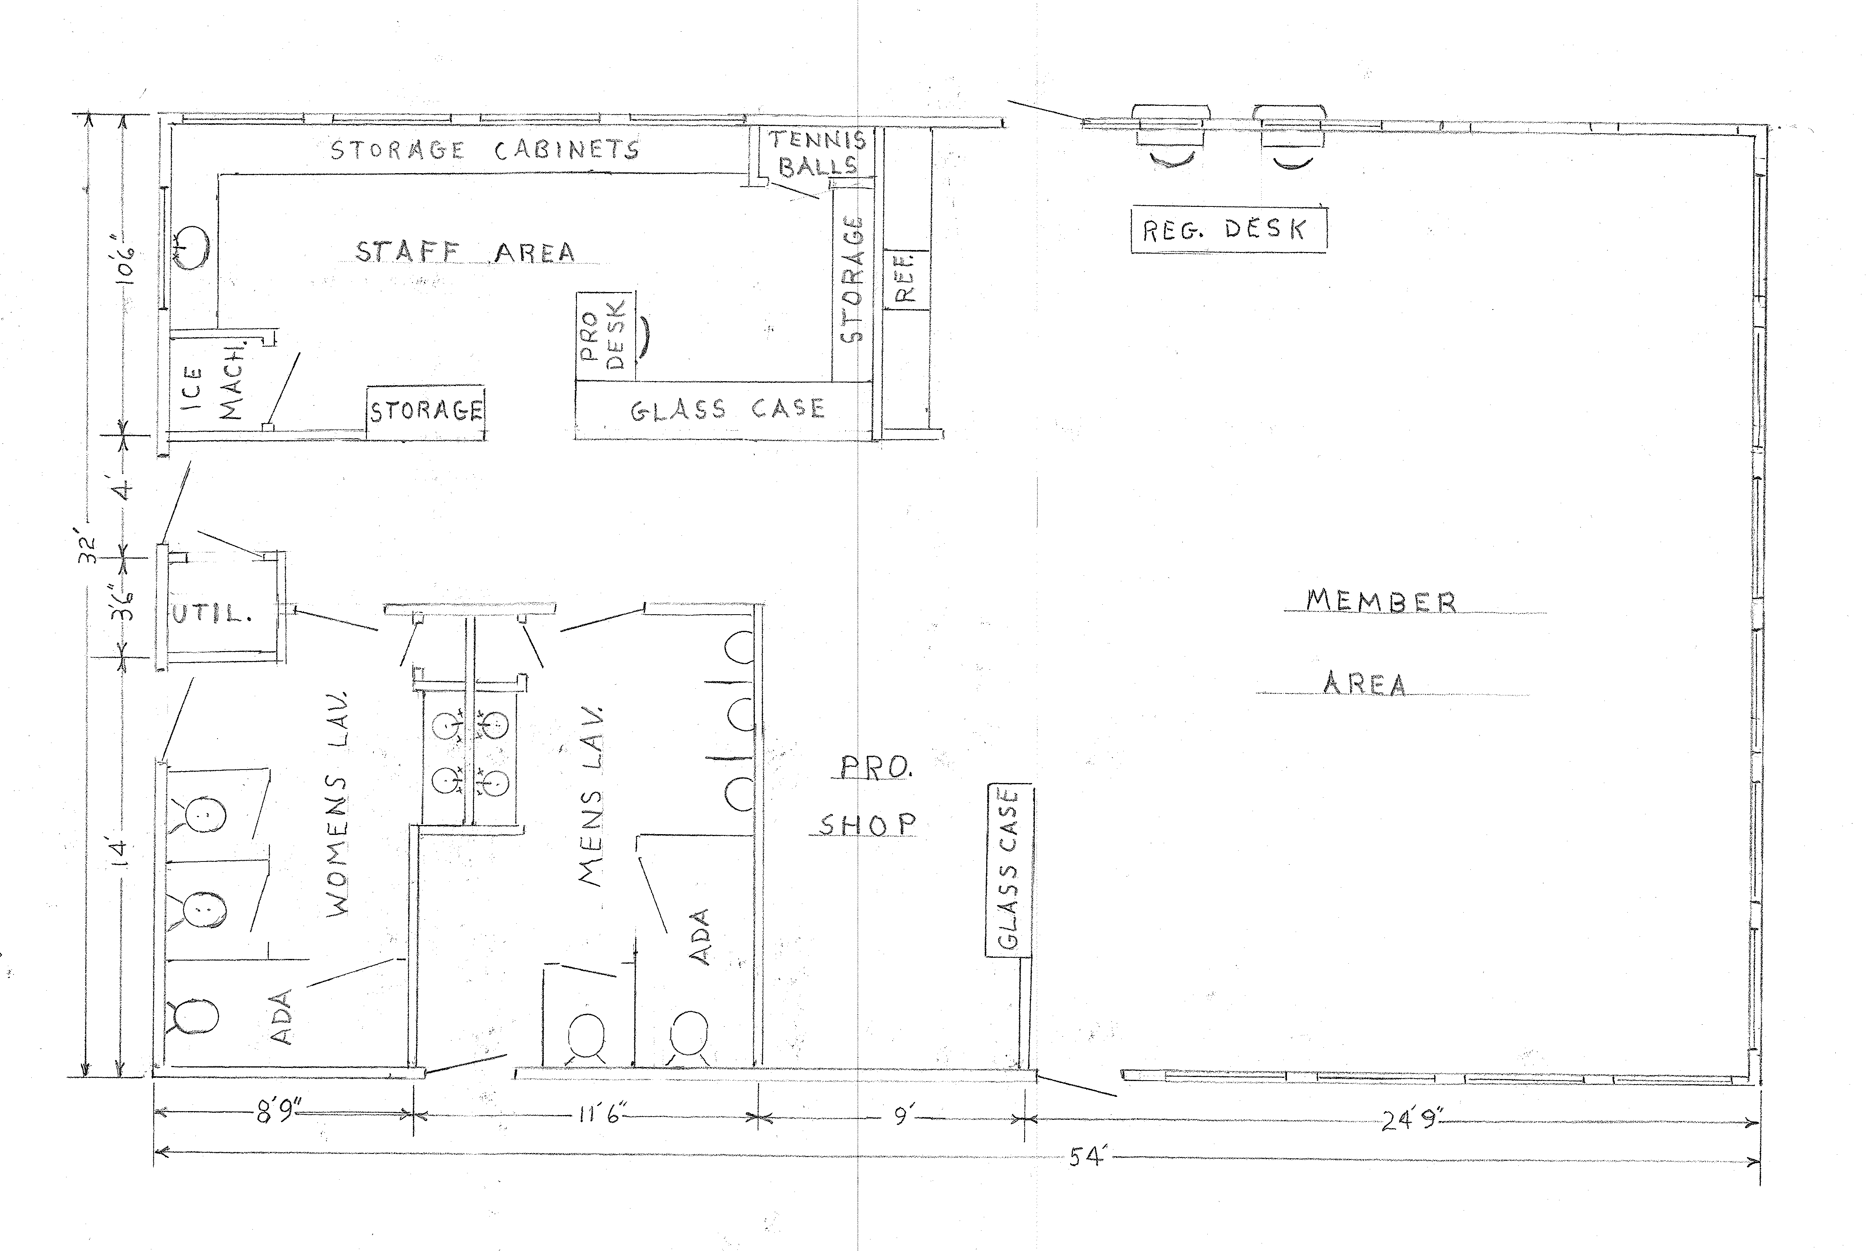
Racquet Sports Building
  Timeline: to begin Fall & Winter 2024/2025
  Estimated Cost: $150,000
  Status: Green (planning stage)

Slide 7
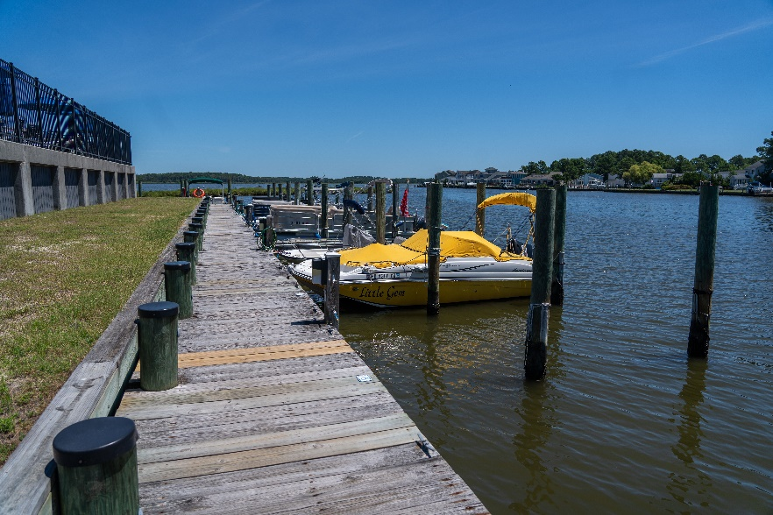
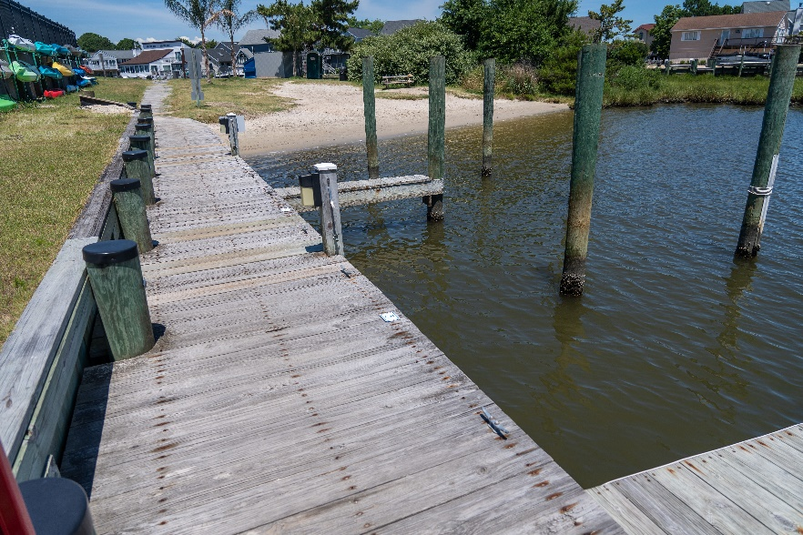
Jet Ski Slips
  Timeline: reviewing options for installing jet ski slips at the Swim & Racquet Marina by next season (we have received interest)
  Cost: TBD
  Status: Green (planning stage – 6 slips)

Slide 8
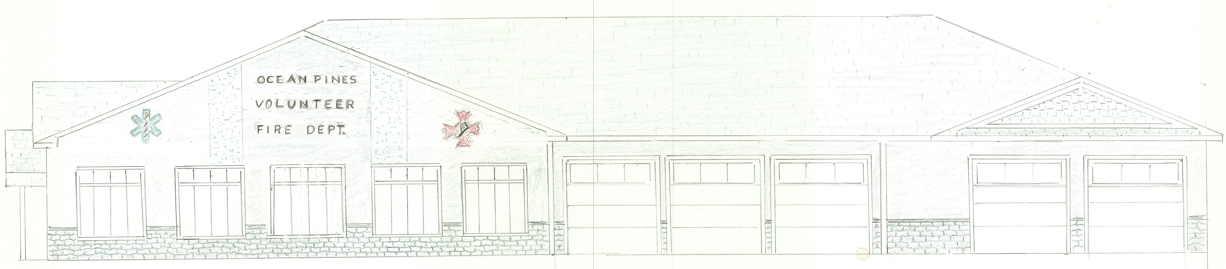
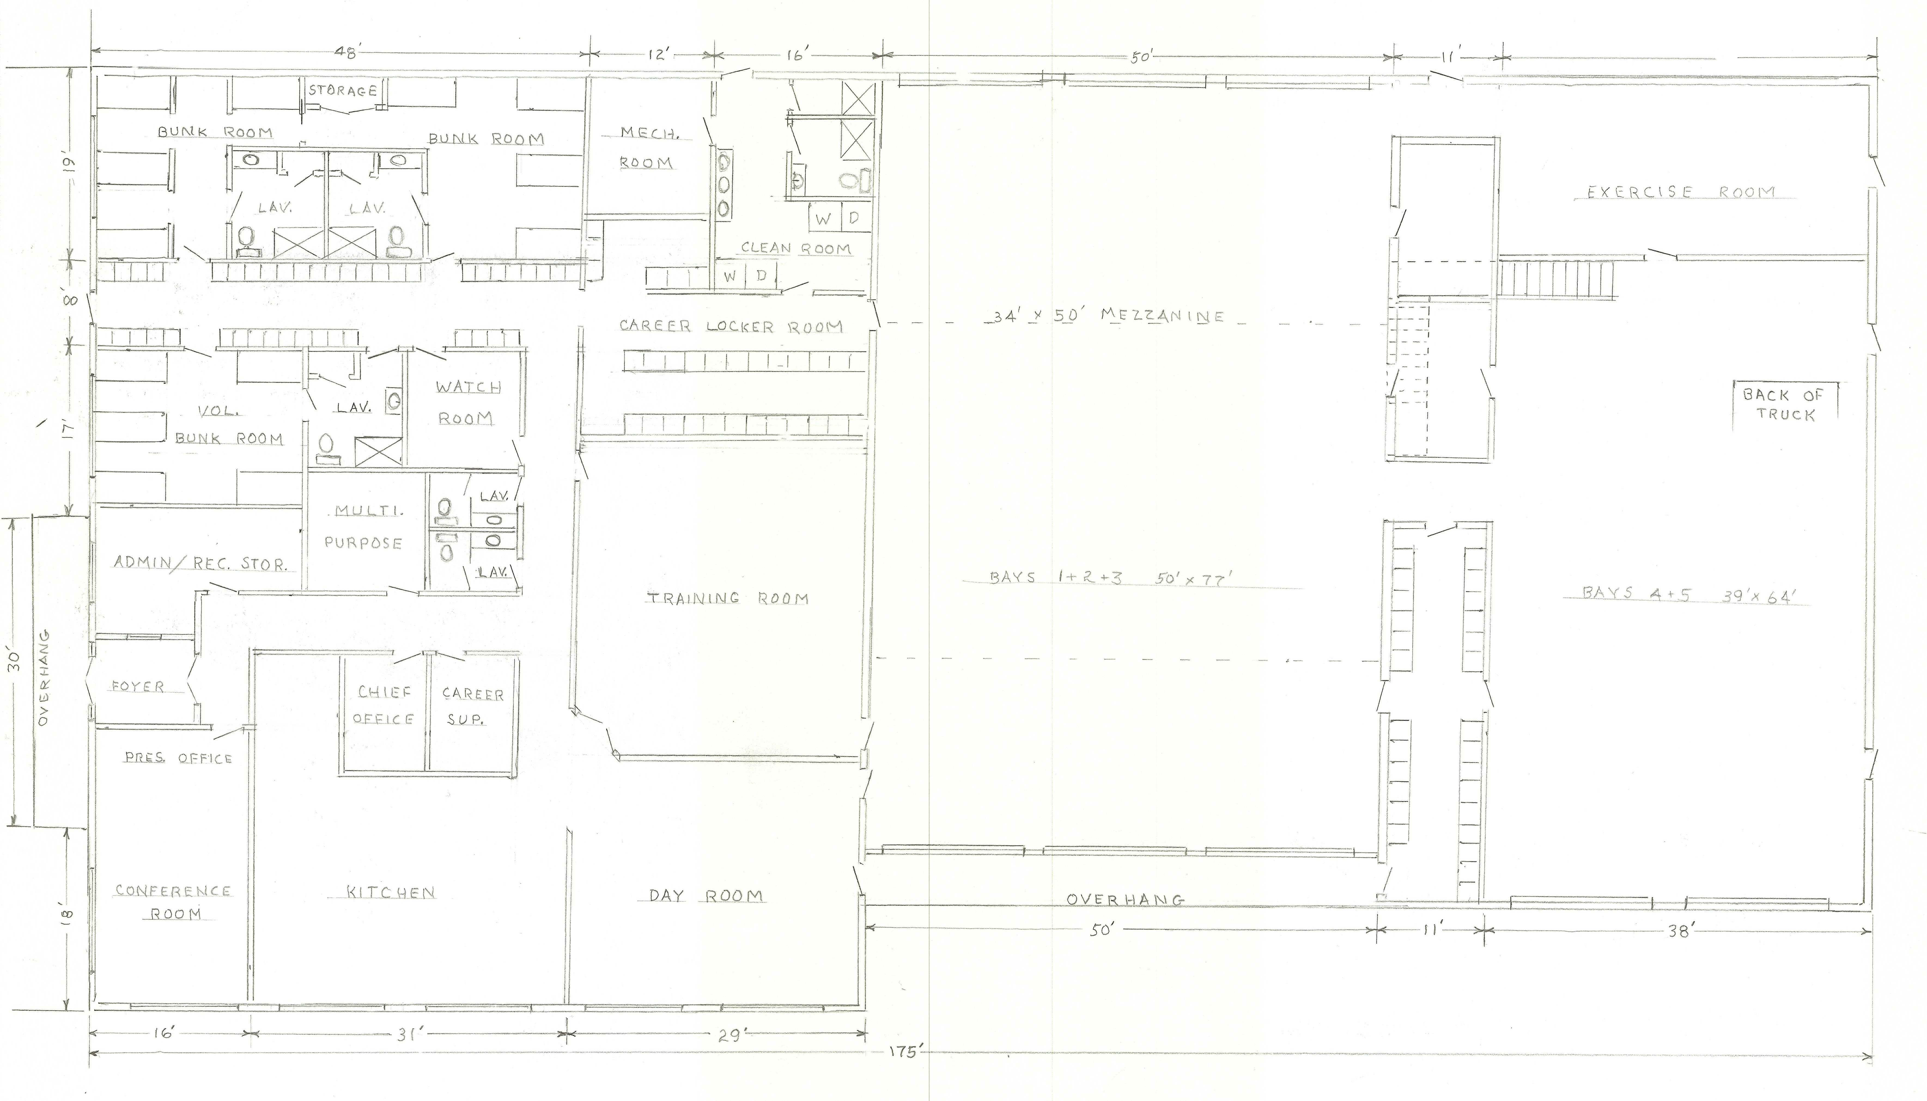
Firehouse
  Timeline: shovel in the ground Fall 2025
  Cost: TBD
  Agreement made on preliminary plans with 15,110 sq. footage
  Status: Green (planning stage)

Slide 9
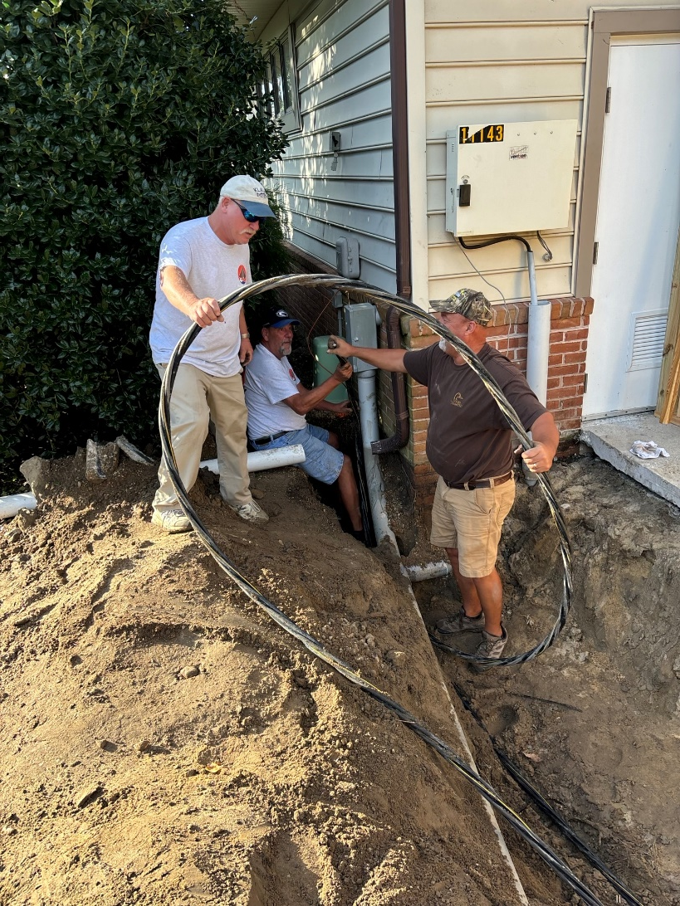
Electrical Issues at Sports Core Pool
  Electrical issues found on September 2nd (loss of power)
  Repairs completed in-house by Public Works to including running new wire to the building
  Outsource vs. in-house

Slide 10
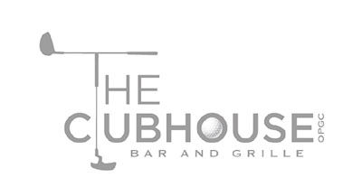
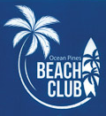
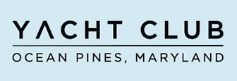
RFP – Food & Beverage
  Current contract for food and beverage services ends April 30, 2025
  RFP required per Section 9.05 of the Bylaws
  RFP release date: September 13, 2024
  Questions & inquiries deadline: October 4, 2024
  Proposal submission deadline: October 18, 2024
  To be presented at the October 26, 2024 Board Meeting
  It is a process – the team is fully engaged

Slide 11
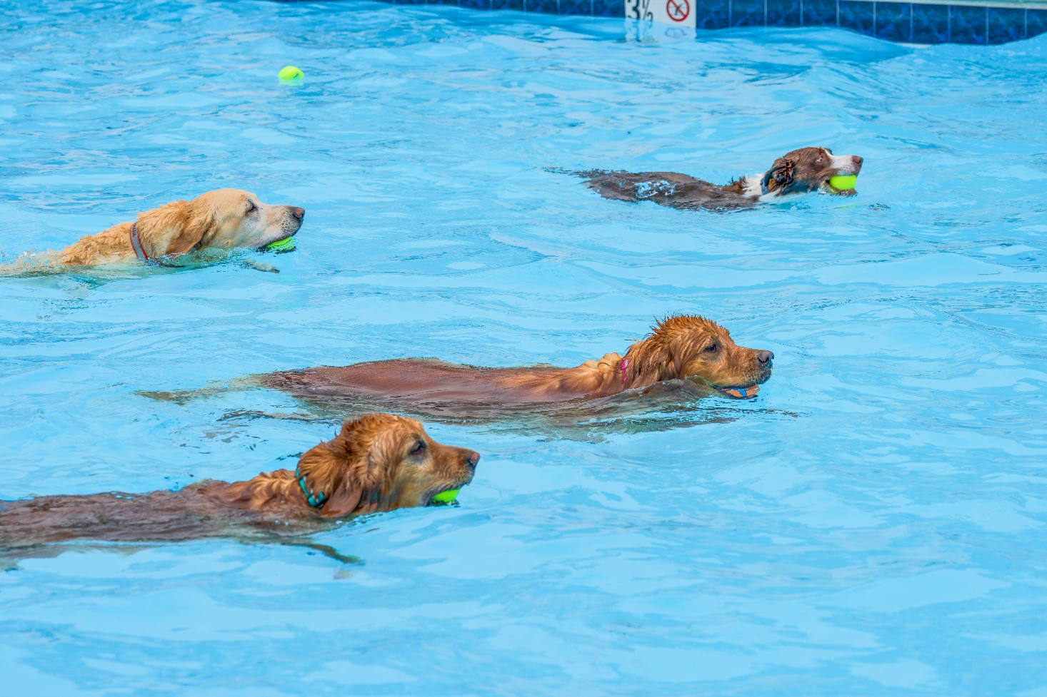
Director of Business Administration –
Linda Martin

Slide 12
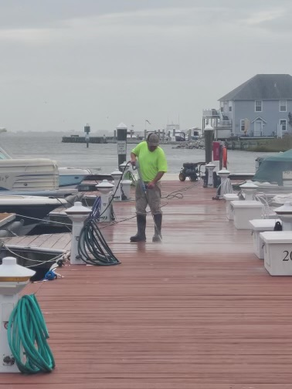
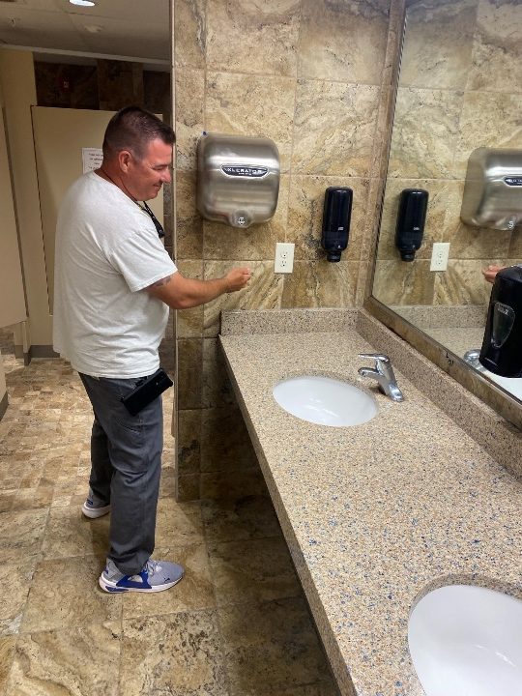
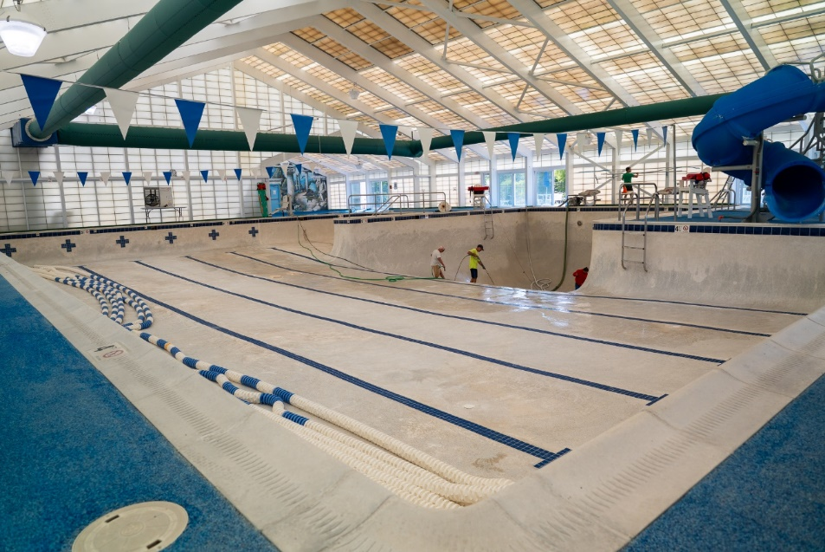
Maintenance
  Beach Club – installed air hand dryers
    Air hand dryer also to be installed in upcoming racquet center bathroom renovation
  Sports Core Pool – closed August 19 – September 2 for cleaning
  Marina – cleaned docks
  Yacht Club Pool – removed ladder for repair

Slide 13
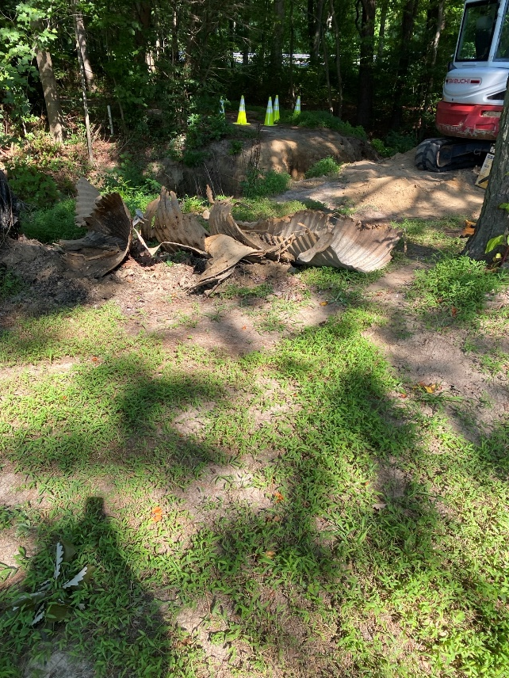
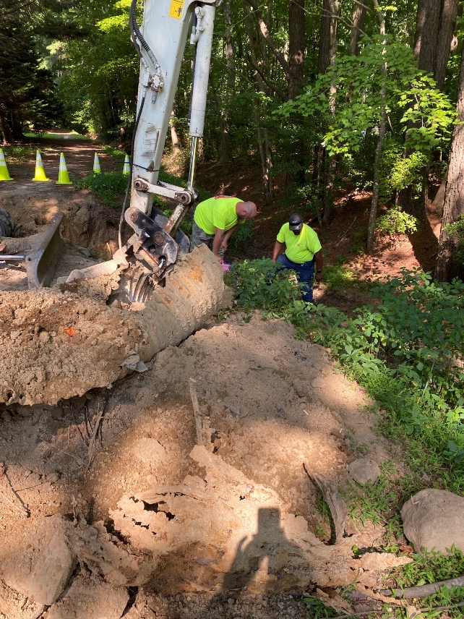
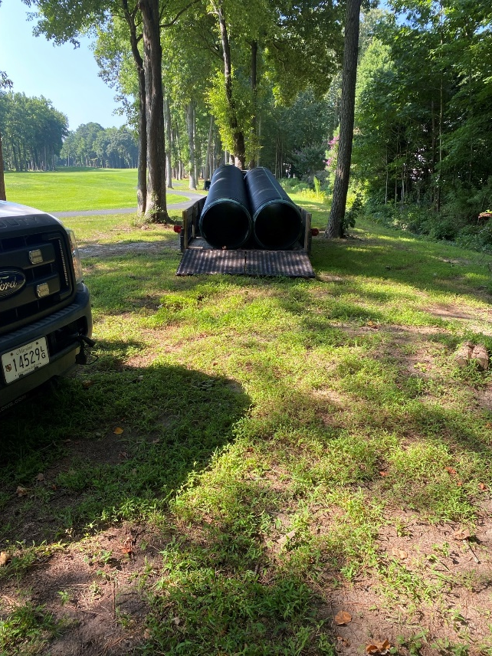
Drainage
  Repair made to failing drainage pipe:
    Work done in-house by Public Works
    Total cost: $1,878

Slide 14
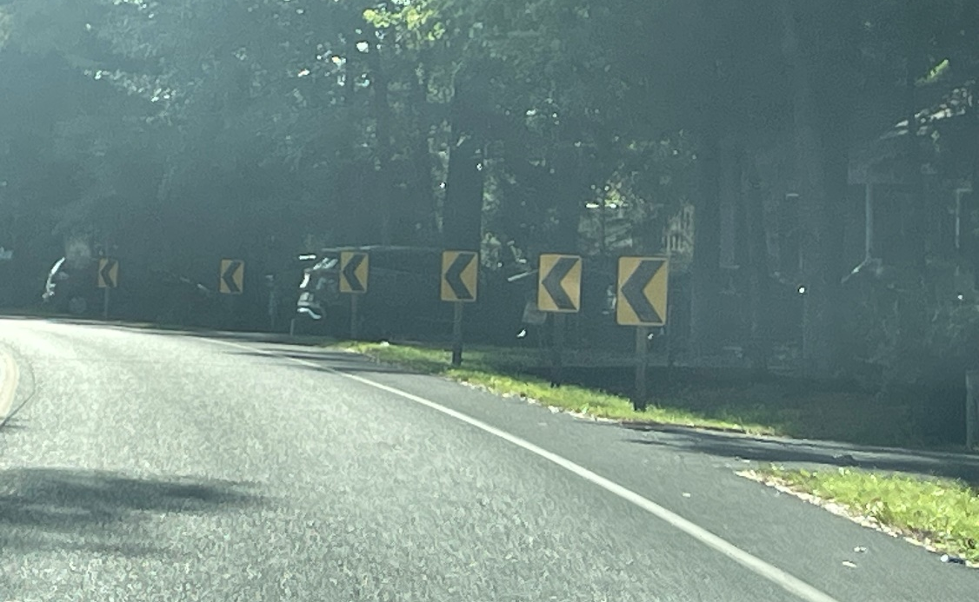
Roads
  Road paving – roads to be completed this year:
    Commodore Court, Dinghy Court, Fairhaven Court, Juneway Lane, Portside Court, Riverside Court & Weeping Willow Court
  Road safety:
    Curve signs added to Ocean Parkway

Slide 15
Bulkheads
  2024/2025 Bulkhead Replacement to begin soon
  Properties to be completed:
    74, 76, 78 & 80 Wood Duck Drive
    4, 8, 10, 14, 16, 18 20, 22, 23, 24, & 25 Mallard Drive East
    3, 5, 7, 9, 11, 13, 15 & 17 Ebb Tide Court

Slide 16
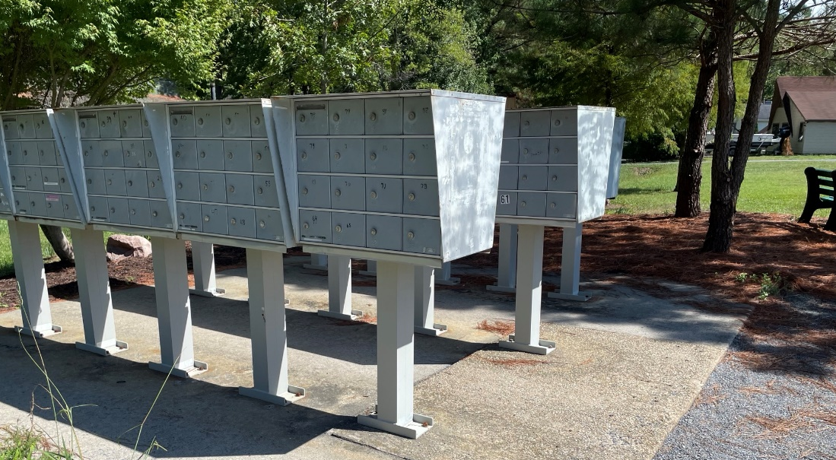
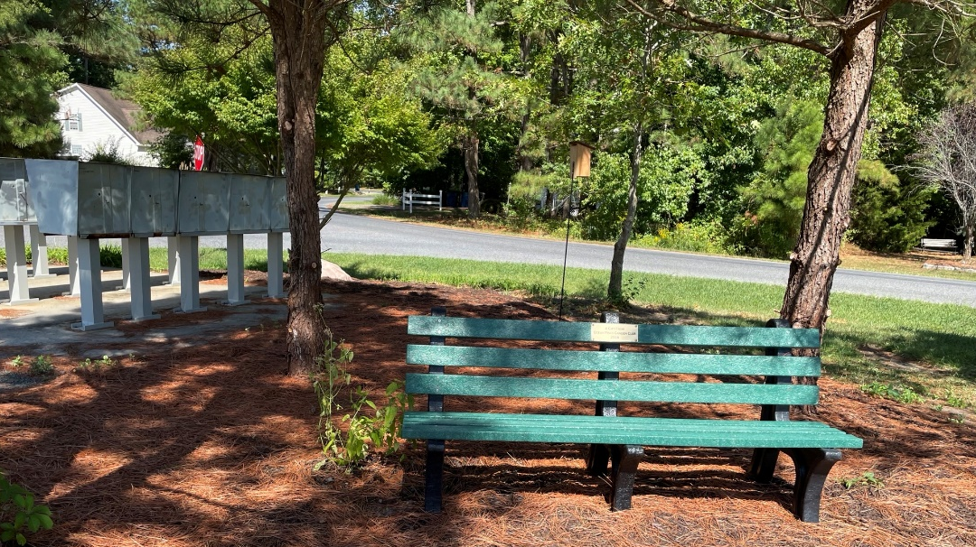
Mailboxes
  Hopewell Court:
    Pedestals replaced (per phase I of the mailbox project)
    Bench donated by the Ocean Pines Garden Club and placed near the mailboxes

Slide 17
CPI Violation Dashboard
August
Violations
As of 8/1/24 | New Violations | Closed Violations | As of 8/31/24
266 | 146 | 169 | 243
146 violations initiated in August: 63 maintenance/trash/debris; 17 no permit; 21 signs; 45 miscellaneous
  Miscellaneous violations includes stop work orders, trailers, unregistered/junk vehicles, and vehicle parking
169 violations complied out; 243 remain open
  97 maintenance/trash/debris; 57 no permit; 14 signs; 75 miscellaneous

Slide 18
Work Orders
August
Open Work Orders as of 8/1/24 | New Work Orders | Closed Work Orders | Open Work Orders as of 8/31/24
202 | 121 | 208 | 115
121 work orders initiated in August: 8 bulkhead; 29 drainage; 15 grounds/landscaping; 2 roads; 3 signs; 64 general maintenance
Majority still open in drainage (56):
  8 – over 30 days; 24 – over 60 days
    Average 1-4 work orders a day to complete depending upon severity

Slide 19
Customer Service Dashboard
(from info@oceanpines.org)
August
Type | # Received – Aug.
Amenities | 31
CPI | 28
Drainage | 2
General | 38
Public Works | 13
TOTAL | 112

Slide 20
Financials

Slide 21
Budget 2025-2026
  Pivot
  The cost of safety and decisions made
  Support department and amenities (Golf, Aquatics, Rec & Parks and Racquet Sports) continue to address costs and efficiencies
  Increase investment in amenities
  Pricing studies

Slide 22
MONTH OF AUGUST 2024
FINANCIAL RESULTS

Slide 23
AUGUST 2024 YTD
FINANCIAL RESULTS

Slide 24
PUBLIC SAFETY PERCENTAGE OF ASSESSMENT

Slide 25
PUBLIC SAFETY INCREASES TO ASSESSMENT

Slide 26
UNAUDITED RESERVE SUMMARY
AUGUST 2024 ($ MILLIONS)
 | General Replace | Bulkheads | Roads | Drainage | New Capital | Total
4/30/24 Balance | $5.5 | $0.3 | $0.8 | $0.4 | $0.1 | $7.1
Contributions/ Interest | 1.8 | 1.1 | - | - | - | 2.9
Casino Funds | - | - | 0.3 | 0.1 | - | 0.4
Transfer (Spend) | (1.1) | (0.3) | - | (0.2) | - | (1.6)
8/31/24 Balance | $6.2 | $1.1 | $1.1 | $0.3 | $0.1 | $8.8
Est Remaining FY Spend | (1.2) | (0.8) | (0.3) | (0.2) | - | (2.5)
4/30/25 Estimate | $5.0 | $0.3 | $0.8 | $0.1 | $0.1 | $6.3

Slide 27

Treasurer’s Report -
Monica Rakowski

Slide 28

Cash & Short-Term Investments
Month of August
As of August 31, 2024, the Association had Approximately (~) $18.9M in Cash
  Cash Increased ~ $0.2M from the Same Time Period Last Year
  Cash Decreased Less than ~ $0.1M from July 2024
  $11.6M Invested in CDAR’s
  $66K in Interest Income Recognized for the Month
  Remaining $7.3M in Insured Cash Sweep, Treasury Bills, Money Market and Other Operating Accounts (Diversified Between 2 Local Banks)

