Slide 1


Public Budget Hearing on
Recommended FY 2024-2025 Budget
February 7, 2024
11:00 AM – Clubhouse Meeting Room

Slide 2
Recommended FY 2024/2025
Key items that were addressed
  Pricing
  Salaries (statutory)
  Reserves
  Safety
  Capital (will address in a separate slide)
Recommended budget highlights
  Increased revenue from amenities
  Increased spend replacement
  Lower assessment

Slide 3
Recommended FY 2024/2025
Infrastructure
  Roads
  Bulkheads
  Drainage
  Capital Replacement
Balance Sheet
DMA Study
  November 2024
Initiatives
  Tiki Bar
  Racquet Sports building
  Veterans Memorial pavilion

Slide 4



Estimate/ Budget
Comparison

Slide 5
Department Summary

Slide 6
Assessment Rates

Slide 7
Assessment Summary

Slide 8
Assessment Detail

Slide 9
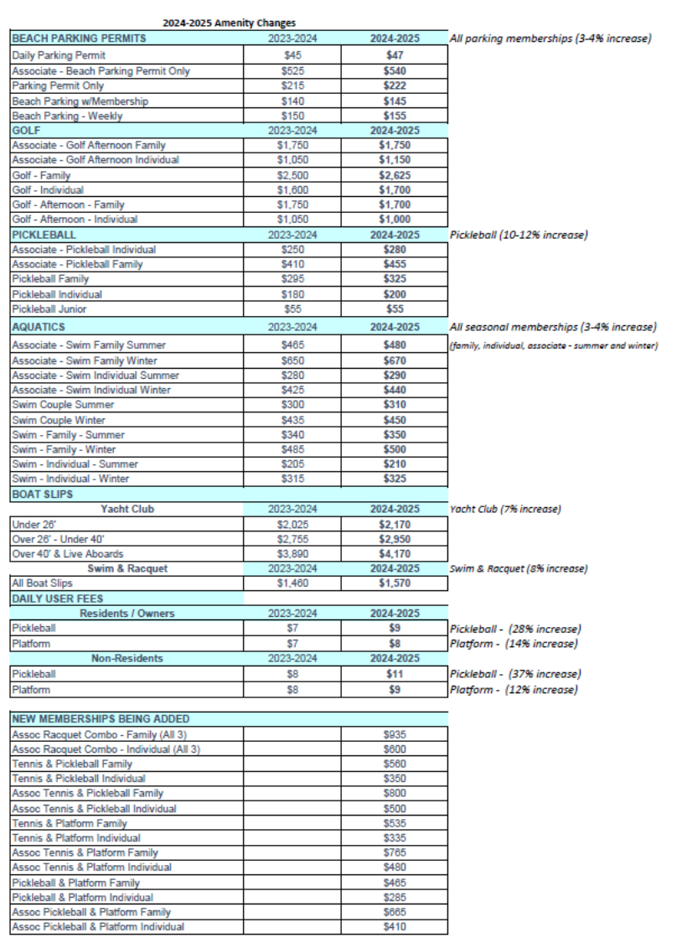
Memberships
Pricing Schedule – Recommended Changes
Daily

Slide 10
Pricing Schedule – Recommended Combo Pricing
New

Slide 11
Capital Summary

Slide 12
Capital Items/Projects

