Slide 1

Ocean Pines
Advisory Committees
Protocols and Helpful Information

Slide 2
Index
Committee Information - Page 3
Committee Protocol - Page 4
Virtual Meeting Protocol - Page 5
Using Microsoft Teams - Page 6
Sharing Documents in Teams - Pages 7-8
Notes on Microsoft Teams - Page 9
FAQ - Pages 10-14

Slide 3
Committee Information
Committee information, including member and liaison emails, meeting minutes and agendas, committee reports, committee resolutions, charging documents, and committee applications, can be found on the Ocean Pines website here: https://www.oceanpines.org/web/pages/includes-advisory-committees.
Committee meeting dates, including links to virtual and hybrid meetings, can be found on the Ocean Pines website here: https://www.oceanpines.org/web/pages/advisory-committees

Slide 4
Committee Protocol
Committee chairpersons should send committee meeting agendas, meeting minutes, and other reports to Michelle Lane-Ross, Administrative Assistant for the General Manager’s Office, at mross@oceanpines.org.
To schedule a committee meeting, email Michelle at mross@oceanpines.org and include the date, time, and requested location.
  Chairs should send meeting info for the new calendar year each January.
  Requests for virtual or hybrid meetings using Microsoft Teams should also made at this time.
All other committee requests should go through the committee liaison.

Slide 5
Virtual Meeting Protocol
Hybrid meetings using Microsoft Teams may be held in the Administrative Conference Room (formerly the Peach Room). Michelle will make sure a member of the IT Department is able to help you start the Teams meeting.
For a fully virtual meeting using Microsoft Teams, committee chairs must coordinate with their liaison to start the meeting.
*NOTE: Committee members may use virtual environments other than Microsoft Teams, such as Zoom, Google Meet, etc. However, those meetings must be set up and run by the committee members, without staff support.

Slide 6
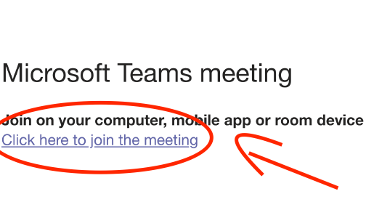
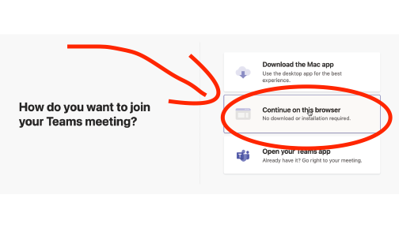
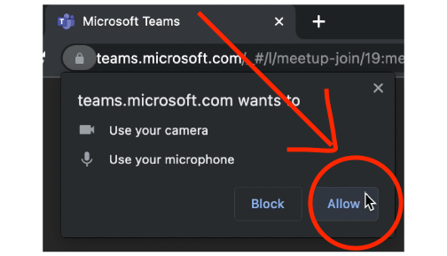
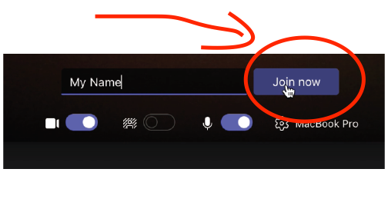
Using Microsoft Teams
To join a Microsoft Teams meeting on your browser, click on the invite link in your email, or find the link on the Ocean Pines website here: https://www.oceanpines.org/web/pages/advisory-committees.
Click on "Continue on this Browser"
If prompted, allow Teams to use your microphone and camera
Enter your name, and click "Join now"

Slide 7
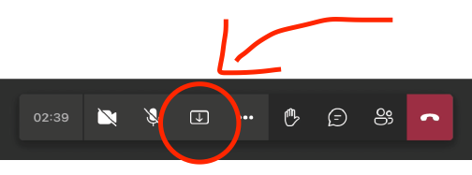
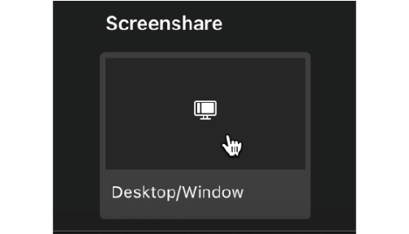
Sharing Documents in Teams (1 of 2)
To share a document on your browser, such as a PDF file or PowerPoint presentation, click on the "Screenshare" icon. Make sure the file is already open.
Click on the "Desktop/Window" button
(Continued on next page)

Slide 8
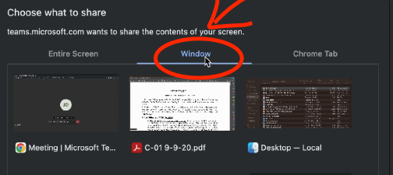
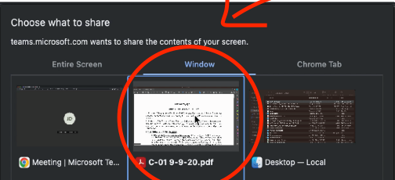
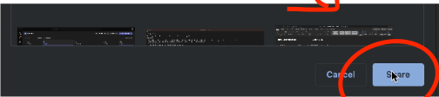
Sharing Documents in Teams (2 of 2)
Select "Window"
Select your file
Click "Share"

Slide 9
Notes on Microsoft Teams
If you are using the Microsoft Teams app, you will need a Microsoft account. To learn how to create a new account, visit https://support.microsoft.com/en-us/account-billing/how-to-create-a-new-microsoft-account-a84675c3-3e9e-17cf-2911-3d56b15c0aaf.
For a video tutorial on joining Microsoft Teams meetings, visit https://youtu.be/6pauAUOl8v4.
For more Microsoft Teams tutorials, visit https://www.youtube.com/@Microsoft365/playlists?view=50&sort=dd&shelf_id=6.

Slide 10
FAQ
Q: How should committees handle recording Microsoft Teams meetings?
A: We currently have three options on how to deal with this:
  The Board makes the decision that committee meetings are not recorded.
  The Board makes the decision that liaisons will handle that responsibility for their committee assignments (they can start and stop the recording and email files to be posted).
  The Board tasks the GM with assigning someone the responsibility (staff would only have to start and stop the recording – does not require attending the whole meeting).
Q. If a meeting is totally virtual and the committee liaison is not available, how will that be handled?
A. If that or any other last-minute requests occur, send an email to Michelle and staff will try to make special accommodations.

Slide 11
FAQ
Q. How much advance notice is needed for special accommodations, such as a virtual, hybrid, or other special meetings?
A. We ask that at least 2-3 days’ notice is provided. Requests for any special accommodations should go to Michelle.
Q. Does screen sharing in Microsoft Teams work with files other than PDF and PowerPoint, such as Microsoft Word documents?
A. Yes. The screen sharing function will work with nearly any file type. However, those files need to be open on your computer prior to being shared.
Q. If a committee chair sets up their own virtual meetings using Zoom or another platform, can those files be uploaded and shared through YouTube?
A. Yes. A link to the file would just need to be emailed to Michelle for posting.

Slide 12
FAQ
Q. Does OPA plan on doing away with the Ocean Pines Association YouTube channel and instead posting meeting videos to a dedicated cloud site that can only be accessed by membership?
A. Not currently. However, as that is a policy question, that would ultimately be up to the Board of Directors.
Q. Is scheduling a hybrid meeting any different than scheduling a normal meeting?
A. Scheduling a hybrid meeting is just like scheduling any committee meeting. The request should go through Michelle, and she will reserve the room and make sure IT is available to help start the meeting.
  Please note: Currently, OPA only has the capability for hybrid meetings in the Administration Conference Room (formerly the Peach Room), which is available from 8 a.m. to 4:30 p.m.

Slide 13
FAQ
Q. What if I need Wi-Fi for a hybrid meeting, to use a laptop or other device to share files through Microsoft Teams?
A. Committee chairs should make that request when scheduling a meeting, and Michelle will let IT know, so they can help connect you to Ocean Pines Wi-Fi.
Q. Do committee chairs need to copy anyone else when sending minutes, reports, or requests for meetings?
A. Michelle will make sure any requests are sent to the appropriate party. There is no need to copy others. However, committee chairs may copy their Board liaisons, so they are aware of committee activities.

Slide 14
FAQ
Q. Do committees who meet 100% in person need to use Microsoft Teams?
A. No. There is currently no requirement for committees to incorporate virtual/hybrid meetings. It’s just a tool available to help if some committee members or Board liaisons are often out of town, are part-time residents, or cannot meet in person for another reason.
Q. How does the audio work for hybrid meetings in the Administration Conference Room?
A. We use a small, circular mic that should be placed on the center of the table, and/or close to the committee chairperson. Before starting, make sure the button in the center is green (unmute) and not red (mute). If you need assistance from IT, please ask the front desk receptionist.

