Slide 1

Board of Directors Meeting
November 18, 2020

Slide 2
Approval of Agenda

Slide 3
Approval of Minutes
October 17, 2020 – Regular Meeting
October 21, 2020 – Special Meeting
October 28, 2020 – Special Meeting

Slide 4
President’s Remarks
Larry Perrone

Slide 5
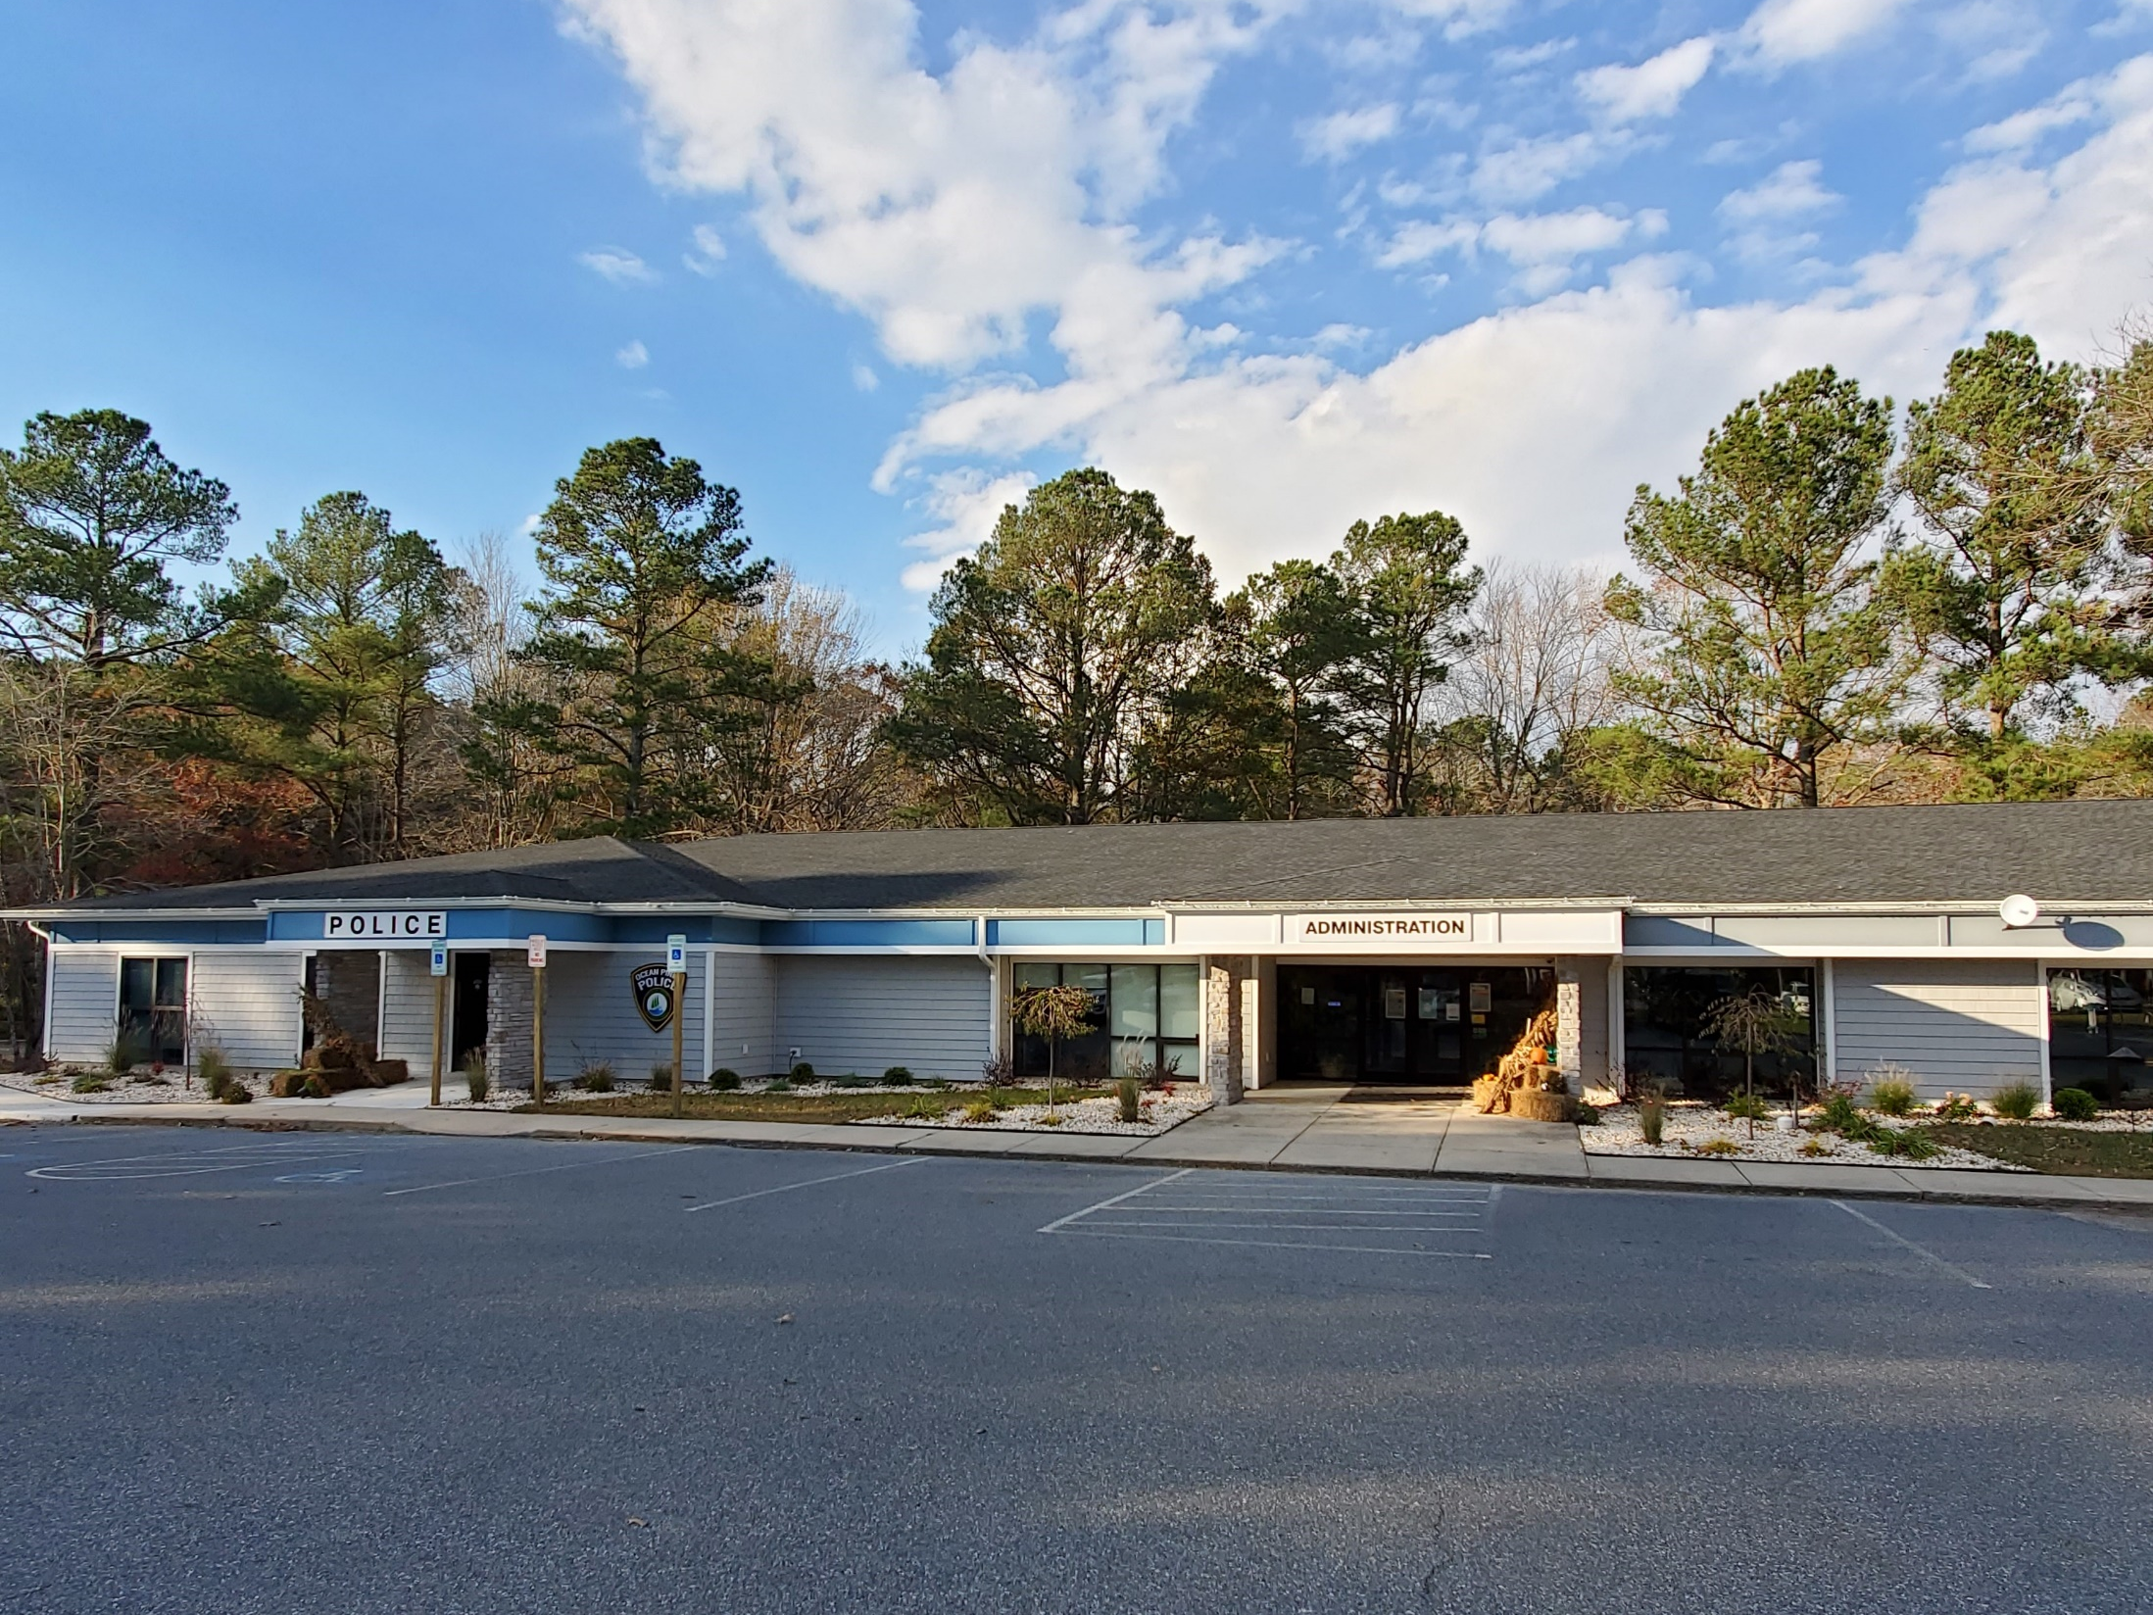
GM team Report
John Viola

Slide 6
FY 2021-22 Proposed Budget Overview
Proposed Budget Binders to be delivered to the Board and B&F Committee on Friday, December 18, 2020.
Prepared based upon B&F and Board guidance utilizing a bottoms up approach. Every Department Head will be involved in their budgets and will be a part of the presentation to the B&F Committee and the Board.
B&F Committee presentation is scheduled for January 6th – 8th, 2021(Wed., Thurs. & Fri.)
Board will conduct Work Sessions on the budget Tuesday, January 19th & Wednesday, January 20th, 2021.
GM will publish recommended Budget on Friday, January 29th, 2021.
*Saturday, Feb. 6, 2021, 9 am, Board conducts hearing on recommended budget
Saturday, Feb. 20, 2021, 9 am, Board conducts final hearing and approves the budget
* Denotes meeting for member comment

Slide 7
GM TEAM REPORT
Personnel
The following have been completed for FY 2019/2020
Performance reviews
Segal Salary Adjustments
Merit Raises
Goals & Objectives
The following are in process-
6-month performance reviews for FY 2020/2021
Goals & Objectives FY 2020/2021
Succession Planning completed for all Direct Reports

Slide 8
GM TEAM REPORT
RFP’s
Waste Services RFP mailed on September 21, 2020. Bids were due on November 9, 2020. 2 bids were received, further negotiations will be conducted with Board approval.
Accounting Services RFP mailed on October 12, 2020. Bids were due on November 2, 2020. 3 bids were received and are being evaluated by staff. Recommendation will be brought to the Dec. Board meeting.

Slide 9
northstar
Budget Actual to Date
$400,000 *$448,000
*Outside Consulting
Needs High Degree of Customization
Success measured by front end users, departments & amenities embracing the system
Staff will continue to work on the system for 6 mos. – 1 year

Slide 10
Racquet center
Concrete replacement in several areas
Dedicated Public Works Employee
Repaired and replaced bathroom fixtures, flooring and paint
New lights and bulbs
Repaired fence and wind screens for Platform tennis
Currently working on estimates for replacement of sections of fence

Slide 11
CPI Violation Dashboard
OCTOber
Violations
As of 9/30/20 | New Violations | Closed Violations | As of 10/31/20
148 | 44 | 76 | 116
Legal Cases
As of 9/30/20 | New Violations to Legal | Closed Violations by Legal | As of 10/31/20
34 | 17 | 8 | 43
As of 10/31/20 | New Violations to Legal | Closed Violations by Legal | Total Count
43 | 6 | 2 + 12 to be resolved out of court with Board/GM approval | 35
The 12 violations noted will need Board approval (December meeting) per the DR’s.

Slide 12
DASHBOARD
Delinquent Accounts
# Lots Delinquent | July 31, 2020 | 1071
# Lots Delinquent | August 31, 2020 | 790
# Lots Delinquent | September 30, 2020 | 601
# Lots Delinquent | October 31, 2020 | 549
1 year or less delinquent |  | 447
# Delinquent Lots Currently with Attorney |  | 59
Resolution F-04
Due May 1st | Interest Added June 1st
1st Delinquent letter | July 1st
2nd Delinquent letter | August 1st
Lien Action letter | September 1st (certified)
Liens are then filed with Worcester County by October 30th (5 mos. From Aug 1st, Jan. 31st)
Accounts 2 years or older forwarded and coordinated with Attorney for collection (from October)

Slide 13
Financial Change month of SEPTEMBER 2020
September (In Thousands)
 | Budget | Current Year | Favor/ (Unfavor) vs. Budget
Net Revenues | $498 | $614 | $116
Expenses | 1,095 | 1,063 | 32
Net Operating | ($ 597) | ($ 449) | $148

Slide 14
Financial Change ytd SEPTEMBER 2020
September YTD (In Thousands)
 | Budget | Current Year | Favor/ (Unfavor) vs. Budget
Net Revenues | $11,232 | $11,454 | $222
Expenses | 6,137 | 5,226 | 911
Net Operating | $5,095 | $6,228 | $1,133

Slide 15
Detail for the Month of SEPTEMBER
Favor/(Unfavorable) Vs. Budget
Public Works/General Maint/CPI | $67.4
Golf Ops/Maintenance | 28.4
Recreation/Parks | 23.4
Beach Club | 22.3
Aquatics | 12.5
Public Relations | 12.2
Clubhouse Grille | 11.7
General Admin | (29.7)
Yacht Club | (5.8)
Other | 5.5
Net Operating | $147.9

Slide 16
Detail for September ytd
Favor/(Unfavorable) Vs. Budget
General Admin. | $976.1
Public Works/Gen Maintenance/CPI | 316.6
Yacht Club | 113.3
Marinas | 49.2
Finance | 43.7
Public Relations | 36.7
Police | 31.1
Clubhouse Grille | 27.7
Manager’s Office/Other (Net) | 5.4
Aquatics | (211.5)
Beach Parking | (188.5)
Rec & Parks | (39.2)
Beach Club | (5.0)
Golf Operations & Maintenance | (8.7)
Racquet Sports | (14.0)
Net Operating | $1,132.9

Slide 17
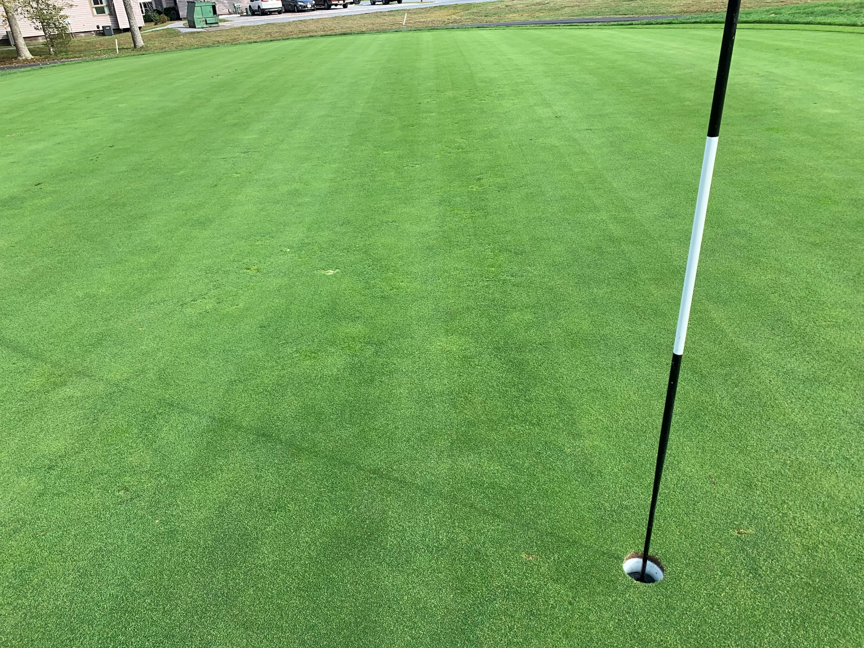

Slide 18
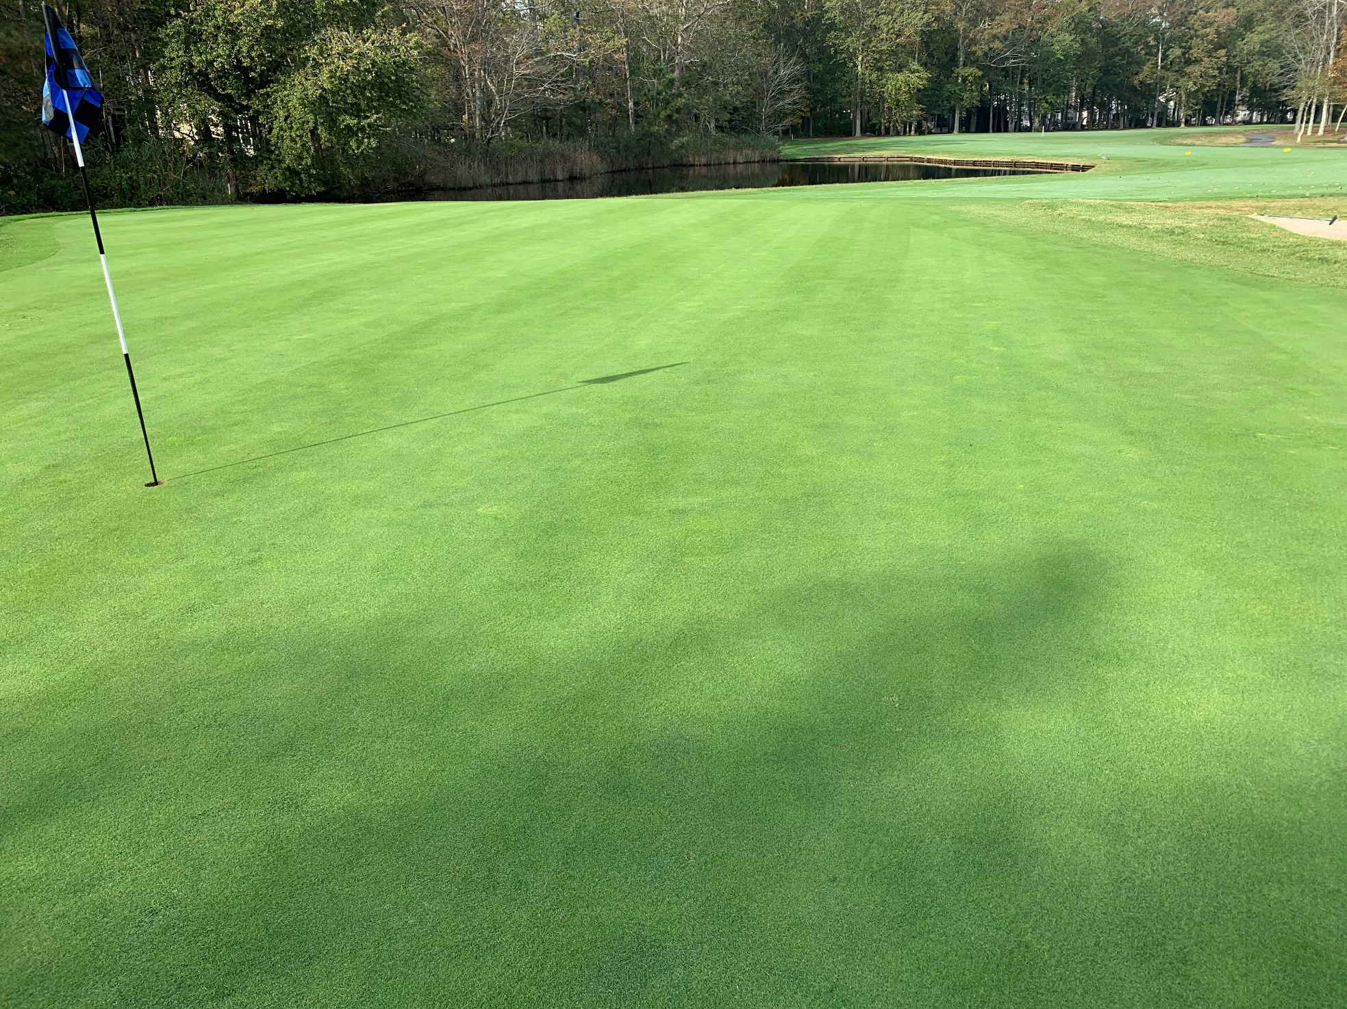

Slide 19
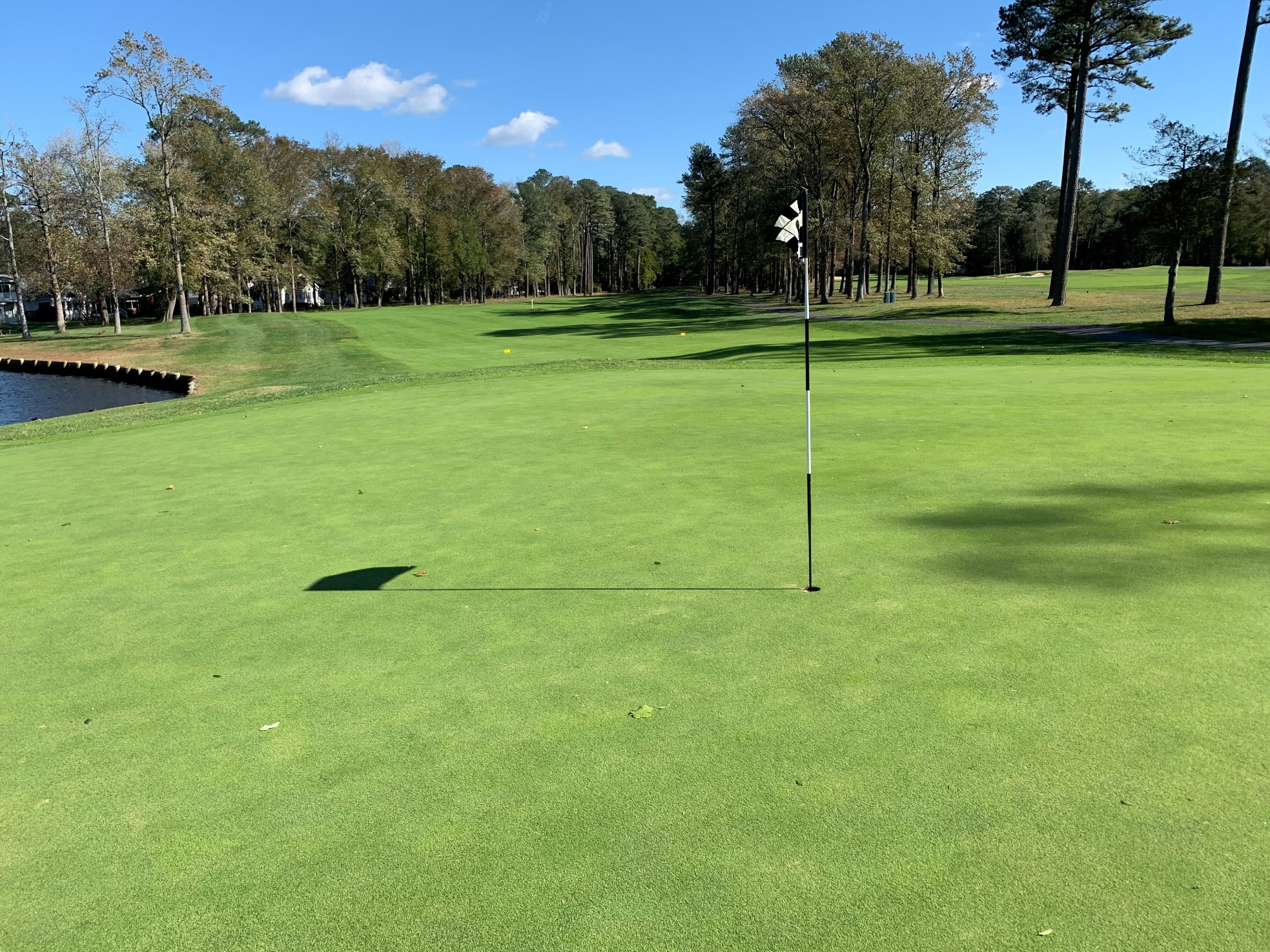

Slide 20
Month of October 2020 flash
October Estimate (In Thousands)
 | Budget | Current Year | Favor/ (Unfavor) vs. Budget
Net Revenues | $470 | $490 | $20
Expenses | 1,215 | 1,105 | 110
Net Operating | ($745) | ($615) | $130

Slide 21

Treasurer’s Report -
Doug Parks

Slide 22

Cash & Short-Term Investments
Activity for Month of September
Overall Laddered Investment Rate of Return on CDAR’s for September Approx. 1.0%
At September 2020, the Association had approx. $13.4 million in cash
  Approx. $7.1 million invested in CDAR’s, fully FDIC insured
  Approx. $6.3 million in Money Market and other operating accounts, fully insured

Slide 24
Unaudited Reserves September 2020 ($Millions)
 | GeneralReplace | Bulkheads | Roads | Drainage | New Capital | Total
4/30/20 Balance | $3.5 | $1.6 | $0 | $0.5 | $0 | $5.6
Assessments/ Interest | 1.8 | 0.9 | - | - | 0.2 | 2.9
Casino Funds | - | - | 0.3 | - | - | 0.3
Transfer (Spend) | (1.1) | (0.4) | (0.1) | (0.05) | (0.1) | (1.7)
9/30/20 Balance | $4.2 | $2.1 | $0.2 | $0.5 | $0.1 | $7.1

Slide 25
Reserves 4/30/21 unaudited estimate
(in thousands)
 | Beginning Balance |  |  | Projected Balance
 | 4/30/2020 | Additions | Expenditures | 4/30/2021
Major Maintenance & Replacement:
Police Renovation |  |  | (604)
Northstar |  |  | (75)
Admin Siding-Roof |  |  | (72)
Aquatics (Splash Pads, etc) |  |  | (50)
Yacht Club + Beach Club |  |  | (40)
Racquet Sports Sidewalks |  |  | (65)
Tractor for Ditch Maintenance |  |  | (150)
Police Vehicle |  |  | (40)
Other |  |  | (150)
Total | 3,481 | 1,825 | (1,246) | 4,060
Bulkheads & Waterways | 1,653 | 900 | (1,800) | 753
Roads | 0 | 330 | (100) | 230
Drainage | 506 | 5 | (529) | (18)
New Capital | 0 | 167 | (72) | 95
TOTAL 4/30/21 | 5,640 | 3,227 | (3,747) | 5,120

Slide 26
Public Comments

Slide 27
Capital Purchase Requests
Public Works – John Deere Tractor with boom
Golf Maintenance – Rough Mower

Slide 28
Public works
John deere tractor with boom
In the Budget for 2020/2021 (+$35,485.09 Covid related increases)
Requesting Authorization to go Forward in 2020/2021 with Staff Recommendation of $150,250.28 for Atlantic Tractor.

Slide 29
Golf Maintenance – Rough Mower
Not In the Budget for 2020/2021 but it is a replacement item
Requesting Authorization to go Forward with Staff Recommendation of $66,732.30 for Turf Equipment Supply Company.

Slide 30
unfinished Business
NONE

Slide 31
new Business
Discussion – Review of By-Laws – Colette Horn
Motion – To Allow GM to finalize Trash Removal Contract – Larry Perrone

Slide 32
Appointments -
Ann Shockley – 1st Term – Golf
Donald Nederostek – 1st Term – Budget & Finance

Slide 33

Adjournment To Closed Session

