Slide 1

Ocean Pines Strategic Planning Advisory Committee
Situation Analysis
3/29 BOD
Work-Session
3/2922

Slide 2
BOD Work-Session Objectives
Review and provide feedback/input to the situation analysis, conclusions &
implications
2. Time permitting, brainstorm preliminary 5-year goals for Ocean Pines
Note: If only accomplish #1 above, the meeting will have accomplished our objective

Slide 3
Agenda
  Review work-session agenda & objectives 9:00-9:15
  Review situation analysis & conclusions/implications 9:15-9:50
  Get input/feedback and/or alignment on analysis, conclusions & implications 9:50-10:10
  Public comments 10:10-10:20
  Start to develop preliminary 5-year goals for Ocean Pines* 10:20-10:45
  Review next steps/timing 10:45-10:50
  Public comments 10:50-11:00 :
*Time permitting. Note-If there is significant input and or feedback to the situation analysis, we will not
move to preliminary goal setting
We may need to be flexible with the agenda but we will end at 11:00 AM

Slide 4
Strategic Planning Advisory Committee
Team Members
Jenny Cropper-Rines
Rebecca Colt-Ferguson
Wes Blakeslee
Rob Keesling
Gary Miller
Helen Johnson
Team Members
Frank Brown
Vicky Eckenrode
Bernie McGorry
Staff Liaison
Josh Davis
Steve Phillips
BOD Liaison
Amy Peck

Slide 5
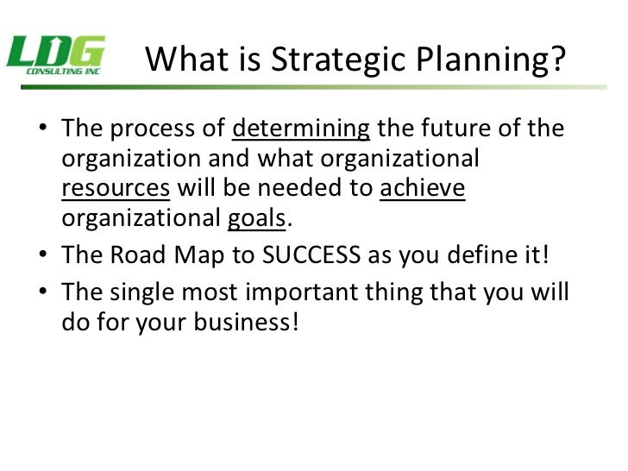
One other thing:
It gives you
permission to
Say NO

Slide 6
Background-Strategic Planning Process
Assessment of Situation
Goals
Objectives &
Strategies
Plan of Action
Action Taking
Gauging Impact
* Source Mellon HR Consulting

Slide 7
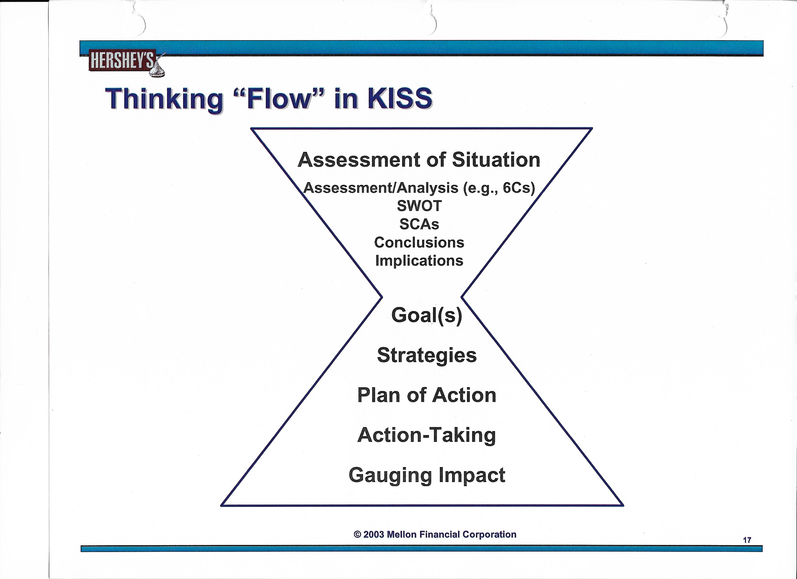
Background-Strategic Planning Process
Here is where we are

Slide 8
Background-Strategic Planning Process
Assessment of Situation
What is happening ?
Why is it happening (cause and effect) ?
Fact based vs. opinion
What are the conclusions ?
What are the implications ?
A good situation assessment should indicate what needs to be accomplished

Slide 9
“Without data, you’re just another person with an opinion.”
W. Edwards Deming

Slide 10
Assessment of Situation
Background
Category-Other HOA’s-Benchmarking
Community-Ocean Pines
Property Owners Survey
  Satisfaction
  Top Priorities
  Culture-Values
  Issues/Opportunities
  Amenities
Summary-10 Conclusions & Implications

Slide 11
Category-Benchmarking Other Communities
We evaluated 9 other homeowners associations to compare with Ocean Pines including:
  Broadlands, Leisure World, Crofton, Montgomery Village, Glen Riddle, Kiawah, The Villages, Bayside, and Sea Colony
  Many had similar amenities but other than The Villages, Ocean Pines had more amenities
    Some had amenities e.g. beach shuttles and fitness centers
    Included these potential “new” amenities in our survey with lukewarm interest
  7 of 9 had BOD; 2 had professional management companies
  HOA fees varied
  Services varied with regard to trash removal, police/fire, public works, etc.
Conclusion: Majority of HOA’s have BOD, amenities, etc. Fees and services varied significantly
Implication: Focus on somewhat similar neighboring HOA resort communities

Slide 12
Category: Benchmarking - Bayside & Sea Colony
 | Ocean Pines | Bayside | Sea Colony
Population/CAGR | 12,500/flat | 9,600/+3.4% | 2,300/-5.8%
Housing | Single Fam, TH, Condo, 55+. Assisted Living | Single Fam, TH | Single Fam, Condo
# of Houses | 8,700 | 9,000 | 8,033
Age (median) | 59.3 | 57 | 68
Income (median $000) | 71 | 89 | 97
Amenities | Pools, racquet sports, golf, waterfront homes, slip rental, beach access | Pools, racquet sports, beach access, fitness center, beach shuttle, spa, golf | Pools, racquet sports, fitness center, beach access, waterfront condos, beach tram
Amenities/Services with HOA | Fire, Police, PW. Trash removal and landscaping available within additional fee for condos, specific neighborhoods | Fire, Police, PW, trash removal, landscaping | Security, trash removal, landscaping
HOA Fee ($) | $1,000-$1,700 + Amenity Fees | $5,000 + annually + $5-$30,000 initial amenity assessment | $2,500-$4,000 HOA + $2,200 Amenity Fees
Conclusion: Ocean Pines has flat growth, a wide variety of housing & amenities, lower income,
waterfront homes with over 20+ sub-sections, some with separate HOA fees & a fair
OPA assessment fee
* Source-pointtohomes.com, worldpopulationreview.com

Slide 13
Assessment of Situation
Category-Other HOA’s-Benchmarking
Community-Ocean Pines
Property Owners Survey
  Satisfaction
  Top Priorities
  Culture-Values
  Issues/Opportunities
  Amenities
Summary-10 Conclusions & Implications

Slide 14
Community-Ocean Pines & Worcester County Census Data
Ocean Pines
Worcester County
-- | 2018 | 2019 | 2020 | %
Population* |  |  | 12,145
-White |  |  | 11,053 | 91.0
-All Other |  |  | 1,092 | 9.0
AGE > 65 |  |  | 4,730 | 38.9
College Degree** or > |  |  |  | 35.3
Income (median $000) | 71.3 | 72.0
Occupancy-Owner |  |  |  | 88.5
Occupancy-Rental |  |  |  | 11.5
 | 2018 | 2019 | 2020 | %
Population* | 51,960 | 52,276 | 52,460
-White |  |  | 41,383 | 78.9
-All Other |  |  | 11.077 | 21.1
AGE > 65 |  |  | 14,139 | 27.0
College Degree** or > |  |  |  | 29.0
Income (median) | 61.1 | 63.5
Occupancy-Owner |  |  | 52,263 | 75.1
Occupancy-Rental |  |  |  | 24.9
Conclusion: Ocean Pines is the largest community in Worcester County (23.2%). It is less
diverse, older, with slightly higher education & income with a lower % of renters
* Source-Census/data.gov
** Based on age 25 or older population

Slide 15
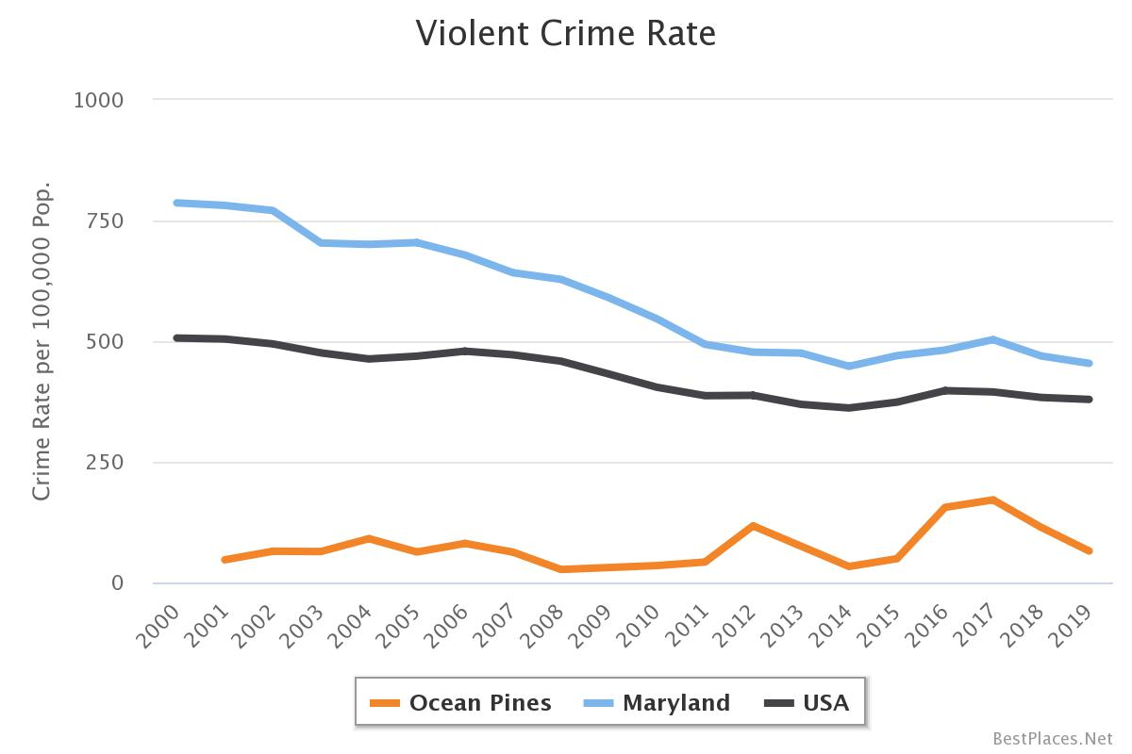
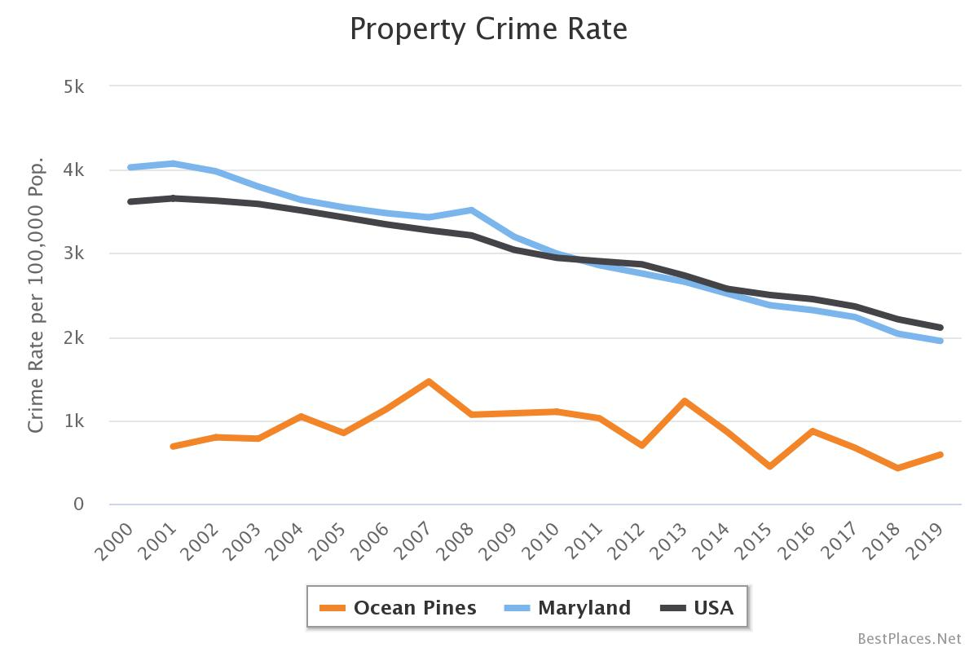
Community-Ocean Pines Safety/Crime Rates
Violent Crime Rate
Property crime Rate
Conclusion: Ocean Pines crime rate is extremely low vs. MD & total USA.
Ocean Pines was ranked the “Safest City in MD* in 2021.
Source-Best Places to Live Website *Safewise

Slide 16
Community-Ocean Pines Financial Performance
$
(000)
Fiscal Year
Conclusion: Ocean Pines has an excellent recent financial track record with 3 straight years of
positive financial performance
* Excludes PPP in 2021

Slide 17
Community-Ocean Pines HOA Assessment Fees
Conclusion: Total amenities represented $4 or 0.5% of HOA Assessment Fee in 2021.
“All Other” represents the largest % of spending.
* Excludes PPP

Slide 18
Assessment of Situation
Category-Other HOA’s-Benchmarking
Community-Ocean Pines
Property Owners Survey
  Satisfaction
  Top Priorities
  Culture-Values
  Issues/Opportunities
  Amenities
Summary-9 Conclusions & Implications

Slide 19
Survey Results
1’st, Some Background on Analyzing the Property Owner Survey Results

Slide 20
Analyzing Results of the Property Owner Survey
When evaluating results, the majority of survey questions had a scale of 1-5 with 1 being the lowest or in most cases negative, 3 being neutral, and 5 being extremely positive, e.g., Satisfaction- Q3: Overall, how satisfied are you being an Ocean Pines property owner or resident?
  1 = Not Satisfied At All
  2 – Slightly Unsatisfied
  3 = Neither Unsatisfied or Satisfied (neutral)
  4 = Slightly Satisfied
  5 = Extremely Satisfied
In the following charts, we use: average scores (e.g. an average score of 4.0=Slightly Satisfied)
We also look at the top two scores (degree of positivity) and determine the % that were positive
  The higher the % of the top 2 scores, the stronger the degree of positivity
  Ideally, you would want a minimum of 60% for the top 2 scores
Balanced

Slide 21
Analyzing Results of the Property Owner Survey
To help analyze and interpret the results, we have color-coded the responses as follows:
Average Score:
Degree of positivity or strength (total of top 2 answer percentages
We also evaluated the responses by different demographics including full-time, part-time, <50
Years Old, Families with Children <18 & found NO SIGNFICANT Differences in the overall results
We have included these other demographic breakouts in a few slides. All other demographic breakouts
are in the appendix
Average Score | Color
1-2 (negative)
3 (neutral)
4-5 (positive)
% Top 2 Box Score | Color
0-29.9
30-59.9
60-100
A key # to
evaluate

Slide 22
Assessment of Situation
Category-Other HOA’s-Benchmarking
Community-Ocean Pines
Property Owners Survey
  Satisfaction
  Top Priorities & Gaps
  Culture-Values
  Issues/Opportunities
  Amenities
Summary-10 Conclusions & Implications

Slide 23
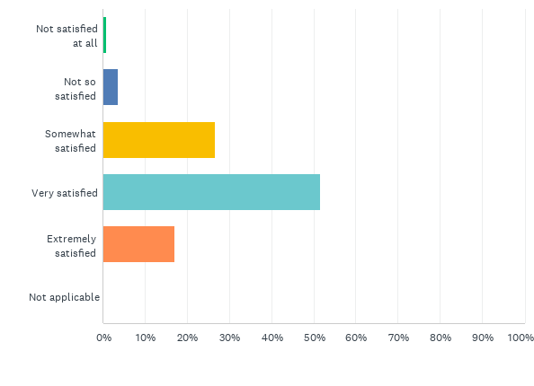
Satisfaction
Q3: Overall, how satisfied are you being an Ocean Pines property owner or resident?(1 = Not Satisfied at All; 5 = Extremely Satisfied)
 | % Overall Satisfaction | % Very or Extremely Satisfied
Total | 95.2 | 68.5
Full Time | 94.4 | 64.8
Part-Time | 97.2 | 74.6
< 50 Years Old | 93.2 | 59.5
Answered: 1,838 Skipped: 0
Part-time residents had slightly higher
satisfaction levels
Overall, 95.2% of property owners were satisfied with
68.5% being either Very or Extremely Satisfied

Slide 24
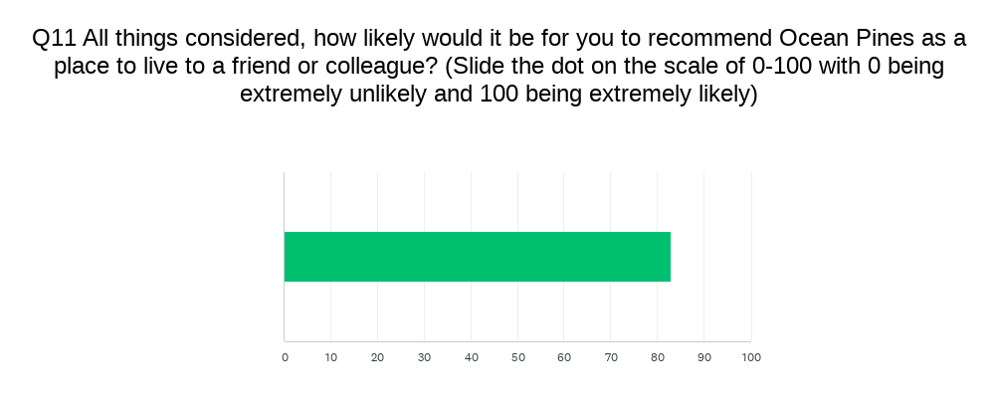
Satisfaction
 | %
Total | 83
Full-Time | 82
Part-Time | 85
< 50 Years | 79
Part-time residents are slightly
more likely to recommend OP; younger
residents (<50) are slightly less likely
Overall, 83% of property owners would recommend
Ocean Pines as a place to live

Slide 25
What is most important?
Q4: As an Ocean Pines property owner or resident, how important are each of the following to you? (1=Not Important at All; 5=Extremely Important)
Rank | Attribute | Weighted Average | % Very Or Extremely Important (Top 2 Box)
#1 | Safety | 4.58 | 95.2
#2 | Maintenance of Infrastructure | 4.49 | 94.2
#3 | Community Appearance/Aesthetics | 4.32 | 89.8
#4 | Assessment Fee Value for the $ | 4.18 | 83.1
#5 | Ocean Pines Overall Customer Service | 4.13 | 83.2
Conclusion: Safety, maintenance of infrastructure &
community appearance had the highest importance

Slide 26
How is Ocean Pines Currently Meeting Expectations?
Q5. As a property owner or resident, please rate how Ocean Pines is currently meeting your expectations with regard to the following? (1=Significantly Below Expectations; 5=Significantly Above Expectations)
Rank (Importance) | Attribute | Importance (Weighted Average) | Satisfaction Weighted Avg. | % Slightly or Significantly Above Expectation
#1 | Safety | 4.58 | 3.83 | 58.0
#2 | Maintenance of Infrastructure | 4.49 | 2.78 | 23.6
#3 | Community Appearance/Aesthetics | 4.39 | 3.62 | 35.5
#4 | Assessment Fee Value for the $ | 4.18 | 3.02 | 24.7
#5 | Ocean Pines Customer Service | 4.13 | 3.22 | 34.0
Conclusion: Safety & community appearance/aesthetics are slightly
exceeding expectations; others are meeting expectations….however…

Slide 27
How is Ocean Pines Currently Meeting Expectations?
Q5. As a property owner or resident, please rate how Ocean Pines is currently meeting your expectations with regard to the following? (1=Significantly Below Expectations; 5=Significantly Above Expectations)
Rank (Importance) | Attribute | Importance (Weighted Average) | Satisfaction Weighted Avg. | % Slightly or Significantly Above Expectation
#1 | Safety | 4.58 | 3.83 | 58.0
#2 | Maintenance of Infrastructure | 4.49 | 2.78 | 23.6
#3 | Community Appearance/Aesthetics | 4.39 | 3.62 | 35.5
#4 | Assessment Fee Value for the $ | 4.18 | 3.02 | 24.7
#5 | Ocean Pines Customer Service | 4.13 | 3.22 | 34.0
…….All 5 priorities have opportunity for improvement (top 2 box)

Slide 28
What is the gap between what is most important & how Ocean Pines is currently meeting expectations?
Rank (Importance) |  | Importance Weighted Average | Satisfaction Weighted Avg. | Gap
#1 | Safety | 4.58 | 3.90 | 0.68
#2 | Maintenance of Infrastructure | 4.49 | 2.83 | 1.66
#3 | Community Appearance/Aesthetics | 4.39 | 3.16 | 1.23
#4 | Assessment Fee Value for the $ | 4.18 | 3.02 | 1.16
#5 | Ocean Pines Overall Customer Service | 4.13 | 3.22 | 0.91
Conclusion: Largest gaps are in 1. Maintenance of Infrastructure,
2. Community Appearance & 3. HOA Fee Value for the $

Slide 29
Assessment of Situation
Category-Other HOA’s-Benchmarking
Community-Ocean Pines
Property Owners Survey
  Satisfaction
  Top Priorities & Gaps
  Culture-Values
  Issues/Opportunities
  Amenities
Summary-10 Conclusions & Implications

Slide 30
Top Issues/Challenges to Address
Q7. Please rate how important the following Ocean Pines challenges/ opportunities are to you? (1=Not Important at All; 5= Extremely Important)
Rank | Issue/Challenge | Total | Full Time | Part-Time | < 50 Yrs.'
1 | Transparency between OPA & Members (INTEGRITY) | 4.43 | 4.45 | 4.41 | 4.37
2 | Infrastructure Issues (e.g. drainage, roads, bh, etc.) | 4.31 | 4.32 | 4.30 | 4.24
3 | BOD & GM working COLLABORATIVELY | 4.24 | 4.29 | 4.19 | 3.96
4 | Responsiveness of OPA to my Requests (ACCOUNTABILTY) | 4.14 | 4.14 | 4.14 | 4.06
5 | Environmental & SUSTAINABILITY Efforts | 4.11 | 4.13 | 4.05 | 3.90
6 | Enforcement of Rules & Regs (ACCOUNTABILITY) | 3.92 | 3.98 | 3.85 | 3.08*
Conclusion: 5 of the top 6 priority issues were directly related to core values
* Significantly different than Total

Slide 31
Core Values
Q.6 Ocean Pines is considering developing a set of core values that will serve as principles and help guide future communications, decision making and culture for the community. Please indicate which of the following core values are most important to you. (1=Not important at all; 5=Extremely Important)
Rank | Core Value | Total | Full Time | Part Time | < 50 yrs.. | > 70 yrs.
#1 | Integrity | 4.48 | 4.49 | 4.46 | 4.33 | 4.45
#2 | Accountability | 4.34 | 4.37 | 4.31 | 4.19 | 4.30
#3 | Collaboration | 4.14 | 4.20 | 4.11 | 4.04 | 4.09
#3 | Respect | 4.14 | 4.22 | 4.02 | 4.05 | 4.13
#4 | Sustainability | 4.10 | 4.13 | 4.05 | 3.93 | 4.09
Results were Consistent Across Demographics:
All 5 Core Values Had High Importance
(Some of the Highest Average Scores in the Survey);
Integrity and Accountability were Ranked #1 and #2

Slide 32
Assessment of Situation
Category-Other HOA’s-Benchmarking
Community-Ocean Pines
Property Owners Survey
  Satisfaction
  Top Priorities & Gaps
  Culture-Values
  Issues/Opportunities
  Amenities
Summary-10 Conclusions & Implications

Slide 33
Key Issues/Opportunities-Level of Agreement
Q-8. Please rate your level of agreement with the following statements. 1=Strongly Disagree; 5=Strongly Agree)
Rank | Statement | Weighted Average | % Slightly or Strongly Agree
1 | Traffic on Route 589 is a concern | 3.81 | 62.5
2 | I support the use of electronic voting for BOD & Ref. | 3.75 | 64.7
3 | The premium paid for non-resident use of amenities is too low | 3.69 | 56.6
4 | OP should invest in improving current amenities | 3.62 | 58.7
5 | I would support an increased enforcement of covenants & regulations | 3.60 | 54.6
Owners slightly agree that traffic on 589 is a major concern
& 64.7% slightly or strongly support electronic voting
Tr
* 3.0 = Neutral; 4.0 = Slightly Agree

Slide 34
Key Opportunities-Level of Agreement
Q-8. Please rate your level of agreement with the following statements. 1=Strongly Disagree; 5=Strongly Agree)
Rank | Statement | Weighted Average | % Slightly or Strongly Agree
2 | I support the use of electronic voting for BOD & Ref. | 3.75 | 64.7
3 | The premium paid for non-resident use of amenities is too low | 3.69 | 56.6
5 | I would support an increased enforcement of covenants & regulations | 3.60 | 54.6
Conclusion: 3 of the top 5 Issues/Opportunities identified were electronic voting,
higher amenity premiums for non-residents and support for
increased enforcement of covenants and regulations
Tr
* 3.0 = Neutral; 4.0 = Slightly Agree

Slide 35
Assessment of Situation
Category-Other HOA’s-Benchmarking
Community-Ocean Pines
Property Owners Survey
  Satisfaction
  Top Priorities & Gaps
  Culture-Values
  Issues/Opportunities
  Amenities
Summary-10 Conclusions & Implications

Slide 36
Level of Agreement
Q-8. Please rate your level of agreement with the following statements. (1=Strongly Disagree; 5=Strongly Agree)
Rank | Statement | Weighted Average | % Slightly or Strongly Agree
4 | OP should invest in improving current amenities | 3.62 | 58.7
9 | Ocean Pines should invest in new amenities | 3.03 | 35.7
Conclusion: There was higher positive support for investing in current amenities
compared to investing in new amenities
Tr
* 3.0 = Neutral; 4.0 = Slightly Agree

Slide 37
New or Improved Amenities and Services
Q-10. Please rate your interest in the following possible new and/or improved amenities or services. (1=Not Interested at All; 5=Extremely Interested)
Rank | New/Improved Amenity or Service | Weighted Average | % Very or Extremely Interested
1 | Improved Walking and Bike Paths | 3.01 | 36.2
2 | Fitness Center | 2.99 | 41.1
3 | Improved Street Lighting | 2.90 | 38.6
4 | Updated Beach Club | 2.66 | 29.5
5 | Improved Disability Access to Amenities | 2.53 | 21.3
While only lukewarm interest for any new/improved amenities or services;
improved walking/bike paths & improved street
lighting could be considered as safety improvements

Slide 38
Amenities
While not a key objective for our survey,
We did collect some usage and customer
satisfaction data
In general, those who use amenities are
“Very Satisfied” with the amenities they use

Slide 39
Amenities
If you have used any of the following Ocean Pines amenities in the past 6 months, please rate your level of satisfaction for each amenity that you have used. If you have not used the specific amenity, simply check “I have not used this amenity.” 1= Not Satisfied at All, 5= Extremely Satisfied
Ranked Based on Highest Claimed Usage
Rank | Amenity | Usage # | Claimed Usage % | Average Satisfaction Score | % Very/Extremely Satisfied
1 | Yacht Club | 1511 | 82.2 | 3.86 | 64.6
2 | Farmers Market | 1473 | 80.1 | 3.96 | 67.1
3 | Parks | 1282 | 69.7 | 3.71 | 54.9
4 | Walking Trails | 1216 | 66.2 | 3.56* | 50.1*
5 | Outdoor Pools | 1022 | 55.6 | 3.67 | 62.5
Yacht Club and Farmers Market had the highest claimed usage (based on those that took the survey) & the highest satisfaction scores
* While still an acceptable score, this was the 2nd lowest score for all amenities

Slide 40
Amenities
If you have used any of the following Ocean Pines amenities in the past 6 months, please rate your level of satisfaction for each amenity that you have used. If you have not used the specific amenity, simply check “I have not used this amenity.” 1= Not Satisfied at All, 5= Extremely Satisfied
Ranked Based on Lowest Claimed Usage
Rank | Amenity | Usage # | Claimed Usage % | Average Satisfaction Score | % Very/Extremely Satisfied
1 | Dog Park | 241 | 13.1 | 3.05* | 28.6*
2 | Racquet Sports | 279 | 15.2 | 3.78 | 59.5
3 | Marina | 557 | 30.3 | 3.82 | 60.3
4 | Boat Ramps | 561 | 30.5 | 3.76 | 59.7
5 | Golf Course | 567 | 30.8 | 3.77 | 60.8
Again, Those that use the respective amenities are “Very Satisfied.”
One exception is the dog park which as the claimed lowest usage and the
lowest satisfaction score (still “Slightly Satisfied”)
* Dog Parks had both the lowest claimed usage and the lowest satisfaction scores

Slide 41
Assessment of Situation Agenda
Category-Other HOA’s-Benchmarking
Community-Ocean Pines
Property Owners Survey
  Satisfaction
  Top Priorities
  Culture-Values
  Issues/Opportunities
  Amenities
Summary-10 Conclusions & Implications

Slide 42
Conclusions & Implications Summary
Conclusions
When compared to similar HOA’s, Ocean Pines has had minimal growth and lower household income. Ocean Pines also has more amenities and waterfront property, with a fair HOA fee.
Ocean Pines is the largest community in Worcester County.
When compared to Worcester County demographics, Ocean Pines residents are less diverse and older, with slightly higher income and education levels and a higher percentage of homeowners.
Ocean Pines’ crime rate is extremely low vs. state and national figures. Ocean Pines was ranked the Safest City* in MD in 2021.
Implications
OPA should continue to invest in the community and control expenses.
OPA should leverage its voting power in Worcester County to receive a fair share of funding and political support.
OPA should continue to embrace our diversity and monitor demographics to ensure inclusion for all.
With safety being ranked #1 in importance, OPA should continue to invest in and improve safety, while also communicating and educating the public.
Source-Best Places to Live Website *Safewise

Slide 43
Conclusions & Implications Summary
Conclusions
Ocean Pines has a great recent financial track record, with three straight years of positive financial performance. Total amenities are profitable.
Ocean Pines property owners are very satisfied and would highly recommend Ocean Pines to others.
The largest gaps between what is important and current customer satisfaction are in maintenance of infrastructure, community appearance and HOA fee value for the money.
Implications
OPA should strive to continue the positive financial performance, while better communicating amenity profitability.
OPA should continue to track satisfaction, and aspire to improve when possible.
OPA should prioritize infrastructure investments, community appearance, and keeping assessments reasonable and appropriate.

Slide 44
Conclusions & Implications Summary
Conclusions
There was higher positive support for investing in current amenities vs. investing in new amenities. Overall, those who used amenities were very satisfied.
All five core values had high importance, and transparency was identified as the #1 issue to address.
Three of the top five “Issues/Opportunities” identified were electronic voting, higher amenity premiums for nonresidents, and support for increased enforcement of covenants and regulations.
Implications
OPA should continue to improve current amenities and track amenity usage, satisfaction and ROI*
OPA should adopt, embrace and activate the six core values of Integrity, Accountability, Collaboration, Respect, Sustainability and Transparency.
OPA could increase satisfaction and profitability through electronic voting, higher nonresident amenity fees, and enhanced enforcement of covenants & regulations.
* Return on Investment

Slide 45
Agenda
  Review work-session agenda & objectives 9:00-9:15
  Review situation analysis & conclusions/implications 9:15-9:50
  Get input/feedback and/or alignment on analysis, conclusions 9:50-10:10
  & implications
  Public comments 10:10-10:20
  Start to develop preliminary 5-year goals for Ocean Pines* 10:20-10:45
  Review next steps/timing 10:45-10:50
  Public comments 10:50-11:00 :
*Time permitting. Note-If there is significant input and or feedback to the situation analysis, we will not
move to preliminary goal setting
We may be flexible with the agenda but we will end at 11:00 AM

Slide 46
Feedback on Situation Analysis Initial Draft
Missing anything?
Feedback?
Surprises?
Agreement on conclusions and implications?
Pass out/refer to one page summary of conclusions & recommendations

Slide 47
Comments/Questions/Feedback

Slide 48
Comments/Questions/Feedback

Slide 49
Agenda
  Review work-session agenda & objectives 9:00-9:15
  Review situation analysis & conclusions/implications 9:15-9:50
  Get input/feedback and/or alignment on analysis, conclusions & implications 9:50-10:10
  Public comments 10:10-10:20
  Start to develop preliminary 5-year goals for Ocean Pines* 10:20-10:45
  Review next steps/timing 10:45-10:50
  Public comments 10:50-11:00 :
*Time permitting. Note-If there is significant input and or feedback to the situation analysis, we will not
move to preliminary goal setting
We may need to be flexible with the agenda but we will end at 11:00 AM

Slide 50
Comments/Questions/Feedback

Slide 51
Agenda
  Review work-session agenda & objectives 9:00-9:15
  Review situation analysis & conclusions/implications 9:15-9:50
  Get input/feedback and/or alignment on analysis, conclusions & implications 9:50-10:10
  Public comments 10:10-10:20
  Start to develop preliminary 5-year goals for Ocean Pines* 10:20-10:45
  Review next steps/timing 10:45-10:50
  Public comments 10:50-11:00 :
*Time permitting. Note-If there is significant input and or feedback to the situation analysis, we will not
move to preliminary goal setting
We may need to be flexible with the agenda but we will end at 11:00 AM

Slide 52
Long-Term (5 year) Goals
Goal Definition:
  The end toward which effort is directed (Source: Webster)
What would you like the Ocean Pines Association to accomplish over the next 5 years?
Unrelated examples of goals:
  Win World War II
  Grow Reese’s Peanut Butter Cup sales
Sometimes referred to as strategic imperatives or strategic actions
Goals are not objectives (not specific and measurable); Objectives will come later

Slide 53
Brainstorm on Long-Term Goals
Goals should:
  Answer the question: what do we want to achieve
  Be realistic/significant
  Align with situation analysis

Slide 54
Importance of Aligning Goals to Analysis
2 Examples/Same Goal
1.
Goal: Grow Reese PB Cup Sales
Conclusion: Reese’s Peanut Butter Cup sales are declining due to a product quality issue
Implication: Invest in quality and R&D
2.
Goal: Grow Reese PB Cup Sales
Conclusion: Mars has launched a similar product and is stealing share
Implication: Invest marketing $

Slide 55
Brainstorm on Long-Term Goals
What would you like Ocean Pines Association to accomplish over the next 5 years?
Goals should
  Answer the question, what do we want to achieve
  Be realistic/significant
  Aligned with situation analysis

Slide 56
Brainstorm on Long-Term Goals

Slide 57
Brainstorm on Long-Term Goals

Slide 58
Brainstorm on Long-Term Goals

Slide 59
Agenda
  Review work-session agenda & objectives 9:00-9:15
  Review situation analysis & conclusions/implications 9:15-9:50
  Get input/feedback and/or alignment on analysis, conclusions & implications 9:50-10:10
  Public comments 10:10-10:20
  Start to develop preliminary 5-year goals for Ocean Pines* 10:20-10:45
  Review next steps/timing 10:45-10:50
  Public comments 10:50-11:00 :
*Time permitting. Note-If there is significant input and or feedback to the situation analysis, we will not
move to preliminary goal setting
We may need to be flexible with the agenda but we will end at 11:00 AM

Slide 60

Ocean Pines Proposed Strategic Planning Timeline
Deeper dive on survey results (Jan/Feb)
Finalize Situation Analysis (Feb)
Conduct a virtual town hall on survey results (late Feb) & communicate results to all (post on website, etc.)
Share Situation Analysis with BOD (March)
Strategic planning work session with BOD (March/April)
Strategic planning work session #2 with BOD (May/June)
Budget Committee collaboration on future budgeting process (June)
Town Hall strategic plan recommendation July
Finalize strategic plan recommendation to BOD (August)
Bring strategic plan to life in budgeting process (August-December)
It may take more than 2
more work-sessions

Slide 61
2019 Artisanal Objective & Plans
We will get here…..be patient
VISION
To be the leading supplier of bakery ingredients and services to the NA artisanal channel
Objective
Strategic Priorities
Strategic Actions
Accelerate Profitable Sales Momentum in the Artisanal Channel
(+6.3%, +$27M)
Grow existing Dawn customers with emphasis on Dawn MFGR
1
Create standard portfolio via Sunrise and deliver digital product catalog to enable sales
Drive activations with ‘always on’ umbrella programs focusing on core categories
Launch regional promos to address specific market needs and increase category penetration
Deliver full value proposition to drive growth in emerging chains and distributor partners (GiGi’s, VooDoo, Hurts)
1.1
1.2
1.3
1.4
2
Aggressively acquire new customers in current and new markets
Improve lead generation and qualification capabilities to drive new customer acquisition
Develop geographic expansion plans
Acquire 2 new emerging chains and execute flawlessly
Identify regional opportunities for expansion (e.g. Latino)
2.1
2.2
2.3
2.4
Deliver Dawn’s full value proposition with a focus on value added services
3
Drive Dawn awareness of our value proposition via the Smile campaign and targeted media
Leverage 2018 learnings to implement customer retention program and reduce churn
Implement TSR service model; develop new service proposition (consult need state) and test launch in 2019
3.1
3.2
3.3
Enablers: Customer/Consumer Insight, Demand/Supply & Service excellence, KAM Model & CRM System

Slide 62
Next Steps
Dependent on progress of this meeting
Establish Goals/get consensus on 4-5 goals
Look for:
  Recap of meeting & copy of slides (will also be posted online)
  Anonymous Survey Monkey survey
  Next work-session

Slide 63
Agenda
  Review work-session agenda & objectives 9:00-9:15
  Review situation analysis & conclusions/implications 9:15-9:50
  Get input/feedback and/or alignment on analysis, conclusions & implications 9:50-10:10
  Public comments 10:10-10:20
  Start to develop preliminary 5-year goals for Ocean Pines* 10:20-10:45
  Review next steps/timing 10:45-10:50
  Public comments 10:50-11:00 :
*Time permitting. Note-If there is significant input and or feedback to the situation analysis, we will not
move to preliminary goal setting
We may need to be flexible with the agenda but we will end at 11:00 AM

Slide 64
Public Comments

Slide 65


Slide 66
Appendix

Slide 67
What is most important?
Q4: As an Ocean Pines property owner or resident, how important are each of the following to you? (1=Not Important at All; 5=Extremely Important)
Rank | Attribute | Total (Avg.) | Full Time | Part Time | < 50 Years | > 70 Years
#1 | Safety | 4.58 | 4.59 | 4.58 | 4.53 | 4.54
#2 | Maintenance of Infrastructure | 4.49 | 4.51 | 4.47 | 4.35 | 4.43
#3 | Community Appearance/Aesthetics | 4.32 | 4.31 | 4.36 | 4.10 | 4.34
#4 | Assessment Fee Value for the $ | 4.18 | 4.20 | 4.16 | 4.36* | 4.08
#5 | Ocean Pines Overall Customer Service | 4.13 | 4.13 | 4.14 | 4.0 | 4.04
Safety, Maintenance of Infrastructure and Community Appearance Were Most
Important for Full-time, Part-time & Older Residents. Those Less than 50 Yrs. Old
ranked Assessment Fee Value higher than Community Appearance
* Not Significant

Slide 68
How is Ocean Pines Currently Meeting Expectations?
Q5. As a property owner or resident, please rate how Ocean Pines is currently meeting your expectations with regard to the following? (1=Significantly Below Expectations; 5=Significantly Above Expectations)
Rank | Attribute | Importance | Total Satisfaction | Full Time Satisfaction | Part Time Satisfaction | < 50 Years Satisfaction | 70 Years Satisfaction
#1 | Safety | 4.58 | 3.83 | 3.81 | 3.87 | 3.74 | 3.86
#2 | Maintenance of Infrastructure | 4.49 | 2.78 | 2.64 | 3.00 | 2.56 | 2.92
#3 | Community Appearance | 4.39 | 3.16 | 3.02 | 3.34 | 2.92 | 3.29
#4 | Assessment Fee Value for the $ | 4.18 | 3.02 | 2.88 | 3.06 | 2.54* | 3.06
#5 | Ocean Pines Customer Service | 4.13 | 3.22 | 3.05 | 3.33 | 2.92 | 3.20
Safety Had the Highest Satisfaction Across All Demographics while Maintenance of Infrastructure Had The Lowest Satisfaction. Generally, Part-Time & Older Residents had slightly Higher Satisfaction While Those <50 Years Old Had Slightly Lower Satisfaction. Those < 50 Had The Lowest Score for Assessment Fee Value for $
*Significantly different than total

Slide 69
What is the gap between what is most important & how Ocean Pines is currently meeting expectations?
Rank (Importance) |  | Gap Total | Gap Full Time | Gap Part Time | Gap < 50 | Gap > 70
#1 | Safety | 0.68 | 0.78 | 0.71 | 0.79 | 0.68
#2 | Maintenance of Infrastructure | 1.66 | 1.87 | 1.47 | 1.79 | 1.51
#3 | Community Appearance/Aesthetics | 1.23 | 1.29 | 1.00 | 1.18 | 1.05
#4 | Assessment Fee Value for $ | 1.16 | 1.32 | 1.10 | 1.82 | 1.02
#5 | Ocean Pines Overall Customer Service | 0.91 | 1.08 | 0.81 | 1.00 | 0.89
Across All Demographics We Evaluated, The Largest gaps are Still:
1. Maintenance of Infrastructure; 2. Community Appearance &
3. HOA Fee Value for the $ (size of gap is just different)

Slide 70
Core Values
Q.6 Ocean Pines is considering developing a set of core values that will serve as principles and help guide future communications, decision making and culture for the community. Please indicate which of the following core values are most important to you. (1=Not important at all; 5=Extremely Important)
Rank | Core Value | Total | Full Time | Part Time | < 50 yrs.. | > 70 yrs.
#1 | Integrity | 4.48 | 4.49 | 4.46 | 4.33 | 4.45
#2 | Accountability | 4.34 | 4.37 | 4.31 | 4.19 | 4.30
#3 | Collaboration | 4.14 | 4.20 | 4.11 | 4.04 | 4.09
#3 | Respect | 4.14 | 4.22 | 4.02 | 4.05 | 4.13
#4 | Sustainability | 4.10 | 4.13 | 4.05 | 3.93 | 4.09
Results were Consistent Across Demographics:
All 5 Core Values Had High Importance
(Some of the Highest Average Scores in the Survey);
Integrity and Accountability were Ranked #1 and #2

Slide 71
Top Issues/Challenges to Address
Q7. Please rate how important the following Ocean Pines challenges/ opportunities are to you? (1=Not Important at All; 5= Extremely Important)
Rank | Issue/Challenge | Total | Full-Time | Part-Time | < 50 Yrs.' | > 70 Yrs.
1 | Transparency between OPA & Members | 4.43 | 4.45 | 4.41 | 4.37 | 4.38
2 | Infrastructure Issues | 4.31 | 4.32 | 4.30 | 4.24 | 4.22
3 | BOD & GM working collaboratively | 4.24 | 4.29 | 4.19 | 3.96 | 4.32
4 | Responsiveness of OPA to my Requests | 4.14 | 4.14 | 4.14 | 4.06 | 4.09
5 | Environmental & Sustainability Efforts | 4.11 | 4.13 | 4.05 | 3.90 | 4.15
6 | Enforcement of Rules & Regulations | 3.92 | 3.98 | 3.85 | 3.08* | 4.06
Results Were Similar Across Demographics,
Transparency, Infrastructure & Collaboration were top 3
* Significantly different than Total

Slide 72
Level of Agreement
Q-8. Please rate your level of agreement with the following statements.
(1=Strongly Disagree; 5=Strongly Agree)
Rank | Statement | Weighted Average | % Slightly or Strongly Agree
1 | Traffic on Route 589 is a concern | 3.81 | 62.5
2 | I support the use of electronic voting for BOD & Ref. | 3.75 | 64.7
3 | The premium paid for non-resident use of amenities is too low | 3.69 | 56.6
4 | OP should invest in improving current amenities | 3.62 | 58.7
5 | I would support an increased enforcement of covenants & regulations | 3.60 | 54.6
Owners Sightly Agree That Traffic on 589 is a Major Concern
& 64.7% Slightly or Strongly Support Electronic voting
Tr
* 3.0 = Neutral; 4.0 = Slightly Agree

Slide 73
Level of Agreement
Q-8. Please rate your level of agreement with the following statements.
(1=Strongly Disagree; 5=Strongly Agree)**
Rank | Statement | Total | Full -time | Part-Time | < 50 Yrs. | > 70
1 | Traffic on Route 589 is a concern | 3.81 | 3.95 | 3.59 | 3.60 | 3.94
2 | I support the use of electronic voting for BOD & Ref. | 3.75 | 3.69 | 3.83 | 3.87 | 3.56
3 | The premium paid for non-resident use of amenities is too low | 3.69 | 3.73 | 3.63 | 3.50 | 3.69
4 | OP should invest in improving current amenities | 3.62 | 3.59 | 3.62 | 3.62 | 3.53
5 | I would support an increased enforcement of covenants & regulations | 3.60 | 3.69 | 3.46 | 3.08* | 3.79
In General, the Level of Agreement Did Not Change Significantly
Across Demographic with Exception of Those <50 had Significantly
Lower Agreement for Increased Enforcement of Covenants & Regulations
Tr
* Significantly different than Total
** 3.0 = Neutral; 4.0 = Slightly Agree

Slide 74
Level of Agreement
Q-8. Please rate your level of agreement with the following statements. (1=Strongly Disagree; 5=Strongly Agree)
Rank | Statement | Weighted Average | % Slightly or Strongly Agree
4 | OP should invest in improving current amenities | 3.62 | 58.7
9 | Ocean Pines should invest in new amenities | 3.03 | 35.7
Conclusion: There was higher positive support for investing in current amenities
compared to investing in new amenities
Tr
* 3.0 = Neutral; 4.0 = Slightly Agree

Slide 75
New or Improved Amenities and Services
Q-10. Please rate your interest in the following possible new and/or improved amenities or services. (1=Not Interested at All; 5=Extremely Interested)
Rank | New/Improved Amenity or Service | Total | Full Time | Part Time | < 50 yrs. | > 70 Yrs.
1 | Improved Walking and Bike Paths | 3.01 | 3.03 | 2.99 | 3.18* | 2.72
2 | Fitness Center | 2.99 | 3.0 | 2.96 | 3.28* | 2.61
3 | Improved Street Lighting | 2.90 | 2.98 | 2.79 | 3.04 | 2.87
Results were similar across demographics:
Only Lukewarm Interest for any
New/Improved Amenities or Services.
Top 3 Were Improved Walking & Bike Paths,
Fitness Center and Improved Street Lighting
* Not Significantly Different vs. Total

Slide 76
Benchmarking Property Values
Conclusion: Ocean Pines Has More Affordable Housing Options With Property
Values Increasing at a 10-year CAGR of 4.6% & More Recently at 11.6% CAGR.
Sea Colony has Experienced a Similar Recent 3-year CAGR While Bayside Avg.
Values Have Declined*
Source: MLS Data
Note that average values are based on average closing price and can be driven
by more sales of higher or lower priced houses

Slide 77
“All Other” Cost Breakout
Conclusion: General Administration is the largest bucket of spending in “other.”
These costs are partially offset by Other Revenue Including Franchise Fees,
Delinquent Fees, Advertising Revenue, etc.)

Slide 78
Previous Survey-Top Concerns
Drainage
Board Conduct
Communication
Unkempt Properties and Guidelines for Rental Properties
Upkeep of OPA Facilities
Road Repair and Maintenance
Mediacom

